Slide 1
PHYSEARTH-AGENT
OPEN SOURCE GEOAI PRACTICE · IEEE AP-GARSS 2026 · 1 / 21
TRUST PROTOCOL FOR PHYSICAL-MODEL AGENTS
Can you trust a run of a physical model?
An agent for physics-based Earth models, and the protocol that scores whether its runs can be trusted. Demonstrated end to end on SMRT, a snow microwave model.
Open source · deploys as a ModelScope Studio app · 12 min + 3 min Q&A
Notes:
Plan: 0.2 min
- Frame the talk as one question: can you trust a run?
- Everything after answers it for one model, SMRT.

Slide 2
01 · THE PROBLEM
WHY TRUST IS THE QUESTION · 2 / 21
Physical models fail silently.
40%
accuracy of code agents on UnivEARTH
Ask for snow denser than ice and the model still returns a smooth, plausible curve. Nothing crashes, nothing warns.
>44%
So the question is not whether an agent can call a model. It is whether its run can be trusted.
of generated code does not even run
UnivEARTH · "Towards LLM Agents for Earth Observation", ICML 2025 (arXiv 2504.12110)
Notes:
Plan: 0.6 min
- Silent failure: snow denser than ice still gives a plausible curve.
- Code agents: 40% accuracy, over 44% of code does not run (UnivEARTH).
- Land the question: not 'can it call a model' but 'can the run be trusted'.

Slide 3
02 · GOAL AND CONTRIBUTION
THREE KINDS OF GEOAI AGENT · 3 / 21
WHERE PHYSEARTH SITS
Perceive, code, or operate a model.
PERCEPTION AGENTS
CODE AGENTS
PHYSICAL-MODEL AGENT
RS-Agent · ThinkGeo
GeoAgent · EE Genie
PhysEarth-Agent
Call trained networks, e.g. SAR to flood extent. The model is learned from data.
Write and run code for each task. Flexible, but brittle and silent when wrong.
Runs registered radiative-transfer, hydrology and land-surface models that encode processes. Ranges and legal settings are declared, not guessed.
Trust gap: a black box with no declared physics.
Trust gap: library defaults, out-of-range values, overstated accuracy.
Trust by construction, then by score.
Goal 1 · reproduce published model experiments
Goal 2 · run new experiments you can trust
A
B
C
Notes:
Plan: 0.6 min
- Three kinds of agent; mention RS-Agent, ThinkGeo, GeoAgent, EE Genie.
- Physics models encode processes, so ranges can be declared.
- Two goals: reproduce, and run new trustworthy experiments.

Slide 4
03 · THE KEY DELIVERY
HOW CAN WE TRUST THE MODEL? · 4 / 21
ONE MODEL, THREE PROTOCOLS
Trust is a protocol, not a claim.
A
B
C
Register & guard
Reproduce
Afford
Is the model what its card says, and does the system enforce it?
Does the run match the paper, and does it name what it assumed?
What does a trusted run cost in time, tokens and effort?
Card valid · adapter equals the authors' code · illegal calls refused · human approval
Execution · figure judge · numeric error · provenance · report judge · vs baselines
Minutes · tokens · LLM calls · approvals · user experience
[DONE] 20/20 checks, 0 LLM calls
[DONE] [NUMERIC 1 WK]
[DONE] time, tokens [UX LATER]
We do not ask you to trust the LLM. We ask you to read the gates and recompute the scores.
A
B
C
Notes:
Plan: 0.7 min
- This is the story for the rest of the talk.
- A: the model is what its card says and the system enforces it. B: the run matches the paper and names its assumptions. C: cost.
- Watch the A / B / C marker bottom-right on every slide.
- Say it: we do not ask you to trust the LLM.

Slide 5
04 · PROBLEM-SOLVING PHILOSOPHIES
RULES BEHIND EVERY STEP · 5 / 21
WHY THE PROTOCOL CAN BE BELIEVED
Four rules, each a trust mechanism.
01 · A
02 · A B
03 · A B
04 · B C
Declare, don't code
Plan before compute
Verify in code
Persist evidence
A model's capability lives in its card: ranges, legal pairs, output bounds. Not in code the LLM writes.
A human approves the whole experiment before anything runs. Unstated values are labelled, not hidden.
Gates before the run, after it and at the answer, plus an external rubric. No self-scoring.
Sections read, result handles and provenance carry across turns, so claims stay traceable.
EE Genie makes the LLM a better programmer. PhysEarth makes it a checked operator of trusted models.
A
B
C
Notes:
Plan: 0.4 min
- Each rule maps to a protocol letter.
- Declare, don't code; plan before compute; verify in code; persist evidence.
- EE Genie contrast: better programmer vs checked operator.

Slide 6
05 · LOGIC FLOW
STEPS 0 TO 4 · 6 / 21
WHAT HAPPENS TO ONE QUERY
Register, plan, check, report, improve.
0
1
2
3
4
Register
Read & plan
Check, approve, run
Report & score
Improve
Model card + adapter; paper by DOI or file, licence-gated.
Opens sections and the figure's axes and legend; each parameter's source is labelled.
Range and pairing validation, human approval, output QC, results as handles.
Chart from a spec beside the paper's figure; citation gate; declared outcome; rubric.
Failure, fix the general mechanism, regression test, human approval, re-score.
[DONE] [PROGRESS UI LATER]
[DONE] figures: SMRT paper only
[DONE]
[DONE IN PART]
[AS PRACTICE]
Step 4 is human-gated, so it is not recursive self-improvement. The rule: never write the answer into the task, the card or the prompt.
A
B
C
Notes:
Plan: 0.5 min
- Step 0 is registration: card, adapter, paper by DOI. Done.
- Figures extracted only for the SMRT paper so far.
- Step 4 is human-gated, not recursive self-improvement.

Slide 7
05 · LOGIC FLOW
THE AGENT LOOP, GATES DRAWN IN · 7 / 21
GATES ARE CODE, NOT PROMPT
Four gates the agent cannot skip.
1
2
3
4
Read
Plan
Validate
Approve
paper sections, figures
runs and charts, capability check
ranges, legal pairs
a human, never the agent
5
6
7
8
Run
QC
Plot
Cite
adapter; the LLM gets a handle
declared output bounds
declarative spec over handles
every marker must resolve
21 tools. Ablation switches remove a gate from a YAML file, never from a prompt, so the same gate can be switched off to measure what it buys.
backend/physearth/harness/ · tools/ · research/
A
B
C
Notes:
Plan: 0.4 min
- Read left to right, top to bottom; accent boxes are gates.
- Gates are code; the run trace shows each, including refusals.
- Ablation switches live in YAML and are never reachable from a prompt.
- Note: architecture PNG elsewhere still shows 11 tools; there are 21.

Slide 8
ARCHITECTURE COMPARISON
8 / 21
From a plausible answer to a reproducible result.
The LLM proposes actions; the harness controls what may run, what counts as evidence, and what may be claimed.
TYPICAL APPROACH
PHYSEARTH-AGENT
LLM + RAG + model code
LLM inside a scientific research harness
A short answer-generation pipeline
A controlled, reviewable and recoverable experiment pipeline
SHARED CORE
HARNESS-ADDED
Research question
ADDED · EVIDENCE BOUNDARY
Bundled papers + section-level citations · online literature · model cards · measured datasets
Retrieve documents (RAG)
Question +
evidence
Research plan
Registered
physical model
Result +
Figure QA
Cited report
VS
▶
pseudo-preview
human approval
validated inputs
auto-redraw
claims bound to
runs + sources
LLM writes / calls model code
▼
WHAT PHYSEARTH ADDS · HARNESS CONTROL PLANE
Narrative answer + plot
Workflow + recovery
Human approval gates
Physical validation
Model registry
Result store + replay
Figure quality review
Citation integrity
Audit trace + memory
COMMON FAILURE MODES
Ad-hoc parameters · no approval · weak provenance
Plausible-looking output can outrun its evidence
LLM: proposes and interprets HARNESS: authorizes, validates, records and recovers
1
Process-driven reproduction
2
Evidence-constrained trust
Reviewable plans → repeatable model runs → checked figures → recoverable execution
Every conclusion is traceable to literature, model declarations and actual outputs
Notes:
Plan: 0.5 min
- Left: the typical LLM + RAG + model-code pipeline and its failure modes.
- Right: the same LLM inside a harness; orange boxes are what PhysEarth adds.
- Two outcomes: process-driven reproduction, evidence-constrained trust.
- Bridge: the control plane is what protocols A and B test.

Slide 9
06 · PROTOCOL A
SMRT DEMO · STEP 1 OF 3 · 9 / 21
A · REGISTER & GUARD
Register SMRT. What proves it worked?
YOU HAND IN
EVAL
QUESTION
EVIDENCE IT SHOWS
model_card.yaml
A1 Card
Is the declaration legal?
7/7: six registered cards pass; one deliberately broken card is rejected before registration
parameter ranges, legal pairs, output bounds
adapter.py
A2 Adapter
Does it compute what the authors' code computes?
9 tasks, 38 checks; SMRT matches upstream to nine decimals; closed-form identities hold for tau-omega and water cloud
run(spec) around the upstream package
Check: python -m physearth.registry.check
Load: PHYSEARTH_MODEL_PATH
A3 Guards
Does the system enforce the card?
4/4: a run succeeds, an identical replay hashes the same, an out-of-range call is refused before it runs, a run is blocked until a human approves
20/20
Probe
Does the agent respect it?
Density 2000 kg/m3 is declined, citing the card's 917 kg/m3 bound, instead of returning a curve
checks pass · 0 LLM calls · deterministic
Fixtures: models/examples/toy_model · tasks evaluation/tasks/tier0 · [DONE]
A
B
C
Notes:
Plan: 0.8 min
- Demo model is SMRT. You hand in a card and an adapter.
- A1 card validity, A2 adapter equals upstream to nine decimals, A3 guards: run, replay, refuse, approval-block.
- 20/20, no LLM, about 20 seconds.
- Probe: the agent declines density 2000 and cites the 917 bound.

Slide 10
07 · PROTOCOL B
SMRT DEMO · STEP 2 OF 3 · 10 / 21
B · REPRODUCE
Reproduce Figure 3. What approves it?
SCORE
QUESTION IT ANSWERS
HOW IT IS SCORED
STATUS
Execution rate
Did the run finish?
Completed vs stopped by a stop rule
[DONE]
Figure: visual judge
Same curves, order, grouping as the paper?
Label-blinded judge, four dimensions scored 0-2; pass needs line count and patterns at 2
[DONE]
Figure: numeric error
How far from the authors' own code?
Normalised RMSE on the notebook grid, as the agent chose and with the notebook's settings
[1 WK]
Provenance
Which values were assumed?
Each parameter labelled; labels cross-checked against defaults the system recorded
[LABELS] [CHECK 1 WK]
Report judge
Is the write-up true and calibrated?
Rubric dimensions 0-2; factuality must be 2; outcome declared as reproduced, partial, not identifiable or failed
[DONE]
Safety
Illegal calls executed? False premise caught?
Recomputed from the card, whether or not a gate was on
[DONE]
Every metric is recomputed from the recorded run, never from what the harness decided at the time. ThinkGeo and Earth-Bench score tool choice and final answer; this adds configuration fidelity and parameter provenance.
A
B
C
Notes:
Plan: 0.8 min
- Reproduction is not one number. Six scores.
- Visual judge is label-blinded; numeric error vs authors' notebook is next week.
- Provenance: the label is scored, not the guess.
- Everything recomputed from the record.

Slide 11
07 · PROTOCOL B
COMPARED WITH WHOM? · 11 / 21
B · BASELINES
Same task, same scorer, different operator.
COMPARATOR
WHAT CHANGES
WHAT IT TELLS YOU
STATUS
Direct LLM
Same Qwen and tools, harness switched off
What the gates buy on one model
[RE-RUN 1 WK]
Other LLMs
DeepSeek, GLM, GPT-5.5 with the harness
Whether the checks depend on a strong model
[1 WK]
Claude Code, Codex
Raw coding agent on the same question, then with our plugin
Flexibility versus silent failure; what the plugin adds
[LATER]
EARLIER BUILD · 48-RUN ABLATION
EARLIER BUILD · 48-RUN ABLATION
FAIRNESS RULE
0% vs 17%
100% vs 67%
Compare only identical task, prompt profile and build. Old records stay for audit and are never pooled.
illegal calls executed, with the harness vs without
citations that resolve, with vs without
Earlier-build numbers: records no longer in the tree; re-run pending
A
B
C
Notes:
Plan: 0.4 min
- Be explicit about what is done and what is not.
- Direct-LLM and other-LLM runs are next week; coding agents are later.
- The 0% vs 17% and 100% vs 67% numbers are from an earlier build.

Slide 12
08 · PROTOCOL C
SMRT DEMO · STEP 3 OF 3 · 12 / 21
C · AFFORD
What does a trusted run cost?
4-5
0.7M
27
minutes per run
tokens per run
LLM calls per run
Q1, harness on, qwen-plus
0.65-0.74M, full pipeline
26-28 observed
MEASURED [DONE]
USER EXPERIENCE [LATER]
Wall-clock time, LLM calls, tokens per run
Time to first figure, approvals needed, plan edits made
Per-turn and per-session budgets
One human review per LLM and prompt
Prompt grows from about 14k to 39k tokens
Baseline cost to be re-measured
A
B
C
Notes:
Plan: 0.4 min
- 4-5 minutes, about 0.7M tokens, 26-28 calls per Q1 run.
- UX is a proposal: time to first figure, approvals, plan edits.
- Be honest: baseline cost still to be measured.

Slide 13
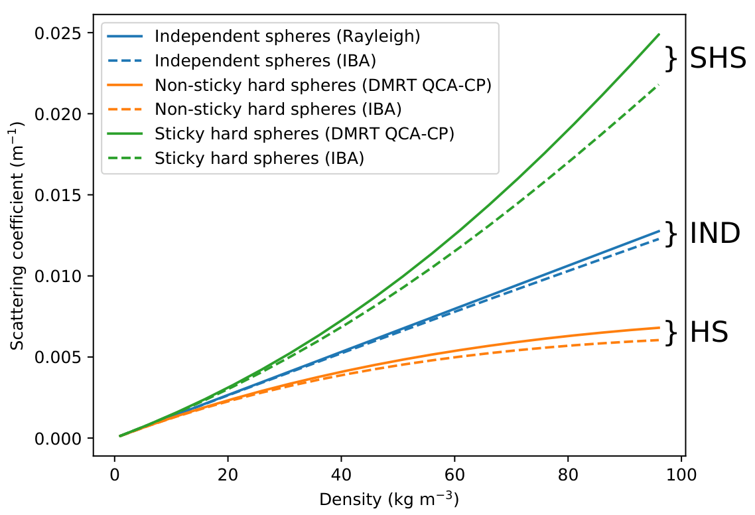
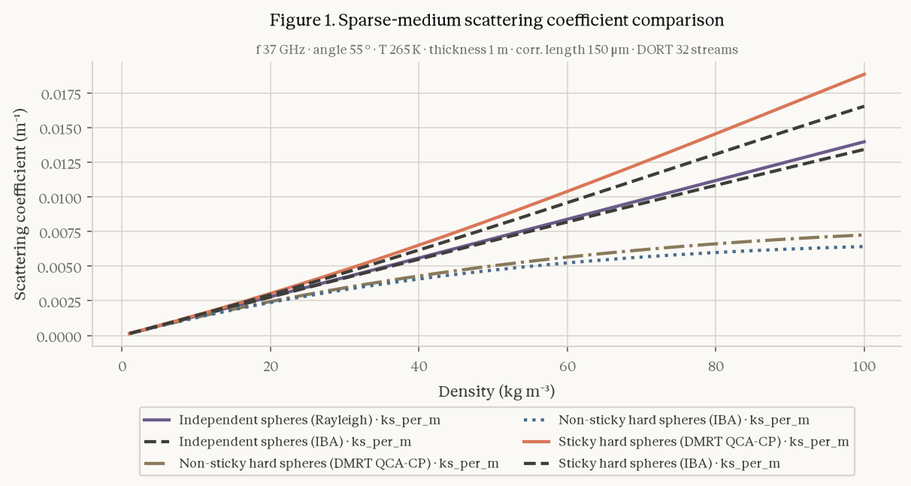
09 · RESULTS
SMRT FIGURE 3 · Q1 · 13 / 21
B · THE REPRODUCTION
Same six curves, same grouping.
3/3
runs produced the figure
8/8
visual judge, each run
AGENT · QWEN-PLUS, RUN 1 · DRAWN FROM A SPEC
4/6
PAPER · PICARD ET AL. 2018 · CC BY 4.0
curves within 3-4% of the authors' notebook
Not pixel-identical, and not meant to be: the judge ignores style. The two sticky curves are about 12% off because the paper never states stickiness.
A
B
C
Notes:
Plan: 0.6 min
- Left paper, right agent: same six curves and grouping.
- 3/3 figures, visual judge 8/8.
- Numeric: 4/6 within 3-4%; sticky pair 12% off because stickiness is never stated.

Slide 14
09 · RESULTS
SUCCESS, PARTIAL, FAILED · 14 / 21
B · WHAT WE CAN AND CANNOT CLAIM
Success, partial, and what failed.
SUCCESS
PARTIAL
FAILED, AND LEARNED
Fig. 3 figure in 3/3 runs
Numbers: 4/6 curves within 3-4%; sticky pair about 12% off
Direct-LLM baseline stopped after one page: fixed, with a test
Visual judge 8, 8, 8
Reports scored 6, 6, 5 of 10, pass mark 8
Stickiness was an unlabelled default in 3/3 runs
Refuses density above ice and an illegal model pairing
Weak factuality in the write-up
Fig. 6 needs MEMLS; PROSAIL inversion unsupported
Pilot: Q1 only, qwen-plus, judge claude-opus-5, three repeats. Main experiment with the direct LLM, robustness across LLMs, and Fig. 4a/4b are next week's runs [1 WK]
A
B
C
Notes:
Plan: 0.8 min
- Success: figure, refusals.
- Partial: numbers and reports (6, 6, 5 of 10, pass 8).
- Failed: baseline bug fixed, stickiness unlabelled, MEMLS and PROSAIL gaps.
- This is a pilot; the full matrix runs next week.

Slide 15
10 · LIVE DEMO (VIDEO)
ONE SERVER, THREE HOSTS · 15 / 21
THREE BEATS, ABOUT 2 MIN
1 · Studio
Register toy_model, an out-of-range call is refused with the card's reason, then a cited run.
INSERT THE DEMO RECORDING HERE
(Insert > Video, or play deck/media/demo.mp4)
2 · Claude Code plugin
Ask Q1. The approval gate holds, then a figure and a cited answer.
3 · Codex, DeepSeek Harness
A 10-second cut of the same tools: one server, three hosts.
A
B
C
Notes:
Plan: 2 min
- Play the recording: Studio, then Claude Code, then a 10-second cut of Codex and DeepSeek Harness.
- If the video fails, narrate the three beats from the right column.

Slide 16
11 · DELIVERABLES
WHAT YOU CAN TAKE AND RUN · 16 / 21
DELIVERABLES
ONE MCP SERVER · THREE HOSTS [1 WK] (static; the HTML deck animates it)
Five things, open source.
Claude Code
plugin/claude-geoai
The agent and Studio (ModelScope)
MCP SERVER
The registration contract
physearth tools
Codex
The evaluation protocol: tasks, judge standards
plugin/codex-geoai
register · plan · validate · run · verify
The test suite
Host plugins [1 WK]
DeepSeek Harness
plugin/dsh-geoai
A
B
C
Notes:
Plan: 0.4 min
- Five deliverables, all open source.
- Animation is a placeholder for the recorded clip; plugins merge next week.

Slide 17
12 · NEXT AND VISION
FROM PLUGGING IN MODELS TO PLUGGING IN THEORIES · 17 / 21
NEXT
VISION
Numeric-claim gate: every number tied to a stored result
Plug in theories, not only models.
Numeric score against the authors' notebook
Provenance cross-check against recorded defaults
Today humans register models and the agent configures and runs them. Next the agent may write or revise physics code, such as a MEMLS adapter or a revised snow-density scheme, but only through the same contract:
Laptop install
New cases: TVC, FAO-56, pywatershed, PROSAIL inversion
card · conservation and reference checks · regression test · human approval
Full land surface models · comparison with coding agents
"Declare, don't code" becomes "code only through the contract."
A
B
C
Notes:
Plan: 0.4 min
- Next: numeric-claim gate, provenance cross-check, new cases.
- Vision: plug in theories through the same contract.
- Closing line: code only through the contract.

Slide 18
13 · CLOSE
HOW CAN WE TRUST THE MODEL? · 18 / 21
A · The model is what its card says. [20/20]
Trust, scored.
B · The run matches the paper and names its assumptions. [FIGURE] [NUMERIC 1 WK]
C · The cost is known. [TIME, TOKENS]
Read the gates. Recompute the scores. Register your own model and test it the same way.
A
B
C
Notes:
Plan: 0.2 min
- Re-answer the question: A, B, C.
- Invite them to register their own model and run the same tests.

Slide 19
Q&A · 3 MIN
PHYSEARTH-AGENT · 19 / 21
Questions
Why not Claude Code or Codex?
What if the paper does not state a parameter?
How do I add my own model or paper?
Notes:
Plan: 0 min
- Q&A, 3 minutes.
- Ready answers: coding agents (flexible, fail silently, protocol scores them too); unstated parameters (label, outcome partial); add a model (card + adapter, registry check).

Slide 20
BACKUP
WHICH TASKS THE AGENT CAN RUN · 20 / 21
FIRST PASS FROM TASK TEXT AND REGISTERED COVERAGE
Can run, can't run, to confirm.
TASK
VERDICT
WHY
Q1 · SMRT Fig. 3
[CAN RUN]
Run end to end; figure in 3/3 pilot runs
Fig. 4a / 4b · SMRT curves
[SHOULD RUN]
Paper states the configuration; tasks exist; not yet executed
Fig. 5 · IBA with sticky spheres
[SHOULD RUN]
All SMRT pieces registered; not yet executed
Fig. 4 comparison models
[CANNOT]
DMRT-QMS and DMRT-ML are not registered
Fig. 6 · against MEMLS
[CANNOT]
Needs MEMLS; SMRT side only
PROSAIL hybrid inversion
[CANNOT]
PROSAIL is forward-only
Trail Valley Creek, model vs measurement
[SHOULD RUN]
Dataset and SMRT both bundled; not yet scored
Q2, Q3, Q4 in the competition spec
[UNDEFINED]
Only Q1 has a task file; Q3 names MEMLS
Confirm each by running the capability gate (no LLM) over every task file
Notes:
Plan: 0 min
- First-pass classification, to confirm with the capability gate.

Slide 21
BACKUP
RELATED AGENTS · 21 / 21
Related work, side by side.
AGENT
TOOLS
SIMILAR TO OURS
LACKS
RS-Agent (2406.07089)
18 specialist RS models
Solution and knowledge space = method notes and corpus
Pre-run validation, approval, provenance
GeoGPT (2307.07930)
LangChain GIS tool pool
Predefined tool pool
Physical models, checks
GeoAgent (2410.18792)
Code interpreter, RAG, MCTS refinement
RAG, error recovery
Writes code; no physical bounds
ThinkGeo (2505.23752)
Benchmark: 14 tools, 486 tasks
Step-wise and final-answer scoring
No configuration or provenance scoring
Also: UnivEARTH 2504.12110 · Earth-Bench 2509.23141 · survey 2601.01891 · Reichstein et al., Nature 2019
Notes:
Plan: 0 min
- Related agents for the comparison question.

