Slide 1
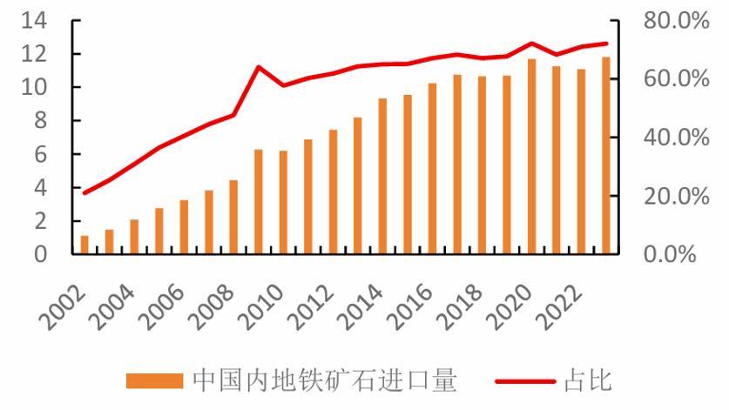
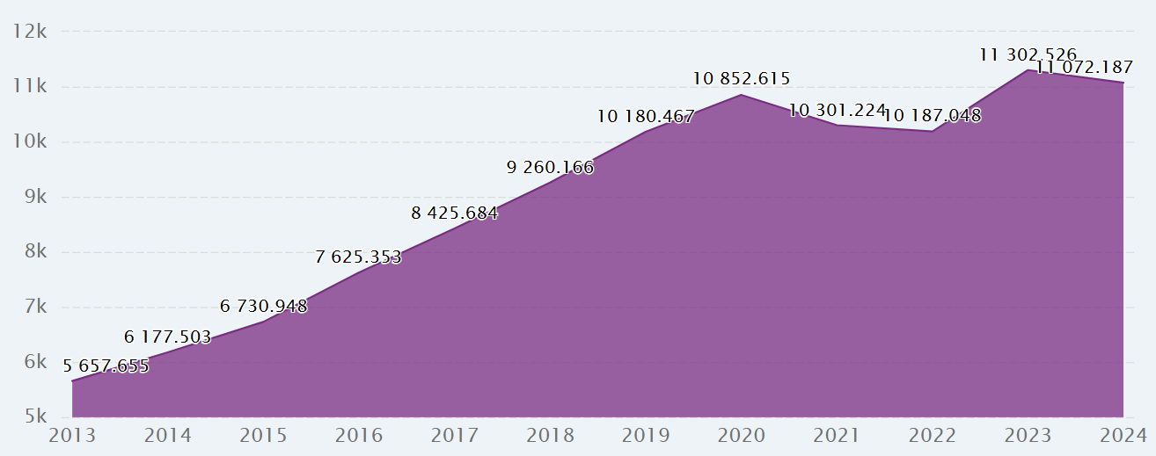
Research Background
1.The Strategic Importance of Energy and Resources
Energy security is an integral component of national security, serving as the foundational safeguard for a nation's economic and social development.
As the world's second-largest economy, China is at a critical juncture of industrialization and urbanization, making stable and cost-effective resource supplies vital to its long-term development.
China's iron ore import volume and its proportion of the global total import volume from 2002 to 2023
Source: China Iron&Steel Association
2.Rising External Dependency
Iron Ore: China is the world's largest steel producer, with import volumes reaching a historical peak of 1.17 billion tons in 2020.
Crude Oil: China is the world’s largest oil importer, with foreign dependency consistently hovering above 70% and projected to exceed 75% by 2030.
China's crude oil import volume from 2013 to 2024
Source: WWW.CEICDATA.COM | Organization of the Petroleum Exporting Countries

Slide 2
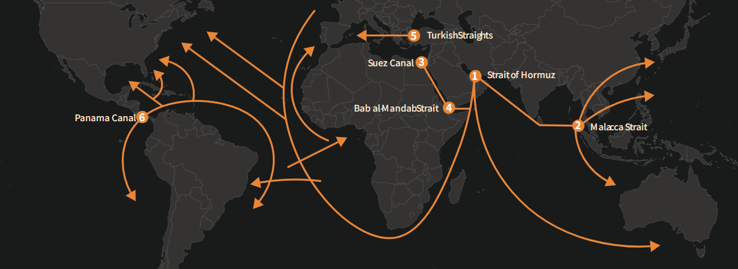
Research Motivation
1.Addressing "Dual Dependence" Vulnerability
High Concentration: Iron ore sourcing is dominated by Australia and Brazil (~90%) , while oil relies heavily on the Middle East and Russia.
Transit Chokepoints: 80% of oil imports pass through the Strait of Malacca , creating a critical "transit dependence".
Critical Maritime Trade Chokepoints
Source: info.oceania.kln.com
2.Mitigating Geopolitical and Security Risks
Global Volatility: Conflict in Ukraine and Middle East tensions (e.g., U.S.-Iran) destabilize resource supply chains.
Maritime Threats: Key lanes face risks from major-power rivalry , piracy in the Somali basin , and shipping accidents.
3.Strategic Diversification & Innovation
The "Malacca Dilemma": An urgent need to break the reliance on a single, vulnerable corridor.
New Strategic Corridors: Evaluating the potential of the China-Pakistan Economic Corridor (CPEC) and the Arctic Sea Route to enhance resilience and reduce costs.

