Slide 1
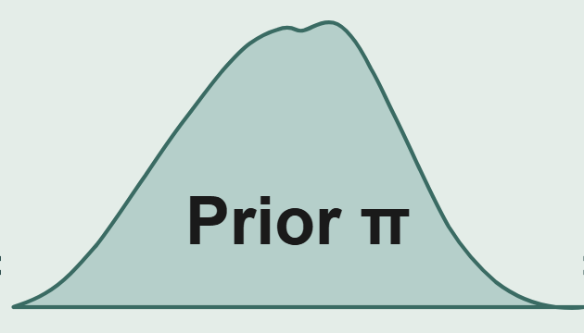

(a) Pre-training: meta-learning on synthetic task prior π
y
y
y
y
…
Task 1(SCM)
Task 2(BNN)
Task m (SCM)
Pre-trained weights θ*
(b) TabPFN-2.5 alternating-attention Transformer encoder architecture
X₁
X₂
…
X_{p}
y
→
…
Positional feature embedding (randomized)
…
…
64 thinking rows
t₁, t₂, …, t₆₄
Attention sinks;
additional compute capacity
…
Positional feature embedding (randomized)
Feature Encoder
Normalize → 2-layer MLP → ℝᵏ
Feature-group embedding, group size = 3
Target Encoder
Pad y* with ȳ_{train} → Embed
Target embedding
Alternate
Transformer Encoder Stack: 18 layers
Feature Attention
Sample Attention
Attention Mask
x₁
x₂
…
x_{p}
y
Row 1
From
To
…
Row 2
Train
x₁
x₂
x_{p}
y
Row N
Thinking
x₁
x₂
…
x_{p}
y
Thinking
Test
Row test
Output Decoder (2-layer MLP)
Point prediction
Full predictive distribution

Slide 2
(a) Pre-training: meta-learning on synthetic task prior π
y
y
y
y
…
Task 1(SCM)
Task 2(BNN)
Task m (SCM)
Pre-trained weights θ*
(b) TabPFN-2.5 alternating-attention Transformer encoder architecture
X₁
X₂
…
X_{p}
y
→
…
Positional feature embedding (randomized)
…
…
64 thinking rows
t₁, t₂, …, t₆₄
Attention sinks;
additional compute capacity
…
Positional feature embedding (randomized)
Feature Encoder
Normalize → 2-layer MLP → ℝᵏ
Feature-group embedding, group size = 3
Target Encoder
Pad y* with ȳ_{train} → Embed
Target embedding
Alternate
Transformer Encoder Stack: 18 layers
Feature Attention
Sample Attention
Attention Mask
x₁
x₂
…
x_{p}
y
Row 1
From
To
…
Row 2
Train
x₁
x₂
x_{p}
y
Row N
Thinking
x₁
x₂
…
x_{p}
y
Thinking
Test
Row test
Output Decoder (2-layer MLP)
Point prediction
Full predictive distribution

Slide 3

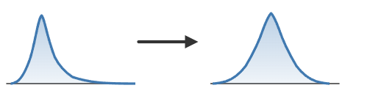

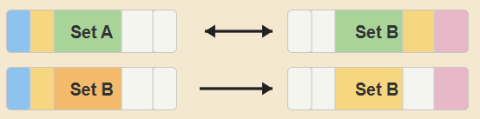
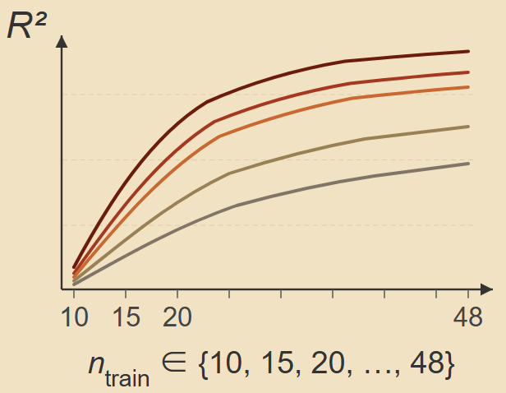

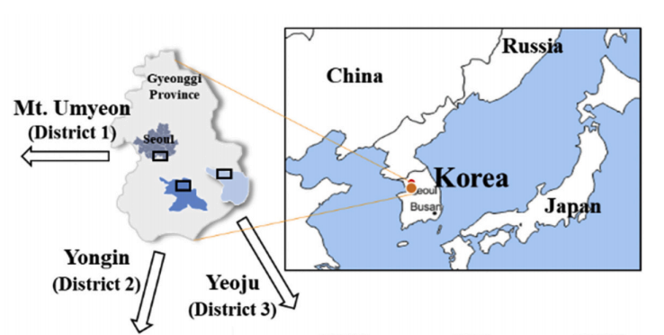
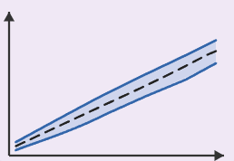
Stage 1: Data preprocessing and target definition
① Primary dataset
② Target transformation
③ Dual feature set design
Set A (6 vars)
A , H, L, D, J ,V_{landslide}
Ablation:
±V_{landslide}
V₀ (×10⁴m³)
log₁₀(V₀)
Set B (5 vars)
Longmenshan Fault Zone，
n=60, 6 predictors + 1 response
A , H, L, D, J
Stage 2: Model configuration and inference mode
① Pre-trained foundation model
Baseline models (×10)
TabPFN-2.5
In-context inference
No hyperparameter tuning
Linear Kernel Neighbor Ensemble Neural net
Ridge
Lasso
Elastic Net
KNN
MLP
SVR
RF
Gradient Boosting Regressor
XGBoost
AdaBoost
Prediction + Distribution
No tuning needed
Bayesian optimization (Optuna TPE, 30 trials, inner 3-fold CV)
Hyperparameter search
Unified outer-fold evaluation
Stage 3: Repeated nested cross-validation and statistical inference
① Nested CV architecture
Metrics
② Statistical inference
Outer loop: 10 × 5-fold CV → 50 test folds
R², RMSE, MAE
Paired Wilcoxon signed-rank
Holm–Bonferroni correction
Train
Train
Train
Train
Test
Inner loop: 3-fold CV (baselines only)
Train
Train
Val
Observation unit: repeat-level mean R² (n = 10)
Stage 4: Feature ablation and sample efficiency analysis
① Cross-feature-set comparison
② Learning curve analysis
ΔR² (Set A – Set B) per model
Two-sided Wilcoxon signed-rank test
n_{train} ∈ {10, 15, 20, ..., 48}
Stage 5: Uncertainty quantification, interpretability, and external validation
① Residual-based prediction intervals
SHAP
③ Independent external benchmark
② SHAP-based interpretability
Lee et al. (2021)

Slide 4
Stage 1: Data preprocessing and target definition
① Primary dataset
② Target transformation
③ Dual feature set design
Set A (6 vars)
A , H, L, D, J ,V_{landslide}
Ablation:
±V_{landslide}
V₀ (×10⁴m³)
log₁₀(V₀)
Set B (5 vars)
Longmenshan Fault Zone，
n=60, 6 predictors + 1 response
A , H, L, D, J
Stage 2: Model configuration and inference mode
① Pre-trained foundation model
Baseline models (×10)
TabPFN-2.5
In-context inference
No hyperparameter tuning
Linear Kernel Neighbor Ensemble Neural net
Ridge
Lasso
Elastic Net
KNN
MLP
SVR
RF
Gradient Boosting Regressor
XGBoost
AdaBoost
Prediction + Distribution
No tuning needed
Bayesian optimization (Optuna TPE, 30 trials, inner 3-fold CV)
Hyperparameter search
Unified outer-fold evaluation
Stage 3: Repeated nested cross-validation and statistical inference
① Nested CV architecture
Metrics
② Statistical inference
Outer loop: 10 × 5-fold CV → 50 test folds
R², RMSE, MAE
Paired Wilcoxon signed-rank
Holm–Bonferroni correction
Train
Train
Train
Train
Test
Inner loop: 3-fold CV (baselines only)
Train
Train
Val
Observation unit: repeat-level mean R² (n = 10)
Stage 4: Feature ablation and sample efficiency analysis
① Cross-feature-set comparison
② Learning curve analysis
ΔR² (Set A – Set B) per model
Two-sided Wilcoxon signed-rank test
n_{train} ∈ {10, 15, 20, ..., 48}
Stage 5: Uncertainty quantification, interpretability, and external validation
① Residual-based prediction intervals
SHAP
③ Independent external benchmark
② SHAP-based interpretability
Lee et al. (2021)

Slide 5
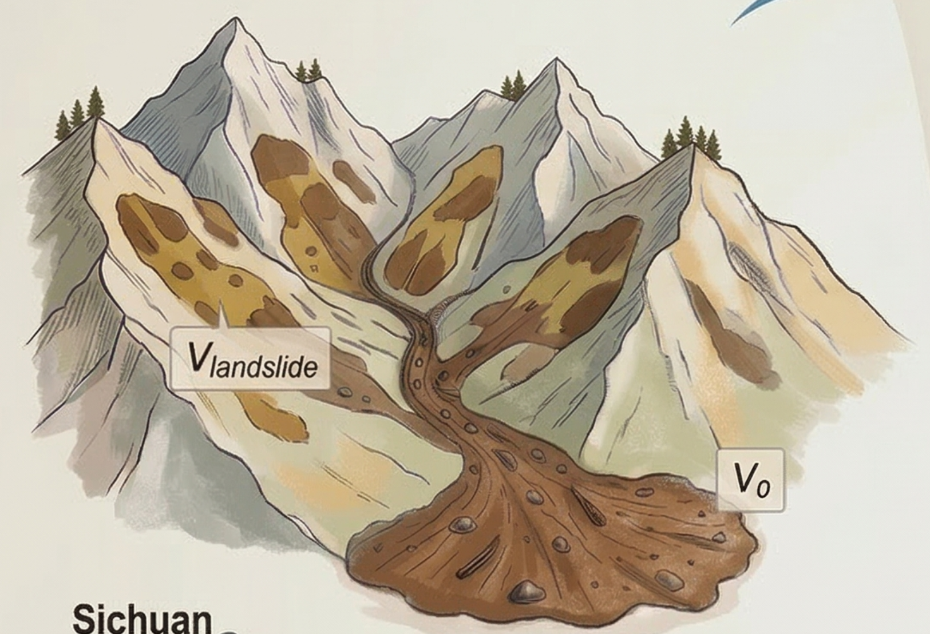
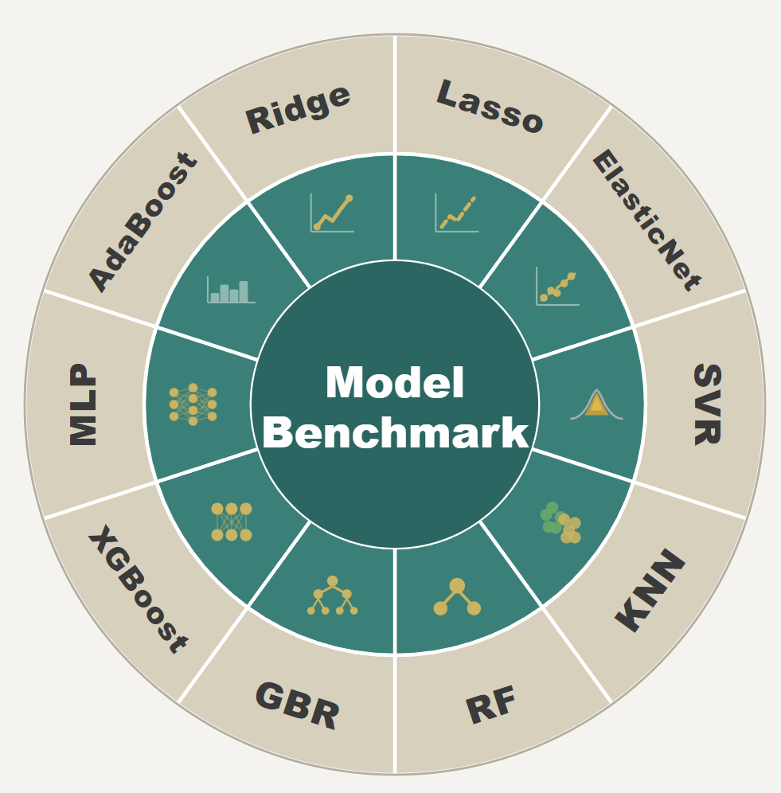

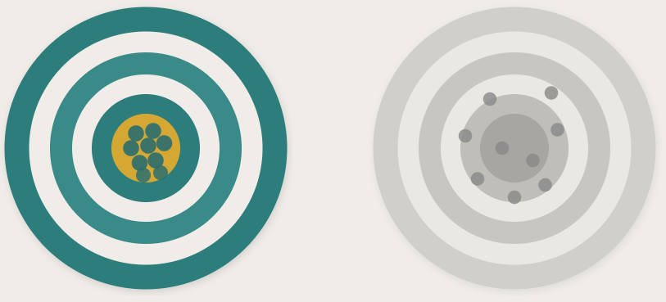
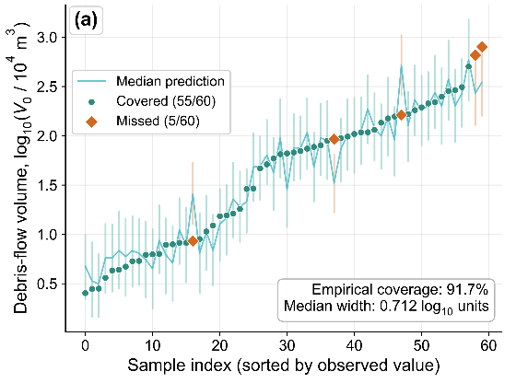
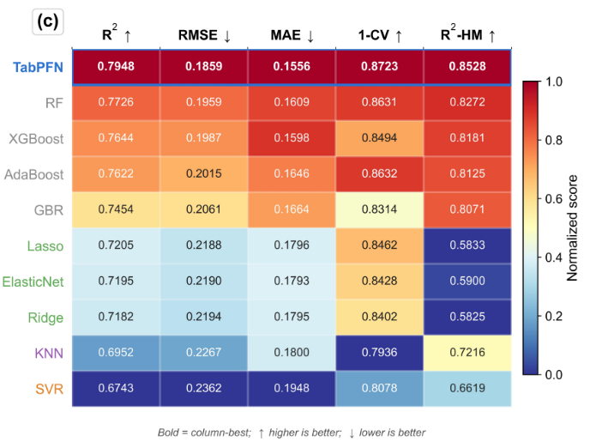

Background
Data→Model
Methods
Model→Insight
Key Findings
_{TabPFN-2.5}
D_{train}
Ablation Study: V_{landslide}
SHAP Analysis
With V_{landslide}
Without V_{landslide}
F-Attn
S-Attn
R²=0.92 R²=0.67
Decision-Support Implications
F-Attn
Conformal Calibration
External Benchmark
S-Attn
❶ How far can a pretrained model go without tuning?
❷ How much does sediment-source info dominate prediction?
Prediction + Distribution
Zero-shot inference
Bayesian optimization
No hyperparameter tuning
10×5-fold nested CV
→ 50 test folds
91.7% empirical coverage
Robustness verification

