Slide 1
Lecture 11 – 二极管电路part2

Slide 2
Introduction
2
本章知识点
理想二极管的特性，以及 包含多个二极管的电路的分析和设计，实现有用、有趣的非线性特性；
PN结二极管的电路模型及其在电路分析与设计中的应用；
①简化模型（理想模型）；
②指数模型；
③恒压降模型；
④小信号模型；

Slide 3
Introduction
3
应用1：用反向串联的、工作于反向击穿区的zener二极管实现直流恒压
应用2：整流电路（日常充电器, ac → dc）
其他应用…

Slide 4
二极管电路的分析方法（理想模型、恒压降模型）
4
假设二极管处于“闭合on”或“打开off”状态，分析电路，再验证是否违背二极管的基本属性，若违背了，则假设错误
开关闭合on，电压为0或V_{D,on}，验证电流；电流只能从正流向负；
开关打开off，电流为0，验证电压；电压只能是负端高于正端
常用的观察电路特性的三种视角
输入 I-V 特性，观察电路的输入电压与输入电流关系
输入-输出特性
时域响应特性

Slide 5
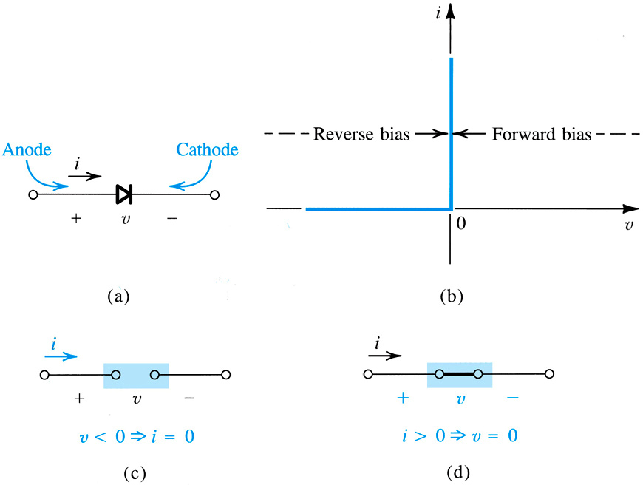
4.1.1. 理想二极管的伏安特性
5
理想二极管 – 最基本的非线性元件
两端元件；
元件符号 如右图所示
两种工作模式(状态)
on and off
I/V：分段线性函数
段内线性；跨段非线性
mode #2: reverse bias = open ckt.
mode #1: forward bias = short ckt

Slide 6
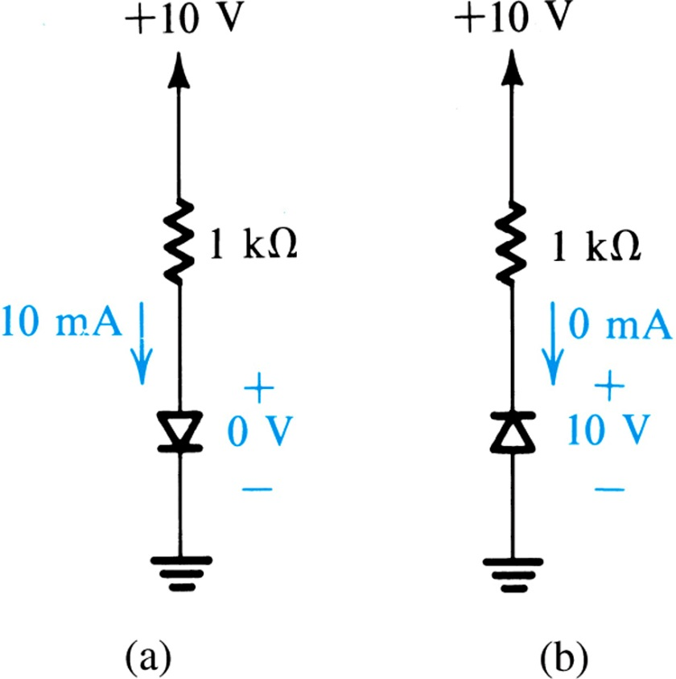
4.1.1. Current-Voltage Characteristic
6
正向导通，最大电流10mA
反向截止，最大反向电压降10 V
需要防止
①极大的正向电流（否则器件会烧毁）；
②极大的反向电压（否则进入反向击穿区后电流也会迅速增加）；
可通过外部电路来限制
Figure 4.2: The two modes of operation of ideal diodes and the use of an external circuit to limit (a) the forward current and (b) the reverse voltage.

Slide 7
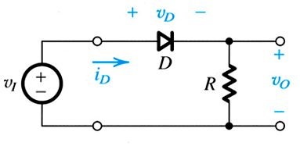
4.1.2: A Simple Application – The Rectifier
7
最基本的应用：整流器
整流，就是将AC转化为DC
One fundamental application of this piecewise linear behavior is the rectifier.
Q: What is a rectifier?
A: Circuit which converts AC waves in to DC…ideally with no loss.
Figure 4.3(a): Rectifier Circuit
Notes:
Of course there is always some loss.

Slide 8
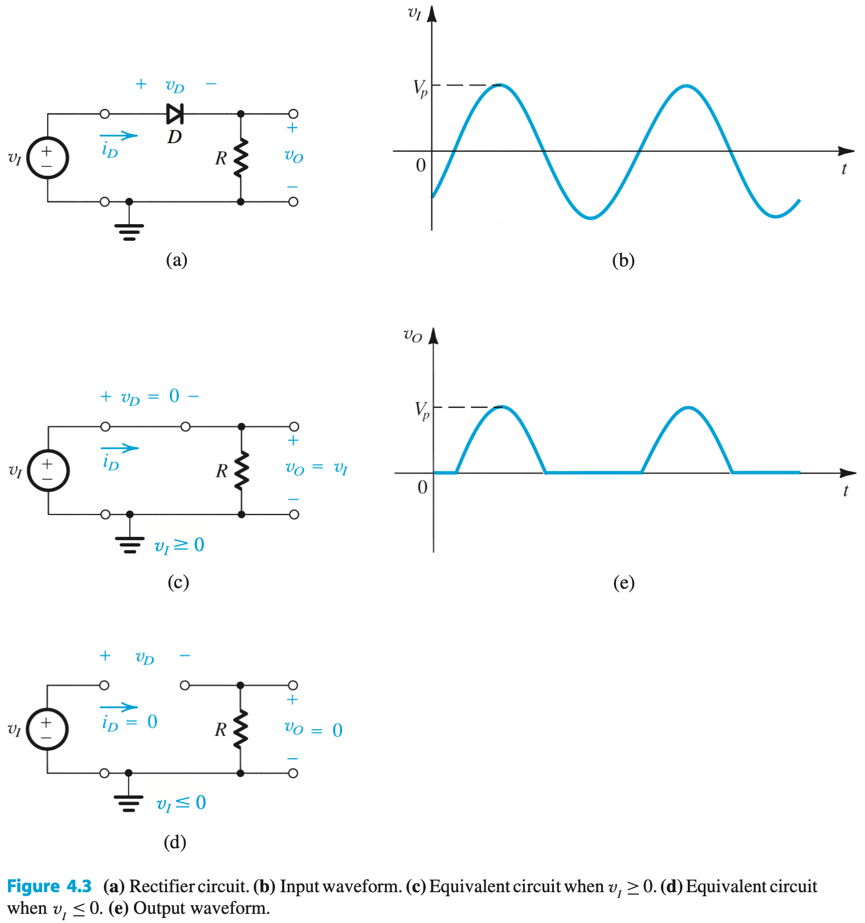
8
时域响应特性
输入时域波形
输出时域波形

Slide 9
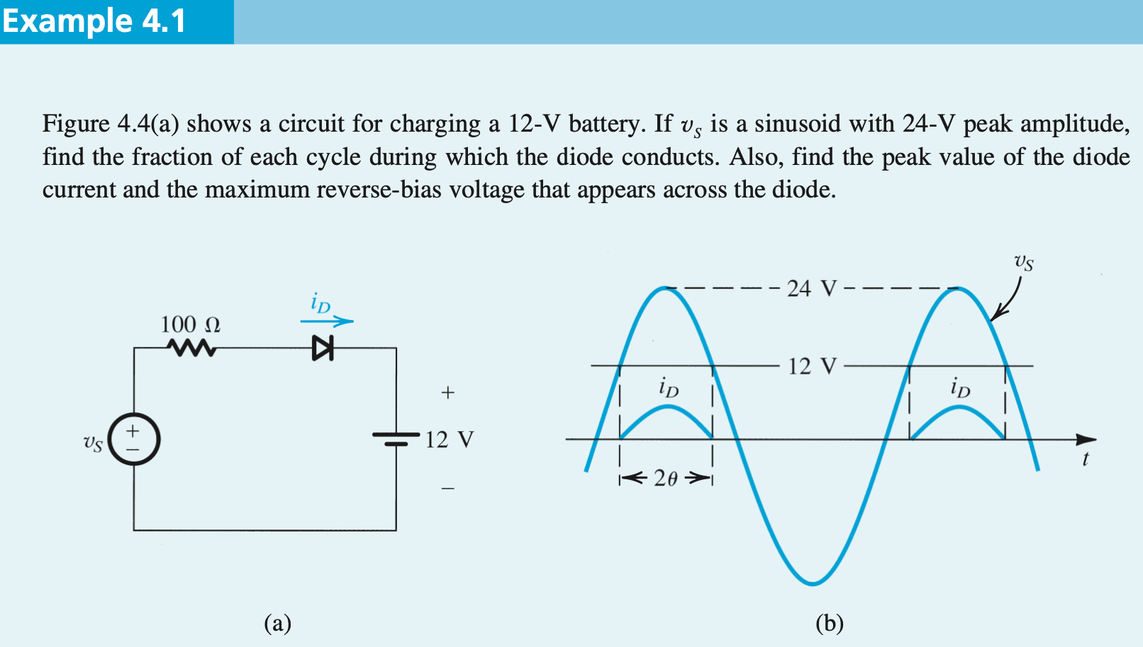



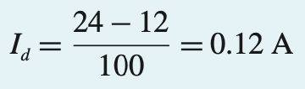
9
大于12V时二极管导通
②
③
①
③ 二极管最大反向电压
② 二极管峰值电流

Slide 10
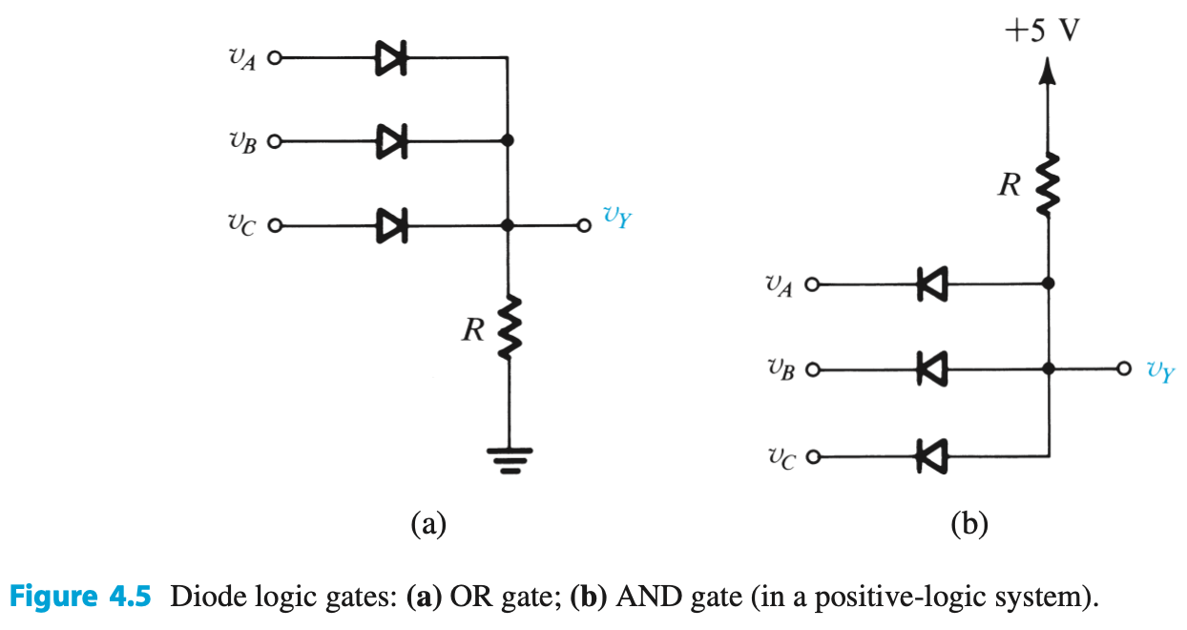
4.1.3. Another Application, Diode Logic Gates
10
另一应用：逻辑门（实际上很少用）
只有ABC都为高电平时，V_{Y}才为高电平
ABC任意一个为高电平，V_{Y}即为高电平
逻辑“或”
逻辑“与”
Notes:
This is Resistor-Diode-Logic, but is generally never used due to practical reasons. The earliest computers used Resistor-Transistor-Logic (RTL) or Diode-Transistor-Logic (DTL).

Slide 11
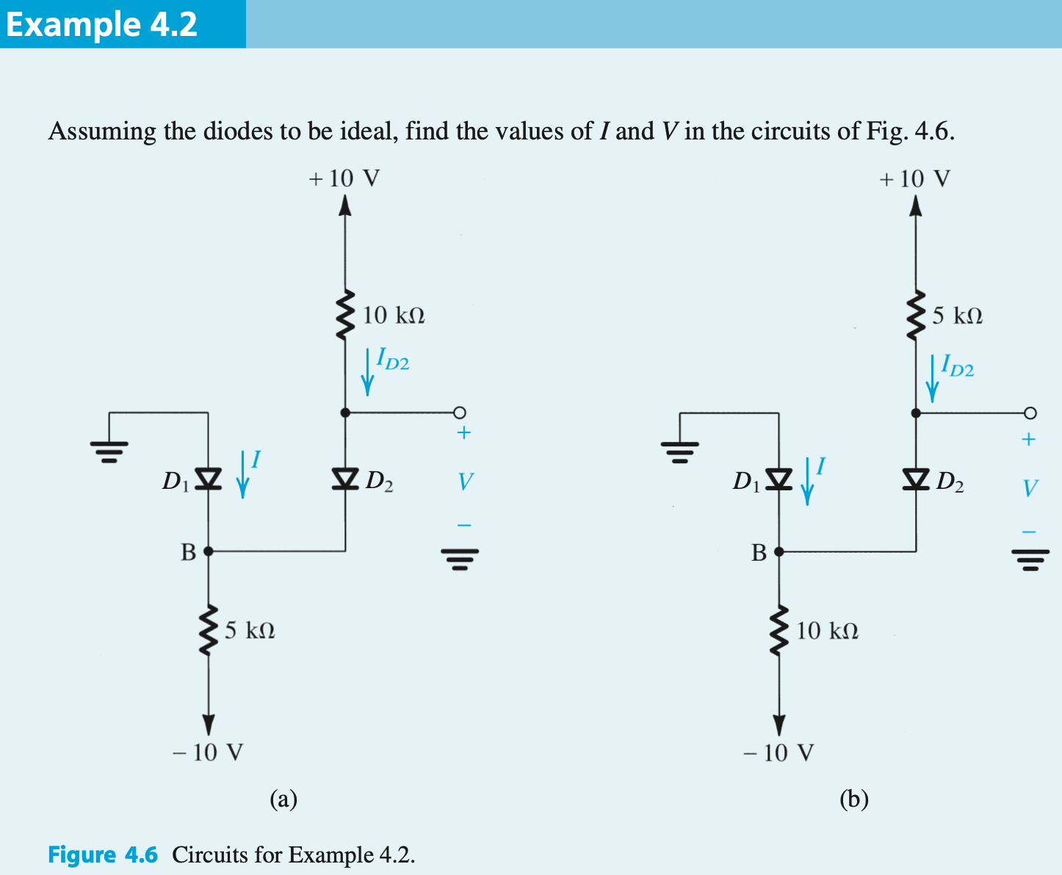


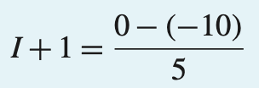

Example 4.2: More Diodes
11
①假设D1和D2都on
②分析
③验证，电流从正流向负，合理
在节点B处

Slide 12
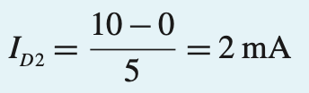
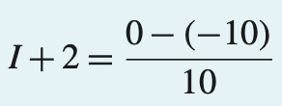

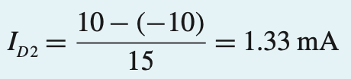

Example 4.2: More Diodes
12
①假设D1和D2都on
②分析
③验证，电流从负流向正，不合理
④重新假设D1off，D2 on
⑤验证，反向偏置，负端电压大于正端电压，合理

Slide 13
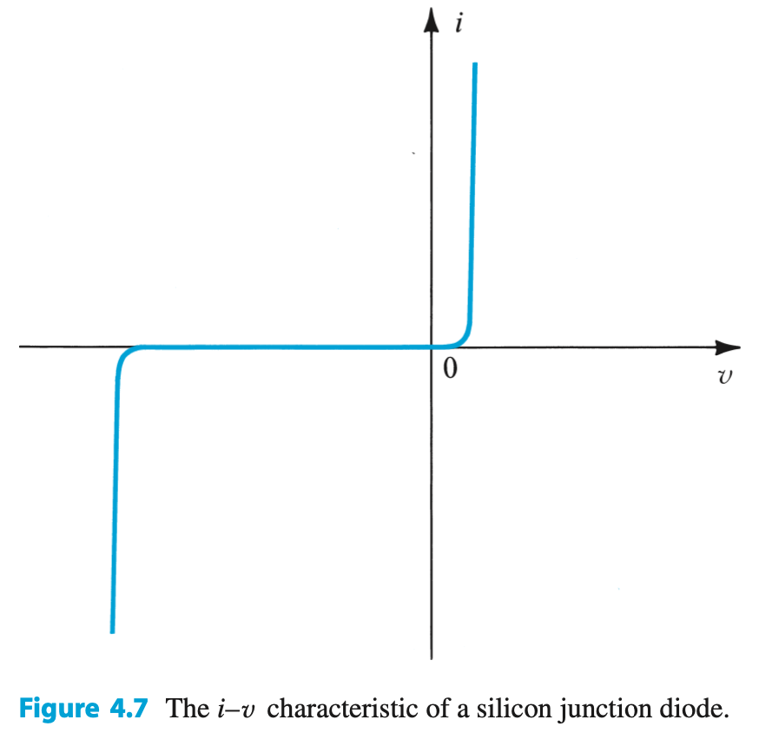
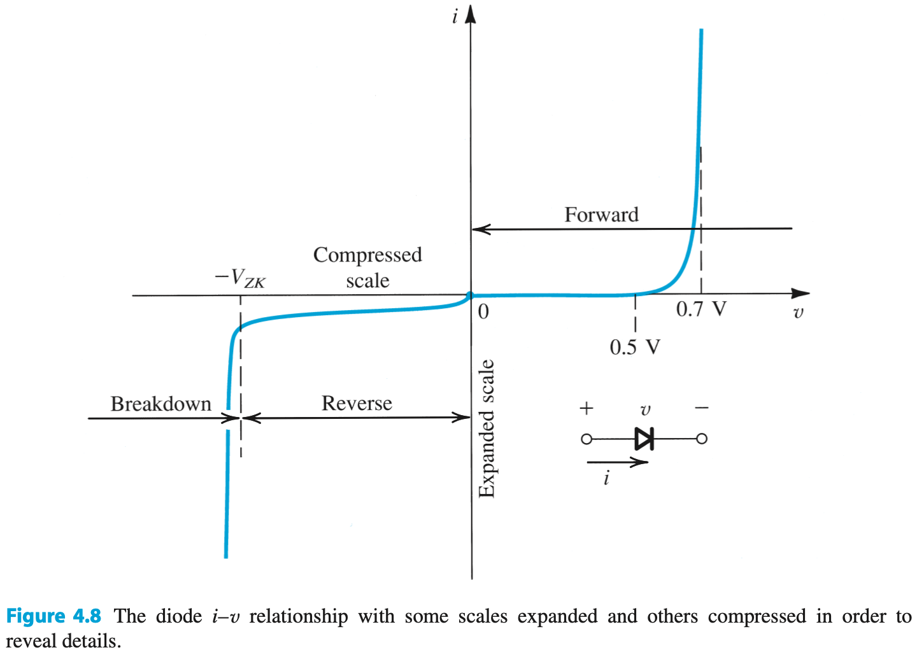
4.2. PN结二极管的特性
13
大多数的二极管都用PN结来实现

Slide 14
4.2.1. The Forward-Bias Region正向偏置区域
14
The forward-bias region of operation is entered when v > 0.
I-V relationship is closely approximated by equations to right.
26 mV
(4.3) is a simplification suitable for large v
对于较大的正向电压V，该式更简单

Slide 15

4.2.1. The Forward-Bias Region
15
根据电压求电流
Equation (4.3) may be reversed to yield (4.4).
This relationship applies over as many as seven decades of current.
根据电流求电压

Slide 16
4.2.1. The Forward-Bias Region
16
分析电压变化对电流的影响，或反之
Q: What is the relative effect of current flow (i) on forward biasing voltage (v)?
A: Very small.
10x change in i, effects 60mV change in v.
正向电压变化 60 mV，电流变化 10倍

Slide 17
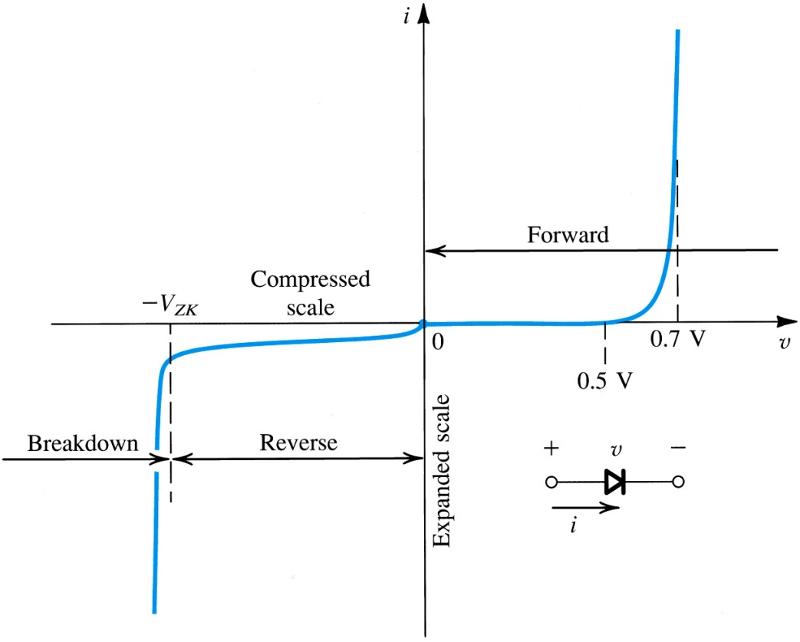
4.2.1: The Forward-Bias Region
17
cut-in voltage – is voltage, below which, minimal current flows
approximately 0.5V
fully conducting region – is region in which R_{diode} is approximately equal 0
between 0.6 and 0.8V
小于0.5V时，电流可忽略
Q：0.6~0.8V 电压对应多少倍的电流变化？
fully conducting region

Slide 18
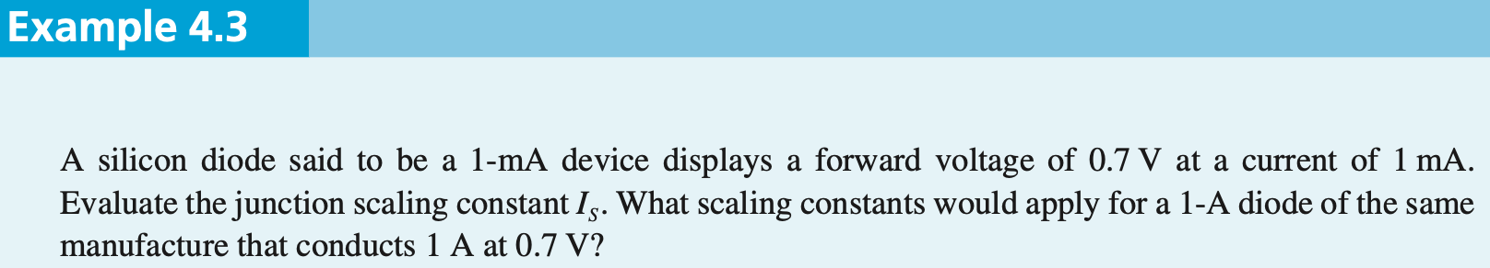



18
①
② 1000个 1-mA device并联，可构成一个 1-A device，所以

Slide 19
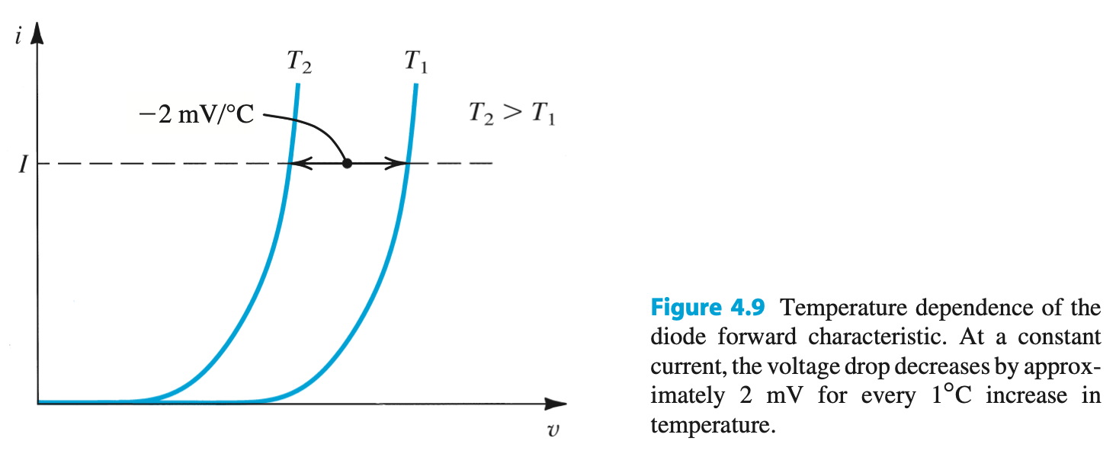
温度特性
19

Slide 20


4.2.2. The Reverse-Bias Region 反向偏置区域
20
The reverse-bias region of operation is entered when v < 0.
I-V relationship, for negative voltages with |v| > V_{T} (26mV), is closely approximated by equations to right.
理论值

Slide 21
4.2.2. The Reverse-Bias Region
21
A “real” diode exhibits reverse-bias current, although small, much larger than I_{S} .
10⁻⁹ vs. 10⁻¹⁴Amps
A large part of this reverse current is attributed to leakage effects.
实际值

Slide 22
4.2.3. The Breakdown Region反向击穿区
22
稳压器：电压基本保持不变，当①负载有变化时；②供电电压有变化时
二极管两个区域都可以用作稳压器
The breakdown region of operation is entered when v < V_{ZK}.
Zener-Knee Voltage (V_{ZK})
This is normally non-destructive. 非破坏性的
电压基本不变，也可用作voltage regulator (稳压器)
breakdown region
Notes:
Calculate the power dissipated to see if it is “Destructive”.

Slide 23


23
V = -V_{ZK}
V = -V_{T}
V = 10V_{T}

Slide 24
4.3. Modeling the Diode Forward Characteristic
24
The previous slides define a robust set of diode models.
Upcoming slides, however, discuss simplified diode models better suited for use in circuit analyses:
exponential model
constant voltage-drop model
ideal diode model
small-signal (linearization) model

Slide 25
4.3.1. The Exponential Model
25
exponential diode model
most accurate 指数模型~最为精确，但最难分析
most difficult to employ in circuit analysis
due to nonlinear nature
Notes:
Spice simulations (as in Multisim or LTSpice) use this model.

Slide 26

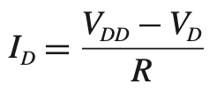
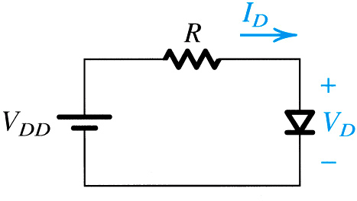
4.3.1. The Exponential Model
26
①二极管的电压电流约束关系：
②外部电路分析
两个未知数，两个方程，可解，但要解超越方程（方法1）
Q: How does one solve for I_{D} in circuit to right?
V_{DD} = 5V
R = 1kOhm
I_{D} = 1mA @ 0.7V
A: Two methods exist…
graphical method 图解法（方法2）
iterative method 迭代法（方法3）
Figure 4.10: A simple circuit used to illustrate the analysis of circuits in which the diode is forward conducting.

Slide 27
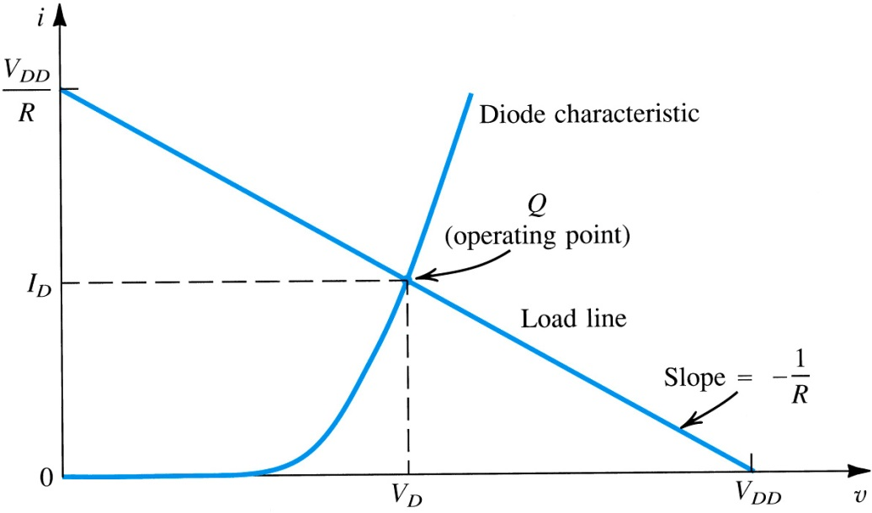
4.3.2. Graphical Analysis Using Exponential Model
27
图解法是求解非线性方程的经典方法
step #1: Plot the relationships of (4.6) and (4.7) on single graph
step #2: Find intersection of the two…
load line and diode characteristic intersect at operating point
Figure 4.11: Graphical analysis of the circuit in Fig. 4.10 using the exponential diode model.
Notes:
Graphical solutions are a classical approach when dealing with nonlinear equations.
The load Line is determined by the linear portion of the circuit.

Slide 28
4.3.2. Graphical Analysis Using Exponential Model
28
Pro’s 优点
Intuitive
Con’s 缺点
Poor Precision
Not Practical for Complex Analyses
multiple lines required
Figure 4.11: Graphical analysis of the circuit in Fig. 4.10 using the exponential diode model.

Slide 29



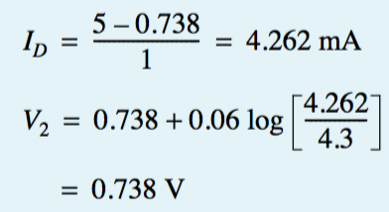


4.3.3. Iterative Analysis Using Exponential Method
29
1 kΩ
5 V
step #1: Start with initial guess of V_{D}.
V_{D}⁽⁰⁾
step #2: Use nodal / mesh analysis to solve I_{D}.
step #3: Use exponential model to update V_{D}.
V_{D}⁽¹⁾ = f(V_{D}⁽⁰⁾)
step #4: Repeat these steps until V_{D}^{(k+1)} = V_{D}^{(k)}.
Upon convergence, the new and old values of V_{D} will match.
4.3mA比1mA大，电压要相应增加

Slide 30
4.3.3. Iterative Analysis Using Exponential Method
30
Pro’s
High Precision
Con’s
Not Intuitive
Not Practical for Complex Analyses
10+ iterations may be required
可见，采用指数模型，不管是图解法还是迭代法，虽然精度高，但效率低；
Notes:
This is a job for a computer, not a person.

Slide 31
4.3. Modeling the Diode Forward Characteristic
31
需要一个能快速分析二极管电路的方法：恒压降模型
Q: How can one analyze these diode-based circuits more efficiently?
A: Find a simpler model.
One example is assume that voltage drop across the diode is constant.

Slide 32
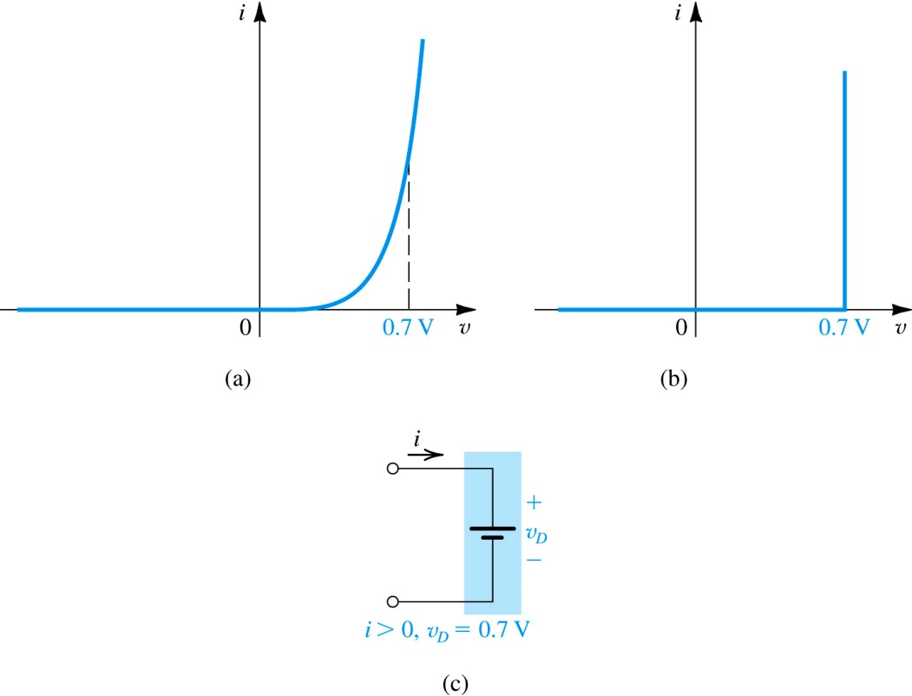
4.3.5. The Constant Voltage-Drop Model
32
1 kΩ
5 V
The constant voltage-drop diode model assumes that the slope of I_{D} vs. V_{D} is vertical @ 0.7V
Q: How does example 4.4 solution change if CVDM is used?
A: 4.262mA to 4.3mA
Figure 4.12: Development of the diode constant-voltage-drop model: (a) the…

Slide 33
4.3.6. Ideal Diode Model
33
更简单的模型：理想模型
1 kΩ
5 V
The ideal diode model assumes that the slope of I_{D} vs. V_{D} is vertical @ 0V
Q: How does example 4.4 solution change if ideal model is used?
A: 4.262mA to 5mA

Slide 34
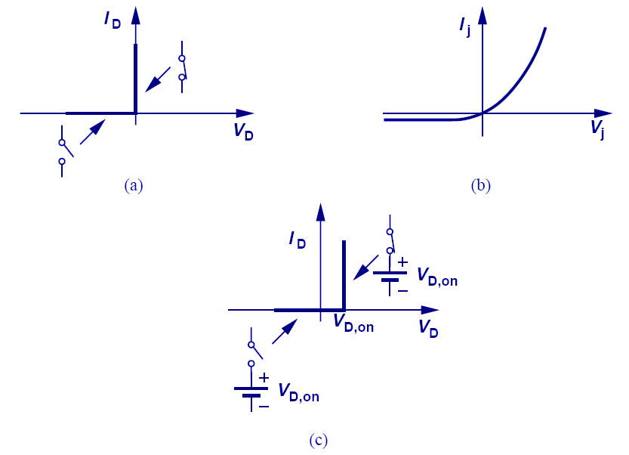
When to use these models?
34
ideal diode model
high voltages >> 0.7V
very complex circuits
cases where a difference in voltage by 0.7V is negligible
一般用于快速判断二极管状态
small-signal model
this is next…
exponential model
low voltages
less complex circuits
emphasis on accuracy over practicality
constant voltage-drop mode:
medium voltages = 0.7V
more complex circuits
emphasis on practicality over accuracy
大部分情况适用 70-80%

Slide 35
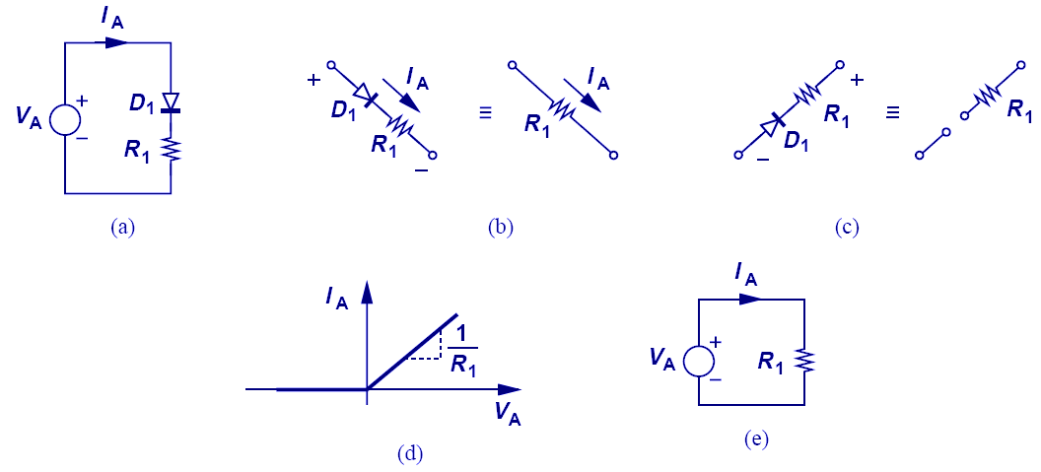
常规电路特性图：①I/V；②输入输出；③时域图
35
①I/V特性图
分析二极管电路的一个原则：二极管刚要开启时（about to turn on）,I_{D}=0，V_{D}=V_{D,on}(0或0.7V，视采用何种模型而定)；V_{A}从-∞到+∞，必有一点电压为使二极管刚要开启的电压

Slide 36
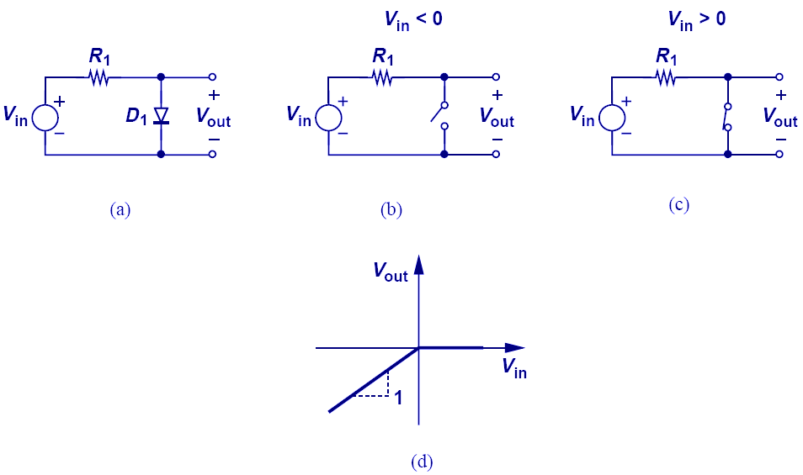
Input/Output Characteristics
36
绘图方法：
①Vin从-∞开始增加→曲线1；
②Vin从+∞开始减小→曲线2；
③曲线1和曲线2的相交点如何
确定？A. 直接延长相交；B. 分析二极管刚要开启的临界点
②输入输出特性图
When V_{in} is less than zero, the diode opens, so V_{out} = V_{in}.
When V_{in} is greater than zero, the diode shorts, so V_{out} = 0.

Slide 37
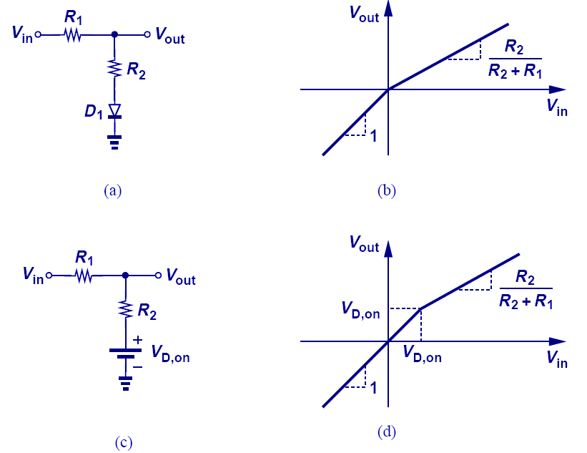
Input/Output Characteristics with Ideal and Constant-Voltage Models
37
理想模型
恒压降模型
The circuit above shows the difference between the ideal and constant-voltage model; the two models yield two different break points of slope.

Slide 38
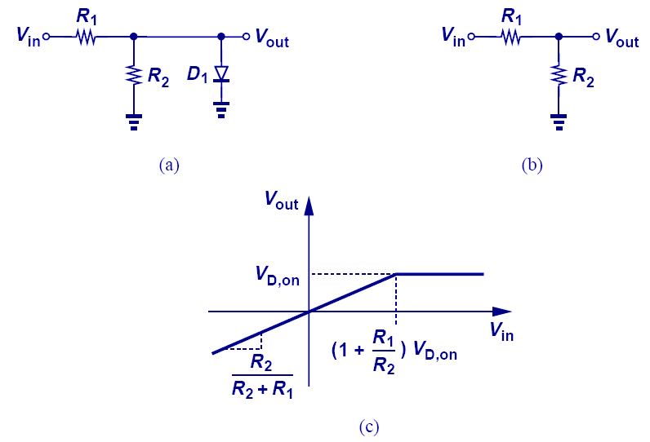
Input/Output Characteristics with a Constant-Voltage Model
38
When using a constant-voltage model, the voltage drop across the diode is no longer zero but V_{d,on} when it conducts.

Slide 39
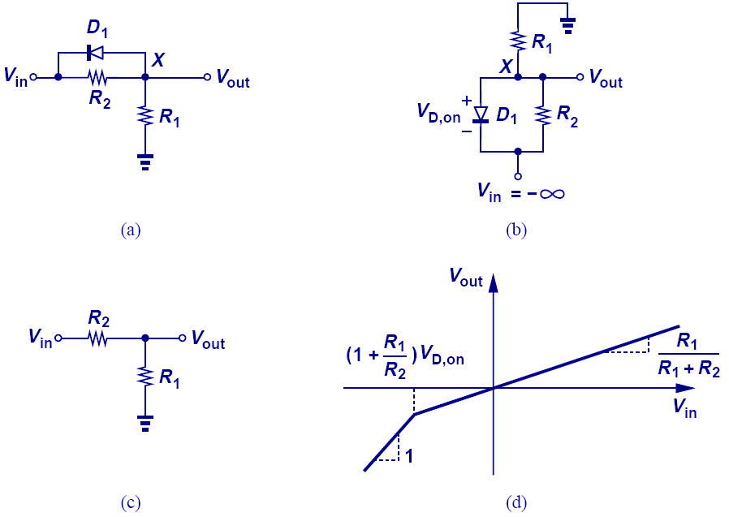
Another Constant-Voltage Model Example
39
-
In this example, since V_{in} is connected to the cathode, the diode conducts when V_{in} is very negative.
The break point where the slope changes is when the current across R₁ is equal to the current across R₂.

Slide 40
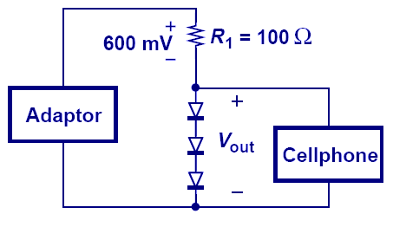
Cell Phone Adapter 手机适配器（稳压器）
40
小信号模型的动机：
有效分析微量变化的响应
稳压器：电压基本保持不变，当①负载有变化时；②供电电压有变化时
I_{x}
V_{out} = 3 V_{D,on} is used to charge cell phones.
However, if I_{x} changes, iterative method is often needed to obtain a solution, thus motivating a simpler technique. （充电器输入电压有微量波动时，如何有效分析v_{out}的变化量）

Slide 41
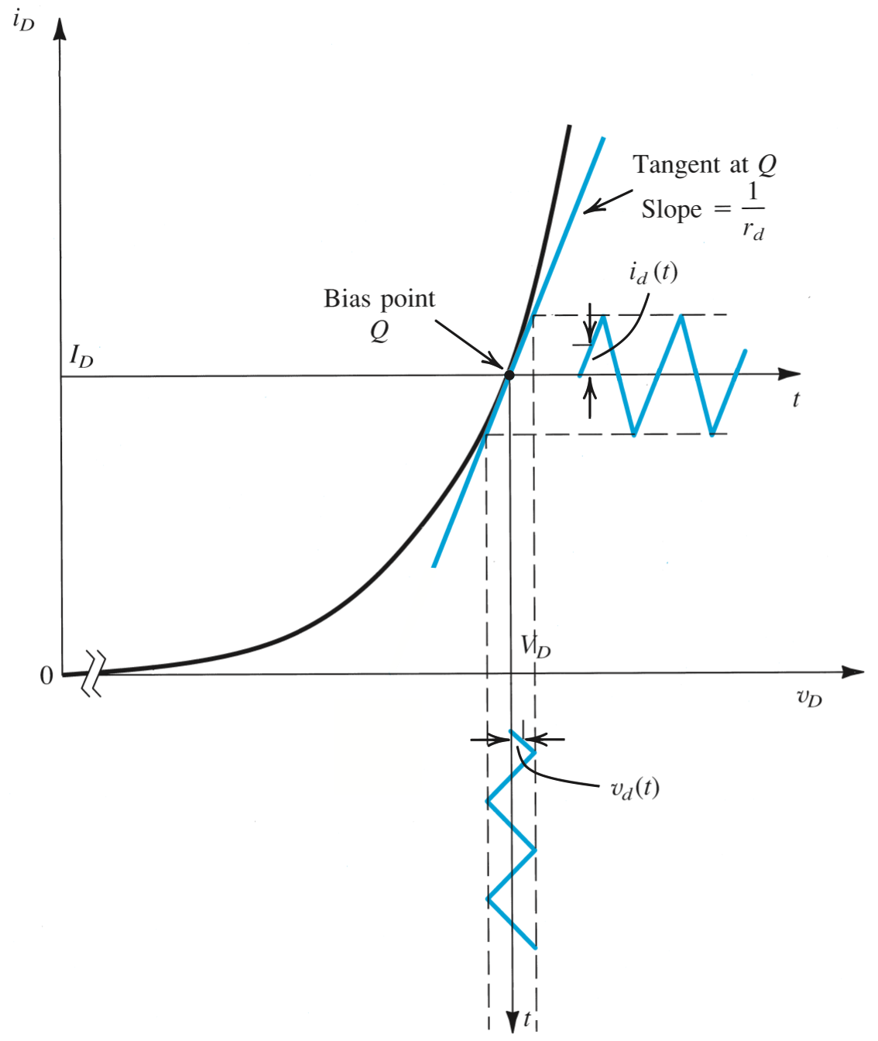
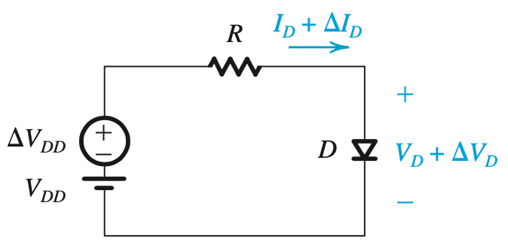




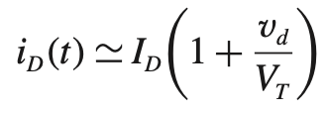
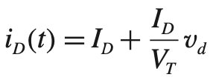

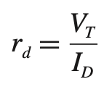
41
二极管的电压电流约束关系
A
③
②
当V_{DD}有微小变化ΔV_{DD}时，分析二极管ΔV_{D}和ΔI_{D}之间的关系
C
B
①
D
②
黑色曲线上A点和B点之间
③ 可以用蓝色曲线上的C点和D点之间来近似，如何近似？（Q点作切线，线性化）什么情况下可以近似？
近似前提：
一般来说，当v_{d} < (1/5)V_{T}时，可近似，即v_{d} < 5mV 时可近似
V_{D}~ 0.7 V
①
定义：

Slide 42
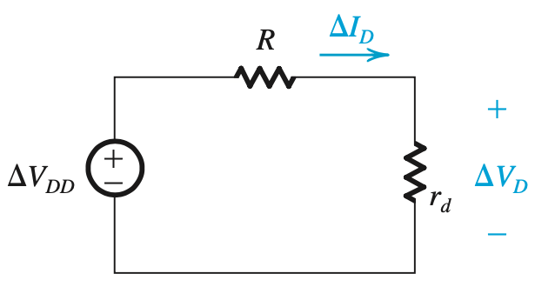
42
二极管的电压电流约束关系
A
C
有微小变化量时的分析方法：因为输入总量是直流和小信号变化量的线性叠加，所以
①先做直流分析（turn off ΔV_{DD} ），求出I_{D}
②根据I_{D}计算出小信号参数r_{d}
③再做小信号分析（turn off V_{DD}）电阻不变，二极管用小信号模型r_{d}代替
④最后将直流和小信号相叠加，得到完整的时域信号
B
D

Slide 43
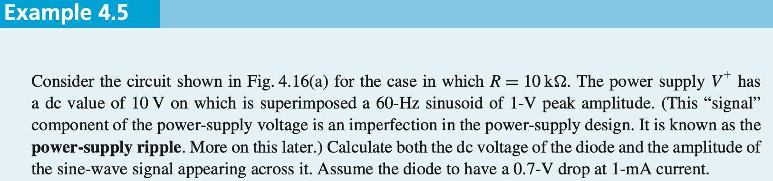
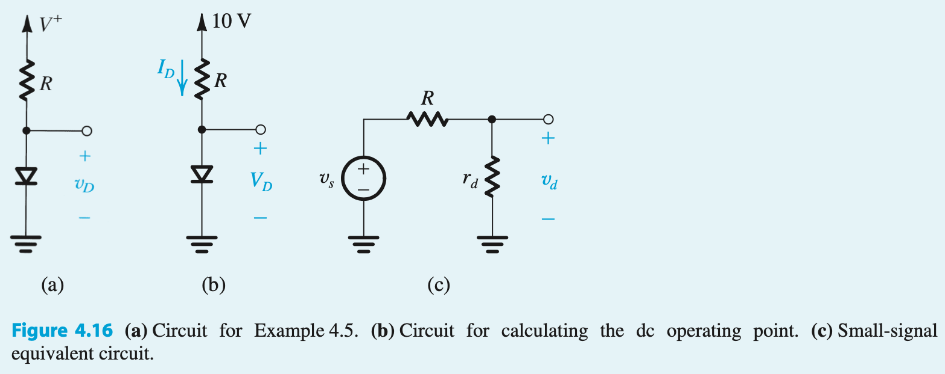


43
①直流分析

Slide 44
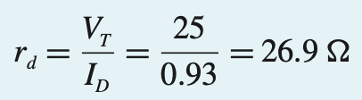
44
②计算小信号参数 * Sedra 的教材为了计算简单，将26 mV 近似成 25 mV

Slide 45

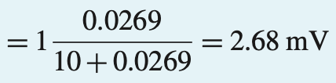
45
③小信号分析（等效电路参见图c）

Slide 46
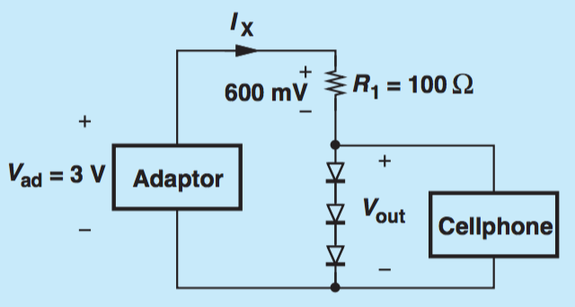
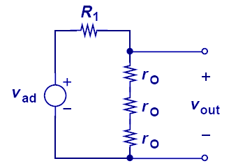

Adapter Example Revisited
46
假设 V_{D} = 800 mV
输入电压变化100mV~输出变化11.5mV
With our understanding of small-signal analysis, we can revisit our cell phone charger example and easily solve it with just algebra instead of iterations.

Slide 47
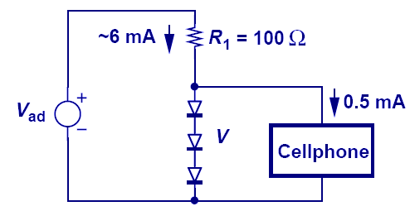
Simple is Beautiful
47
小信号分析需验证近似前提是否成立
每个二极管上电压变化约2.2mV，小于 5mV，小信号近似适用
假设 6 mA 不变
当不接入手机时，二极管上流过的电流为 6 mA
当接入手机后，手机分流走0.5mA，二极管上流过的电流变为 5.5 mA，请问给三个二极管串联的总电压变化多少？
In this example we study the effect of cell phone pulling some current from the diodes. Using small signal analysis, this is easily done. However, imagine the nightmare, if we were to solve it using non-linear equations.

Slide 48
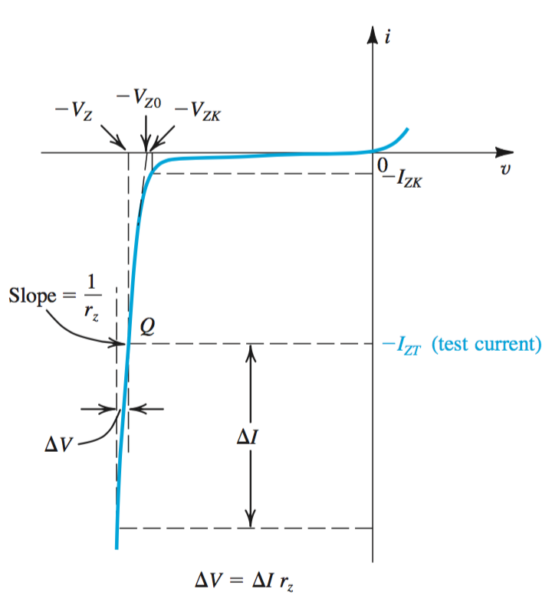
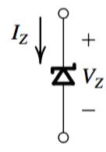
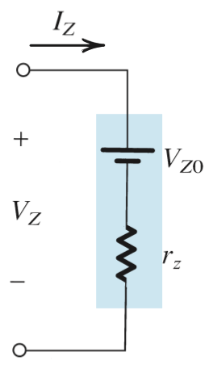
4.4. Operation in the Reverse Breakdown Region – Zener Diodes反向截止区作为稳压器，齐纳二极管
48
齐纳二极管稳压器已基本不用，现在实用的稳压器（voltage regulator）都用 IC 实现
Under certain circumstances, diodes may be intentionally used in the reverse breakdown region.
These are referred to as Zener Diodes.
齐纳二极管的符号
V_{ZK}，I_{ZK}，反向截止区的起始点
V_{Z}， I_{ZT}，工作点
V_{Z0}，线性化与横坐标的交点
等效电路，用电路描述线性化区域：
Notes:
A somewhat better way to built a shunt regulator. The diode is used in reverse bias.

Slide 49
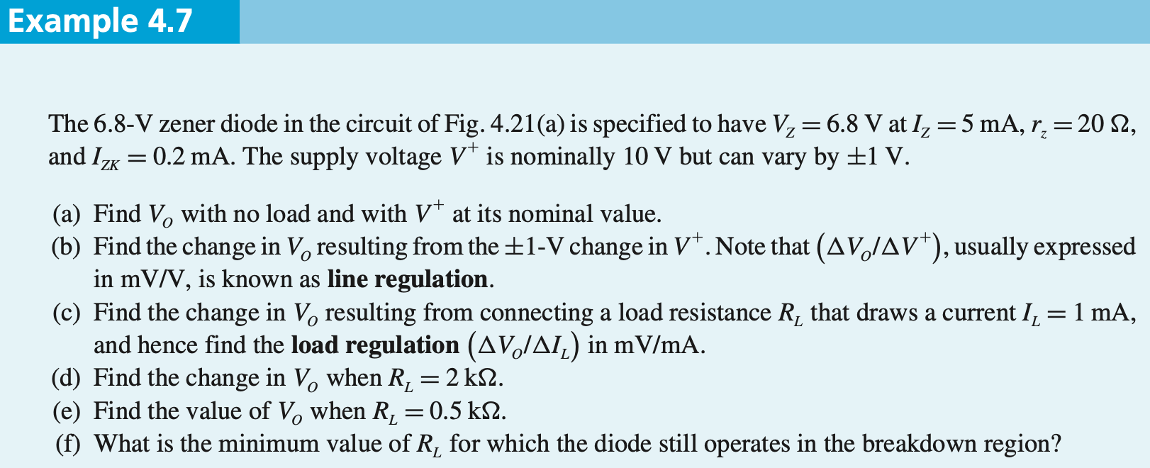
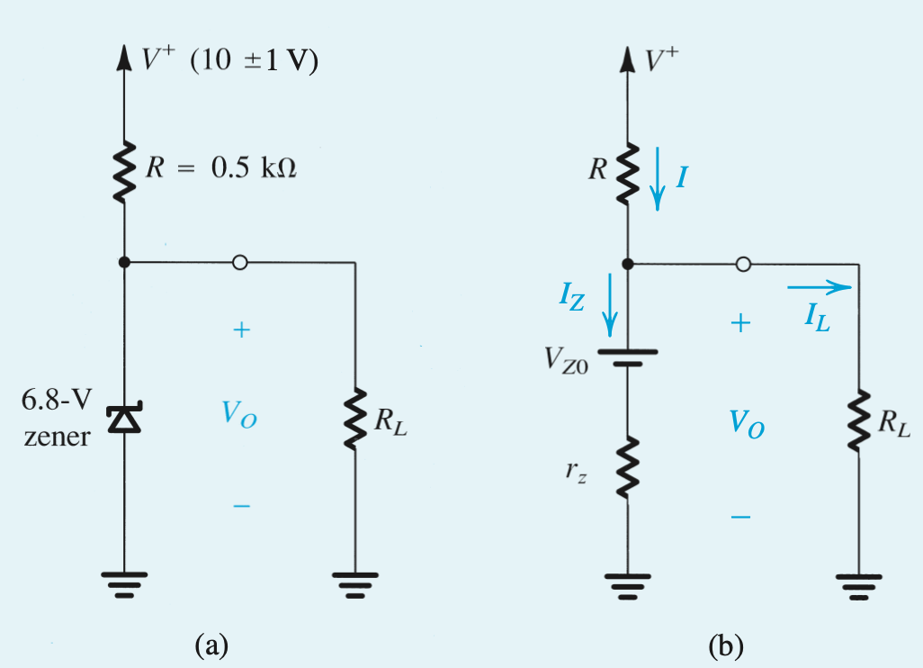



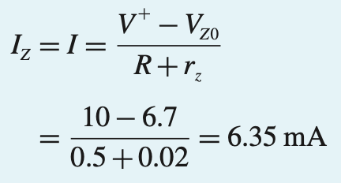
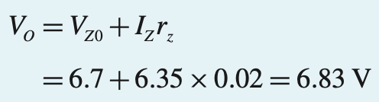
49
用等效电路替代
第一步，求V_{Z0}
已知直线斜率，某一点坐标，求与x轴的交点
(a) 不接负载时

Slide 50
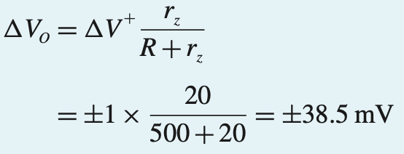

50
用等效电路替代
(b) 供电电压变化时
(c) 负载变化时

Slide 51


51
中文教材不给出r_{z}，则默认r_{z}为0

Slide 52

4.5. Rectifier Circuits 整流电路
52
One important application of diode is the rectifier –
Electrical device which converts alternating current (AC) to direct current (DC)
One important application of rectifier is dc power supply.

Slide 53

53
step #1: increase / decrease rms magnitude of AC wave via power transformer
step #2: convert full-wave AC to half-wave DC (still time-varying and periodic)
step #3: 滤去高频分量，使曲线更光滑
step #4: employ voltage regulator to eliminate ripple
step #5: supply dc load .
Figure 4.20: Block diagram of a dc power supply
Notes:
The diagrams indicate a “full-wave” rectifier.

Slide 54

4.5.1. The Half-Wave Rectifier 半波整流
54
half-wave rectifier – utilizes only alternate half-cycles of the input sinusoid
Constant voltage drop diode model is employed.
Figure 4.21: (a) Half-wave rectifier (b) Transfer characteristic of the rectifier circuit (c) Input and output waveforms

Slide 55
4.5.1. The Half-Wave Rectifier
55
current-handling capability – what is maximum forward current diode is expected to conduct?
peak inverse voltage (PIV) – what is maximum reverse voltage it is expected to block w/o breakdown?
需关注两个参数：最大正向电流、最大反向电压

Slide 56
4.5.1. The Half-Wave Rectifier
56
exponential model? It is possible to use the diode exponential model in describing rectifier operation; however, this requires too much work.
small inputs? Regardless of the model employed, one should note that the rectifier will not operate properly when input voltage is small (< 1V).
Those cases require a precision rectifier.
半波整流电路只适合于输入较大的信号

Slide 57

4.5.2. The Full-Wave Rectifier
57
全波整流的实现方法之一
D1 off，D2 on
D1 on，D2 off
最大反向电压

Slide 58
4.5.2. The Full-Wave Rectifier
58
流经负载的电流方向不变
相比半波整流利用率更高
最大反向电压较大
Q: What are most important observation(s) from this operation?
A: The direction of current flowing across load never changes (both halves of AC wave are rectified). The full-wave rectifier produces a more “energetic” waveform than half-wave.
PIV for full-wave = 2V_{S} – V_{D}

Slide 59

4.5.3. The Bridge Rectifier
59
全波整流的实现方法之二：
桥式整流
An alternative implementation of the full-wave rectifier is bridge rectifier.
Shown to right.
Figure 4.23: The bridge rectifier circuit.
Notes:
You can buy Bridge Rectifier modules at Radio Shack.

Slide 60
60
when instantaneous source voltage is positive, D₁ and D₂ on while D₃ and D₄ off
Figure 4.23: The bridge rectifier circuit.

Slide 61
61
when instantaneous source voltage is negative, D₁ and D₂ off while D₃ and D₄ on
Figure 4.23: The bridge rectifier circuit.

Slide 62

62
整流器直接输出有较大波动，需要用滤波器滤除
最大反向电压
被两个二极管分摊

Slide 63
4.5.3: The Bridge Rectifier (BR)
63
Q: What is the main advantage of BR?
A: No need for center-tapped transformer.
Q: What is main disadvantage?
A: Series connection of TWO diodes will reduce output voltage.
PIV = V_{S} – V_{D}
无需变压器中间抽头
最大反向电压较小；
但，输出电压有两个V_{D,on}的压差
Notes:
Also you need to be careful to control grounds!

Slide 64

4.5.4. The Rectifier with a Filter Capacitor 滤波电容
64
Pulsating nature of rectifier output makes unreliable dc supply.
As such, a filter capacitor is employed to remove ripple.
Figure 4.24: (a) A simple circuit used to illustrate the effect of a filter capacitor. (b) input and output waveforms assuming an ideal diode.
Notes:
Reduce ripple, not remove it.

Slide 65

4.5.4. The Rectifier with a Filter Capacitor
65
step #1: source voltage is positive, diode is forward biased, capacitor charges.
step #2: source voltage is reverse, diode is reverse-biased (blocking), capacitor cannot discharge.
step #3: source voltage is positive, diode is forward biased, capacitor charges (maintains voltage).
D off
A
D on
Figure 4.24 (a) A simple circuit used to illustrate the effect…

Slide 66
4.5.4. The Rectifier with a Filter Capacitor
66
Q: Why is this example unrealistic?
A: Because for any practical application, the converter would supply a load (which in turn provides a path for capacitor discharging).

Slide 67

4.5.4. The Rectifier with a Filter Capacitor
67
Q: What happens when load resistor is placed in parallel with capacitor?
A: One must now consider the discharging of capacitor across load.

Slide 68
4.5.4. The Rectifier with a Filter Capacitor
68
The textbook outlines how Laplace Transform may be used to define behavior below.
circuit state #1
circuit state #2
Notes:
Laplace transforms are introduced in both the Differential Equations math course and the second Circuits course. They are heavily used in the Signals and Systems and Feedback Control courses.

Slide 69

69
Figure 4.25: Voltage and Current Waveforms in the Peak Rectifier Circuit WITH RC >> T. The diode is assumed ideal.
Notes:
So in the steady state:
The diode conducts when the input voltage is above the capacitor voltage and the capacitor charges up to the peak voltage of the sinusoid.
When the input voltage is below the capacitor voltage, the capacitor discharges due to the load current. The discharge is approximately linear if the ripple is small.

Slide 70








70
电容放电时：
假设 ，指数衰减变直线
电容充电时间
近似
这一电路也可以用来检测波形的峰值，可用作峰值检波电路

Slide 71

滤波之后加稳压电路
71
The ripple created by the rectifier can be unacceptable to sensitive load; therefore, a regulator is required to obtain a very stable output.
Three diodes operate as a primitive regulator.

Slide 72

Evolution of AC-DC Converter
72
半波整流 + 滤波
全波整流 + 滤波
全波整流 + 滤波 + 稳压

Slide 73

Limiting Circuits （限幅电路）
73
The motivation of having limiting circuits is to keep the signal below a threshold so it will not saturate the entire circuitry.
When a receiver is close to a base station, signals are large and limiting circuits may be required.

Slide 74

74

Slide 75

Input/Output Characteristics
75
Note the clipping of the output voltage.

Slide 76

Limiting Circuit Using a Diode: Positive Cycle Clipping
76
As was studied in the past, the combination of resistor-diode creates limiting effect.

Slide 77

Limiting Circuit Using a Diode: Negative Cycle Clipping
77

Slide 78

Limiting Circuit Using a Diode: Positive and Negative Cycle Clipping
78

Slide 79

General Voltage Limiting Circuit
79
Two batteries in series with the antiparalle diodes control the limiting voltages.

Slide 80

Non-idealities in Limiting Circuits
80
The clipping region is not exactly flat since as Vin increases, the currents through diodes change, and so does the voltage drop.

Slide 81




Capacitive Divider
81
理解 1：输出开路，电容电荷Q无法导走（电容无法充放电），即电容两端Q不变，所以V也不变（Q=CV）
理解 2：【电压趋势跟随】电容电压不能突变，若V_{in} 有上升/下降的趋势，则 V_{out} 也有上升/下降的趋势（不限于输出开路的情况）
$$=∆Q_{1}$$
理解1:电荷变化相等
理解2:复阻抗分压

Slide 82

钳位电路
82
钳位电路（clamping circuit）把输入电压变成峰值钳制在某一预定的电平上的输出电压，而不改变波形
在B点t₁⁺时刻，V_{in}从峰值下降，C₁电压不能突变，所以V_{out}也从0V有下降的趋势，一旦有下降的趋势，D1就off
B
﹢ ﹣
状态 1
A
状态 2
电容电压从 0 增加到 V_{p}
电容电压保持在 V_{p}
初始状态A点，V_{in} = 0，V_{C1} = 0； B点，V_{C1} = V_{p}；后续 V_{C1} = V_{p}
As V_{in} increases, D₁ turns on and V_{out} is zero. 电容充电
As V_{in} decreases, D₁ turns off, and V_{out} drops with V_{in} from zero. The lowest V_{out} can go is -2V_{p}, doubling the voltage.
二极管电容电路的分析，需 focus 在电容电压和二极管状态的变化

Slide 83

Waveform Shifter: Peak at 2Vp
83
﹢ ﹣
状态 1
A
B
电容电压保持在 0
状态 2
C
电容电压从 0 变化到-V_{p}
电容电压保持在 -V_{p}
状态 1
Similarly, when the terminals of the diode are switched, a voltage doubler with peak value at 2V_{p} can be conceived.
A点，V_{C1} = 0； B点开始电容充电；C点 V_{C1} = V_{p}；后续 V_{C1} = V_{p}

Slide 84


Voltage Doubler 倍压电路
84
C
C₁ = C₂
A点，V_{C1} = 0 V_{C2} = 0
①C1开始充电
B点，V_{C1} = V_{p} V_{C2} = 0
②电容分压，输出变化是输入变化的一半
C点，V_{C1} = 0 V_{C2} = V_{p}
③D2 off，假设D2 on，则电流从负端到正端
D点，D1 on
④C1开始充电
E点，V_{C1} = V_{p} V_{C2} = V_{p}
⑤D1 off
F点， X点电压 = V_{p}
⑥D2 on，电容分压，输出变化是输入变化的一半
②
③
⑥
A
D
F
①
②
④
⑤
①
⑤
B
E
V_{out}增加V_{p,}
③
④
②
The output increases by V_{p,} V_{p/2,} V_{p/4,} etc in each input cycle, eventually settling to 2 V_{p.}
V_{out}增加V_{p}/2

Slide 85




小结
85
二极管模型
直流 + 小信号分析方法 p43
指数模型
理想模型
恒压降模型
小信号模型：电阻

Slide 86
小结
二极管电路的分析方法： 假设——分析——验证
会画二极管电路的 ①I/V；②输入输出；③时域图
熟悉 AC-DC 各部分功能电路

Slide 87



作业
$$V_{D,on}=0.8V$$

Slide 88


1

Slide 89



Slide 90

V_{T} 取 25mV

