Slide 1
Lecture 13 – MOSFET 场效应晶体管-part2
Chapter 5 from Microelectronic Circuits Text by Sedra and Smith
Oxford Publishing

Slide 2
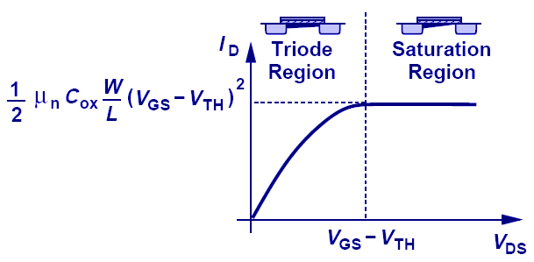
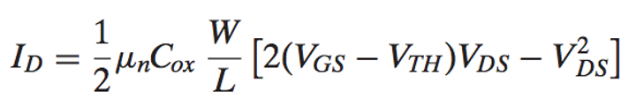
不同的工作区域
2
非饱和区
饱和区
不考虑沟道调制效应

Slide 3
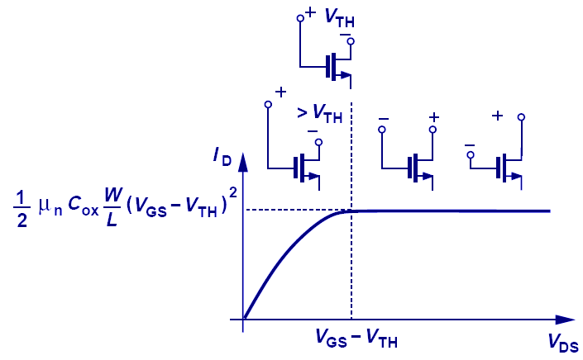
如何判断工作区域（很重要！）
3
方法一，从物理上理解：当V_{G}-V_{D} > V_{TH} 时, 漏极附近仍有沟道，MOSFET 工作在非饱和区；当V_{D}继续增加，导致V_{G}-V_{D}等于或小于 V_{TH} 时，漏极附近无沟道（沟道夹断），MOSFET进入饱和区。
方法二，从符号上理解（电路分析中最有效），要使MOSFET工作在饱和区，V_{D}的下限为V_{G}-V_{TH}（参考电路图）；
方法三，记住这张图的横坐标，当V_{DS} > V_{OV}时，进入饱和区；

Slide 4
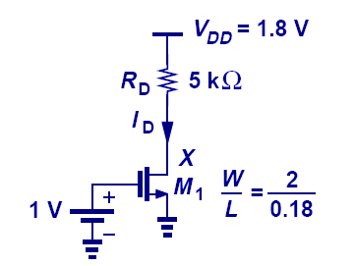
饱和区 还是 非饱和区?
4
当工作区域不确定时，我们采用本课程通用的方法：“先假设，再验证”！

Slide 5
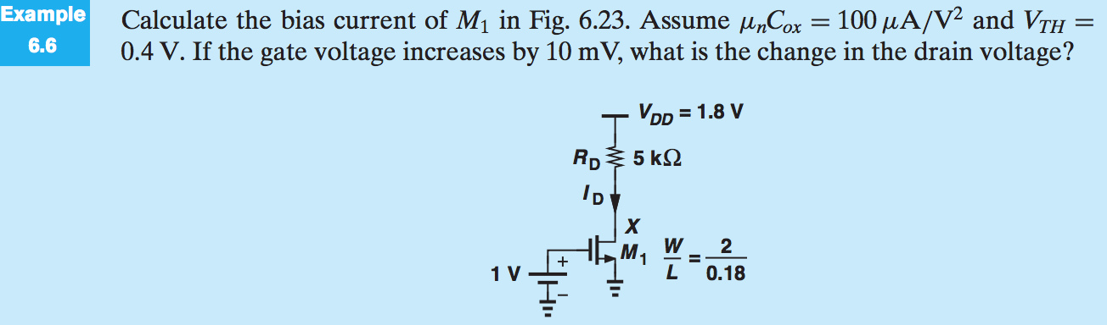
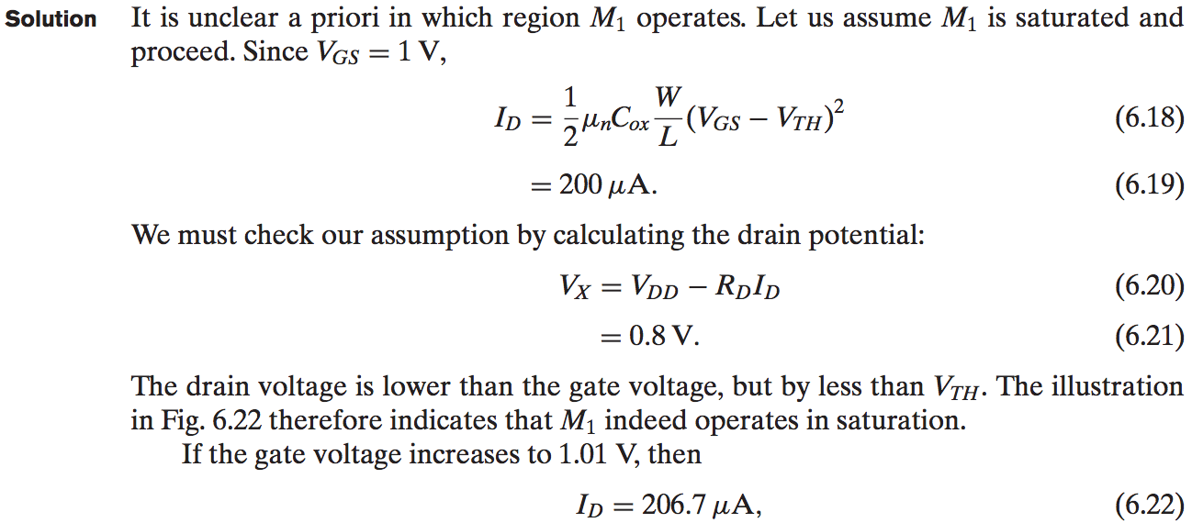
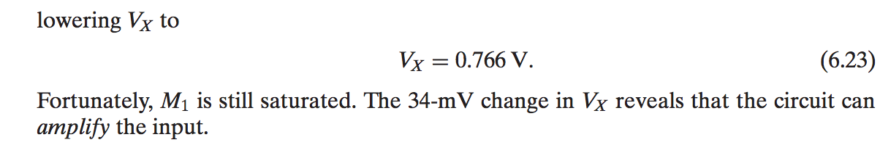
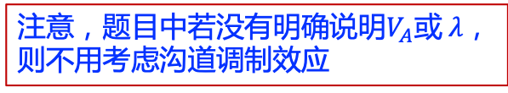
5
注意，题目中若没有明确说明$V_{A}$或$λ$，则不用考虑沟道调制效应
V_{D}最低不得低于V_{G}-V_{TH}

Slide 6
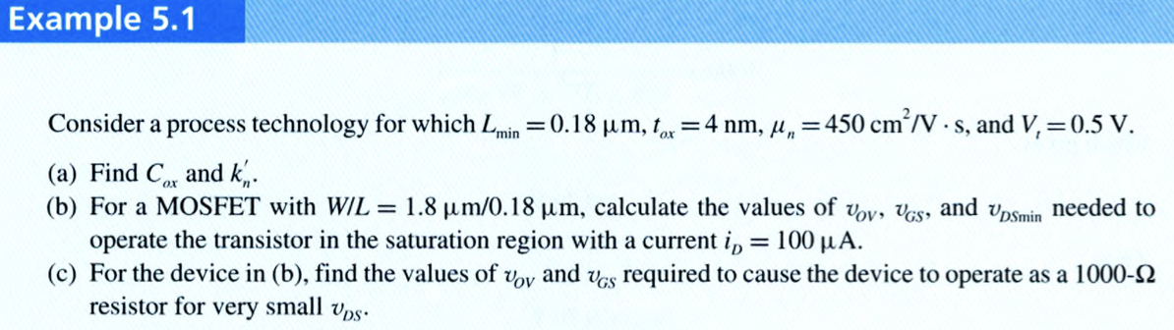
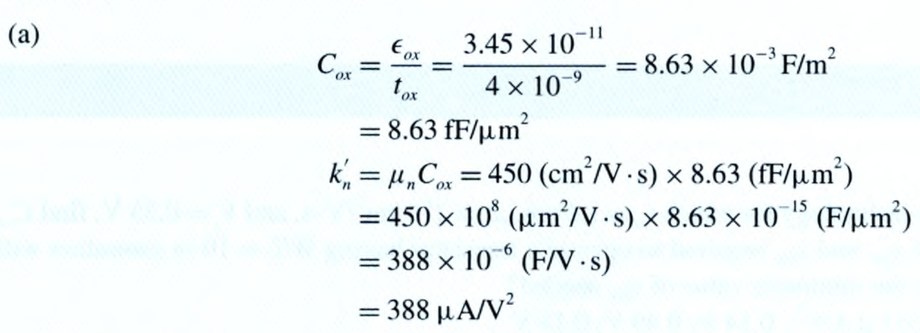
6

Slide 7
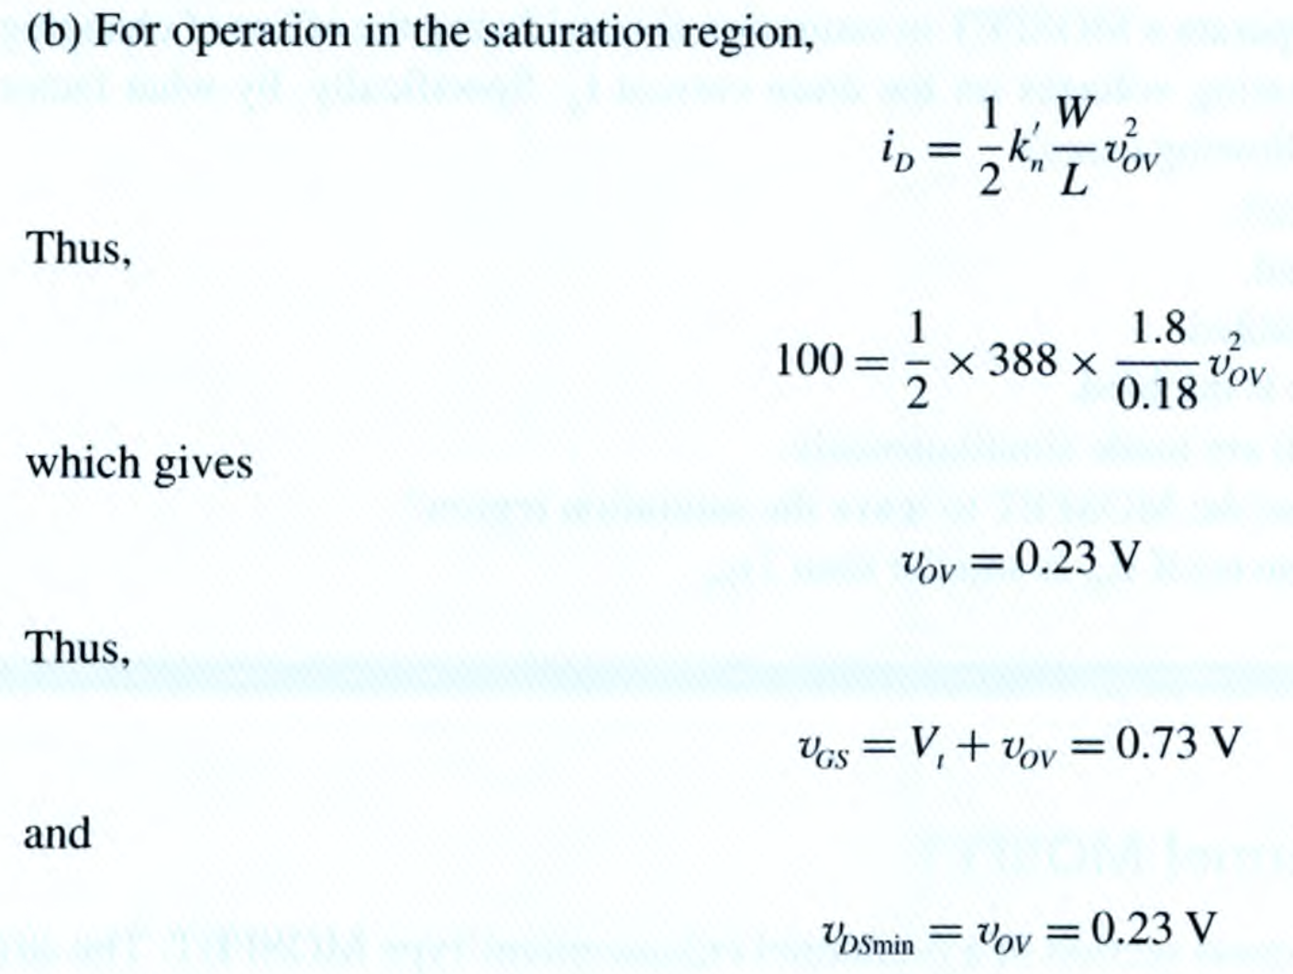
7

Slide 8
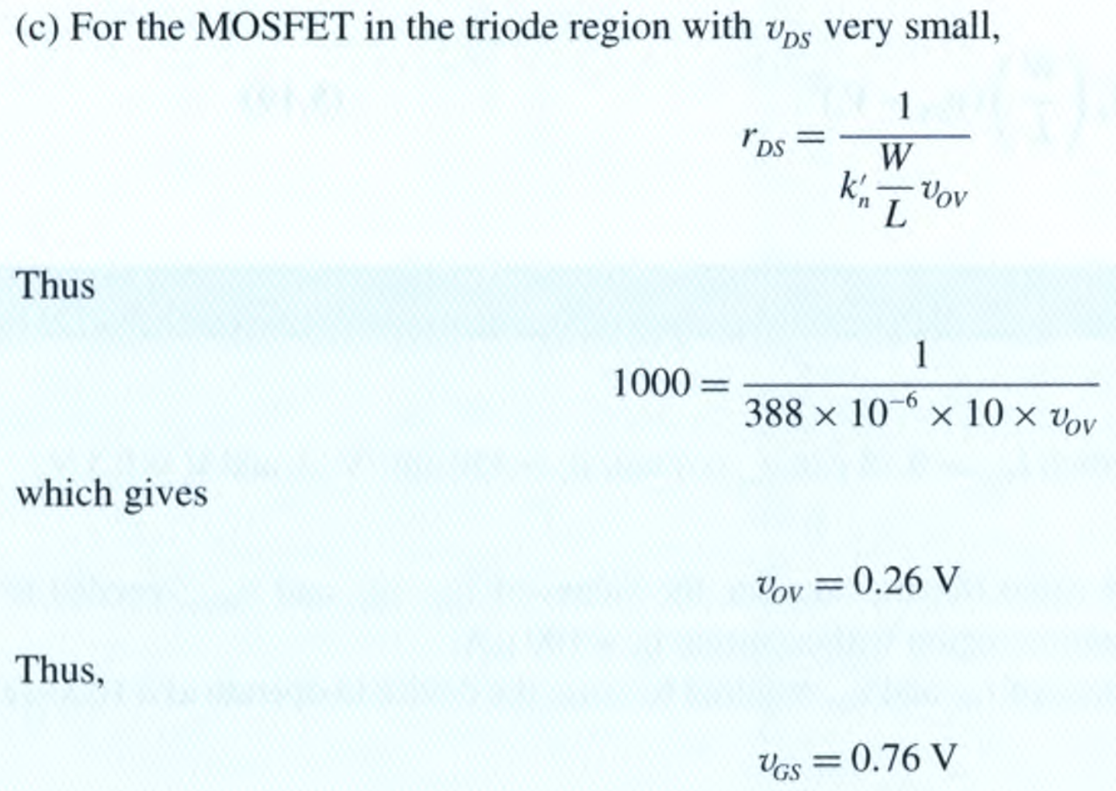
8

Slide 9
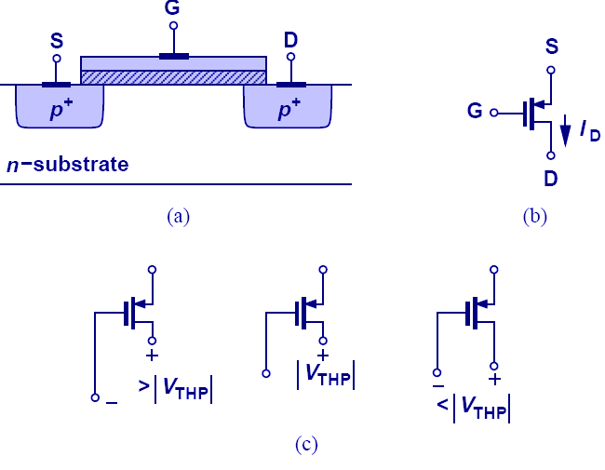
PMOS 晶体管
9
如何判断工作区：
从符号上理解（电路分析中最有效），要使PMOS工作在饱和区，V_{D}的上限为V_{G} + |V_{TH}|
临界
非饱和区
饱和区
MOSFET 器件也可以制造在n衬底上，以空穴作载流子，这类MOSFET被称为 PMOS 晶体管，相应的，之前我们讨论的制造在p衬底上，以电子作为载流子的MOSFET被称为NMOS.
PMOS的特性与NMOS类似，只是极性相反。S电势最高

Slide 10
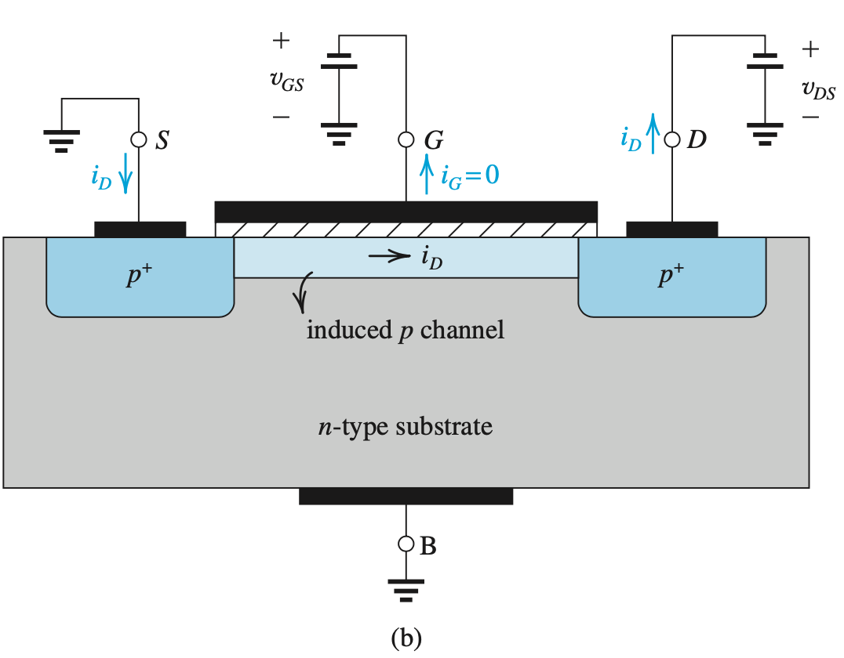
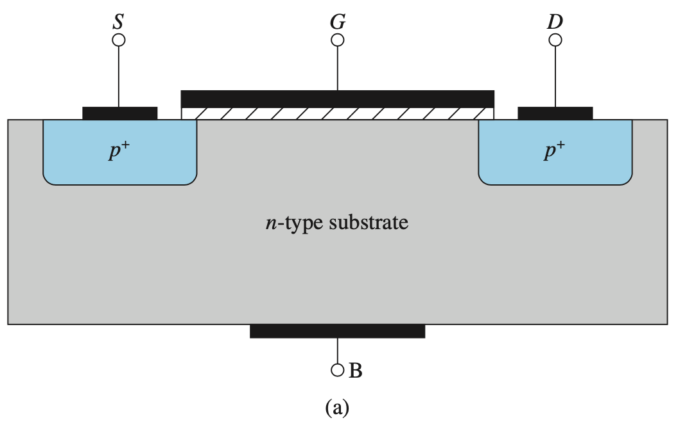
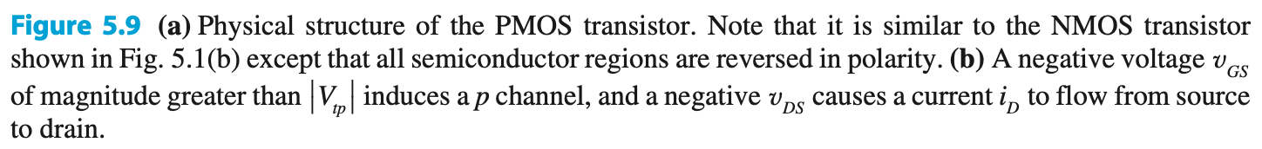
10

Slide 11
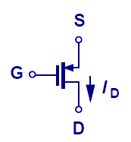
PMOS 方程
11
用绝对值表示，公式与NMOS可以统一

Slide 12
5.1.7. The p-Channel MOSFET
12
PMOS technology originally dominated the MOS field (over NMOS). However, as manufacturing difficulties associated with NMOS were solved, “they” took over
Q: Why is NMOS advantageous over PMOS?
A: Because electron mobility μ_{n} is 2 – 4 times greater than hole mobility μ_{p}.
complementary MOS (CMOS) technology – is technology which allows fabrication of both N and PMOS transistors on a single chip.

Slide 13
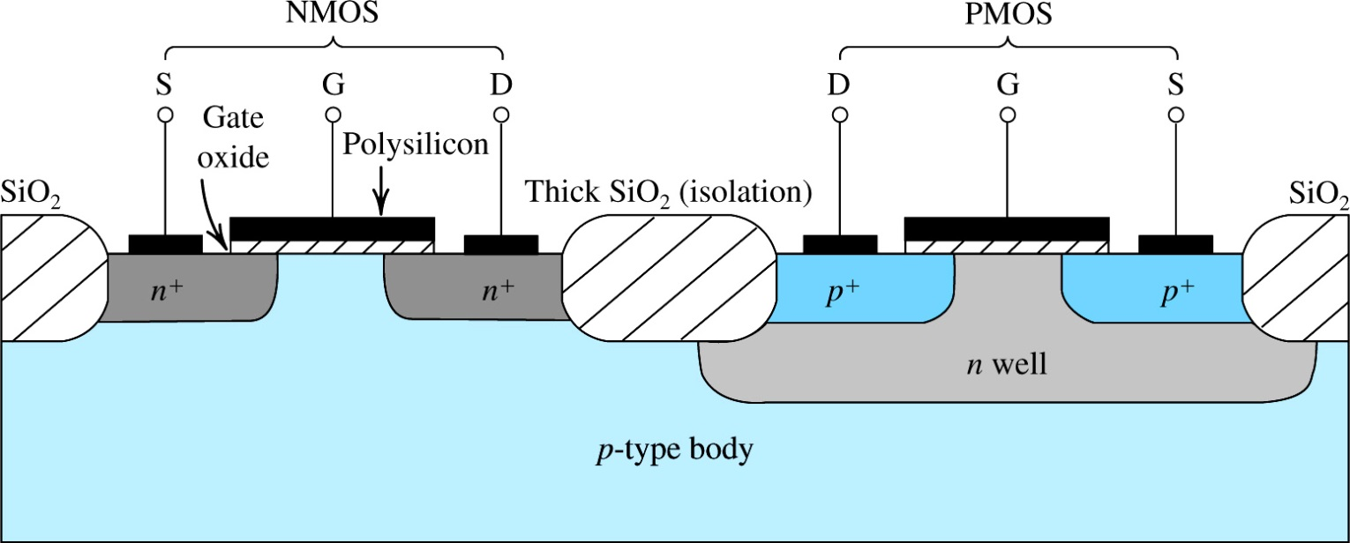
5.1.8. Complementary MOS or CMOS
Figure 5.10: Cross-section of a CMOS integrated circuit. Note that the PMOS transistor is formed in a separate n-type region, known as an n well. Another arrangement is also possible in which an n-type body is used and the n device is formed in a p well. Not shown are the connections made to the p-type body and to the n well; the latter functions as the body terminal for the p-channel device.
13
CMOS employs MOS transistors of both polarities.
在p衬底上先制备一个n阱（n-well），然后在n阱里制备PMOS，在p衬底上制备NMOS，该技术称之为CMOS（Complementary MOS）.
Intel第一代CPU，4004，是使用纯NMOS技术，之后都采用了CMOS技术
Notes:
First demonstrated by RCA for watches. They owned the technology but frittered it away by a series of management errors.

Slide 14
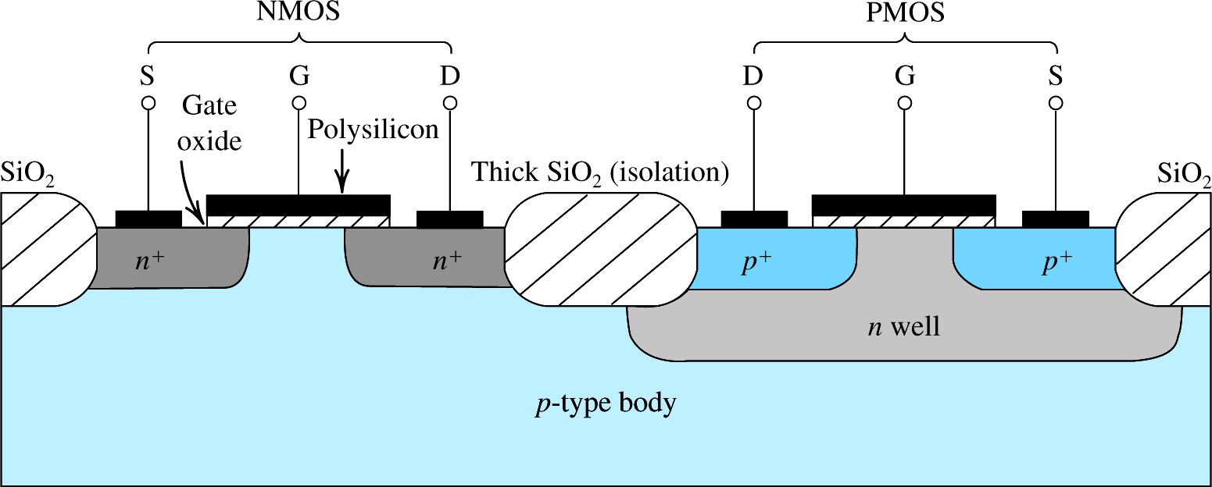
14
Figure 5.10: Cross-section of a CMOS integrated circuit. Note that the PMOS transistor is formed in a separate n-type region, known as an n well. Another arrangement is also possible in which an n-type body is used and the n device is formed in a p well. Not shown are the connections made to the p-type body and to the n well; the latter functions as the body terminal for the p-channel device.
p-type semiconductor provides the MOS body (and allows generation of n-channel)
n-well is added to allow generation of p-channel
SiO₂ is used to isolate NMOS from PMOS
Notes:
The diode between the n-well and the p-type substrate isolates the PMOS transistor.

Slide 15
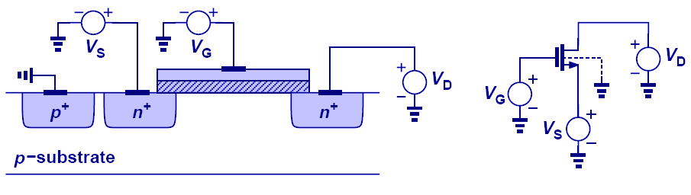
衬底效应
15
了解就可以
NMOS，当源极电压大于零时，因衬底始终接地，V_{SB}会对MOSFET的阈值电压产生影响，称之为衬底效应（Body Effect）

Slide 16
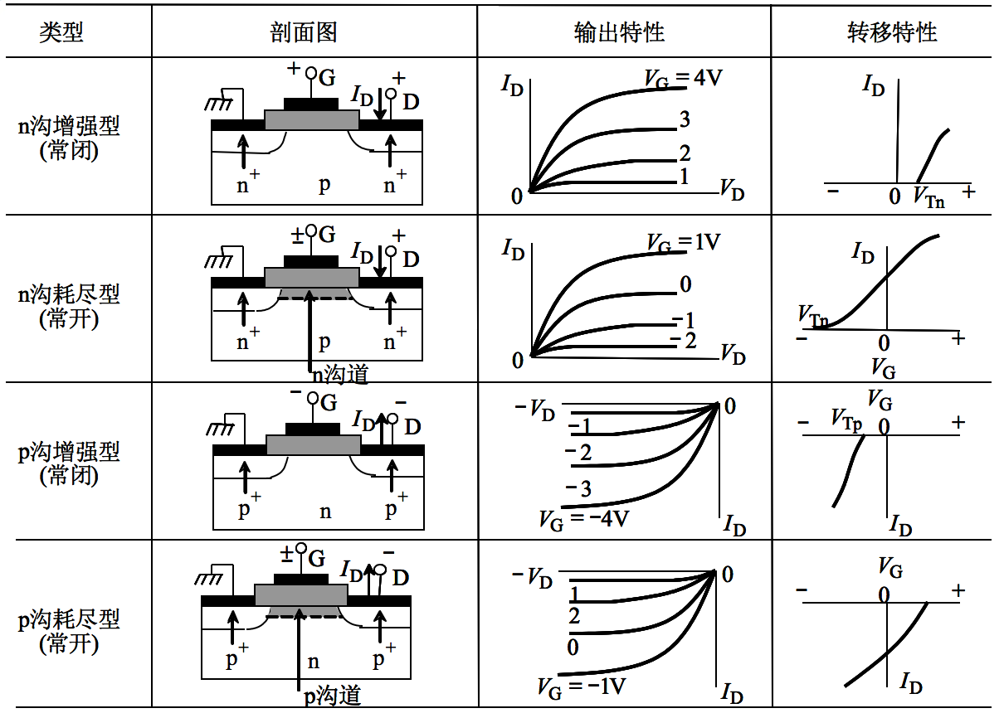
MOSFET的种类
16
重点理解
耗尽型：V_{GS}=0 时已具有沟道

Slide 17
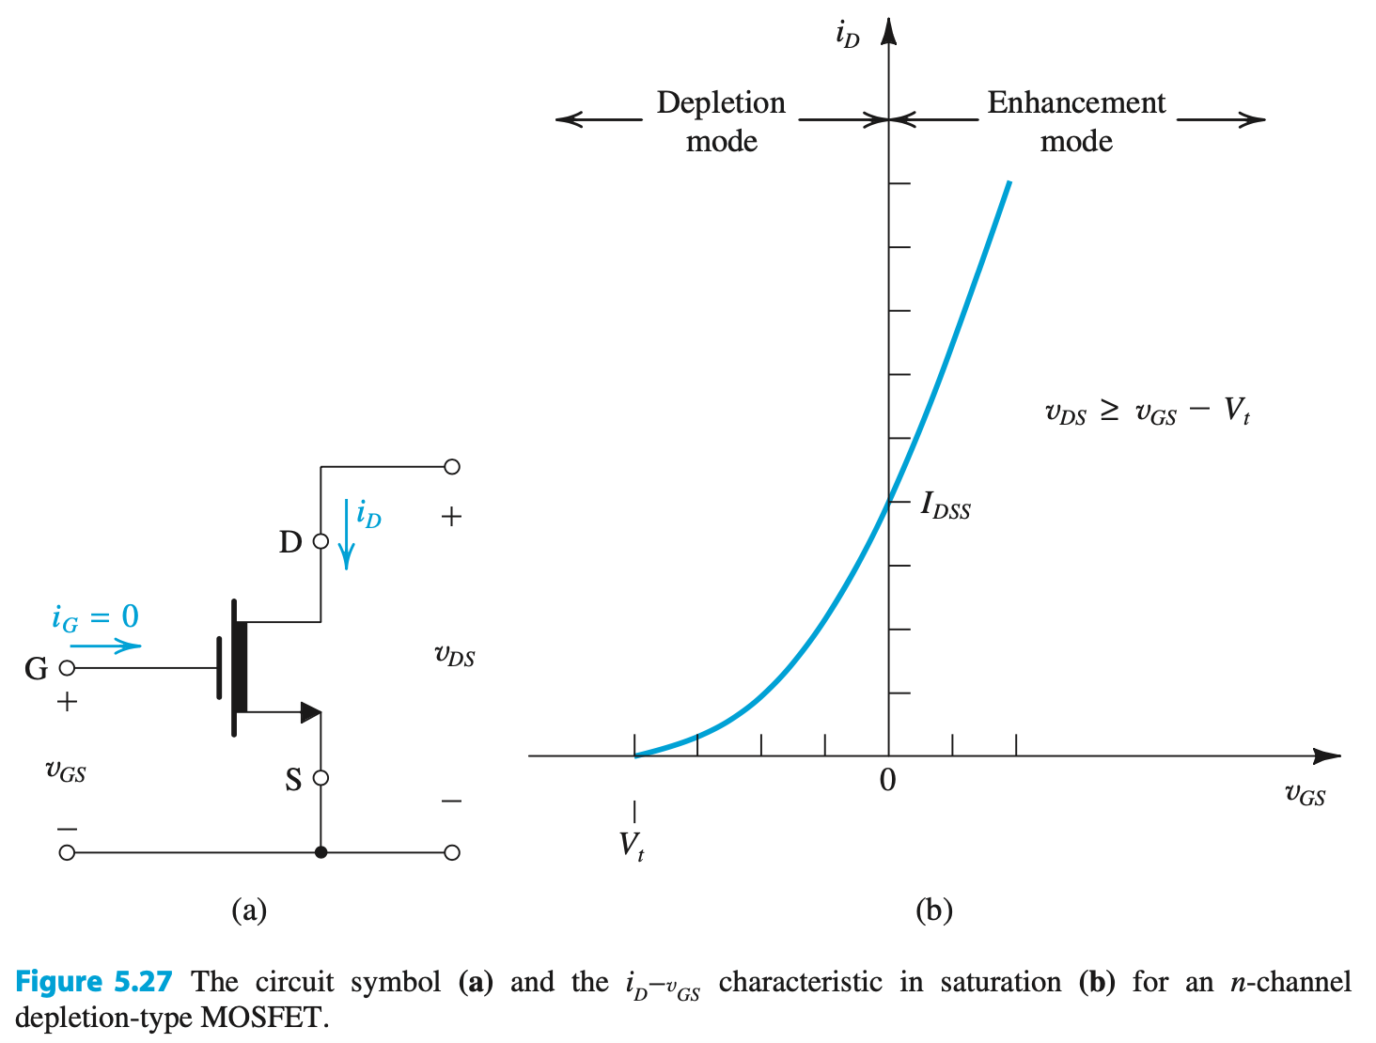
17

Slide 18
Quick Recap!
18
The equation used to define i_{D} depends on relationship btw v_{DS} and v_{OV}.
v_{DS} << v_{OV}
v_{DS} < v_{OV}
v_{DS} >= v_{OV}
v_{DS} >> v_{OV}
（饱和区）
最重要！

Slide 19
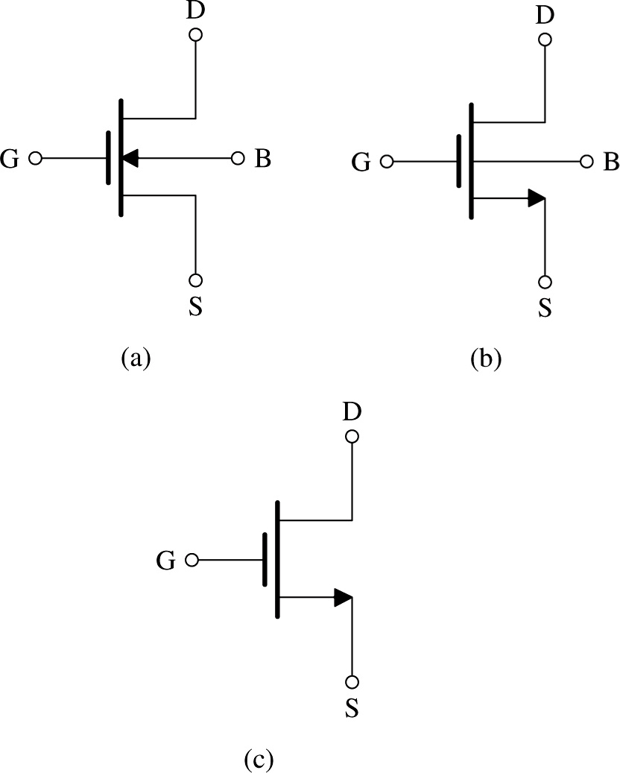
5.2. Current-Voltage Characteristics 伏安特性，电流电压约束关系
19
Figure 5.11. shows an n-channel enhancement MOSFET. N沟道增强型MOSFET的电路符号
There are four terminals:
drain (D), gate (G), body (B), and source (S).
Although, it is assumed that body and source are connected.
Figure 5.11 (a): Circuit symbol for the n-channel enhancement-type MOSFET. (b) Modified circuit symbol with an arrowhead on the source terminal to distinguish it from the drain and to indicate device polarity (i.e., n channel). (c) Simplified circuit symbol to be used when the source is connected to the body or when the effect of the body on device operation is unimportant.
Notes:
Note that there are several different circuit symbols used for MOSFETs. The symbol used for P-Channel MOSFETs in Multisim causes much confusion.

Slide 20
5.2. Current-Voltage Characteristics
20
v_{D} is always > v_{S}
Although MOSFET is symmetrical device, one often designates terminals as source and drain.
Q: How does one make this designation?
A: By polarity of voltage applied.
Arrowheads designate “normal” direction of current flow
Note that, in part (b), we designate current as D→S.
No need to place arrow with B.
箭头标记在S端
箭头表示电流方向
NMOS，S在下 PMOS，S在上
Figure 5.11 (a): Circuit symbol for the n-channel enhancement-type MOSFET. (b) Modified circuit symbol with an arrowhead on the source terminal to distinguish it from the drain and to indicate device polarity (i.e., n channel). (c) Simplified circuit symbol to be used when the source is connected to the body or when the effect of the body on device operation is unimportant.
Notes:
The “symmetry” is not quite true for commercially available devices due to connection from the substrate to the source. They do not wok when upside down.

Slide 21
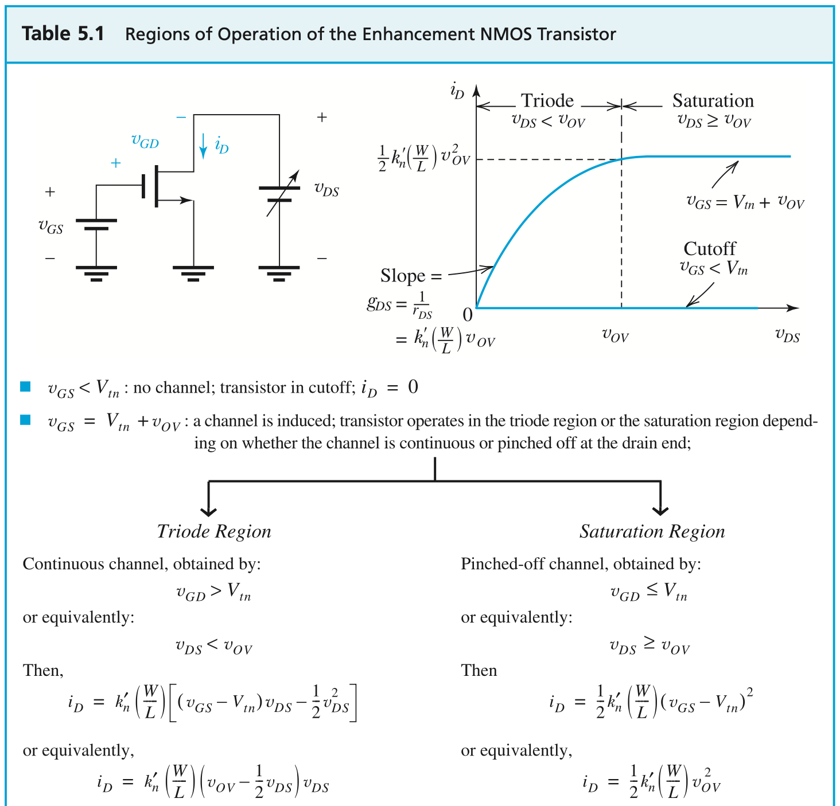
21
三个不同的工作区域

Slide 22
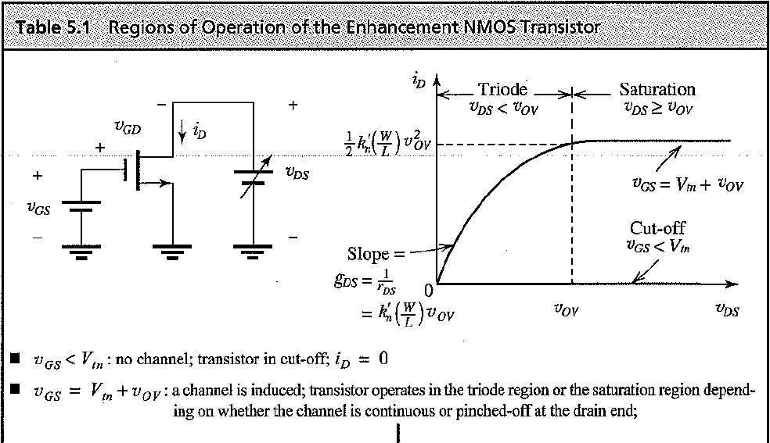
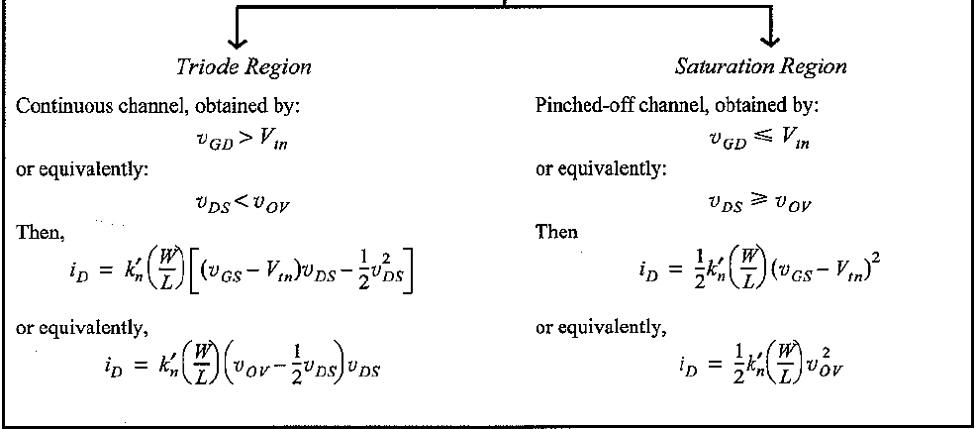
5.2.2. The i_{D}-v_{DS} Characteristics
22
At top of table, it shows circuit consisting of NMOS transistor and two dc supplies (v_{DS}, v_{GS})
This circuit is used to demonstrate i_{D}-v_{DS} characteristic
1st set v_{GS} to desired constant
2nd vary v_{DS}
Two curves are shown…
v_{GS} < V_{tn}
v_{GS} = V_{tn} + v_{OV}

Slide 23
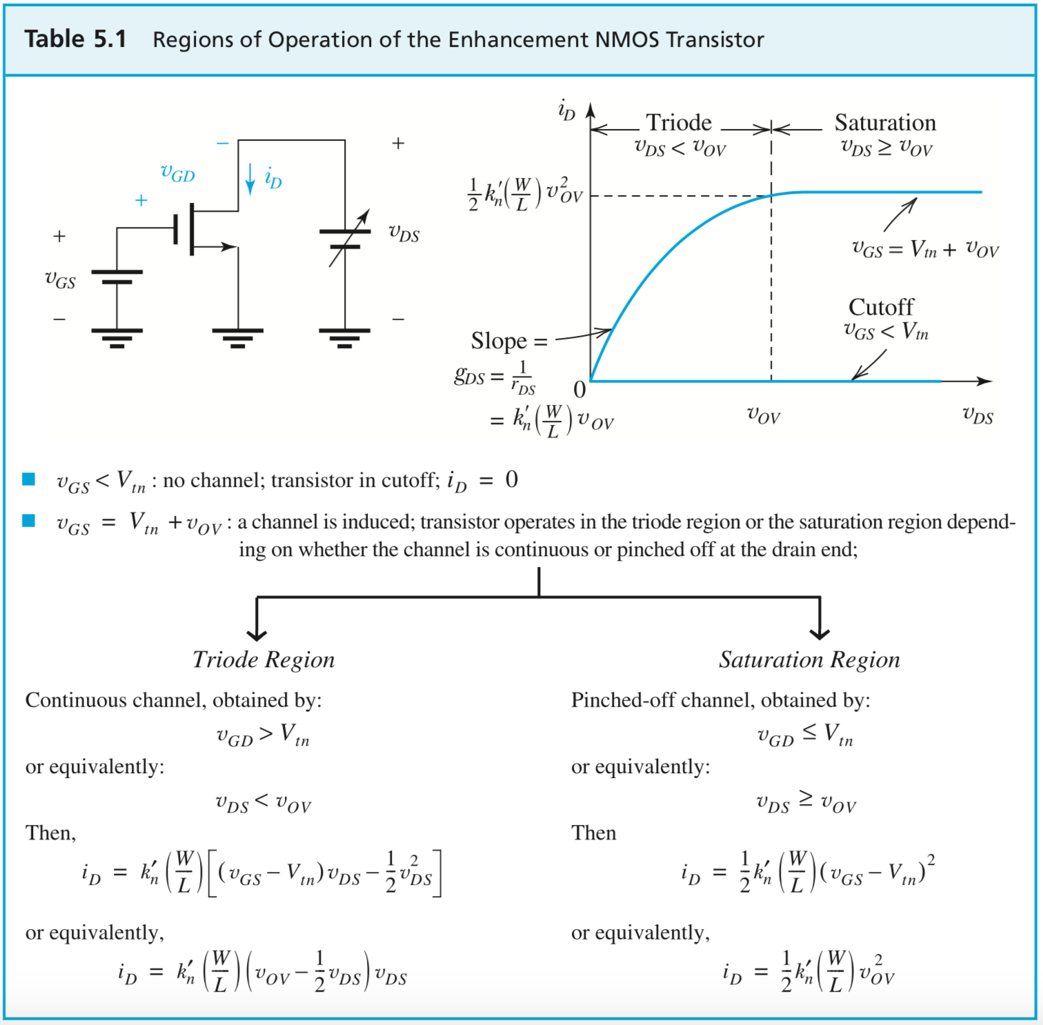
23
首先根据 V_{GS} 判断器件是否 turn on
其次，再根据 V_{D} 与 V_{G} 的关系，判断器件是否在饱和区
若作为放大器使用，一般都需要工作在饱和区，可以先假设，再验证
Notes:
Put a sticky at this page!

Slide 24
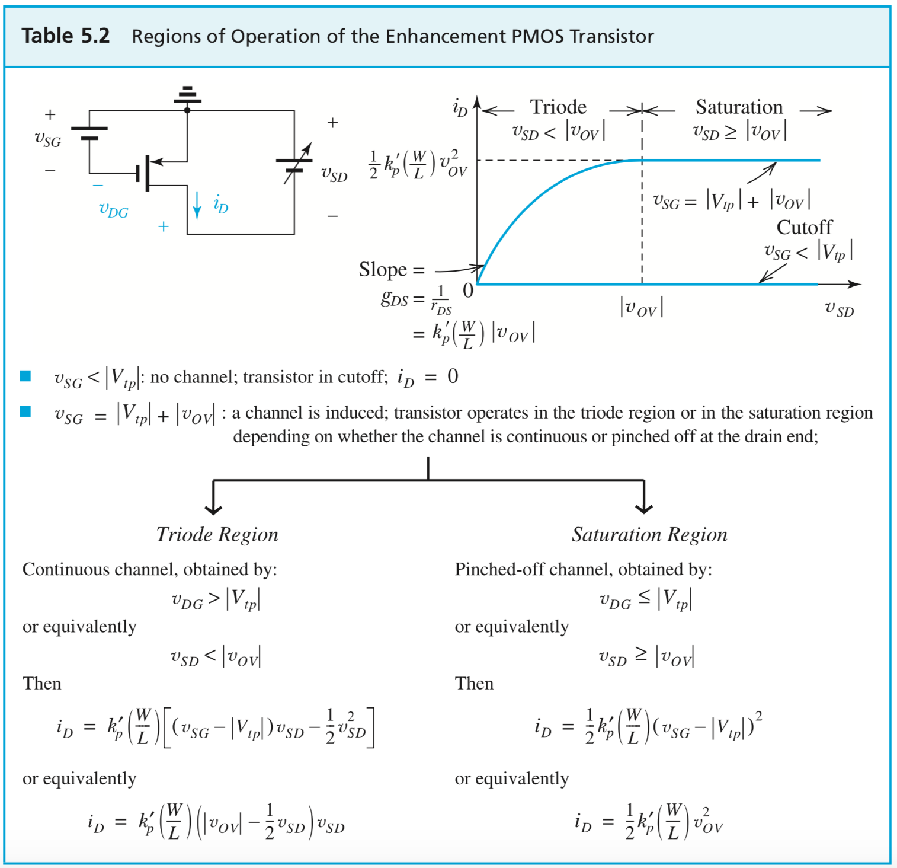
24

Slide 25
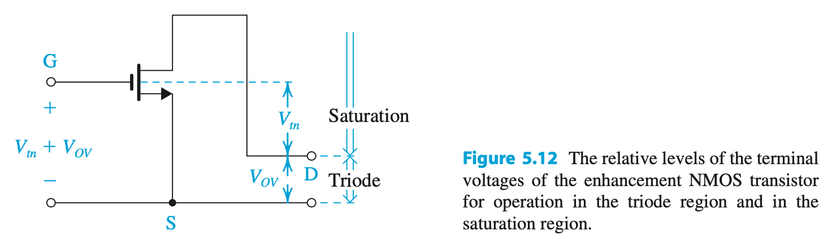
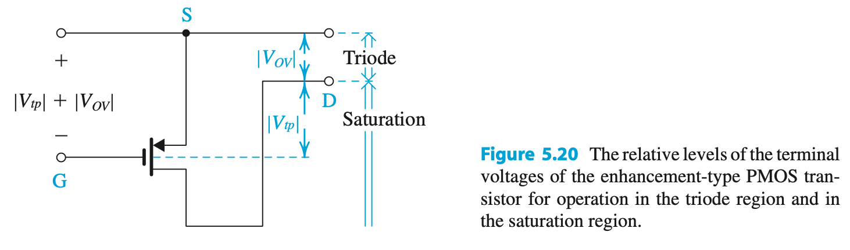
25
NMOS: V_{D}最低不得低于V_{G}-V_{TH}
PMOS: V_{D}最高不得高于V_{G}+|V_{TH}|

Slide 26
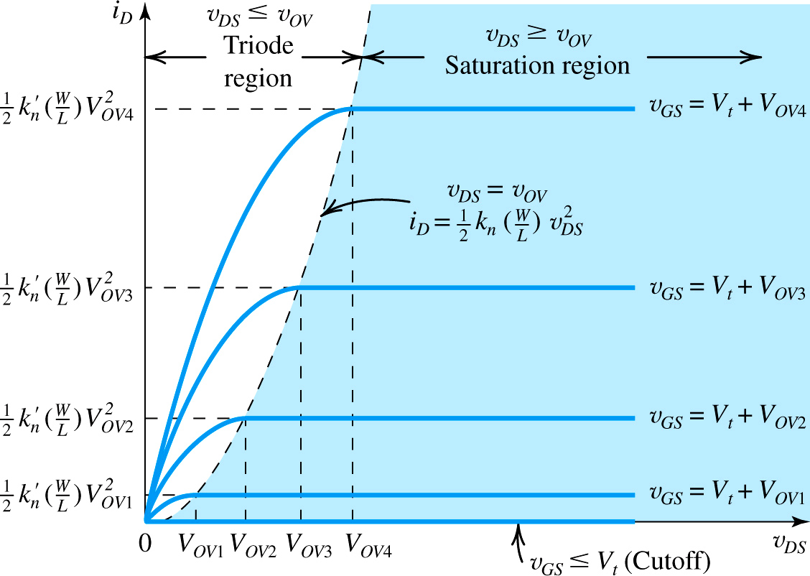
26
equation (5.14)
as v_{GS} increases, so do the (1) saturation current and (2) beginning of the saturation region
Figure 5.13: The i_{D} – v_{DS} characteristics for an enhancement-type NMOS transistor
Notes:
Add a “Load Line” to find the Quiescent point.

Slide 27
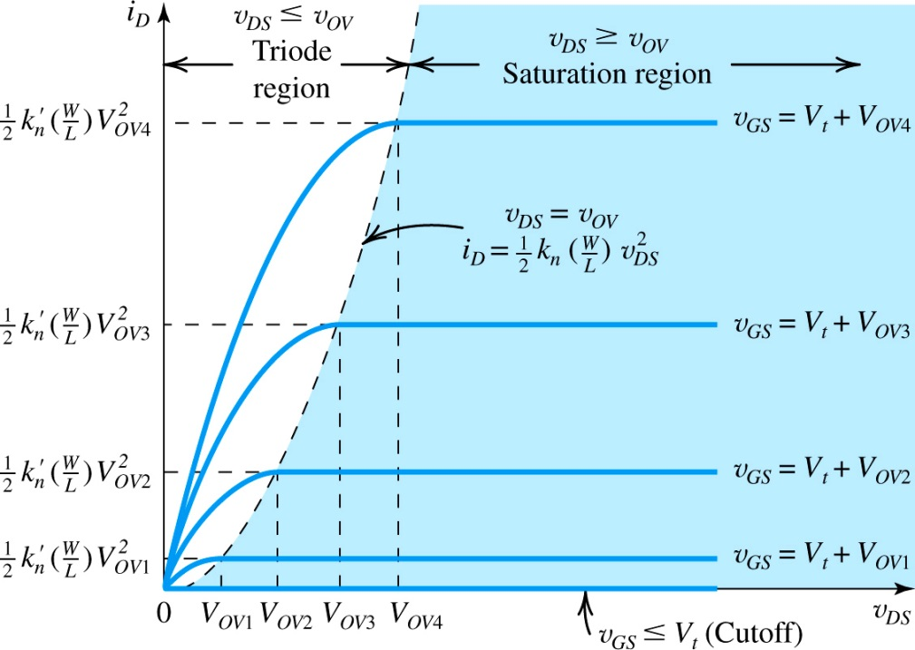
5.2.2. The i_{D}-v_{DS} Characteristic 输出特性
27
Q: When MOSFET’s are employed to design amplifier, in what range will they be operated?
A: saturation
In saturation, the drain current (i_{D}) is…
dependent on v_{GS}
independent of v_{DS}
理想的压控电流源！
In effect, it becomes a voltage-controlled current source.
This is key for amplification.
Figure 5.13: The i_{D} – v_{DS} characteristics for an enhancement-type NMOS transistor

Slide 28
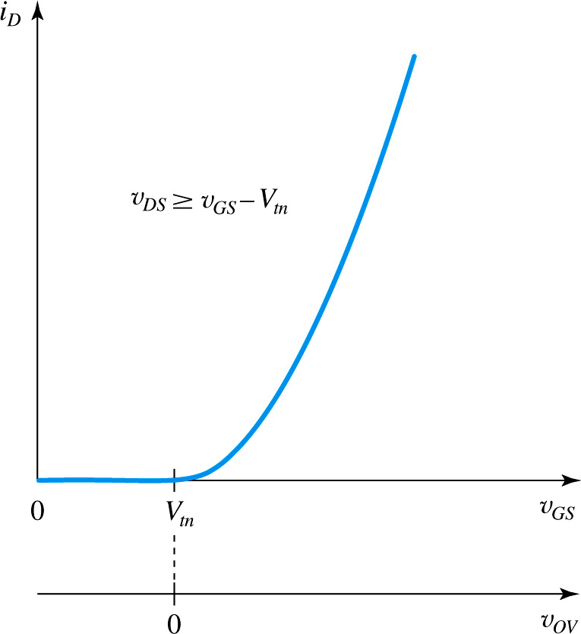
5.2.2. The i_{D}-v_{GS} Characteristic 转移特性
28
Q: What is one problem with (5.21)?
A: It is nonlinear w/ respect to v_{OV} … however, this is not of concern now.
In effect, it becomes a voltage-controlled current source.
This is key for amplification.
Refer to (5.21).
Figure 5.14: The i_{D}-v_{GS} characteristic of an NMOS transistor operating in the saturation region. The i_{D}-v_{OV} characteristic can be obtained by simply re-labeling the horizontal axis, that is, shifting the origin to the point v_{GS} = V_{tn}.

Slide 29
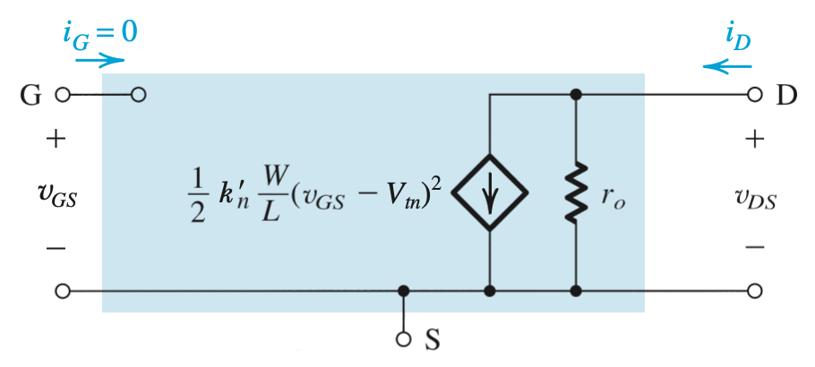
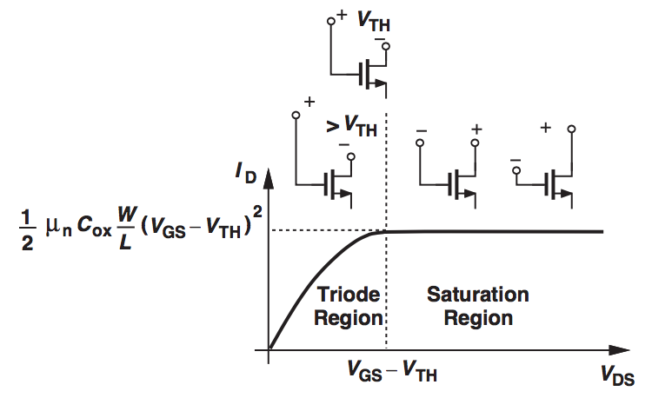
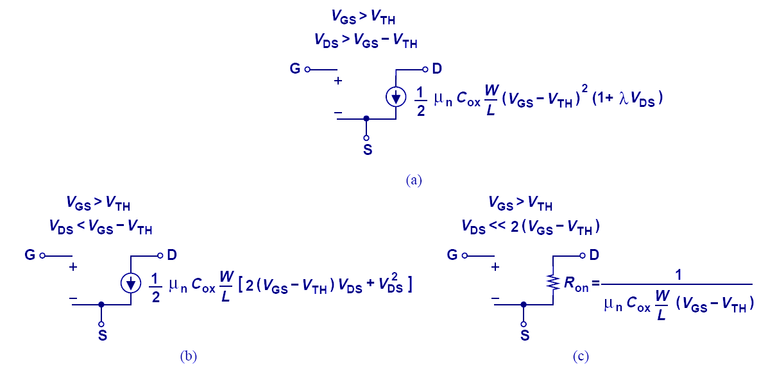
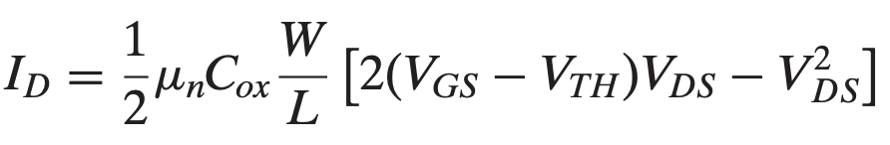
large-signal models 大信号模型
29
饱和区，考虑沟道调制效应
非饱和区
非饱和区（V_{DS}很小时）
基于V_{DS}的不同, MOSFET 有不同的大信号模型.
大信号模型~器件大范围的电压电流约束关系，往往是非线性的；小信号模型~叠加于大信号模型某一直流工作点之上的微小变化信号的模型，将非线性曲线在微小范围内线性化

Slide 30
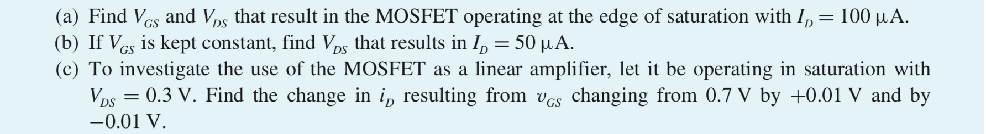
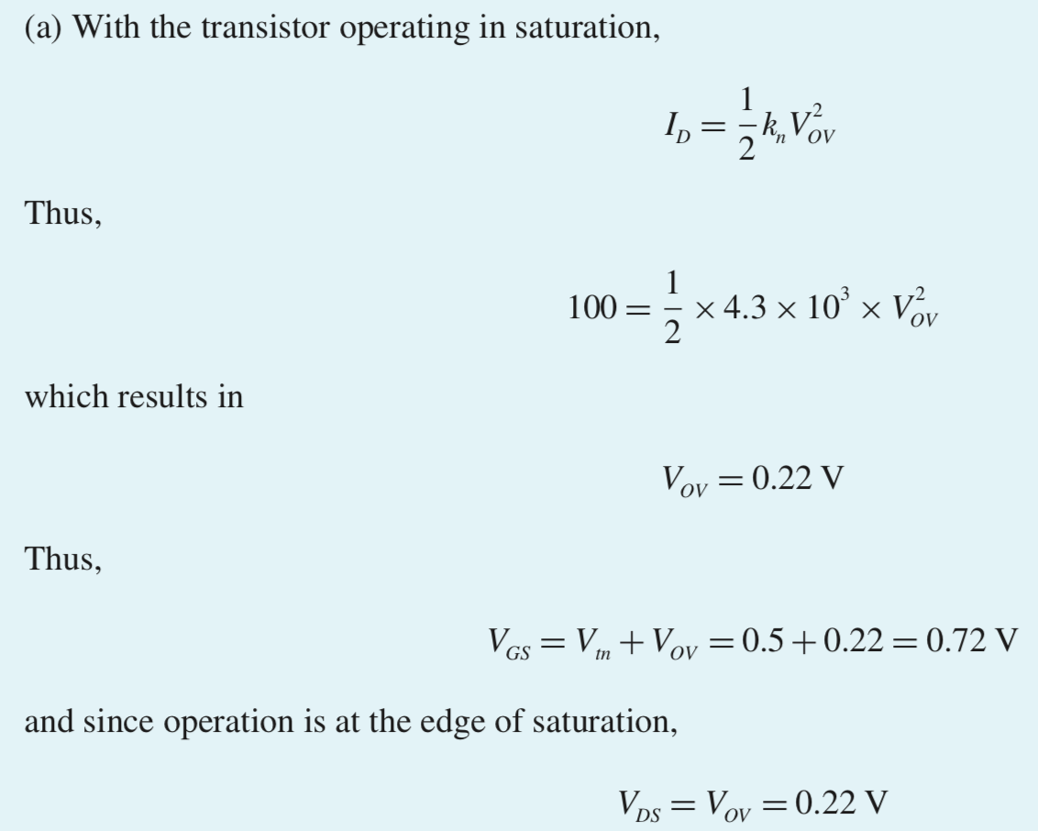
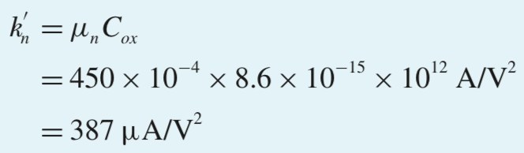
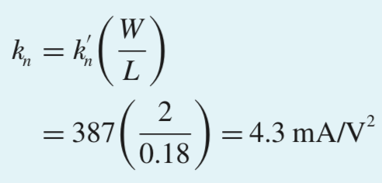
30

Slide 31
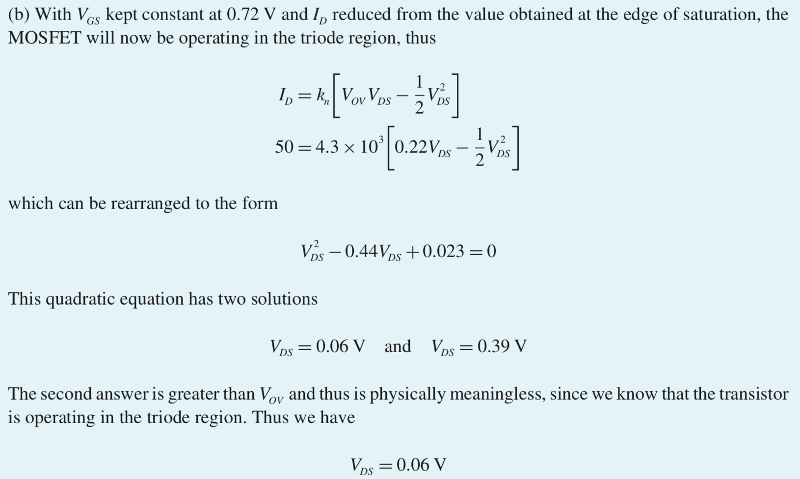
31
50小于100，进入非饱和区

Slide 32
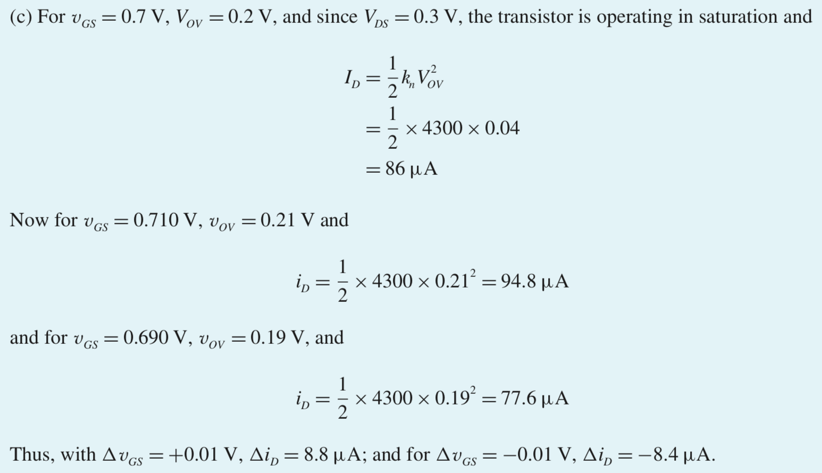

32
$$v_{OV}=v_{GS}−v_{tn}$$

Slide 33
MOSFET 电路直流分析
基于 MOSFET 的“电流电压”约束关系
基于基本电路原理与分析方法
为简单起见，若无明确说明，一般我们不考虑沟道调制效应
根据有效电压V_{OV}来分析电路，会比较方便

Slide 34
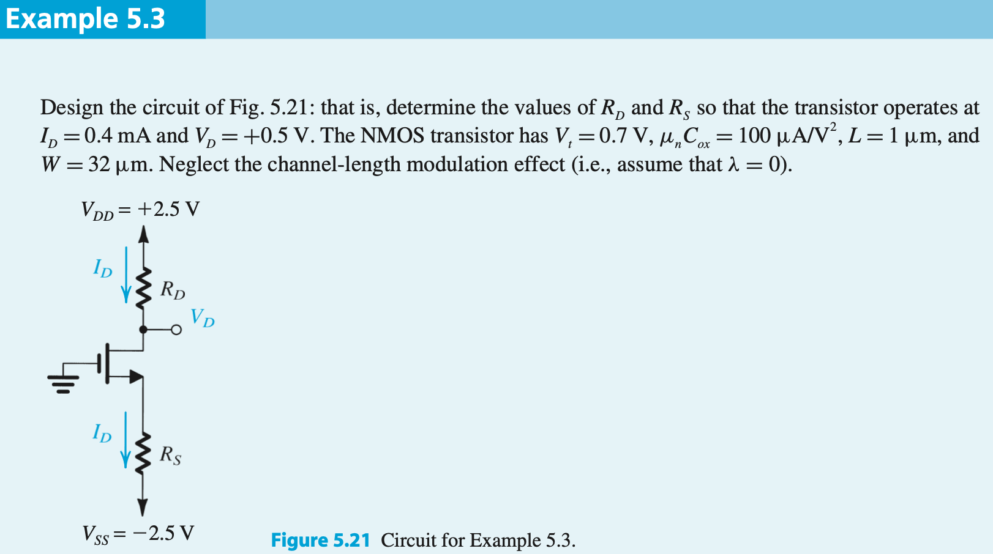
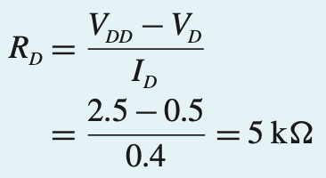
①根据V_{DD}，V_{D}，I_{D}，求R_{D}

Slide 35
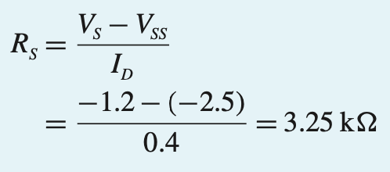
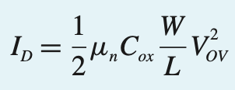


②求R_{S}，需要知道V_{S}，V_{S}可以根据V_{GS}得到，V_{GS}可以由V_{OV} + V_{TH}得到，V_{OV}由I_{D}决定。
③判断MOSFET的工作状态。V_{D} > V_{G} → 饱和区

Slide 36
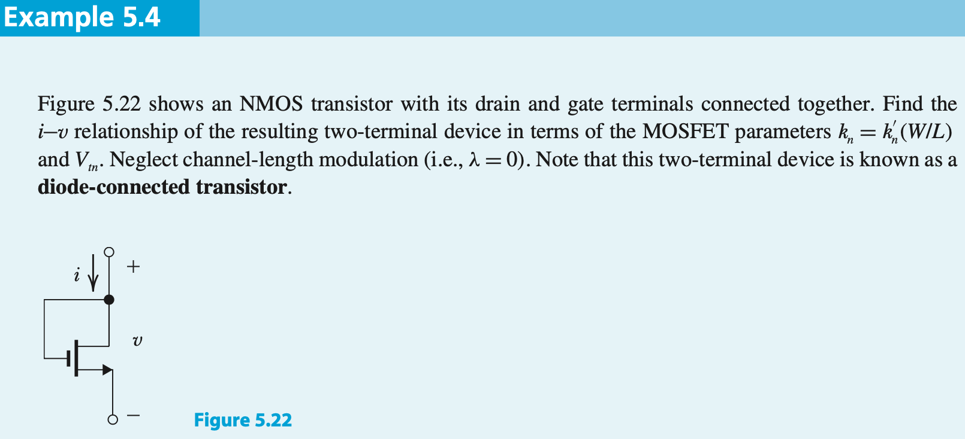
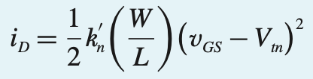

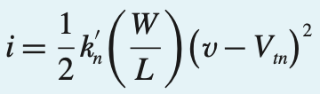

① V_{D} = V_{G} → 工作于饱和区
②

Slide 37





①V_{D}低于V_{G}-V_{TH} → 工作于非饱和区
②根据V_{D}求R_{D}

Slide 38





②
④
①
③
③ 假设工作在饱和区

Slide 39


②
④
①
③
③ 两个解 > 5 V

Slide 40



②
④
①
③
④ > 5 V

Slide 41






①工作于饱和区
$$V_{G}=3 V$$

Slide 42


②确保V_{D}的上限不超过 V_{G} + |V_{TH}|

Slide 43



②假设工作在饱和区
①
③确认在饱和区
I_{DP} = I_{DN} → I = 0 → V_{O} = 0

Slide 44





① Q_{P} cut off
② V_{D} < 0 → 比V_{G} – V_{TH} 要低 → 工作在非饱和区

Slide 45

① Q_{N} cut off
② V_{D} > 0 → 比V_{G} + |V_{TH}| 要高 → 工作在非饱和区

Slide 46


作业

Slide 47


