Slide 1
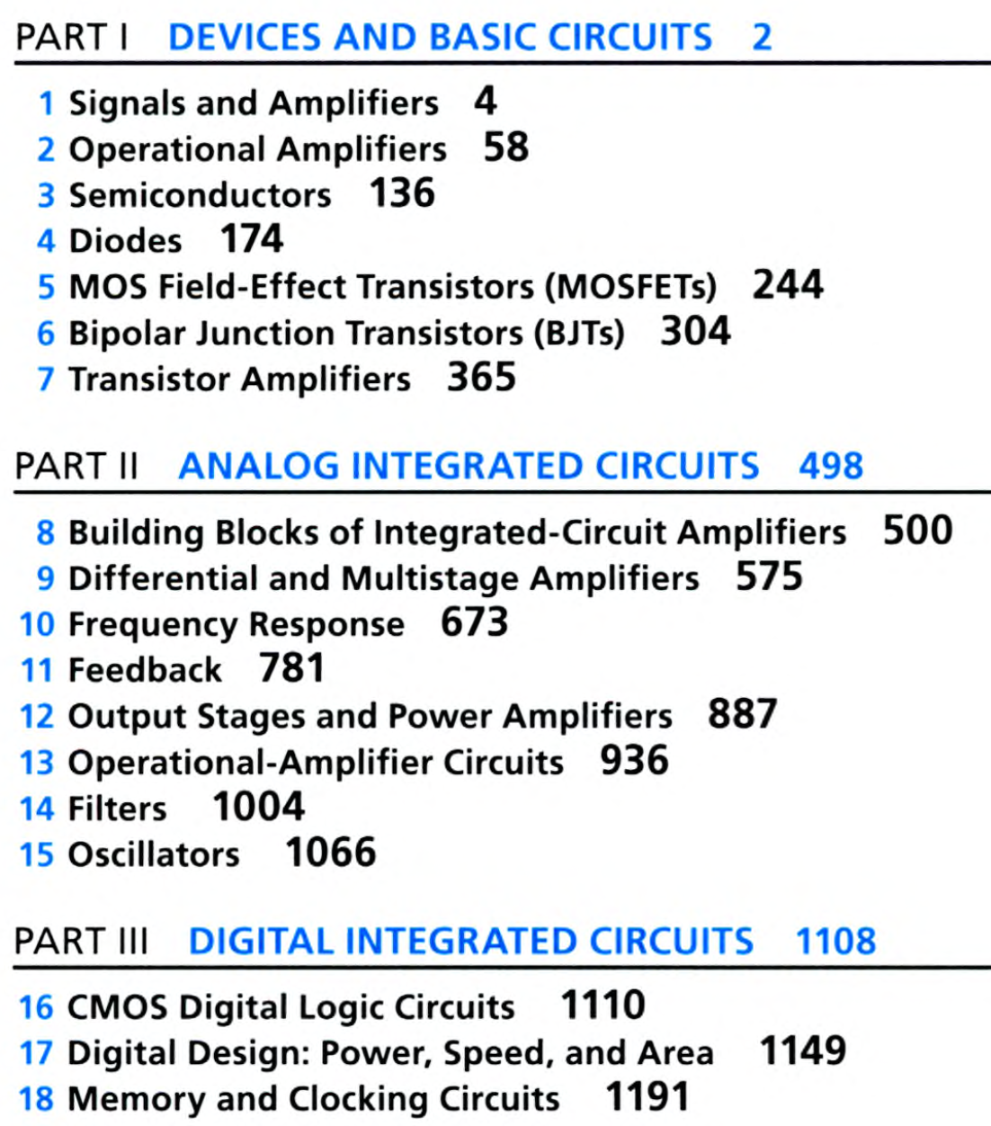
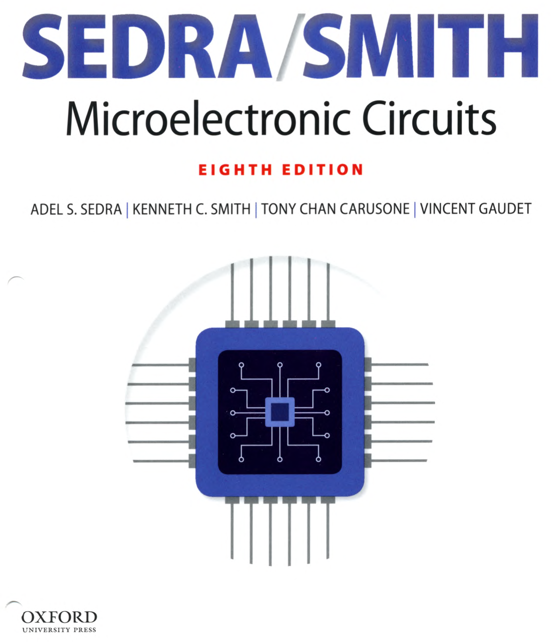

Slide 2
Chapter #1: Signals and Amplifiers
from Microelectronic Circuits Text
by Sedra and Smith
Oxford Publishing

Slide 3
Introduction
IN THIS CHAPTER YOU WILL LEARN…
That electronic circuits process signals, and thus understanding electrical signals is essential to appreciating the material in this book.处理信号的电路，因此，理解“什么是电信号”是基础
The Thevenin and Norton representations of signal sources.信号源的戴维南和诺顿表示
The representation of a signal as sum of sine waves.信号可以由一些列的正弦信号叠加而构成
The analog and digital representations of a signal.模拟信号与数字信号

Slide 4
Introduction
IN THIS CHAPTER YOU WILL LEARN…
The most basic and pervasive signal-processing function: signal amplification, and correspondingly, the signal amplifier. 最为基础和普遍的信号处理——信号放大，以及相应的电路——信号放大器
How amplifiers are characterized (modeled) as circuit building blocks independent of their internal circuitry.理解放大器的行为模型，不care内部实现
How the frequency response of an amplifier is measured, and how it is calculated, especially in the simple but common case of a single-time-constant (STC) type response.放大器的频率响应

Slide 5
1.1. Signals
signal – contains information 信号——包含有用信息
e.g. voice of radio announcer reading the news
process – an operation which allows an observer to understand this information from a signal (extract information from signal) 处理——从信号从提取信息的运算
generally done electrically
transducer – device which converts signal from non-electrical to electrical form 换能器——将非电信号转换为电信号
e.g. microphone (sound to electrical)

Slide 6
1.1: Signals
Q: How are signals represented? 信号表示形式
A: thevenin form – voltage source v_{s}(t) with series resistance R_{S}
preferable when R_{S} is low
A: norton form – current source i_{s}(t) with parallel resistance R_{S}
preferable when R_{S} is high
电压信号一般内阻较小，用戴维南；
电流信号一般内阻较大，用诺顿；

Slide 7
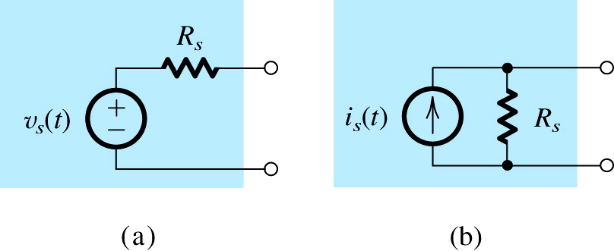
1.1. Signals
信号源的两种表示形式
电压信号
电流信号
Figure 1.1: Two alternative representations of a signal source: (a) the Thévenin form; (b) the Norton form.

Slide 8
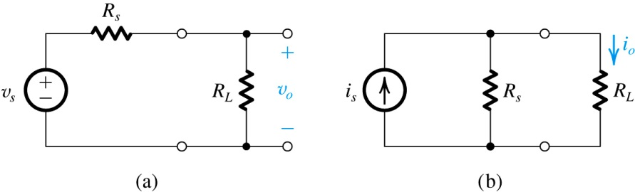




Example 1.1: Thevenin and Norton Equivalent Sources
输出电阻：从输出端看进去的等效电阻，限制着信号实际到达负载的多少
Consider two source / load combinations to upper-right.
note that output resistance of a source limits its ability to deliver a signal at full strength (分压/分流)
Q(a): what is the relationship between the source and output when maximum power is delivered?
共轭匹配
Q(b): what are ideal values of R_{S} for norton and thevenin representations?
电压源~小内阻；电流源~大内阻
并不是所有情况，我们都希望最大功率传输。对于原本就比较微弱的信号，我们更关心电压（或电流）强度衰减的最小化，或者说更关心电压/电流强度的放大

Slide 9
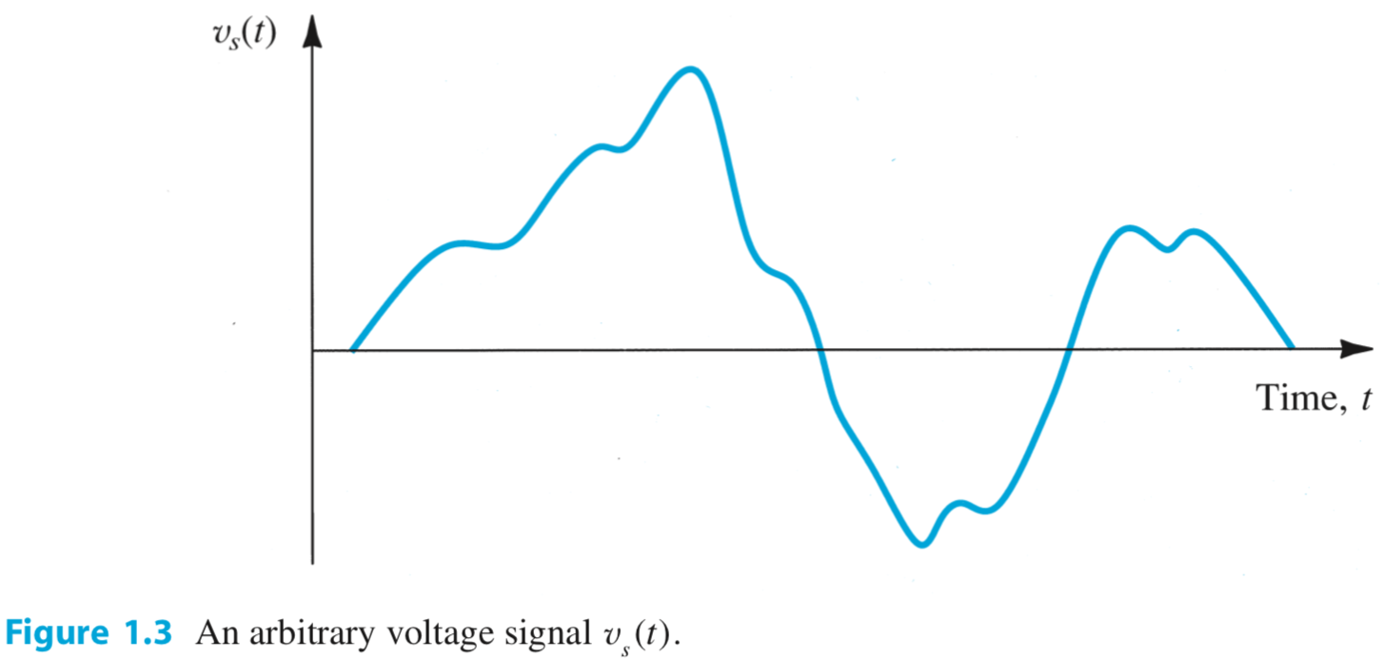
一个任意的电压信号
幅度的变化包含了信息
难以写出解析表达式
一个信号可以有两个 views：
时域 ←→ 频域

Slide 10
1.2. Frequency Spectrum of Signals
frequency spectrum 频谱 – The frequency spectrum of an electrical signal is the distribution of the amplitudes and phases of each frequency component against frequency. 时域信号在频域里的表达
Q: What is a Fourier Series? 傅里叶级数
A: An expression of a periodic function as the sum of an infinite number of sinusoids whose frequencies are harmonically related 周期信号可以表达成无限个正弦信号的和，且这些正弦信号的频率呈谐波关系

Slide 11
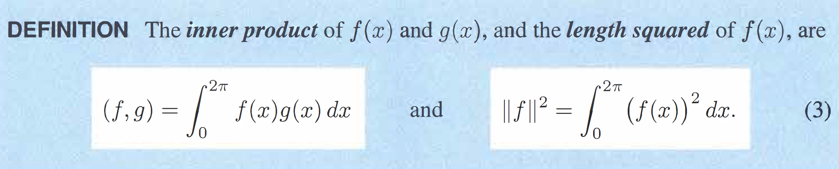
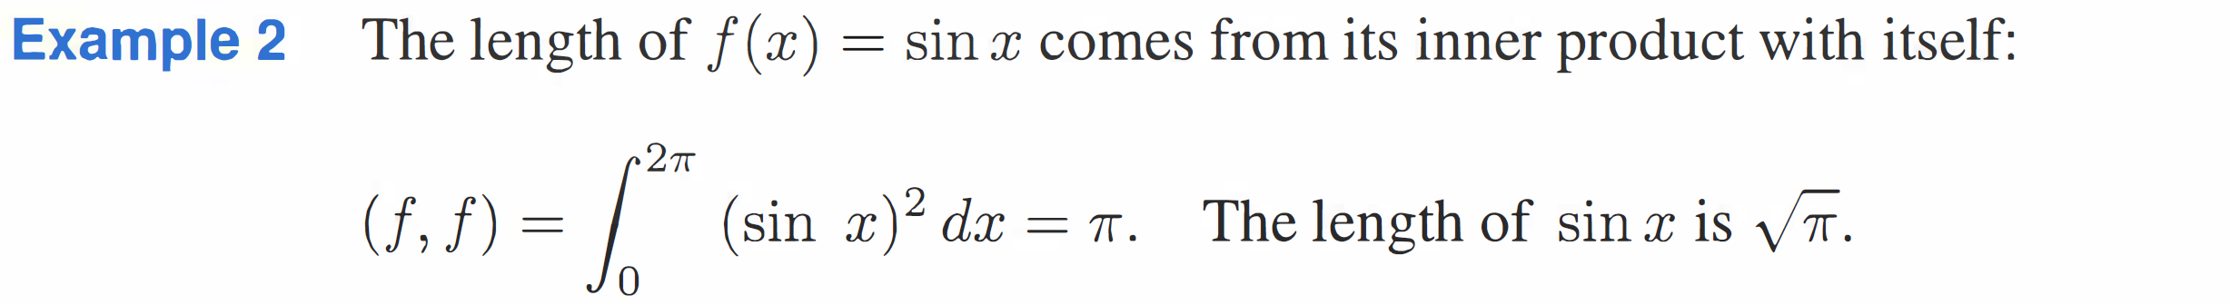
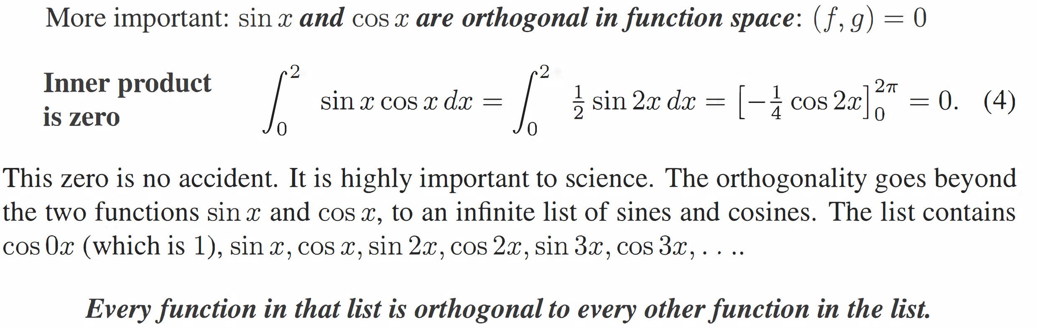
① 类比二维坐标：内积是矢量在基底矢量（坐标轴）上的投影
长度
内积
② 1, sinx, cosx, sin2x, cos2x, sin3x, cos3x, … 两两正交
③ 构建函数空间的基底矢量，无穷多维

Slide 12
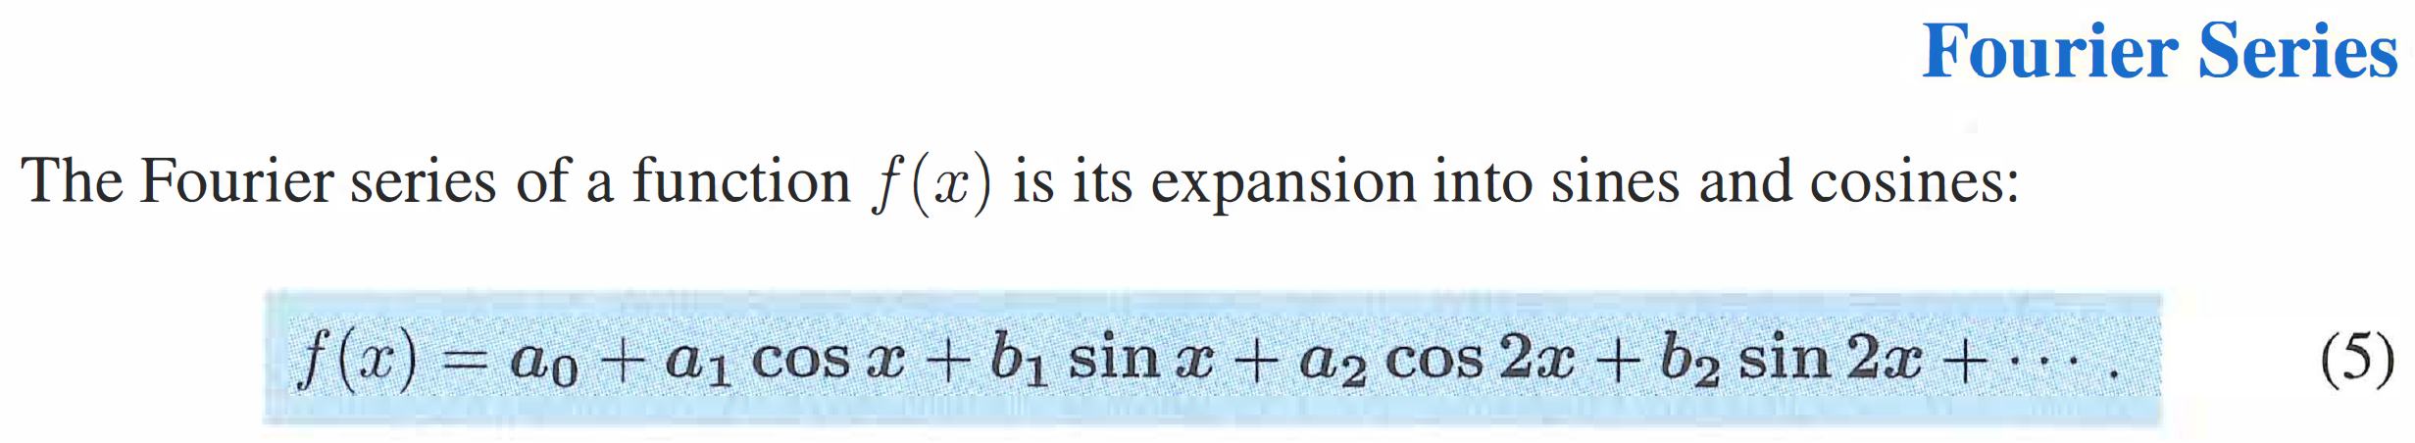
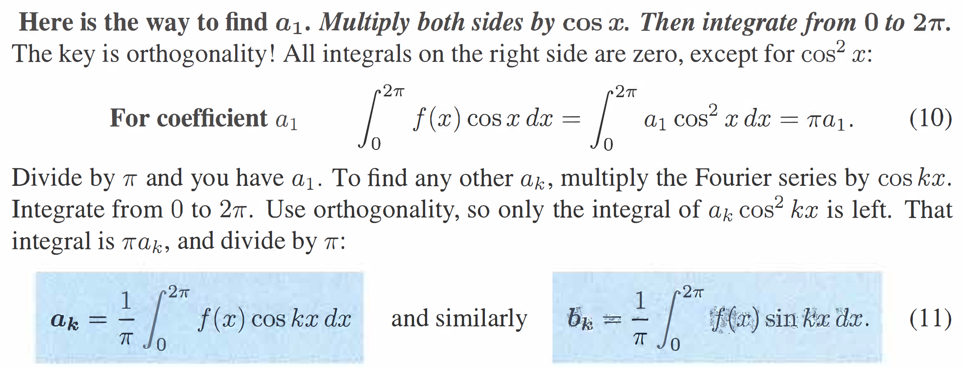
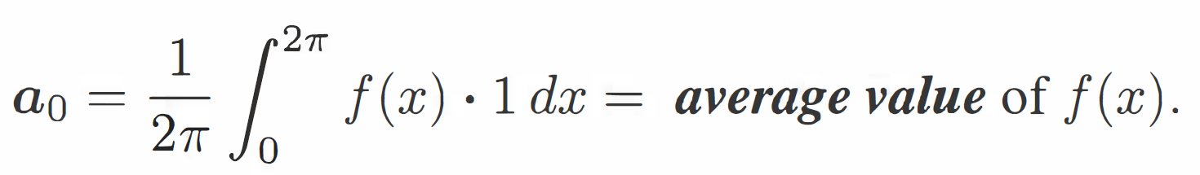
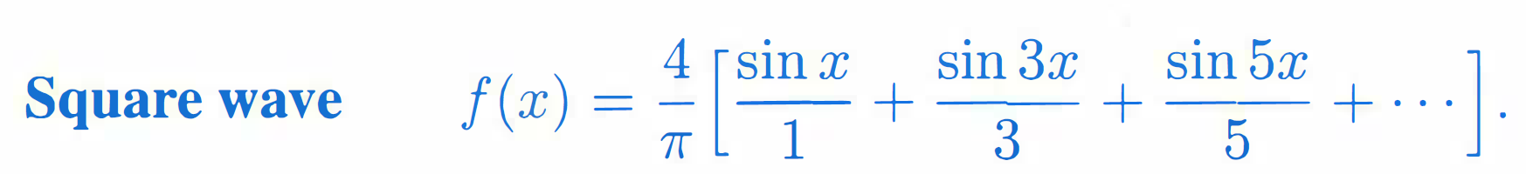
④ 将函数写成在基底矢量上的分解，系数为函数与基底的内积（写成上页③的形式更清晰）
⑤ 以均值为0的方波为例

Slide 13
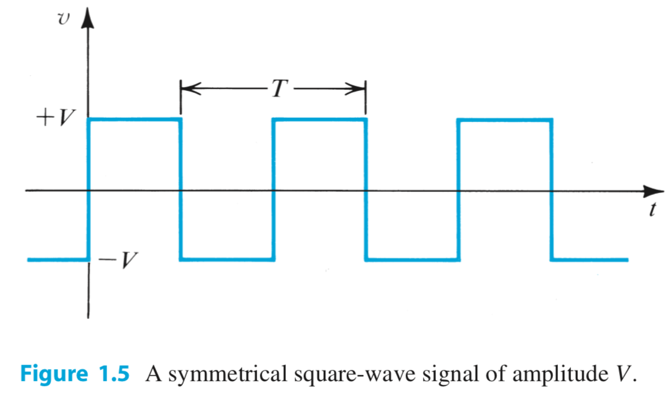
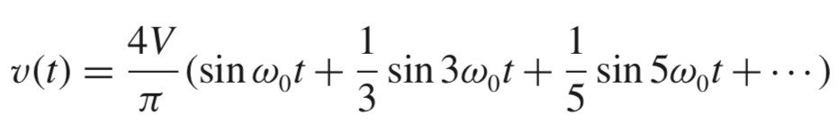
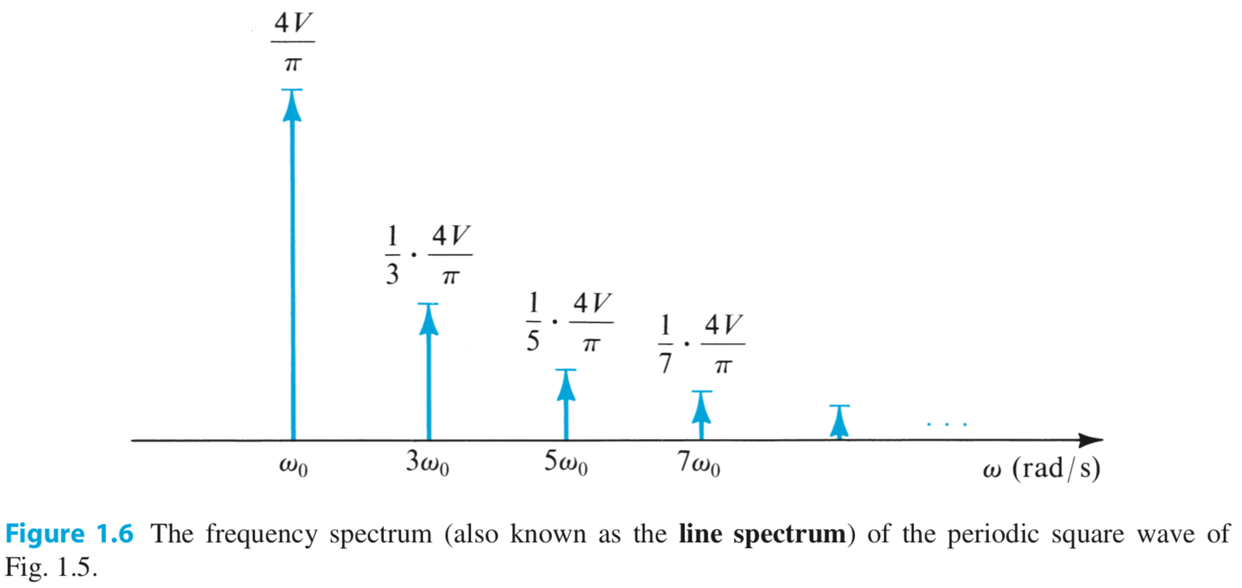
Fourier Series Example
高阶可以忽略
频率越高，幅度越小

Slide 14
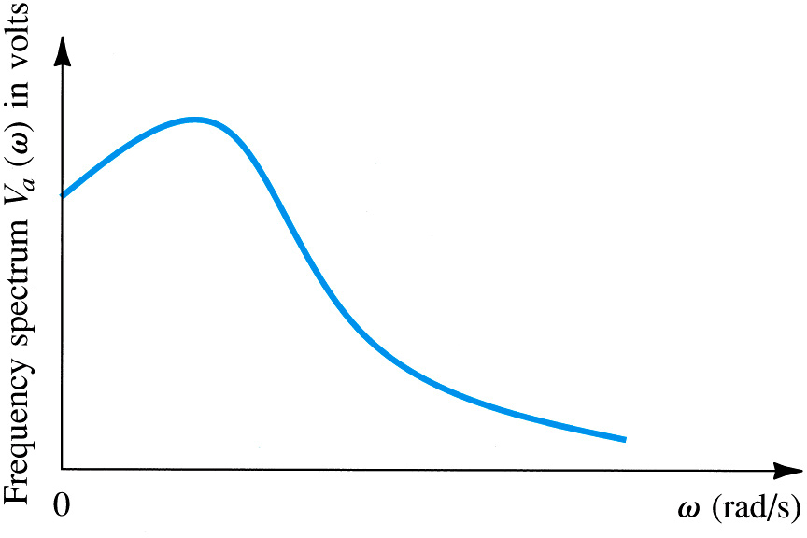
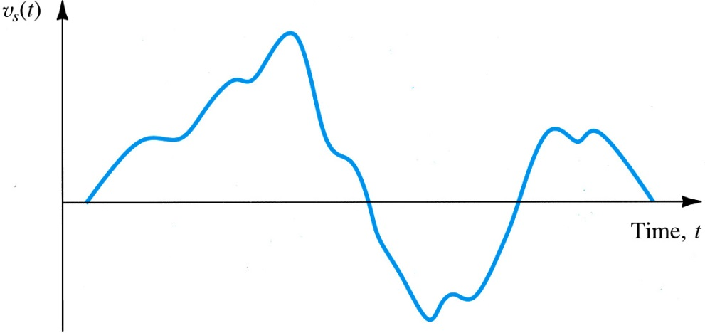
1.2. Frequency Spectrum of Signals
周期信号 → 离散频谱
非周期信号 → 连续频谱
Q: Can the Fourier Transform be applied to a non-periodic function of time?
A: Yes, however (as opposed to a discrete frequency spectrum) it will yield a continuous…

Slide 15
1.3. Analog and Digital Signals
analog signal (模拟信号) – is continuous with respect to both value and time 时间和数值都连续变化
discrete-time signal (离散时间信号) – is continuous with respect to value but sampled at discrete points in time 在离散的时间点上对模拟信号进行抽样
digital signal (数字信号) – is quantized (applied to values) as well as sampled at discrete points in time 对离散时间信号的数值进行量化/数字化

Slide 16

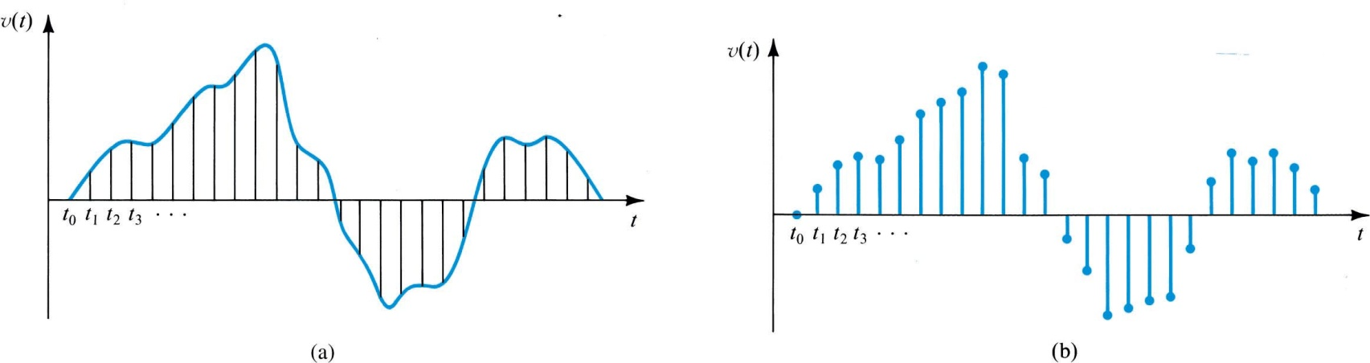
1.3. Analog and Digital Signals
analog signal
模拟信号
discrete-time signal
digital signal
离散时间信号
数字信号

Slide 17
1.3. Analog and Digital Signals
模拟信号
sampling
①在离散的时间点上对模拟信号进行抽样，x轴
离散时间信号
quantization
数字信号
②对离散时间信号的数值进行量化/数字化， y轴
Notes:
The “Sampling” (A/D conversion) and “Reconstruction” (D/A) processes form the connection between the Analog world (where we live) and the universe as seen by your computer.

Slide 18
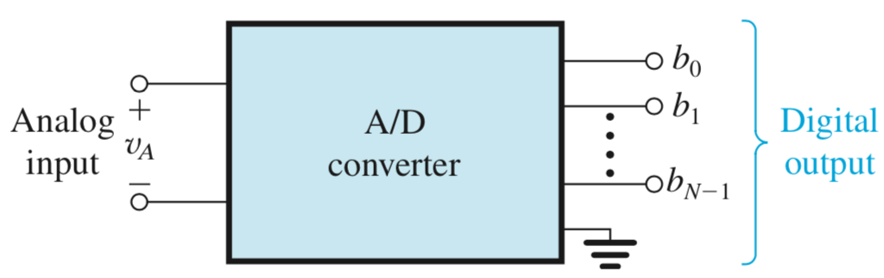
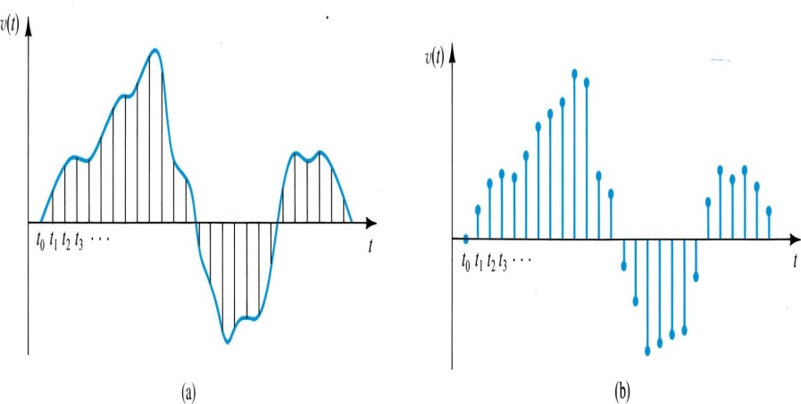
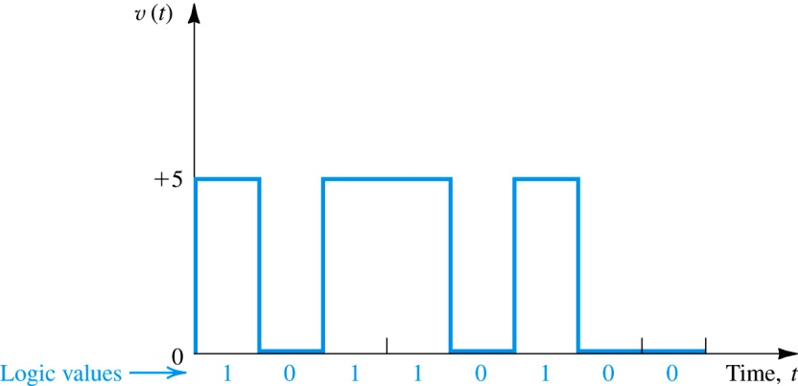
1.3. Analog and Digital Signals
“数字信号”和“二进制信号”是同义词吗？
Q: Are digital and binary synonymous?
A: No. The binary number system (base₂) is one way to represent digital signals.
digital
digital and binary
“二进制信号”是“数字信号”的特例
Notes:
Sampled signals are “Discrete-Time” signals
Digital Signals also have discrete values.
Binary is a particular number system used to represent the “Quantized” sample values. We sometimes use Octal (Base “8” – 3 bits/word) or Hex (Base “16” – 4 bits/word) as shorthand number systems to represent a binary system.

Slide 19
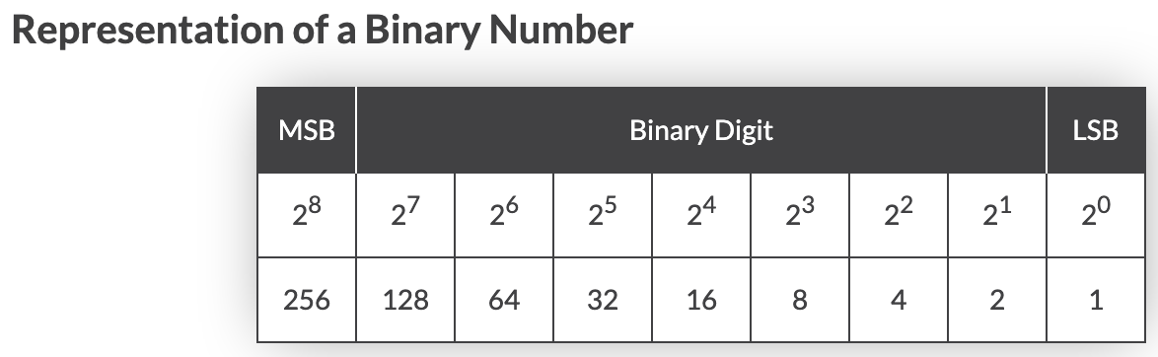
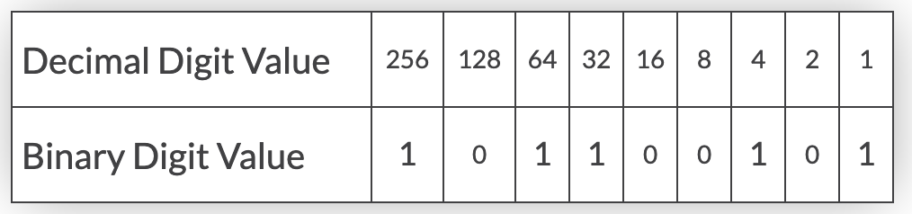


Most Significant Bit
最高位
Least Significant Bit
最低位
二进制数值 → 十进制数值

Slide 20
1.4. Amplifiers 放大器
Q: Why is signal amplification needed?为何需要信号放大？
A: Because many transducers yield output at low power levels (mW) 信号源（换能器产生的电信号）的初始信号往往幅度很小
linearity (线性度)– is property of an amplifier which ensures a signal is not “altered” from amplification
Distortion (失真) – is any unintended change in output

Slide 21
1.4.1. Signal Amplification
voltage amplifier – is used to boost voltage levels 目的是增加信号的电压幅度
power amplifier – is used to boost power levels 目的是增加信号的功率，提供中等程度的电压增益，但提供大幅的电流增益
voltage gain
Notes:
Power amplification is a function of the impedances (Input & Output) as well as voltage gain.

Slide 22
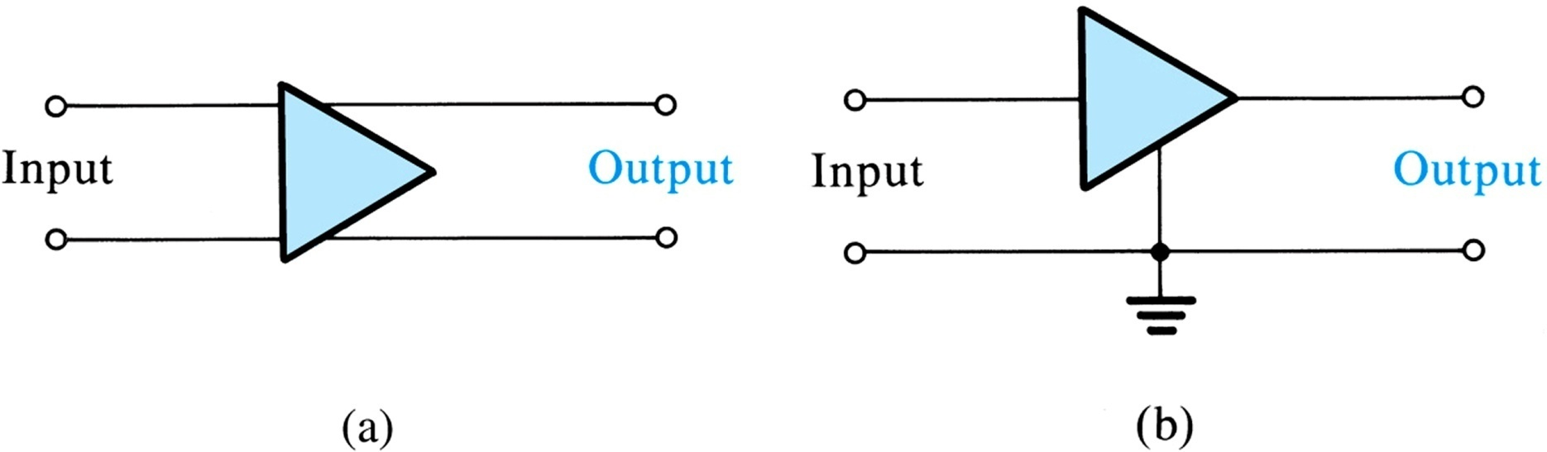
1.4.2. Amplifier Circuit Symbol 放大器的符号
通用符号
输入输出有公共地时
Figure 1.11: (a) Circuit symbol for amplifier. (b) An amplifier with a common terminal (ground) between the input and output ports.
Notes:
Double ended (balanced) input and output (differential mode signals). This configuration attempts to reject common mode signals at the input.
Single-ended (unbalanced) input and output (common mode signals).

Slide 23
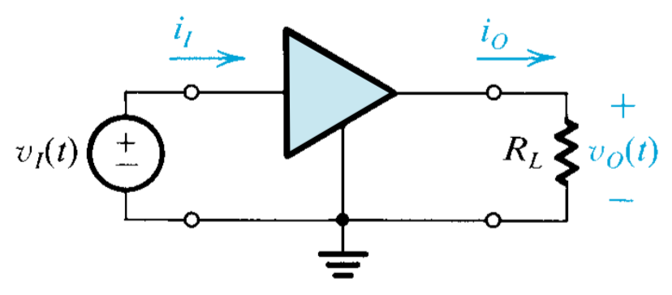
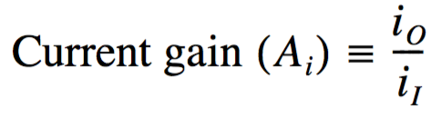

1.4.4. Power and Current Gain
放大器和变压器的主要区别是什么？两者都能改变电压幅度
Q: What is one main difference between an amplifier and transformer? …Because both alter voltage levels.
A: Amplifier may be used to boost power delivery.
power delivers to the load / power draws from the signal source
变压器没有功率增益
Notes:
Transformers:
Do not work at DC!
Power out = power in (No Power Gain, Some power lost)

Slide 24
1.4.5. Expressing Gain in Decibels
Q: How may gain be expressed in decibels?
电子工程中，常常将一个无量纲的比值，如电压增益、功率增益等，用对数的形式（以10为底）表述。这是工程惯例, 功率乘以10，电压电流乘以20
A_{V}为负表示相位相差180度，并非表示信号衰减；
而dB值若为负，则表示信号衰减！ 1:1 ~ 0 dB
Notes:
You should know how to deal with logarithms and their inverse, the exponential function.

Slide 25
Using dB
Commonly used (and easy to remember) dB values:
+10 dB = 10 times the power
-10 dB = one tenth power
+3 dB = double power
-3 dB = half the power
For example:
some power + 10 dB = 10 times the power
some power - 10 dB = one tenth power
some power + 3 dB = double power
some power - 3 dB = half the power
Notes:
Memorize these values! You will use them very often.

Slide 26
dBm and mW
What if we want to measure an absolute power with dB? We have to define a reference. 指定一个参考功率作为分母，就可以用 dB 来表示功率的绝对值（常常用1mW作为参考值）
The reference point that relates the logarithmic dB scale to the linear watt scale may be for example this:
m 指以 1mW 为参考功率
1 mW → 0 dBm
The new m in dBm refers to the fact that the reference is one mW, and therefore a dBm measurement is a measurement of absolute power with reference to 1 mW. dBm表示以1mW为参考值的功率绝对值
Notes:
What if I want to use a logarithmic scale to express a power?
To do so, I have to use a reference value of power. Let’s assume it’s 1 mW. So I define the dBm.
Using dBm, the reference is 1 milliwatt.
0 dBm is therefore equal to 1 mW.
Note that it is impossible to represent 0 mW (zero power, i.e. no power at all) using dBm!

Slide 27
dBm and mW
To convert power in mW to dBm:
PdBm = 10 log₁₀ PmW
10 times the logarithm in base 10 of the “Power in mW”
To convert power in dBm to mW:
PmW = 10 ^{PdBm/10}
10 to the power of ( “Power in dBm” divided by 10 )
Notes:
These formulas are the definition of dBm and can be used to convert between dBm and mW, but there is a simpler way to do it that does not require a calculator, and we will see it very soon!

Slide 28
dBm and mW
Example: mW to dBm
Example: dBm to mW
Radio power: 100mW
PdBm = 10 log₁₀(100)
100mW → 20dBm
Signal measurement: 17dBm
PmW = 10 ^{17/10}
17dBm → 50 mW
Notes:
Example: imagine a radio with an output power of 100mW
Example: imagine a signal measurement of 17 dBm
To find the log or the power, in these formulas, you will probably need a calculator. But there are much simpler ways to do these calculations in your mind, we are going to see them in a few minutes!

Slide 29
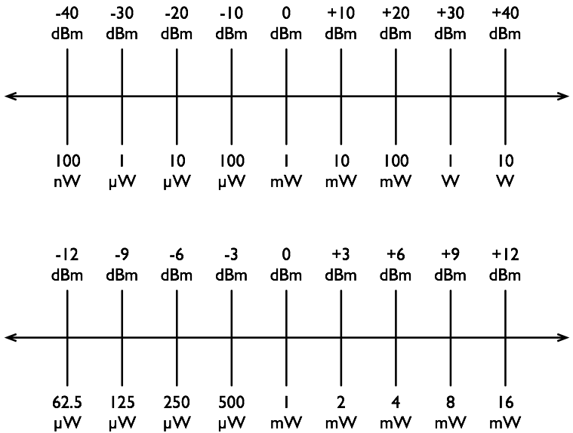
Using dB

Slide 30
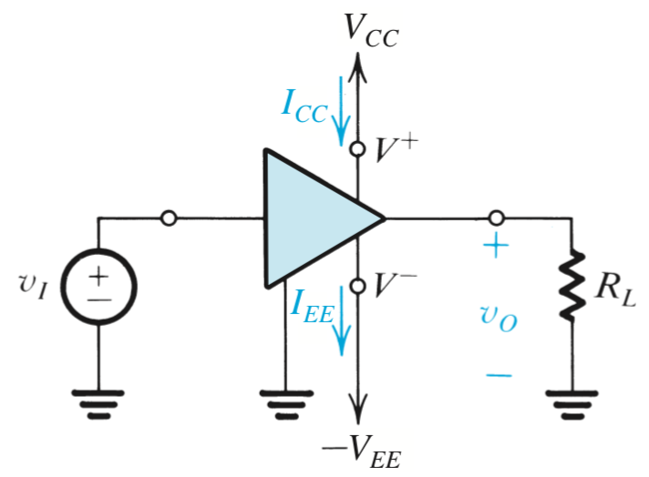
1.4.6. Amplifier Power Supply 放大器供电
supplies – an amplifier has two power supplies
V_{CC} is positive, current I_{CC} is drawn
-V_{EE} is negative, current I_{EE} is drawn
power draw – from these supplies is defined below
P_{dc} = V_{CC} I_{CC} + V_{EE} I_{EE}
The “CC” relates to the “collector” of an npn, bipolar transistor.
Similarly, “EE” relates to the emitter of an npn, bipolar transistor.
Notes:
These terms are used generically in circuits using other components. In an earlier era we used notation from Vacuum Tubes!

Slide 31
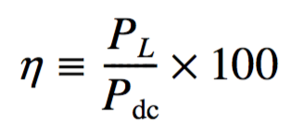
1.4.6. Amplifier Power Supply
conservation of power （功率守恒）– dictates that power input (P_{i}) plus that drawn from supply (P_{dc}) is equal to output (P_{L}) plus that which is dissipated (P_{dis}).
P_{i} + P_{dc} = P_{L} + P_{dissapated}
efficiency （效率）– is the ratio of power output to input.
efficiency = P_{L} / (P_{i} + P_{dc})
因为P_{i}往往非常小，所以：
Efficiency η = (Power delivered to the load)/(Power supplied to Amplifier).
Notes:
Where does the rest of the power go?

Slide 32
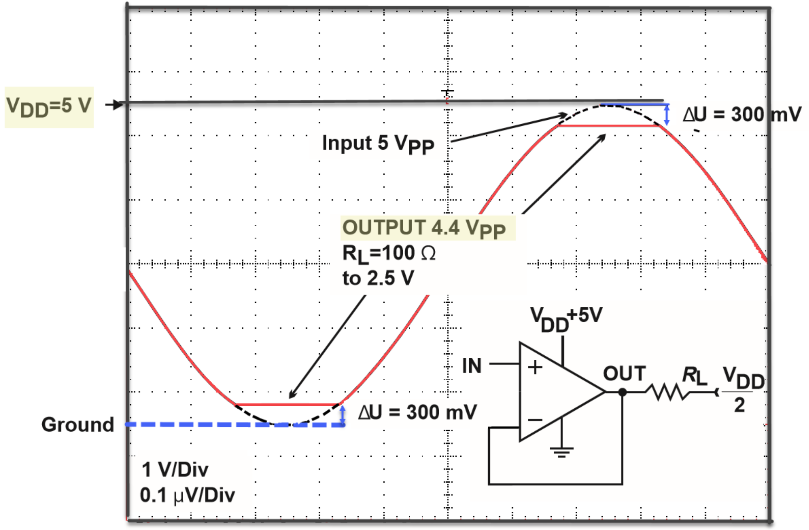
This amp is not rail-to-rail
Positive power supply rail
Negative power supply rail
swing: 电压摆幅
rail: 电源轨； rail-to-rail: 轨到轨，输入/输出电压摆幅非常接近于电源轨

Slide 33
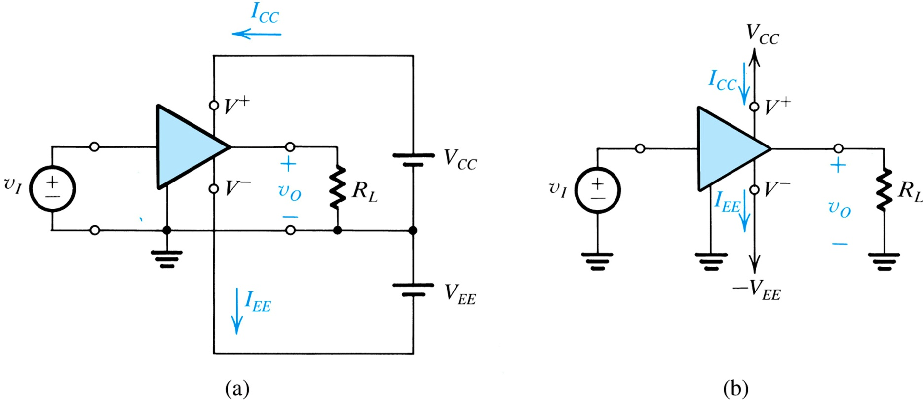
1.4.6. Amplifier Power Supply
Symmetric ± power supplies allow the inputs/outputs to swing symmetrically +/- and signals can approach the “rails”.
对称的正负电源供电，可以使输入输出信号以“0 V”为基线呈对称摆幅
Figure 1.13: An amplifier that requires two dc supplies (shown as batteries) for operation.
Notes:
The ground on the OpAmp is shown incorrectly! It is the other differential input (no input signal) that is grounded

Slide 34
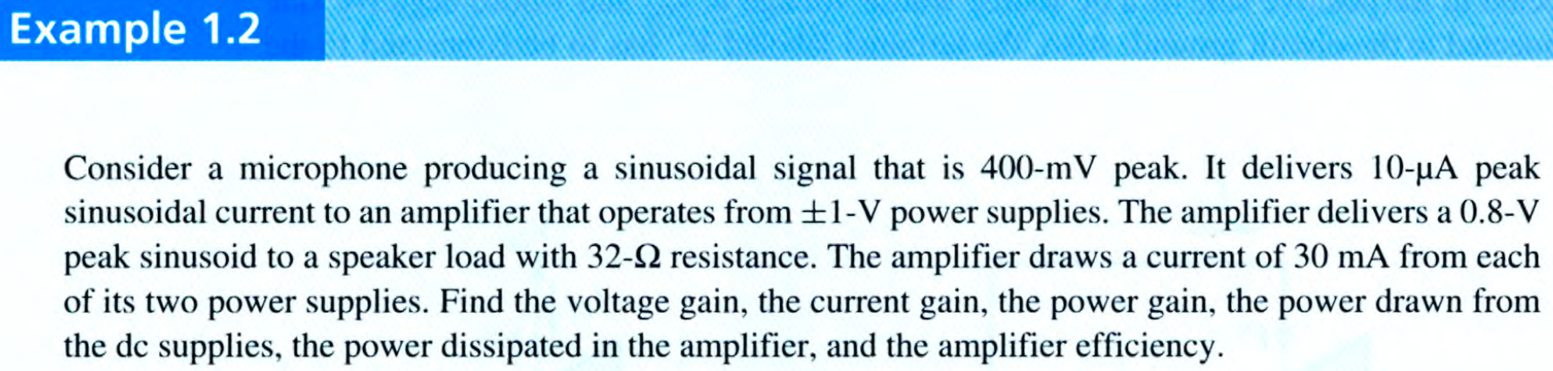
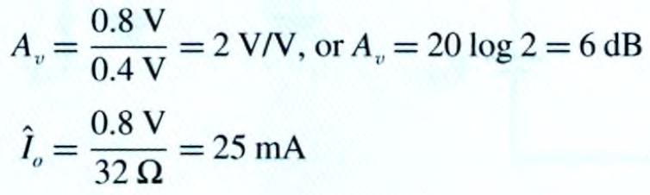
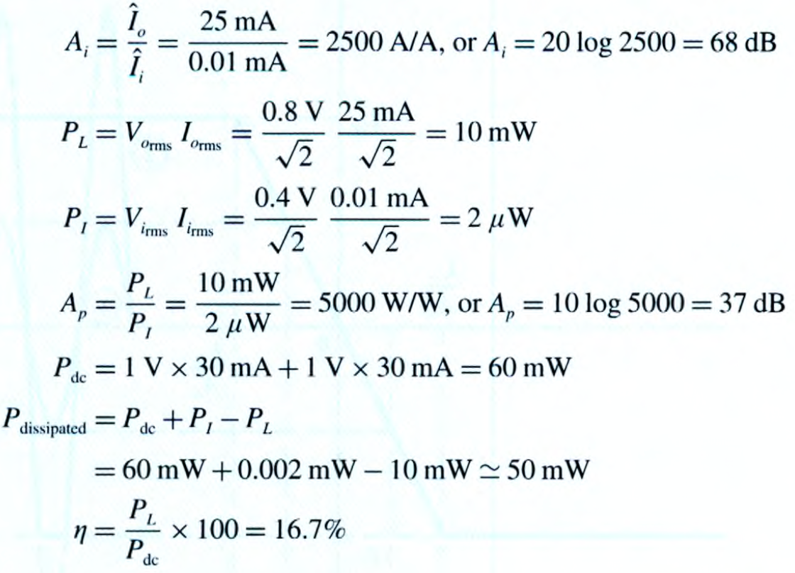
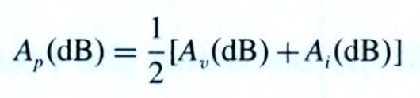

$$A_{p}\text{(}\text{dB}\text{)}≠A_{v}\text{(}\text{dB}\text{)}+A_{i}\text{(}\text{dB}\text{)}$$
Why?

Slide 35
1.4.7. Amplifier Saturation
limited linear range – practically, amplifier operation is linear over a limited input range.
saturation (饱和)– beyond this range, saturation occurs.
output remains constant as input varies
输入范围 = 输出范围/增益

Slide 36
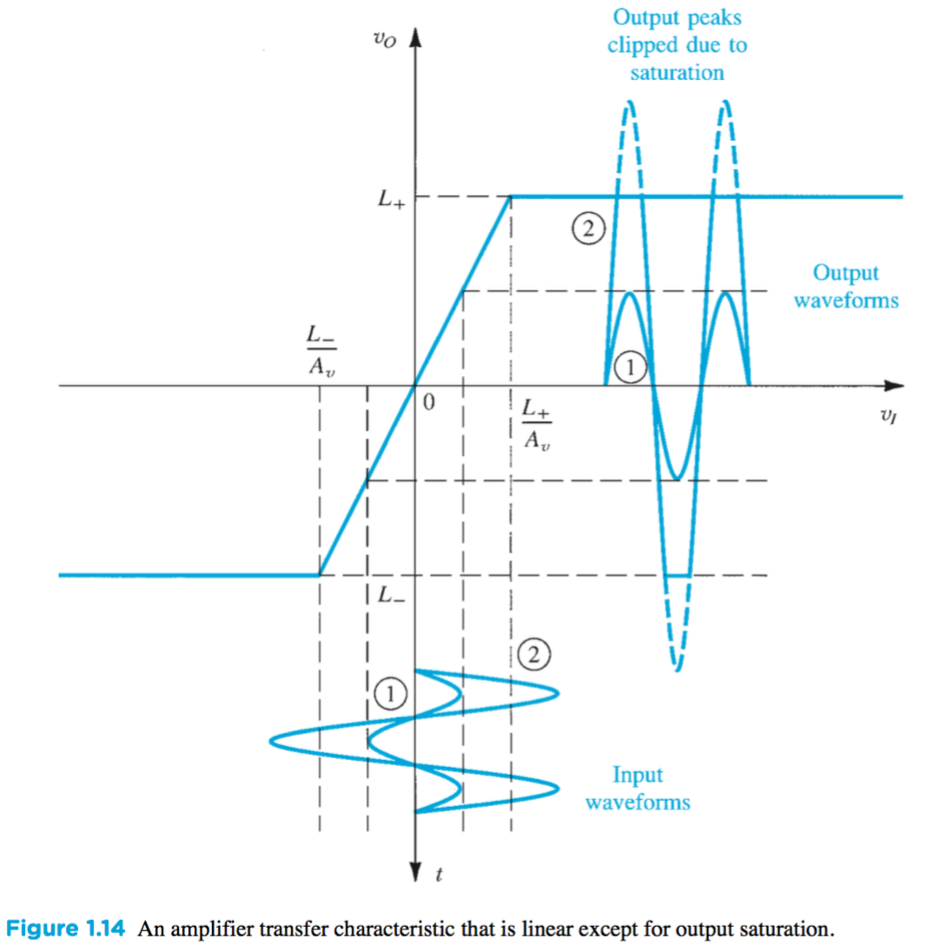
1.4.7. Amplifier Saturation
模电的核心：输入输出在大范围呈非线性关系，但局部某一点（称为静态工作点）附近的小范围可以线性近似（称为动态小信号）即 “静态工作点+动态小信号” 的分析理念
In our previous work (LTI systems), the world was assumed to be linear so that “superposition” could be used.
The real world is non-linear and we must learn to deal with it.
We can always do a “Small Signal Analysis” where an assumption of linearity is still reasonably accurate.
The slope of the device operational curve(s) at the “Quiescent Point” determines the small signal parameters.
This set of curves indicate that there would be “soft clipping” of the signal as the output signal approached the “rails”.
输入输出特性
静态工作点(Q) ➕ 小信号分析(小幅摆动)
Q point
输入在Q点附近摆动，①摆动比较小时，输出与输入为线性关系
② 若摆动比较大，则线性关系不成立→ 夹断、饱和

Slide 37
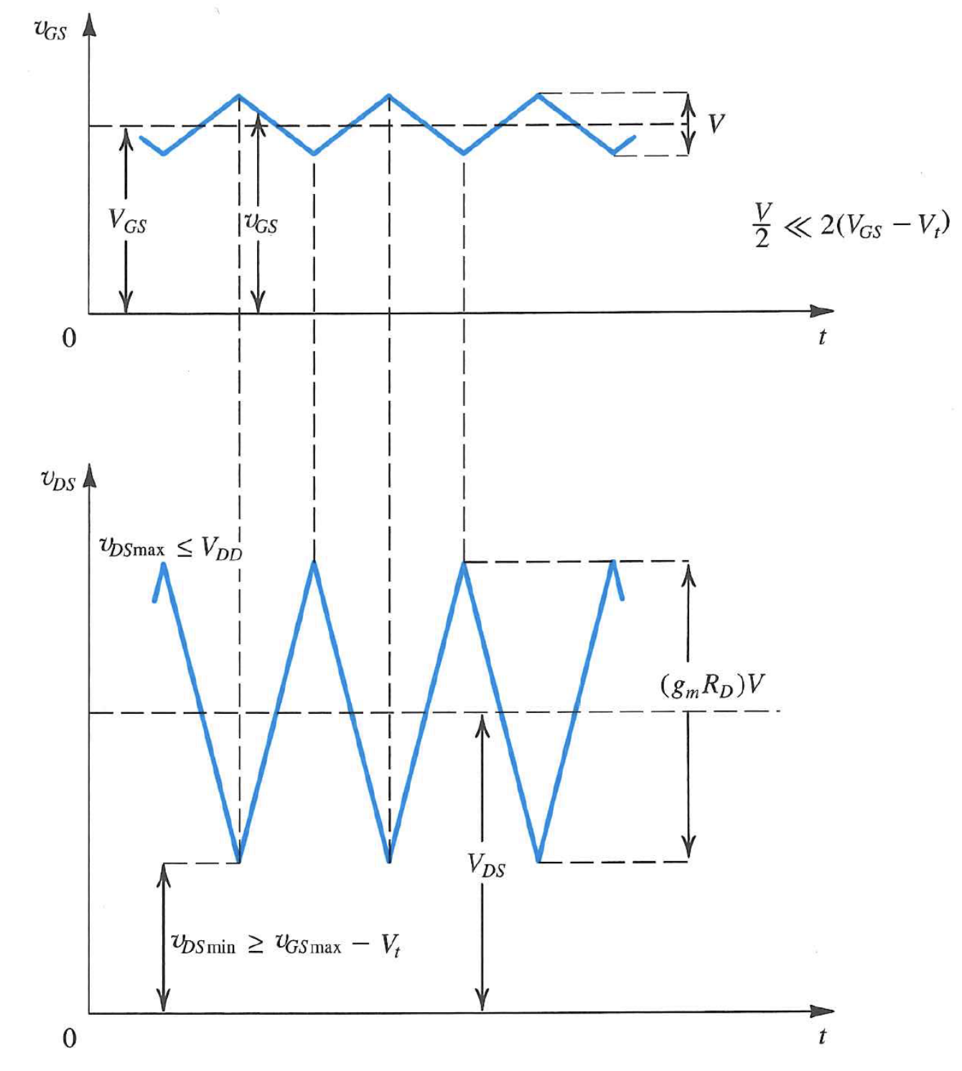
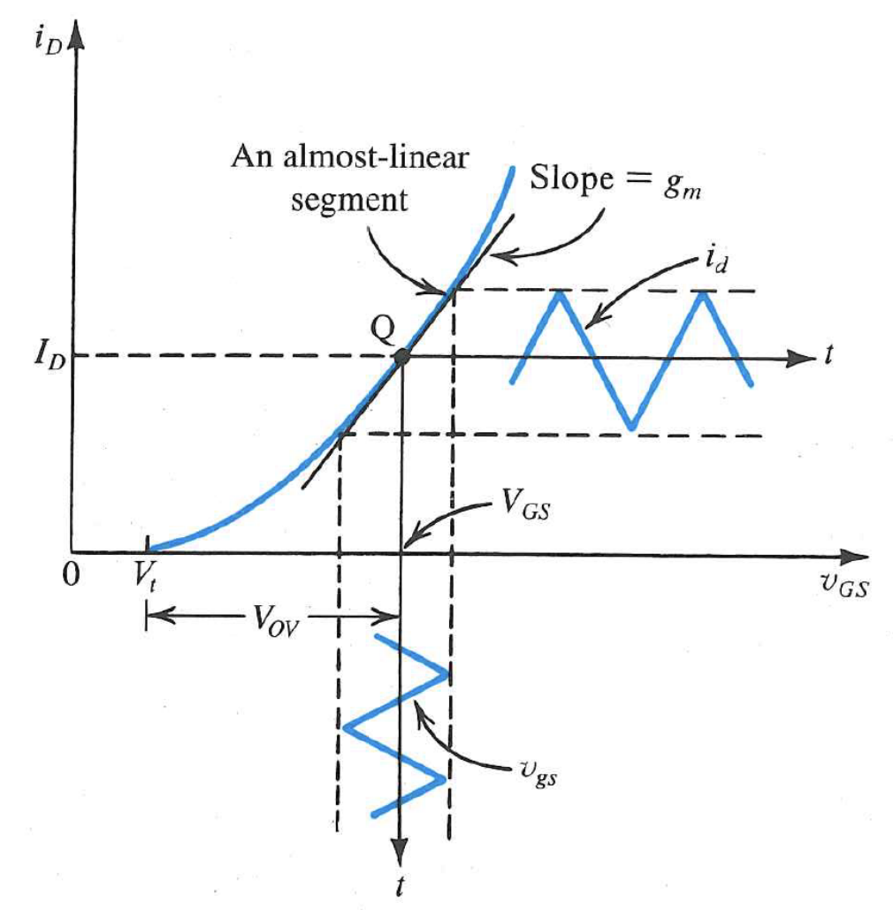
非线性的输入输出关系
静态工作点附近小范围内的线性近似
静态工作点Q
更实际的一个例子
i_{d} 施加在一个电阻上，转换成放大的输出电压

Slide 38


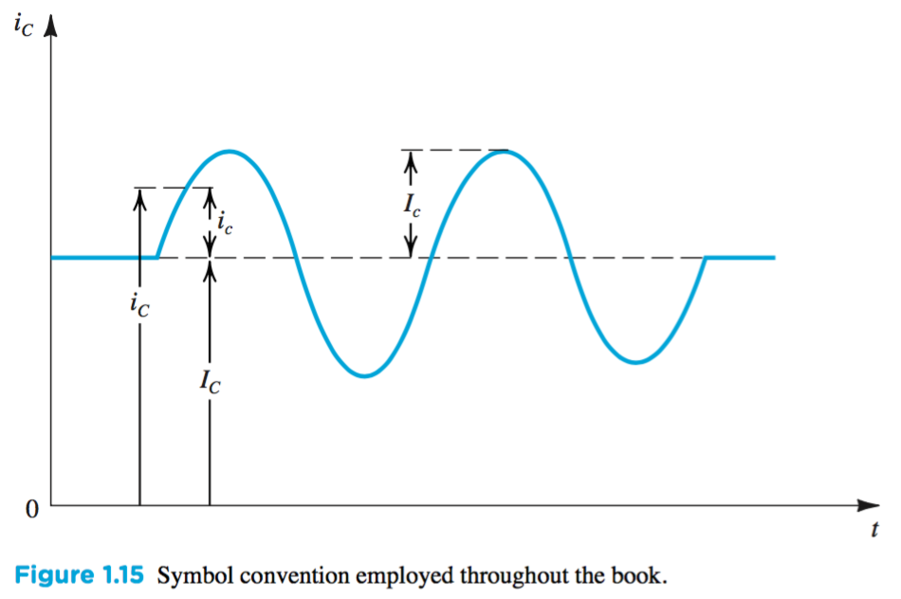
符号规范
① 小写_{大写}：瞬时总量
②大写_{大写}：直流量
③小写_{小写}：瞬时增量（交流量）
④大写_{小写}：正弦量的幅度

Slide 39
1.5. Circuit Models for Amplifiers 放大器的电路模型
model – is the description of component’s (e.g. amplifier) terminal behavior
neglecting internal operation / transistor design
Modelling is about building representations of things in the ‘real world’, and it is a way of expressing a particular view of an identifiable system of some kind.
物理模型：从器件的物理机理出发，推导出具有物理意义的数学表达式，用来表征该器件的特性；
等效电路模型：用电路的形式来等效器件的特性，电路参数不一定要具有物理意义。

Slide 40
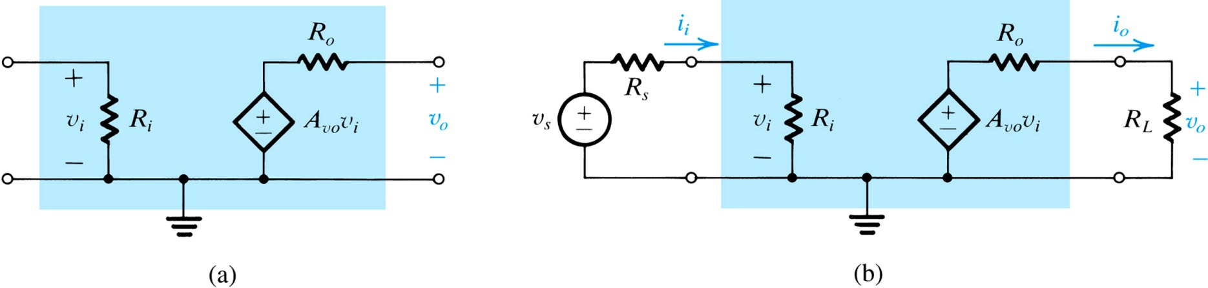
1.5.1. Voltage Amplifiers
This assumes linear behavior. Amplifiers can exhibit non-linear behavior as well.
Turn off 独立源v_{s}
电压放大器输入端口等效模型
电压放大器输出端口等效模型
输入端口看进去的等效电阻？
R_{i}
输出端口看进去的等效电阻？
R_{o}

Slide 41
1.5.1. Voltage Amplifiers
Q: How can one model the amplifier behavior from previous slide?
A: Model which is function of: v_{s}, A_{vo}, R_{i}, R_{s}, R_{o}, R_{L}

Slide 42
1.5.1. Voltage Amplifiers
Q: What is one “problem” with this behavior?
A: Gain (ratio of v_{o} and v_{s}) is not constant, and dependent on input and load resistance.电压增益受输入电阻R_{i}和输出电阻R_{o}的影响
Notes:
This is NOT nonlinearity!

Slide 43
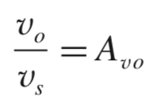

1.5.1. Voltage Amplifiers
ideal amplifier model – is function of v_{s} and A_{vo} only!!
It is assumed that R_{o} << R_{L}…
It is assumed that R_{s} << R_{i}…
理想电压放大器的电压增益
ideal model
key characteristics of ideal voltage amplifier model = high input impedance, low output impedance理想电压放大器：输入电阻∞，输出电阻为0
Notes:
Note that real OpAmps are not quite “Ideal”

Slide 44
1.5.1. Voltage Amplifiers
ideal amplifier model – is function of v_{s} and A_{vo} only!!
It is assumed that R_{o} << R_{L}…
It is assumed that R_{s} << R_{i}…
key characteristics of ideal voltage amplifier model = source resistance R_{S} and load resistance R_{L} have no effect on gain

Slide 45
Buffer amplifier 缓冲放大器
如果R_{L}较小，而信号的R_{s}较大，则不能直接将两者相连（直接驱动），Why？
我们可以插入一个 buffer amplifier，其输入阻抗=∞；输出阻抗=0，而增益Av并不作要求。

Slide 46
1.5.2. Cascaded Amplifiers 放大器级联
In real life, an amplifier is not ideal and will not have infinite input impedance or zero output impedance. 实际情况，输入阻抗可能不是∞，输出阻抗也可能不是0 → 可以通过级联来解决
Cascading of amplifiers, however, may be used to emphasize desirable characteristics.
first amplifier – high R_{i}, medium R_{o}
last amplifier – medium R_{i}, low R_{o}
aggregate – high R_{i}, low R_{o}

Slide 47
Example 1.3: Cascaded Amplifier Configurations
Examine system of cascaded amplifiers on next slide.
Q(a): What is overall voltage gain?
Q(b): What is overall current gain?
Q(c): What is overall power gain?

Slide 48
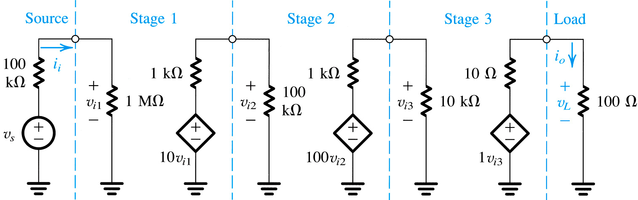
Example 1.3: Cascaded Amplifier Configurations
注意：A_{v}是v_{L}/v_{i1}，而不是v_{L}/v_{s}
aggregate amplifier with gain
Figure 1.17: Three-stage amplifier for Example 1.3.

Slide 49
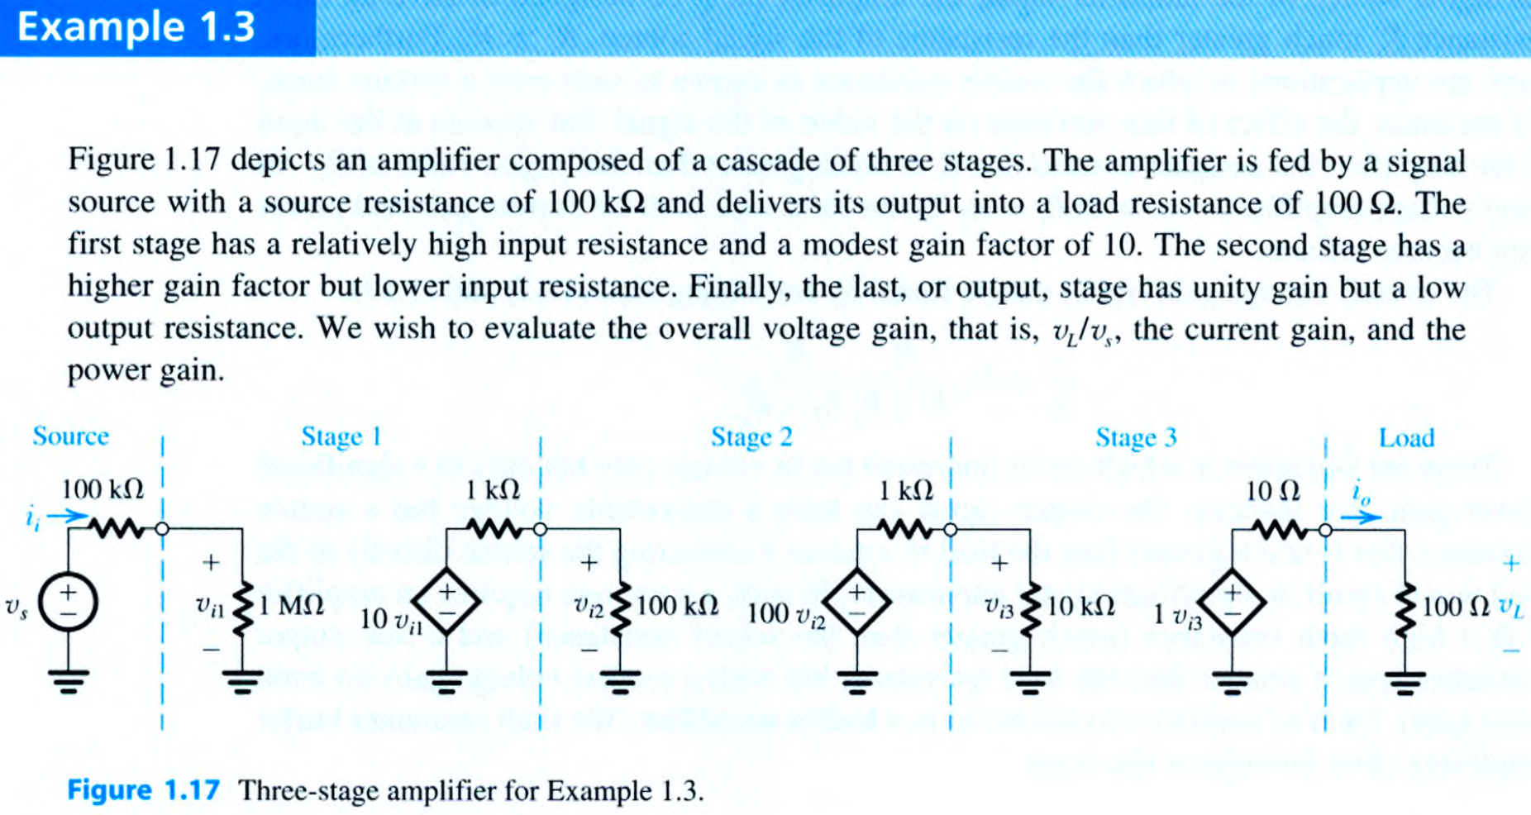

Slide 50
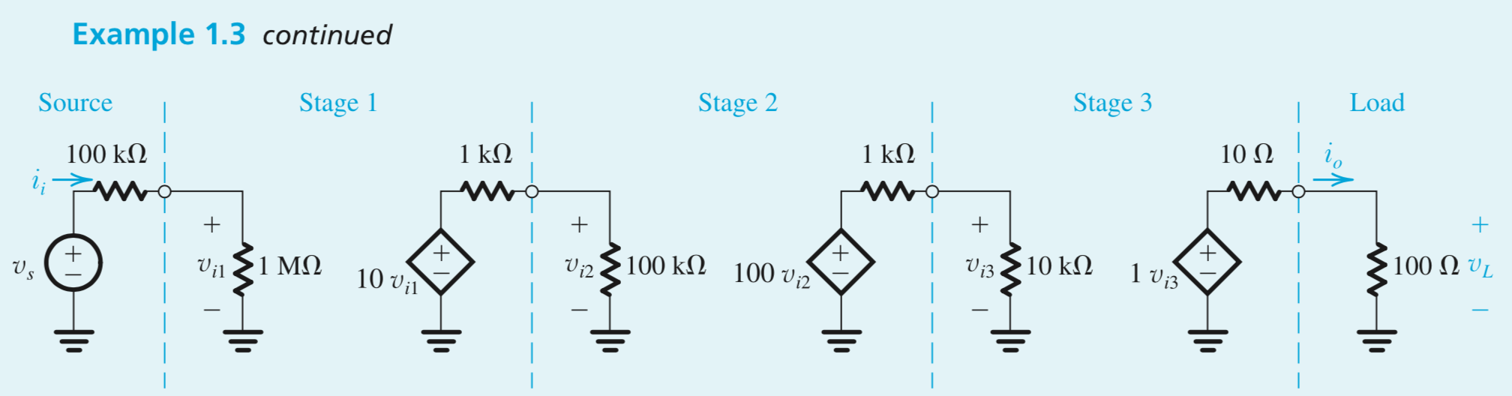
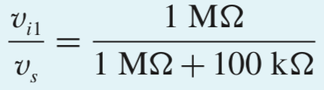
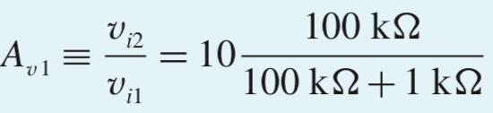
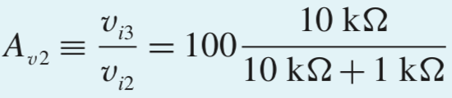
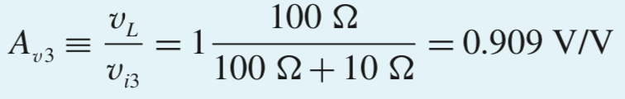
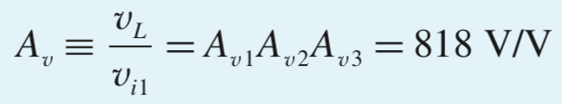
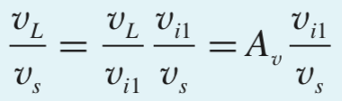



Slide 51

1.5.3. Other Amplifier Types
voltage amplifier
current amplifier
transconductance amp.
transresistance amp.
Notes:
These devices do exist as integrated cicuit products that we can use in our designs.

Slide 52
1.5.3. Other Amplifier Types
A_{is}
voltage amplifier
current amplifier
transconductance amplifier
transresistance amplifier

Slide 53
1.5.4. Relationship Between Four Amp Models
interchangeability – although these four types exist, any of the four may be used to model any amplifier
they are related through A_{vo} (open circuit gain)
电路等效：
①开路电压相等；
②短路电流相等
基于 Source Transformation

Slide 54
1.5.5. Determining R_{i} and R_{o}
输入输出电阻的计算
就是 戴维南等效电阻的计算
Q: How can one calculate input resistance from terminal behavior?
A: Observe v_{i} and i_{i}, calculate via R_{i} = v_{i} / i_{i}
Q: How can one calculate output resistance from terminal behavior?
A:
Remove source voltage (such that v_{i} = i_{i} = 0)
Apply voltage to output (v_{x})
Measure negative output current (-i_{o})
Calculate via R_{o} = -v_{x} / i_{o}
输出电阻也可以用 “开路电压/短路电流” 计算
~ Trun off 独立源

Slide 55

Section 1.5.5: Determining R_{i} and R_{o}
question: how can we calculate input resistance from terminal behavior?
answer: observe v_{i} and i_{i}, calculate via R_{i} = v_{i} / i_{i}
question: how can we calculate output resistance from terminal behavior?
answer:
remove source voltage (such that v_{i} = i_{i} = 0)
apply voltage to output (v_{x})
measure negative output current (-i_{o})
calculate via R_{o} = -v_{x} / i_{o}
Figure 1.18: Determining the output resistance.
Notes:
You can also vary the “load” resistor to determine the output resistance.

Slide 56
1.5.6. Unilateral Models
unilateral model (单向模型) – is one in which signal flows only from input to output (not reverse)
However, most practical amplifiers will exhibit some reverse transmission…

Slide 57


Example 1.4: Common-Emitter Circuit
Examine the bipolar junction transistor (BJT).
three-terminal device
when powered up with dc source and operated with small signals, may be modeled by linear circuit below.
C
B
E
Notes:
A bipolar transistor is best modeled as a current controlled current amplifier.

Slide 58
Example 1.4.
input resistance (r_{π})
base
collector
output resistance (r_{o})
examine:
bipolar junction transistor (BJT):
three-terminal device
when powered up with dc source and operated with small signals, may be modeled by linear circuit below.
short-circuit conductance (g_{m})
Figure 1.19 (a) small-signal circuit model for a bipolar junction transistor (BJT)
emitter
Notes:
This is only a small signal model! As the input actually looks like a diode, not a resistor.
It also exhibits Saturation and Cutoff nonlinear characteristics.

Slide 59

Example 1.4: Common-Emitter Circuit
Q(a): Derive an expression for the voltage gain v_{o} / v_{s} of common-emitter circuit with:
R_{s} = 5kohm
r_{π} = 2.5kohm
g_{m} = 40mA/V
r_{o} = 100kohm
R_{L} = 5kohm

Slide 60

input and output share common terminal
v_{be} = v_{s} * r_{π}/(R_{s} + r_{π})
v_{o} = g_{m}*v_{be} * r_{o}/(R_{L} + r_{o}) * R_{L}
source
load
Figure 1.19(b): The BJT connected as an amplifier with the emitter as a common terminal between input and output (called a common-emitter amplifier).

Slide 61
1.6.1. Measuring the Amplifier Frequency Response
Q: How does one examine frequency response?
A: By applying sine-wave input of amplitude V_{i} and frequency ω.
Q: Why?
A: Because, although its amplitude and phase may change, its shape and frequency will not.
this characteristic of sine wave applied to linear circuit is unique
Notes:
And is why we (EEs) use single frequency analysis!
Another way that is often used to measure frequency response is to apply a “white noise” signal and examine the output “spectrum”.

Slide 62

1.6.1: Measuring the Amplifier Frequency Response
input and output are similar for linear amplifier
Notes:
“similar” in shape as in similar triangles

Slide 63
1.6.1. Measuring the Amplifier Frequency Response 放大器频率响应
amplifier transfer function (T) – describes the input-output relationship of an amplifier – or other device – with respect to various parameters, including frequency of input applied.
It is a complex value, often defined in terms of magnitude and phase shift.
Notes:
The phase shift is related to “Delay” by the frequency (actually the period) of the signal.
Phase should be in Radians but is commonly stated in degrees.

Slide 64
1.6.2. Amplifier Bandwidth 放大器带宽
Q: What is bandwidth of a device?
A: The range of frequencies over which its magnitude response is constant (within 3dB).
Q: For an amplifier, what is main bandwidth concern?
A: That the bandwidth extends beyond range of frequencies it is expected to amplify.

Slide 65

1.6.2. Amplifier Bandwidth
The 3dB points are the “half power” points of the frequency response curve.

Slide 66
1.6.4. Single Time-Constant Networks单时间常数网络
single time–constant (STC) network – is composed of (or may be reduced to) one reactive component and one resistance. RC或RL电路
low pass filter – attenuates output at high frequencies, allow low to pass
high pass filter – attenuates output at low frequencies, allow high to pass
time constant (τ.) – describes the length of time required for a network transient to settle from step change (τ = L / R = RC)
Notes:
Again from your circuits course!

Slide 67

1.6.4. Single Time-Constant Networks
Figure 1.22: Two examples of STC networks: (a) a low-pass network and (b) a high-pass network.
low pass filter (left) attenuates output at high s
high pass filter (right)
Notes:
These RC circuits were studied in the first Circuits course.

Slide 68
1.6.4. Single Time-Constant Networks

Slide 69



1.6.4. Single Time-Constant Networks
s = jω
低通STC
高通STC
传递函数标准形式

Slide 70




Figure: Low-Pass Filter Magnitude (top-left) and Phase (top-right) Responses as well as High-Pass Filter (bottom-left) and Phase (bottom-right) Responses
波特图的特性：随着频率的增加，每碰到一个零点，幅度的斜率增加20dB/十倍频，相位增加90度（从0.1到10倍频率）；每碰到一个极点，幅度的斜率减小20dB/十倍频，相位减小90度（从0.1到10倍频率）

Slide 71
-20dB/decade drop, beginning from maximum gain at corner frequency
-45 degrees/decade drop, moving outward from -45 degree shift at corner frequency
Figure: Low-Filter Magnitude (top-left) and Phase (top-right) Responses as well as High-Pass Filter (bottom-left) and Phase (bottom-right) Responses
+20dB/decade incline, until maximum gain is reached at corner frequency
-45 degrees/decade drop, moving outward from +45 degree shift at corner frequency
An octave is the range over which the frequency is doubled (from music).

Slide 72



Slide 73










Example 1.5: Voltage Amplifier

Slide 74

Example 1.5: Voltage Amplifier
Q(b): What is unity-gain frequency? How is it calculated?
A: Gain = 0dB
A: It is known that the gain of a low-pass filter drops at 20dB per decade beginning at ω₀. Therefore unity gain will occur two decades past ω₀ (40dB – 20dB – 20dB).
Q(c): Find v_{o}(t) for each of the following input: v_{s} = 0.1sin(10²t), v_{s} = 0.1sin(10⁵t)

Slide 75


1.6.5. Classification of Amps Based on Frequency Response
internal capacitances – cause the falloff of gain at high frequencies 节点到地的寄生电容：高频时增益下降的原因
like those seen in previous example
coupling capacitors (隔直电容)– cause the falloff of gain at low frequencies 隔直电容：低频时增益下降的原因
are placed in between amplifier stages
generally chosen to be large
隔离不同 stages 放大器的直流
Notes:
Coupling capacitors block “DC” so that you can separately “bias” each amplifier stage.

Slide 76


1.6.5. Classification of Amps Based on Frequency Response
directly coupled / dc amplifiers – allow passage of low frequencies
capacitively coupled amplifiers – allow passage of high frequencies
tuned amplifiers – allow passage of a “band” of frequencies

Slide 77

作业

Slide 78




