Slide 1
Chapter #2: Operational Amplifiers 运算放大器
from Microelectronic Circuits Text
by Sedra and Smith
Oxford Publishing

Slide 2
课程纲要
9. 理想运算放大器及其应用电路（建议4学时）
9.1 运算放大器基础
9.1.1 运算放大器的结构及其电路符号
9.1.2 运算放大器的理想模型
9.2 运算放大器基本应用电路
9.2.1 反相和同相接法电路
9.2.2 常用运算放大器应用电路（包括线性和非线性应用电路）

Slide 3
Introduction
IN THIS CHAPTER YOU WILL LEARN
The terminal characteristics of the ideal op-amp.理想运放的基本特性
How to analyze circuits containing op-amps, resistors, and capacitors. 基本运放电路的分析
How to use op-amps to design amplifiers having precise characteristics. 利用运放设计精确放大器

Slide 4
Introduction
IN THIS CHAPTER YOU WILL LEARN
How to design more sophisticated op-amp circuits, including summing amplifiers, instrumentation amplifiers, integrators, and differentiators.
运放主要应用电路分析

Slide 5
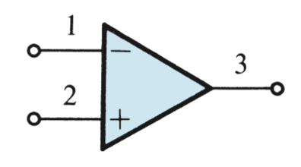

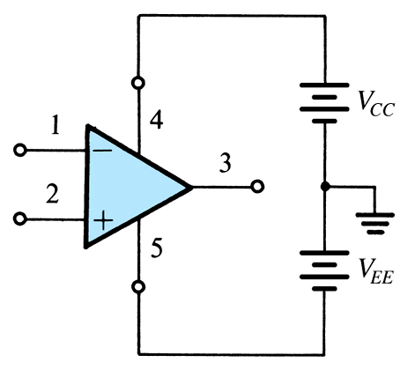
2.1.1. The Op Amp Terminals
从信号角度讲，op amp 是一个三端元件（1、2、3），4和5是供电。
“电压电流约束关系”：
terminal #1 反相输入端
inverting input
terminal #2 同相输入端
non-inverting input
terminal #3 输出端
output
terminal #4 供电电源（+）
positive supply V_{CC}
terminal #5 供电电源（-）
negative supply V_{EE}
Op amp 也是一个基本的 building block，就如R、L、C
Notes:
A useful integrated circuit implementation of an almost idealized amplifier. Often
V_{CC} = V_{EE} for balance with respect to ground (important as it maintains symmetry when overdriven)
Some OpAmps also have differential outputs

Slide 7
2.1.3. Differential & Common-Mode Signals
差分信号 & 共模信号
差分：v_{di} = v₂ - v₁
共模：v_{cmi} = (v₂ + v₁ )/2
Q: How is common-mode input (v_{cmi}) defined in terms of v₁ and v₂?
任意两个信号v₁，v₂，都可以分解成共模信号（v_{cmi}） 与 差分信号（V_{di}）的叠加

Slide 8
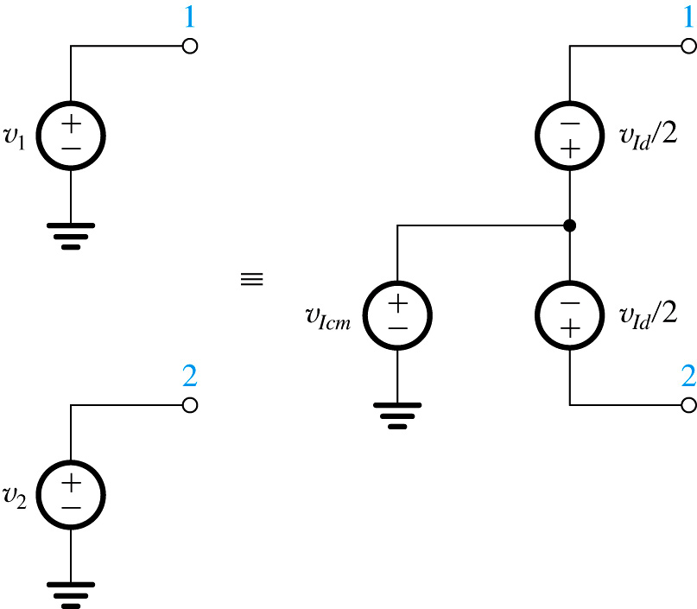
2.1.3. Differential & Common-Mode Signals
Notes:
A good equivalent circuit as long as your system is balanced

Slide 9
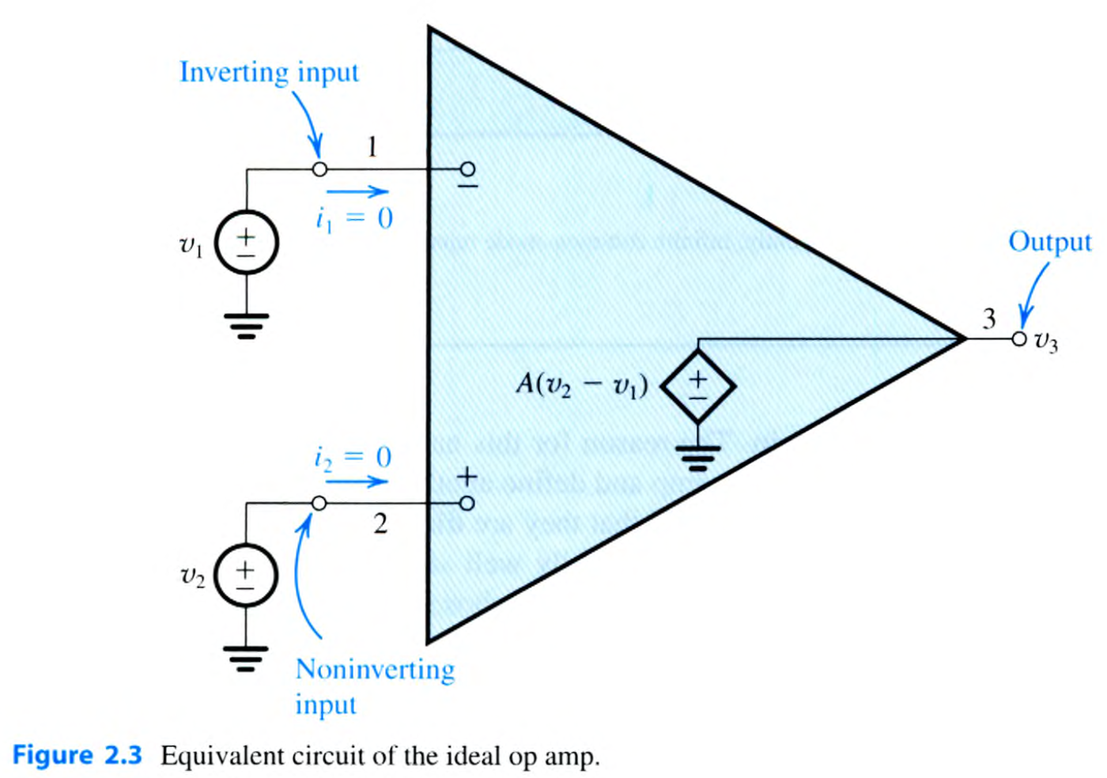
2.1.2. Function and Characteristics of Ideal Op Amp
了解理想运放的基本特性，就如需要了解RLC元件的基本特性一样
电压关系：
电流关系：i₁=i₂=0
理想运放的等效电路
ideal input characteristic is infinite impedance
ideal output characteristic is zero impedance
differential gain (A) is infinite
common mode gain is zero
bandwidth gain is constant from dc to high frequencies
输入阻抗=∞
输出阻抗=0
差分电压增益=∞
共模电压增益=0
带宽= ∞
理想运放不单独使用，输入输出需构成闭环再应用，所以A也称为开环增益（open-loop gain），相应的，构成闭环后的增益成为闭环增益（closed-loop gain）
Q: But, is an amplifier with infinite gain of any use?

Slide 10
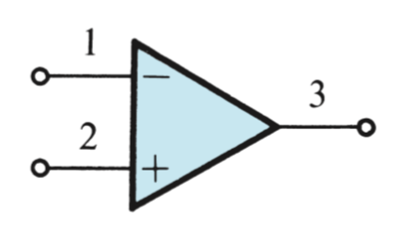
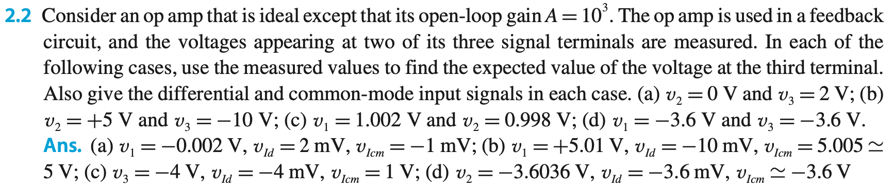
简化 symbol，常用

Slide 11
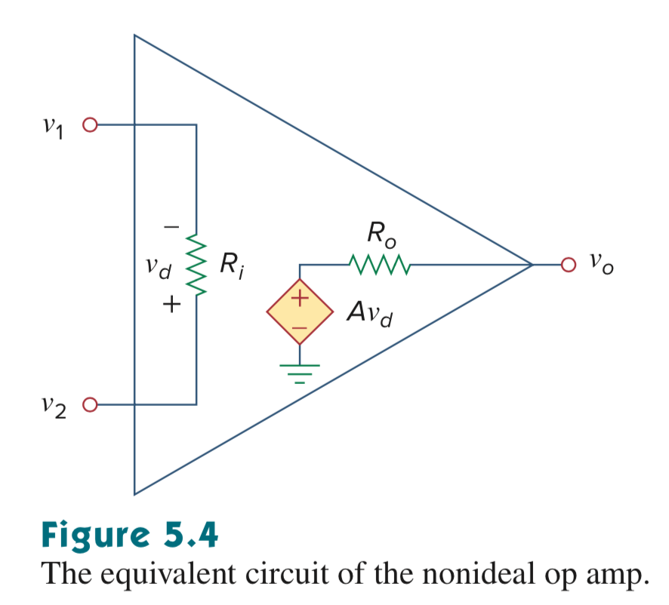
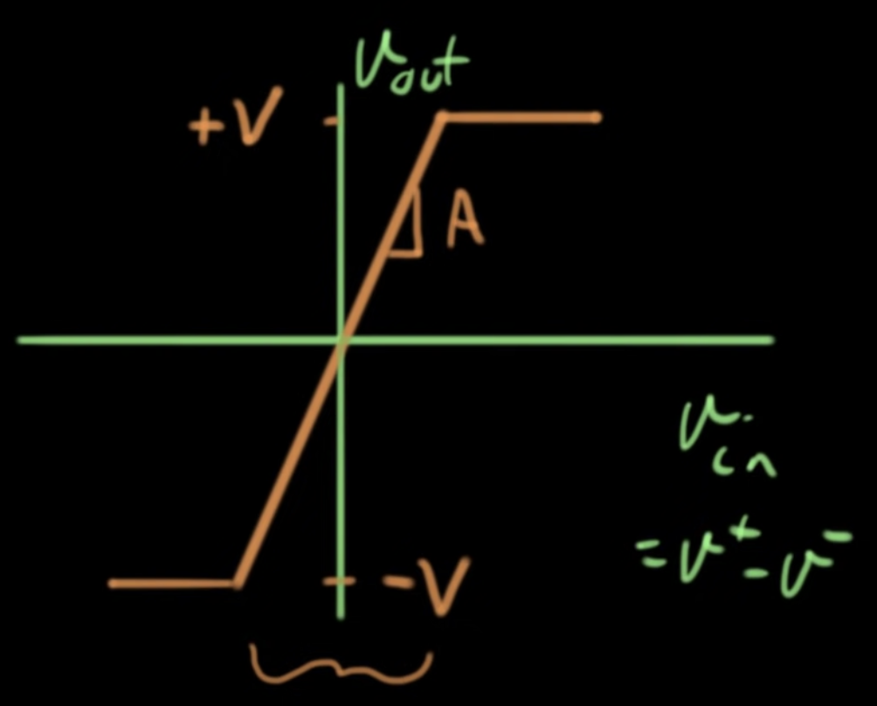
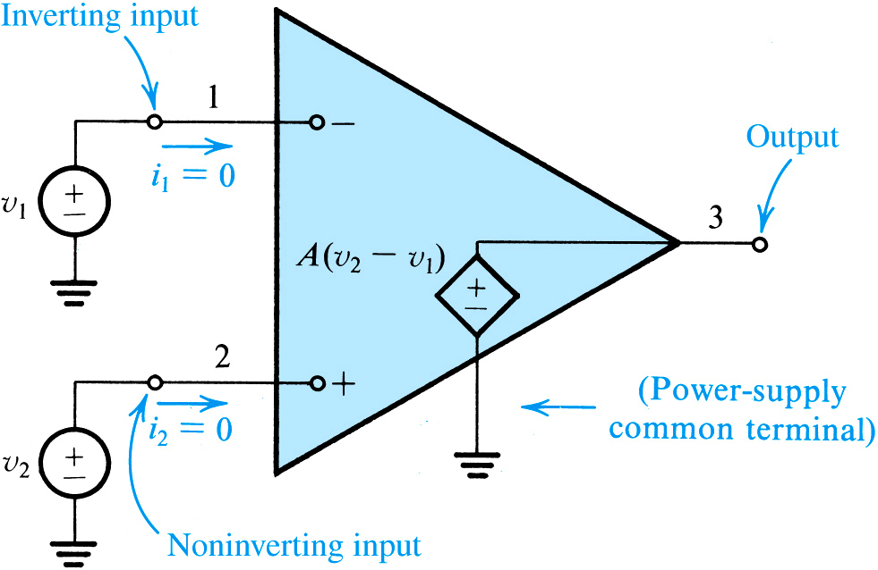
2.1.2. Function and Characteristics of Ideal Op Amp
理想运放的特性：
①输入阻抗=∞；→ i₁=i₂=0 虚断
②输出阻抗=0；
③只放大输入差分信号；
④差分电压增益=∞；→ v₁=v₂ 虚短
⑤带宽=∞
④
ideal gain: is defined below
ideal input characteristic: infinite impedance
ideal output characteristic: zero impedance
理想运放的等效电路
Notes:
Idealized OpAmp:
Infinite input impedance (no source loading)
Extremely high gain (A – watch out for oscillation)
Zero output impedance (can deliver power to a load), but real OpAmps are not Zero (741 has 75 ohm Z_{out})
Differential input (high degree of “common mode” rejection)
Sometimes differential output

Slide 12

2.1.2. Function and Characteristics of Ideal Op-Amp
运放的特性：
抑制共模信号、放大差分信号
An amplifier’s input is composed of two components…
differential input (v_{dfi}) – is difference between inputs at non-inverting and inverting terminals
common-mode input (v_{cmi}) – is input present at both inverting and non-inverting terminals
Similarly, two components of gain exist…
differential gain (A) – gain applied to differential input ONLY
common-mode gain (A_{cm}) – gain applied to common-mode input ONLY
运放的增益也可看成两部分构成：差分增益+共模增益
Notes:
An OpAmp tries to reject the common-mode input while amplifying the differential input.

Slide 13
2.1.2. Function and Characteristics of Ideal Op Amp
理想运放可以用集成运放（集成电路，而非分立元件实现运放）来近似实现
This “Ideal” is only approached by IC op amps
Z_{i} – usually high enough to ignore
Z_{o} – often higher than needed – follow by a low output impedance stage (emitter-follower)
A_{cm} – usually quite good
A – usually high enough when not asking for too much gain with feedback
BW – needs to be evaluated in use.
输入阻抗往往够高
∞
输出阻抗往往不够低，需后接一级低输出阻抗的电路
0
共模增益往往够小
0
差分增益往往够高
∞
需根据实际情况估算，≠∞
∞

Slide 15
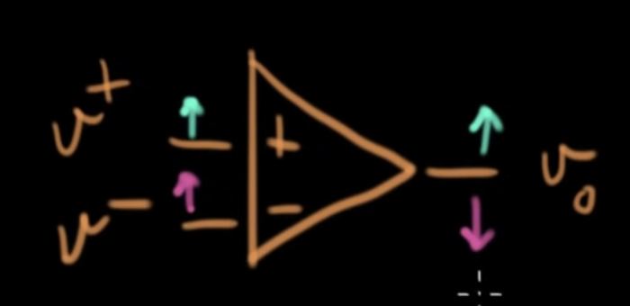
2.2. The Inverting Configuration
反相（倒相）接法
Q: What are two basic closed-loop op-amp configurations which employ op-amp and resistors alone?
A: 1) inverting and 2) non-inverting op amp
若仅可使用运放和电阻，那么有两种构成闭环的接法：①反相接法，输入在反相输入端；②同相接法，输入在同相输入端
Notes:
Two of the three most used configurations

Slide 16
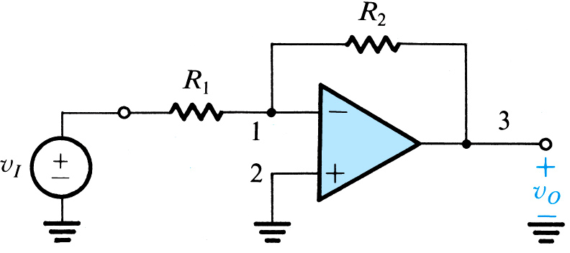
2.2. The Inverting Configuration
Figure 2.5: The inverting closed-loop configuration.
R₂ facilitates “negative feedback”
R₁ regulates level of this feedback
question: what are two basic closed-loop op amp configurations which employ op-amp and resistors alone?
answer: inverting and non-inverting op amp
note: here we examine the inverting type
non-inverting input is grounded
source is applied to inverting input
Notes:
How can we calculate the gain?

Slide 17
2.2.1. Closed-Loop Gain
Q: How does one analyze closed-loop gain for inverting configuration of an ideal op-amp?
step #1: Begin at the output terminal
step #2: If v_{Out} is finite, then differential input must equal 0
virtual short circuit between v₁ and v₂
virtual ground exists at v₁
关键点：因为输出电压为有限值，所以输入必须为零（增益A为∞），也即 v₂ = v₁
1 和 2 之间电压相等，但实际物理上没有连接 → “虚短”
2的电压碰巧是0V，所以1称为“虚拟地”
Notes:
Step “2” is a deduced fact! – very clever

Slide 18
2.2.1. Closed-Loop Gain
step #3: Define current into inverting input (i₁).
step #4: Determine where this current flows?
refer to following slide…
Notes:
Here we are using Node Equations

Slide 19
2.2. The Inverting Configuration
Figure 2.5: The inverting closed-loop configuration.
i₁
question: what are two basic closed-loop op amp configurations which employ op-amp and resistors alone?
answer: inverting and non-inverting op-amp
note: here we examine the inverting type
i₁
i = 0
Notes:
Here we are using “Node equations” to solve for amplifier gain.
Note that V2 = V1 ! Why?
V1 is at a “virtual ground” due to the high gain (v_{o} is finite)

Slide 20
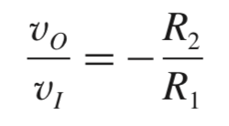
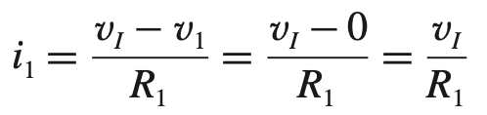
2.2.1. Closed-Loop Gain
step #5: Define v_{Out} in terms of current flowing across R₂.
step #6: Substitute v_{in} / R₁ for i₁.
note: this expression is one of the fundamentals of electronics
Notes:
We had this result in Circuits!

Slide 21
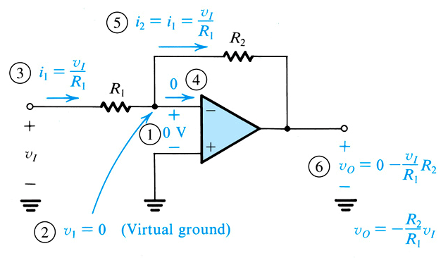
2.2.1. Closed-Loop Gain
Figure 2.6: Analysis of the inverting configuration. The circled numbers indicate the order of the analysis steps.
question: how will we…
step #4: define v_{Out} in terms of current flowing across R₂
step #5: substitute v_{in} / R₁ for i₁.
closed-loop gain G = -R₂/R₁

Slide 22
2.2.1. Effect of Finite Open-Loop Gain
若开环增益A≠∞，如何计算？
Q: How does the gain expression change if open loop gain (A) is not assumed to be infinite?
A: One must employ analysis similar to the previous, result is presented below…
non-ideal gain
ideal gain
Notes:
Seldom needed as the gain is very high

Slide 23
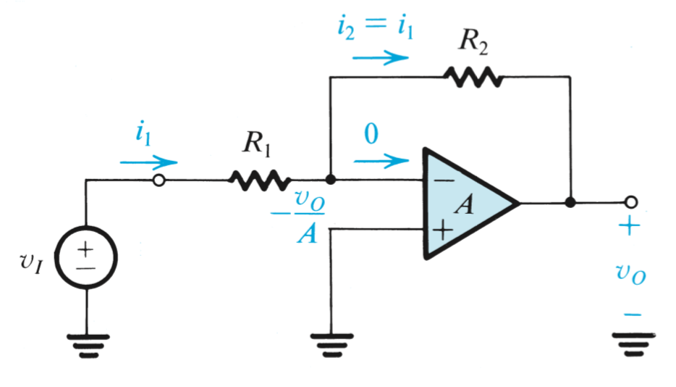
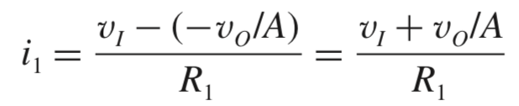
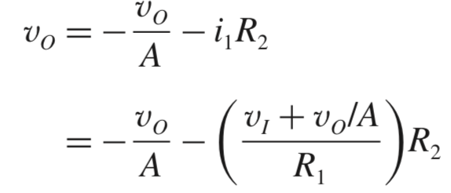
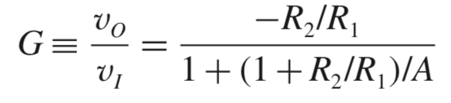

Slide 24
2.2.1. Effect of Finite Open-Loop Gain
什么条件下G可近似等于 -R₂/R₁？
Q: Under what condition can G = -R₂ / R₁ be employed over the more complex expression?
A: If 1 + (R₂/R₁) << A, then simpler expression may be used.
ideal gain
non-ideal gain

Slide 25
Example 2.1: Simple Inverting Amplifier
Problem Statement: Consider an inverting configuration with R₁ = 1kOhm and R₂ = 100kOhm.
Q(a): Find the closed-loop gain (G) for the cases below. In each case, determine the percentage error in the magnitude of G relative to the ideal value.
cases are A = 10³, 10⁴, 10⁵…
What is the voltage v₁ that appears at the inverting input terminal when v_{In} = 0.1V.
Q(b): If the open loop gain (A) changes from 100k to 50k, what is percentage change in gain (G)?

Slide 26
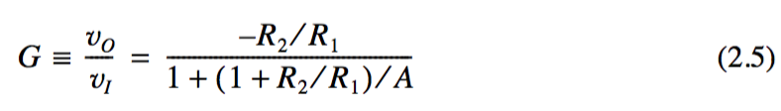
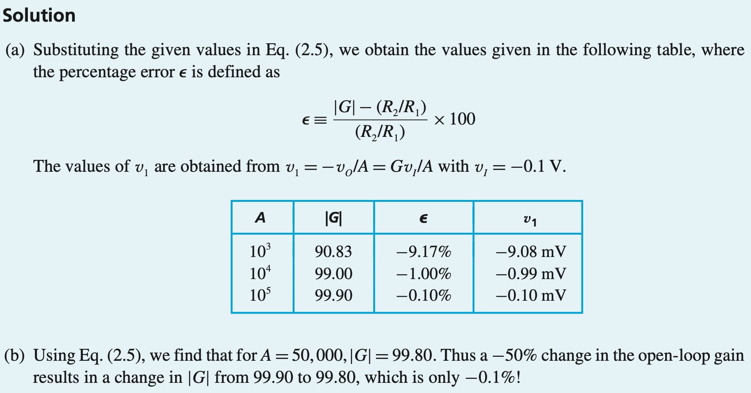
* Op amp 独自是不能用的，因为开环增益A为无穷大，必须外接电阻或电容等元件构成闭环反馈。Inverting configuration 是常见的一种构成闭环反馈的结构，其闭环电压增益仅与外接电阻有关。【trade-off：trade gain for accuracy】

Slide 27
2.2.3. Input and Output Resistances
输入电阻 & 输出电阻
Q: What is input resistance for inverting op-amp? How is it defined mathematically?
A: R₁ (refer to math below)
Q: What does this say?
A: That, for the combination of ideal op-amp and external resistors, input resistance will be finite…
关键点：V₁=V₂=0；
assumes ideal op-amp
Notes:
Input resistance is determined by R₁
Take this into account in your designs or use a “Buffer amp”

Slide 28
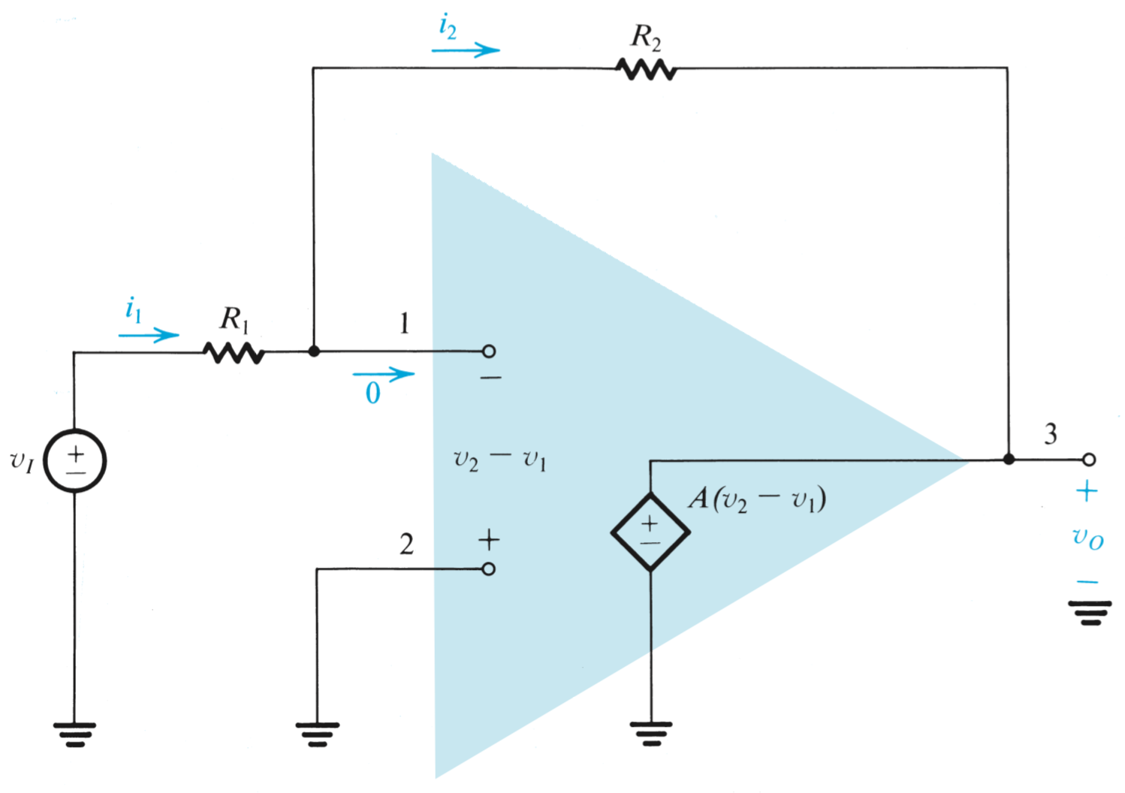
输出电阻呢？
0
理想op amp 输出是一个理想电压源，内阻为零，外接反馈电阻不影响输出电阻

Slide 29
思考
理想的电压电压放大器，要求输入阻抗尽可能大 → 输入阻抗（R1）要尽可能大；
大的增益（-R2/R1） → R2的值会大得不切实际，如几MΩ等 → 只能牺牲R1，取较小的R1值
因此，常规反相连接运放电路存在输入阻抗较低的缺点

Slide 30
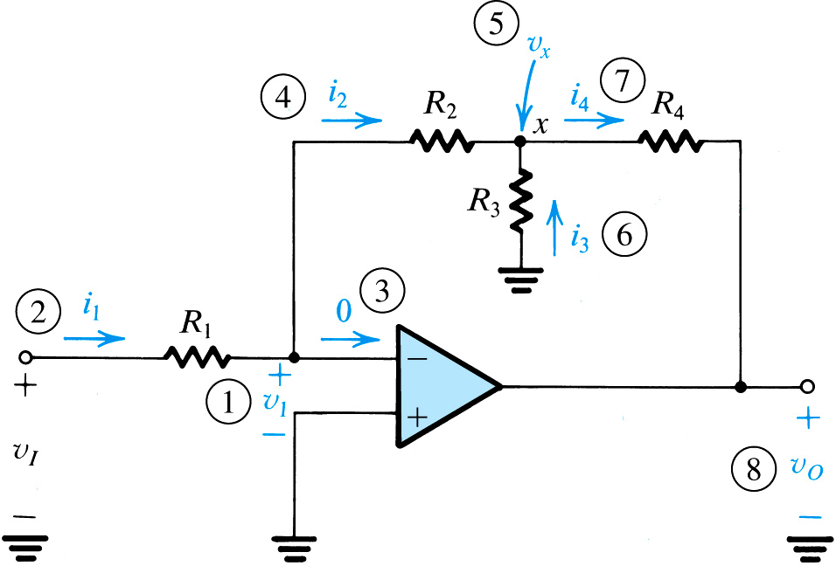
Example 2.2: Another Inverting Op-Amp
Problem Statement: Consider the circuit below...
Q(a): Derive an expression for the closed-loop gain v_{Out}/v_{In} of this circuit.
Q(b): Use this circuit to design an inverting amplifier with gain of 100 and input resistance of 1Mohm.
Assume that one cannot use any resistor with resistance larger than 1Mohm.
Q(c): Compare your design with that based on traditional inverting configuration.
Figure 2.8: Circuit for Example 2.2. The circled numbers indicate the sequence of the steps in the analysis.

Slide 31




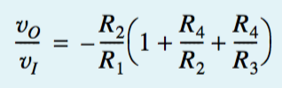


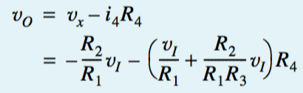
①
②
④
⑤
⑥
⑦
⑧
R1=1MΩ → R2=1MΩ →R4=1MΩ → R3用来实现增益 10.2kΩ
传统电路实现100的增益，R2=100MΩ

Slide 32
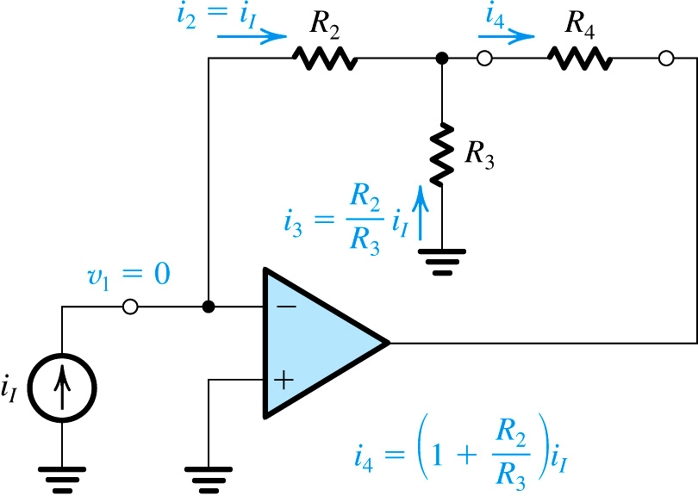
Example 2.2: Another Inverting Op-Amp
PART B: Use this circuit to design an inverting amplifier with gain of 100 and input resistance of 1Mohm. Assume that one cannot use any resistor with resistance larger than 1Mohm.
Figure 2.9: A current amplifier based on the circuit of Fig. 2.8. The amplifier delivers its output current to R₄. It has a current gain of (1 + R₂ /R₃)
The largest resistor on may choose is 1Mohm
Q: Where does one begin (in choosing the resistor values)? Which resistor would you define to be 1Mohm?
A: The input resistance (R₁) should be set as high as possible, therefore 1Mohm
Q: What other resistor values should be defined?
A: R₂ = 1Mohm, R₄ = 1Mohm, R₃ = 10.2kohm
换个角度思考：
【Insight】
R2、R3是并联的 → 若R3为R2的1/k，则i₃是i₂的k倍 → i₄是i₂(i₁)的k+1倍

Slide 33
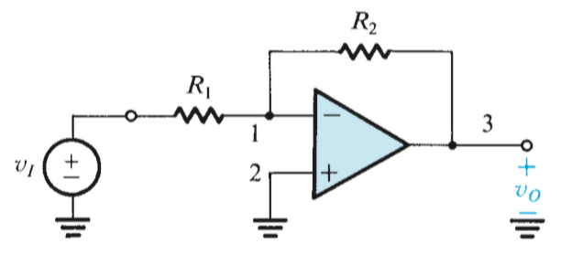
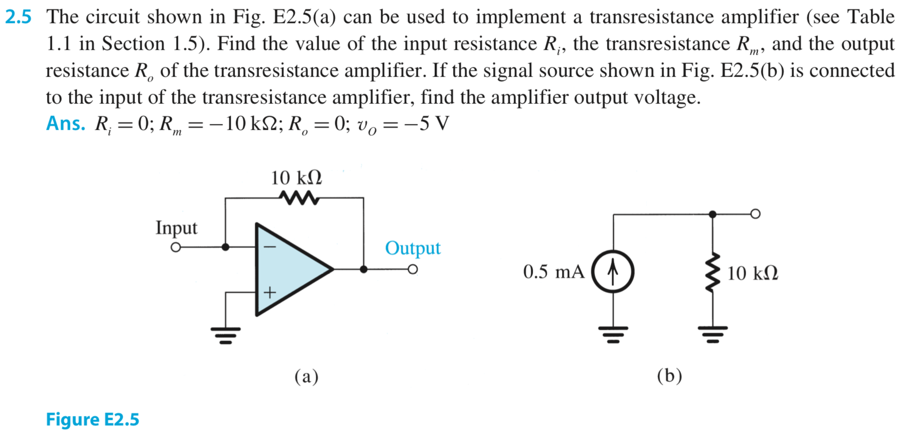

Slide 34
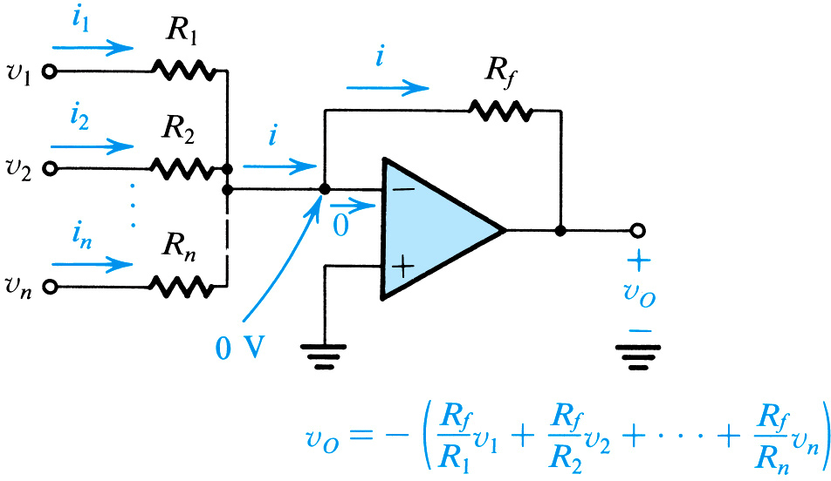
2.2.4. An Important Application – The Weighted Summer
加法器
weighted summer - is a closed-loop amplifier configuration which provides an output voltage which is weighted sum of the inputs.
Figure 2.10: A weighted summer.
Notes:
An important configuration

Slide 35
2.2.4. An Important Application – The Weighted Summer
v_{Out} = -[ (R_{f.}/R_{In1})v_{In1} + (R_{f.}/R_{In2})v_{In2} + (R_{f.}/R_{In3})v_{In3} + … ]
weighted summer - is a closed-loop amplifier configuration which provides an output voltage which is weighted sum of the inputs.
R_{In1}
R_{f}
v_{In1}
R_{In2}
v_{In2}
R_{In3}
v_{Out}
Figure 2.10: A weighted summer.
v_{In3}

Slide 36
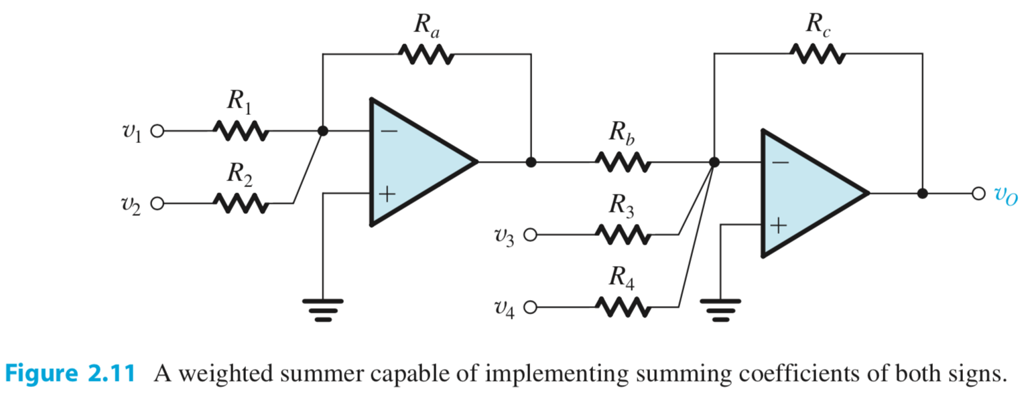

实现加减法

Slide 37
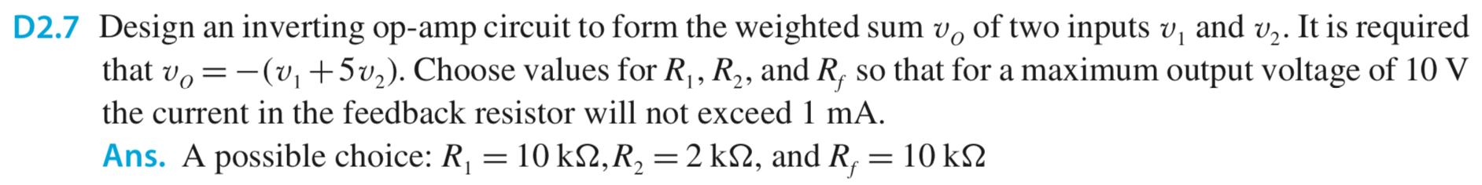

Slide 38
2.3. The Non-Inverting Configuration
同相接法
non-inverting op-amp configuration – is one which utilizes external resistances (like the previous) to effect voltage gain. However, the polarity / phase of the output is same as input.

Slide 39
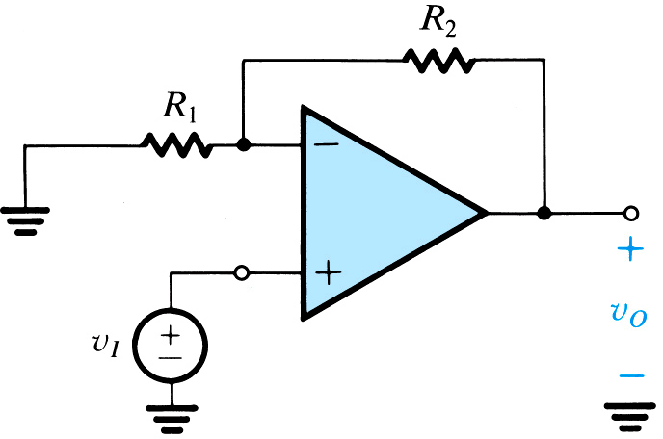
2.3. The Non-Inverting Configuration
Figure 2.12: The non-inverting configuration.
R₁ and R₂ act as voltage divider, regulating negative feedback to the inverting input
inverting input is grounded through R₁
不管是inverting，还是non-inverting，反馈电阻都是接到“➖”端
node #1
node #2
source is applied to non-inverting input

Slide 40
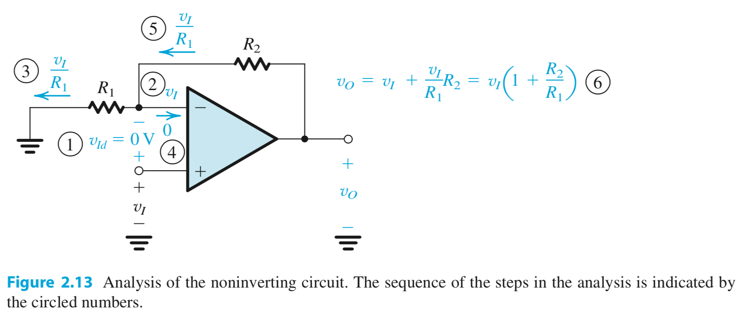




可以看成分压
①
②
③
④
⑤
⑥

Slide 41
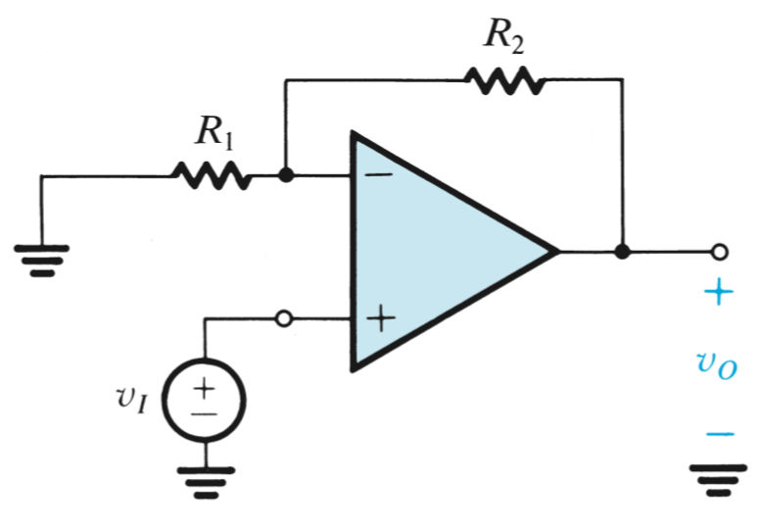
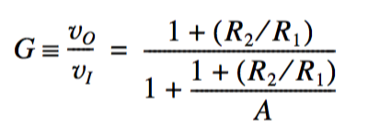
v₂-v₁=v_{o}/A
若开环增益A不是无穷大，则如何计算？
同样，输入阻抗为∞，输出阻抗为0

Slide 42
Characteristics of Non-Inverting Op-Amp Configuration
Notes:
Note the 1+ in the Gain!

Slide 43
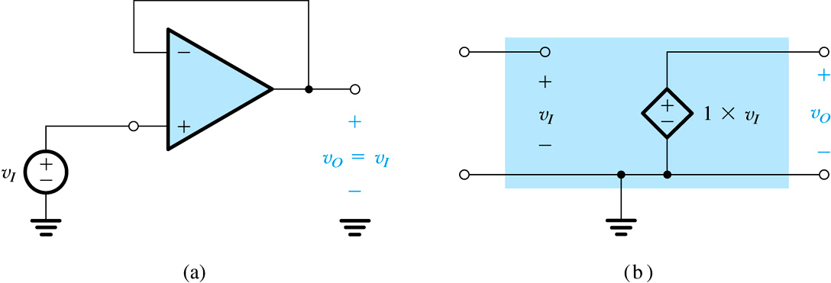
Configuration and Characteristics of Buffer / Voltage-Follower Op-Amp Configuration
Buffer amp: 提供高输入阻抗、低输出阻抗，增益非主要考虑因素
Figure 2.14: (a) The unity-gain buffer or follower amplifier. (b) Its equivalent circuit model.
Notes:
This is a useful configuration to “buffer” sub-circuits.

Slide 44
Configuration and Characteristics of Buffer / Voltage-Follower Op-Amp Configuration
Main point? For the buffer amp, output voltage is equal (in both magnitude and phase) to the input source. However, any current supplied to the load is drawn from amplifier supplies (V_{CC}, V_{EE}) and not the input source (v_{I}).
Figure 2.14: (a) The unity-gain buffer or follower amplifier. (b) Its equivalent circuit model.

Slide 45
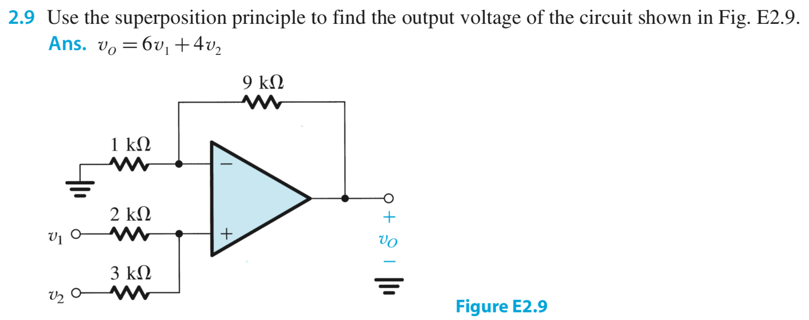
对v1，v2应用叠加原理

Slide 46
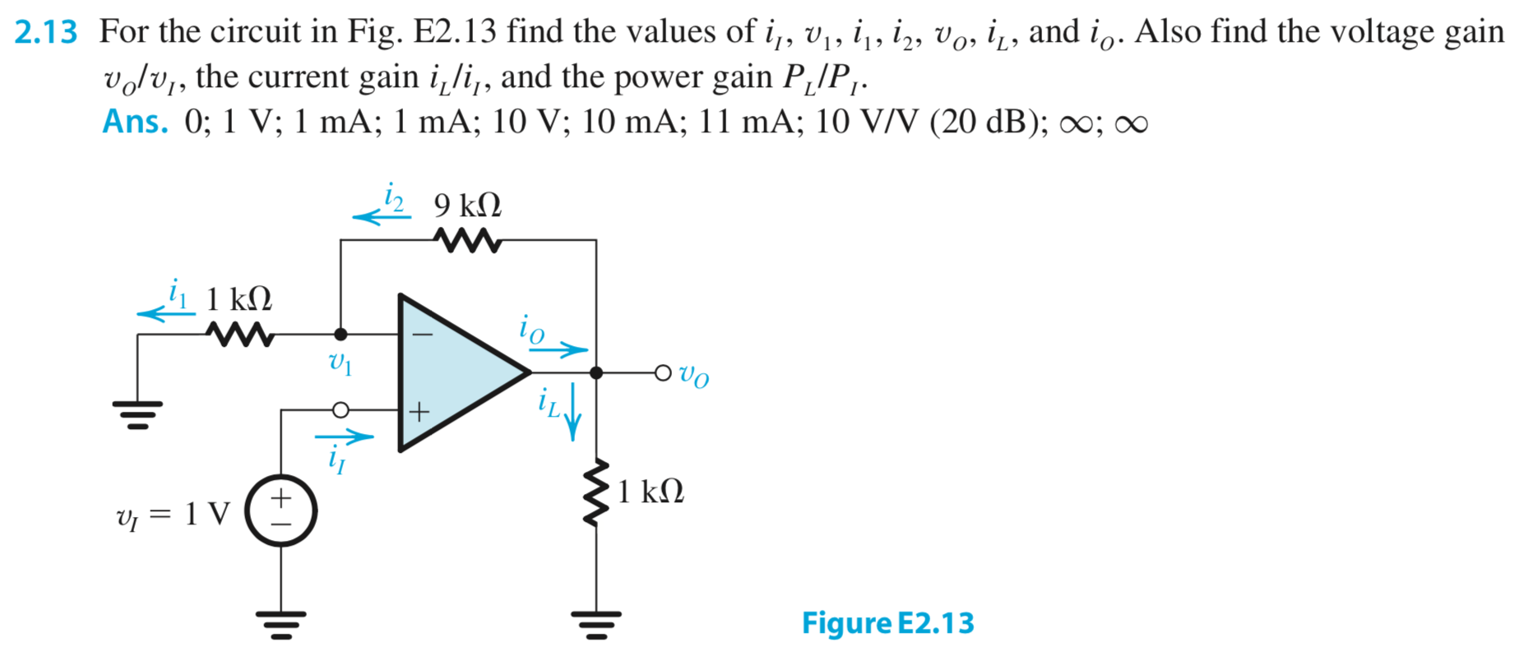

Slide 47
2.4. Difference Amplifiers 差分放大器
理想差分放大器，只放大输入的差分信号，对输入共模信号的增益为零
但实际上，会存在较小的共模增益
difference amplifier – is a closed-loop configuration which responds to the difference between two signals applied at its input and ideally rejects signals that are common to the two.
Ideally, the amp will amplify only the differential signal (v_{dfi}) and reject completely the common-mode input signal (v_{cmi}). However, a practical circuit will behave as below…

Slide 48
2.4. Difference Amplifiers
common-mode input
common-mode gain
differential input
differential gain

Slide 49
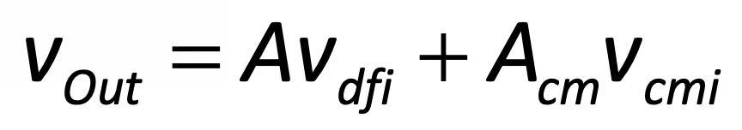
2.4. Difference Amplifiers
共模抑制比
common-mode rejection ratio (CMRR) – is the degree to which a differential amplifier “rejects” the common-mode input.
Ideally, CMRR = infinity…

Slide 50
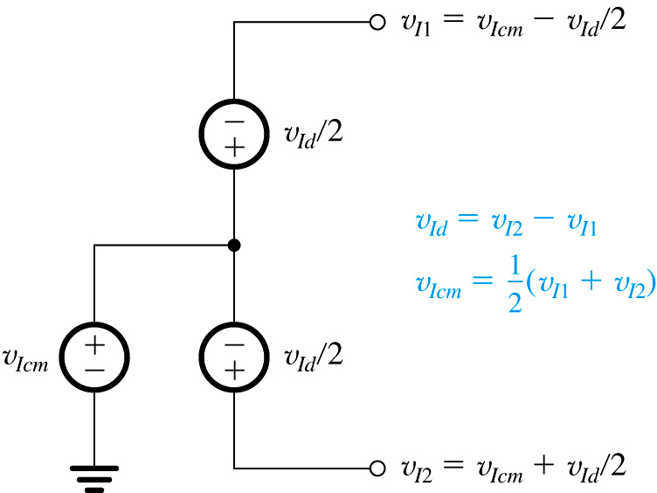
2.4. Difference Amplifiers
Figure 2.15: Representing the input signals to a differential amplifier in terms of their differential and common-mode components.

Slide 51
2.4. Difference Amplifiers
Q: The op amp itself is differential in nature, why cannot it be used by itself? 运放本身就是差分输入的，为何不能直接用作差分放大器？
A: It has an infinite gain, and therefore cannot be used by itself. One must devise a closed-loop configuration which facilitates this operation.
运放增益太大，且不稳定、不精确（一个很大的增益是做不到稳定和精确的）
我们需要牺牲增益，来换取稳定性和精确性（trade-off，折衷）

Slide 52
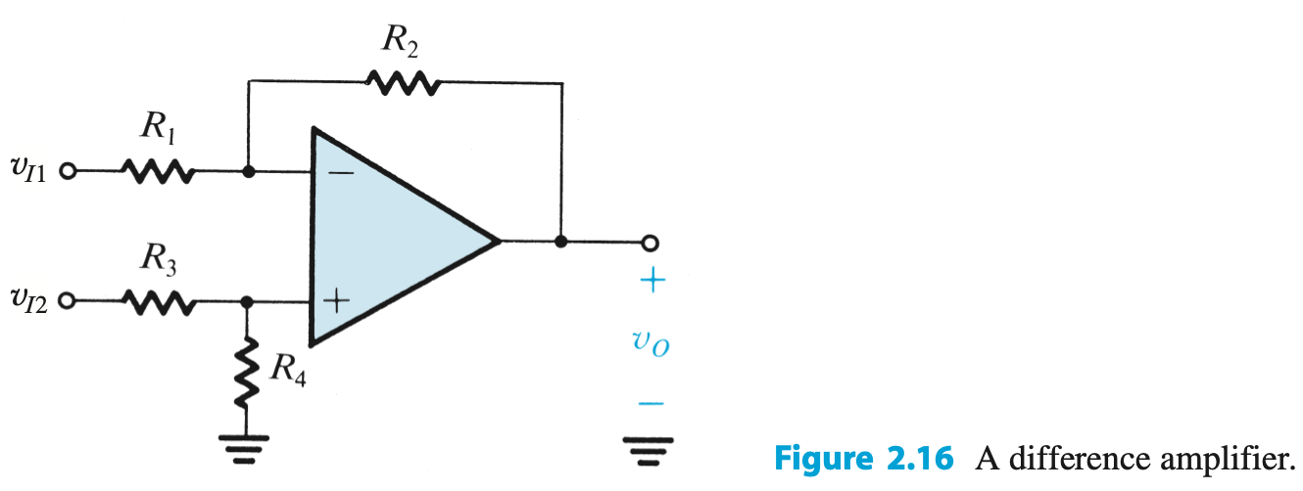
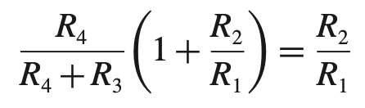
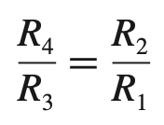
【Insight】如何构建一个差分放大器？
将noninverting configuration的输入适当衰减，使其总的增益等于R2/R1，则可构成一个差分放大器

Slide 53
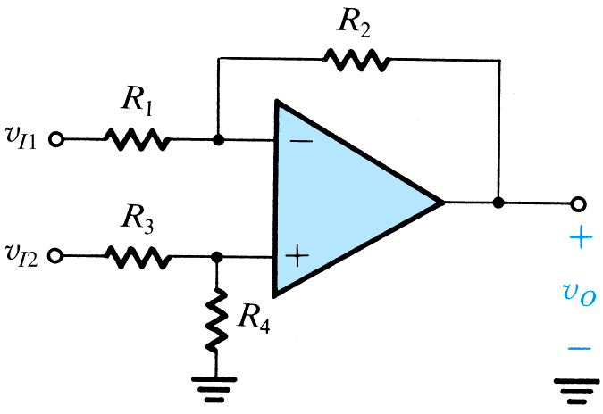
2.4. Difference Amplifiers
Figure 2.16: A difference amplifier.
利用叠加原理计算

Slide 54
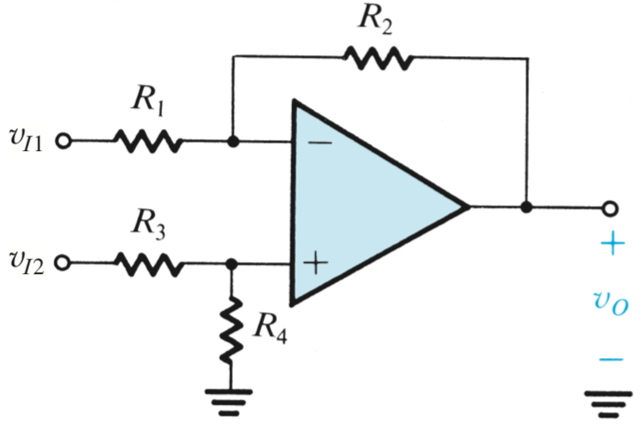

2.4.1. A Single Op-Amp Difference Amp
Q: What are the characteristics of the difference amplifier?
A: Refer to following equations…
平衡条件
Notes:
Note: the resistors must be matched to maintain “balance”!
R₁ = R₃
R₂ = R₄

Slide 55

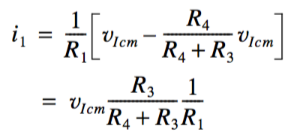
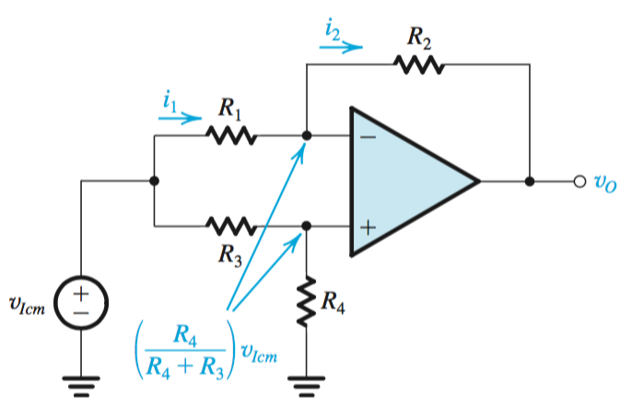

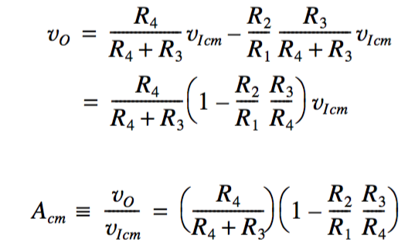
共模输入情况
①
②
③
④
⑤
④
③
②
⑤
①
平衡时，A_{cm}=0；若不平衡，A_{cm}≠0

Slide 56
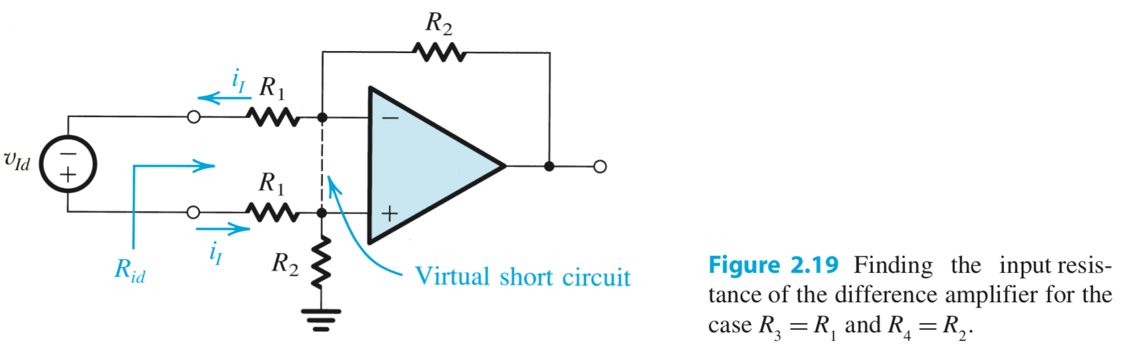

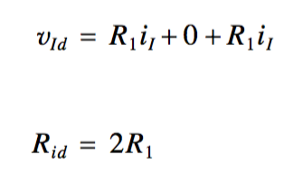
输入阻抗
存在的缺点：
差分放大器需要提供较大差分增益（R2/R1） → R1要小 → 输入阻抗变小！
如何解决这一缺点？
① R_{id} 差分输入阻抗
② 考虑平衡情况

Slide 57
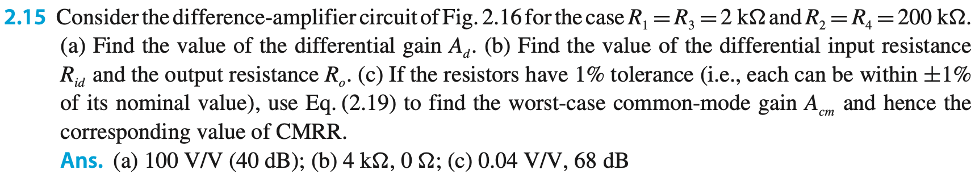



Slide 58
A Shift in Notation
Before this point…
The parameter A is used to represent open-loop gain of an op amp.
The parameter G is used to represent ideal / non-ideal closed-loop gain of an op amp.
After this point…
The parameter A is used to represent ideal gain of an op amp in a given closed-loop configuration.
The parameter G is not used.
A代表理想运放的闭环增益

Slide 59
2.4.2. The Instrumentation Amplifier 仪表放大器
Q: What is one problem associated with the difference amplifier? 差分放大器存在的缺点
A: Low input impedance. 输入阻抗低
Q: And, what does this mean practically? 有什么影响
A: That source impedance will have an effect on gain. 输入端分压衰减 → 施加于放大器输入端的有效信号电压降低
Q: What is the solution? 解决方法
A: Placement of two buffers at the input terminals, amplifiers which transmit the voltage level but draw minimal current. 在输入端插入buffer amp，提高R_{in}

Slide 60
2.4.2. The Instrumentation Amplifier
Q: However, can one get “more” from these amps than simply impedance matching?
A: Yes, maybe additional voltage gain???
在插入buffer amp，以提高输入阻抗的同时，还可以获得额外的增益

Slide 61

2.4.2. The Instrumentation Amplifier
Figure 2.20: A popular circuit for an instrumentation amplifier.
stage #1
stage #2
question: however, can we get “more” from these amps than simply impedance matching?
answer: yes, maybe additional voltage gain???
non-inverting op amp (A₁)
difference op amp (A₃)
v_{o1} = (1 + R₂/R₁)v_{In}
v_{Out} = (R₄/R₃)v_{dfi}
non-inverting op amp (A₂)

Slide 62
2.4.2. The Instrumentation Amplifier
Q: However, can one get “more” from these amps than simply impedance matching?
A: Yes, maybe additional voltage gain???
additional voltage gain

Slide 63
2.4.2. The Instrumentation Amplifier
Advantages优点 of instrumentation amp
very high input resistance 输入阻抗很大
high differential gain 差分增益变大
symmetric gain (assuming that A₁ and A₂ are matched)
Disadvantages缺点 of instrumentation amp
A_{Di} and A_{Cm} are equal in first stage – meaning that the common-mode and differential inputs are amplified with equal gain… 第一级放大器对差分输入和共模输入进行了同样程度的放大！ → ①信号幅度过大容易使运放饱和；②第二级有更大的CMRR压力

Slide 64
What is problem with A_{Cm} = A?
v_{In1}
v_{In1}
A = 10
A = 25
A = 10 x 25
v_{In2}
v_{In2}
differential gain >> common-mode gain
differential gain = common-mode gain
Case 1: 没有共模增益时
Case 2: 当第一级有共模增益时

Slide 65
differential gain >> common-mode gain
v_{In1} = 10.02V
v_{Out}= 250 x (10.03-10.02)V
v_{Out} = 2.5V no problem!!!
A = 10 x 25
v_{In2} = 10.03V

Slide 66
differential gain = common-mode gain
供电电源 ±15 V，限制了电路中最大允许的电压范围
v_{Out1}= 10 x 10.02 = 15V saturation
v_{In1} = 10.02V
A = 25
A = 10
v_{Out}= 25 x (15-15)V
v_{Out} = 0V problem!!!
v_{In2} = 10.03V
v_{Out2}= 10 x 10.03 = 15V saturation

Slide 67
2.4.2. The Instrumentation Amplifier
advantages of instru. amp
very high input resistance
high differential gain
symmetric gain (assuming that A₁ and A₂ are matched)
disadvantages of instrumentation amp
A_{Di} and A_{Cm} are equal in first stage – meaning that the common-mode and differential inputs are amplified with equal gain…
need for matching – if two op amps which comprise stage #1 are not perfectly matched, one will see unintended effects 如果第一级不完美匹配，那么将会对第二级的输入引入额外的差分信号

Slide 68
2.4.2. The Instrumentation Amplifier
Q: How can one fix this (alleviate these disadvantages)?
A: Disconnect the two resistors (R₁) connected to node X from ground, making the configuration “floating” in nature…
A: Refer to following slide…

Slide 69


2.4.2. The Instrumentation Amplifier
Figure 2.20: A popular circuit for an instrumentation amplifier. (b) The circuit in (a) with the connection between node X and ground removed and the two resistors R₁ and R₁ lumped together. This simple wiring change dramatically improves performance.
仅仅是简单地将X点的接地去掉，就能解决上述问题！【巧妙的工程实现】
Notes:
A useful configuration

Slide 70
2.4.2. The Instrumentation Amplifier
Q: How can one analyze this circuit?
Notes:
Again – maintain balance!

Slide 71





对比原先电压
$$v_{I1}−\frac{v_{Id}}{2R_{1}}∙R_{2}$$
①
④
⑤
②
③
①
④
$$v_{I2}+\frac{v_{Id}}{2R_{1}}∙R_{2}$$
⑥
对比原先电压
共模信号输入呢？
流经2R₁的电流为零 → 流经R₂的电流也为零 → A₁、A₂的输出电压即V_{I1}、V_{I2}
→ 第一级没有对共模信号进行放大！

Slide 72


第一级实现增益
第一级实现共模抑制
把第二级增益设定为1

Slide 73



10 kΩ 是常用电阻

Slide 74
2.5. Integrators and Differentiators 积分电路 & 微分电路
integrator / differentiator amplifier – is one which outputs an integral or derivative of the input signal.
用模拟电路来实现积分、微分、加减法运算，这就是“运算”放大器名称的由来
In earlier days we use Analog computers using adders, integrators and multipliers.
Now Simulink (in MatLab) simulates an Analog computer using a digital computer.

Slide 75

2.5.1. The Inverting Configuration with General Impedances
Q: Does the transfer function for the inverting op amp change if the feedback and input impedances are not purely resistive? 在反相接法中，若将电阻换成更普遍的阻抗，会如何？
A: 增益形式不变，只需将R替换成Z

Slide 76




一阶电路特性回顾
s = jω
低通STC
高通STC
传递函数标准形式

Slide 77

Example 2.4: Other Op-Amp Configurations 例题
考虑右边的电路
Q(a): Derive an expression for the transfer function v_{Out} / v_{In}. 求传输函数的表达式
Q(b): Show that the transfer function is of a low-pass STC circuit. 验证传输函数是低通STC电路
Q(c): By expressing the transfer function in standard form of Table 1.2, find the dc-gain and 3dB frequency.
用STC的标准表达式，计算直流增益和3dB频率

Slide 78






Example 2.4: Other Op-Amp Configurations
Figure 2.23: Circuit for Example 2.4.

Slide 79
2.5.2. The Inverting Integrator 反相积分电路
Q: How can inverting op-amp be adapted to perform integration? 如何用反相接法的运放实现积分功能
A: Utilization of capacitor as feedback impedance.
利用电容作为反馈阻抗

Slide 80





③
④
②
时域
①
频域
CR称为积分器的时间常数
波特图
该结构的积分电路也被称为
Miller积分器
-20 dB/十倍频
= -6 dB/两倍频
（积分器频率）

Slide 81
2.5.2. The Inverting Integrator
Q: What is the problem with this configuration (related to dc gain)? 存在的问题
A: At dc frequency (ω = 0), gain is infinite 低频增益∞
Gain = 1 / (ω.R₁C_{F})
Q: Solution? 解决的办法
A: By placing a very large resistor in parallel with the capacitor, negative feedback is employed to make dc gain “finite.” 用一个大电阻并联反馈电容

Slide 82


2.5.2. The Inverting Integrator
Figure 2.25: The Miller integrator with a large resistance RF connected in parallel with C in order to provide negative feedback and hence finite gain at dc.
就是前面例题2.4的情况
但引入R_{F}后，积分特性变得不完美了！
因此，R_{F}的取值需在dc性能和信号积分性能之间取trade-off

Slide 83







假设电容初始电压为0
1. 没有 R_{F} 的情况
时间常数
t 的单位是 ms
1 V 电压产生 0.1 mA 电流，对 C 进行充电

Slide 84





假设电容初始电压为0
2. 有 R_{F} 的情况
1 V 电压产生 0.1 mA 电流，流入 C 和 R_{F} 网络
C的初始电压 0，稳态电压 0.1mA x R_{F} = 100 V，时间常数 τ =R_{F} x C = 10 ms
从方波产生三角波

Slide 85

2.5.3. The Op-Amp Differentiator 微分电路
Q: How can one adapt integrator to perform differentiation? 如何构建微分电路呢？
A: Interchange locations of resistors and capacitors.
将积分电路的R和C交换，即可实现微分电路
Figure 2.27: A differentiator.

Slide 86

2.5.3. The Op-Amp Differentiator
高频时，C阻抗很小，增益很大，输出容易饱和。因此常常在输入端与C串联一个电阻，以抑制高频增益

Slide 87
2.5.3. The Op-Amp Differentiator
filtering characteristic is high pass filter
magnitude of transfer function is |V_{Out} / V_{In}| = ωR_{F}C₁
phase of transfer function is φ = -90^{O}
differentiator time-constant is frequency at which unity gain occurs and defined as ω = 1 / R_{F}C₁
Q: What is the problem with differentiator?
A: Differentiator acts as noise amplifier, exhibiting large changes in output from small (but fast) changes in input. As such, it is rarely used in practice.
输入有突变，则输出无穷大
Notes:
Again you can parallel the input capacitor to limit the noise problem.

Slide 88




补充说明
Op amp 输入端电压相等只是在开环增益为无穷大的理想情况下成立，若开环增益为有限值，输入端电压差为“输出/开环增益”

Slide 89



补充说明
V_{in2} 看作 V_{out} 的分压

Slide 90




小结
运放的“电压电流约束关系”
理想运放的特性
输入阻抗无穷大
输出阻抗为0 (输出是理想电压源)
共模增益为0
开环增益 A 无穷大
带宽无穷大

Slide 91








Inverting Configuration
Noninverting Configuration
$$R_{o}=0$$
$$R_{i}=∞$$
$$R_{o}=0$$

Slide 92






差分放大器
仪表放大器
$$R_{o}=0$$
$$R_{i}=∞$$
$$R_{o}=0$$

Slide 93



应用 1：加法
应用2：Buffer

Slide 94


应用 3：积分
应用4：微分

Slide 95

作业

Slide 96


10 kΩ 是常用电阻

Slide 97


Slide 98



