Slide 1
Welcome to Appreciation of English and American Literature

Slide 2
Meet your classmates
Turn to the people nearby.
Say hello and ask what their names are.
Tell them something interesting about yourself.

Slide 3
English Literature
What is your favourite piece of English or American Literature?
What is the favourite piece of English or American Literature you’ve read in English?

Slide 4
English Literature
What is English literature or American literature?
What is ‘good’ literature?
Why is it something that should be appreciated?

Slide 5
The Syllabus

Slide 6
Course Aims:
Learn about English verse and prose stylistically
How it works in form and composition, on the page, when spoken, and in performance.
Learn about the content of literature
Why was it written?
What was the context of its creation, and of its readership since?
Consider what the result of that form and content may be
How form affects content, and vice versa – to create meaning.
How the whole may have value and be worth appreciating – or not.

Slide 7
Course Aims:
Gain an understanding of the English Literature canon:
From circa 700AD to the present, covering various movements and styles, British and American… etc.
Practice writing in the various styles we study, engaging with their literary themes.
Try poetry and prose techniques, and learn about them through creativity.
Develop your interests in literature and enjoy reading!
Write an academic essay, referencing research on a literary topic.

Slide 8
Grading

Slide 9
Grading
5% Attendance
15% Class Participation
20% Creative Writing Portfolio
60% Final Literature Essay

Slide 10
Attendance 5%
Attendance is important! Why?
If you are absent for over 1/3 of the classes you will fail the course!
Outside activities like internships will be excused if the university grants you permission.
If you are ill or have any valid reason for being absent, please give me a signed form from the university.
If you miss classes, then do your best to catch up with the missed material.

Slide 11
Participation – 15%
This score applies to general participation in class, and in preparation for class:
- paying attention
- answering questions and having group discussions
- writing in class
- completing homework reading and writing
- punctuality
- and not sleeping, etc…

Slide 12
Writing Portfolio – 20%
During the course you will attempt some of your own creative writing, based on the literature we study.
The main objective is to try your best and take part. You are not expected to write as well as Shakespeare. Some tasks will be difficult – just make a good effort!
You should submit a portfolio of at least 4 different pieces of writing written during the course. At least 3 pieces should be creative poetry/prose and 1 may be academic (handed in week 16).
If you complete the portfolio (showing your active participation) then you will score well. However, if you write some wonderful pieces then you could also score extra points.

Slide 13
Final Literature Essay – 60%
An Argumentative Research Essay – 1200 – 1500 words
(Handed in Week 16)
The essay should be researched and written about a literature topic of your own choosing (confirmed with Dominic). As an argumentative essay it should set out a thesis and then try to prove this throughout a series of paragraphs (no abstract or subtitles are needed).
It should have an academic style and structure, and correctly reference at least 3 different academic sources (in addition to the literature studied).
Class time in weeks 14 and 15 will be spent as essay writing workshops, for you to ask any questions and build your essay argument.

Slide 14
A word about PLAGIARISM !!!!!

Slide 15
What is plagiarism?
It means using someone else’s words as if they were your own.
It is cheating.
It is intellectual theft.
In many countries you can be thrown out of university, or lose your job if you do this.

Slide 16
Be careful not to plagiarise
Keep notes of where you get quotes and ideas from – which book, article, etc., so you don’t forget later.
When you write any work in class, for homework, or for assessment, remember to give credit for original ideas to their creators.
You can use signal phrases such as, “As George Herbert writes…” and then add a reference to your work. (Also, paraphrasing and quoting someone can be powerful techniques.)

Slide 17
Be careful not to plagiarise
Using ‘ChatGPT,’ or similar programs to get ideas for an essay is still technically a form of plagiarism:
- ChatGPT works by drawing its answers from many different sources on the internet (other people’s words and ideas).
However, we need to be realistic, that this kind of technology, and internet searches, can be useful methods to gather information.

Slide 18
Be careful not to plagiarise
So, you can use this technology to a limited amount. Perhaps, if you get stuck, then find some ideas from the internet, but then build on them, be creative and original, consider your own arguments, and use your own words.
Your essay and your creative portfolio must be self-written. Also, limit your use of Chinese-English translation programs. You should write your own English as much as possible.
ChatGPT gives derivative, typical answers, and internet translations do not read as well-expressed English. They fail to be original (because AI has no creativity – it’s not human) and will not get you a good score.

Slide 19
Contacting Me
You can send me a message on DingTalk, or email me at: dommgraham@outlook.com
My WeChat ID is DominicGraham
My office is in East 6 building – 203B
If you’d like to talk in person, then please get in touch and we can arrange a meeting time.

Slide 20
The Meaning and Interpretation of Literature

Slide 21
The Appreciation of Literature
Why should we appreciate literature?
Is there something that makes literature, literature?
Why does a book/poem/writer get a place in the ‘canon’ of English/American literature?
What makes something ‘good’ literature?

Slide 22
The Eagle
Is this ‘good’ literature that we should study?
How can you tell?
Discuss together about the poem:
What is it about?
How does the writer use English?
How should we value it?
He clasps the crag with crooked hands;
Close to the sun in lonely lands,
Ringed with the azure world, he stands.
The wrinkled sea beneath him crawls;
He watches from his mountain walls,
And like a thunderbolt he falls.

Slide 23
The Eagle
He clasps the crag with crooked hands;
Close to the sun in lonely lands,
Ringed with the azure world, he stands.
The wrinkled sea beneath him crawls;
He watches from his mountain walls,
And like a thunderbolt he falls.
Two stanzas
Each stanza has three lines – called a ‘tercet’
They rhyme in a pattern of AAA BBB

Slide 24
The Eagle
He clasps the crag with crooked hands;
Close to the sun in lonely lands,
Ringed with the azure world, he stands.
The wrinkled sea beneath him crawls;
He watches from his mountain walls,
And like a thunderbolt he falls.
What is the ‘metre’?
How many syllables are there per line?
What is the syllable pattern of unstressed – stressed ?

Slide 25
The Eagle
This metre is called ‘Iambic tetrameter.’
However, lines 2 and 3 begin with a ‘trochee.’
He clasps the crag with crooked hands;
Close to the sun in lonely lands,
Ringed with the azure world, he stands.
The wrinkled sea beneath him crawls;
He watches from his mountain walls,
And like a thunderbolt he falls.
What is the ‘metre’?
How many syllables are there per line?
What is the syllable pattern of unstressed – stressed ?

Slide 26
The Eagle
This metre is called ‘Iambic tetrameter.’
However, lines 2 and 3 begin with a ‘trochee.’
He clasps the crag with crooked hands;
Close to the sun in lonely lands,
Ringed with the azure world, he stands.
The wrinkled sea beneath him crawls;
He watches from his mountain walls,
And like a thunderbolt he falls.
What is the ‘metre’?
How many syllables are there per line?
What is the syllable pattern of unstressed – stressed ?

Slide 27
The Eagle
He clasps the crag with crooked hands;
Close to the sun in lonely lands,
Ringed with the azure world, he stands.
The wrinkled sea beneath him crawls;
He watches from his mountain walls,
And like a thunderbolt he falls.

Slide 28
The Eagle
He clasps the crag with crooked hands;
Close to the sun in lonely lands,
Ringed with the azure world, he stands.
The wrinkled sea beneath him crawls;
He watches from his mountain walls,
And like a thunderbolt he falls.
Alliteration
Assonance
(vowels)
Both of the above, plus Consonance
Simile

Slide 29
The Eagle
Personification
He clasps the crag with crooked hands;
Close to the sun in lonely lands,
Ringed with the azure world, he stands.
The wrinkled sea beneath him crawls;
He watches from his mountain walls,
And like a thunderbolt he falls.
Alliteration
Assonance
(vowels)
Both of the above, plus Consonance
Simile

Slide 30
The Eagle
He clasps the crag with crooked hands;
Close to the sun in lonely lands,
Ringed with the azure world, he stands.
The wrinkled sea beneath him crawls;
He watches from his mountain walls,
And like a thunderbolt he falls.
What is the poem about?
Is it about an eagle?
Is it about anything else?

Slide 31
Does it matter who wrote The Eagle, when they wrote it, or why they wrote it?
Can we figure out the poem just by its text?
In the mid-twentieth century a method called New Criticism tried to appreciate writing by the text alone, with no need to consider the author, the cultural context, or the reader’s subjectivity.
Later in the century, a way of academic reading called New Historicism said we need to understand cultural context to understand a text. However, it tends to assume that culture and texts are formed based on Power Discourse Theory and that writing should be deconstructed and reinterpreted – such as in Feminist/Post-colonial/Racial, readings, etc.

Slide 32
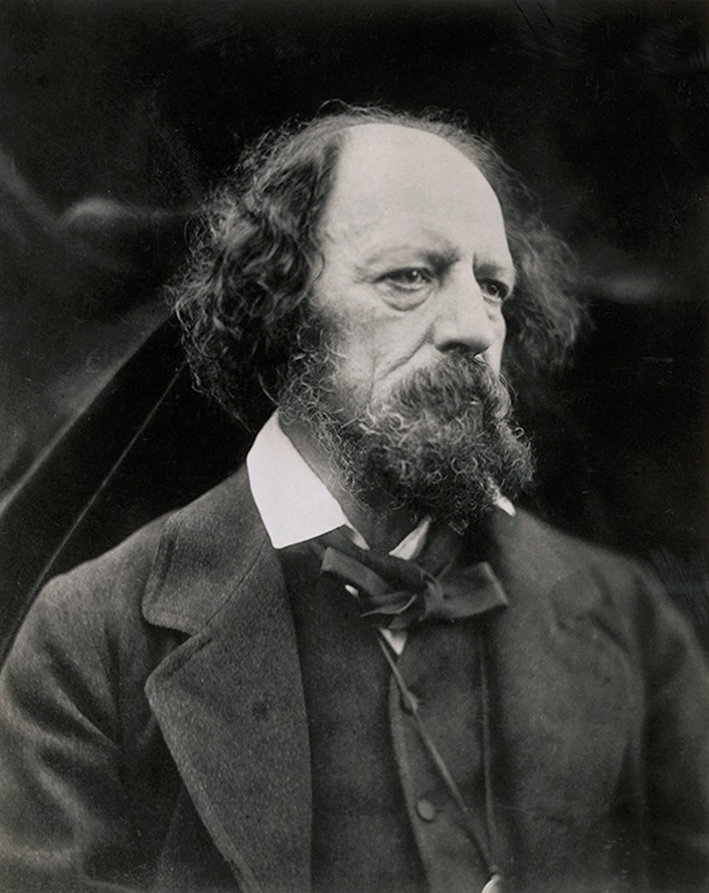
The Eagle
by Alfred Lord Tennyson (1851)
He clasps the crag with crooked hands;
Close to the sun in lonely lands,
Ringed with the azure world, he stands.
The wrinkled sea beneath him crawls;
He watches from his mountain walls,
And like a thunderbolt he falls.
1809-1892
He was poet Laureate (Britain’s official poet) during much of Queen Victoria’s reign

Slide 33
The Eagle
by Alfred Lord Tennyson (1851)
Does the eagle represent tyranny and isolation, or is it positive about a lonely strength?
Should its interpretation be based on what Tennyson thought, or what, you, or I, or critics think?
Is it ‘good’ writing, which should be appreciated on a course like this?
He clasps the crag with crooked hands;
Close to the sun in lonely lands,
Ringed with the azure world, he stands.
The wrinkled sea beneath him crawls;
He watches from his mountain walls,
And like a thunderbolt he falls.

Slide 34
Excerpt from the play ‘De Montfort’ (De Montfort is becoming lost in hate – worsened by believing lies – and blaming it all on Rezenvelt.)
De Montfort - Think'st thou there are no serpents in the world
But those that slide along the grassy sod,
And sting the luckless foot that presses them?
There are who in the path of social life
Do bask their spotted skins in Fortune's sun,
And sting the soul - Ay, till its healthful frame
Is chang'd to secret, fest'ring, sore disease,
So deadly is the wound.

Slide 35
Excerpt from the play ‘De Montfort’ (Rezenvelt walks through a wood, blind to De Montfort’s hate, and unknowing that De Montfort waits to murder him.)
Rezenvelt – Between me and the star-bespangled sky
Those aged oaks their crossing branches wave,
And thro’ them looks the pale and placid moon.
How like a crocodile, or winged snake,
Yon sailing cloud bears on its dusky length!
And now transform’d by the passing wind,
Methinks it seems a flying Pegasus…
(a bell heard at some distance)

Slide 36
Excerpt from the play ‘De Montfort’ (Rezenvelt walks through a wood, blind to De Montfort’s hate, and unknowing that De Montfort waits to murder him.)
Rezenvelt – What bell is this?
It sends a solemn sound upon the breeze.
Now, to a fearful superstitious mind,
In such a scene, ‘twould like a death-knell come;
For me it tells but of a shelter near,
And so I bid it welcome.

Slide 37
Excerpt from the play ‘De Montfort’ (Rezenvelt walks through a wood, blind to De Montfort’s hate, and unknowing that De Montfort waits to murder him.)
Rezenvelt – What bell is this?
It sends a solemn sound upon the breeze.
Now, to a fearful superstitious mind,
In such a scene, ‘twould like a death-knell come;
For me it tells but of a shelter near,
And so I bid it welcome.
10 syllables per line in an unstressed-stressed metre – called Iambic Pentameter

Slide 38
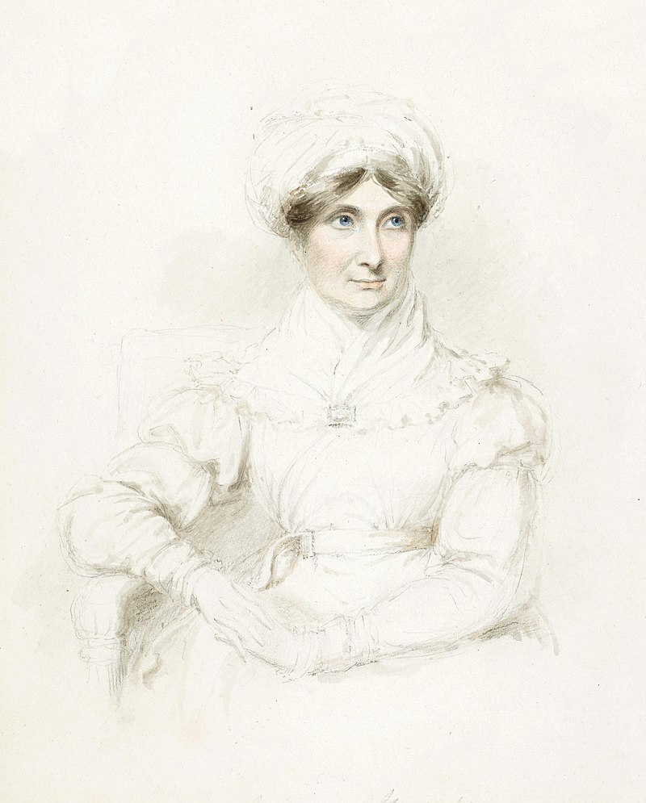
‘De Montfort’ by Joanna Baillie
Written in 1798 as part of a series of plays, each focusing on a passion – this play examines hatred.
She was admired by famous writers such as Walter Scott and was well known in the early 19th century.
De Montfort: A Tragedy was staged in a London theatre, but not well-received. Most of her plays have never been performed in a theatre.
The 19th century trend was for Romantic poetry, and then the Novel, not for tragic theatre. Joanna Baillie gradually lost prominence.
Joanna Baillie
1762-1851

Slide 39
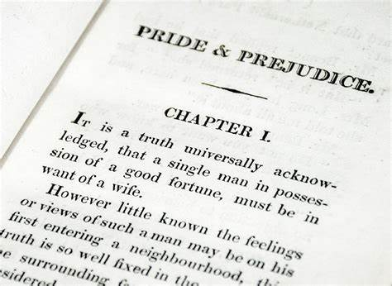
To consider a contrary example: Pride and Prejudice (1813) and Emma (1815) by Jane Austen
The novels did quite well when first published, but generally weren’t considered anything too remarkable.
The novelist Charlotte Bronte wrote in a letter to a friend about Austen and Emma:
“Can there be a great artist without poetry?... the Passions are perfectly unknown to her… ; even to the Feelings she vouchsafes no more than an occasional graceful but distant recognition; too frequent converse with them would ruffle the smooth elegance of her progress.”

Slide 40
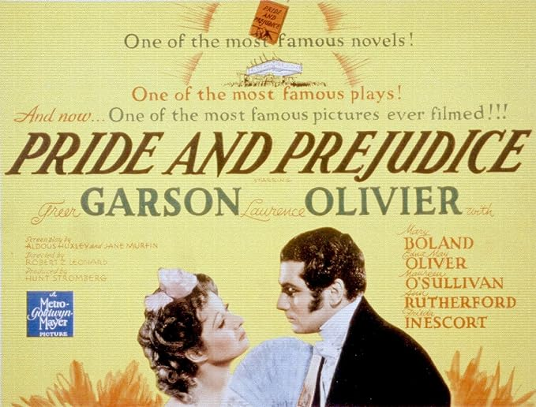
To consider a contrary example: Pride and Prejudice (1813) and Emma (1815) by Jane Austen
Yet, her novels remained popular during the later 19th century.
In 1940 there was a Hollywood movie of Pride and Prejudice, staring Laurence Olivier and Greer Garson.
Academics began to write about her, and in 1949 F. W. Leavis placed Austen in the top five of all English novelists, in his book The Great Tradition.
In 1995 the BBC made a TV series of Pride and Prejudice that has since been shown around the world. Another film was released in 2013, soon regarded as a classic period adaptation.

Slide 41
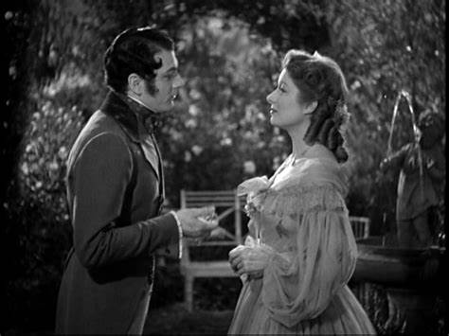
To consider a contrary example: Pride and Prejudice (1813) and Emma (1815) by Jane Austen
Why is Jane Austen considered part of the literary canon?
Is it because of her writing style and content, or the tastes of readership?
Is it connected to a certain kind of characterisation and storytelling, which appeals to subsequent societal trends (and crucially, longing for what is missing): some feminine independence, with purity; gentlemanly emotion and self-control?
Laurence Olivier and Greer Garson in Pride and Prejudice (1940)

Slide 42
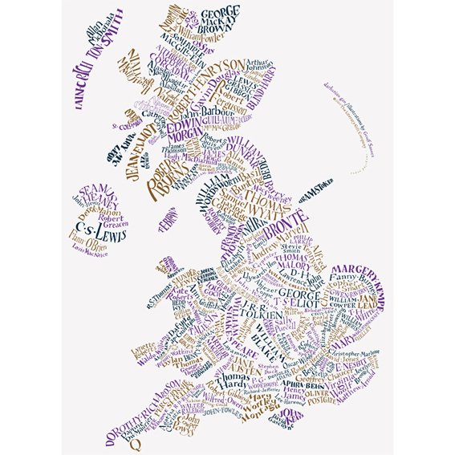
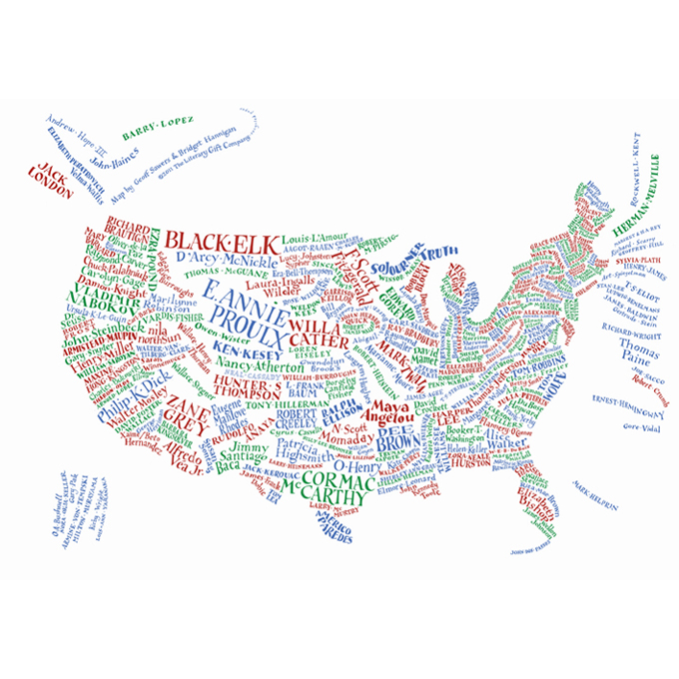
Literary Maps of Britain and America
How do you decide what to value and appreciate about a writer and their work?

Slide 43
Appreciation of English and American Literature Course Reading List:
Beowulf – by unknown
Sir Gawain and the Green Knight – by unknown
The Canterbury Tales – by Geoffrey Chaucer
Paradise Lost – by John Milton
Robinson Crusoe – by Daniel Defoe
The Last of the Mohicans – by James Fenimore Cooper
Lyrical Ballads (poems) – by William Wordsworth and Samuel Taylor Coleridge
Odes… (poems) – by John Keats
Ivanhoe – by Walter Scott
Pride and Prejudice – by Jane Austen
The Borough (poems) – by George Crabbe
Little Women – Louisa May Alcott
Perhaps choose one to read in full during the semester (all on ‘Learning in ZJU’)

Slide 44
Appreciation of English and American Literature Course Reading List:
The Time Machine – by H. G. Wells
The Waste Land (poem) – by T. S. Eliot
The Great Gatsby – by F. Scott Fitzgerald
Dubliners – by James Joyce
The Lighthouse – by Virginia Woolf
The Famous Five Series – Enid Blyton
The Call of the Wild – Jack London
Winter Trees (poems) – by Sylvia Plath
There Will Come Soft Rains – Ray Bradbury
The Spirit Level (poems) – by Seamus Heaney
The Bourne Identity – by Robert Ludlam
The Cuckoos calling – by J. K. Rowling

Slide 45
The Eagle
He clasps the crag with crooked hands;
Close to the sun in lonely lands,
Ringed with the azure world, he stands.
The wrinkled sea beneath him crawls;
He watches from his mountain walls,
And like a thunderbolt he falls.
Two stanzas
Each stanza has three lines – called a ‘tercet’
They rhyme in a pattern of AAA BBB

Slide 46
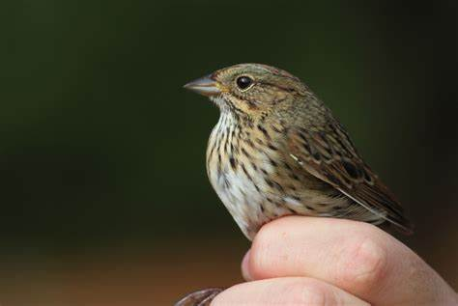
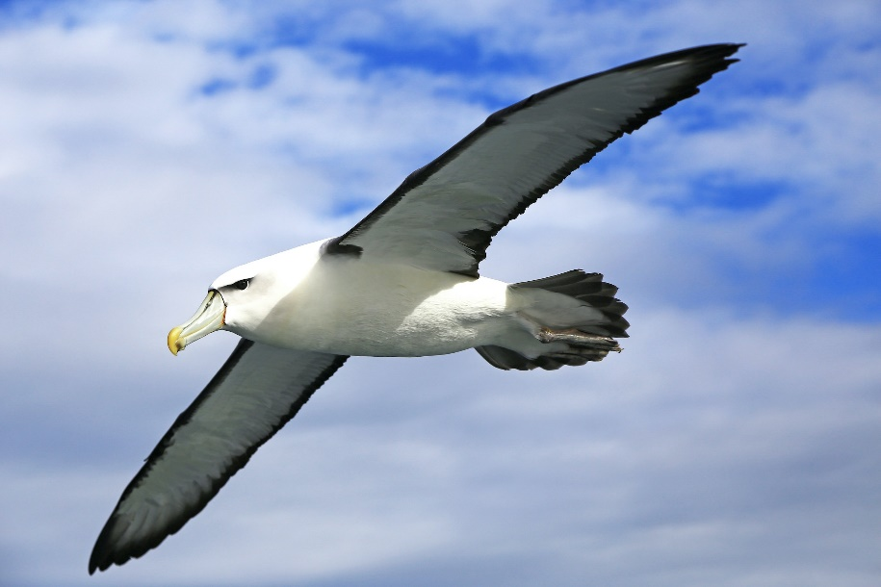
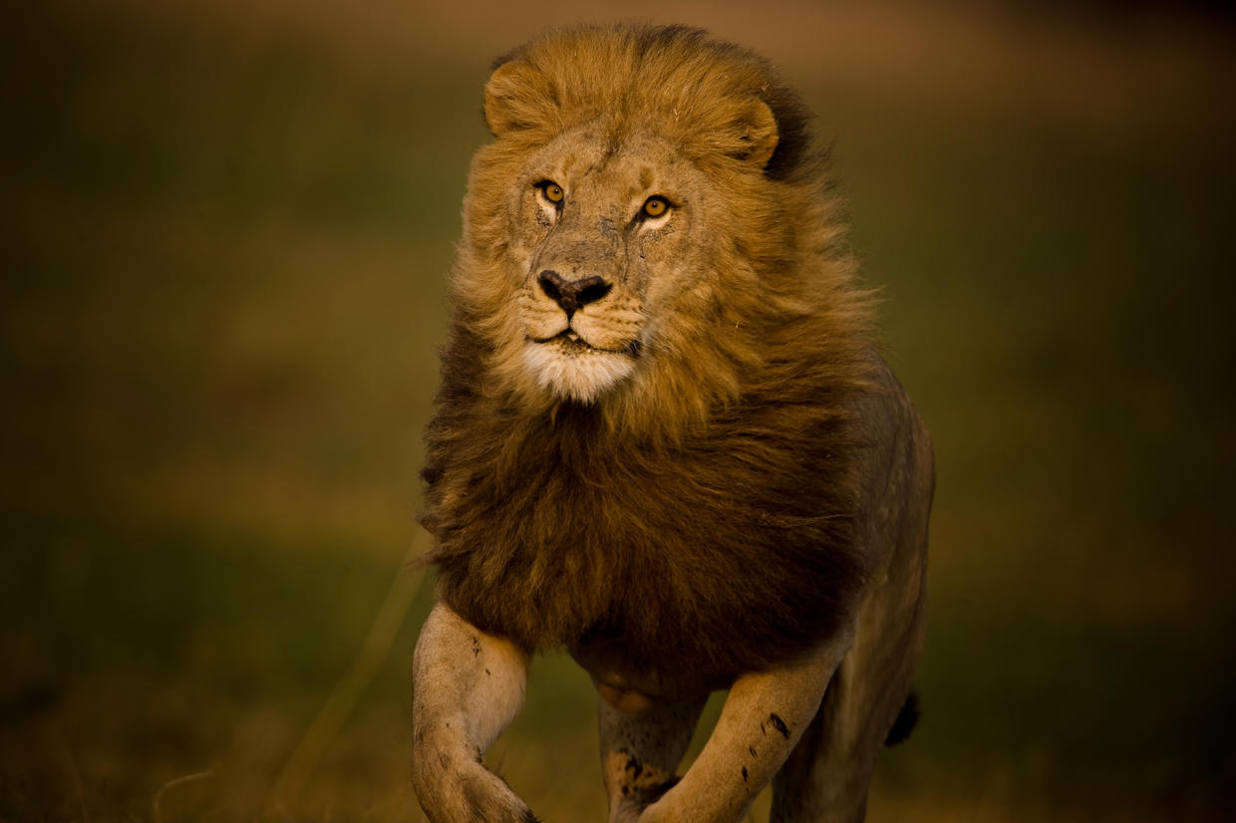
Poetry Writing
Have a go at writing a poem like The Eagle, about a bird or animal.
Attempt to make an AAA BBB rhyme pattern and see if you can even structure 8 syllables per line.
The Sparrow
The Lion
The Albatross

Slide 47
Homework
Read short excerpts from Beowulf and from Geoffrey Chaucer’s The Canterbury Tales,
There is also extra reading, if you are interested: an essay on Beowulf by J. R. R. Tolkien. (on Learning in ZJU)

