Slide 1

Part 1. Identifying the distribution with data

Slide 2








9.2.1Histograms
Divide the range of the data into intervals.
01
Label the horizontal axis to conform to the intervals selected.
02
03
Find the frequency of occurrences within each intervals.
Label the vertical axis so that the total occurrences can be plotted for each interval.
04
05
Plot the frequencies on the vertical axis.

Slide 3
Notes
The number of class intervals depends on the number of observations and the amount of scatter or dispersion in the data. Chosing the number of class intervals approximately equal to the square root of the sample size often works well in practice . If the intervals are too wide ,the histogram will be coarse,or blocky,and its shape and other details will not show well.If the intervals are too narrow,the histogram will be ragged and will not smooth the data.

Slide 4
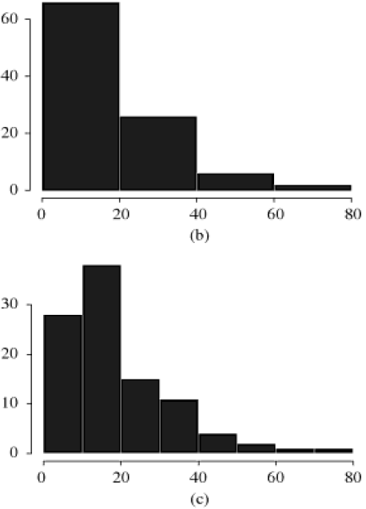
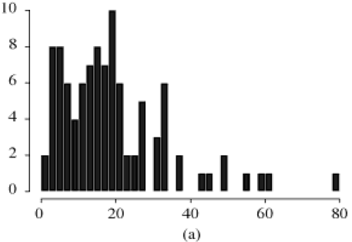
Original data——too ragged
Combining adjacent cells——too coarse

Slide 5
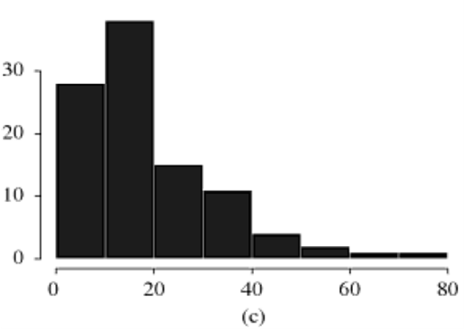
Combining adjacent cells——appropriate

Slide 6
Example 9.5: Discrete Data
The number of vehicles arriving at the northwest corner of an intersection in a 5-minute period between 7:00 A.M. and 7:05 A.M. was monitored for five workdays over a 20-week period. Table 9.1 shows the resulting data. The first entry in the cable indicates that there were 12 5-minute periods during which zero vehicles arrived, 10 periods duriog which one vehicle arrived, and so on.
Table 9.1 Number of Arrivals in a 5-Minute Period
Arrivals per Period | Frequency | Arrivals per Period | Frequency
0 | 12 | 6 | 7
1 | 10 | 7 | 5
2 | 19 | 8 | 5
3 | 17 | 9 | 3
4 | 10 | 10 | 3
5 | 8 | 11 | 1

Slide 7
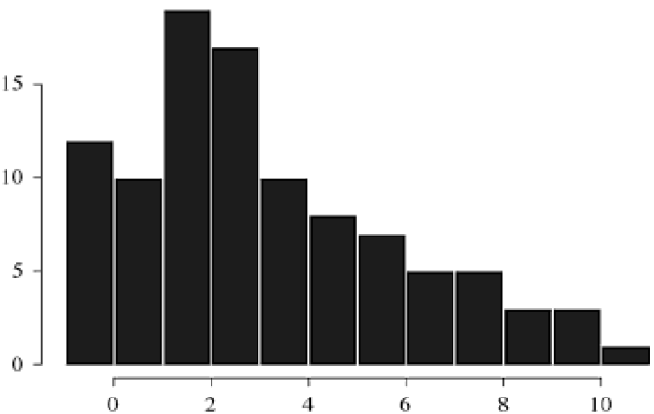
The number of automobiles is a discrete variable, and there are ample data, so the histogram may have a cell for each possible value in the range of the data. The resulting histogram is shown in Figure 9.4
Number of arrivals per period
Figure 9.4 Histogram of number of arrivals per period

Slide 8
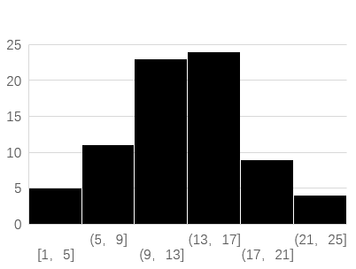
9.2.2 Selecting the Family of Distribution
In Chapter 5,some distributions that arise often in simulation were described. Additionally, the shapes of these distributions were displayed. The purpose of preparing a histogram is to infer a known pdf or pmf.A family of distributions is selected on the basis or what might arise in the context being investigated along with the shape of the histogram. For example, the histogram below has shape similar to the pdf in Figure 5.12, the assumption of a normal distribution would be warranted.
Duducing

Slide 9
There arc literally hundreds of probability distributions that have been created,many were created with some specific physical process in mind. One aid to selecting distributions is to use the physical basis of the distributions as a guide. Here are some examples:
Poisson: Models the number of independent events that occur in a fixed amount of time or space. For example, the number of customers that arrive to a store during I hour, or the number of defects round in 30 square meters of sheet metal.
Poission pmf

Slide 10
Normal: Models the distribution of a process that can be thought of as the sum of a number of component processes:for example,a time to assemble a product that is the sum of the times required for each assembly operation. Notice that the normal distribution admits negative values, which could he impossible for process times.
pdf of normal distribution
Exponential: Models the time between independent events, or a process time that is memoryless(knowing how much time has passed gives no information about how much additional time will pass before the process is cnmplete),for example,the times between the arrivals from a large population of potential coustomers who act independently of one another. The exponential is a highly variable distribution;it is sometimes overused,becnusc it often leads to mathematically tractable models. Recall that. if the time between events is exponentially distributed. then the number of events in u fixed period of ti.me is Poisson.
pdf of exponential distribution

Slide 11
9.2.3 Quantile-Quantile Plots
Defects of histograms
1.When there is a small number of data points,say30,or fewer,a histogram can be rather ragged.
2.Grouping data into cells makes it difficult to compare a histogram to a continuous probability density function.
Problem Solving
A quantile-quantile(q-q)plot is a useful tool for evaluating distribution fit,one that does not suffer from these problems.

Slide 12
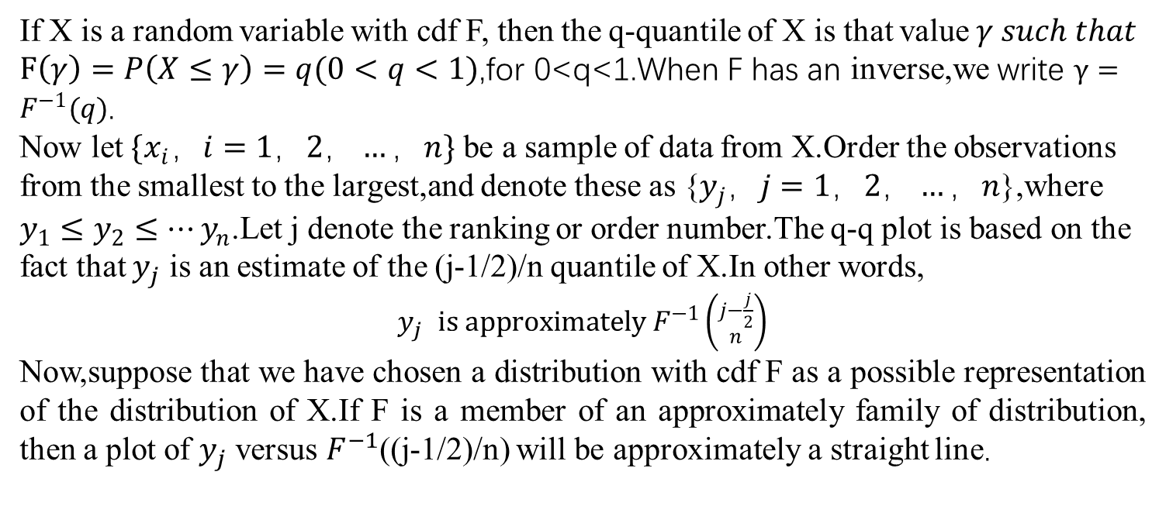
What is a q-q plot ?
If X is a random variable with cdf F, then the q-quantile of X is that value$γ such that$ $F\left(γ\right)=P\left(X≤γ\right)=q(0<q<1)$,for 0<q<1.When F has an inverse,we write $γ=F^{−1}(q)$.
Now let ${\{x}_{i}，i=1，2，…，n\}$ be a sample of data from X.Order the observations from the smallest to the largest,and denote these as {$y_{j}，j=1，2，…，n$},where $y_{1}≤y_{2}≤…y_{n}$.Let j denote the ranking or order number.The q-q plot is based on the fact that $y_{j}$ is an estimate of the (j-1/2)/n quantile of X.In other words,
$y_{j}$ $is approximately F^{−1}\left({j−\frac{j}{2} \atop n}\right)$
Now,suppose that we have chosen a distribution with cdf F as a possible representation of the distribution of X.If F is a member of an approximately family of distribution, then a plot of $y_{j}$ versus $F^{−1}$((j-1/2)/n) will be approximately a straight line.

Slide 13
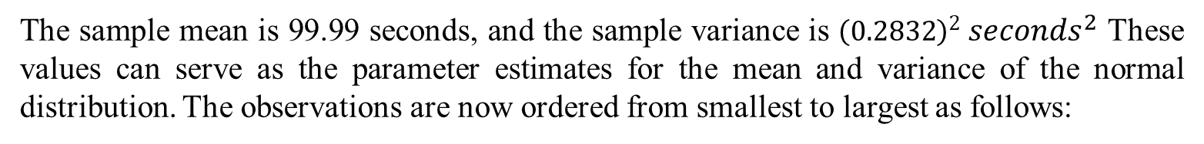
Example 9.7:Normal Q-Q Plot
A robot is used to install the doors on automobiles along an assembly line. It was thought that the installation times followed a normal distribution. The robot is capable of measuring installation times accurate I y. A sample of 20 installation times was automatically taken by the robot, with the following results, where the values are in seconds:
99.79 | 99.56 | 100.17 | 100.33
100.26 | 100.41 | 99.98 | 99.83
100.23 | 100.27 | 100.02 | 100.47
99.55 | 99.62 | 99.65 | 99.82
99.96 | 99.90 | 100.06 | 99.85
The sample mean is 99.99 seconds, and the sample variance is ${\left(0.2832\right)}^{2} {seconds}^{2}$ These values can serve as the parameter estimates for the mean and variance of the normal distribution. The observations are now ordered from smallest to largest as follows:

Slide 14
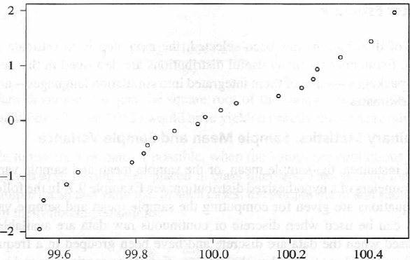
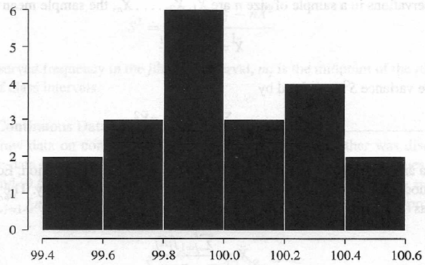
j | Value | j | Value | j | Value | j | Value
1 | 99.55 | 6 | 99.82 | 11 | 99.98 | 16 | 100.26
2 | 99.56 | 7 | 99.83 | 12 | 100.02 | 17 | 100.27
3 | 99.62 | 8 | 99.85 | 13 | 100.06 | 18 | 100.33
4 | 99.65 | 9 | 99.90 | 14 | 100.17 | 19 | 100.41
5 | 99.79 | 10 | 99.96 | 15 | 100.23 | 20 | 100.47
We can use the method above to obtain a q-q plot. The plotted values are shown in Figure below, along with a histogram of the data. Notice that it is difficult to tell whether the data are well represented by a normal distribution from looking at the histogram, but the general perception of a straight line is quite clear in the q-q plot and supports the hypothesis of a normal distribution.

Slide 15
Part 2. Parameter Estimation

Slide 16
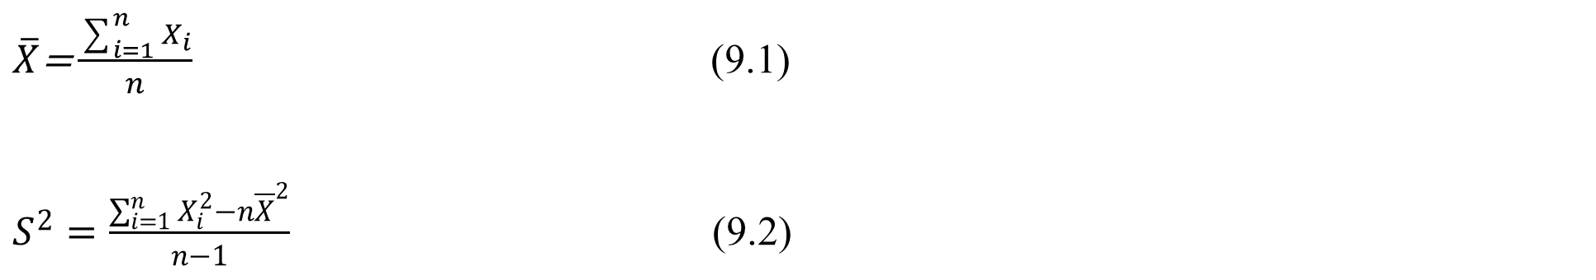
9.3.1 Preliminary Statistics: Sample Mean and Sample Variance
Three sets of equations are given for computing the sample mean and sample variance.
Case 1: When discrete or continuous raw data are available.
$\overline{X}\text{=}\frac{\sum_{i=1}^{n}{X_{i}}}{n}$ (9.1)
$S^{2}=\frac{\sum_{i=1}^{n}{X_{i}^{2}−n{\overline{X}}^{2}}}{n−1}$ (9.2)

Slide 17
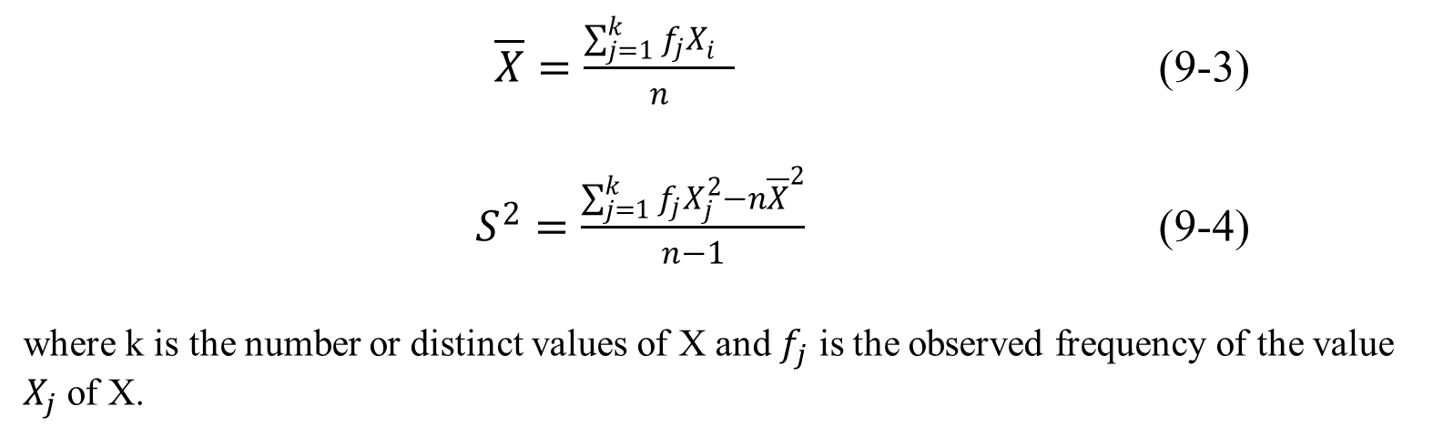
Case 2: When the data are discrete and have been grouped in a frequency distribution.
$\overline{X}=\frac{\sum_{j=1}^{k}{{f_{j}X}_{i}^{}}}{n}$ (9-3)
$S^{2}=\frac{\sum_{j=1}^{k}{{f_{j}X}_{j}^{2}−n{\overline{X}}^{2}}}{n−1}$ (9-4)
where k is the number or distinct values of X and $f_{j}$ is the observed frequency of the value $X_{j}$ of X.

Slide 18
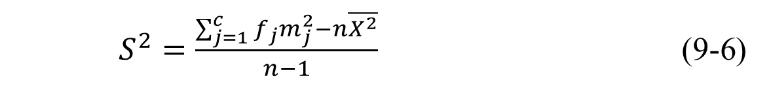
Case 3: When the raw data are unavailable, we can get approximation with equations below.
$\overline{X}=\frac{\sum_{j=1}^{c}{f_{j}m_{j}}}{n}$ (9-5)
$S^{2}=\frac{\sum_{j=1}^{c}{f_{j}m_{j}^{2}−n\overline{X^{2}}}}{n−1}$ (9-6)

Slide 19
Thanks for watching.

