Slide 1

WRITE HERE SOMETHING
STATE
WRITE HERE SOMETHING

Slide 2




CONTENT
WRITE HERE SOMETHING
WRITE HERE SOMETHING
THE ONE
THE TWO
WRITE HERE SOMETHING
WRITE HERE SOMETHING
THE THREE
THE FOUR

Slide 3

WRITE HERE SOMETHING
THE ONE
Entrepreneurial activities differ substantially depending on the type of organization and creativity. Entrepreneurial activities differ substantially.
WRITE HERE SOMETHING

Slide 4

BRUSH STYLE
Entrepreneurial activities differ substantially depending on the type of organization and creativity. Entrepreneurial activities differ substantially.
STATE

Slide 5
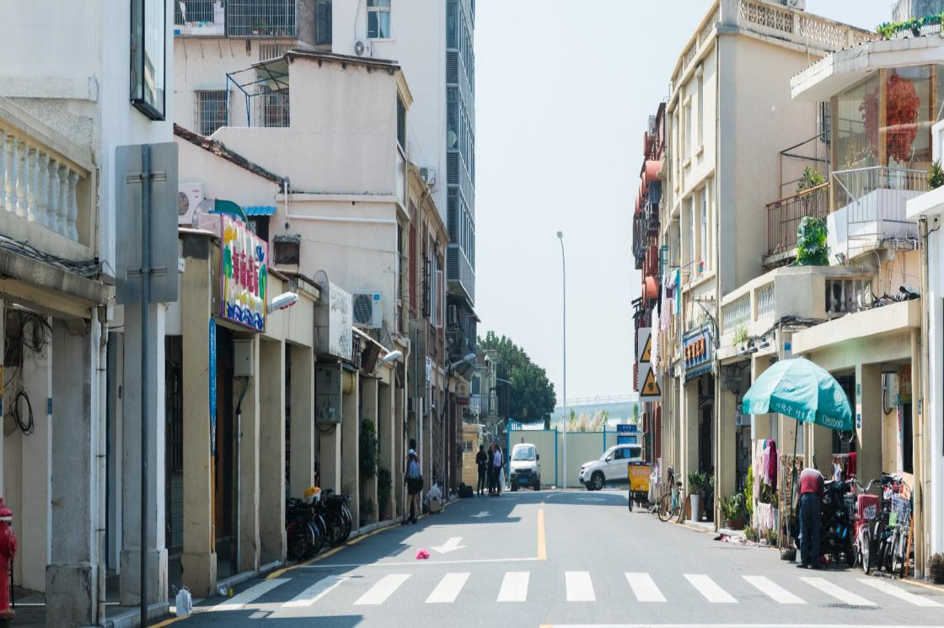
BRUSH STYLE PLACEHOLDER
Entrepreneurial activities differ substantially depending on the type of organization and creativity. Entrepreneurial activities differ substantially.

Slide 6

BRUSH STYLE PLACEHOLDER
Entrepreneurial activities differ substantially depending on the type of organization and creativity. Entrepreneurial activities differ substantially.
A company is an association or collection of individuals, whether natural persons, legal persons, or a mixture of both. Company members share a common purpose and unite in order to focus their various talents and organize their collectively available skills or resources to achieve specific, declared goals

Slide 7

BRUSH STYLE PLACEHOLDER
STATE
A company is an association or collection of individuals, whether natural persons, legal persons, or a mixture of both. Company members share a common purpose and unite in order to focus their various talents and organize their collectively available skills or resources to achieve specific, declared goals

Slide 8
WRITE HERE SOMETHING
THE TWO
Entrepreneurial activities differ substantially depending on the type of organization and creativity. Entrepreneurial activities differ substantially.
WRITE HERE SOMETHING

Slide 9


BRUSH STYLE PLACEHOLDER
A company is an association or collection of individuals, whether natural persons, legal persons, or a mixture of both. Company members share a common purpose and unite in order to focus their various talents and organize their collectively available skills or resources to achieve specific, declared goals

Slide 10


STATE
WRITE HERESOMETHING
WRITE HERESOMETHING
A company is an association or collection of individuals, whether natural persons, legal persons, or a mixture of both. Company members share a common purpose .
A company is an association or collection of individuals, whether natural persons, legal persons, or a mixture of both. Company members share a common purpose .

Slide 11

PLACEHOLDER
BRUSH
WRITE HERE SOMETHING
A company is an association or collection of individuals, whether natural persons, legal persons, or a mixture of both. Company members share a common purpose and unite in order to focus their various talents and organize their collectively available skills or resources to achieve specific, declared goals

Slide 12

BRUSH STYLE
Entrepreneurial activities differ substantially depending on the type of organization and creativity. Entrepreneurial activities differ substantially.
STATE

Slide 13
WRITE HERE SOMETHING
THE THREE
Entrepreneurial activities differ substantially depending on the type of organization and creativity. Entrepreneurial activities differ substantially.
WRITE HERE SOMETHING

Slide 14

PLACEHOLDER
BRUSH
A company is an association or collection of individuals, whether natural persons, legal persons, or a mixture of both. Company members share a common purpose and unite in order to focus their various talents and organize their collectively available skills or resources to achieve specific, declared goals

Slide 15



BRUSH STYLE
STATE
Entrepreneurial activities differ substantially depending on the type of organization and creativity. Entrepreneurial activities differ substantially.
Entrepreneurial activities differ substantially depending on the type of organization and creativity. Entrepreneurial activities differ substantially.

Slide 16

BRUSH STYLE PLACEHOLDER
WRITE HERE SOMETHING
A company is an association or collection of individuals, whether natural persons, legal persons, or a mixture of both. Company members share a common purpose and unite in order to focus their various talents and organize their collectively available skills or resources to achieve specific, declared goals
WRITE HERE SOMETHING

Slide 17


PLACEHOLDER
BRUSH
A company is an association or collection of individuals, whether natural persons, legal persons, or a mixture of both. Company members share a common purpose and unite in order to focus their various talents and organize their collectively available skills or resources to achieve specific, declared goals

Slide 18
WRITE HERE SOMETHING
THE FOUR
Entrepreneurial activities differ substantially depending on the type of organization and creativity. Entrepreneurial activities differ substantially.
WRITE HERE SOMETHING

Slide 19

PLACEHO
BRUSH
WRITE HERE SOMETHING
A company is an association or collection of individuals, whether natural persons, legal persons, or a mixture of both. Company members share a common purpose and unite in order to focus their various talents and organize their collectively available skills or resources to achieve specific, declared goals

Slide 20




PLACEHOLDER
BRUSH
A company is an association or collection of individuals, whether natural persons, legal persons, or a mixture of both. Company members share a common purpose and unite in order to focus their various talents and organize their collectively available skills or resources to achieve specific, declared goals

Slide 21

PLACEHO
BRUSH
A company is an association or collection of individuals, whether natural persons, legal persons, or a mixture of both. Company members share a common purpose and unite in order to focus their various talents and organize their collectively available skills or resources to achieve specific, declared goals

Slide 22

PLACEHO
BRUSH
A company is an association or collection of individuals, whether natural persons, legal persons, or a mixture of both. Company members share a common purpose and unite in order to focus their various talents and organize their collectively available skills or resources to achieve specific, declared goals

Slide 23


PLACEHO
BRUSH
A company is an association or collection of individuals, whether natural persons, legal persons, or a mixture of both. Company members share a common purpose and unite in order to focus their various talents and organize their collectively available skills or resources to achieve specific, declared goals

Slide 24
WRITE HERE SOMETHING
THANK
WRITE HERE SOMETHING

Slide 25

https://ibaotu.com/ppt/
素材授权/素材来源@包图网
本素材仅供学习研究使用。禁止商用、传播、转载。

Slide 26

可以在下列情况使用
个人学习、研究。
拷贝模板中的内容用于其它幻灯片母版中使用。
不可以在以下情况使用
任何形式的在线付费下载。
刻录光碟销售。
PPT模板： www.1ppt.com/moban/ 行业PPT模板：www.1ppt.com/hangye/
节日PPT模板：www.1ppt.com/jieri/ PPT素材： www.1ppt.com/sucai/
PPT背景图片：www.1ppt.com/beijing/ PPT图表： www.1ppt.com/tubiao/
优秀PPT下载：www.1ppt.com/xiazai/ PPT教程： www.1ppt.com/powerpoint/
Word教程： www.1ppt.com/word/ Excel教程： www.1ppt.com/excel/
个人简历： www.1ppt.com/jianli/ PPT课件： www.1ppt.com/kejian/
手抄报： www.1ppt.com/shouchaobao/ 试题下载： www.1ppt.com/shiti/
教案下载： www.1ppt.com/jiaoan/ 字体下载： www.1ppt.com/ziti/

