Slide 1
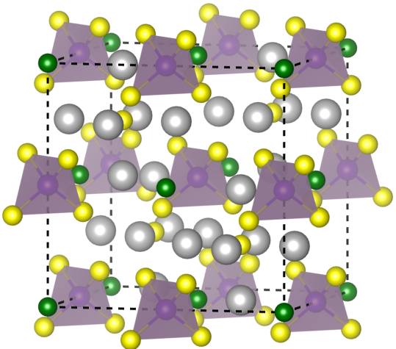
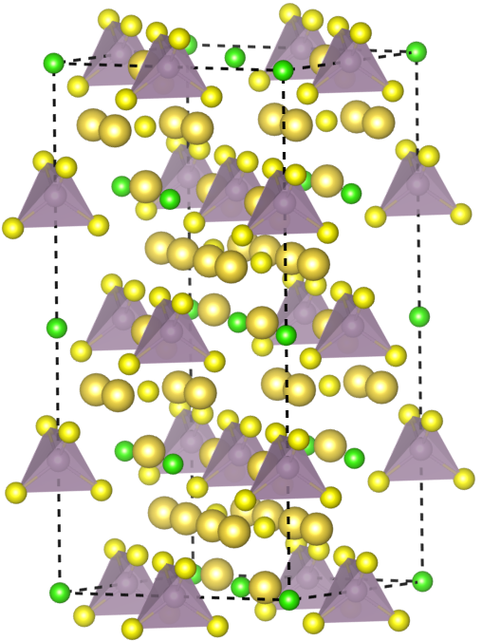
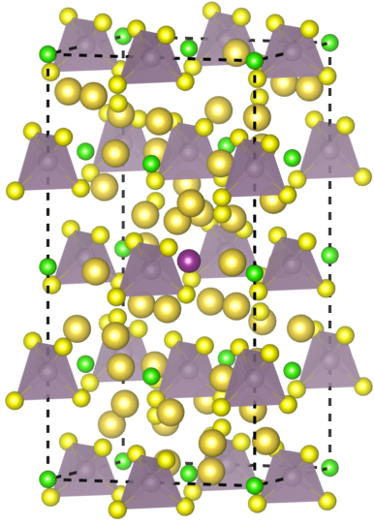
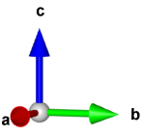
(a)
(b)
 | Li₆PS₅Cl-calc | Li₆PS₅Cl-exp | Δ
a (Å) | 10.01233 | 9.857815 | 1.57%
Li₆PS₅Cl
Li₆PS₅Cl_{0.875}I_{0.125}
a = 9.81861 Å α = 90.0000°
b = 9.81861 Å β = 90.0000°
c = 19.04939 Å γ = 90.0000°
V = 1836.4603 Å^3

Slide 2
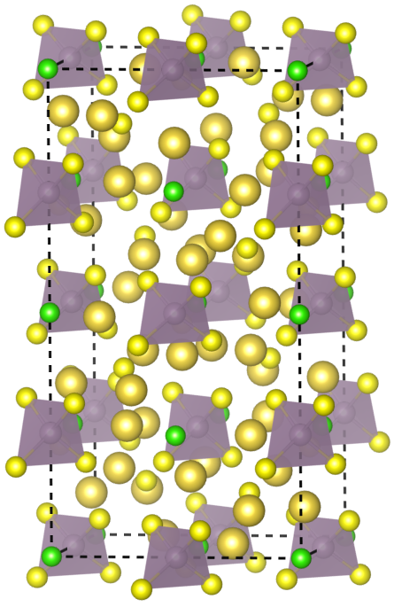
BVSE
Li₆PS₅Cl
Li₆PS₅Cl_{0.875}I_{0.125}
Percolation barriers:
1D percolation barrier is 0.3711 eV
2D percolation barrier is 0.3711 eV
3D percolation barrier is 0.4004 eV
Percolation barriers:
1D percolation barrier is 0.3516 eV
2D percolation barrier is 0.3516 eV
3D percolation barrier is 0.4102 eV
parser.add_argument("--r-cut", type=float, default=8.0, help="截断半径，")
parser.add_argument("--resolution", type=float, default=0.3, help="网格分辨率)
parser.add_argument("--k", type=int, default=100, help="近邻搜索个数上限)
parser.add_argument("--encut", type=float, default=5.0, help="渗流势垒能量截断)

