Slide 1
A brief introduction of MXNET
-----------------------------------------
by zhangkun

Slide 2
What's mxnet:
Flexible and Efficient Deep Learning Library on Heterogeneous Distributed Systems.
MXNet is a deep learning framework designed for both efficiency and flexibility. It allows you to mix the flavours of deep learning programs together to maximize the efficiency and your productivity.

Slide 3
how to create a network:
data = mx.symbol.Variable('data')
fc1 = mx.symbol.FullyConnected(data = data, name='fc1', num_hidden=128)
act1 = mx.symbol.Activation(data = fc1, name='relu1', act_type="relu")
fc2 = mx.symbol.FullyConnected(data = act1, name = 'fc2', num_hidden = 64)
act2 = mx.symbol.Activation(data = fc2, name='relu2', act_type="relu")
fc3 = mx.symbol.FullyConnected(data = act2, name='fc3', num_hidden=10)
mlp = mx.symbol.SoftmaxOutput(data = fc3, name = 'softmax')

Slide 4
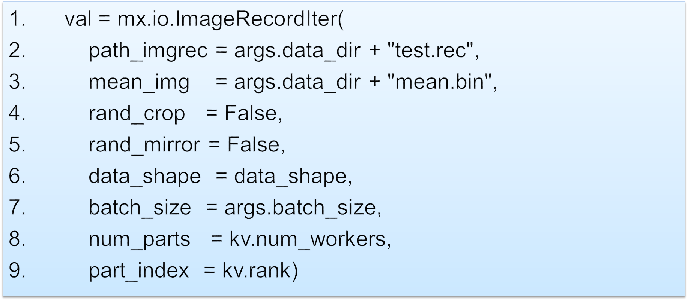
how to get data:

Slide 5
how to training(1):
model = mx.model.FeedForward(
ctx = devs,
symbol = network,
num_epoch = args.num_epochs,
learning_rate = args.lr,
momentum = 0.9,
wd = 0.00001,
initializer = mx.init.Xavier(factor_type="in", magnitude=2.34),
**model_args)
model.fit(
X = train,
eval_data = val,
kvstore = kv,
batch_end_callback = mx.callback.Speedometer(args.batch_size, 50),
epoch_end_callback = checkpoint)

Slide 6
how to training(2):
mx.model.FeedForard.create(X, y=None, ctx=None, num_epoch=None, epoch_size=None, optimizer='sgd', initializer=<mxnet.initializer.Uniform object>, eval_data=None, eval_metric='acc', epoch_end_callback=None, batch_end_callback=None, kvstore='local',
logger=None, work_load_list=None, **kwargs)

Slide 7
how to save,load and predict
model:
mxnet.model.FeedForward.save(**)
mxnet.model.FeedForward.load(**)
symbol:
mxnet.symbol.save(**)
mxnet.symbol.load(**)
predict:
mxnet.model.FeedForward.predict(**)

Slide 8
material:
http://mxnet.readthedocs.org/en/latest/index.html
https://github.com/dmlc/mxnet
http://www.52cs.org/?p=639

Slide 9


