Slide 1
ML Project for Regression
Yiqing Hu 455858
Raffaele Ricci K-15305

Slide 2

Data Checking
Correlation
Distribution
NA

Slide 3
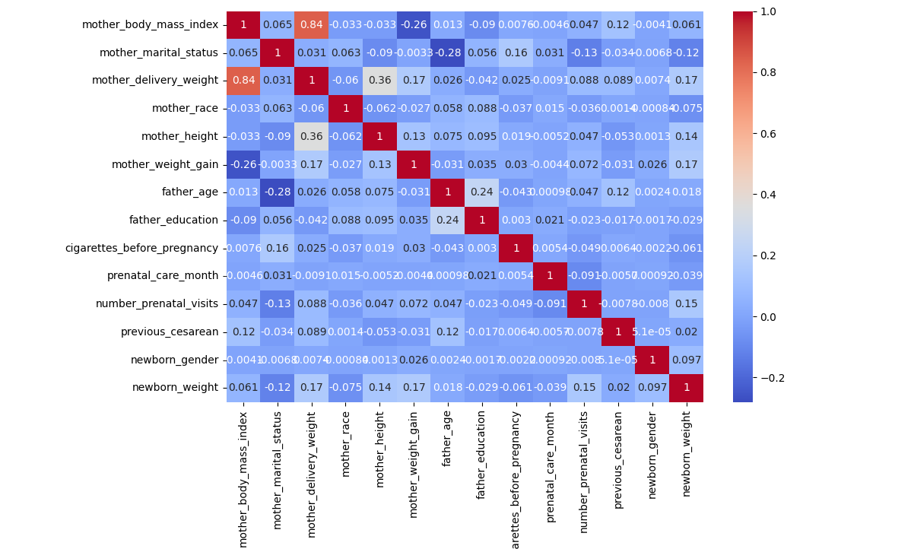

Slide 4
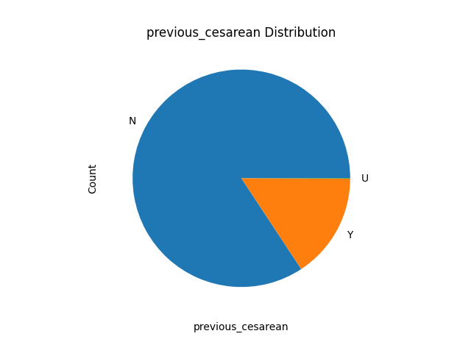
Visualization
Distribution of Discrete Data

Slide 5
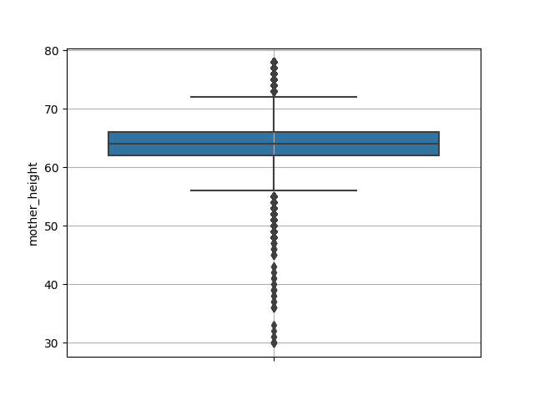
Visualization
Distribution of Float Data

Slide 6
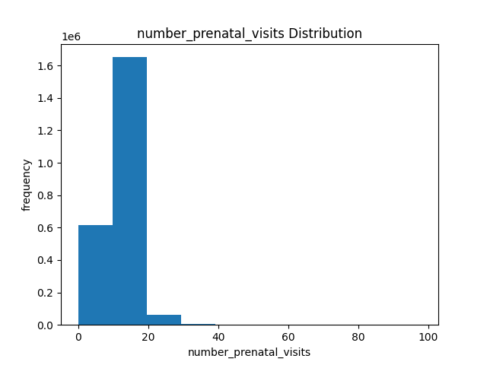
Visualization
Distribution of Int Data

Slide 7
NA Checking
col_name | col_type | NA_ratio
father_age | float64 | 18.53563
mother_marital_status | float64 | 17.20142
mother_height | float64 | 10.19671
mother_body_mass_index | float64 | 6.11313
mother_weight_gain | float64 | 3.06378
number_prenatal_visits | float64 | 2.49784
mother_delivery_weight | float64 | 1.45773
cigarettes_before_pregnancy | float64 | 0.47124
mother_race | int64 | 0.0
father_education | int64 | 0.0
prenatal_care_month | int64 | 0.0
previous_cesarean | object | 0.0
newborn_gender | object | 0.0
newborn_weight | int64 | 0.0

Slide 8

Feature Engineering
int/float/discrete
Fill NA/outlier with median/mean to int and float features
Make a new feature for old with which row has NA
Truncate outliers
Standardization and normalization for int and float features
Make discrete features as dummies
Power features which have high correlation with newborn weight

Slide 9
Algorithms
GLM/SVM/GBT
LM, Ridge, Lasso, ElasticNet, FM
SVR
LGBMRegressor

Slide 10
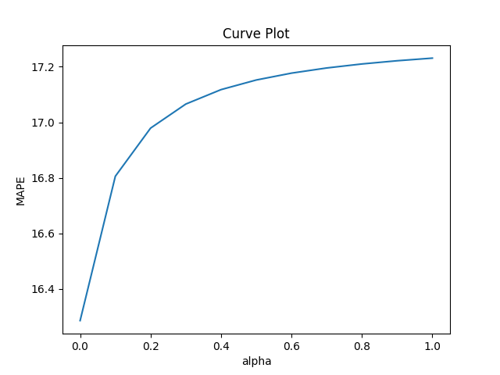
Tuning
For Lasso

Slide 11
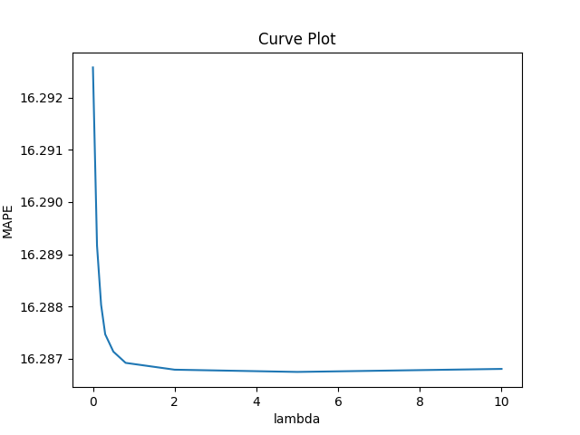
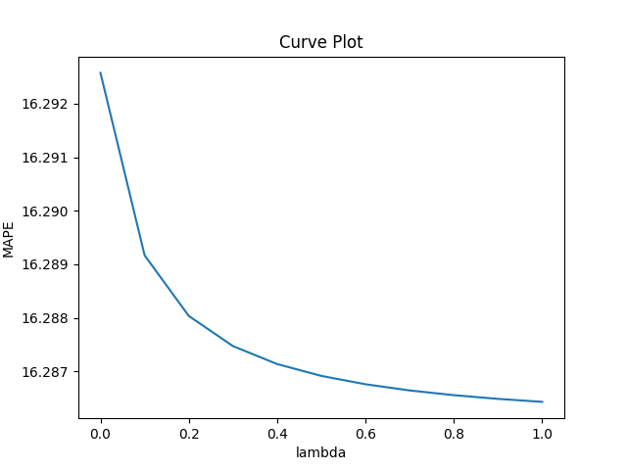
Tuning
For Ridge

Slide 12
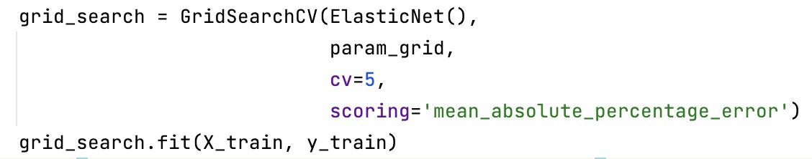
Tuning
For ElasticNet

Slide 13
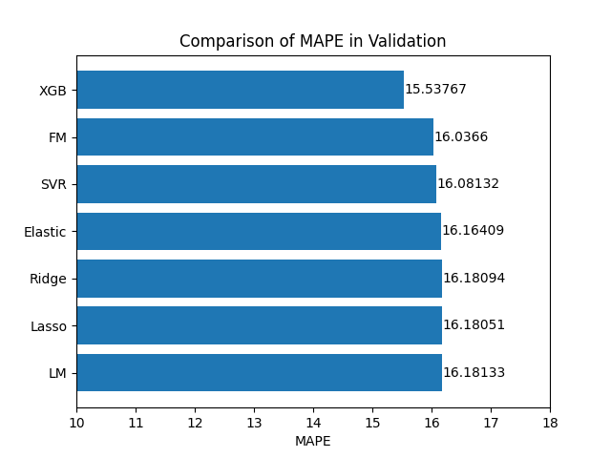

Slide 14
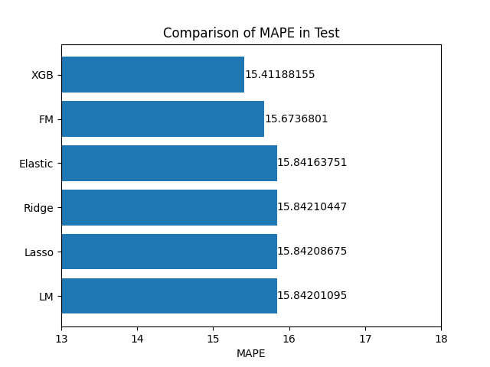

Slide 15
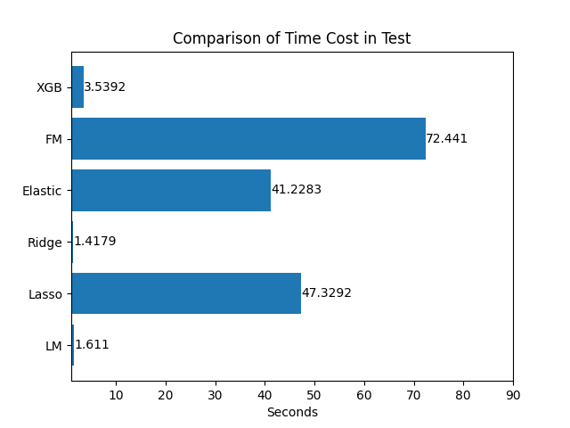

Slide 16
Result
LGT
Train time cost: within 3s for full train data
MAPE: 15.411% for 10% testset

Slide 17
ML Project for Classification
Yiqing Hu 455858
Raffaele Ricci K-15305

Slide 18
Dimension of dataset = 10127, 21
Na Values
customer sex = 1018
total transaction amount 407
customer age = 624
customer salary range = 681
Unknown Values
customer education = 1519
customer civil status = 749

Slide 19
Feature Selection
#customer_age
mean in group closed mean in group open
46.62196 46.25996
Test t: p-value = 0.09492
#customer_sex
0.003424409 corr. account_status
we replace the NA value in total transaction amount with the mean
Replace NA values with "Unknown“
actually in the variable of salary range we believe that the people with lower or higher salary are unlikely to say own salary

Slide 20
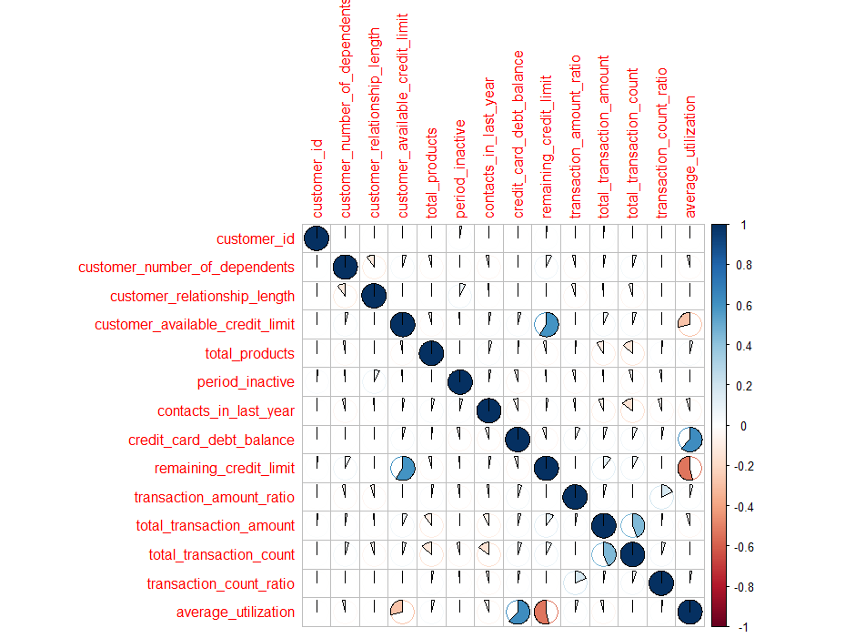
Feature Selection
customer_number_of_dependents -0.0189905963
customer_relationship_length -0.0136868512
customer_available_credit_limit 0.0174582135
total_products 0.0795483222
period_inactive -0.1524488063
contacts_in_last_year -0.2044905100
credit_card_debt_balance 0.2630528831
remaining_credit_limit 0.0002850775
transaction_amount_ratio 0.1310628478
total_transaction_amount 0.0959313407
total_transaction_count 0.3714027012
transaction_count_ratio 0.1208377823
average_utilization 0.1784103316

Slide 21
Feature Selection
Recode ordinal variables with levels, including Unknown as a level
Correlation with account_status
customer_education = 0.035
customer_civil_status = 0.024
customer_salary_range = 0.037
credit_card-classification = 0.015
we don't remove anything from the earlier apart from the variable sex and age

Slide 22
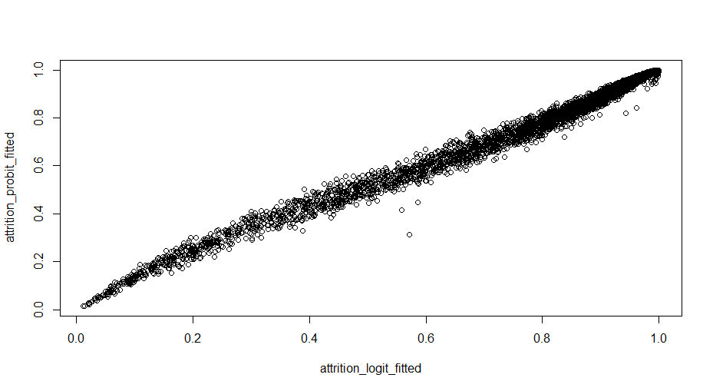
Logistic Regression
Division of the dataset in train and test sample
No big difference in predictions using probit and logit
Balanced accuracy = 0.735

Slide 23
Feature Selection
In logistic regression we have some insignificant variables
IN LOGIT :
remaining_credit_limit
average_utilization
customer_available_credit_limit
customer_civil_status
IN PROBIT :
customer_civil_status 4
customer_available_credit_limit 7
remaining_credit_limit 13

Slide 24
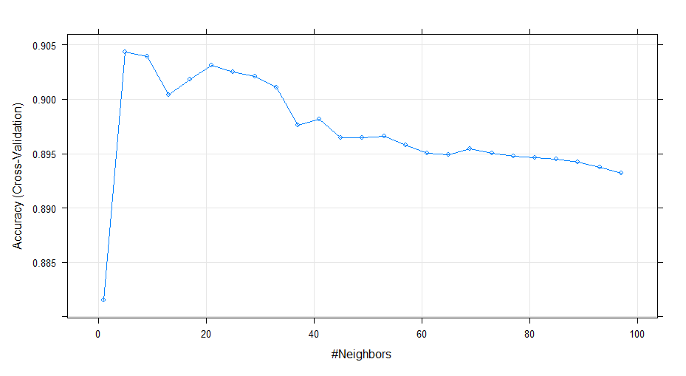
KNN Model
Using cross-validation :
Accuracy was used to select the optimal model using the largest value.
The final value used for the model was k = 5.
Balanced Accuracy = 0.7995

Slide 25

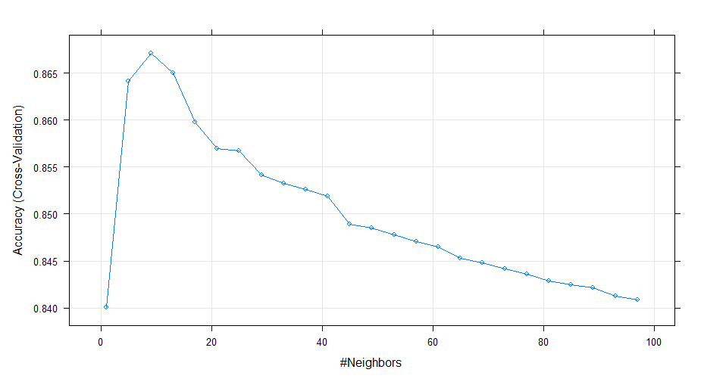
We compared all the models with scaling the variables but still the best balanced Accuracy remains 0.7995 of the model with K = 5

Slide 26
SVM Model
# the value of 0.5 is indicated as optimal,
# but the accuracy is identical for all C apart from 0.001
# C Accuracy Kappa
#0.001 0.8393286 0.0000000
#0.010 0.8918042 0.5004691
0.020 0.8931677 0.5161437
0.050 0.8936379 0.5267727
0.100 0.8938730 0.5299907
0.200 0.8940611 0.5328512
0.500 0.8941081 0.5334885
1.000 0.8940141 0.5330844
2.000 0.8939670 0.5330912
5.000 0.8940611 0.5334981
Accuracy was used to select the optimal model using the largest value.
The final value used for the model was C = 0.5.
Balanced accuracy : 0.73

Slide 27

Thanks
guys

