Slide 1
喵喵喵
李阳

Slide 2
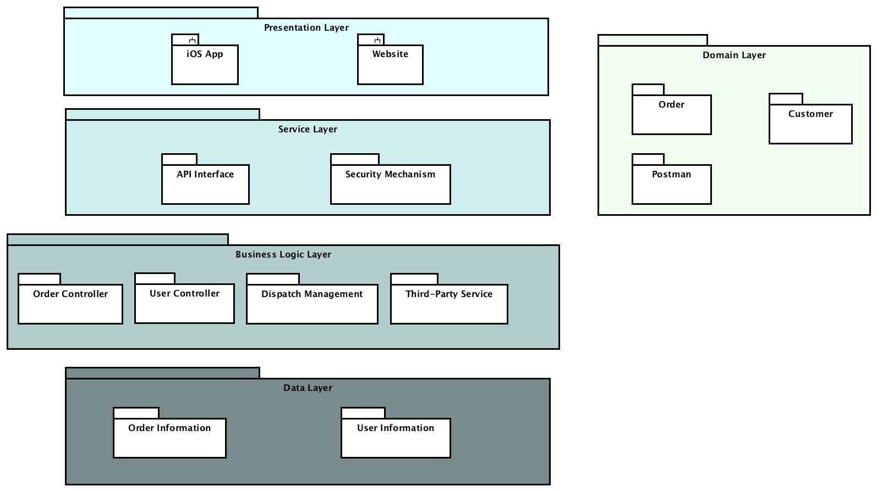
Architecture
Presentation Layer
Services Layer
Business Logic Layer
Data Layer
Notes:
我们整个Architecture由高到低可以分为4个layer，分别为Presentation Layer, Services Layer, Controller Layer, Business Logic Layer, and Data Layer.
还有一个domain layer，
OOADDomain-Driven Design
下面我们先分别介绍一下每个layer具体都包含了什么

Slide 3
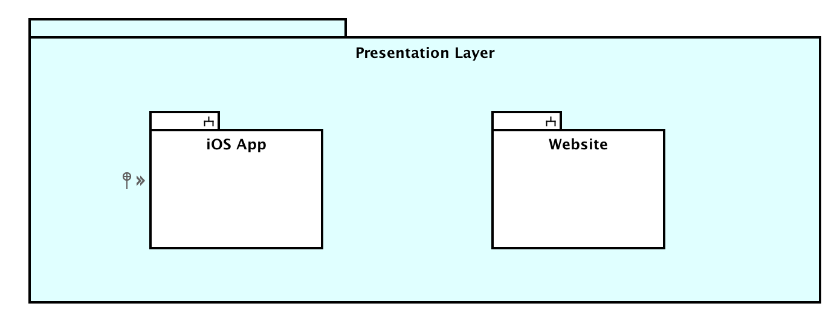
Presentation Layer
Interface showed to users.
Notes:
首先是Presentation Layer, 这里包含了app和web的ui that 展现给用户的界面，也就是用户在使用该系统时的看到的东西

Slide 4
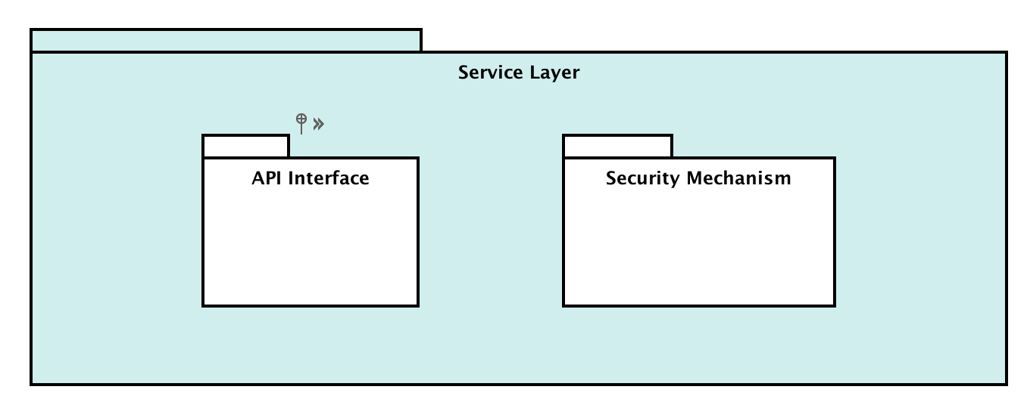
Services Layer
Include APIs and security mechanism
Notes:
第二个就是Services Layer, 包含了各种应用程序编程接口，比如说 appAPI, webAPI
参考维基百科第一段https://en.wikipedia.org/wiki/Service_layer
service layer is a conceptual layer within a network service provider architecture. It aims at providing middleware that serves third-party value-added services and applications at a higher application layer. The service layer provides capability servers owned by a telecommunication network service provider, accessed through open and secure Application Programming Interfaces (APIs) by application layer servers owned by third-party content providers. The service layer also provides an interface to core networks at a lower resource layer.^{[1]} The lower layers may also be named control layer and transport layer (the transport layer is also referred to as the access layer in some architectures).^{[citation needed]}
The Security mechanism controls all data access to the API. It should at least provide limit rating mechanism and application-layer access control (for example, IP blocking) functionality, aims to reduce security ricks from large scale brute-force / dictionary based enumerations. Besides, the Controllers connect the action from the Presentation Layer and the main logic from the Business Logic Layer.

Slide 5
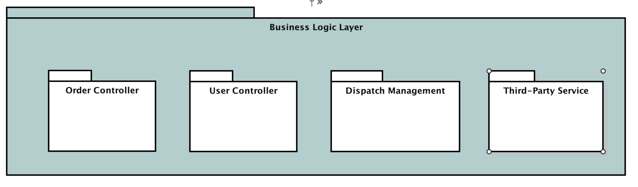
Business Logic Layer
Include controllers and (third-party services)
Notes:
下面这个是Business logic layer， 针对具体的问题进行操作，也就是对下面的数据层(Data layer)的操作，对数据的逻辑处理processing。
这一层时连接presentation layer和data layer两层的桥梁，实现他们之间的数据交互
https://en.wikipedia.org/wiki/Business_logic
business logic or domain logic is the part of the program that encodes the real-world business rules that determine how data can be created, stored, and changed. It is contrasted with the remainder of the software that might be concerned with lower-level details of managing a database or displaying the user interface, system infrastructure, or generally connecting various parts of the program.

Slide 6
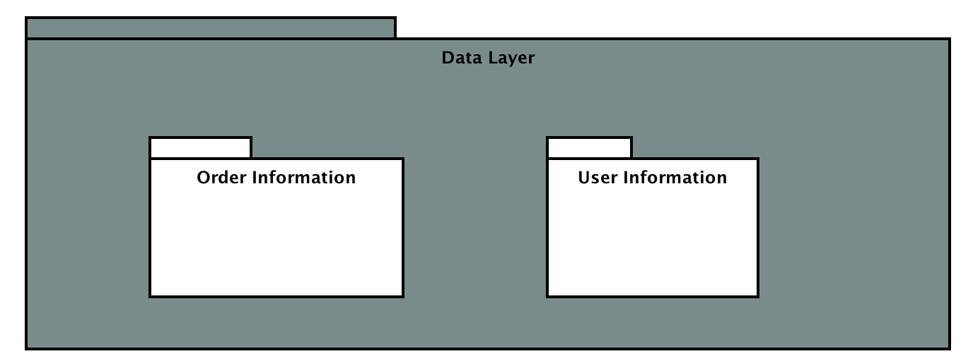
Data Layer
Direct access to the database
Notes:
Data layer这一层所做的事情就是直接操作数据库，针对数据进行增添，删除，修改，查询等，接受business layer的命令，对数据进行处理

Slide 7
Class Diagram
Create a order
Check a order
Notes:
接下来我们以create a order 和 check a order为例，画出class diagram

Slide 8
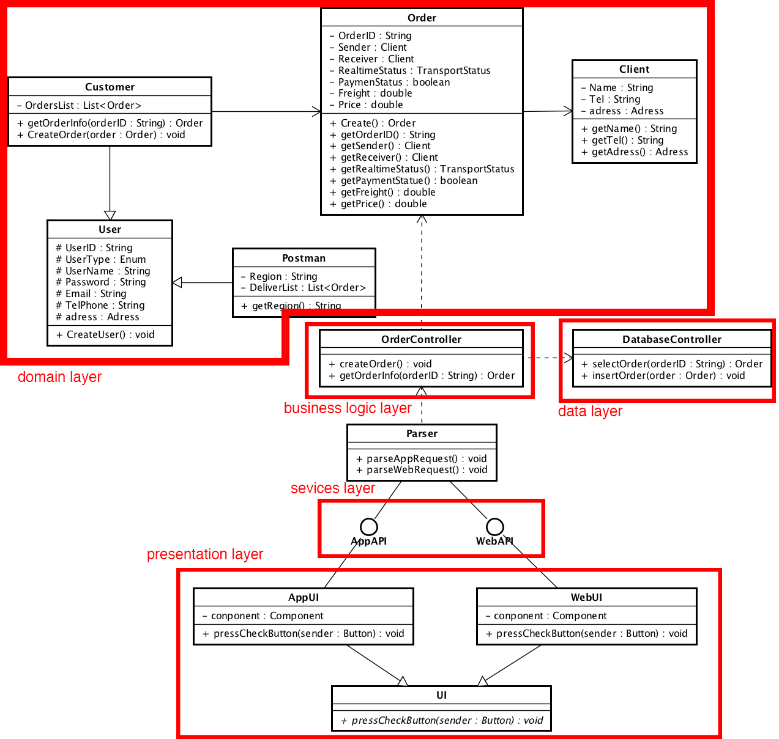
Notes:
这个部分是presentation layer，有一个虚类UI？(这里怎么描述)appUI和 webUI ， 分别包含了组成界面的组件和响应的函数
第二个部分是sevices layer，包含了ui连接到controller所需要的api，parser用来解析接收到的信号是来自app还是来自web
第三个部分是business logic layer，包含了一个controller：order controller，实现了ui和data layer 和database之间的数据交互，接受到parser传送过来的信号之后，访问domain和database访问和存储数据
Domain 包含了几个关键的类，customer 和postman类继承了user类，其中customer类(包含??换一个词描述这个关系)了order类

Slide 9
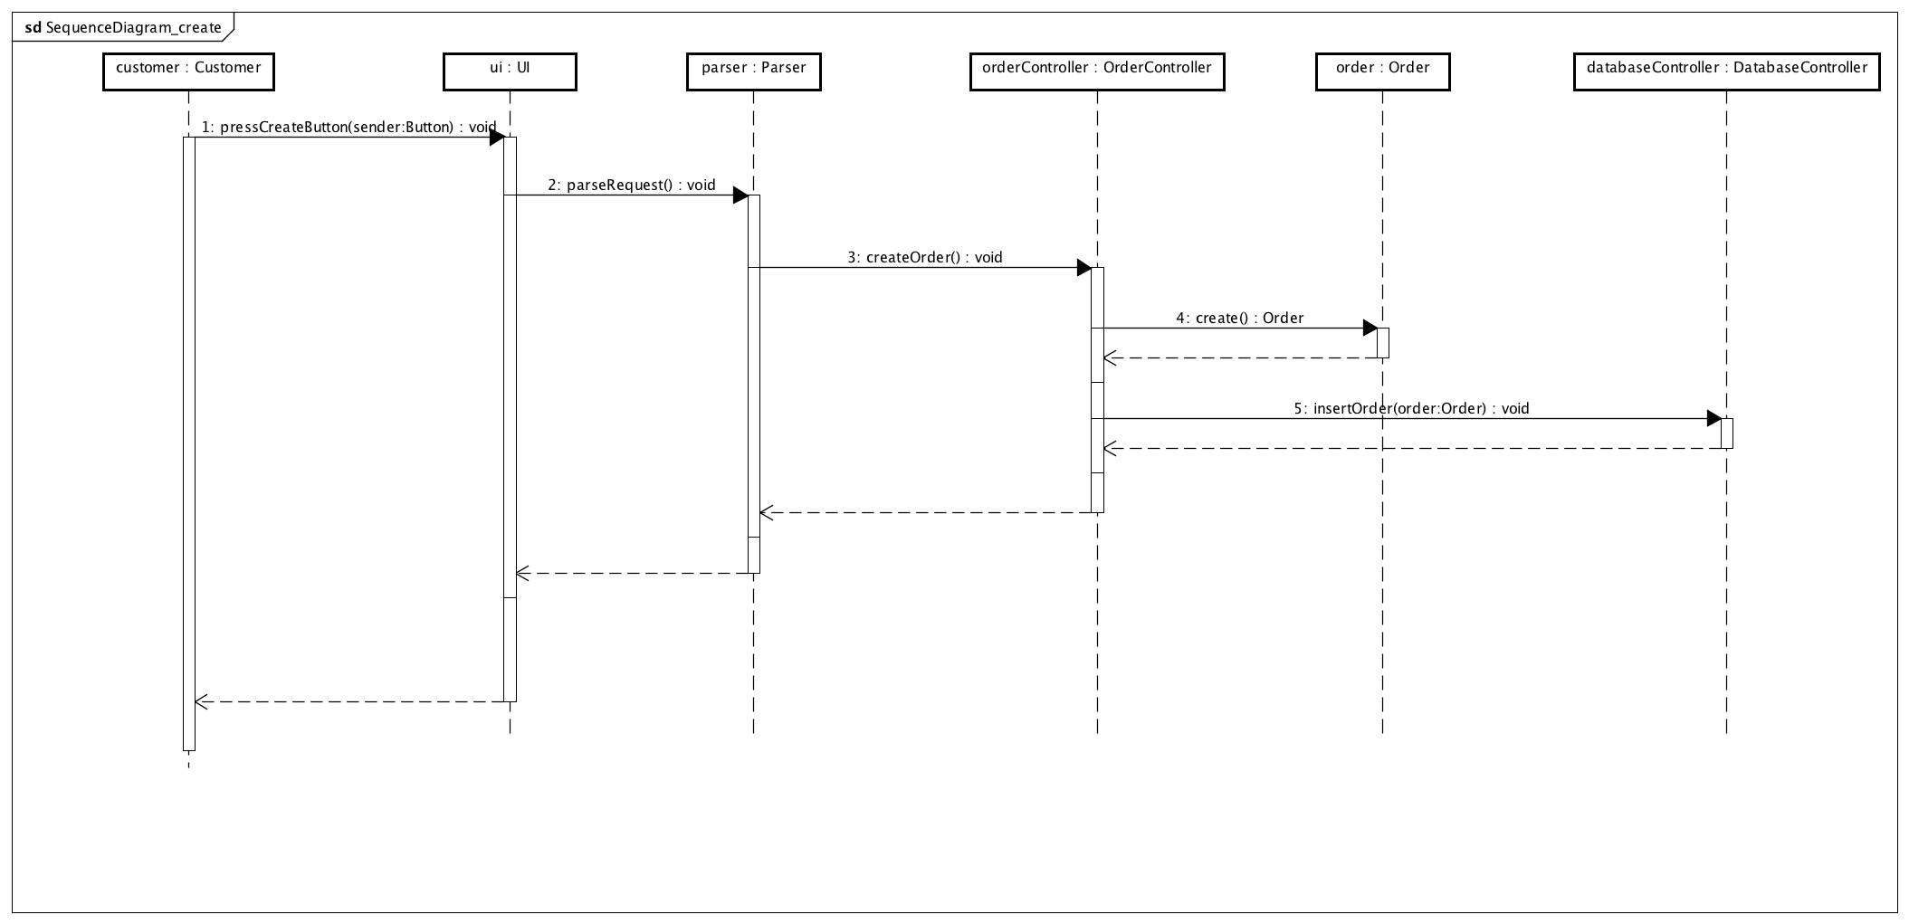
Sequence Diagram (create)

Slide 10
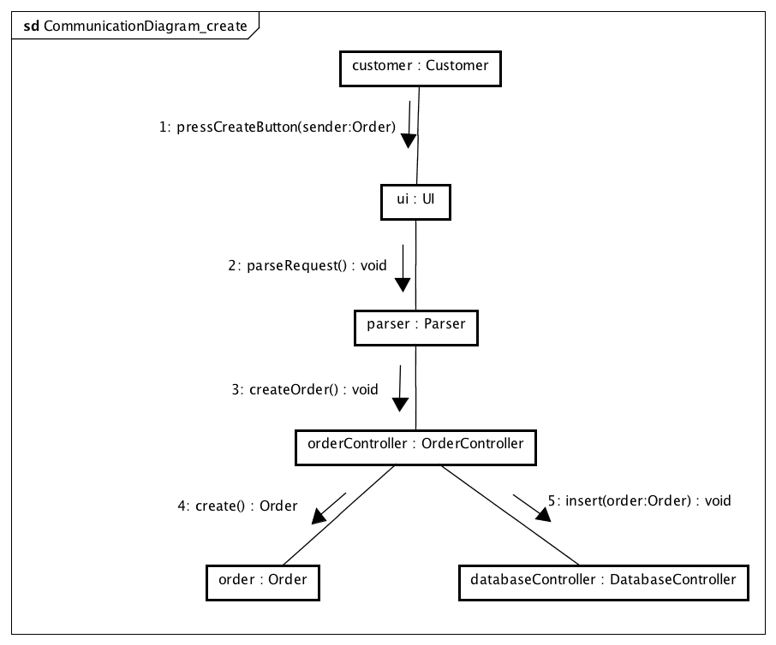
Communication Diagram (create)

