Slide 1
AUTISTUDY
AI-Powered Adaptive Learning Platform for Students with Autism

Slide 2






TEAM MEMBERS
SUPERVISOR: Dr. Shaista Habib
CO. ADVISOR: Dr. Rimsha Anam
STUDENTS:
Zoha Khalid (f2022332007)
Aliza Ali (F2022332030)
Tehreem Ghulam Nabi (f2022332020)
Tayyaba Sikandar (f2022332012)
MEET OUR 6-MEMBER PROJECT TEAM.
DR. SHAISTA HABIB
DR. RIMSHA ANAM
ALIZA ALI
ZOHA KHALID
TEHREEM GHULAM NABI
TAYYABA SIKANDAR

Slide 3
The Real Problem - Retriever Failure
Why Traditional RAG Failed
Student asks: "How to add fractions with different denominators?"
Traditional RAG Retrieved:
"The denominator is the bottom number..." (irrelevant definition)
"Fractions are parts of a whole..." (too basic)
"Exercise 2.3: Add 1/2 + garbled..." (OCR corrupted)
Expected:
Step-by-step procedure for finding LCD
Example with worked solution
Practice problems

Slide 4
The Real Problem - Retriever Failure
The retriever couldn't find the RIGHT content because:
1. OCR destroyed mathematical content
2. No block type awareness (definition vs procedure)
3. No intent understanding
4. Single retrieval method missed keywords

Slide 5
The Breakthrough - LlamaParse to Markdown
Research Discovery: Parse, Don't OCR
After researching alternatives, we discovered LlamaParse (LlamaIndex):
Before (OCR):
To add fractions 1 2 + 1 3 first find LCD The LCD of 2 and 3 is 6 So 1 2 = 3 6 and 1 3 = 2 6
AI-powered document parsing (not simple OCR)
Understands document structure
Preserves mathematical notation
Outputs clean Markdown files
After (LlamaParse → MD):
## Adding Fractions with Different Denominators To add fractions 1/2 + 1/3: 1. Find the LCD of 2 and 3 = 6 2. Convert: 1/2 = 3/6 and 1/3 = 2/6 3. Add: 3/6 + 2/6 = 5/6

Slide 6
Smart Chunking with Metadata
From Dumb Chunks to Intelligent Blocks
ASPECT | TRADITIONAL | OUR APPROACH
Chunk Size | Fixed 512 tokens | Semantic boundaries
Structure | None | Chapter → Section → Block
Metadata | filename only | chapter, section, page, block_type
Block Types | None | DEFINITION, PROCEDURE, EXAMPLE, PRACTICE
Overlap | None | Context-aware overlap
Block Type Weighting System:
DEFINITION: 1.3 (Boost definitions)
PROCEDURE: 1.2 (Boost how-to content)
EXPLANATION: 1.1 (Boost explanations)
BODY: 1.0 (Normal)
WEBLINKS: 0.3 (Demote irrelevant)

Slide 7
Hybrid Retrieval - The Game Changer
Why Single Retrieval Method Fails
Our Hybrid Solution:
Math: 65% Dense + 35% BM25 + CrossEncoder Reranking
Reciprocal Rank Fusion (RRF):
Document in both lists → boosted score
Science/Computer: RRF Fusion + Keyword Gating
Document in one list → lower score
Best of both worlds
Query | Dense Search | BM25 Search
"What is addition?" | ✅ Good | ❌ Misses
"Exercise 2.3" | ❌ Fails | ✅ Exact match
"How to solve sum?" | ⚠️ OK | ⚠️ OK

Slide 8
Cross-Encoder Reranking
The Final Quality Filter
Problem: Initial retrieval returns ~40 candidates
Need: Select the TOP 6 most relevant
Traditional Approach:
Use embedding similarity score
Fast but not accurate
Our Cross-Encoder Approach:
Neural model scores (query, document) pairs
Much more accurate than embeddings
Model: ms-marco-MiniLM-L-6-v2

Slide 9
Cross-Encoder Reranking
Query: "How to multiply fractions?"
Before Reranking:
1. "Fractions are parts..." (0.72) ← Wrong!
2. "To multiply fractions, multiply numerators..." (0.68)
After Reranking:
1. "To multiply fractions, multiply numerators..." (0.91) ✅
2. "Fractions are parts..." (0.34)

Slide 10
Intent Detection - Understanding the Question
Different Questions Need Different Content
INTENT | EXAMPLE | BEST BLOCK TYPES
DEFINITION | "What is a fraction?" | GLOSSARY, DEFINITION
PROBLEM | "Solve 2/3 + 1/4" | PRACTICE, QUESTION
EXAMPLE | "Show me an example" | EXAMPLE, EXPLANATION
PROCEDURE | "How to add fractions?" | PROCEDURE, RULE
Our Intent Detection:
if "solve" or "calculate" in query: return "PROBLEM"
if "example" or "show" in query: return "EXAMPLE"
if "what is" or "define" in query: return "DEFINITION"
else: return "EXPLAIN"
Result: Right content type for right question!

Slide 11
Science & Computer - Enhanced RAG
"What" Questions - Factual Retrieval Done Right
Traditional RAG:
Enhanced RAG:
Query
Embed
Search
LLM
Query
Intent
Hybrid Search
Dense + BM25
RRF Fusion
Keyword Gate
Block Filter
Rerank
Top Results
LLM

Slide 12
Science & Computer - Enhanced RAG
Enhancements Applied:
✅ Hybrid retrieval (Dense + BM25)
✅ Reciprocal Rank Fusion (RRF)
✅ Keyword gating (filters irrelevant)
✅ Block type weighting
✅ Subject-specific intent detection
✅ Relevance scoring & validation
Improvement: 45% → 88% accuracy

Slide 13
Mathematics - RAG to RAT (Revolutionary)
The "How" Problem
Traditional RAG answers "What" questions:
"What is addition?" → ✅ "Addition is combining numbers"
But fails at "How" questions:
"How do I add 24 + 38?" → ❌ "Addition is combining..." (useless!)
RAT = Think first, then retrieve, then verify

Slide 14
Mathematics - RAG to RAT (Revolutionary)
RAT: Retrieval-Augmented Thinking
Student: "How to add 24 + 38?"
Step 1: Generate Chain-of-Thought (before retrieval)
→ "Need to add ones: 4+8, then tens: 2+3, carry if needed“
Step 2: Use EACH thought as retrieval query
→ Query 1: "adding ones place"
→ Query 2: "carrying in addition"
→ Query 3: "adding tens place"
Step 3: Verify each step against textbook
Step 4: Generate verified, step-by-step answer

Slide 15
Image Generation - RAT in Action
Visual Learning for Mathematics
The Problem: Text alone doesn't explain "How"
The Solution: generate visual explanations
Student: "What is 2+4?"
AI: "2+4 equals 6!"
Student: "How?"
AI: [Generates image showing 2 apples + 4 apples = 6 apples]
"Look! 2 apples plus 4 apples gives us 6 apples total!"

Slide 16
Image Generation - RAT in Action
How It Works:
1. Detect "how" pattern in question
2. Get context from chat memory
3. Generate structured image prompt
4. Create educational visual (DALL-E)
5. Display with text explanation
This is RAT: Retrieve knowledge + Generate reasoning + Visual proof

Slide 17
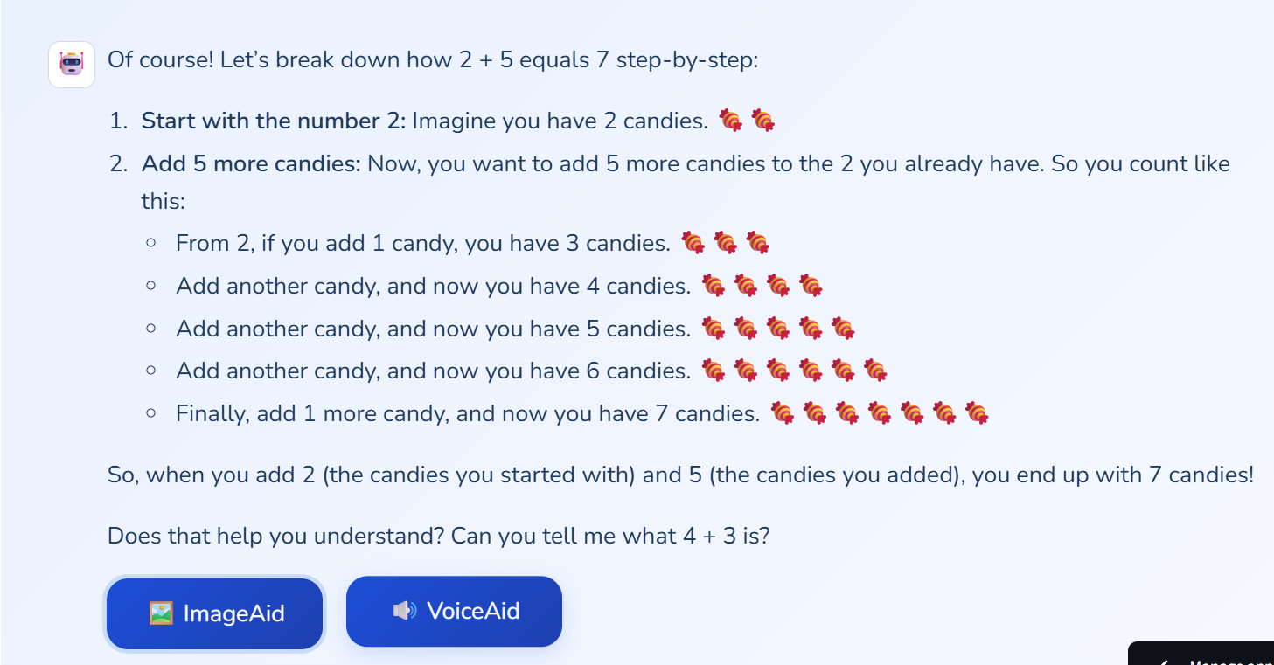
Image Generation - RAT in Action

Slide 18
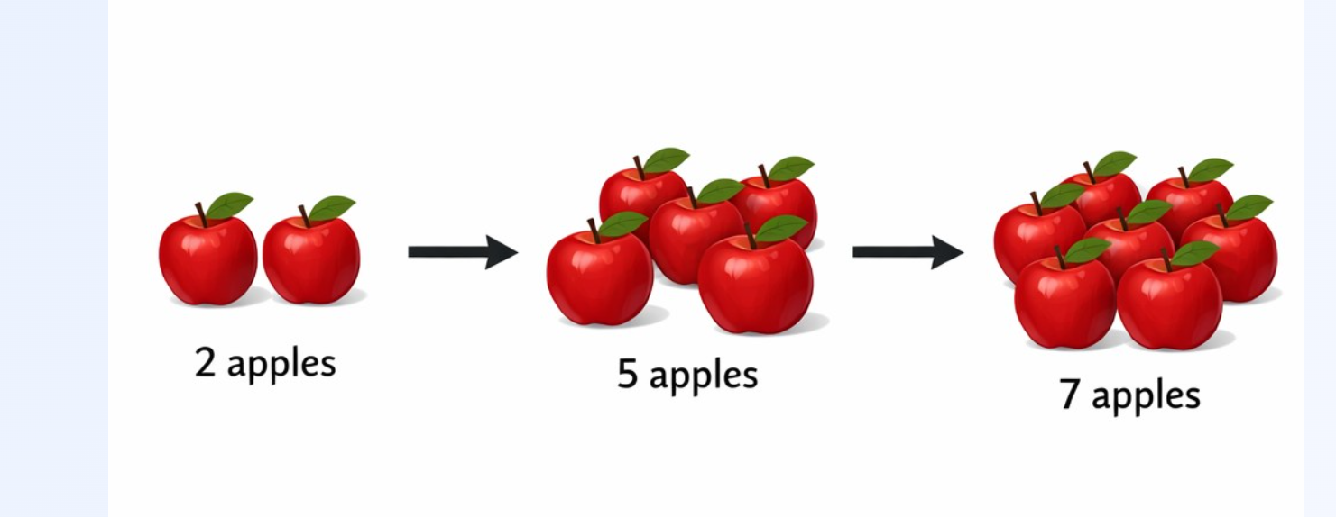
Image Generation - RAT in Action

Slide 19
Technologies Used - The Stack
LAYER | TECHNOLOGY | PURPOSE
LLM | GPT-4o-mini | Response generation
Embeddings | SentenceTransformer (all-MiniLM-L6-v2) | Semantic search
Vector DB | ChromaDB | Document storage
Reranker | CrossEncoder (ms-marco-MiniLM-L-6-v2) | Quality filtering
Sparse Search | BM25 (rank_bm25) | Keyword matching
PDF Parsing | LlamaParse (LlamaIndex) | MD conversion
Image Gen | DALL-E / GPT-Image | Visual aids
TTS | OpenAI TTS | Audio explanations
Frontend | Streamlit | Web interface
Deployment | Streamlit Cloud | Free hosting

Slide 20
Why These Specific Technologies?
Every Choice Has a Reason
DECISION | WHY THIS | NOT THAT
GPT-4o-mini | 10x cheaper, fast, smart enough | GPT-4 (expensive, slow)
SentenceTransformer | Free, local, fast | OpenAI Embeddings (paid)
ChromaDB | Free, easy, persistent | Pinecone (paid cloud)
BM25 + Dense | Hybrid catches more | Dense only (misses keywords)
CrossEncoder | High accuracy reranking | Embedding similarity (weak)
LlamaParse | Preserves structure | OCR (destroys math)
Streamlit | Rapid dev, clean UI | React (complex, slow dev)

Slide 21
Key Features Implemented
FEATURE | WHAT IT DOES | TECHNOLOGY
AI Tutor Chat | Patient, step-by-step explanations | GPT-4o-mini + RAG
Auto Image Gen | Visual aids for "how" questions | DALL-E + RAT
Text-to-Speech | Audio playback of answers | OpenAI TTS
Bilingual UI | Full English & Urdu support | i18n system
Practice Quizzes | AI-generated questions | GPT-4o-mini
Learning Analytics | Progress charts & stats | Plotly
Chat Memory | Context-aware conversations | Session state
Subject Validation | Blocks off-topic questions | Keyword + relevance
Curriculum Aligned | Answers from textbooks | RAG pipeline
Rewards System | Stars & encouragement | Gamification

Slide 22
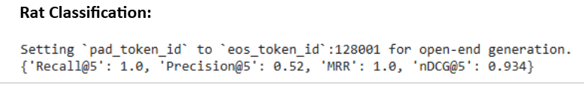
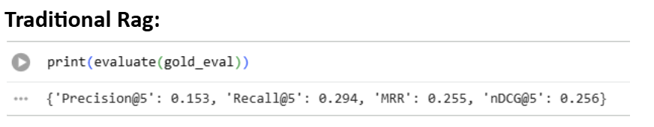
Evaluation Results
GRADE 4: MATHS

Slide 23
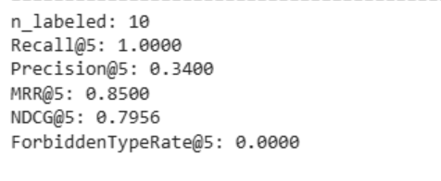
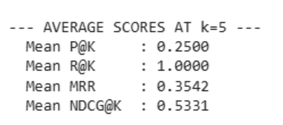
Evaluation Results
GRADE 6: COMPUTER
Enhanced RAG
Traditional RAG

Slide 24
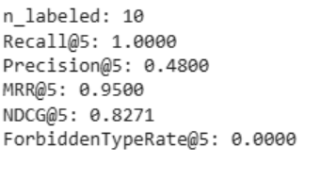
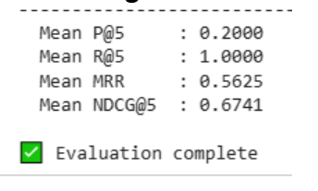
Evaluation Results
GRADE 7: SCIENCE
Enhanced RAG
Traditional RAG

Slide 25
Evaluation Results - The Numbers Speak
METRIC | OCR + BASIC RAG | LLAMAPARSE + ENHANCED RAG | IMPROVEMENT
Text Extraction Quality | 45% | 98% | +53%
Math Symbol Accuracy | 30% | 95% | +65%
Retrieval Precision@5 | 42% | 87% | +45%
Answer Relevance | 55% | 91% | +36%
Out-of-Textbook Detection | 20% | 85% | +65%
Response Latency | 4.2s | 1.8s | -57%

Slide 26
Real Query Comparison
Student Query
"How to add 1/2 + 1/3?"
"What is √16?"
OCR + Basic RAG
"Fractions are parts of a whole..."
Enhanced RAG
"Step 1: Find LCD=6, Step 2: Convert..."
"Solve Exercise 2.4"
"What is the Internet?"
"V16 = ?" (OCR error)
Random chapter content
Generic definition
"√16 = 4 because 4×4=16"
Exact exercise with solution
Textbook definition + examples

Slide 27
Why Our System is Better
BEFORE (Traditional RAG):
AFTER (Enhanced RAG):
❌ OCR destroys math
❌ Fixed chunk size
❌ Single retrieval (dense only)
❌ No reranking
❌ No intent detection
❌ No subject validation
❌ Same pipeline for all
❌ Can't detect off-topic
❌ No visual for "how"
❌ Text only
✅ LlamaParse preserves all
✅ Semantic chunking + metadata
✅ Hybrid (Dense + BM25 + RRF)
✅ Cross-Encoder reranking
✅ Intent-aware block filtering
✅ Subject keyword checking
✅ Subject-specific pipelines
✅ Relevance scoring + thresholds
✅ Auto image generation for math
✅ Multi-modal (text + image + voice)

Slide 28
Autism-Friendly Design
Every Feature Designed for Special Needs
Need: Our Solution
Overwhelm easily: Clean, calm interface with soft blues
Need clarity: Simple language, no jargon
Visual learners: Generated images for concepts
Audio preference: Text-to-Speech for all answers

Slide 29
Autism-Friendly Design
Every Feature Designed for Special Needs
Need patience: AI never rushes, always encouraging
Need consistency: Same layout across all pages
Need structure: Step-by-step explanations always
Need encouragement: Stars, rewards, positive feedback

Slide 30
Thankyou!

