Slide 1

uZumaKi
Benchmarking Suite
ZK Bankai

Slide 2
Why do we need a benchmarking suite?
Navigating Diversity
Rapid Evolution
Informed Decision-Making
Progress with historical data
Testing Systems Under Heavy load
Limitations with current benchmarks

Slide 3
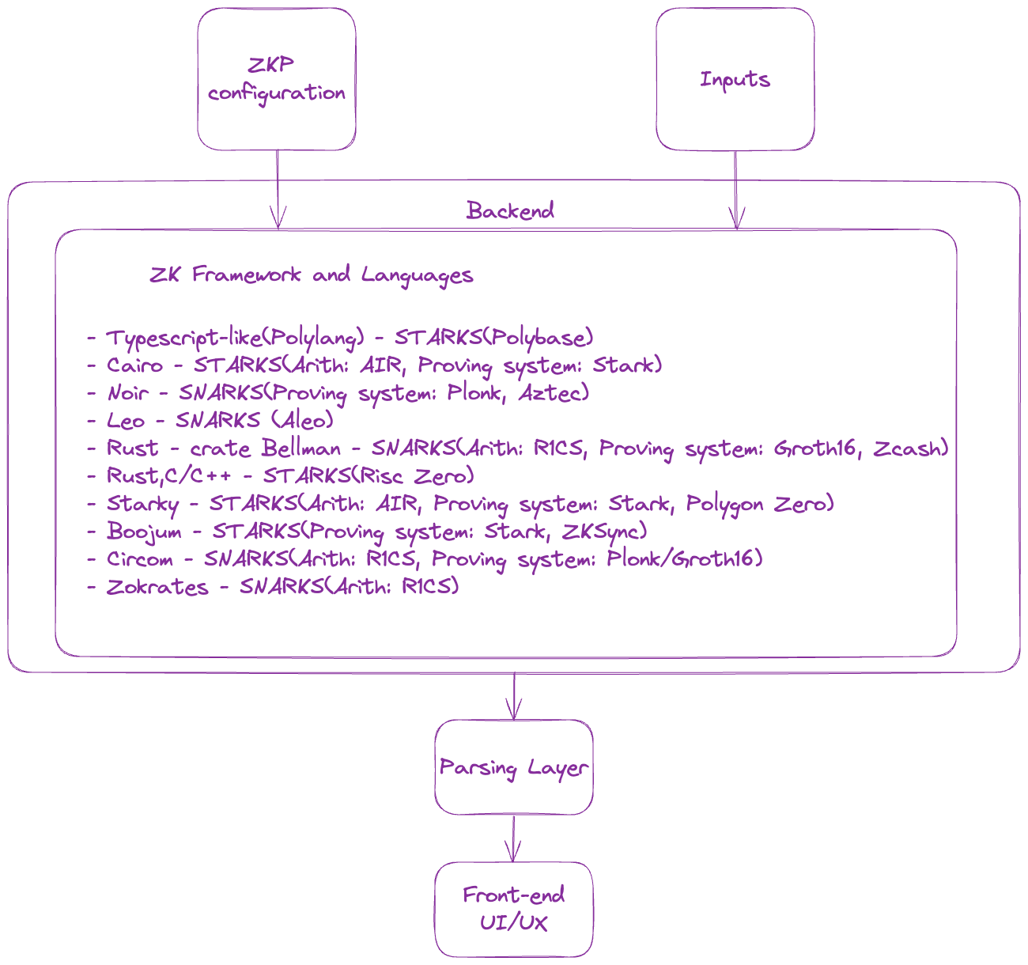
High Level Design

Slide 4
Current Roadmap of proving systems and frameworks
Starks
Prover | Language/Library | Arithmetization
Stone | Cairo | AIR
Miden | Polylang(Typescript-like) | -
RiscZero | Rust/C/C++ | -
Boojum(ZkSync) | Rust | -

Slide 5
Snarks
Prover | Language/Library | Arithmetization
Plonk | Noir | -
Aleo | Leo | -
Groth16 | Bellman(Rust) | R1CS
Groth16 | Circom | R1CS
Marlin/Groth16 | Zokrates | R1CS

Slide 6
Assessments
Prover performance
Verifier performance
Proof size
Proof Generation Time (including witness generation time)
Peak Memory usage during proof generation
Average CPU Utilization % during proof generation (Reflects parallelization degree)
Proof cost (Dependent on field and curve efficiency, proof techniques, and computation model)
EVM Verifier
External libraries support
Ease of Use: Learning curve and user-friendliness of each DSL
Security Features: Built-in security measures of each DSL
Community and Ecosystem: Community size, resources, documentation, and support
Version Tracking: Include version numbers of DSLs for updates and improvements
Parallelization and Scalability: Support for parallel computations and scaling

Slide 7
Benchmarks developed till now
Miden Stark Prover
RiscZero Prover
Stone Prover(Starkware)

Slide 8
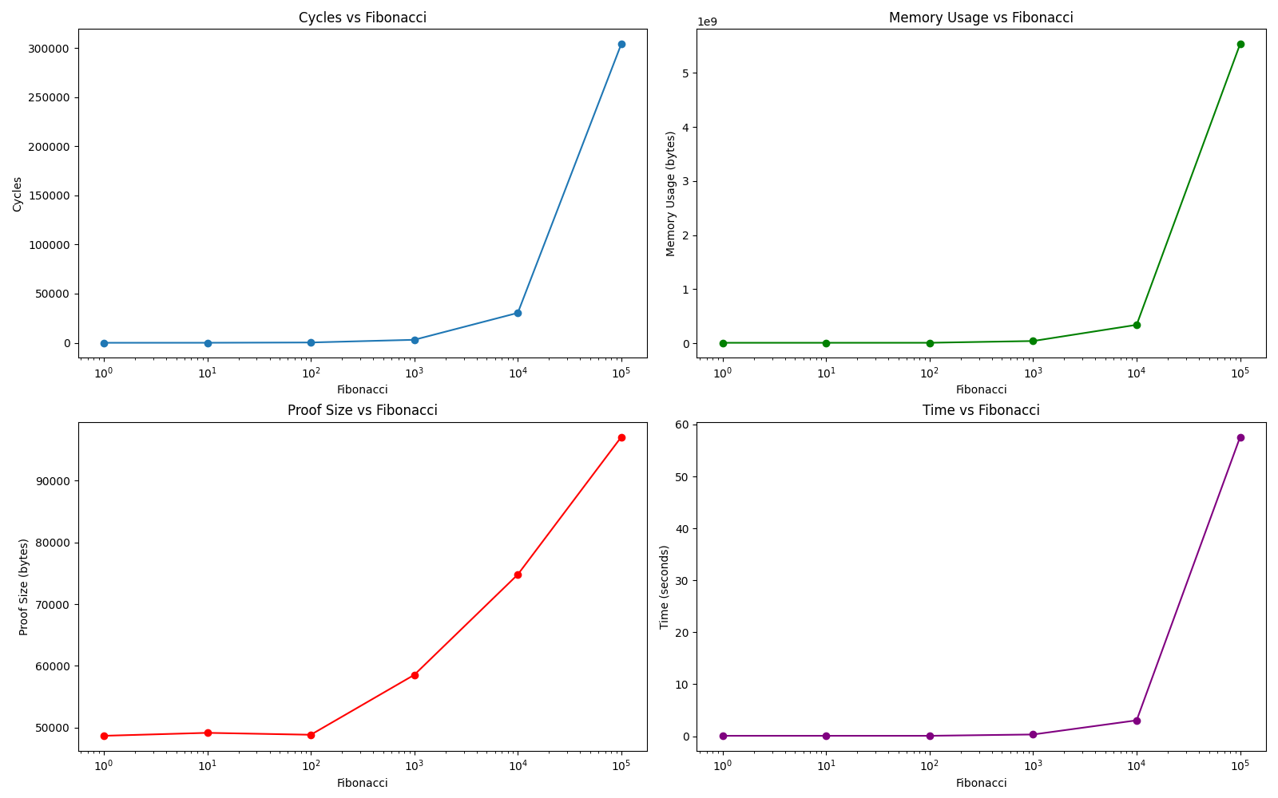
Miden Stark Fibonacci Prover

Slide 9
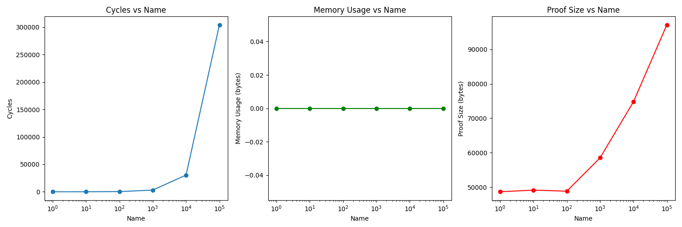
Miden Stark Fibonacci Verifier

Slide 10
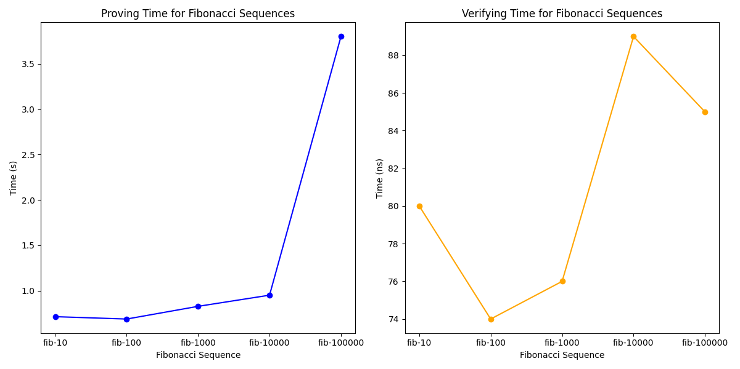
RiscZero Stark Fibonacci Prover & Verifier

Slide 11
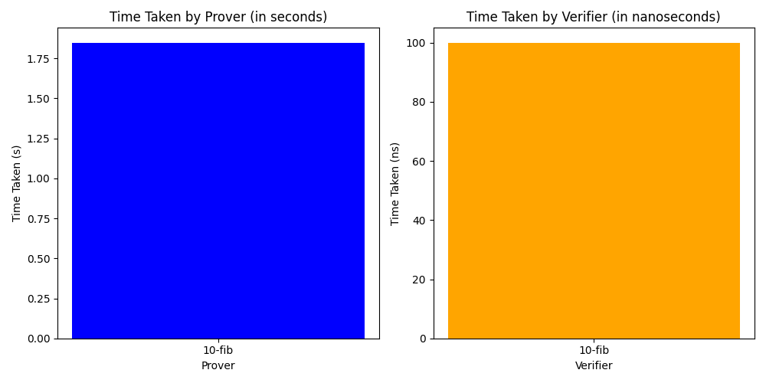
Stone Prover Fibonacci Prover and Verifier

Slide 12
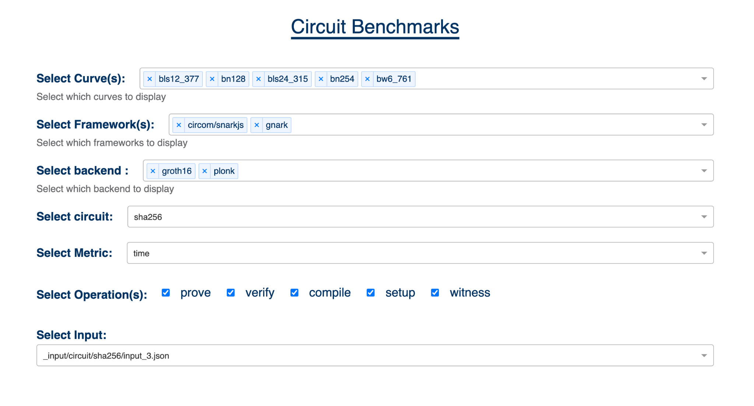
UI/UX Circuit Benchmarking for Snarks

Slide 13
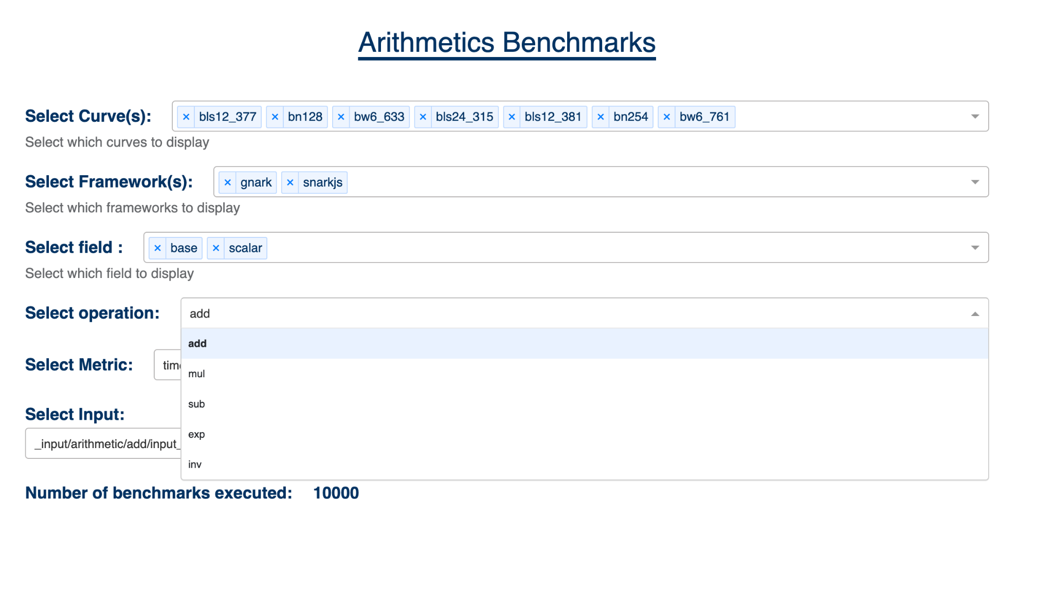
UI/UX Arithmetic Benchmarking for Snarks

Slide 14
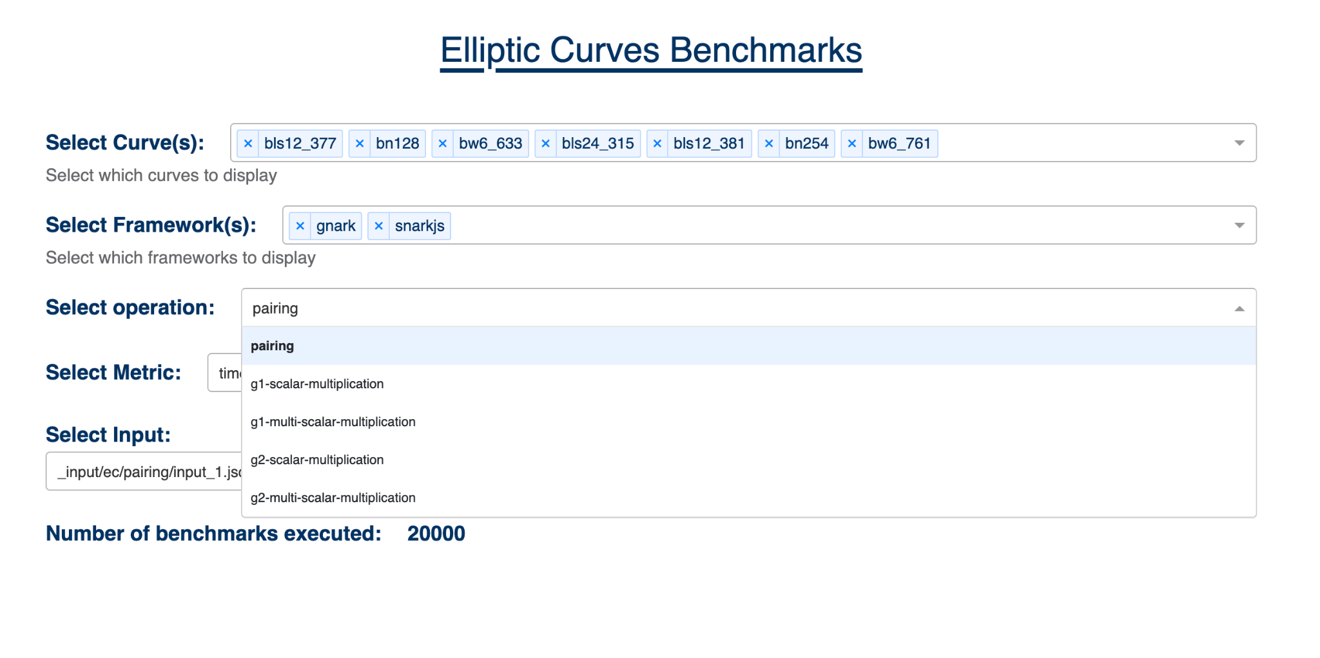
UI/UX Elliptic Benchmarking for Snarks

Slide 15
Future Prospects:
Benchmarking
DSL frameworks without proving systems
Compute on Icicle
Sequencers
Different zkVMs (e.g., Scroll, Polygon zkEVM, Consensys zkEVM, zkSync, Risc Zero, zkWasm)
IR compiler frameworks (e.g., zkLLVM)

Slide 16
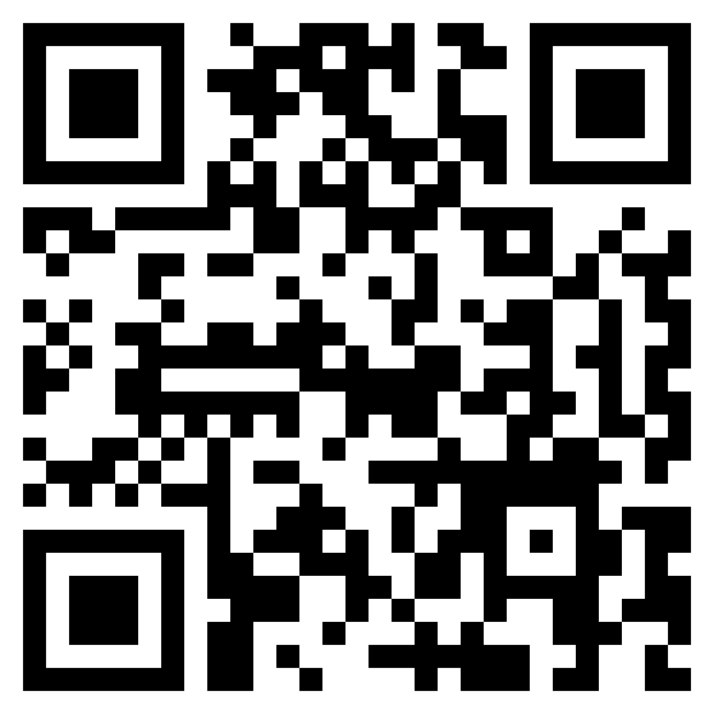
Thank you!!!
Github Link :
https://github.com/zk-bankai/uzumaki

