Slide 1

Estimation of Background Noise Based on Excitation Patterns in Cochlear Implants
Opening Proposal of Student Research Project
Fang Xiao, B.Sc.
Reemt Hinrichs, M.Sc. (TNT)
Max-Heinrich Laves, M.Sc. (IMES)
Prof. Dr.-Ing. Tobias Ortmaier (IMES)
Prof. Dr.-Ing. Jörn Ostermann (TNT)
Institut für Informationsverarbeitung
Leibniz Universität Hannover

Slide 2

Overview
Structure
Introduction
Background
Motivation
Progress So Far
General Ideas
Candidate Algorithms (Preliminary Results)
EP-based modification
Future Plans
Testing Scenarios
Statistical Evaluation
Timetable

Slide 3
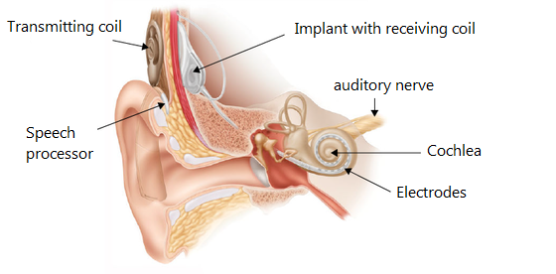
Introduction
Cochlear Implant (CI)
Components: microphone, speech processor and electrodes.
Limitation: intelligibility decreases in non-stationary environments.
Binaural sound coding strategy (BSCS, Gajecki et al., 2018)
Source: https://www.csun.edu/ncod/cochlear-implants
2
Notes:
What’s CI; Components
Limitations: Noise, Battery
BSCS: Master/ Slave model; EP-based
Motivation: compare by EP
SCS (EP intro):

Slide 4
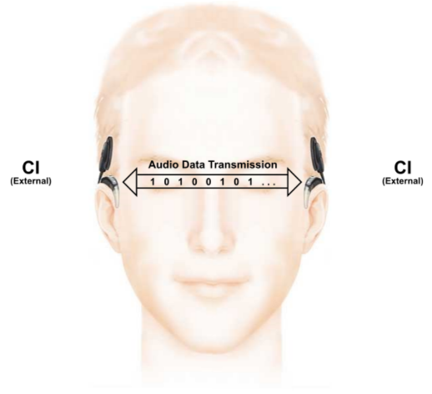
Introduction
Cochlear Implant (CI)
Components: microphone, speech processor and electrodes.
Limitation: intelligibility decreases in non-stationary environments.
Binaural sound coding strategy (BSCS, Gajecki et al., 2018)
3

Slide 5
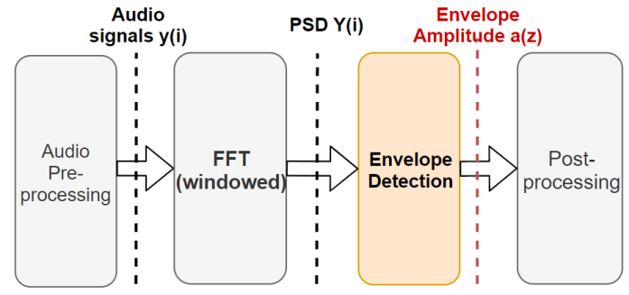
Introduction
Sound coding strategy
Choice: Advanced Combinational Encoder (ACE)
Illustration (part one): from audio signals to envelope
4

Slide 6
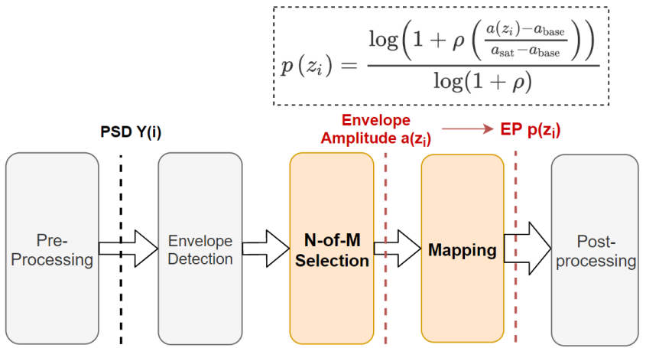
Introduction
Sound coding strategy
Choice: Advanced Combinational Encoder (ACE)
Illustration (part two): from envelope to excitation patterns (EP)
5

Slide 7
Overview
Structure
Introduction
Background
Motivation
Progress So Far
General Idea
Candidate Algorithms
EP-based modification
Future Plans
Testing Scenarios
Statistical Evaluation
Timetable

Slide 8
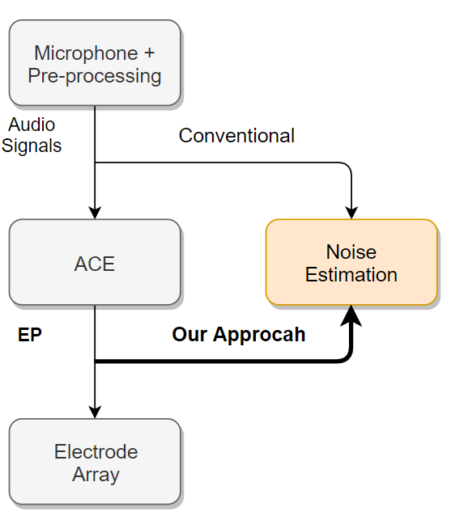

Progress So Far
General Idea
$$SNR=10⋅\log_{10}{\frac{{E[P}_{speech}]}{E[P_{noise}]}}$$
7

Slide 9
Progress So Far
Candidate Algorithms
1. Improved Minimum Controlled Recursive Averaging (IMCRA, Cohen, 2003)
Estimation by recursive averaging with “soft decision” (speech presence probability, or “SPP”)
Minimum-controlled estimation with two orders of smoothing
2. MMSE-based Noise PSD Tracking (MMSE-BC, Hendricks et. al, 2010)
Bias Compensation
Safety Net
3. Unbiased MMSE-based Noise Power Estimation (MMSE-SPP Gerkmann et. al, 2012)
Use of “soft decision” avoiding BC and safety net
8

Slide 10
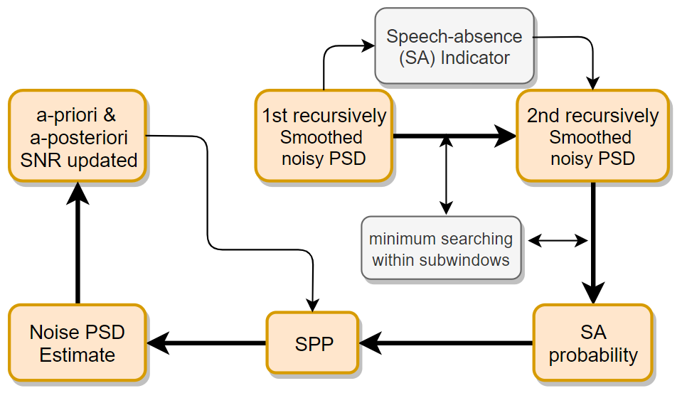
Candidate Algorithms
IMCRA [Cohen,2002]
Fang Xiao
xiaofang@tnt.uni-hannover.de
9
Notes:
Move equations to Backup

Slide 11
Progress So Far
Candidate Algorithms
1. Improved Minimum Controlled Recursive Averaging (IMCRA, Cohen, 2003 )
Estimation by recursive averaging (with “soft decision”)
Minimum-controlled estimation
2. MMSE-based Noise PSD Tracking (MMSE-BC, Hendricks et. al, 2010)
Bias Compensation
Safety Net
3. Unbiased MMSE-based Noise Power Estimation (MMSE-SPP, Gerkmann et. al, 2012)
Use of “soft decision” avoiding BC and safety net
10
Notes:
Full name of abbr.!

Slide 12
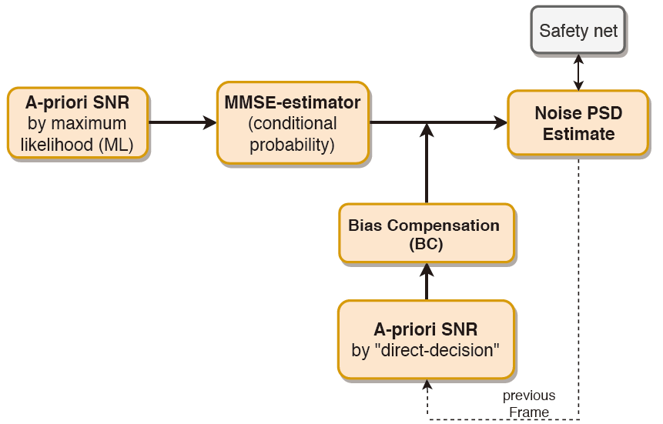
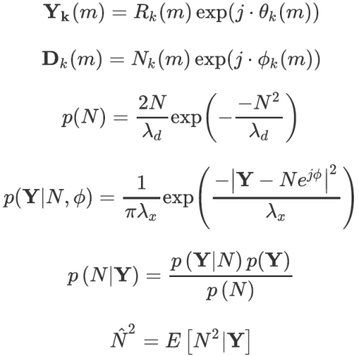
Candidate Algorithms
MMSE-BC [Hendricks, 2010]
11

Slide 13
Progress So Far
:Candidate Algorithms
1. Improved Minimum Controlled Recursive Averaging (IMCRA, Cohen, 2003)
Estimation by recursive averaging (with “soft decision”)
Minimum-controlled estimation
2. MMSE-based Noise PSD Tracking (MMSE-BC, Hendricks et. al, 2010)
Bias Compensation (BC)
Safety Net
3. Unbiased MMSE-based Noise Power Estimation (MMSE-SPP, Gerkmann et al., 2012)
Use of “soft decision” avoiding BC and safety net
12

Slide 14
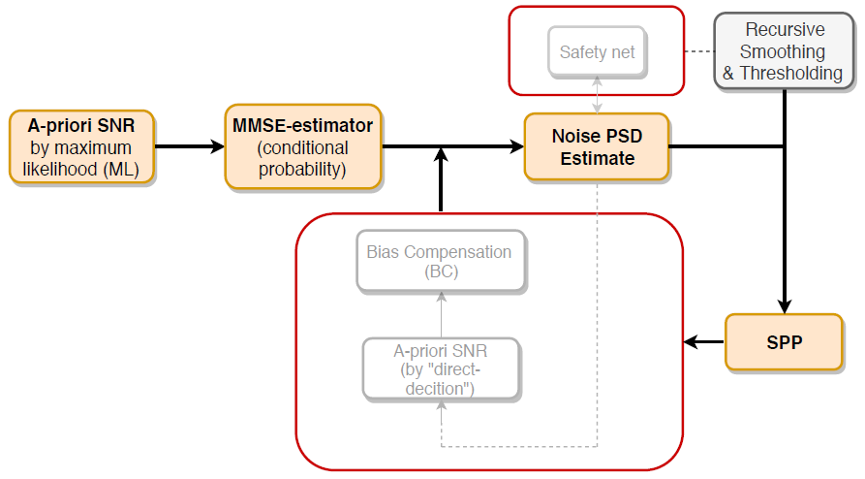
Candidate Algorithms
MMSE-SPP [Gerkmann, 2012]
Almost identical procedures to the MMSE-BC
Rough decision → “soft weighting”
13

Slide 15
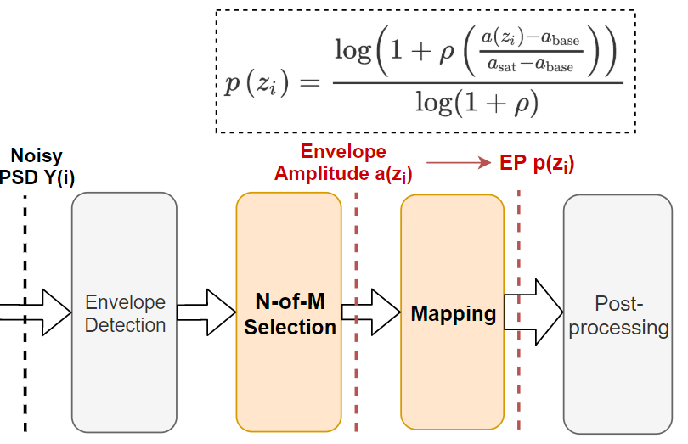
Progress So Far
EP-based Modification
N-of-M selection causes information loss
EP instead of audio signals as input
Treated as a special kind of PSD
14

Slide 16
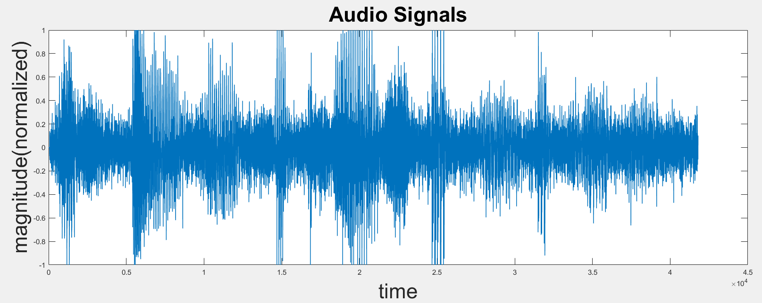
Preliminary Results
Original Audio Signals
15

Slide 17
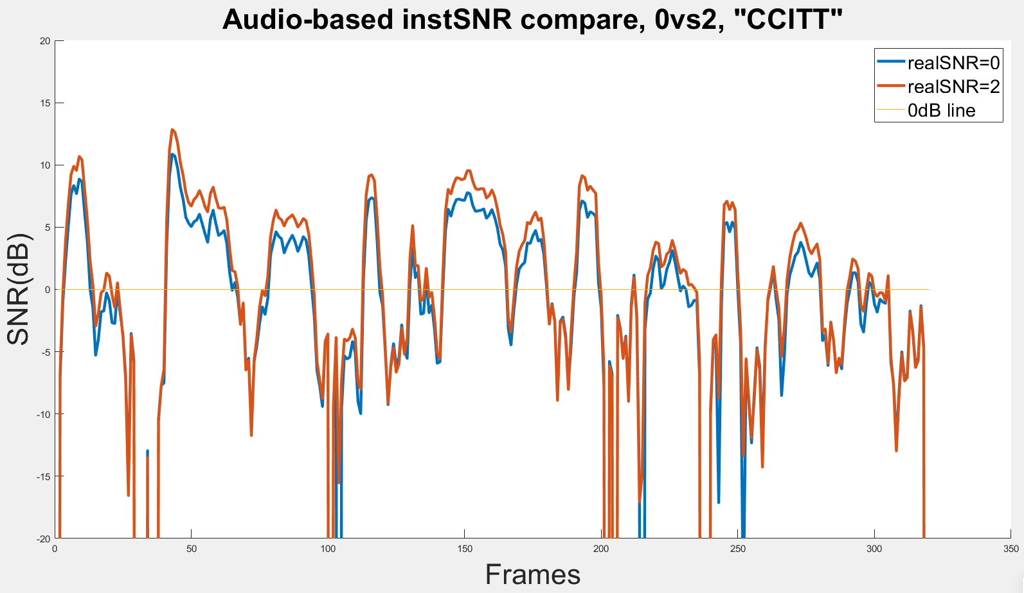
Preliminary Results
Audio-based Noise Estimation
16

Slide 18
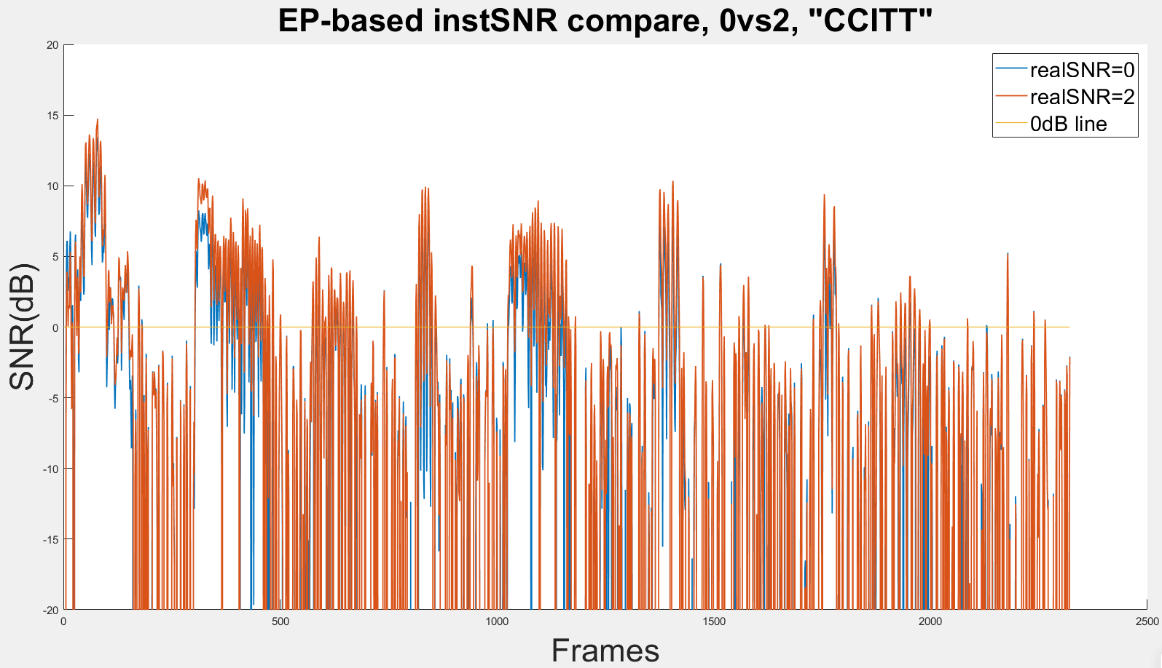
Preliminary Results
EP-based Noise Estimation
17

Slide 19
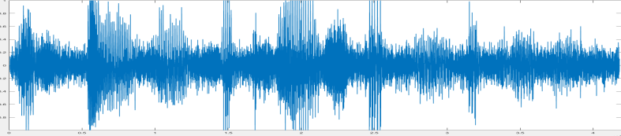
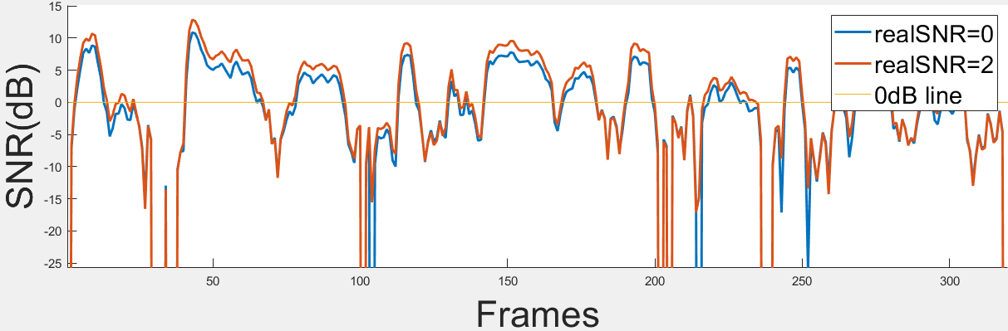
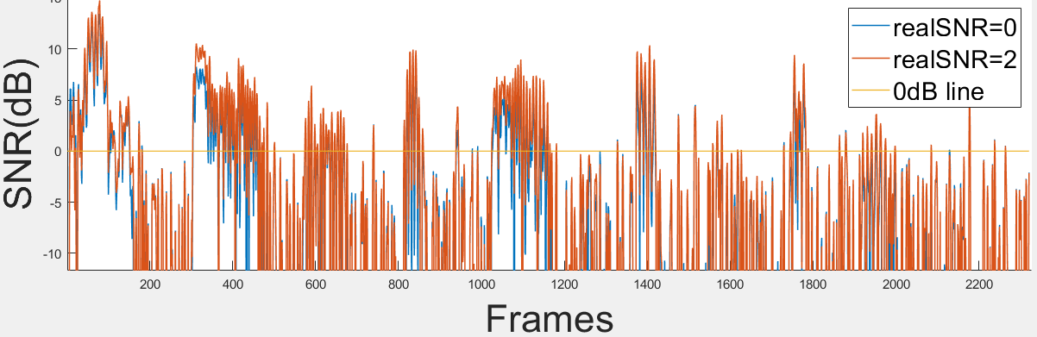
Preliminary Results
Rough Comparison
18

Slide 20
Overview
Structure
Introduction
Background
Motivation
Progress So Far
General Idea
Candidate Algorithms
EP-based modification
Future Plans
Testing Scenarios
Statistical Evaluation
Timetable

Slide 21
Future Plans
Testing Scenarios
The typical influencing factors of noises:
Noise types: CCITT, Office, etc…
Noise levels: constant / variant in segments
Real-world position simulation
Multiple noise sources (“Cocktail party effect”)
“Codec-introduced” noise
Further testing factors：
Stimulation rate: “N-of-M” selection
Band selection: rough prediction
20

Slide 22
Future Plans
Evaluation
Estimation Accuracy
Segmental SNR
Log-error distortion measure
Statistical Evaluation
Standard error
Confidence interval
21
Notes:
Explain!
In words (definition; how it works in comparing process)
Equation in Backup

Slide 23
Timetable
Timetable (planned)
Official Start: 11.11.2019 Official Deadline: 10.05.2020
01.Nov – 30.Nov (2019) | Literature review; Code implementation of the first algorithm of noise estimation
01.Dec – 31.Dec | Code implementation of two other algorithms; Perform preliminary comparison
01.Jan – 31.Jan (2020) | Designing testing scenarios and statistical evaluation; Verifying further possibilities of EPs
01.Feb – 29.Feb | Performing testing scenarios; Statistical evaluation; Refining the codes.
01.Mar – 31.Mar | Formulate the thesis

Slide 24
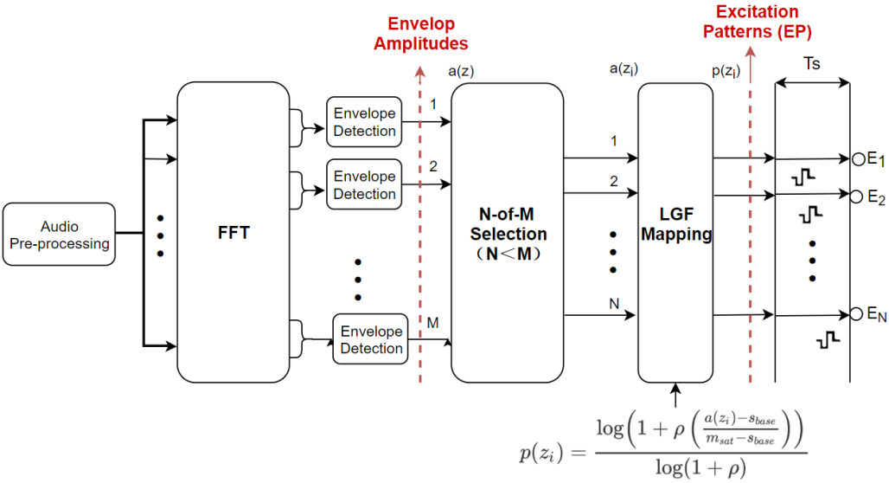
Backup
Detailed ACE Process
23

Slide 25
Backup
Complex Gaussian Distribution Assumption
& MMSE-Estimator (Bayes’ Rule)
24

Slide 26
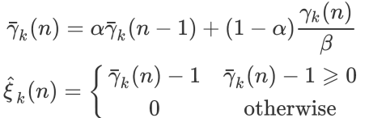
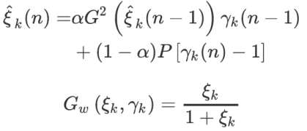

Backup
Maximum-Likelihood Estimation of a-priori SNR
Decision-Directed Approach of a-priori SNR
Gain Function Modified in IMCRA
25

Slide 27

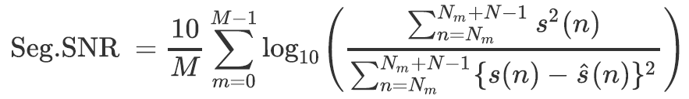

Backup
Log-Error Distortion Measure
$$LogErr = LogErr_{un} + LogErr_{ov}$$
Segmental SNR
26

Slide 28
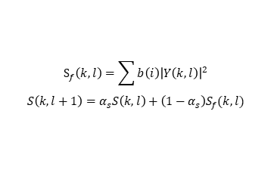


Progress So Far: Candidate Algorithms
IMCRA [Cohen,2002]
$$S_{f}\left(k,l\right)=\sum{b\left(i\right){\left|Y\left(k,l\right)\right|}^{2}}$$
$$S\left(k,l+1\right)=α_{s}S\left(k,l\right)+\left(1−α_{s}\right)S_{f}(k,l)$$
Two order of recursive averaging in both T-F domain
Rough decision:
strong noise identification
Soft decision: speech presence
$$p\left(k,l\right)=P\left(H_{1}\left(k,l\right) \right| y(k,l))$$
Noise Estimation, integrated with SPP-based smoothing
$${\hat{λ}}_{d}\left(k,l+1\right)=$$
$$α_{spp}⋅{\hat{λ}}_{d}\left(k,l\right)+\left(1−α_{spp}\right){⋅\left|Y\left(k,l\right)\right|}^{2}$$
Fang Xiao
xiaofang@tnt.uni-hannover.de
27
Notes:
- DETAILED FLOW CHARTS!
- Move equations to Backup

Slide 29



Progress So Far: Candidate Algorithms
MMSE-BC [Hendricks, 2010]
- Bayes’ rule
- Complex Gaussian distribution assumption for noise and speech power
MMSE-estimation of noise power
$$E\left\{N^{2} | Y;\hat{ξ}\right\}=\frac{E\left\{Y;\hat{ξ} | N^{2}\right\}×E\{N^{2}\}}{E\{Y;\hat{ξ}\}}$$
Direct-decision approach
for a-priori SNR estimate
$${\hat{ξ}}_{DD}\left(l\right)=α\frac{\hat{A}\left(l−1\right)}{λ_{d}\left(l−1\right)}$$
$$+\left(1−α\right) P[γ\left(l\right)−1]$$
Bias compensation
and safe net
$$\hat{σ_{N}^{2}}\left(k,l\right)=E\left\{N^{2} | Y;\hat{ξ}\right\}⋅B({\hat{ξ}}_{DD}\left(l\right))$$
$$\hat{σ_{N}^{2}}\left(k,l\right)=max⁡\{ \hat{σ_{N}^{2}}\left(k,l\right), { P}_{min}\left(k,l\right)\}$$
28

