Slide 1
Unraveling Cellular Complexity
Insights from Single-Cell Gene Expression Analysis
Team Lead: Shaolei Ma
Members: Peng Su; Yilei Yang; Zhuodiao Kuang

Slide 2
Introduction
Gaussian-Mixture model
EM algorithm
Principal Component Analysis
Raw Data
Clusters
Explore gene-expression signatures in each of Clusters
Which genes are important to differentiate the clusters?

Slide 3
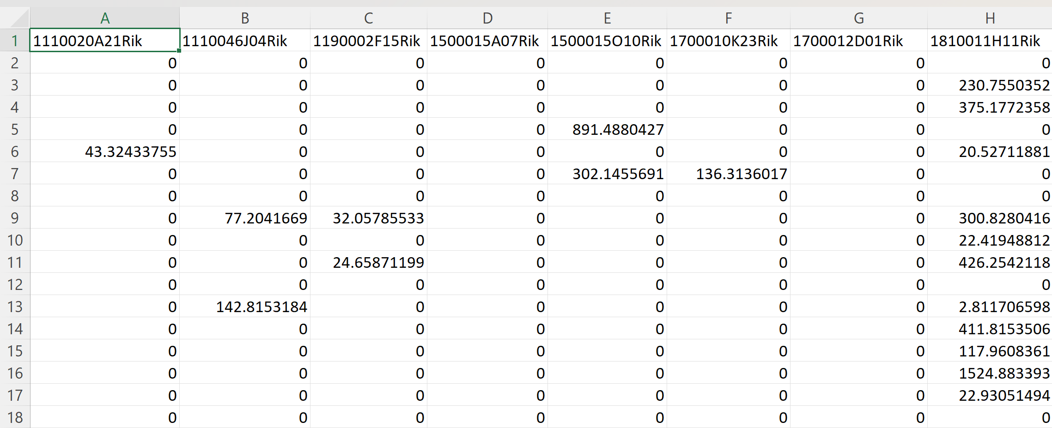
Data Overview
Dataset Composition:
716 cells
Analysis of 558 genes per cell.

Slide 4
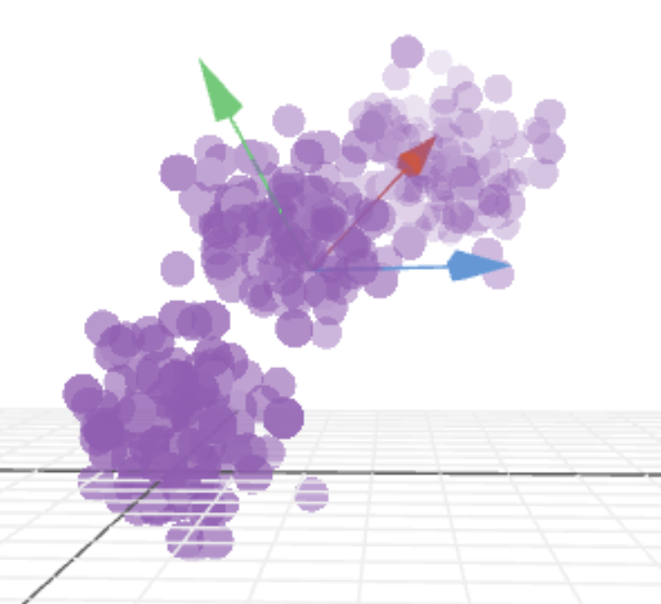
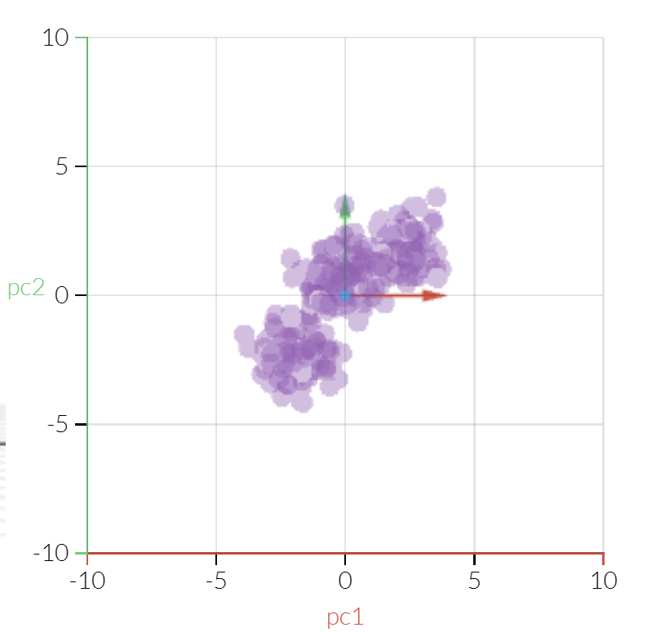
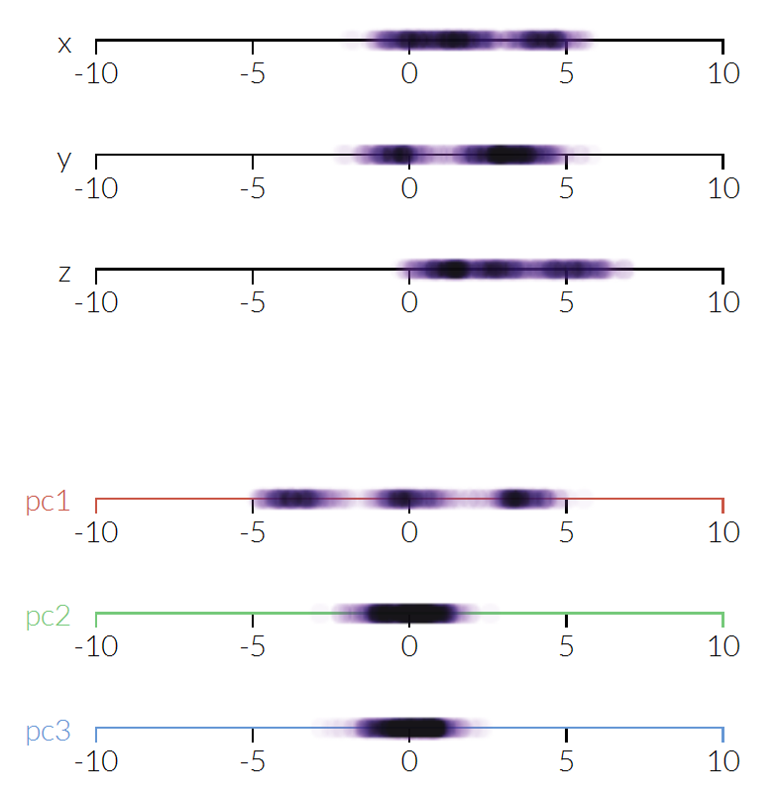
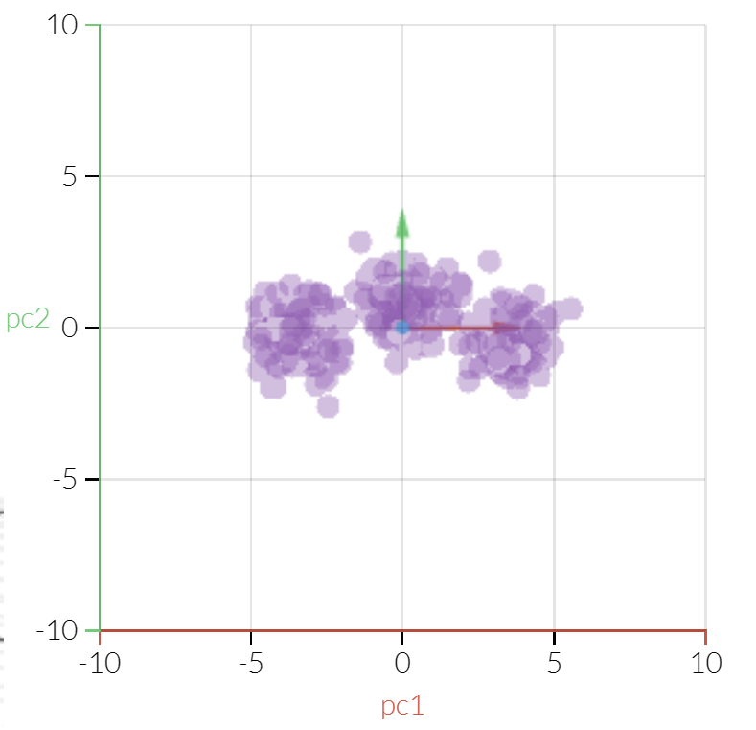
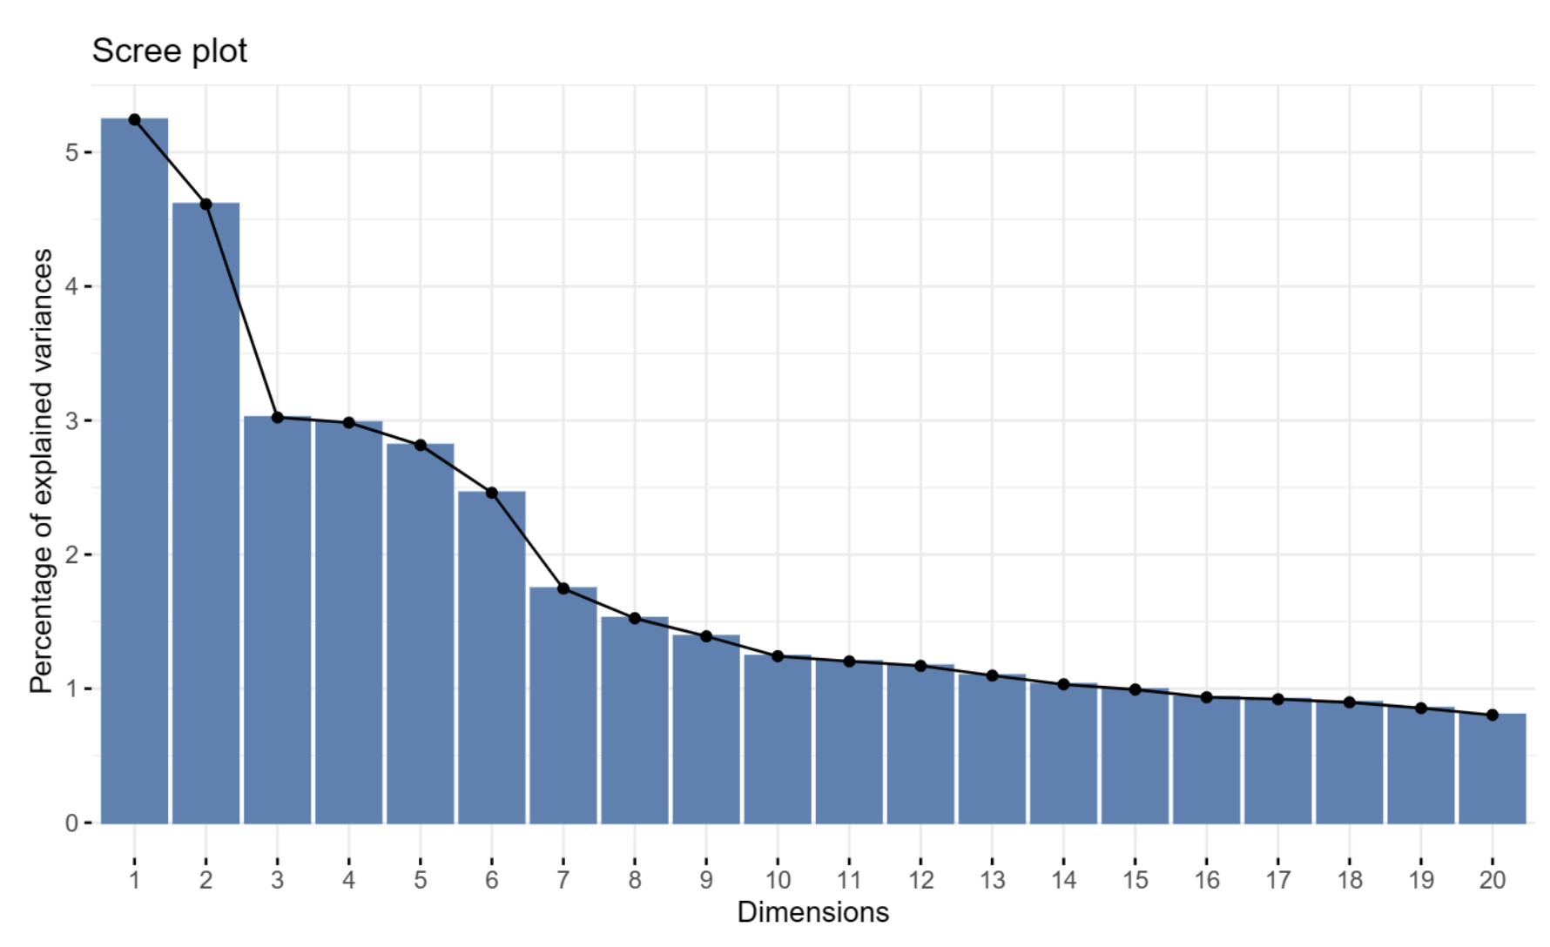
Principal Component Analysis (PCA)
Objective:
Capture major variability in gene expressions.
Methodology:
Using `prcomp` from R.
Outcome:
Selected principal components: 3, 7, 10 based on the scree plot.
Source:
https://setosa.io/ev/principal-component-analysis/

Slide 5
Significantly Differential Expressed Genes —— Method
Differential Gene Expression analysis
Data Transformation and weights estimation
log 2 transformed and normalized
precision weights estimation
Linear model fitting and updating
Fit linear model for each gene
model updated by integrating group comparison information
Improvements in statistical testing
Empirical Bayes: to refine the statistical inference
Cluster 1: 23 DEGs
21 up regulated
2 down regulated
Cluster 2: 27 DEGs
18 up regulated
9 down regulated
Cluster 3: 14 DEGs
8 up regulated
6 down regulated

Slide 6
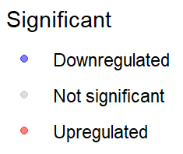
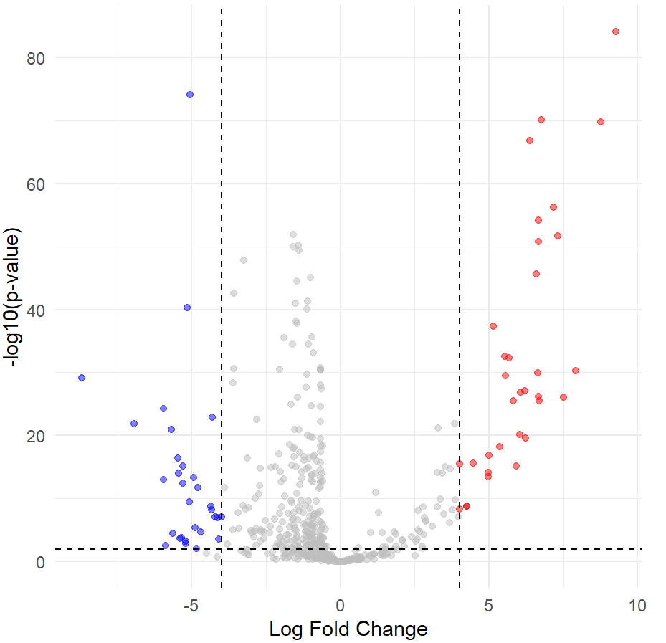
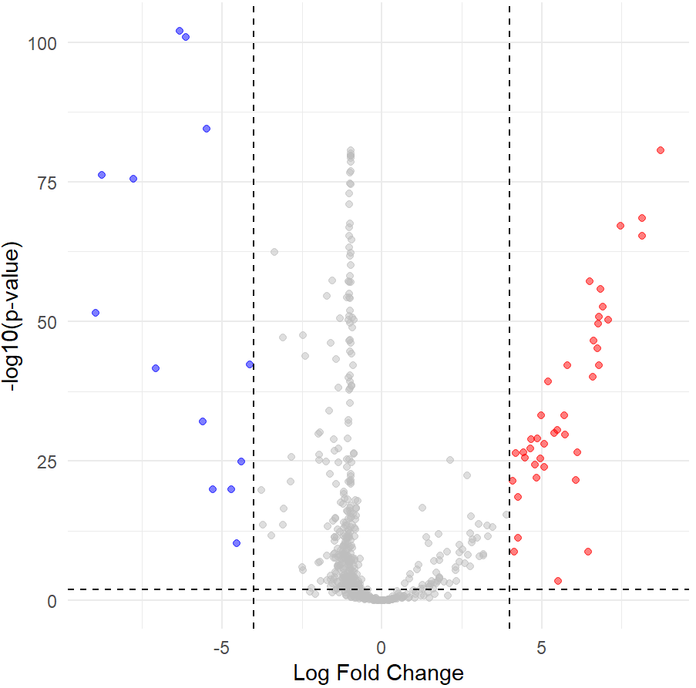
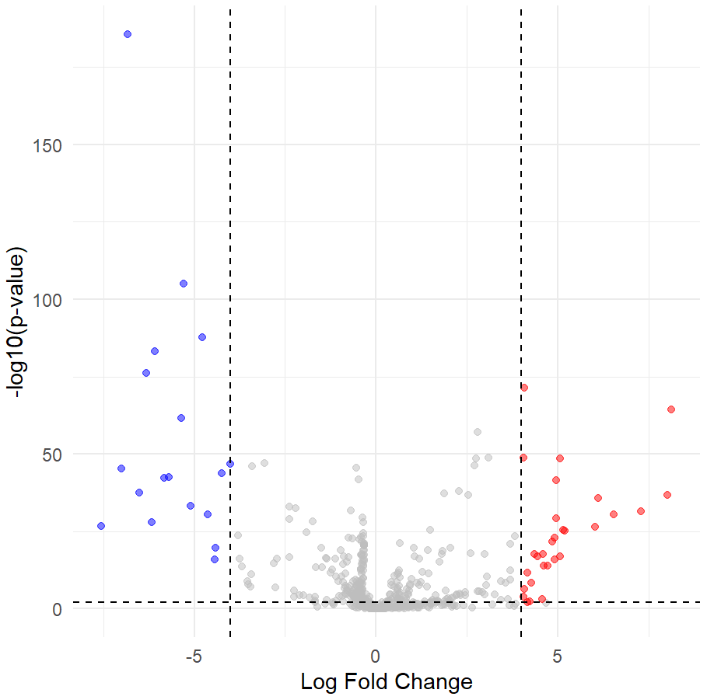
Significantly Differential Expressed Genes —— Method
A
B
C
Cluster 1 VS 2
Cluster 1 VS 3
Cluster 2 VS 3

Slide 7
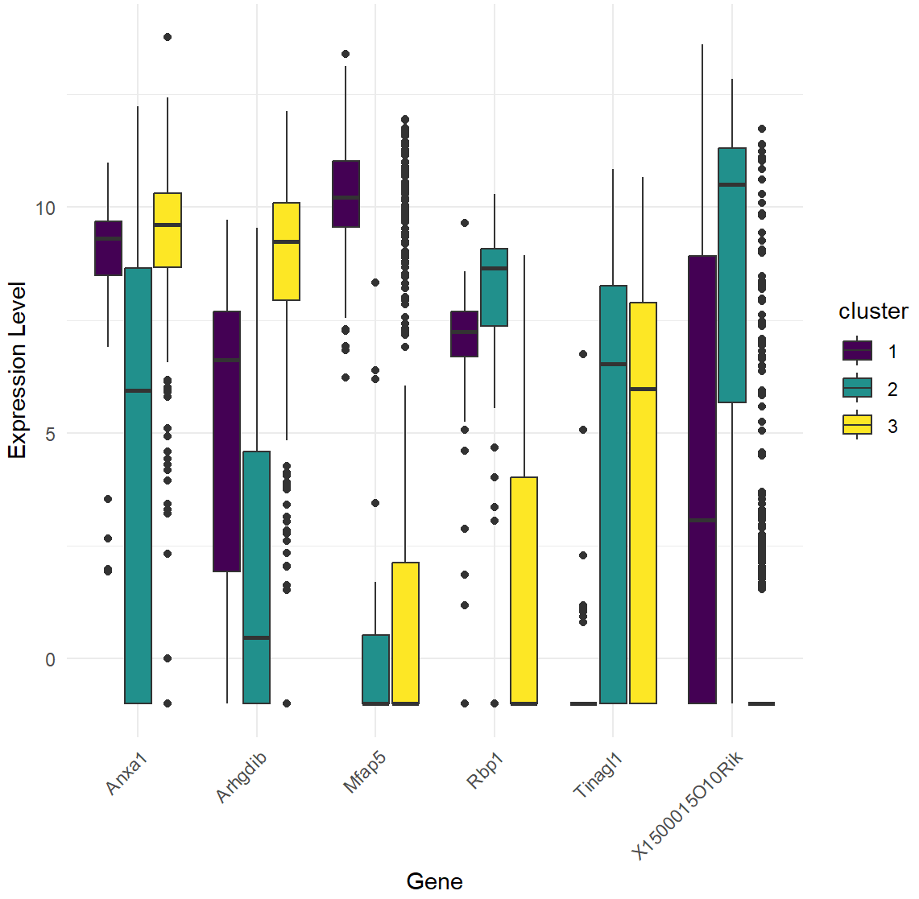
Significantly Differential Expressed Genes —— Method
Cluster 1 |  | Cluster 2 |  | Cluster 3
Up | Down | Up | Down | Up | Down
Mfap5 | Tinagl1 | X1500015O10Rik | Anxa1 | Arhgdib | Rbp1

