Slide 1
Unraveling Cellular Complexity
Insights from Single-Cell Gene Expression Analysis
Team Lead: Shaolei Ma
Members: Peng Su; Yilei Yang; Zhuodiao Kuang

Slide 2
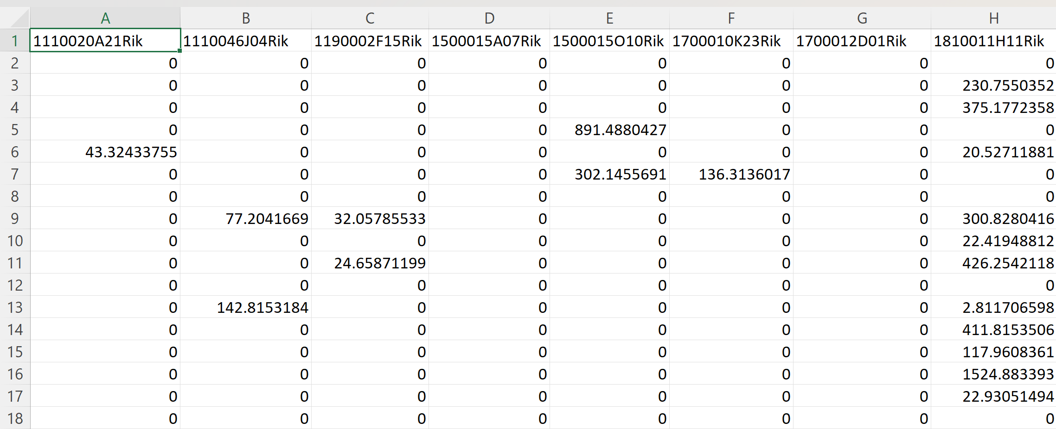
Data Overview
Dataset Composition:
716 cells
Analysis of 558 genes per cell.

Slide 3
Introduction
Gaussian-Mixture model
EM algorithm
Principal Component Analysis
Raw Data
Clusters
Explore gene-expression signatures in each of Clusters
Which genes are important to differentiate the clusters?

Slide 4
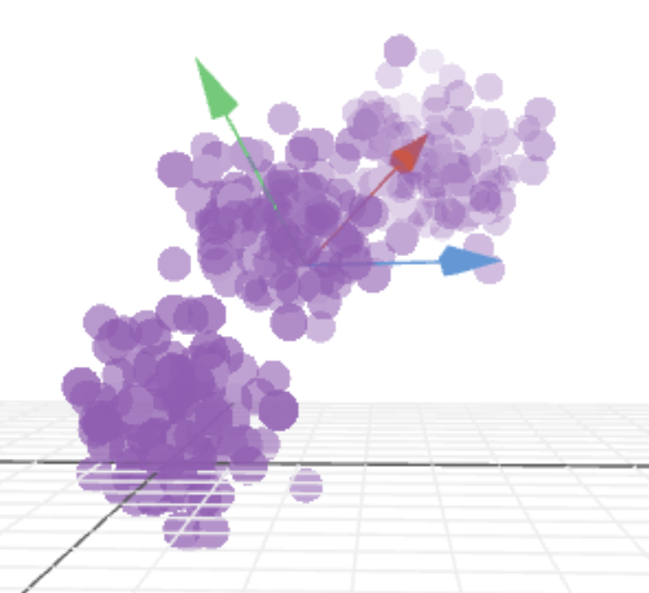
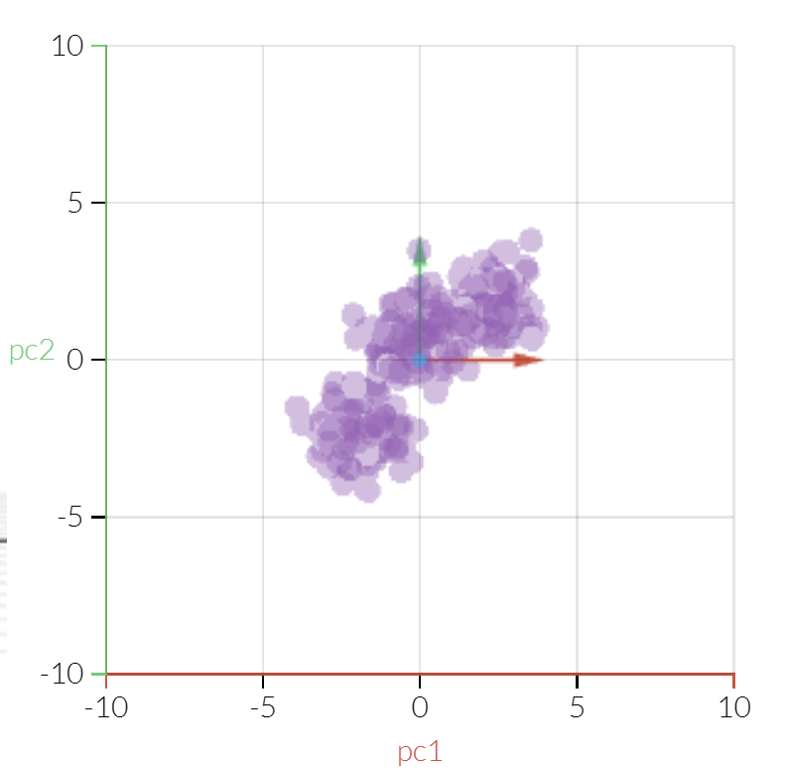
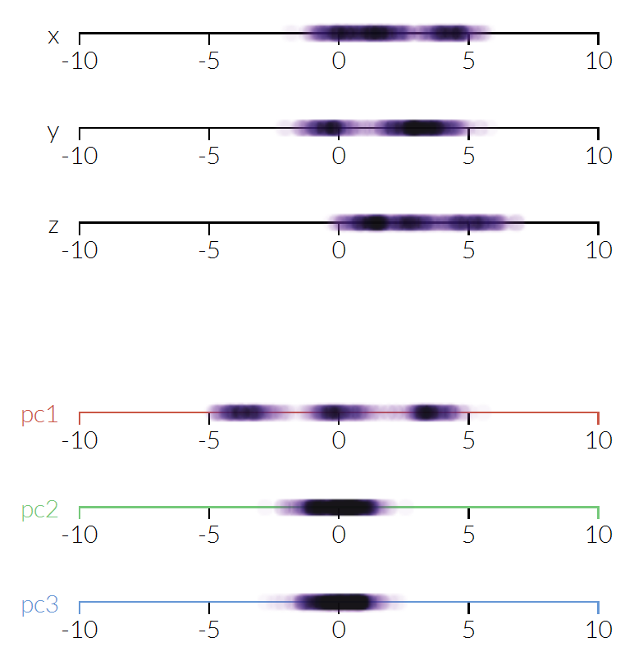
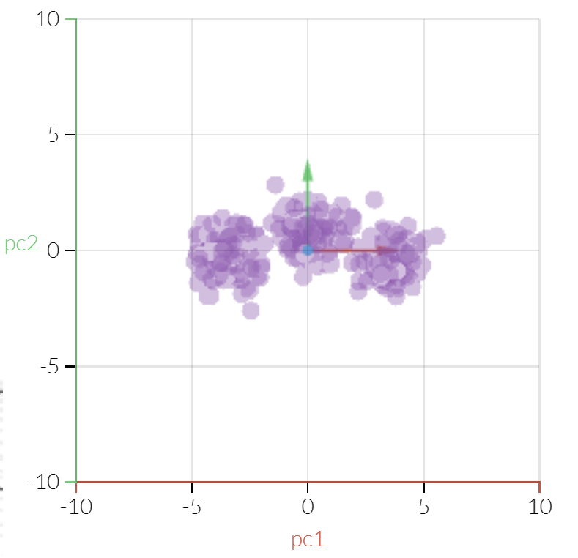
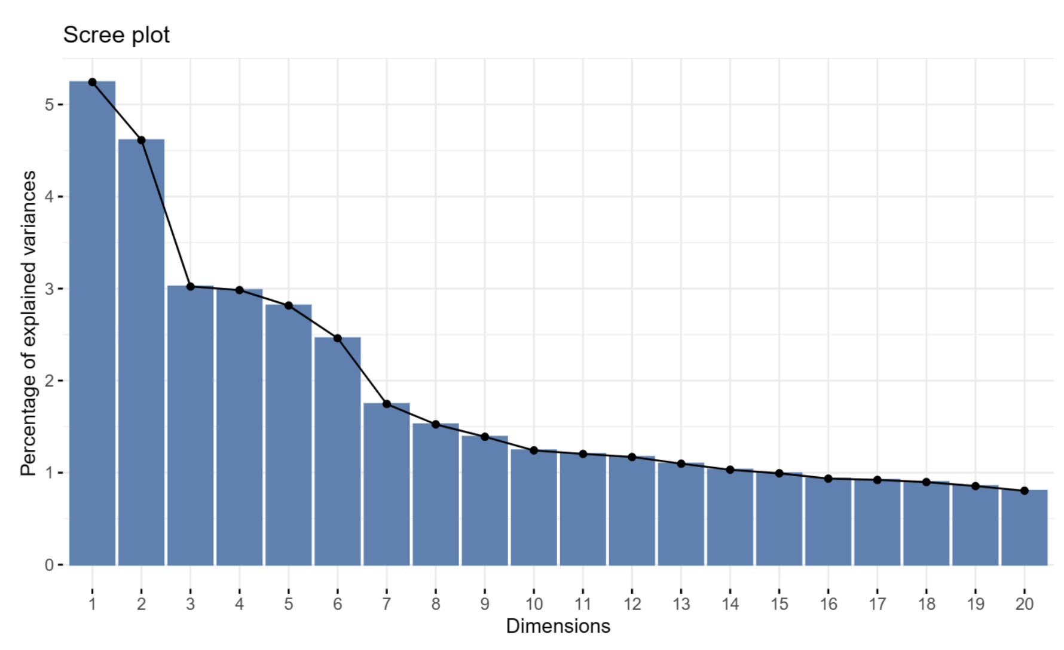
Principal Component Analysis (PCA)
Objective:
Capture major variability in gene expressions.
Methodology:
Using `prcomp` from R.
Outcome:
Selected principal components: 3, 7, 10 based on the scree plot.
Source:
https://setosa.io/ev/principal-component-analysis/

