Slide 1

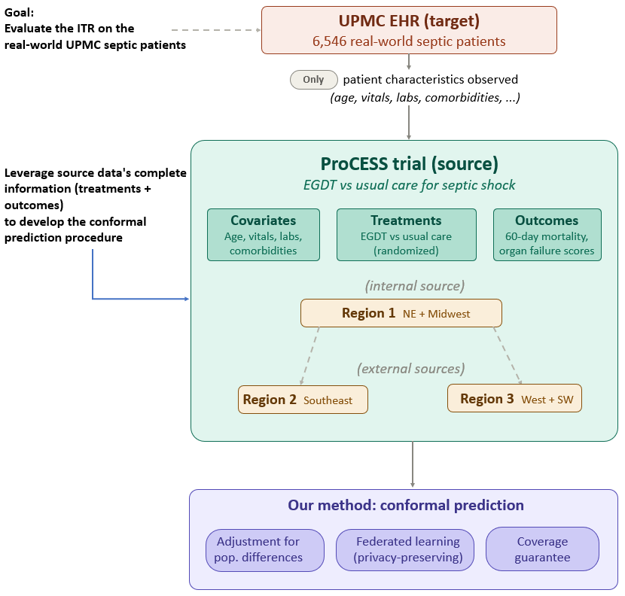
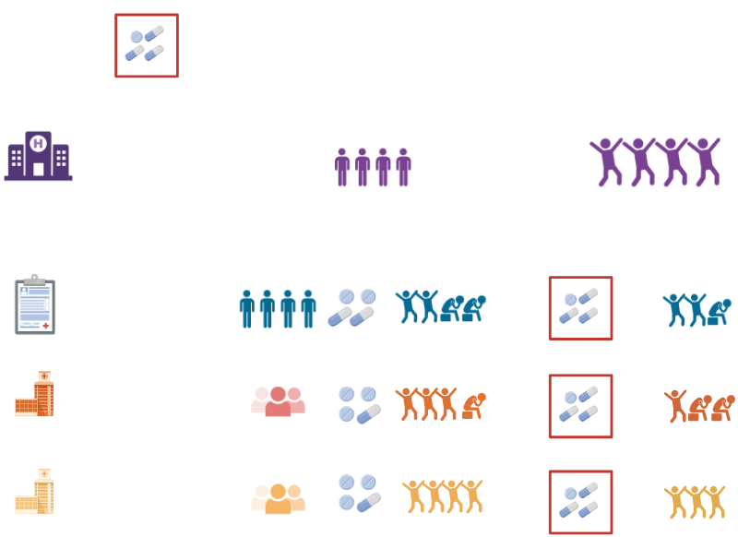
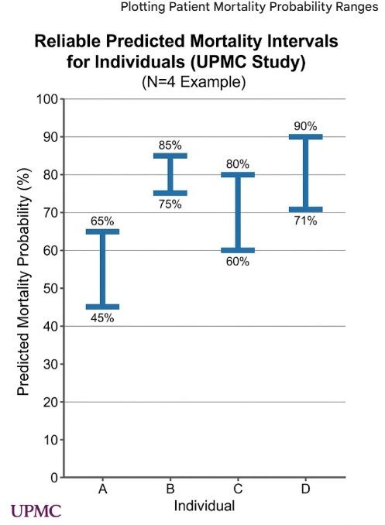
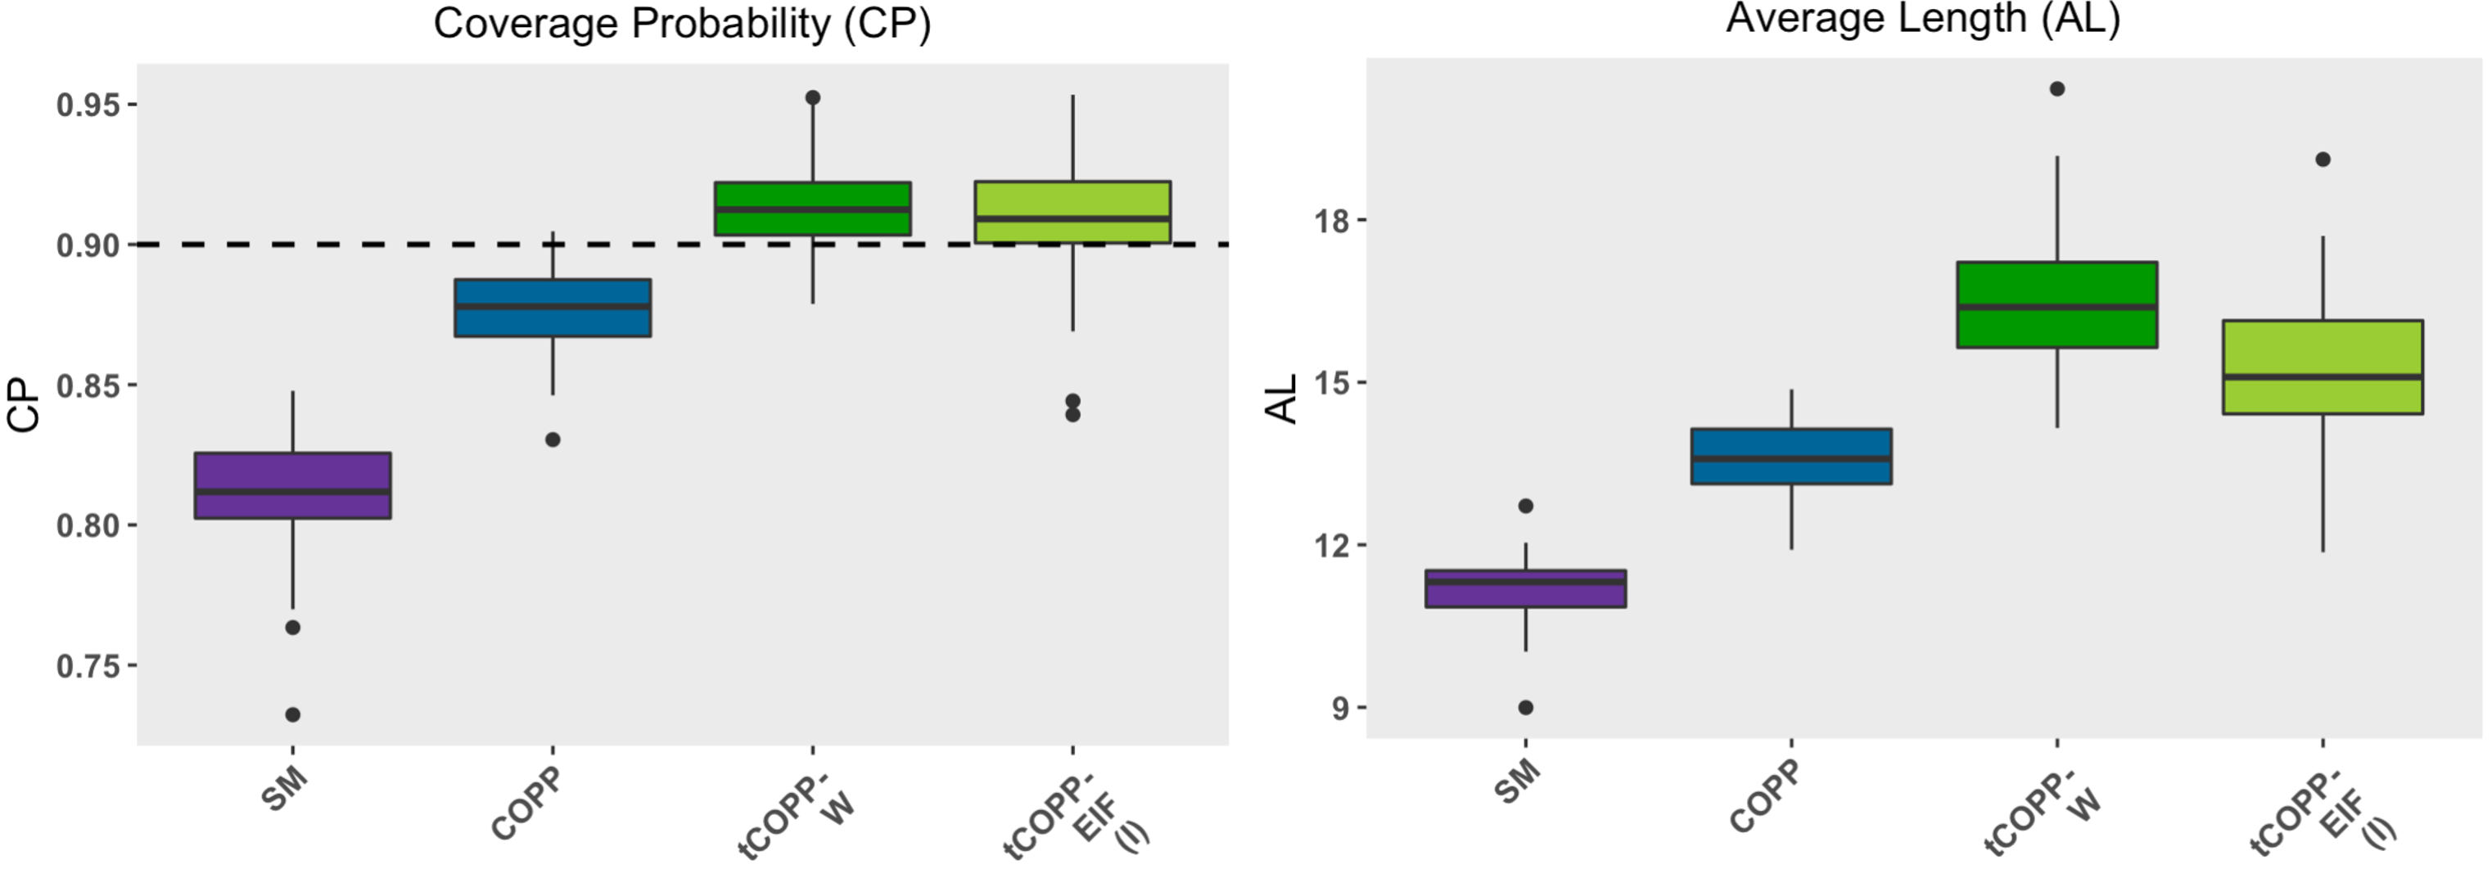

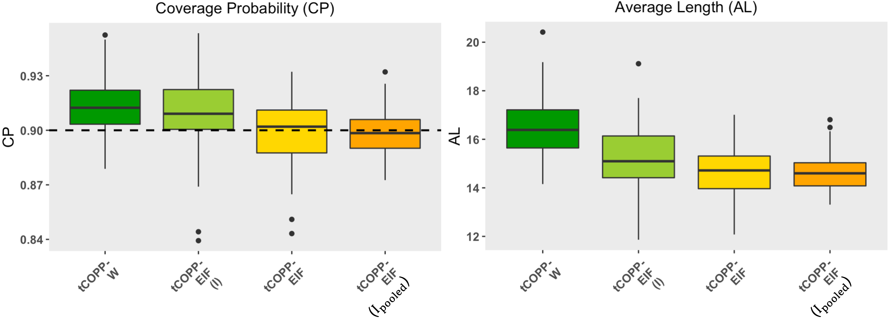
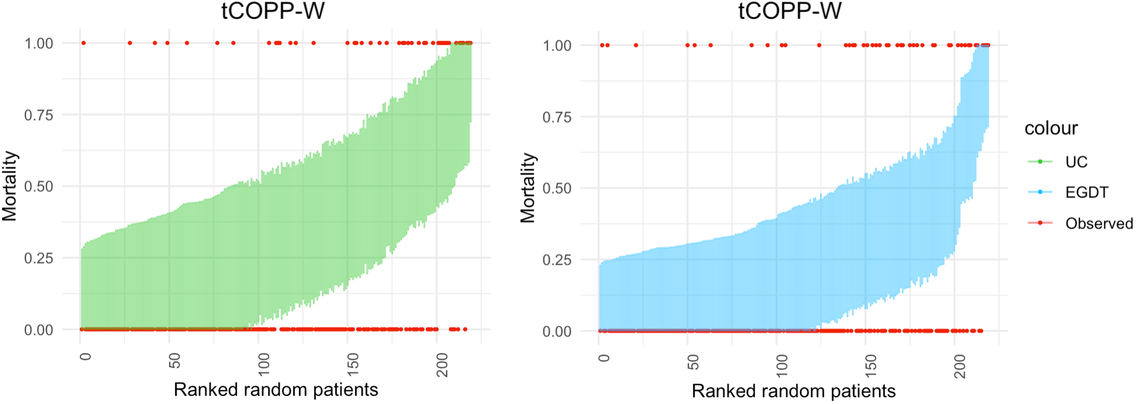
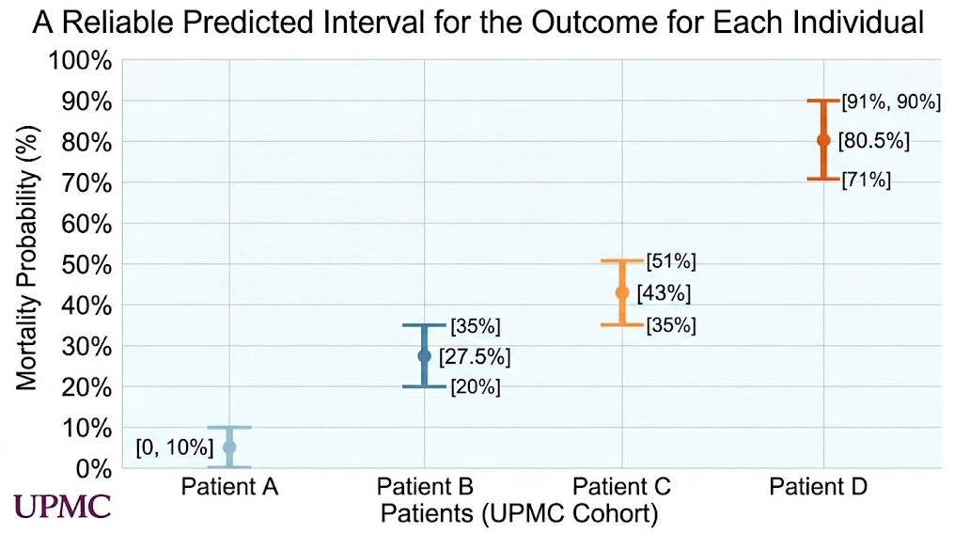
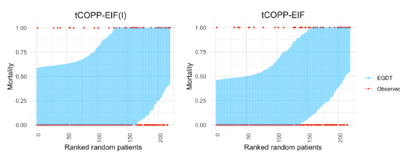
Conformal Inference of Individualized Treatment Rules
under Distributional Shift
Zhuodiao Kuang, Zhiyu Sui, Lu Tang, Ying Ding
Department of Biostatistics and Health Data Science, University of Pittsburgh
Introduction
Problem Setup & Method Summary
Results: Simulation
Our goal
New Treatment Rule to Evaluate
Figure 1. CP and AL using internal source only.
Individual-level prediction to evaluate ITR before it is deployed
Methods
ITR Evaluation
Data
Potential Outcomes
Goal:
Conformal Inference
Target
Covariates
Only
Existing Treatment Rules
Tech 2: Covariate Shift Correction
SM and COPP undercover by ignoring covariate shift; tCOPP-W and tCOPP-EIF(I) achieve nominal 90% coverage at the cost of moderately wider intervals.
tCOPP-W
tCOPP-EIF(I)
Internal Source (RCT)
Covariates
Outcomes
Tech 1: Subsampling Correction
Figure 2. CP and AL using internal + multiple external sources.
tCOPP-EIF(M)
.
.
.
External Source
.
.
.
.
.
.
.
.
.
.
.
.
Tech 3:
Summary Statistics
Method | Type | Internal source | External sources | Subsampling correction | Covariate shift correction | Handles CCOD violation
SM | Baseline | 𝔻₁ | — | N/A | No | N/A
COPP | Baseline | 𝔻₁ | — | Yes | No | N/A
tCOPP-W | Proposed | 𝔻₁ | — | Yes | Yes | N/A
tCOPP-EIF(I) | Proposed | 𝔻₁ | — | Yes | Yes | N/A
tCOPP-EIF(M) | Proposed | 𝔻₁ | 𝔻₂, …, 𝔻ₖ | Yes | Yes | Yes (federated)
(M)
(M)
tCOPP-EIF(M) achieves nominal coverage with shorter, less variable intervals by adaptively borrowing from external sources — even when CCOD is violated.
Results: Real-World Data
Figure 3. Predicted 60-day mortality, all ProCESS as internal source.
All of this can be realized before the treatment rule is deployed on the target population.
Key Conditions for Valid Prediction
Fair treatment assignment | Every patient in the trial could have received either treatment, and no hidden factors drove both treatment choice and outcome.
Overlapping populations | Every type of patient in the real world also appears in the trial data.
Common Conditional Outcome Distribution (CCOD) | Patients with the same characteristics respond to treatment the same way, whether they're in the trial or the real world.
tCOPP-W provides individualized risk stratification under both treatment policies; comparing intervals across arms can inform personalized treatment decisions.
Conclusions & Discussion
Figure 4. Predicted 60-day mortality, Region 1 as internal source.
Proposed a conformal inference framework that provides personalized prediction intervals for treatment outcomes before a new treatment rule is deployed
Method relies on assumptions such as population overlap and no unmeasured confounding — violations may affect coverage.
Current framework focuses on binary treatments; extension to multi-arm or continuous treatment settings is a natural next step.
Combining conformal prediction with adaptive or learned treatment rules is a promising future direction.
Sepsis application demonstrates the practical value of providing trustworthy, patient-specific risk assessments to support clinical decision-making.
(M)
Contributions
Individual-level prediction with uncertainty, not just population-level.
Works even when trial participants don’t fully represent the real-world patients.
Borrows strength from multiple hospitals without sharing patient-level data.
Both methods stratify mortality risk well; tCOPP-EIF(M) yields tighter intervals than tCOPP-EIF(I) by leveraging Regions 2 and 3.
Key References: Vovk, V., Gammerman, A., and Shafer, G. (2005). Algorithmic Learning in a Random World. Springer-Verlag. Tibshirani, R.J., Barber, R.F., Candès, E.J., et al. (2019). Conformal prediction under covariate shift. Curran Associates Inc. Yang, Y., Kuchibhotla, A.K., and Tchetgen Tchetgen, E. (2024). Doubly robust calibration of prediction sets under covariate shift. Journal of the Royal Statistical Society Series B, 86(4), 943–965. Liu, Y., Levis, A.W., Normand, S.L., et al. (2024). Multi-source conformal inference under distribution shift. arXiv:2405.09331. Zhang, Y., Shi, C., and Luo, S. (2023). Conformal off-policy prediction. Proceedings of the 26th International Conference on Artificial Intelligence and Statistics (AISTATS), 206, 2751–2768. Taufiq, M.F., Ton, J.F., Cornish, R., et al. (2022). Conformal off-policy prediction in contextual bandits. arXiv:2206.04405. Lei, L. and Candès, E.J. (2021). Conformal inference of counterfactuals and individual treatment effects. Journal of the Royal Statistical Society Series B, 83(5), 911–938. Romano, Y., Patterson, E., and Candès, E. (2019). Conformalized quantile regression. Advances in Neural Information Processing Systems, 32. Rubin, D.B. (2005). Causal inference using potential outcomes. Journal of the American Statistical Association, 100(469), 322–331. Han, L., Hou, J., Cho, K., et al. (2025). Federated adaptive causal estimation (FACE) of target treatment effects. Journal of the American Statistical Association, 0(ja), 1–25.
Zhuodiao Kuang, zhk22@pitt.edu

