Slide 1
STOCK VOLUME PREDICTION
Kalbi
Flavian
Zongo

Slide 2
Background/Data
Quantequote detains stocks data from 500 companies
Dataset for each company has variables such as: date, time, open price, high price, low price, closed price, trading volume
Time variable has only zeros for most of the companies-drop it
Considered data from one company (AGILENT TECHNOLOGIES INC ) that has 3452 obs
What is the average trading volume for a given period of time?

Slide 3
Methods
Response = trading volume
Multiple regression on original data : M1
Multiple regression – 8 order (degree) polynomial regression with first order interaction terms (39 features) : M2
Ridge regression (L2 penalty) : M3
Lasso regression (L1 penalty) : M4

Slide 4
Results
M1: very poor-R-sq=.07%
M2: better than M1 R-sq = 23% with a Mean Pred.error = 1.72
M3 Ridge: as better as M2 Pred.error = 1.72
M4 Lasso: best model with Pred.error = .82

Slide 5
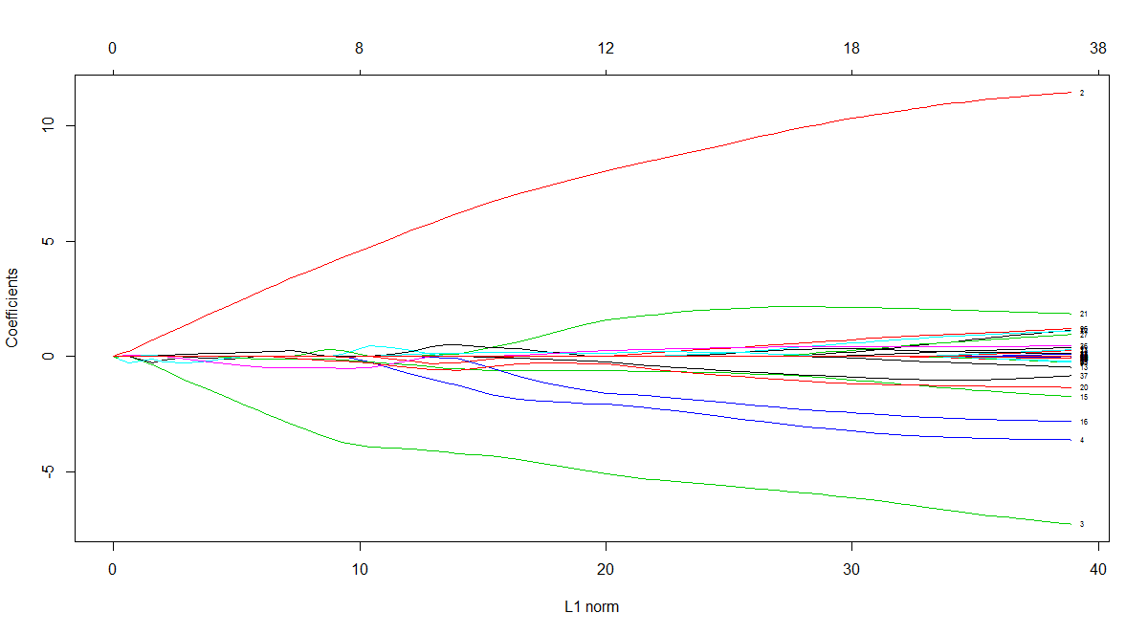
Results

Slide 6
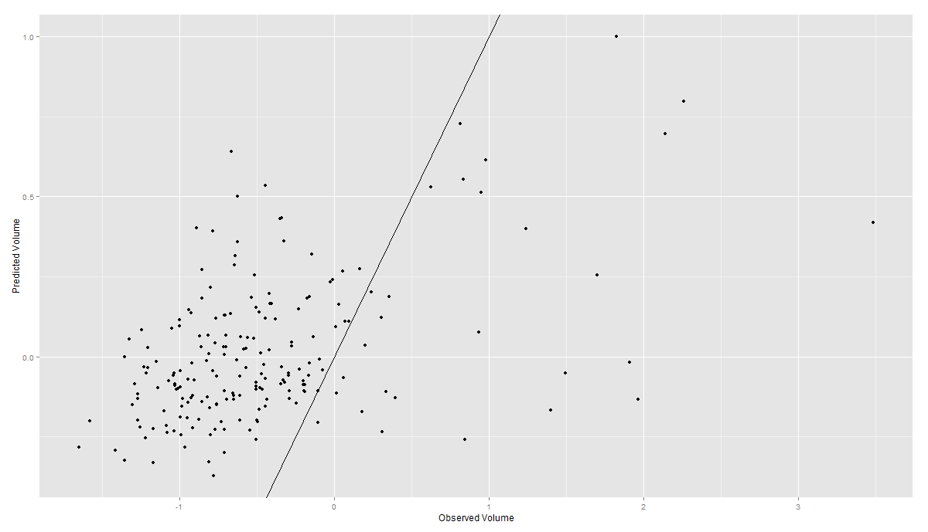
Results

Slide 7
Future works
Transform back to the original scale
Integrate time and date variables into analysis
Collecting additional new predictors
Try different algorithm like neural network or SVM or boosting methods

