Slide 1
Value and waste in software engineering
Matthias Galster
University of Canterbury
Christchurch, New Zealand
mgalster@ieee.org

Slide 2
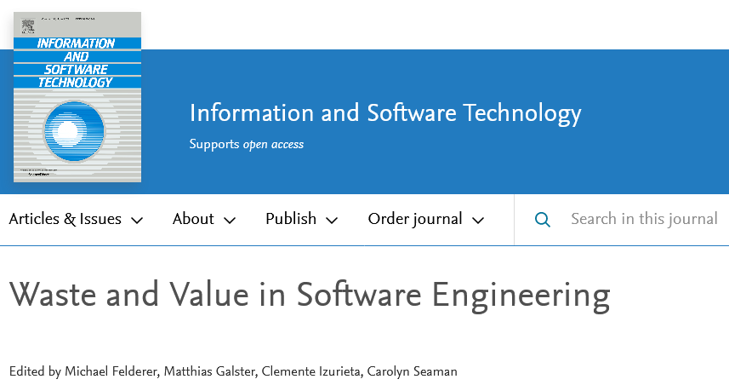
Links to studies mentioned in talk: shorturl.at/lyHNR

Slide 3



?
Value
Waste
Engineers

Slide 4
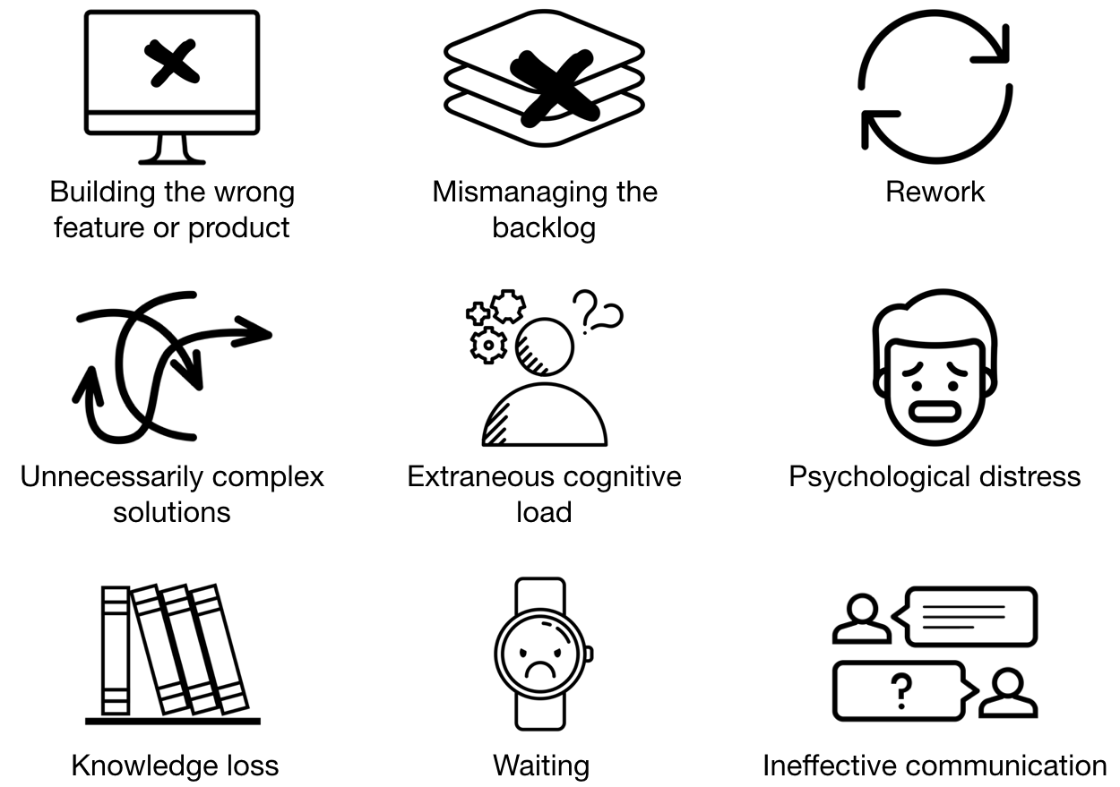

What is waste?
Activities that consume resources but create no “value”
 Understanding waste + causes empowers us to address it explicitly
2-year 5-month participant observation, interviews at software consultancy [Sedano et al.]

Slide 5

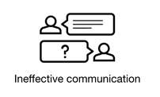

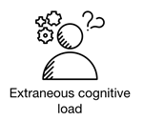
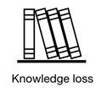

Waste – bad code reviews
What are bad code review practices and resulting waste?
Lack of review
Ping-pong
Missing context
Looks good to me
Large change sets
Review buddies
Sleeping
 Plan and communicate expectations for review
Literature review, survey, interviews, ~226k code reviews from 8 OSS [Doğan &Tüzün]

Slide 6

Waste – technical debt
What to fix? Who should fix it?
Focus dedicated TD removal on types less likely to be fixed, e.g., design debt
 Other types, e.g., code debt, defect debt, are self-fixed
Code debt, defect debt: if urgent, ask those who introduced it
Design debt: ask others (not self-fixed, survive longer)
44k commits from 20 Python and 16 Java projects [Tan et al.]

Slide 7

Value – human values?
How can we integrate human values in software?
?
Contextualized description
Human values
Engineers
Dignity
“Maintain honour + respect for users”
(e.g., what user information is kept, how is it shared; how can users unsubscribe)
Inclusiveness
“Facilitate different origins, languages, cultures, knowledge”
(e.g., what languages are supported in a multi-cultural usage environment)
Etc.
Etc.
1,097 issue discussions of Firefox, K-9 Mail, Signal Private Messenger [Nurwidyantoro et al.]

Slide 8
Summary: create value + reduce waste
We know what review smells, how they cause waste and why.
Use review smells to plan + communicate expectations for reviews (and training).
We know what kinds of TD get self-fixed, e.g., code debt.
Focus dedicated activities on those that don’t, e.g., design debt.
We know how to conceptualize human values for software engineering.
Use them to identify product requirements and build responsible software.

Want to know more? Want to collaborate? Email mgalster@ieee.org

Acknowledgments: Contributors to Special Issue, co-guest editors; Greg Wilson, Michael Hoye
Notes:
to email me.

