Slide 1
“It’s Like Coding in the Dark”
The need for learning cultures
within coding teams
Dr. Cat Hicks
Catharsis Consulting, 2022

Slide 2
Let’s start with a familiar story

Slide 3
People are always looking for clues to whether or not they are in a safe place for learning.
Code that works requires continual learning.
Learning Debt: when learning is necessary but discouraged,
so developers’ learning becomes hidden, covert, and unhappy.

Slide 4
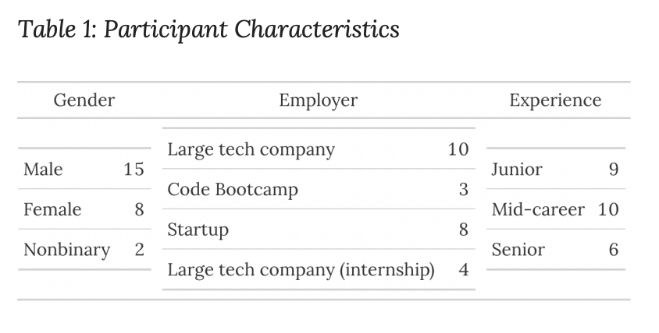
“Coding in the Dark” study
Reflective: 25 in-depth interviews with developers.
prompts: collaboration, feedback & review, and barriers
Real problem-solving: “search observations”: talk-out-loud as developers worked on an active, real task.
→Thematic analysis over these
30+ hours of conversation.
https://www.catharsisinsight.com/reports

Slide 5
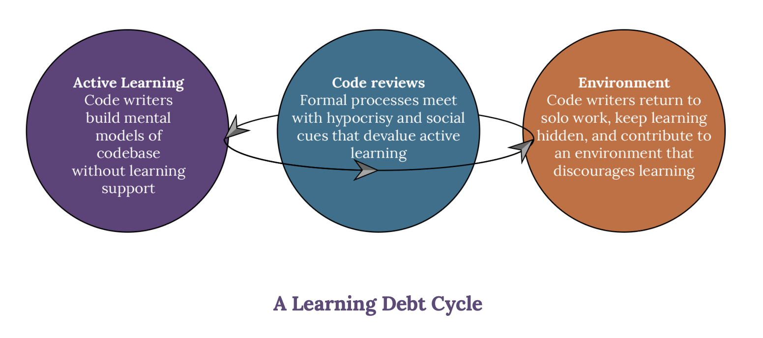
https://www.catharsisinsight.com/reports

Slide 6
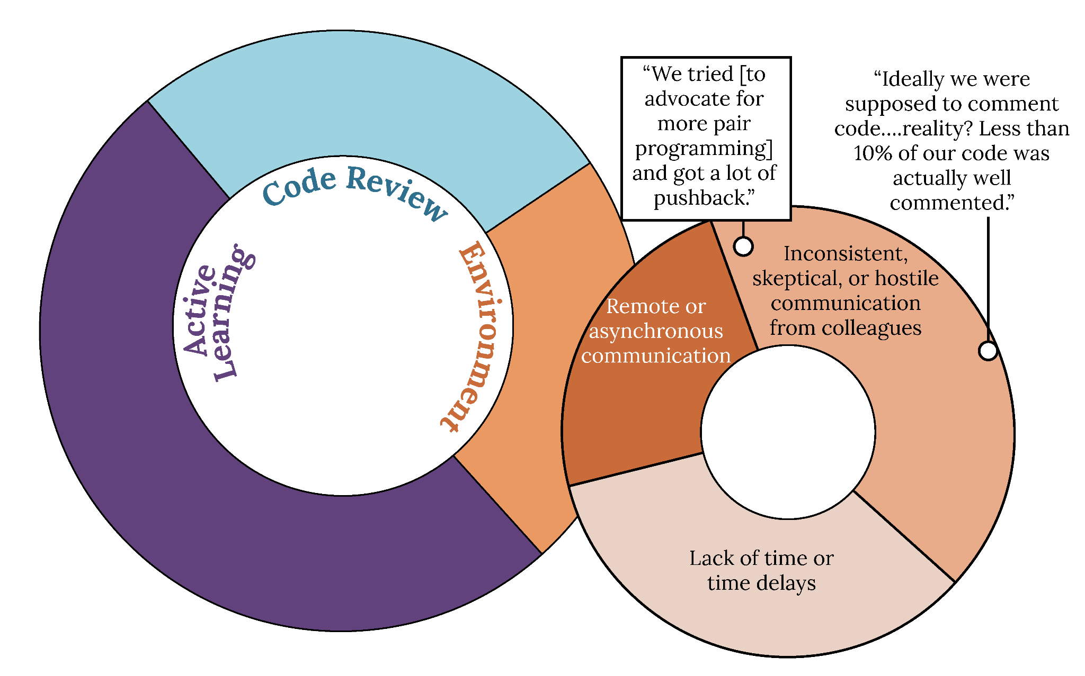
https://www.catharsisinsight.com/reports

Slide 7
If learning matters so much, why is it so hard to create learning culture?
We invest in technology, but assume human stuff magically “just works”
What “counts” & is measured is only performance & output
Performance Culture
“Feedback” moments are actually criticism moments
“No one else feels like I do, learns like I do, struggles like I do….”

Slide 8
If learning matters so much, why is it so hard to create learning culture?
A key paradox of sustainable learning:
It looks worse before it gets better

Slide 9
People are always looking for clues to whether or not they are in a safe place for learning.
Code that works requires continual learning.
If we care about learning, our environment needs to protect it (measure, recognize, reward)

Slide 10
Signals of an authentic learning culture
People can exercise agency: Co-create definitions of “success”
People can develop: Developmental feedback is separated from defending performance
People can reflect & pass on knowledge: Documentation “counts”
People can celebrate and affirm: Support work & learning is celebrated

