Slide 1
To Search, or Not to Search
Code
Code
Depends on the question
Dr. Katie Stolee
Associate Professor
NC State University

Slide 2
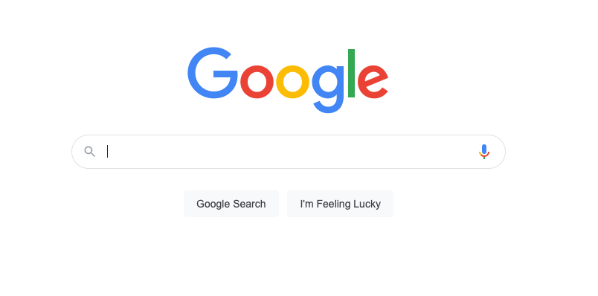
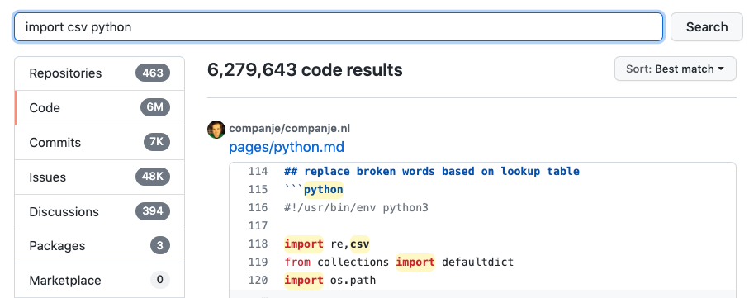
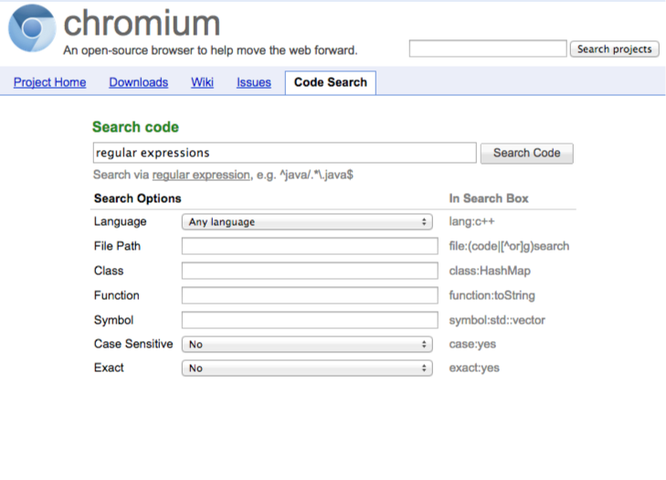
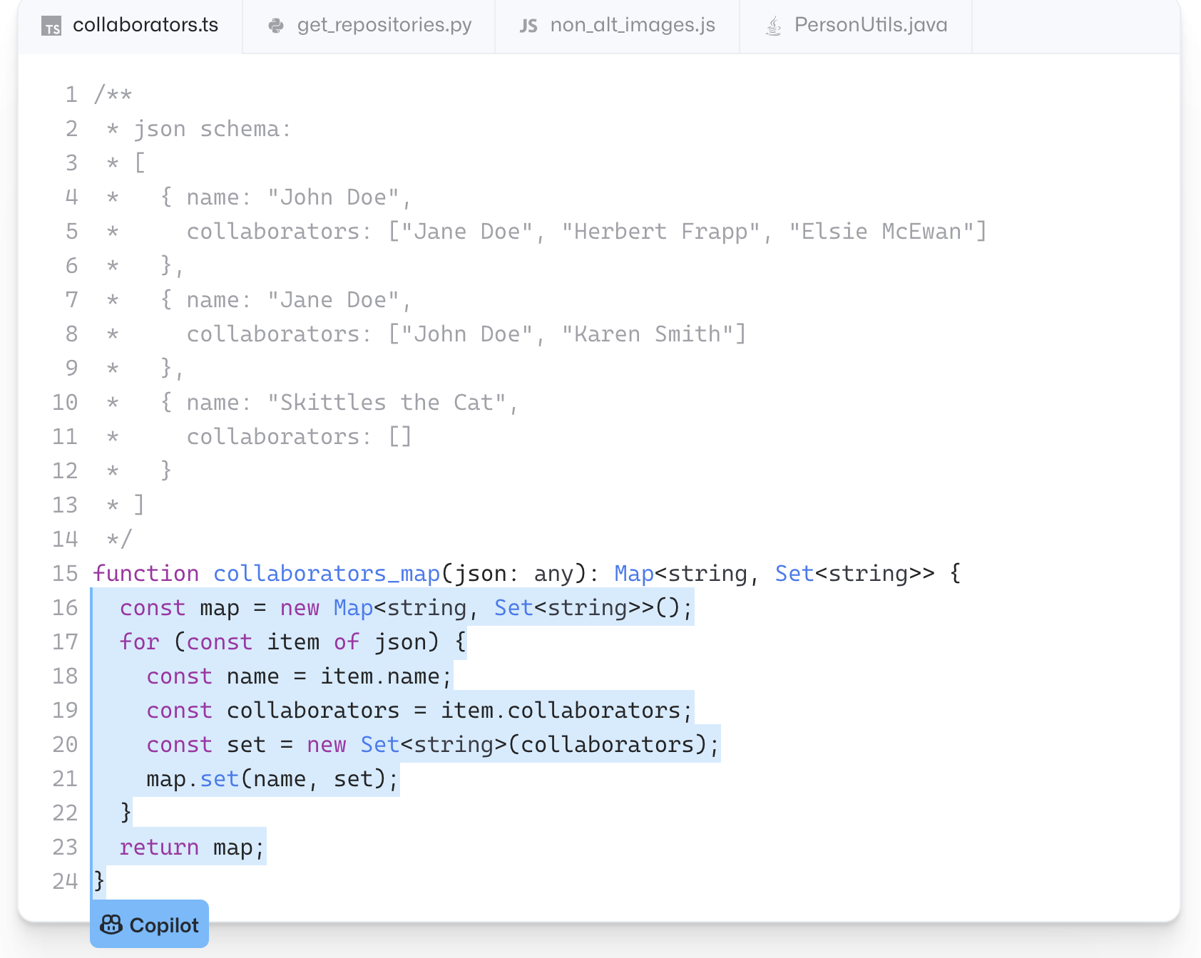
Many interfaces.

Slide 3
Code search is frequent
~12x per developer per day
Search sessions involve multiple queries
Code search with Google takes more time, more clicks, and more query reformulation than non-code search

Slide 4
Four Distinct Needs
Example Code, how to do something (33%)
Explaining what it does (26%)
Where in the code base (16%)
Why is the code doing something (16%)

Slide 5
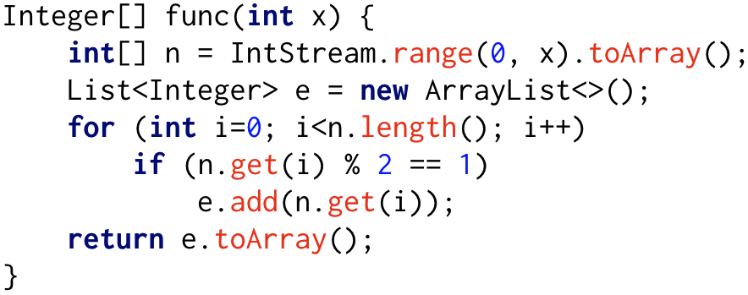

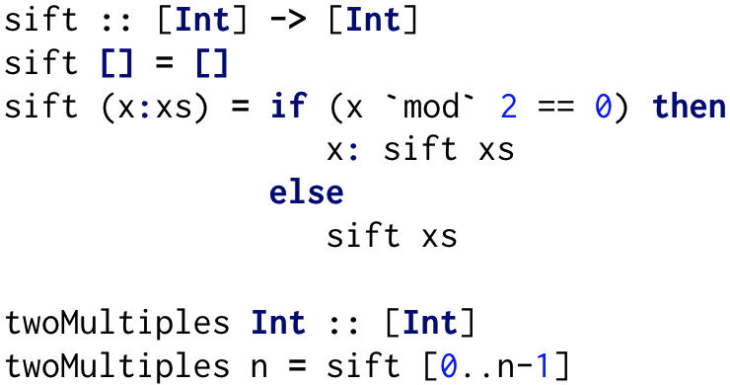
“How” → Example Code
I have…
I want…
Java for loop to populate array of even numbers

Slide 6
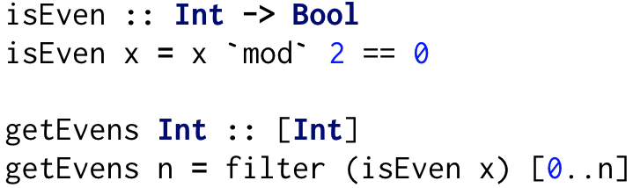
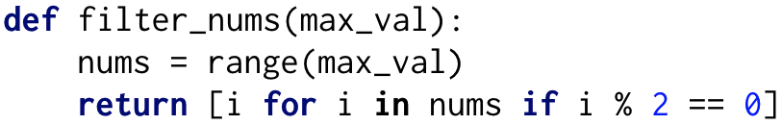
Code-to-Code Search
Mystery
Box

Slide 7
The Halting Problem 😱
It’ll never work in theory.

Slide 8
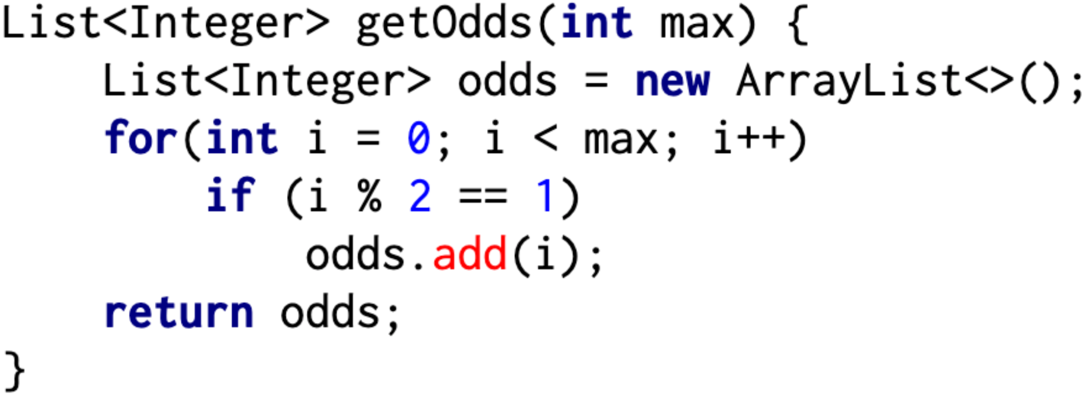
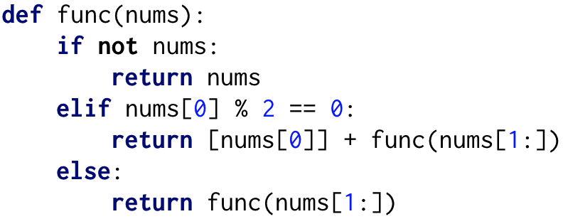
Code-to-code Search
Haskell: List of even numbers using chaining
Java: for loop to populate array of odd numbers
Haskell: List of even numbers using recursion
Python: List of even numbers using list-comprehension
Java: List of even numbers using IntStream
Python: List of even numbers using recursion

Slide 9
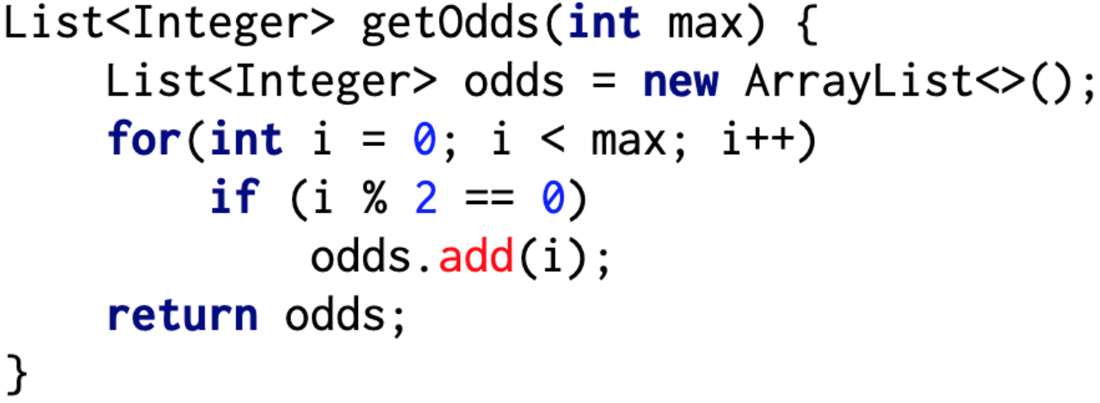
Code-to-code Search - Language
Haskell: List of even numbers using chaining
Java: for loop to populate array of odd numbers
Haskell: List of even numbers using recursion
Python: List of even numbers using list-comprehension
Java: List of even numbers using IntStream
Python: List of even numbers using recursion

Slide 10
Code-to-code Search - Behavior
Haskell: List of even numbers using chaining
Java: for loop to populate array of odd numbers
Haskell: List of even numbers using recursion
Python: List of even numbers using list-comprehension
Java: List of even numbers using IntStream
Python: List of even numbers using recursion

Slide 11
Code-to-code Search - Structure
Haskell: List of even numbers using chaining
Java: for loop to populate array of odd numbers
Haskell: List of even numbers using recursion
Python: List of even numbers using list-comprehension
Java: List of even numbers using IntStream
Python: List of even numbers using recursion

Slide 12



Code-to-code Search - In Practice
Query
Tokens / Context
😴
✅
🏃🏽‍♀️
Word Embedding
+
Tree Embedding
Source Code
Behavior
Non-dominated Sorting
Similar Code
Structure

Slide 13
Four Distinct Needs
Example Code, how (33%)
Explaining what it does (26%)
Where in the code base (16%)
Why is the code doing something (16%)

Slide 14
🔩🔨

Slide 15
Four Distinct Needs
Example Code, how (33%)
Explaining what it does (26%)
Where in the code base (16%)
Why is the code doing something (16%)
Can be done in practice with search
Code comprehension – not search
Code Navigation – works pretty well
Impact analysis – not search

Slide 16
Know why you’re searching!
How?
✅
What?
🚫
☎
Where?
✅
Why?
🚫

Slide 17

Thank you for listening.
Thank you to my collaborators:
Sebastian Elbaum
George Mathew
Baishakhi Ray
Caitlin Sadowski
Thank you to my sponsors:
ktstolee@ncsu.edu

