Slide 1

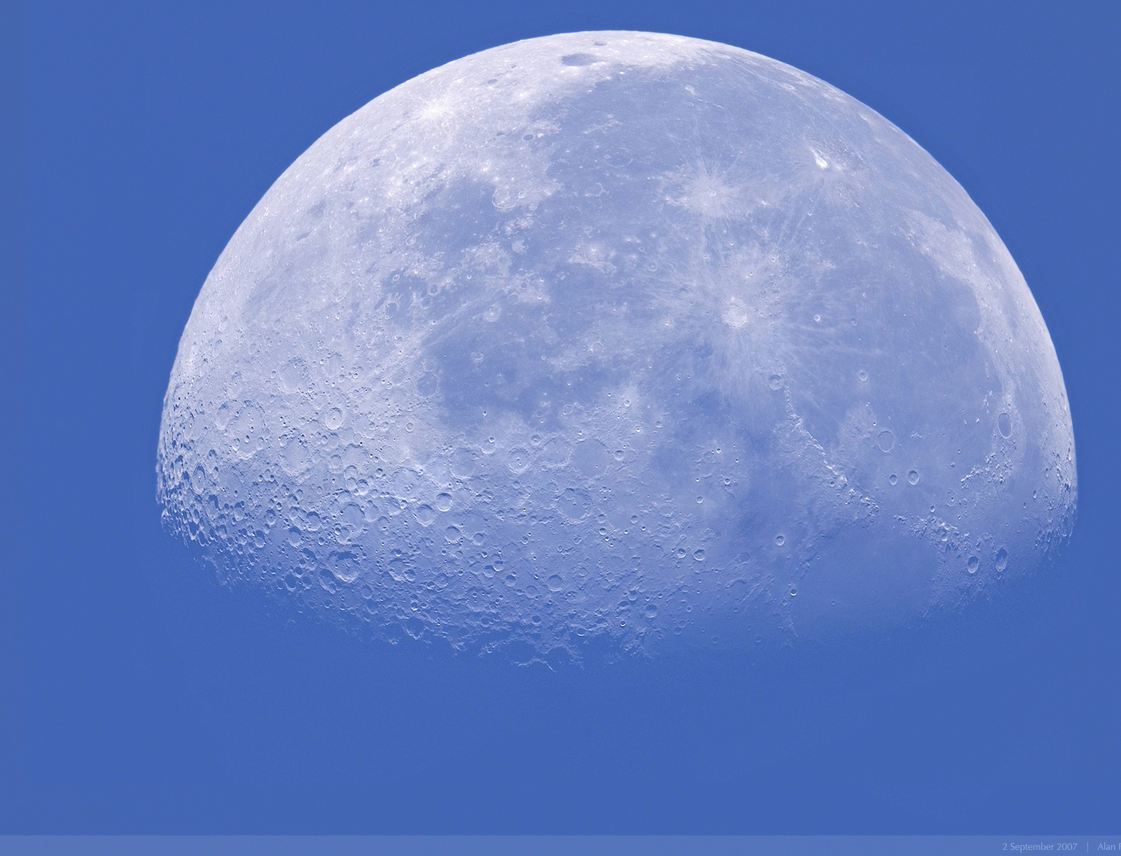

Programmer by Day, Tester by Night
Andy Zaidman
Delft University of Technology
The Netherlands
azaidman

Slide 2



Slide 3


Slide 4
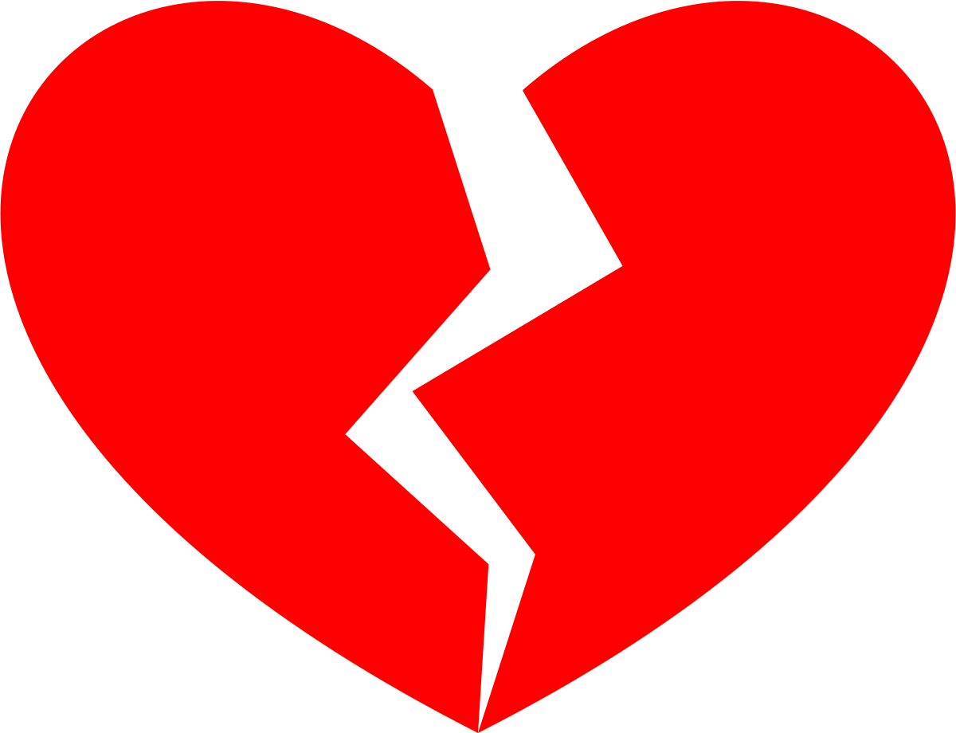

Slide 5
Dishes
Dishes
Cooking
takes 30 minutes
Dishes
take hours
Dishes

Slide 6
Chronoception
How do you perceive time for tasks that you enjoy
versus tasks that you dread

Slide 7
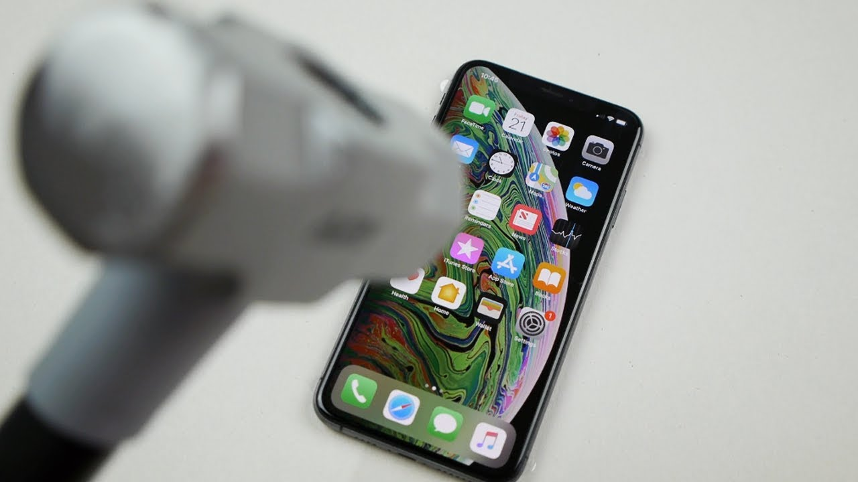
So how about testing?
Do people like to test software?

Slide 8





An IDE plug-in to measure test activities
2,443 developers, 68 countries
Observation: min. 5 months, max 2.5 years → ∼150 person years of development

Slide 9
Self-estimated time of test engineering in the IDE
49.5% - 50.5%
test code
production code

Slide 10
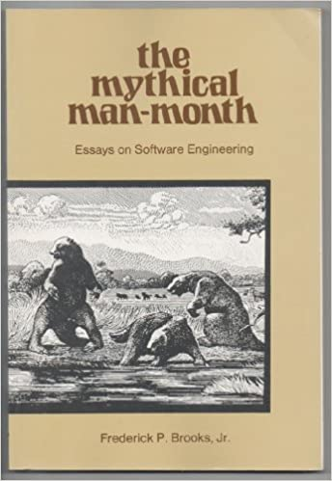
Self-estimated time of test engineering in the IDE
49.5% - 50.5%
test code
production code

Slide 11
WatchDog measurements…
25% - 75%
test code
production code

Slide 12
Software testing is a “destructive activity”?

Slide 13
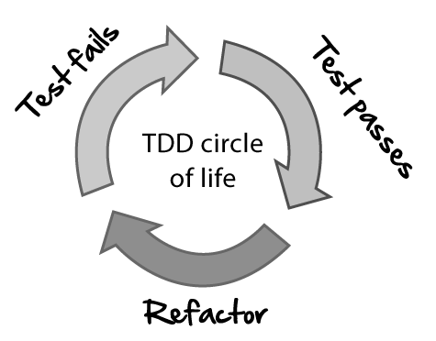
Test-driven development
574 developers claim to do TDD
47 developers actually do TDD

Slide 14
Takeaway 1
What developers think/estimate
≠
What developers do

Slide 15
Takeaway 1
What developers think/estimate
≠
What developers do
Chronoception of SW engineering tasks

Slide 16
Takeaway 2
Software analytics
Understand SW engineering tasks and their effort
Estimations

Slide 17
Chronoception of SW engineering tasks
Software analytics
azaidman
Thanks to: Moritz, Georgios, Annibale, Sven, Sebastian, Wouter, Igor & Niels.

