Slide 1
HMM
Seq #1
1, 2, 3, 4, 5, 6, 7, 8
Seq #2
1, 3, 4, 2, 5, 7, 8 . . .
Seq #100
1, 2, 3, 4, 5, 6, 7, 8
Seq #101
1, 3, 4, 2, 5, 7, 8 . . .
Discrete data
Discrete data
Training data
(behavior groups)
Testing data
Model each group
Run a testing sequence through all HMM models
HMM models (trained)
Classify
Result: a log-likelihood vector
(if all element values are less than a threshold, the it is abnormal)

Slide 2
PCA
Seq #1
2.05, 3.512, 6.123, 0.123
1.12, 4.511, 6.122, 1.001 . . .
Seq #11
1.75, 3.612, 6.153, 0.523
1.15, 3.511, 67122, 0.901 . . .
Continuous data
Continuous data
Training data
(Only normal)
Testing data
Project each observation onto the PC space
Append all sequences?
PCA (trained)
Project data
Find the distance
How do we classify at runtime?
Distance between a testing sequence and training sequences
Normal or Abnormal?

Slide 3
HMM + SVM
Seq #1
[2.05, 3.512, 6.123, 0.123]
[1.12, 4.511, 6.122, 1.001] . . .
Seq #11
[1.75, 3.612, 6.153, 0.523]
[1.15, 3.511, 67122, 0.901] . . .
Likelihood vectors
Likelihood vectors
Training data
(Normal + Abnormal)
Testing data
Append all sequences?
SVM (trained)
HMM models (trained)
How do we classify at runtime?
Get the log-likelihood vectors
Classify
Training data
(Normal+ Abnormal)
Normal or Abnormal?

Slide 4
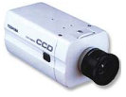
Camera sensors
Video
Foreground extraction
Background modeling
List of blobs
Multiple human tracking
Feature vectors
Behavior pattern bootstrapping
HMM₁
HMM₂
. . .
HMM_{n}
Construct log-likelihood vectors
SVM classifier
PCA classifier

Slide 5
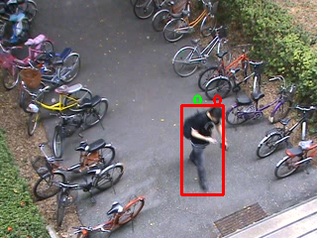


(a)
(b)
(c)

Slide 6
