Slide 1

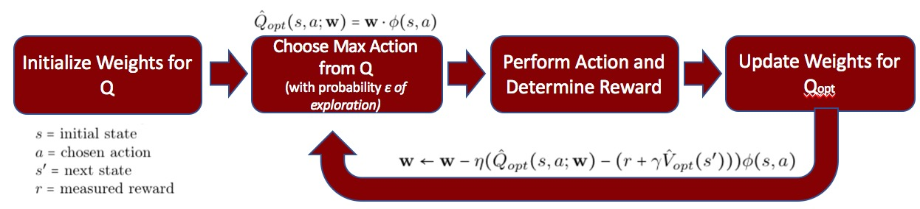
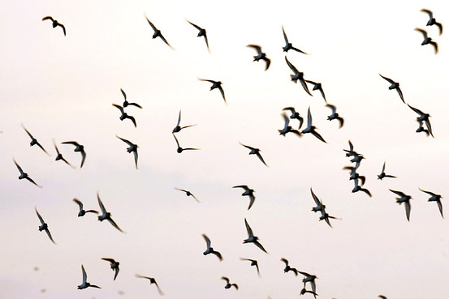
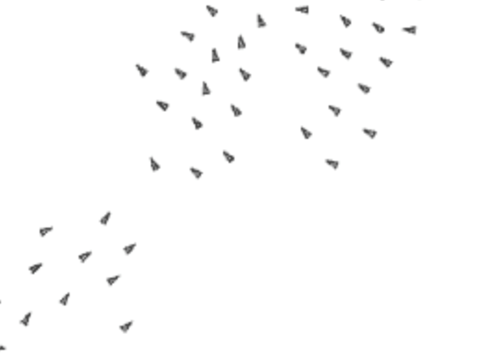
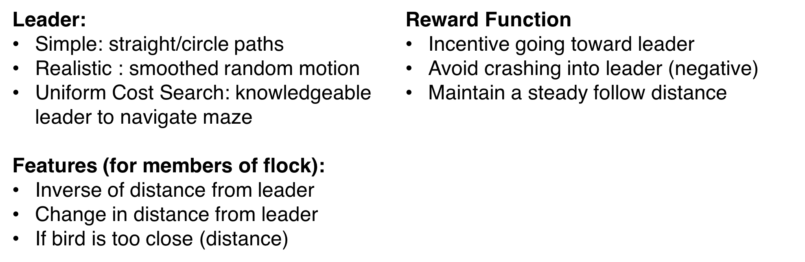
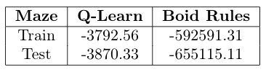
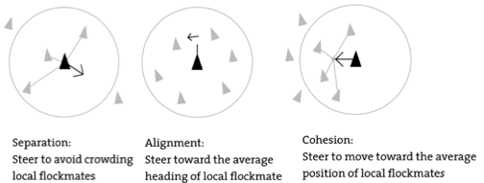

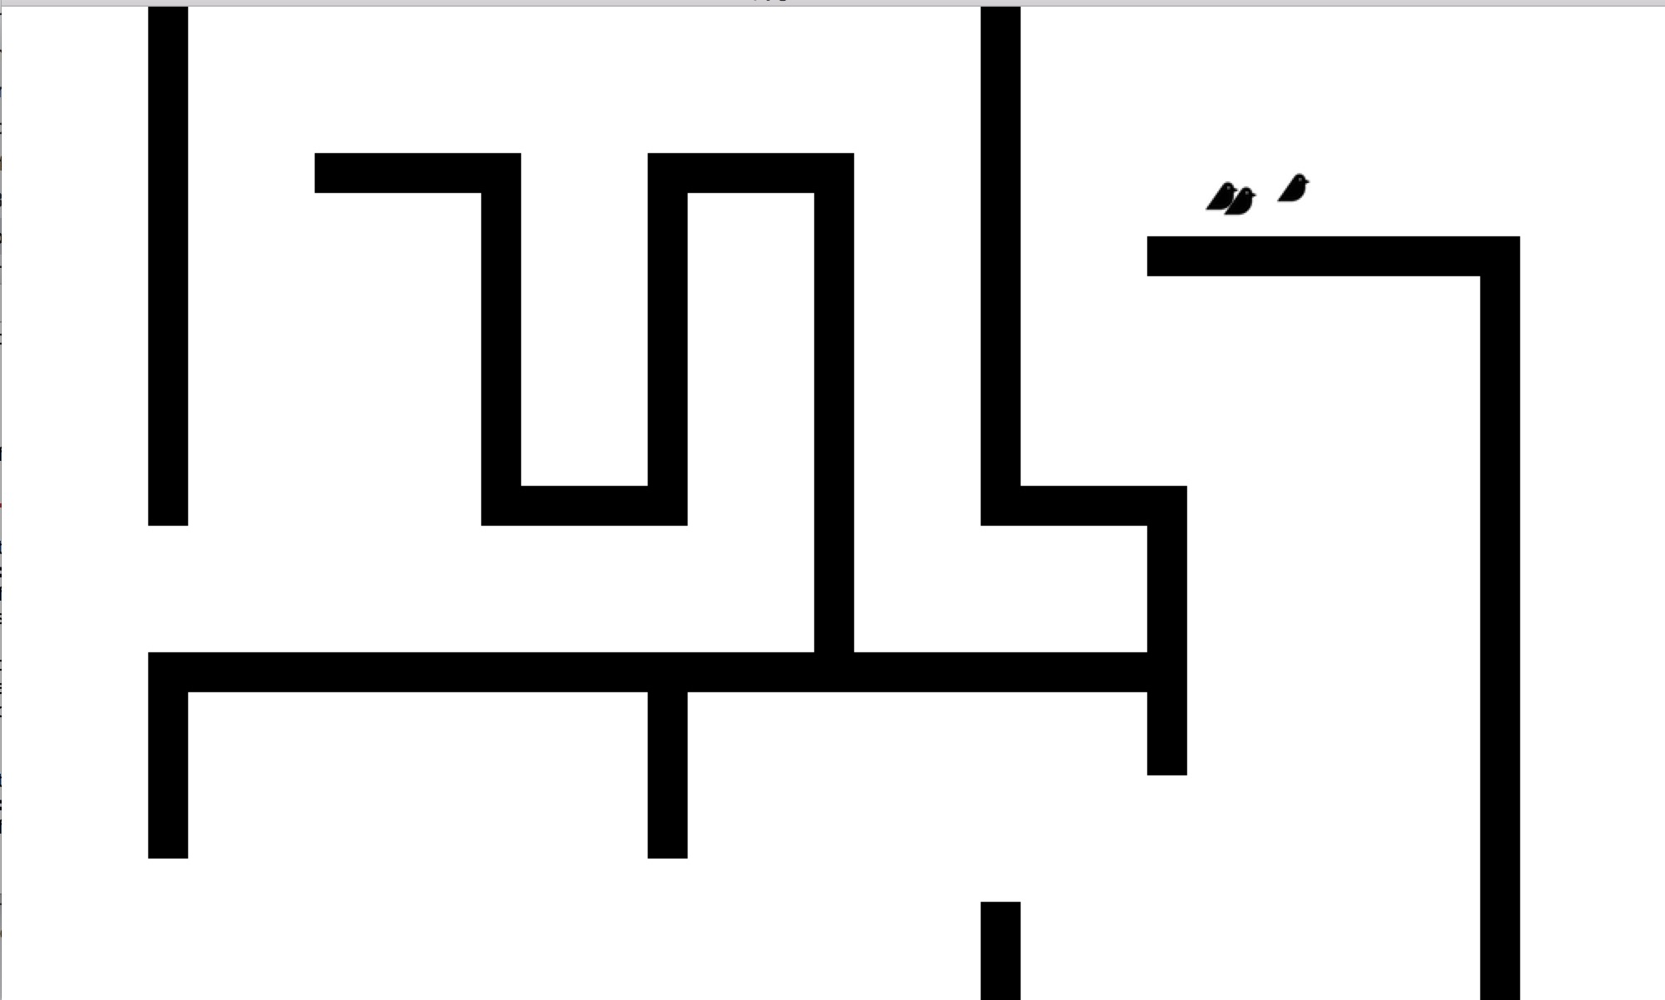
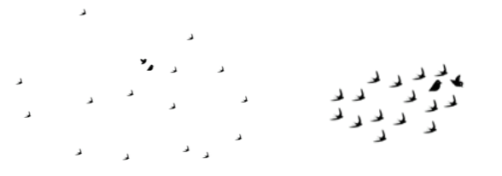
Flocking Behavior: Multi-agent Q Learning, Obstacle Manipulation and Real World Simulations
By Emily Cohen, Jonathan Gomes-Selman, and Zane Kashner
Motivation
Methods
Results and Analysis
Flocking is a natural phenomenon seen in birds, schools of fish, and other animals
“Boids”: artificial life research program to model and learn from flocking
Learning Flocking Behavior: Leader & Feature Extraction
Previous work: rule based models to dictate the motion of flocking agents
Our approach: use learning instead
Compare these approaches in scenarios
Obstacle Manipulation: average cumulative reward over 20 iterations, 1200 actions each
Problem Definition
Can a learning algorithm outperform tradition rules in open space? With constraints?
Multi-Agent Behavior
Obstacle Manipulation
Features
Centroid of K nearest birds
Distance to leader of flock
If neighbors too close (1st/2nd closest)
Reward Function
Incentive going toward the centroid
Avoid being too close (negative)
Incentivize going toward leader
One “robot” with domain knowledge
Add obstacles to world in form of maze
Leader: Uniform Cost Search
Q-learning for weights (R: negative for walls, positive for following)
Compare average reward of learned actions to those of hard coded rules.
Train maze and (unseen) test maze
Challenges
Future Work
Defining an unstructured task
  Defining a reward function
  Defining a metric
  Determining features (number of)
Creating our own environment
Training multiple Boids simultaneously
Training time
Remove the leader (unclear how realistic)
Incorporate multi-agent flocking behavior to world with obstacles
Comparison of methods with other forms of noise (random Gaussian noise)
Crowdsource feedback on evaluation metrics
Before
After

