Slide 1
Lifelong Multi-Agent Pickup-and-Delivery
Explainable Fleet Concurrency Control
in a Meeting-based Hybrid Stack
Meeting-RH × Geometry-gated Protocols × StageNet × FACN
Technical talk · ~12 minutes
Lifelong MAPD · Meeting-RH Hybrid Stack
1/29

Slide 2
Outline
Problem → Related Work → Method → Details → Results
§1
Problem & Value
Rules, VALID criteria, hardness
§2
Prior Work
CBS/ECBS, PP, PIBT, MAPD, RHCR
§3
Our Method
Contributions & overview
§4.1
Meeting
Trigger → I/O → process → return
§4.2
Protocol Stack
Failure mode → tool
§4.3
AI Modules
StageNet / FACN: arch, I/O, ablation
§5
Results
done · sim · wall; why best
Lifelong MAPD · Meeting-RH Hybrid Stack
2/29

Slide 3
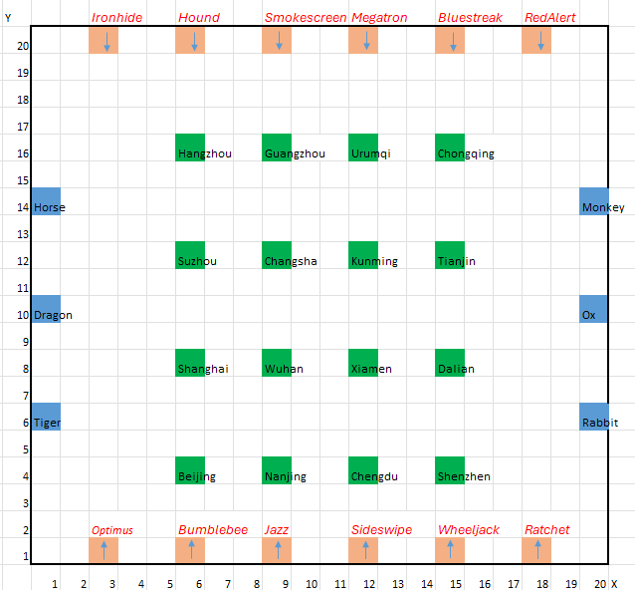
§1 Problem and Value
Lifelong MAPD: continuous pickup–delivery under collision constraints
• Definition: on a shared grid G=(V,E), AGVs continuously receive pickup→delivery tasks; allocate and plan online for high throughput without conflicts.
• vs one-shot MAPF: goals keep changing; a single offline plan is insufficient — periodic re-coordination is mandatory.
• Value: warehouses mix open floors and capacity-1 corridors; static parameters and purely reactive policies fail across regimes.
• Research question: under limited online compute, which slow variables (pose, priority, concurrency) and which periods keep completion high and wall-clock practical?
• Stance: protocols for correctness; small auditable nets for adaptation; geometry gates for trust.
Lifelong MAPD · Meeting-RH Hybrid Stack
3/29

Slide 4
Operating Rules and VALID Criteria
All hard constraints must hold; otherwise the trajectory is invalid
Class | Rule | Check
Kinematics | 4-connected; turns∈{±90°,180°}; move/turn/load/unload/wait = 1 | Legal actions
Capacity | One package/agent; FIFO at pickup; ≤1 pickup/station/sec | Task semantics
Delivery | Unload only at designated adjacent cells | Correct goal
Vertex conflict | Two agents same cell same time → illegal | VALID=false
Swap conflict | Opposite edge swap → illegal | VALID=false
Bounds | Obstacle/out-of-map → illegal | VALID=false
Quality | done = correct deliveries; full100 = all tasks done | Primary
Efficiency | sim = finish time; wall = runtime | Secondary
All comparisons require VALID; a smaller sim on an invalid trajectory does not count as better.
Lifelong MAPD · Meeting-RH Hybrid Stack
4/29

Slide 5
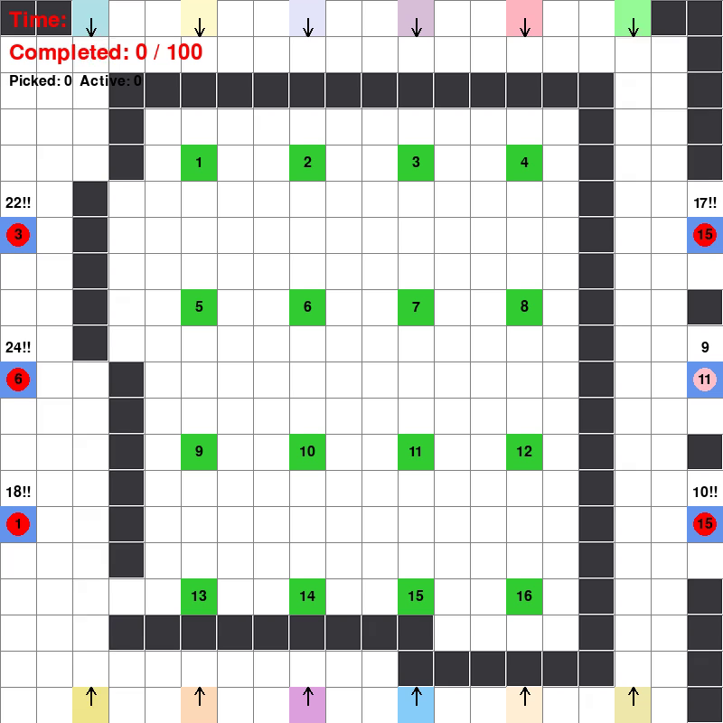
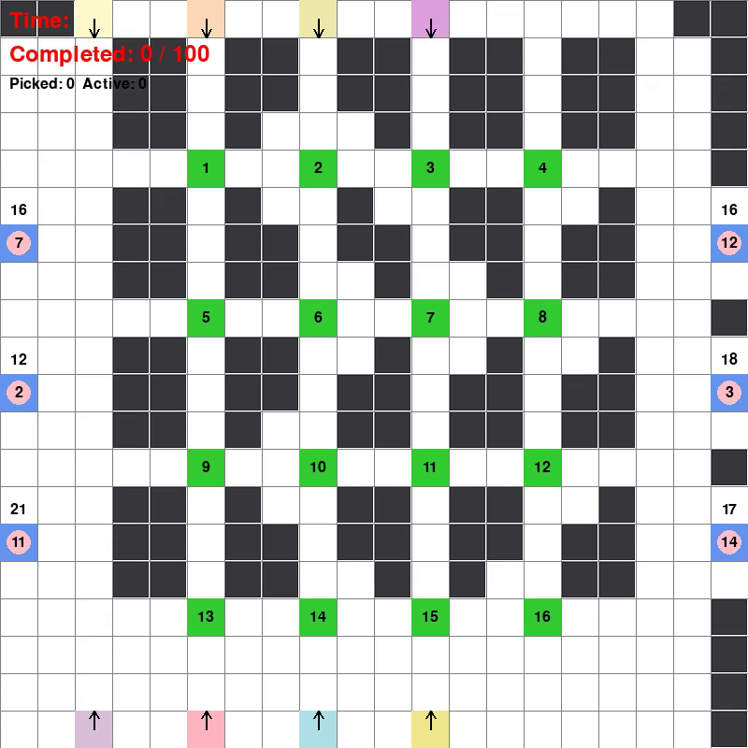
Hardness: Why a Hybrid Stack
Throughput, validity, heterogeneous geometry, online compute
• Capacity-1 corridors: same-destination / deg≤2 throats create structural head-ons.
• Heterogeneous maps: open large fleets need higher concurrency; dense mazes need throttling — one static K fails.
• Lifelong streams: dual timescales — slow vars negotiated periodically; fast conflicts repaired every tick.
• Complete search is costly: windowed ECBS completes but costs hundreds of seconds; PIBT is fast but fragile.
• Explainability: black-box policies cannot audit who enters a corridor and how many agents may stay busy.
Lifelong MAPD · Meeting-RH Hybrid Stack
5/29

Slide 6
§2 Related Work (I): Classical MAPF
Citations and one-line mechanisms
Method | Reference | Idea | Limit (for us)
CBS | Sharon et al., AIJ 2015 | High-level conflict split + low-level A* | One-shot; lifelong needs repeats
ECBS | Barer et al., SoCS 2014 | Focal-search bounded-suboptimal CBS | High completion, heavy wall-clock
Priority Planning | Classical PP / CA* | Serial space-time A* by priority | Bad priorities → deadlock
PIBT | Okumura et al., AIJ 2022 | Priority inheritance + backtracking | Scalable but fragile in corridors
Our baselines: M0=space-time A*+greedy assign; PP=priority A*; ECBS=windowed ECBS.
Lifelong MAPD · Meeting-RH Hybrid Stack
6/29

Slide 7
§2 Related Work (II): Lifelong / MAPD and Gaps
From task streams to rolling horizons — table + how gaps drive our design
Method | Reference | Idea | Gap for us
MAPD | Ma et al., AAAI 2017 | Coupled assign + routing | No learned operational concurrency K
RHCR | Li et al., AAAI 2021 | Replan every h; resolve in window w | Still costly; no pose/K learning
exRHCR | Madar et al., SoCS 2022 | Warm-start priorities in PBS | Faster search ≠ how-many-busy
Hier(M0↔ECBS) | Our baseline stack | M0 easy / ECBS hard | High full100, wall 700–1000s
• Gap → design:
(i) reactive fragile → contracts+protocols;
(ii) slow search problem→ windowed search, meet on slow vars only;
(iii) stage vs throttle not split → StageNet=stage, FACN=K only (not which agent);
(iv) no explainable failure tools → geometry-gated ASA/TBC/corridor/PGFA.
Lifelong MAPD · Meeting-RH Hybrid Stack
7/29

Slide 8
§3 Method and Contributions
Meeting-RH hybrid: protocols for VALID; small nets for adaptation; ablatable boundaries
C1 Dual timescales
C2 FACN throttle
Slow: MEET_H=12 negotiates pose/priority/commits (W∈{16,28}); StageContract ttl=16.
Fast: Follow contracts; Gap yield; PGFA single-focal altruism.
vs RHCR: we explicitly factor what must be negotiated, not full conflict resolution every step.
Learn Δ∈{−2..+4}, K=clip(K_TBC+Δ); claim valve only — BFS costs untouched.
Controls how-many-busy, not which agents (assignment/priority chooses who).
AFA gates thrash; raise K on open maps, throttle when dense.
C3 StageNet stage
C4 Geometry-gated protocols
Score FINAL/APPROACH/CLEAR + scalar priority; trained by IL.
ASA switches net↔teacher via (n, near_pad_deg2).
Ablation: hard maps collapse without StageNet (e.g., SH10/SH17).
Contested-dest / Pad-egress / FG-CEBI / E4 / Progress-pulse / PGFA…
Each tool maps to a reproduced failure (pad head-on, post-unload throat, mutual yield…).
No map-id: gates use geometry/state only.
Non-goals: end-to-end black-box step policies; map-id hardcoding; direction fields as the main lever.
Lifelong MAPD · Meeting-RH Hybrid Stack
8/29

Slide 9
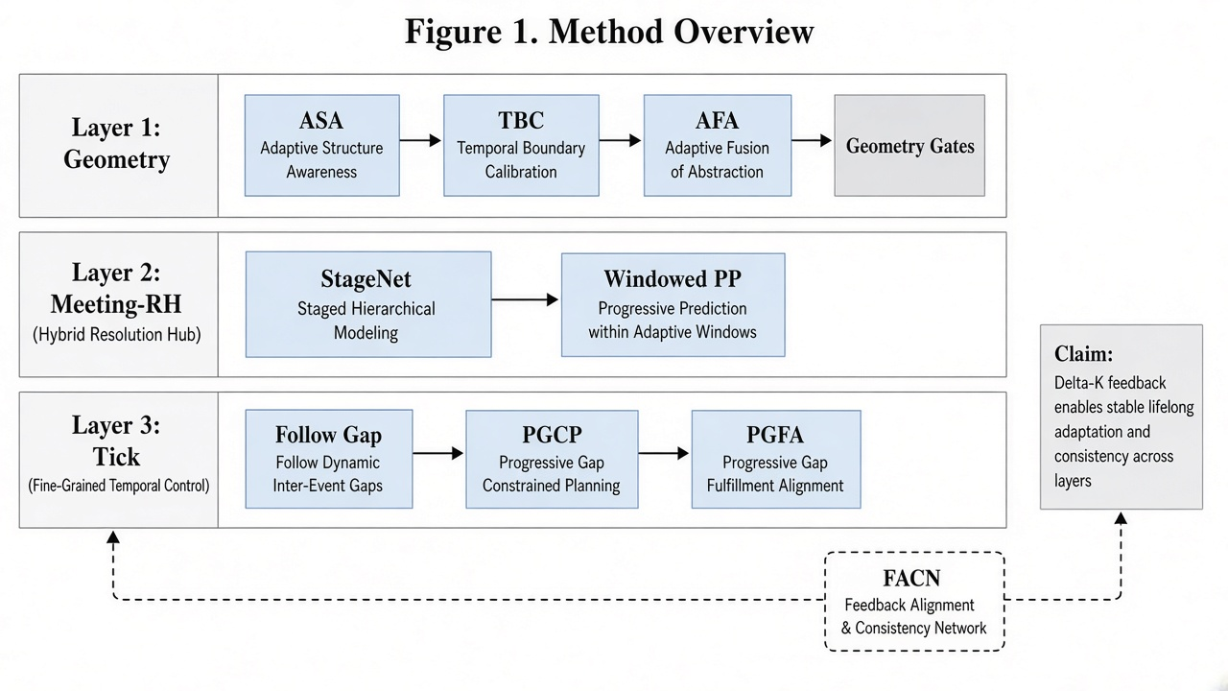
Method Overview
Layers: geometry gates → Meeting-RH → tick execution; FACN feedback on K
Lifelong MAPD · Meeting-RH Hybrid Stack
9/29

Slide 10
Design: Decouple · Gate · Dual Timescale
Each module maps to a named failure — no giant catch-all net
Decouple
Gate
Dual scale
StageNet=stage; FACN=throttle; PGCP=corridor lights. Wrong stage ≠ wrong concurrency — learn and ablate separately.
ASA trusts StageNet; AFA allows Δ ≠ 0; FG-CEBI/E4 only under geometry. Trust is auditable.
Meeting TTL≈16; tick Gap/Egress; FACN TTL=36/PERIOD=24. Progress stall forces meet and widens W:16→28.
Lifelong MAPD · Meeting-RH Hybrid Stack
10/29

Slide 11
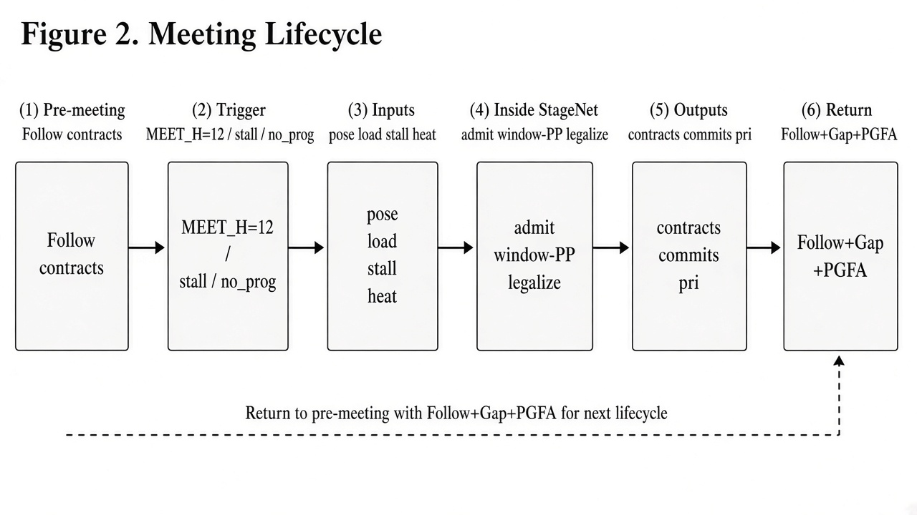
§4.1 Meeting Lifecycle
Pre → trigger → inputs → process → outputs → return
Lifelong MAPD · Meeting-RH Hybrid Stack
11/29

Slide 12
Meeting: Triggers and I/O
should_meet + force rules; executable contracts, not natural language
Stage | Content | Key fields / thresholds
Pre | Follow StageContract; tick egress/contested | ttl=16
Trigger | period / stall / dense·sparse no_prog | MEET_H=12; stall≥24; n≥12∧gap≥4
Inputs | pose, load, goals, stall, heat, near_pad_deg2 | observable state
Process | StageNet/teacher→admit→window PP→repair→legalize | W∈{16,28}
Outputs | stages, priorities, commits, contracts, desired | waypoints[:6], exclusive_pad
Return | Follow + Gap; event PGFA | stall≥25 / streak≥12
Lifelong MAPD · Meeting-RH Hybrid Stack
12/29

Slide 13
Inside the Meeting and Inter-meeting Repair
Ten steps in run_meeting + three inter-meeting mechanisms
• ①–② BFS cache; StageNet/teacher batch stages (ASA sets use_net).
• ③–④ region_admit; assemble goals & priorities (holder/egress boosts).
• ⑤–⑥ contested-dest rewrite; pad-egress (FG-CEBI / E4).
• ⑦–⑧ plan_committed(W); window_repair.
• ⑨–⑩ DLO legalize (10≤n≤14 only); issue StageContract(ttl=16).
• Follow: commit head else next waypoint.
• Gap: low-priority yields next cell.
• PGFA: clear BFS prefix for one focal agent.
• Note: FACN updates K on the tick loop, outside run_meeting.
What is negotiated?
• Pose toward goal (FINAL/APP/CLEAR)
• Relative priorities
• Space-time commits over W
• Who holds exclusive_pad
• How idles clear the throat
Lifelong MAPD · Meeting-RH Hybrid Stack
13/29

Slide 14
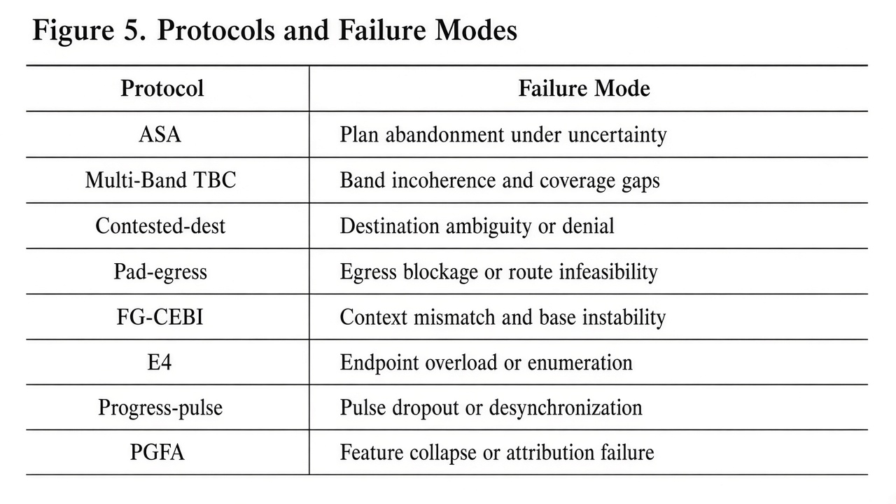
§4.2 Protocol Toolbox Overview
Following slides detail trigger / effect / failure / non-goals
Lifelong MAPD · Meeting-RH Hybrid Stack
14/29

Slide 15
How Protocols Stack
near = #walkable deg≤2 cells within radius 6 of unload pads
• PGCP: umbrella for Contested-dest, Pad-egress (+FG-CEBI/E4), Progress-pulse, idle hygiene — not one switch.
• Geometry first: (n,near) sets ASA and Multi-Band TBC (K0); AFA clips FACN Δ → effective K.
• Every tick: Pad-egress (+conditional FG-CEBI/E4) and Contested-dest rewrite goals / clear throats.
• Meeting only: StageNet/teacher → region_admit → window PP → DLO → contracts.
• When stuck: Progress-pulse (brief lower K, widen W, meet more) + PGFA (one focal beneficiary).
• Ablation: disabling PGCP suite drops completion on SH10/11/12/17.
• Shared rule: no map-id; gates use geometry/state only.
Lifelong MAPD · Meeting-RH Hybrid Stack
15/29

Slide 16
Protocols: ASA · Multi-Band TBC · AFA
Trust the net? Base how-many-busy?
ASA — Adaptive Stage Authority
Multi-Band TBC — Throat-Band Capacity
AFA — Adaptive FACN Authority
• What: choose StageNet vs goal-flow teacher from (n, near) once at start.
• When: n∈[10,14]→net; most n≤9→teacher (exceptions if near≥90…); n==18→teacher; else net.
• Changes: StageSelector(use_net). Only pose source.
• Prevents: net noise on small fleets; teacher stuck on some mid fleets.
• Not: K, paths, assignment; overridable by CLI flags.
• What: static base concurrency K0 from fleet size + throat geometry.
• When: default 6; mid→5; dense→5; mega n≥28→≥7.
• Changes: claim busy cap init; FACN's k_tbc baseline.
• Prevents: K=6 too hot in mid throats; too conservative on huge fleets.
• Not: per-agent goals/priorities/paths; runtime K changes via FACN/pulse.
• What: geometry clips FACN's Δ to stop thrash.
• When: attach only if n>k_tbc; raise capped by near; lower only if structural congestion ∧ (stall/no_prog).
• Changes: clipped Δ → K=clip(k_tbc+Δ).
• Prevents: raise on tiny fleets; death-spiral lowers (e.g. SH39).
• Not: which agent / path / stage — throttle only.
Lifelong MAPD · Meeting-RH Hybrid Stack
16/29

Slide 17
Protocols: Contested-dest · Pad-egress · FG-CEBI
Same-pad head-on and egress-before-ingress
Contested-dest
Pad-egress
FG-CEBI (E2 lane-lock)
• What: when multiple loaded agents crowd one unload hub, only one holder may enter; others wait off-throat.
• When: ≥2 loaded at same hub and ≥2 within Manh≤6 of a pad.
• Changes: pick holder (TTL=48); non-holders retarget deg≥3; ban pads/deg≤2/prefix last 4; holder pri +3e5. Every tick + meeting.
• Prevents: head-on jams into one narrow unload.
• Not: task identity; far agents (>6); idle blockers already in throat (Pad-egress).
• What: force idle/post-unload agents off pads/deg≤2 throats to deg≥3 before ingress.
• When: idle on pad/sibling/pressured throat; soft leave after unload. Every tick + meeting.
• Changes: idle goal→deg≥3 with high EGRESS_PRI; may retarget approaching carriers off-corridor without demoting carrier role pri.
• Prevents: egress↔ingress deadlock at pads.
• Not: multi-destination corridor unions; global sticky (that is E4).
• What: on extreme throats, lane-lock carriers whose shortest path crosses an active egress corridor — rewrite their stage goal outward.
• When: n≥10 ∧ near≥100 and path crosses an egressor corridor.
• Changes: stage/motion goal only; priority role unchanged.
• Prevents: outsiders squeezing into a clearing extreme throat.
• Not: n<10 or near<100; mid throats / fragile tiny fleets; full E1–E5 FSM.
Lifelong MAPD · Meeting-RH Hybrid Stack
17/29

Slide 18
Protocols: E4 · Progress-pulse · PGFA
Sticky egress, progress pulse, focal altruism
E4 sticky (SHARP-lite)
Progress-pulse
PGFA — Focal Altruism
• What: after unload on mid throats with large fleets, keep forcing egress while still on deg≤2 — no need to wait for ingress pressure.
• When: n≥19 ∧ near∈[70,85]; sticky memory of last_unload_pad.
• Changes: hard egress to deg≥3 at top priority.
• Prevents: parking on endpoint/throat after unload (SH12-class).
• Not: ungated global sticky (breaks SH02/08/11/15/17); fixed havens.
• What: when progress freezes, briefly lower concurrency and replan more often.
• When no_prog: contested ∧ (done-stale or manh-stale) with ≥2 carriers.
• Changes: if n≥12, busy_pulse 28 ticks with cap→min(base,3); may shorten meet gap and widen W 16→28.
• Prevents: dense livelock with frozen done/Manh.
• Not: lower K when n<12; permanent cap cut; geometry rewrite alone.
• What: help exactly one beneficiary — clear blockers on its BFS prefix.
• When: rem≤5 or stall≥25 or any carrier streak≥12.
• Changes: focal priority order egress>holder>nearest carrier; +1e7 pri; side-step blockers; switch focal only after no-progress thresholds.
• Prevents: mutual-yield livelock from unconditional altruism.
• Not: clear corridors for all busy agents; yield among non-focal carriers.
Lifelong MAPD · Meeting-RH Hybrid Stack
18/29

Slide 19
Protocols: DLO · region_admit · Boundaries
Legalize order and soft region caps
DLO — Dual Lexicographic Order
region_admit
Boundaries to remember
• What: when agents contend for a cell, try two tie-break orders; keep the one with smaller carrier ΣManh.
• When: inside legalize_desired, only 10≤n≤14 and ≥2 carriers.
• Changes: compare (−pri,name) vs (−pri,Manh,name); strip swaps; ban illegal cells.
• Prevents: hash/name-order attractor jitter on mid fleets.
• Not: stage goals/tasks; outside n∈[10,14] falls back to one order.
• What: in meetings, stop too many FINAL poses packing one 5×5 tile.
• When: after StageNet choices; cap=clamp(free/8,2,5).
• Changes: lower excess FINAL to CLEAR/YIELD toward near path cells; protect TO_DROP.
• Prevents: arterial jams from many FINALs in one tile.
• Not: same-unload prefix carrier count; global hard fleet cap (TBC/FACN).
• FACN: how-many-busy only — not which agent.
• StageNet: pose+priority only — not step actions.
• Protocols: rewrite goals/pri/K/legalize via observable geometry.
• Window PP: finite-horizon commits — not complete CBS.
• Ablation: PGCP suite + StageNet for completion; FACN for open-map sim.
Lifelong MAPD · Meeting-RH Hybrid Stack
19/29

Slide 20
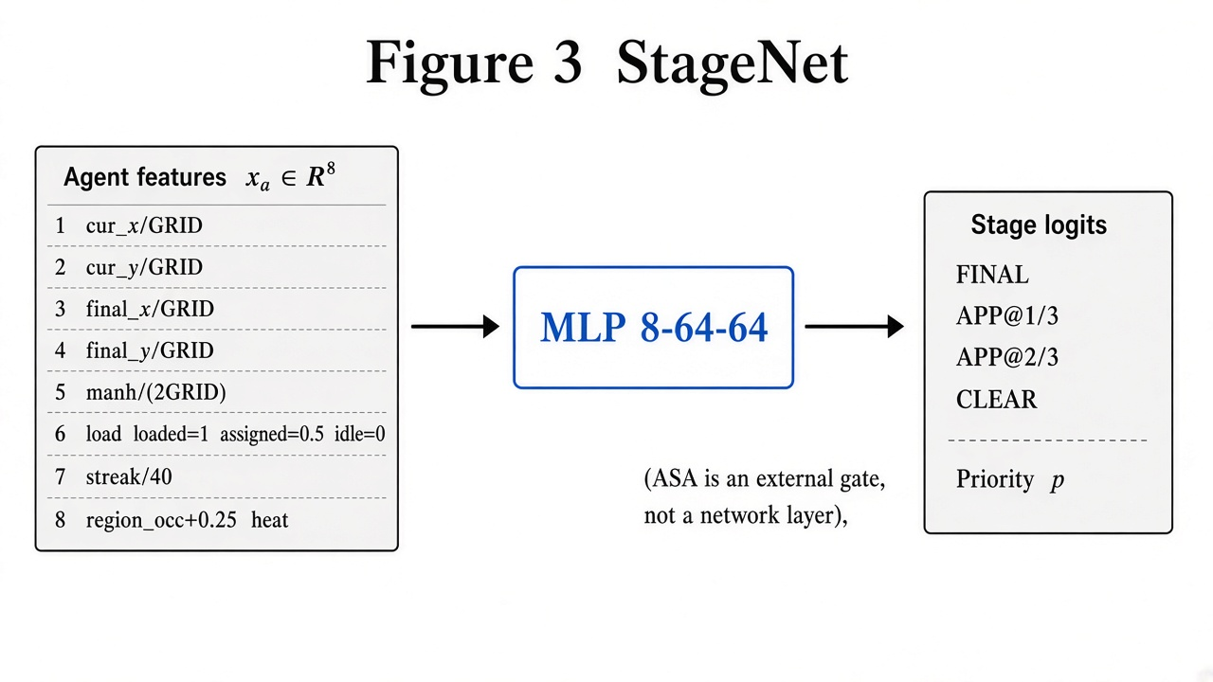
§4.3 StageNet: Architecture and I/O
Left panel lists all 8 agent dims; next slide table + ablation
Lifelong MAPD · Meeting-RH Hybrid Stack
20/29

Slide 21
StageNet: 8-D State, ASA, Ablation
List every agent feature; hard maps collapse without the net
Dim | Meaning | Norm
1–2 | current cell cur_x, cur_y | / GRID
3–4 | final goal final_x, final_y | / GRID
5 | Manhattan manh(cur,final) | / (2·GRID)
6 | load status: loaded=1, assigned=0.5, idle=0 | discrete
7 | blocked streak | min(streak/40, 1)
8 | region_occ + 0.25·conflict heat | clipped
• Cand ∈ R¹⁰: cell xy, manh to agent/goal, kind, FINAL/CLEAR flags, stay, occupied, edge+region. K=4 stages.
• Ablation: no_stagenet → SH10=60*, SH17=32*; ASA switches net↔teacher via (n,near).
Lifelong MAPD · Meeting-RH Hybrid Stack
21/29

Slide 22
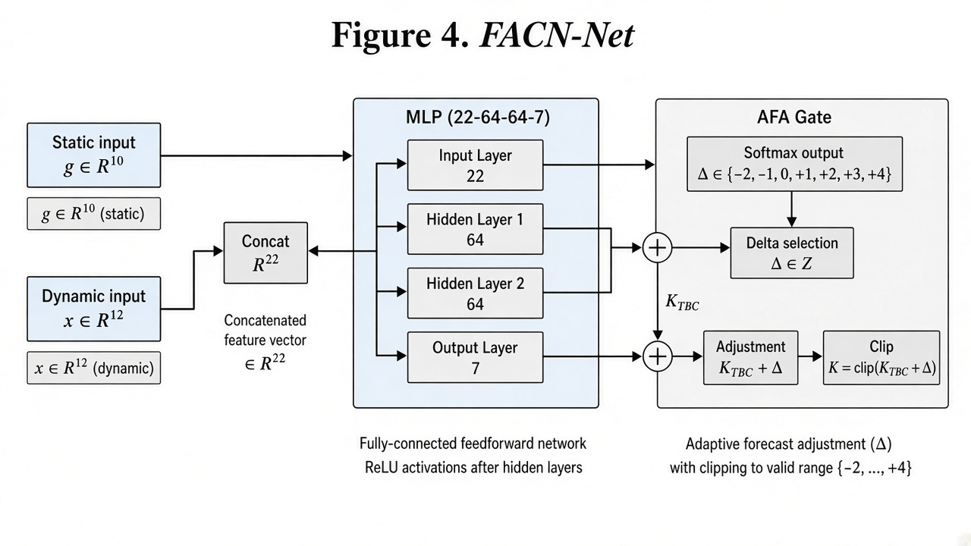
§4.3 FACN: Architecture and I/O
Static+dynamic 22-D → Δ class → fleet concurrency K
Lifelong MAPD · Meeting-RH Hybrid Stack
22/29

Slide 23
static
dynamic
# | Feature | Norm
1 | Number of agents nn | / 30
2 | Free cells | / 400
3 | near_pad_deg2 (throat proxy) | / 160
4 | Number of pickup stations | / 12
5 | Number of drop-off outlets | / 12
6 | Density n/freen/free | / 0.15
7 | Idle-pool ratio (n−KTBC)/n(n−KTBC​)/n | clip to [0,1]
8 | Baseline KTBCKTBC​ from TBC | / 16
9 | Mean free cells over regions | / 50 then clip
10 | Max free cells over regions | / 80 then clip
# | Feature | Norm
1 | Busy agents | / 16
2 | Idle agents | / 30
3 | Remaining tasks | / 100
4 | Recent done_rate | / 0.25
5 | Stall | / 80
6 | Avg commit horizon avg_h | / 28
7 | Repairs in recent window | / 200
8 | Conflict heat | already ~[0,1]
9 | Region occupancy | / 4
10 | Number of dest-gates | / 20
11 | Same-destination cluster size | / 8
12 | Throat occupancy | / 8

Slide 24
FACN: Control Target, AFA, Gains
Novelty: learn how-many-busy, not which-edge
• Target: effective_fleet_cap only; K = clip(K_TBC + Δ), Δ ∈ {−2..+4}.
• Stickiness: TTL=36, PERIOD=24, MIN_GAP=12; AFA gates raise/lower/attach.
• Train: offline K* sweep → Δ* = K* − K_TBC → CE cloning.
Compare | avg sim | better/same/worse | GATE
noFACN → FACN v2 (SH01–40) | 1579.7 → 1487.8 (−5.82%) | 20 / 13 / 5 | PASS
SH20 | 813 → 660 (−153) | K:7→10 | Main case
SH24 | 1036 → 602 (−434) | K→10 Δ=+4 | Large gain
Lifelong MAPD · Meeting-RH Hybrid Stack
23/29

Slide 25
§5 Experimental Setup
SH01–20 with official 100-task streams; fixed reproduction knobs
• Maps: SH01–20 stress suite; extended SH21–40.
• Tasks: ~100 lifelong pickup–delivery jobs per map.
• Metrics: VALID; full100; avg_done; avg_sim; avg_wall.
• Repro: PYTHONHASHSEED=0; CPU; per-map subprocess isolation.
• Baselines: PIBT, M0, PP, windowed ECBS, Hier(M0↔ECBS).
• Ours: Meeting-RH + protocols + StageNet(ASA) + FACN(AFA).
Lifelong MAPD · Meeting-RH Hybrid Stack
24/29

Slide 26
Main Results: done · sim · wall (SH01–20)
Same task set; VALID reported for all
Method | full100 | VALID | avg_done | avg_sim | avg_wall
PIBT | 8/20 | 20/20 | 63.9 | 62811 | 40.5s
M0 | 4/20 | 20/20 | 44.6 | 942† | 1478s
PP | 1/20 | 7/20 | 32.4 | 848† | 1716s
ECBS | 20/20 | 20/20 | 100 | 7364 | 543s
Hier(a*+ecbs) | 20/20 | 20/20 | 100 | 4018 | 1032s
Ours | 20/20 | 20/20 | 100 | 1708 | ~28s
† sim on incomplete maps is not “faster”. Ours: given VALID∧full100, sim≈42% of Hier with 1–2 orders lower wall.
Lifelong MAPD · Meeting-RH Hybrid Stack
25/29

Slide 27
Why Is the Proposed Method Best?
Optimize sim and wall inside the VALID∧full100 feasible set
• vs PIBT/M0/PP: they miss full100 or VALID; smaller sim from early failure is not comparable.
• vs ECBS/Hier: all reach 20/20 full100, but ECBS sim=7364/wall≈543s and Hier sim≈4018/wall≈1032s; Ours≈1708/~28s.
• Mechanism: spend windowed PP only on slow vars; contracts+local repair avoid per-step complete search; FACN raises K on open maps; protocols kill corridor deadlocks.
• Pareto: Ours is bottom-left inside the high-completion subset — not speed by invalidity.
• Increments: vs legacy FULL −9.0% sim (0 worse); FACN v2 another −5.82% (GATE PASS).
Lifelong MAPD · Meeting-RH Hybrid Stack
26/29

Slide 28
Component Ablations and SH20 Case
Completion evidence + throttle evidence
Disable | Typical effect | Reading
no_pgcp | SH10=46, SH12=45, SH11=54 | Corridor suite critical
no_stagenet | SH10=60, SH17=32 | Pose head necessary
no_pgfa | SH17=20; SH03 sim×2 | Mutual-yield / waste
noFACN | SH20:660→813 etc. | Open-map throughput loss
• SH20: n≈30, TBC≈7 → large idle pool; FACN raises K≈10, sim 813→660. Lever is operational concurrency.
Lifelong MAPD · Meeting-RH Hybrid Stack
27/29

Slide 29
Limitations and Conclusions
Honest bounds + takeaways
• Limits: hardest maps remain stressful; FACN held-out gap; protocol maintenance cost; no optimality claim vs ECBS.
• C1: Lifelong MAPD needs dual timescales — meetings for slow vars, ticks for fast repair.
• C2: Effective AI = StageNet + FACN + geometry-gated protocols, each ablatable.
• C3: Inside VALID∧full100, we improve both sim and wall — a practical Pareto point.
• C4: Meeting triggers/I/O are auditable by construction.
Lifelong MAPD · Meeting-RH Hybrid Stack
28/29

Slide 30
Thank You · Q&A
Meeting-RH × StageNet × FACN × Geometry-gated Protocols
Lifelong MAPD · Meeting-RH Hybrid Stack
29/29

