Slide 1


▶ ▶ ▶ ▶ ▶
AGV Multi-Agent Path Planning and Task Scheduling System
MC566823 曾凱博
MC567612石軒
MC566422 遊浩業
MC566896 盛俊偉
MC564922 吳宛萦
Group AA

Slide 2

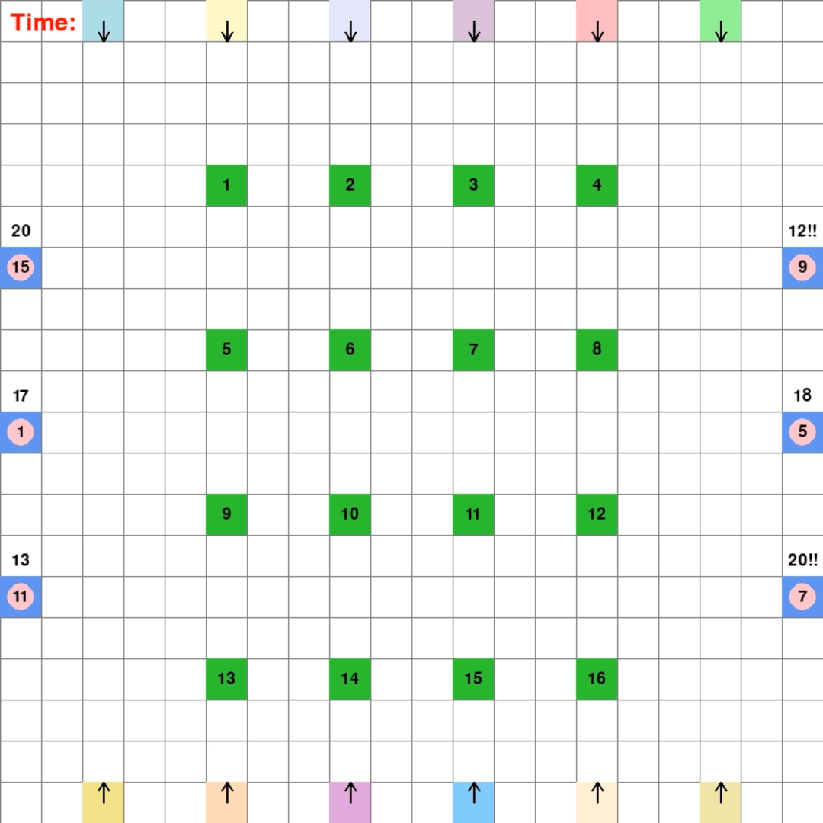
0.
Intruduction
This project implements a comprehensive multi-agent path planning and task scheduling system for Automated Guided Vehicles (AGVs) in a warehouse environment. The system coordinates 12 AGVs to efficiently complete 100 tasks across a 20×20 grid warehouse, ensuring collision-free operations and optimal task allocation.

Slide 3
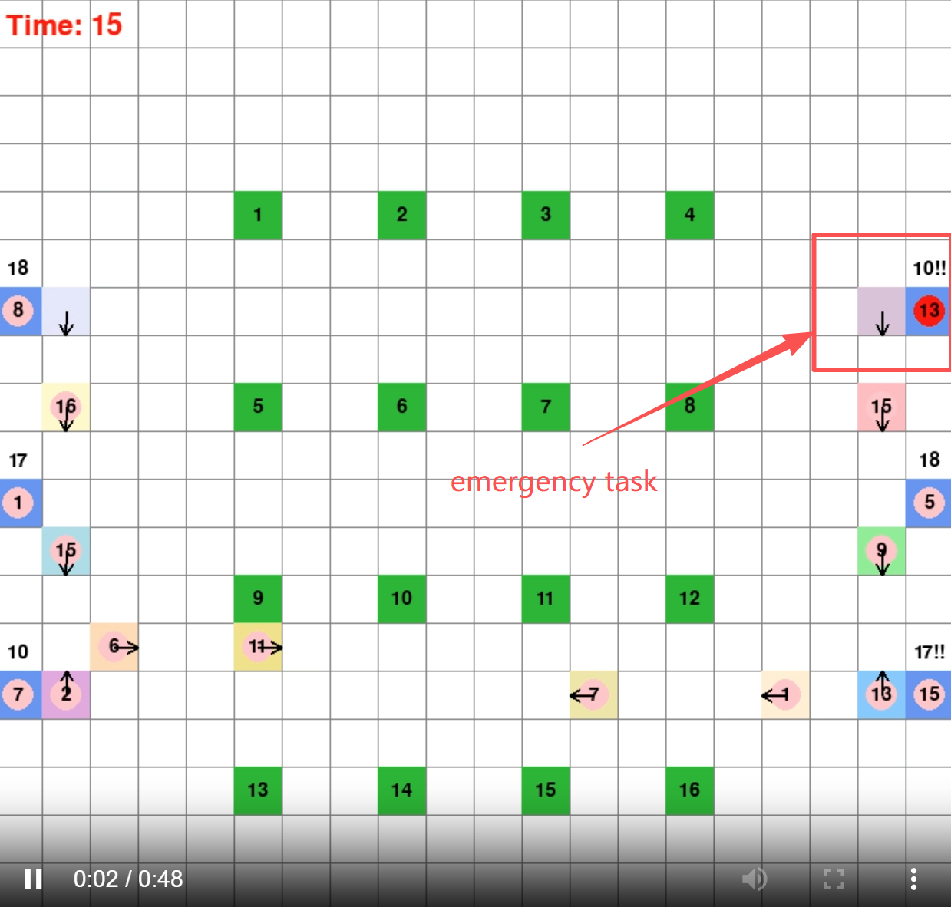
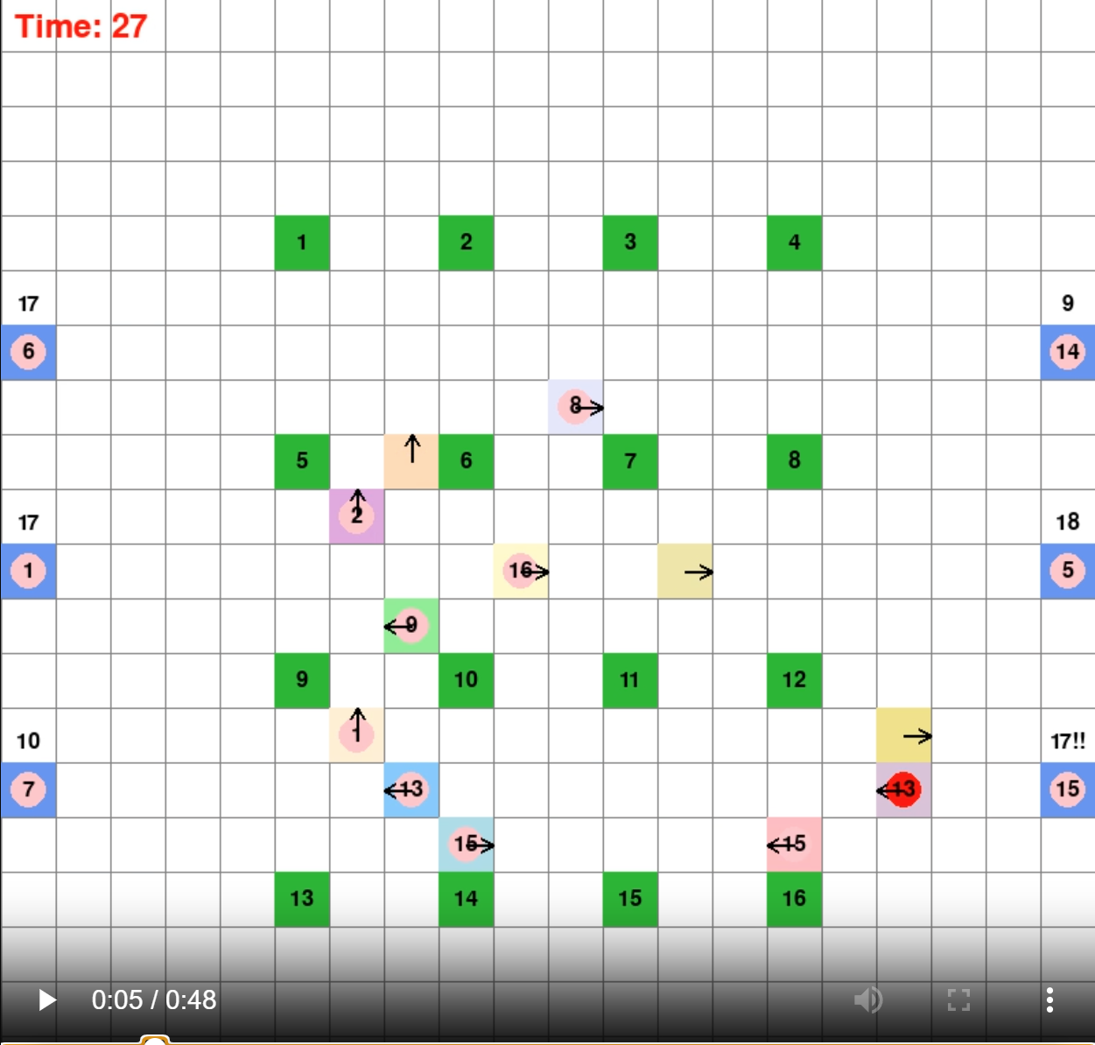
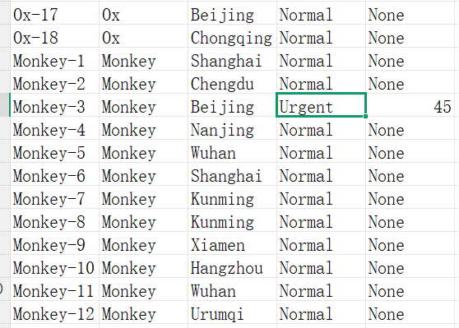
0.
Intruduction
emergency packages:
High-priority shipments shall be unloaded into the designated destination slots prior to the expiry of the specified remaining time.

Slide 4
1.
Instruction
-The system provides two CSV dataset files:
-`agv_position.csv`: Contains the warehouse layout and initial AGV positions, including pickup station locations, sorting outlet locations, and AGV initial coordinates and orientations.
-`agv_task.csv`: Contains the task definitions with 100 package tasks , specifying pickup stations, destination outlets, priority types, and remaining time for urgent tasks. The system randomly generates 100 package tasks, including 2 high-priority tasks that must be completed within specified time limits.
-Goal for Task Generation:
-AGV Trajectory CSV File: Generate a CSV file containing AGV trajectory information for each AGV at each timestamp, including:
- Timestamp
- AGV trajectory coordinates (X, Y)
- Orientation sequence
- Cargo status (whether carrying a package)
- Package destination outlet
- Emergency status (whether it's a high-priority task)

Slide 5
1.
Instruction
Applications in Robotics
Challenges
Path planning: Finding collision-free paths for multiple agents simultaneously.
Task Scheduling: Optimally assigning tasks to AGVs based on distance, priority, and availability.
Conflict Resolution: Collisions, deadlocks and head-on cross …
Game AI
Logistics
Our System
Plan paths: 12 AGVs operate in a 21×21 grid warehouse
Dynamically assign tasks: 6 pickup points → 16 delivery points
Ensure collision-free and deadlock-free
Handle urgent task prioritization and task sequence constraints
Key Programming Packages
Csv, heapq, collections.defaultdict, pandas, matplotlib & seaborn, pygame, numpy

Slide 6
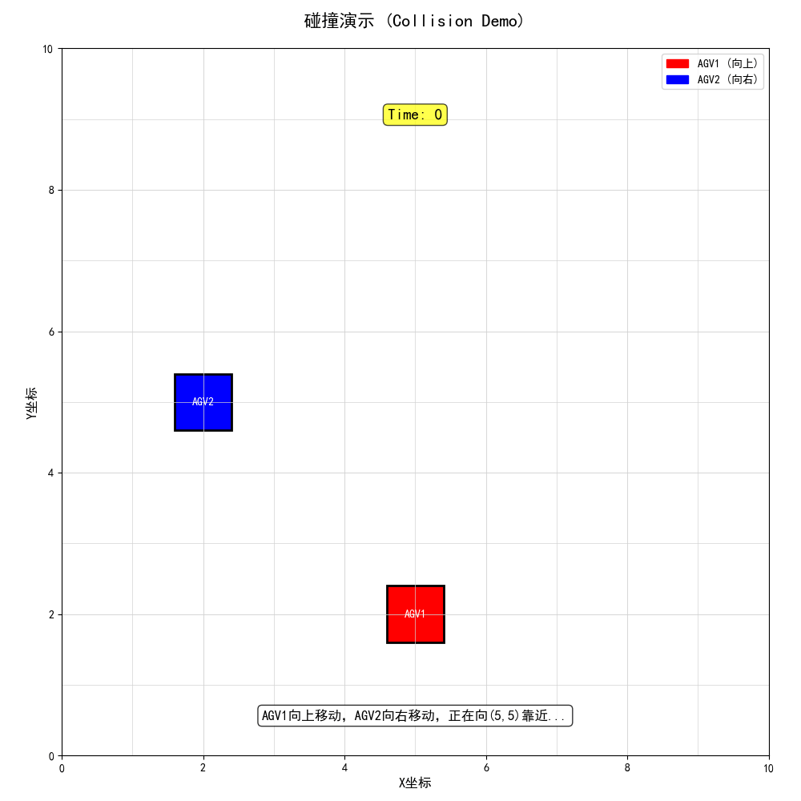
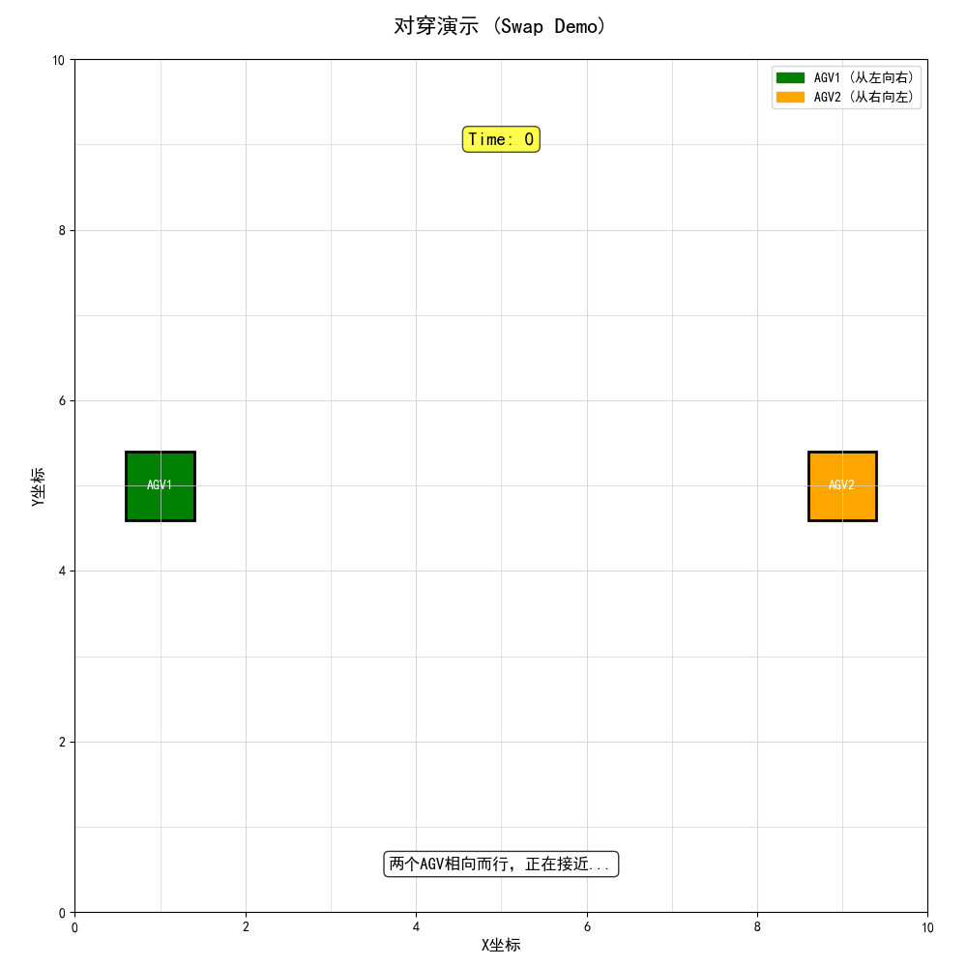
0.
Intruduction
Head-on Crossing & Swap (gifs, please play the ppt to see)

Slide 7
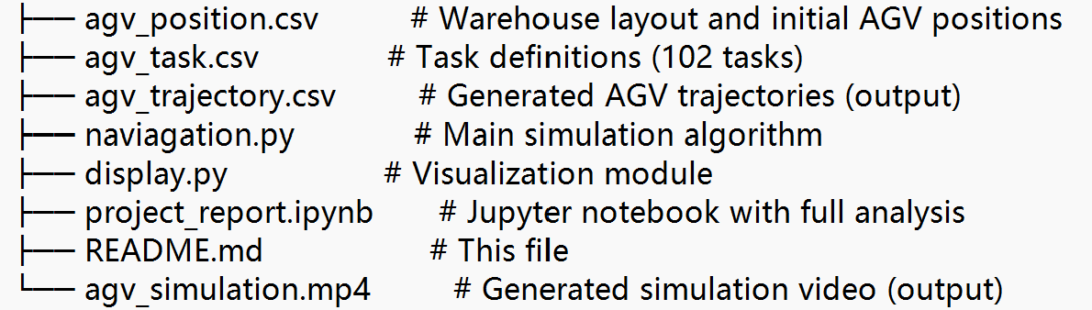
1.
Instruction
Features
Multi-Agent Path Planning: A* algorithm with temporal constraints for collision-free pathfinding
Dynamic Task Allocation: Cost-matrix-based greedy assignment with priority handling
Conflict Resolution: Prevents collisions and path swaps through forward-looking prediction
Real-time Visualization: Interactive pygame-based visualization with video export capability
Task Sequence Management: Ensures tasks are picked up in correct order from each pickup point
Final Version

Slide 8
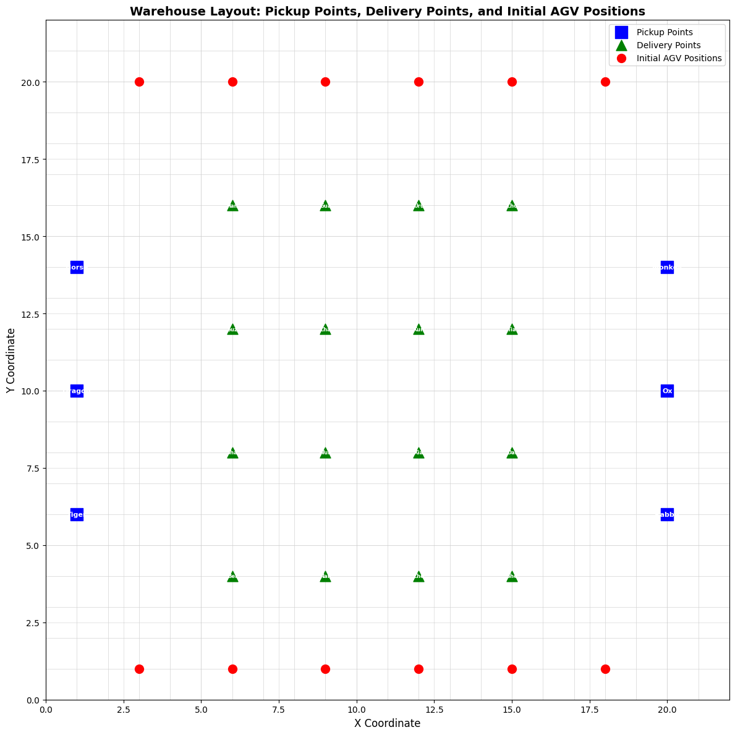
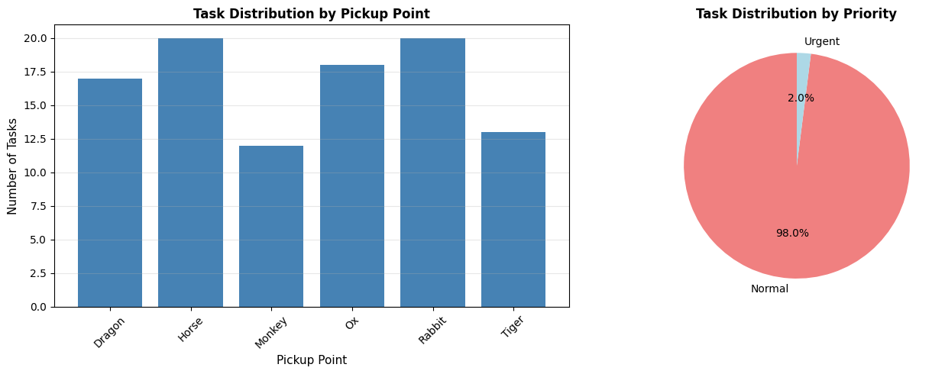
2.
Data Collection
Dataset Overview
Process
agv_position.csv : Defines the warehouse layout and initial AGV positions.
agv_task.csv : Contains all tasks to be executed by AGVs.
agv_trajectory.csv : Generated output containing the complete trajectory of all AGVs.
Warehouse Layout: 20×20 grid
Pickup Points: (6 - Tiger, Dragon, Horse, Rabbit, Ox, Monkey)
Delivery Points: (16 - Beijing, Shanghai, Guangzhou, etc.)
AGV Fleet: (12 - Optimus, Bumblebee, Jazz, etc.)
Task Set: (102 - Normal/Urgent)

Slide 9
3.1 Data Cleaning
Missing value check: Check for null/missing values in each dataset
  Use isnull().sum() Count the number of missing items in each column
Duplicate data detection: Identify and count duplicate data entries
  Use duplicated().sum() Count the number of duplicate rows
Data Quality Assessment Process : check for missing values → check for duplicate data
  Clear output: Use separators and formatted printing to improve readability
  Strong scalability: can easily add other validation rules (such as data types, scope checks)
Actual operation result analysis
  Location data: pitch There is a design deficiency in the field (which does not affect the core functionality)
  Task data: remaining_time Field is empty when task is not executed

Slide 10
3.1 Data Cleaning
Data loading and preprocessing：From CSV File loading warehouse layout, tasks, and AGV Initial state
  get_object_position()： parse location CSV， Separate the starting point, ending point, and AGV
  get_task_list()： Read task list grouped by starting point
  use csv.DictReader Perform structured reading
State initialization and modeling
  get_agv_state()： For each AGV Create a state dictionary: including location and task ID、 Key information such as path and loading status
  get_task_state()： Convert original tasks into executable format: calculate pick-up points, unloading points, and emergency task tags
Coordinate and Position Calculation
  get_pickup_coord()： Calculate the exact pickup location based on the starting point type: the starting point on the east side is offset to the right, and the starting point on the west side is offset to the left
  get_end_points()： Generate 4 optional locations around each unloading point to avoid congestion and improve scheduling flexibility
Emergency task processing logic: detect task priority field 'Urgent'
Trajectory recording and output
  append_to_csv()： Write simulation steps into trajectory file

Slide 11
3.2 Feature Engineering
Selection of Distance Measurement Methods
  Using Manhattan distance: |x1-x2| + |y1-y2|
  Implementation method: manhattan_distance() Simple and efficient functions
Coordinate data preprocessing
  start_positions： Map the starting point name to the (x, y) coordinates
  end_positions： Map the endpoint name to the (x, y) coordinates
Feature engineering implementation
  Distance feature addition: task_df['distance']
  apply Function application: Calculate the distance from the starting point to the endpoint for each task line
  lambda Expression: Concise implementation of line by line coordinate extraction and calculation
Step 1: Data Loading
├── Read start_points.csv → Dictionary: {name: (x,y)}
├── Read end_points.csv → Dictionary: {name: (x,y)}
└── Read agv_task.csv → DataFrame with columns
Step 2: Feature Calculation (Core)
for each task in DataFrame:
start_coord = start_dict[task.start_point]
end_coord = end_dict[task.end_point]
distance = |start_x - end_x| + |start_y - end_y|
task['distance'] = distance
Step 3: Analysis & Output
├── Calculate statistics: mean, max, min
├── Display formatted results
├── Export enhanced dataset
└── Prepare for visualization

Slide 12
3.3 Data Management
We organized our project with clear folder structure and version control:
final_version/
├── agv_position.csv # Warehouse layout and initial positions
├── agv_task.csv # Task definitions
├── agv_trajectory.csv # Generated AGV trajectories
├── main right copy.py # Main simulation algorithm
├── display.py # Visualization module
├── project_report.ipynb # This notebook
└── README.md # Project documentation
```
All code is version-controlled using Git, ensuring reproducibility and collaboration.

Slide 13
3.4.1 Path planning and task scheduling module
1. State management architecture
  AGV Status Dictionary : Unified management of location, task, path, priority
  Task state transition : Convert the original CSV Convert data into executable task objects
  Real time status tracking: Through` agv_states` Real time status of dictionary maintenance system
2. Coordinate System and Path Calculation
  Intelligent Coordinate Conversion: Dynamically calculate pick-up coordinates based on the starting point position
  Unloading point extension mechanism : Generate 4 adjacent selectable positions for each endpoint
  Manhattan Distance Calculation: Path Planning Algorithm for Grid Warehouse Adaptation
3. Conflict detection and task validation
  Trajectory collision detection : Check AGV Is there any positional overlap between them
  Path Intersection Recognition : Detection AGV Is there a conflict of wearing
  Task sequence verification : Ensure AGV Execute the task sequence in the correct order
4. Data persistence and output
  Track file record : Record all by time step AGV status
  CSV Structured storage : including location, loading status, and tasks ID Waiting for complete information
  Checkpoint Verification: Passed` check_trajectory_conflicts()` Ensure system reliability

Slide 14
3.4.1
Simulation class
1. Simulation engine architecture
  State Management System: Unified Management AGV Status, task queue, environment status, and timeline
  Hierarchical initialization: Initialize sequentially AGV Objects, surface tasks, task queues, ensure system consistency
  Time advancement mechanism: Through time_forward() Method for implementing discrete-time step simulation
2. Intelligent task allocation and replanning
  Dynamic task allocation: based on the cost matrix (distance+urgency weight) AGV Allocate optimal tasks
  Conflict detection and replanning:
    Real time detection of task mismatches (sequence errors)
    Intelligent task exchange algorithm (replan() method)
    Failed task recording mechanism (tried_tasks collection)
  Path validity verification: Pre verify the feasibility of the path before assigning tasks
3. Improved type A* Path planning algorithm
  Two stage planning: segmented path planning from starting point → pickup point → unloading point
  Dynamic obstacle handling:
    Static obstacle (fixed position)
    Time related obstacles (predict position 1 second, 2 seconds later)
    Temporary obstacles (specific locations for specific tasks)
  Steering and waiting mechanism: supports in place waiting and direction adjustment to avoid deadlocks
  Multiple unloading point selection: Generate multiple optional positions for each task endpoint to improve path flexibility

Slide 15
3.4.1
Environment class
1. Multi level obstacle modeling
  Static obstacles: fixed starting and ending positions
  Time prediction obstacle:
    forward_one_second_obstacles： Predict position in 1 second
    forward_two_seconds_obstacles： Predict position in 2 seconds
    Temporary obstacle: Specific AGV Temporary occupation position at a specific time point
2. Conflict detection mechanism
  Path Intersection Detection: judge_swapping() judgment AGV Has there been any cross dressing
  Path validity verification: is_valid_path() Check for conflicts between new paths and existing trajectories
    Endpoint verification: The path must reach a valid unloading point
    Collision detection: avoid overlapping positions at the same time point
    Wear detection: avoid AGV swap positions
3. Dynamic environment updates and management
  Mobile obstacle tracking: Real time recording of all obstacles AGV The movement trajectory
  Unloading point extension: Generate 4 adjacent selectable positions for each endpoint
  Status query interface: provides a unified method for obtaining obstacle information and supports path planning decisions

Slide 16
3.4.1
AGV class
State management encapsulation
  Core attributes: Name, Location Status, Task ID、 Priority marking, path trajectory
  Complete lifecycle: Record the entire path and steps from task assignment to completion
  Priority mechanism: priority Marking urgent tasks that affect scheduling priority
2. Data tracing and debugging
  Path record: path The array stores the complete movement trajectory (coordinates+time+direction)
  Step storage: steps Array records the detailed status of each time step (loading, destination, etc.)
  Debugging friendly:__ repr__() Method provides structured object information output for easy problem troubleshooting

Slide 17
3.4.2
Visualization module
Step 1: Import Required Libraries
├── pygame (graphics rendering)
├── csv, numpy (data processing)
├── math, time (calculations & timing)
└── collections, sys (system utilities)
Step 2: Initialize Graphics Engine
├── Initialize pygame
├── Check initialization success
└── Prepare for visualization
Step 3: Configure Display Parameters
├── Grid size: 40 pixels
├── Window size: 800×800 pixels (20×20 grid)
└── Frame rate: 5 FPS (optimized for path planning)
Step 4: Define Color System
├── Basic colors: White, Black, Red, Gray
├── Functional colors:
│ ├── Blue (100,149,237): Pickup points
│ ├── Green (50,205,50): Delivery points
│ └── Pink (255,192,203): Normal tasks
└── AGV colors: 16 distinct pastel shades
Step 5: Create City Mapping
├── Map 16 city names to numbers (1-16)
├── Example: Hangzhou→1, Guangzhou→2
└── Used for delivery point labeling
Step 6: Check Optional Libraries
├── Verify imageio availability
├── Prepare for animation recording
└── Optional functionality
Step 7: Module Ready
└── Visualization system prepared for execution

Slide 18
3.4.2
Visualization module
1. Multi source data management and status tracking
  Three level data loading: location CSV( Static layout), tasks CSV( Assignment definition, trajectory CSV( Dynamic Path
  Intelligent state tracking system: real-time recording of task completion status AGV Current task, remaining task count
  Task sequence management: Maintain a task queue sorted by number for each starting point, supporting natural sorting (such as Tiger-1 in Tiger-10 Previously)
2. Real time rendering and dynamic display engine
  Grid coordinate system: 20 × 20 grid (40 pixels/grid), coordinate conversion adapted to display coordinate system
  Layered drawing strategy: Background → Static objects (starting/ending points) → AGV → Goods → Directional arrows → Information overlay
  State change detection: By comparing the time steps before and after, accurately identify task loading/unloading events
3. Configurable output and performance optimization
  Flexible speed control: supports playback speed adjustment (FPS × FPS) speed Factor)
  Video recording function: optional generation mp4 File, use imageio Library ensures format compatibility
  Error handling mechanism: elegant resource cleaning to ensure the integrity of video files

Slide 19
4.1
Algorithm Core: A* Path Planning and Task Allocation
A* Path Planning Algorithm
Task Allocation Algorithm
Goal: Used for finding optimal paths from AGV positions to pickup points and from pickup points to delivery points.
Heuristic Function: Employs the Manhattan distance.
Cost Function: Includes Movement cost (1 unit) plus turn cost (1 additional time step).
Constraint Handling: Incorporates constraints for Static obstacles, dynamic obstacles (other AGVs), and swap prevention (to avoid two AGVs crossing paths).
Strategy: Tasks are allocated using a cost matrix approach.
Cost Calculation: Based on the Manhattan distance from the AGV to the pickup point.
Priority Weighting: Urgent tasks receive a 0.7× cost multiplier to prioritize their assignment.

Slide 20
4.2
Conflict Resolution
Conflict Resolution Mechanisms
Collisions: Ensuring two AGVs do not occupy the same position at the same time.
Swaps: Avoiding two AGVs crossing paths or swapping positions.
Task Misalignment: Ensuring tasks are picked up in the correct sequence/order.

Slide 21
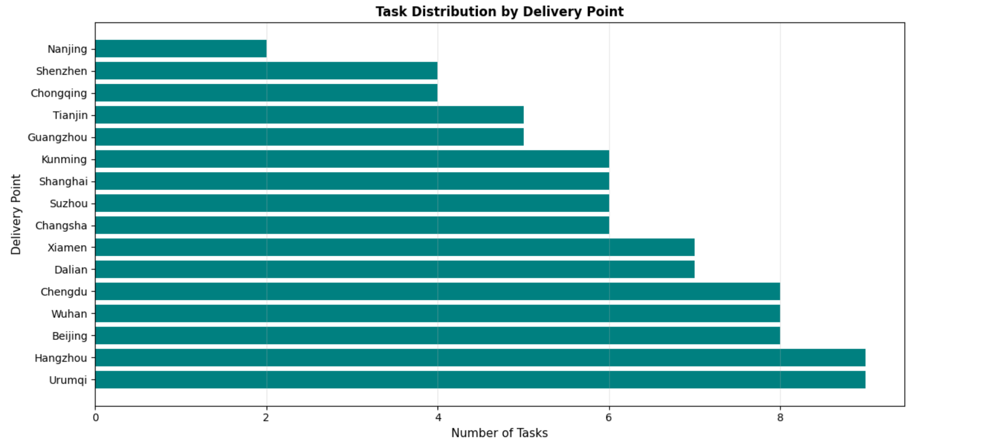
4.3
Task Distribution
Task Distribution by Pickup Point
Task Distribution by Delivery Point
Tasks were concentrated at Rabbit (20 tasks) and Horse (20 tasks)
Most popular delivery point: Urumqi (9 tasks).
Least popular delivery point: Nanjing (2 tasks).

Slide 22
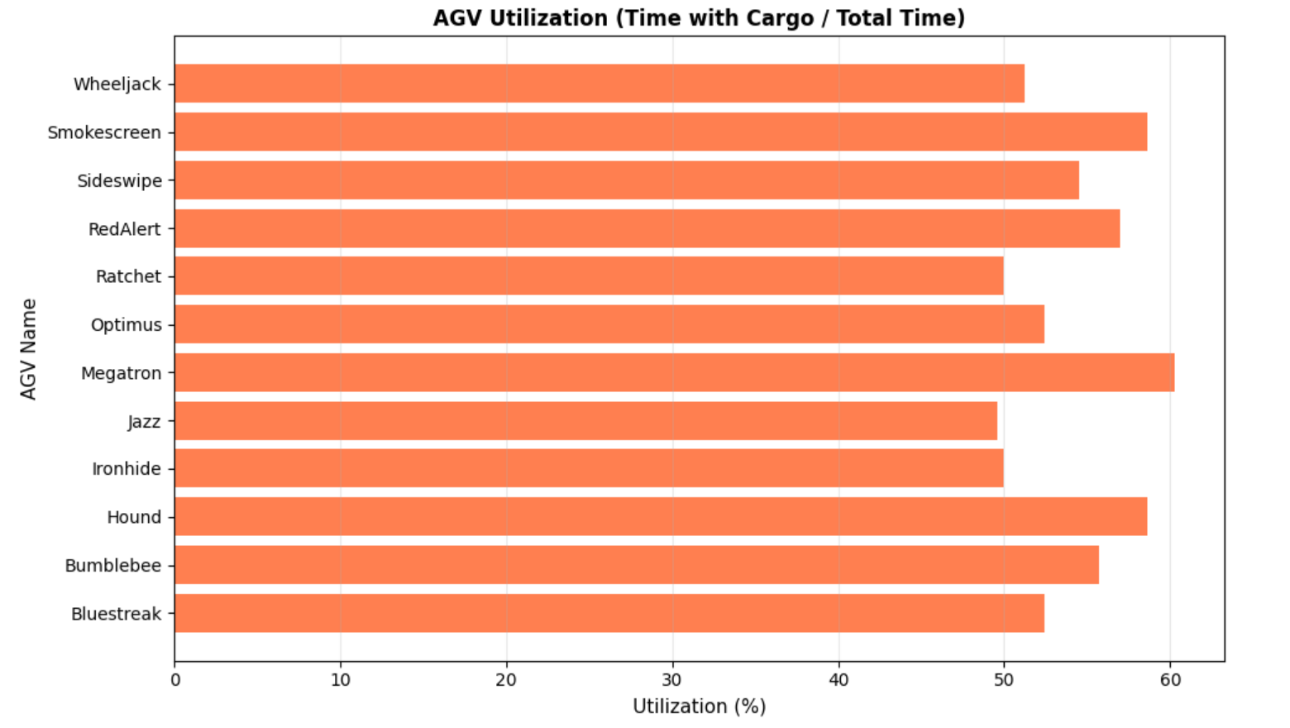
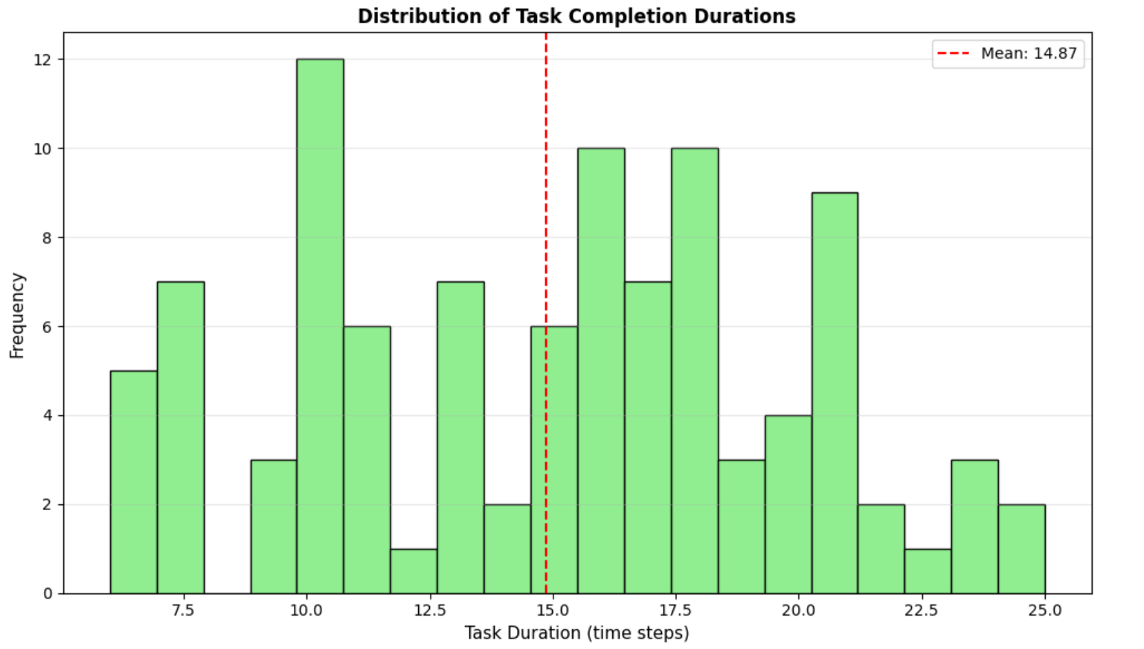
4.4
Simulation Results: Duration and AGV Utilization
Simulation Overview
Total simulation time: 243 time steps.
Total trajectory records: 2928.
Average records per time step: 12.00.
AGV Utilization Analysis
Utilization is calculated as (Time with Cargo / Total Time) * 100%.
Highest Utilization: Megatron (60.25%).
Lowest Utilization: Jazz (49.59%).
Task Duration Analysis
Total 100 tasks were analyzed for completion duration.
Average task duration: 14.87 time steps.
Task durations ranged from 6 (shortest) to 25 (longest) time steps, with a median of 16.00.

Slide 23
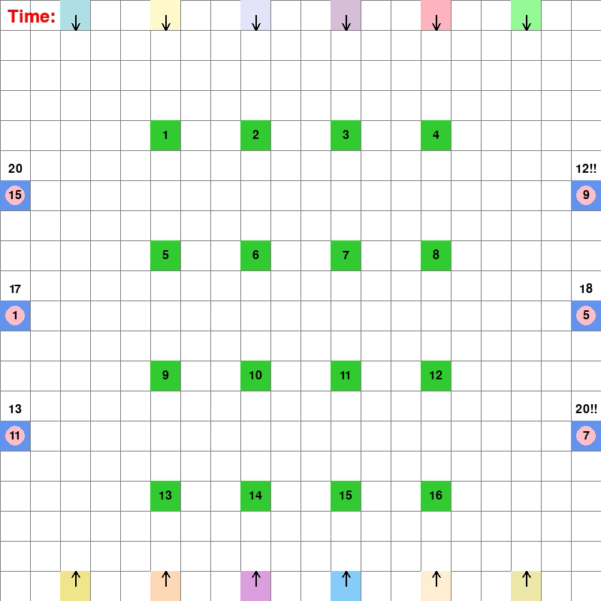
4.5
Visualization of AGV Trajectories
Real-time Visualization System
Tool Used: Developed using the Pygame library.
Purpose: Provides real-time visualization of AGV movement trajectories and task execution.
Visual Elements: The video visualization shows:
  AGV paths and direction.
  Cargo states: Pink for normal tasks and red for urgent tasks.
  Timestamp information.

Slide 24
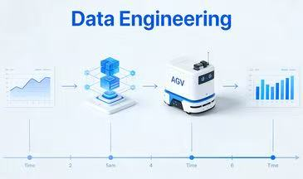
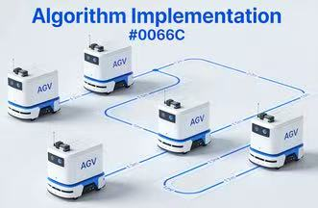
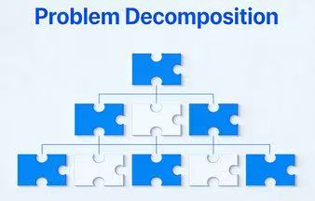

5.3 Reflection on Learning
Key Learning & Practical Gains
Algorithm Implementation：Adapt A* algorithm for multi-agent scenarios with temporal constraints
Data Engineering：Process and manage spatial-temporal data for simulation systems
Problem Decomposition：Break down complex coordination problems into manageable modules
Visualization Design：Create effective visualizations to present system behavior
Programming Best Practices：Write modular, maintainable code with proper data structures

Slide 25
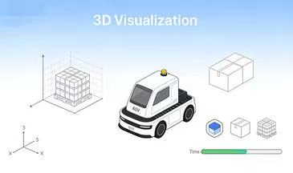
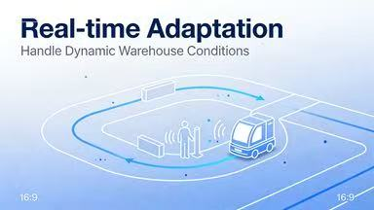
5.4 Future Improvements
Advanced Pathfinding: Implement more sophisticated MAPF algorithms (e.g., Conflict-Based Search, Push and Swap) for better scalability
Optimization-Based Task Allocation: Replace greedy allocation with optimization algorithms (e.g., linear programming, constraint programming) for global optimality
Dynamic Replanning: Add capability to replan paths when new information becomes available or when conflicts are detected
Real-time Adaptation: Implement mechanisms to handle dynamic obstacles and changing warehouse conditions
Performance Metrics: Add comprehensive metrics (throughput, makespan, AGV utilization) and compare against baseline algorithms
Machine Learning Integration: Explore using reinforcement learning for adaptive task allocation and path planning
3D Visualization: Enhance visualization to show AGV orientations, cargo states, and temporal evolution more clearly

Slide 26
06：References
Hart, P. E., et al. (1968). A formal basis for the heuristic determination of minimum cost paths. IEEE transactions on Systems Science and Cybernetics, 4(2), 100-107.
Stern, R., et al. (2019). Multi-Agent Pathfinding: Definitions, Variants, and Benchmarks. Proceedings of the International Symposium on Combinatorial Search, 10(1), 151-158.
Python Software Foundation. (2023). Python 3 Documentation. https://docs.python.org/3/
Pandas Development Team. (2023). pandas: powerful Python data analysis toolkit. https://pandas.pydata.org/
Matplotlib Development Team. (2023). Matplotlib: Visualization with Python. https://matplotlib.org/

Slide 27
Thank You For Watching

