Slide 1
Project 1

Slide 2
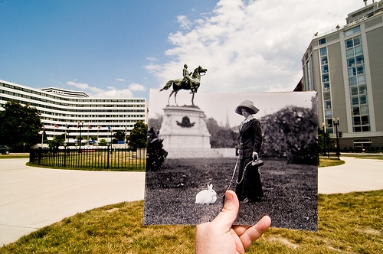
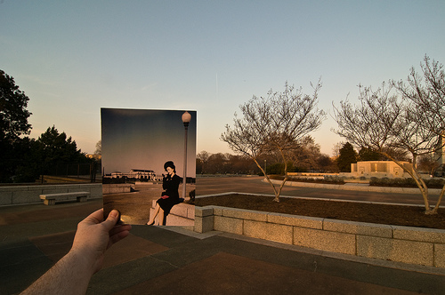
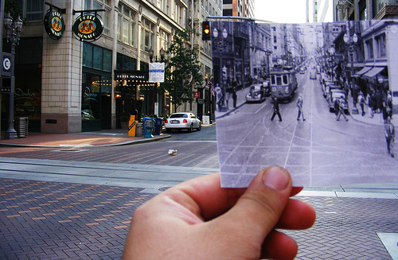
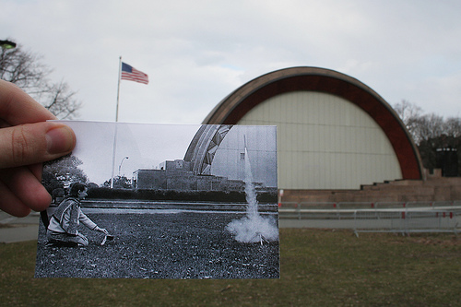
A look into the past
http://blog.flickr.net/en/2010/01/27/a-look-into-the-past/

Slide 3
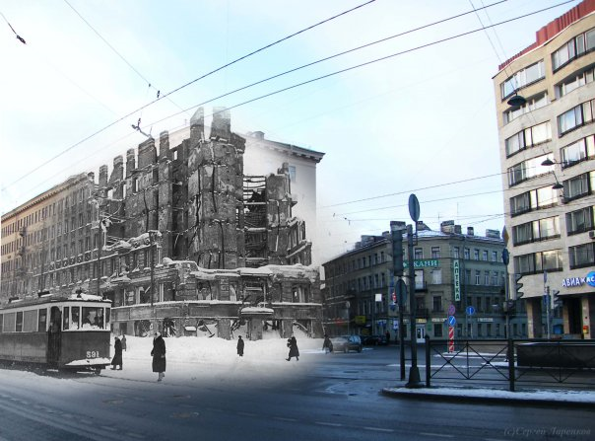
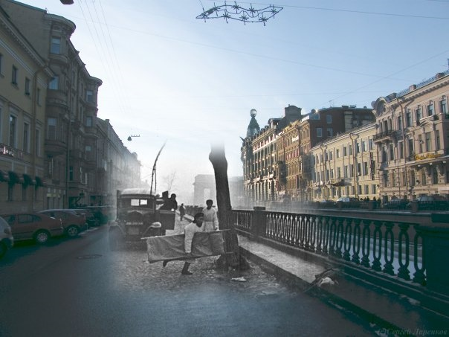
A look into the past
Leningrad during the blockade
http://komen-dant.livejournal.com/345684.html

Slide 4
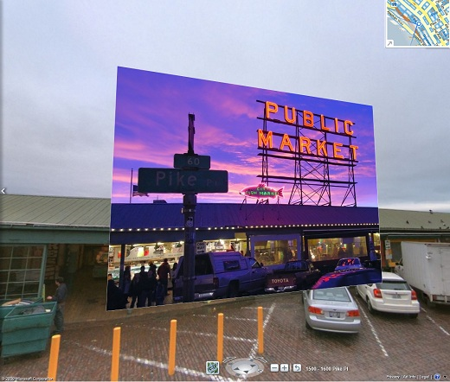
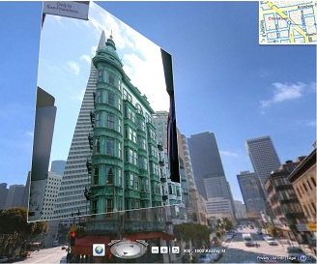
Bing streetside images
http://www.bing.com/community/blogs/maps/archive/2010/01/12/new-bing-maps-application-streetside-photos.aspx

Slide 5
考核方式
项目报告：2-4人一组，从五个候选项目中任选一个，实现并提交项目报告以及源代码。

