Slide 1
Forecasting Electricity Demand
Micro-Project 4
Repository: <add your GitHub repository link>
Zeena Keshwji
November 6, 2026

Slide 2
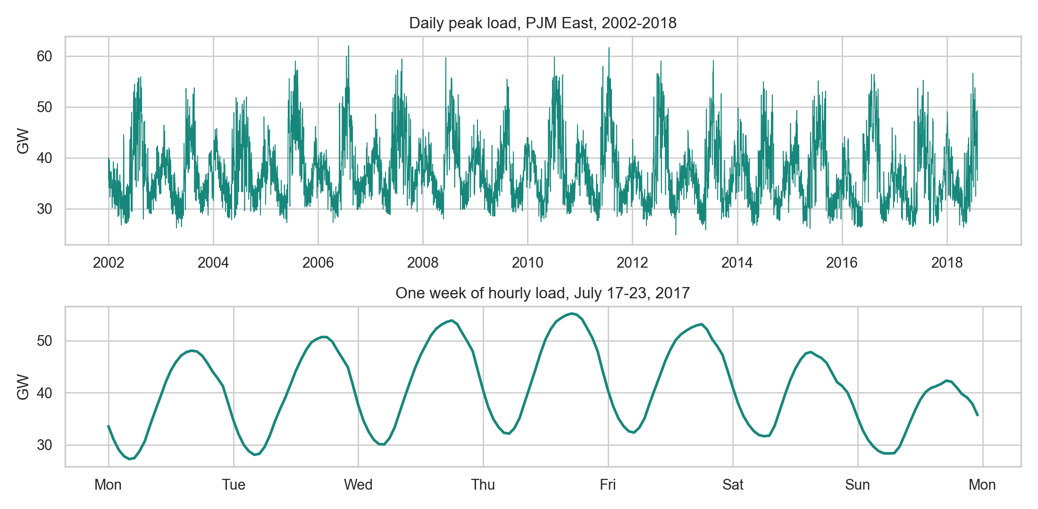
Problem Statement
Electricity is hard to store at grid scale, so supply must match demand hour by hour.
PJM East load swings between 14,500 MW and 62,000 MW.
Forecasting too low risks shortages and costly last-minute generation; too high wastes committed capacity.
Question: How accurately can deep learning predict each of the next 24 hourly loads from past load and the calendar?
Source: Kaggle, Hourly Energy Consumption (robikscube), PJM East region

Slide 3
Hypothesis Formulation
Demand is a repeating pattern with memory, so a model that reads load as a sequence should forecast it best.
H1: Load has strong daily, weekly and annual cycles.
H2: A recurrent network beats naive and linear baselines.
H3: Gated RNNs (LSTM, GRU) beat a plain RNN and a dense network.
H4: One week of history beats one day.
H5: The largest errors fall on summer peaks and holidays, since there is no weather data.
Hypothesis | Planned test
H1 | Autocorrelation, calendar profiles
H2 | Paired block bootstrap on daily MAE
H3 | Paired block bootstrap on daily MAE
H4 | Each model at 24 h vs. 168 h window
H5 | Mann-Whitney test by day type
All tests at α = 0.05 on a chronological hold-out set

Slide 4
Acquire
Identify: Kaggle “Hourly Energy Consumption” (robikscube): load published by PJM Interconnection, a U.S. grid operator.
Retrieve: Downloaded the ZIP from Kaggle's public API; the notebook re-downloads it if the local copy is missing.
Query: Read PJME_hourly.csv, the longest regional series, into pandas: 145,366 rows × 2 columns.
Target: the next 24 hourly loads in MW, all continuous, so this is multi-output regression.
Item | Value
Column 1 | Datetime (hourly timestamp)
Column 2 | PJME_MW (load, megawatts)
Period | Jan 1, 2002 to Aug 3, 2018
Mean load | 32,079 MW
Lowest | 14,544 MW (Hurricane Sandy, 2012)
Highest | 62,009 MW (Aug 2, 2006)
kaggle.com/datasets/robikscube/hourly-energy-consumption

Slide 5
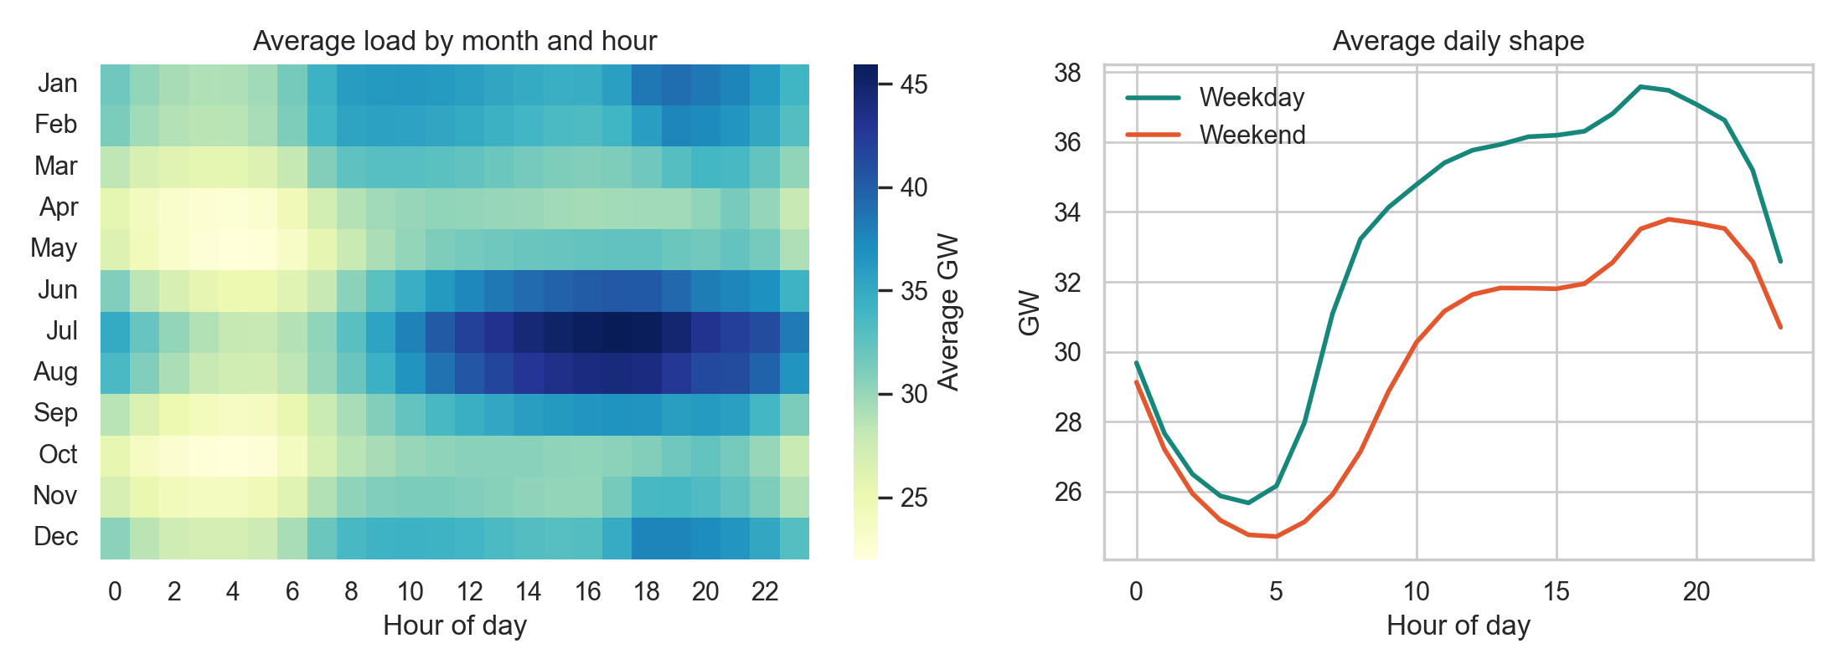
Prepare
Rows were out of order: sorted by time.
8 rows shared a timestamp (fall clock change): averaged.
30 single hours were missing, mostly the spring clock change: interpolated.
Result: a complete grid of 145,392 hours.
H1 supported: peak hour is 43% above the overnight low, July is 36% above April, and weekdays run 11% above weekends.
Demand peaks on summer afternoons and on winter evenings

Slide 6
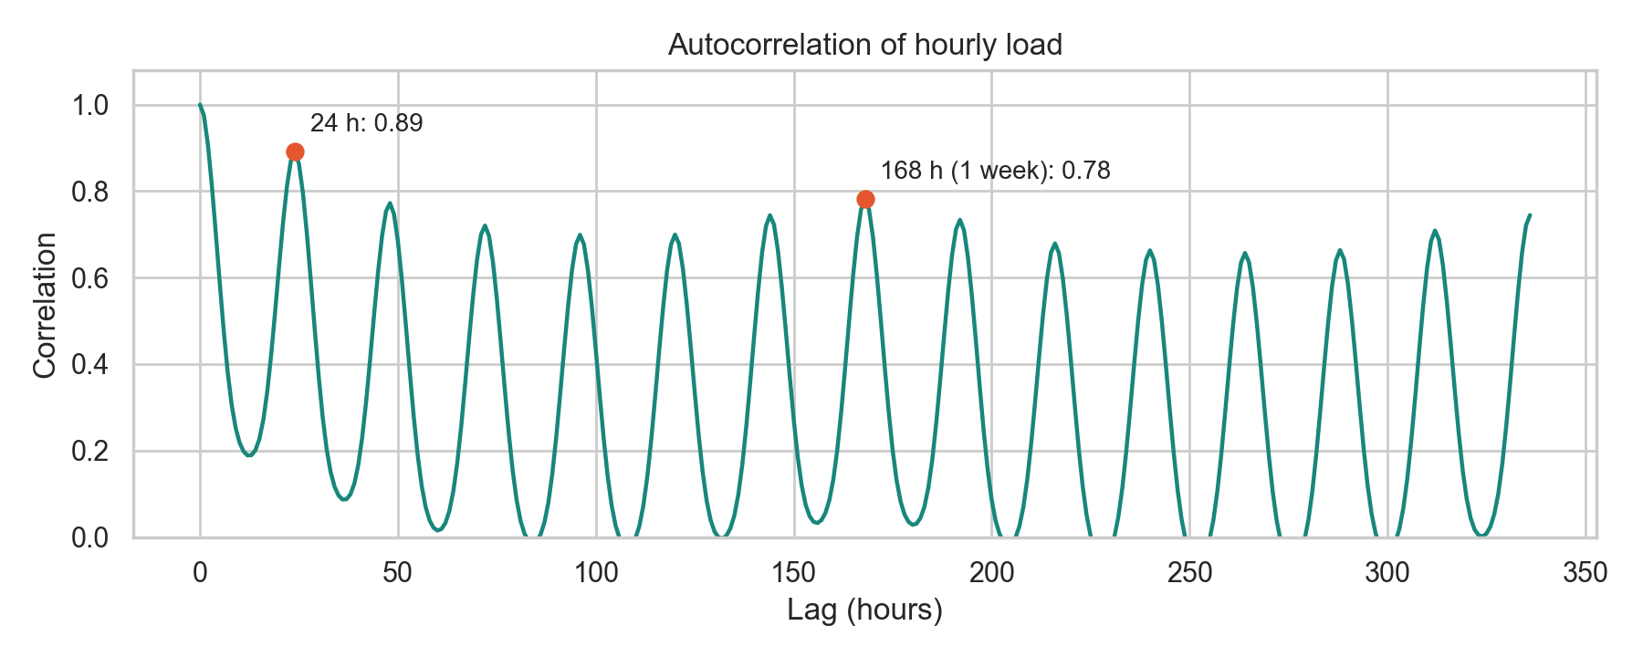
Prepare (cont.): Features and Windows
Inputs: past load plus calendar features (sine and cosine of hour, weekday and day of year; weekend or holiday flag).
Known in advance: the calendar of the next 24 hours.
Scaling: load standardized with training statistics only.
Chronological split, no shuffling:
Load correlates 0.89 with the same hour yesterday and 0.78 with the same hour last week
Set | Dates | Forecasts
Train | 2002 to 2014 | 18,960 (every 6 h)
Validation | 2015 to 2016 | 731 (daily)
Test | Jan 2017 to Aug 2018 | 579 (daily)

Slide 7
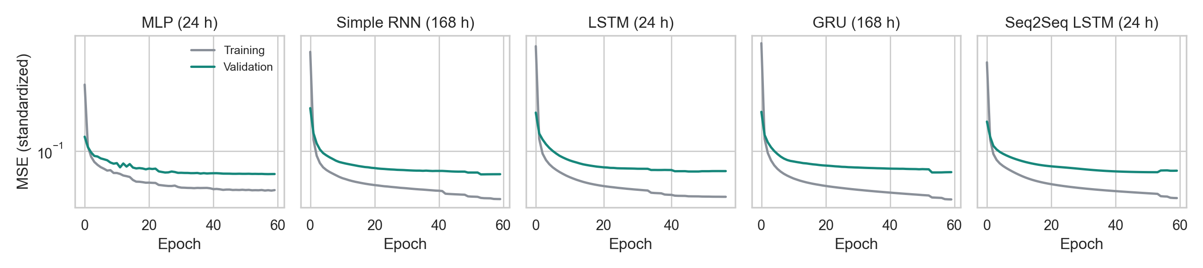
Analyze data
Baselines: same hour yesterday, same hour last week (seasonal naive), ridge regression, gradient boosting.
Deep learning (Keras): dense network (MLP), Simple RNN, LSTM, GRU, Seq2Seq LSTM.
Fair comparison: every trained model tried 24 h and 168 h windows and kept the better one on validation.
Training: Adam, MSE loss, early stopping, 3 seeds per network, forecasts averaged across seeds.
Iteration: the first run was redone after finding unequal windows and an epoch cap.

Slide 8
Analyze Data (cont.): Results
Model | Window | Val MAE | Test MAE | Test MAPE | Test R²
Simple RNN (final) | 168 h | 1,151 | 1,337 | 4.1% | 0.902
MLP | 24 h | 1,160 | 1,331 | 4.1% | 0.900
GRU | 168 h | 1,165 | 1,359 | 4.2% | 0.900
Seq2Seq LSTM | 24 h | 1,190 | 1,374 | 4.3% | 0.898
LSTM | 24 h | 1,203 | 1,412 | 4.4% | 0.893
Ridge | 168 h | 1,245 | 1,378 | 4.2% | 0.892
Gradient boosting | 24 h | 1,248 | 1,416 | 4.4% | 0.888
Same hour yesterday | n/a | 2,137 | 2,300 | 7.3% | 0.738
Seasonal naive | n/a | 3,312 | 3,511 | 11.0% | 0.387
Test-set comparison | MAE gain | p
Simple RNN vs. naive | 2,174 | < 0.001
Simple RNN vs. boosting | 79 | < 0.001
Simple RNN vs. ridge | 40 | 0.12
Simple RNN vs. MLP | −6 | 0.53
Simple RNN vs. GRU | 22 | 0.014
Simple RNN vs. LSTM | 75 | < 0.001
Paired block bootstrap on daily MAE, 14-day blocks
MAE in MW. Final model chosen on validation MAE; the MLP's small test lead is not significant.

Slide 9
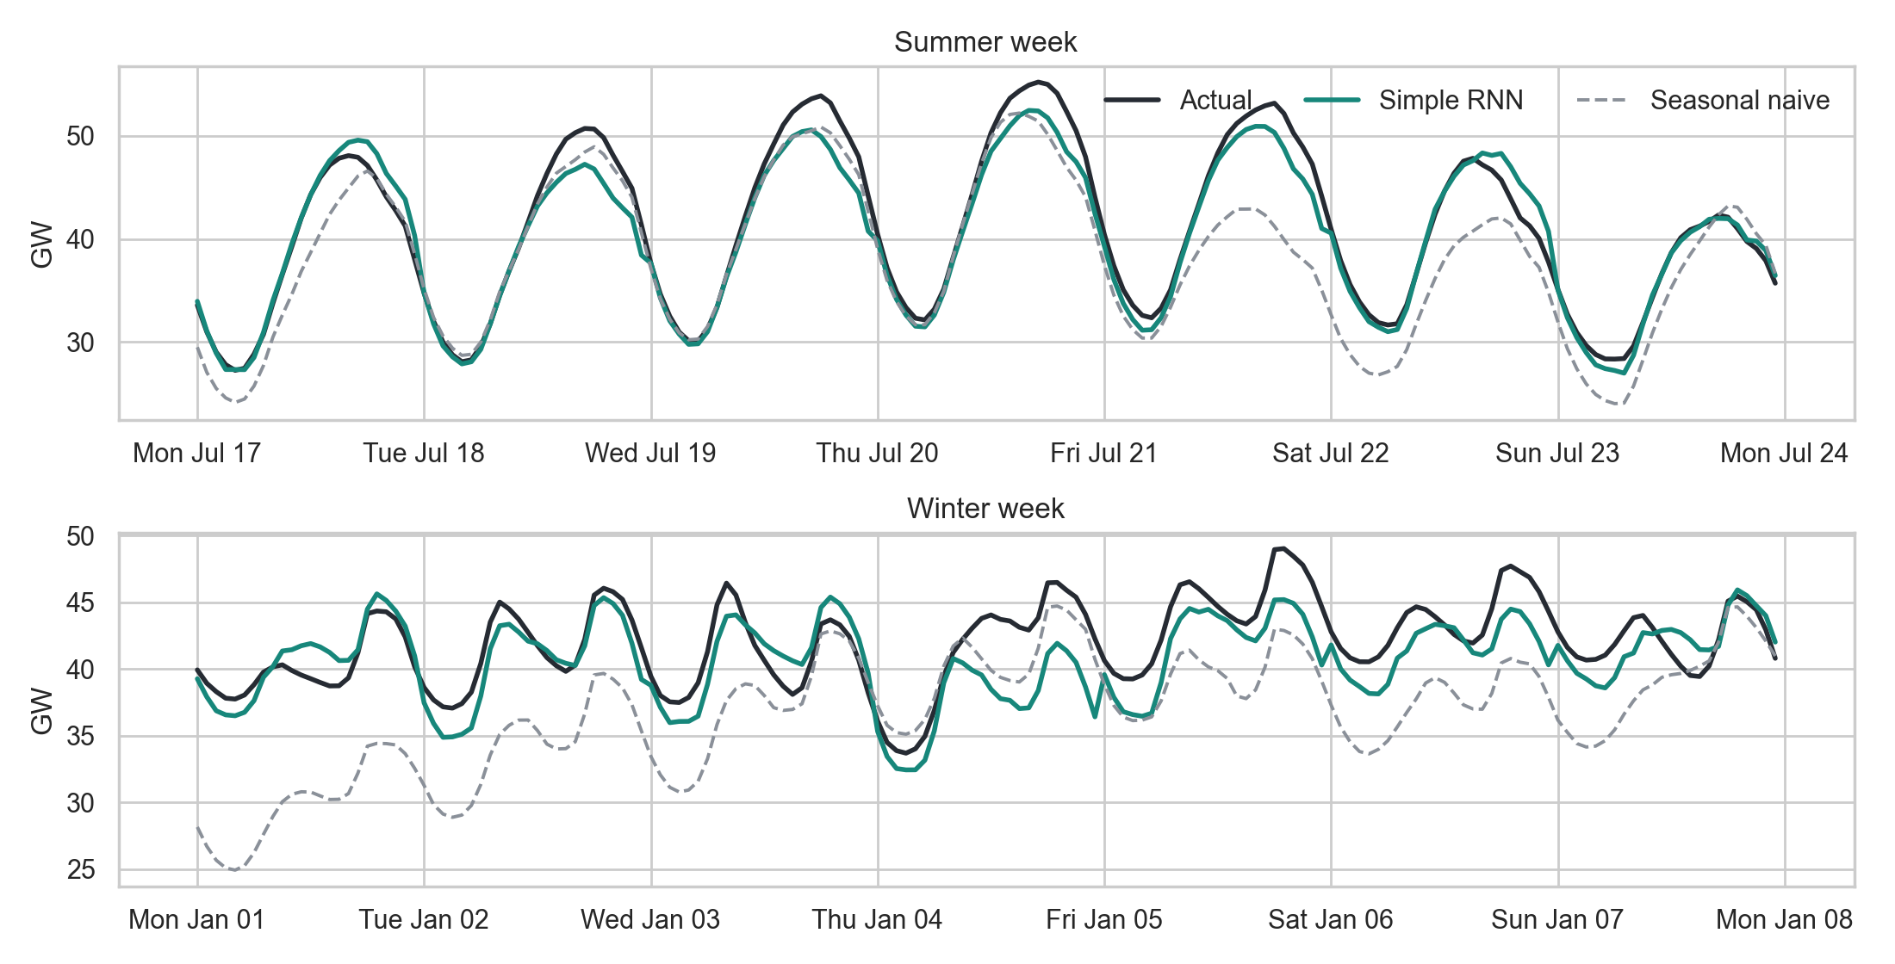
Report
4.1%
average error of the Simple RNN (1,337 MW)
−62%
error vs. the seasonal-naive forecast
Hypothesis | Verdict
H1 Strong cycles | Supported
H2 RNN beats baselines | Partly: tie with ridge
H3 Gated RNNs win | Not supported
H4 One week beats one day | Partly: ridge, GRU only
H5 Errors at peaks, holidays | Partly: peaks only
The RNN tracks the daily shape closely but runs low during the January 2018 cold snap

Slide 10
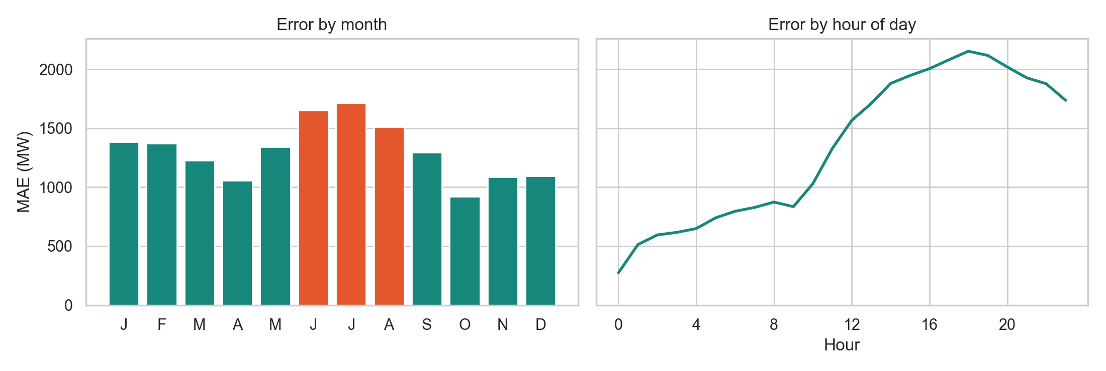
Report (cont.): Where Errors Fall
Summer error is highest: 1,646 MW vs. 1,099 to 1,320 MW in other seasons (p < 0.001).
Top 5% peak days: 1,777 MW vs. 1,311 MW on normal days (p < 0.001).
Holidays: no detectable difference (p = 0.18, only 15 days).
Worst five days: all over-forecasts after a sharp drop in peak load, which fits sudden weather changes, though the data cannot confirm this.
Error grows with lead time: 274 MW at 1 hour, 1,737 MW at 24 hours.
Error is highest in June through August and in the late afternoon and evening

Slide 11
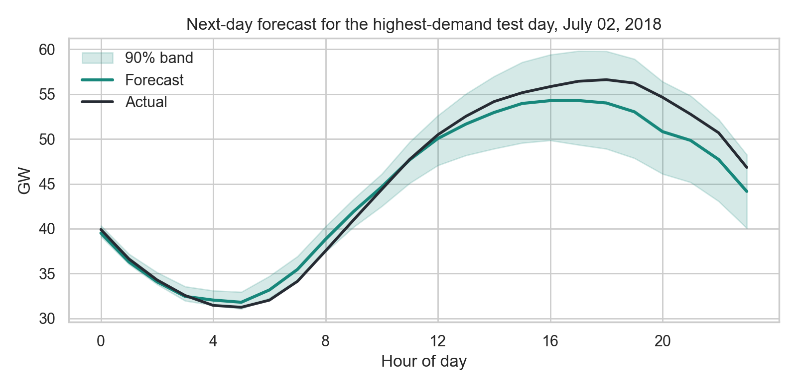
Act
Use the Simple RNN: lowest validation error, smallest network, trains in about 2 minutes. Keep ridge as a transparent backup.
Size reserves from measured error: about 4,500 MW above forecast covered 94.5% of test peaks, vs. about 9,400 MW for naive. Ridge needs a similar 4,586 MW.
Recalibrate bands: the 90% band covered only 86.6% of hours (81% in summer).
Add weather next: it is the most likely source of the remaining error.
Limits: one region, data ends in 2018, and forecasts are issued at midnight, later than a real day-ahead market.
Highest-demand test day: the forecast peak came in 4.1% low

