Slide 1
Convolutional Neural Networks

Slide 2


Image Classification
Person
Cat
Doge
1 image = 1 class/label

Slide 3
Image Classification
97% Person
2% Doge
1% Cat
88% Cat
9% Person
3% Doge
92% Doge
6% Cat
2% Person
1 image = 1 class/label

Slide 4
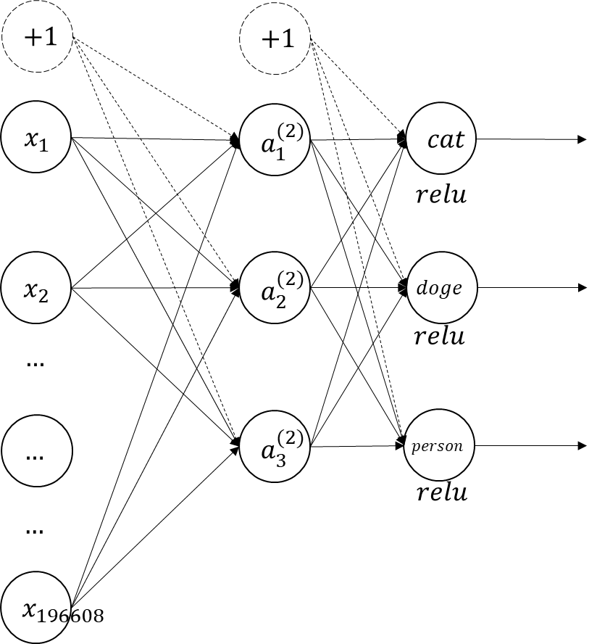

Image Classification
470
13
49
+
$$256∗256∗3=196608$$
532
532
532

Slide 5



Image Classification
470
532
$$=88\%$$
13
$$=3\%$$
532
49
$$=9\%$$
532
$$256∗256∗3=196608$$

Slide 6
Image Classification
88% Cat
9% Person
3% Doge
Softmax

Slide 7
Object Detection
Branch
Glass
Cat
Doge
Flower
Person
Person
Plate
1 image = banyak label

Slide 8
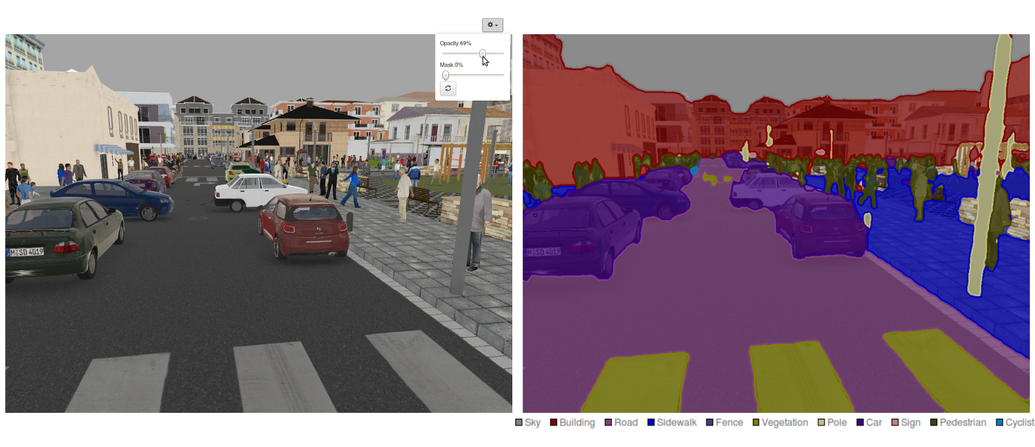
Image Segmentation

Slide 9


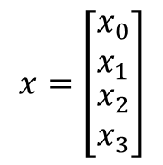






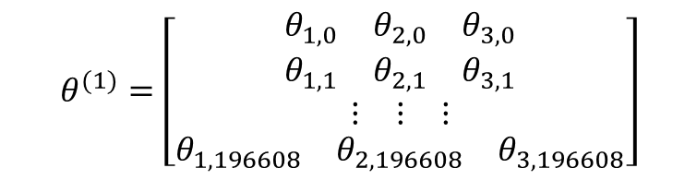




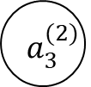
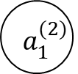



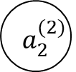
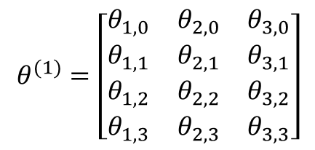





$$x_{0}$$
$$θ_{1,0}^{(1)}$$
$$θ_{3,0}^{(1)}$$
$$θ_{2,0}^{(1)}$$
$$x_{1}$$
$$θ_{1,1}^{(1)}$$
$$a_{1}^{(2)}$$
$$θ_{2,1}^{(1)}$$
$$θ_{3,1}^{(1)}$$
$$x_{2}$$
$$θ_{1,2}^{(1)}$$
$$θ_{2,2}^{(1)}$$
$$a_{2}^{(2)}$$
$$h_{θ}(x)$$
$$θ_{3,2}^{(1)}$$
$$θ_{1,3}^{(1)}$$
$$θ_{2,3}^{(1)}$$
$$x_{3}$$
$$a_{3}^{(2)}$$
$$θ_{3,3}^{(1)}$$
$$x=\left[\begin{matrix}x_{0} \\ x_{1} \\ \begin{matrix}x_{2} \\ x_{3}\end{matrix}\end{matrix}\right]$$
$$θ^{(1)}=\left[\begin{matrix}\begin{matrix}θ_{1,0} & θ_{2,0} & θ_{3,0}\end{matrix} \\ \begin{matrix}θ_{1,1} & θ_{2,1} & θ_{3,1}\end{matrix} \\ \begin{matrix}\begin{matrix}θ_{1,2} & θ_{2,2} & θ_{3,2}\end{matrix} \\ \begin{matrix}θ_{1,3} & θ_{2,3} & θ_{3,3}\end{matrix}\end{matrix}\end{matrix}\right]$$
$$θ^{(1)}=\left[\begin{matrix}\begin{matrix}θ_{1,0} & θ_{2,0} & θ_{3,0}\end{matrix} \\ \begin{matrix}θ_{1,1} & θ_{2,1} & θ_{3,1}\end{matrix} \\ \begin{matrix}\begin{matrix}⋮ & ⋮ & ⋮\end{matrix} \\ \begin{matrix}θ_{1,196608} & θ_{2,196608} & θ_{3,196608}\end{matrix}\end{matrix}\end{matrix}\right]$$
$$θ^{(1)}=ℝ^{4x3}$$
$$θ^{(1)}=ℝ^{196608x3}$$
$$\sim 600ribu$$

Slide 10
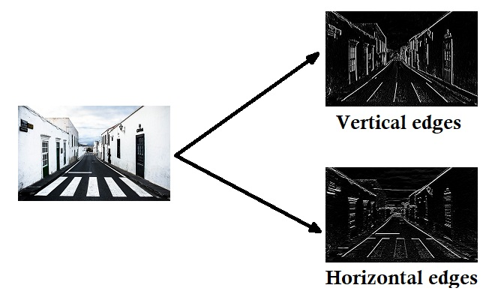
Convolution

Slide 11
Convolution
5 | 4 | 5 | 2 | 2
2 | 3 | 5 | 1 | 1
0 | 1 | 2 | 3 | 2
3 | 2 | 3 | 2 | 3
4 | 2 | 3 | 4 | 3
1 | 0 | -1
1 | 0 | -1
1 | 0 | -1

Slide 12
Convolution
5 | 4 | 5 | 2 | 2
2 | 3 | 5 | 1 | 1
0 | 1 | 2 | 3 | 2
3 | 2 | 3 | 2 | 3
4 | 2 | 3 | 4 | 3
1 | 1 | 1
0 | 0 | 0
-1 | -1 | -1

