Slide 1

REGRESI LINEAR SEDERHANA
$\hat{y}=θ_{0}+θ_{1}x_{1}$
$θ_{1}=\frac{cov(x,y)}{var(x)}$
$θ_{1}=\frac{\sum{(x −\text{x}\text{̅})(\text{y}−\text{y}\text{̅ })}}{\sum{{(x −\text{x}\text{̅})}^{2}}}$
$θ_{0}=\overline{y}−θ_{1}\overline{x}$

Slide 2

X (Distance) | y (Fee)
5 | 11
13 | 32
2.3 | 6
4 | 10
6 | 13
7 | 20
5.7 | 13
12 | 27
$$\hat{y}=\text{2}\text{.}\text{3658}\text{x}\text{ + }\text{0}\text{.}\text{235}$$

Slide 3

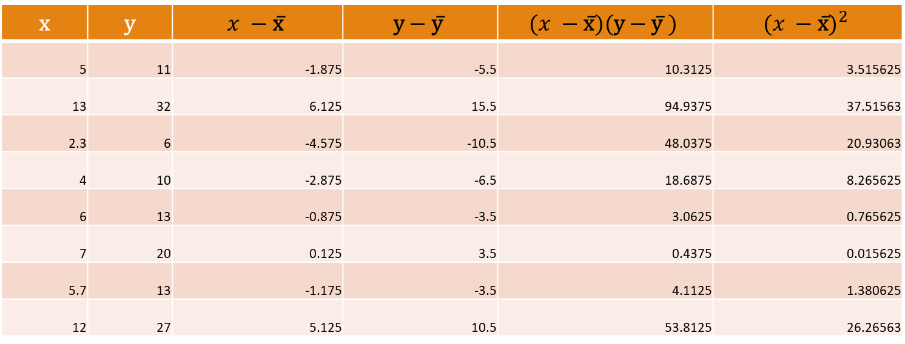
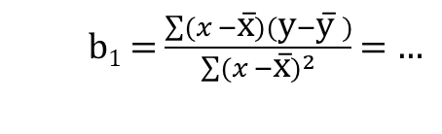

REGRESI LINEAR SEDERHANA
x | y | $$x −\text{x}\text{̅}$$ | $$\text{y}−\text{y}\text{̅}$$ | $$(x −\text{x}\text{̅})(\text{y}−\text{y}\text{̅ })$$ | $${(x −\text{x}\text{̅})}^{2}$$
5 | 11 | -1.875 | -5.5 | 10.3125 | 3.515625
13 | 32 | 6.125 | 15.5 | 94.9375 | 37.51563
2.3 | 6 | -4.575 | -10.5 | 48.0375 | 20.93063
4 | 10 | -2.875 | -6.5 | 18.6875 | 8.265625
6 | 13 | -0.875 | -3.5 | 3.0625 | 0.765625
7 | 20 | 0.125 | 3.5 | 0.4375 | 0.015625
5.7 | 13 | -1.175 | -3.5 | 4.1125 | 1.380625
12 | 27 | 5.125 | 10.5 | 53.8125 | 26.26563
x̅ = 6.875
y̅ = 16.5
$$\sum{\left(x −\text{x}\text{̅}\right)\left(\text{y}−\text{y}\text{̅ }\right)=\text{233}\text{.}\text{4 }}$$
$$\sum{{(x −\text{x}\text{̅})}^{2}=\text{98}\text{.}\text{655 }}$$
b₁ = $\frac{\sum{(x −\text{x}\text{̅})(\text{y}−\text{y}\text{̅ })}}{\sum{{(x −\text{x}\text{̅})}^{2}}}$ = $…$
b₀ = y̅ - b₁ x̅
= …
ŷ = b₀ + b₁x
= …

Slide 4

Ordinary Least Squares
How to:
$y−\overline{y}$
${(y−\overline{y})}^{2}$
$S=\sum{{(y−\overline{y})}^{2}}$
Untuk masing-masing parameter $θ_{i}$
$\frac{∂S}{∂θ_{i}}=0$

