Slide 1
Whoop-Txt!
Anthony Balmeo
Jessica Kain
Zorayr Khalapyan
Wade Norris
Zachary Policzer
Parth Shah

Slide 2
What Is Whoop-txt?
A geo-aware mobile web application intended to fuse multiple mobile platforms with Facebook, Google Maps, and other social sites to create an engaging and entertaining text-sharing environment.
Software Goals:
Support creation of texting groups.
Enable users to text others within a certain user-defined vicinity.

Slide 3
Requirements
System Features will include:
Group creation and management
Whoop Sharing
Whoop-Txt conversation list
Dependent on API’s
Facebook
Google Maps
Twitter
User interface will be easy to navigate and is organized into several pages

Slide 4
Group Creation & Management
Allows users to specify who they will send and receive information to and from
Functionality:
Create new groups for sharing information
Invite friends to become member of group
Accept/decline invitations
Leave from subscribed group

Slide 5
Whoop Sharing
Create a post and share it with explicitly selected “tags” that will modify who will be able to see this post.
Functionality:
The user will be able to select “Public” as a tag to share the post with all of the members in the user’s Whoop-Txt application.
The user will be able to select “Nearby” as a tag to restrict sharing the post only to those within a certain physical distance calculated using user’s geo-locations
The user will be able to select multiple groups they are part of and “Nearby” to share a post with members of the groups within the vicinity.

Slide 6
Whoop-txt Conversation Lists
The users shall be able to view posts that have been shared with them by other Whoop-Txt users.
Functionality:
View a list of posts.
Select an individual post and view the post’s contents, group members, and the responses that have been shared by recipients of the post.
Share a reply to a post that will be visible by all of the recipients of the original post.
Re-share a post they have received with the same tagging options and interface given to a new share.

Slide 7

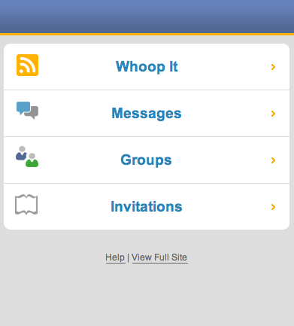
User Interface
Authentication page
User’s log in with Facebook account
Message Stream page
List of user’s most recent message posts from other Whoop-Txt users along with their Facebook profile pictures. Included in the top screen of this page is a Menu button.
Menu page
Lists different navigation links:
Whoop It- Takes you to the Write Message Page.
Messages - Directs you to the Message Stream Page.
Groups - Directs you to the Groups Page.
Invitations – Directs you to the Invitations Page.
Whoop-Txt

Slide 8
User Interface (contd.)
Whoop It page
Allows you to share posts to other Whoop-Txt users. The user will have the choice of explicitly selecting “tags” that will modify who will be able to see or be notified of this post or they can text people a certain distance away from them.
Groups page
Lists all the groups the user is a part of, whether it is one they have created or have been added to. Users will be able to create custom groups and view members within the groups.
Invitations
View your pending requests to join other groups
Help and View Full Site

Slide 9
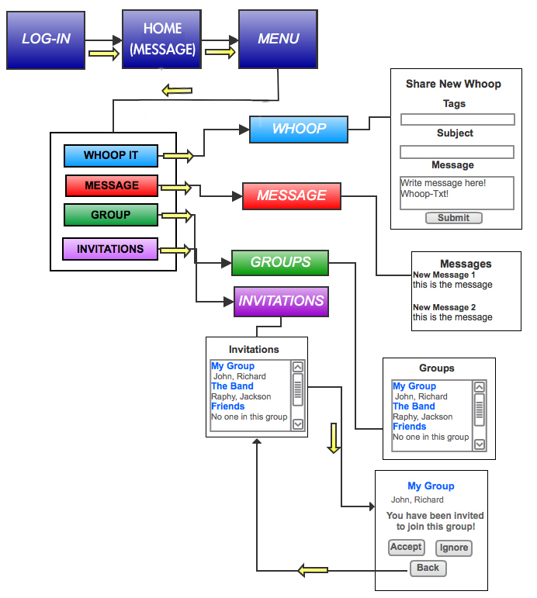
Interface Design

Slide 10
Architectural Design – Front End
The front end client utilizing JavaScript will issue AJAX requests to the server which after committing appropriate queries will return query results in JSON format wrapped in an HTTP response.
Using technologies such as AJAX/JSON it is possible to separate responsibilities for the server side developer and the front end developer.
JavaScript utility component for generation of Mobile Web Framework Code based on data received from the back end.
JavaScript utility component for communication with the back end PHP code.

Slide 11
Architectural Design – Server SIDE
Main components will include:
PHP back end component for interfacing with the database.
Database component for the storage of user data and messages.
Using REST technology for API calls.
Using Active Record paradigm for database access.
In order to authenticate and authorize users, the server will contact Facebook and utilizing OAuth 2.0 protocol will gain a privileged access token to be used for future requests.

Slide 12
Component Design
HTML Component
JavaScript MWF Component
JavaScript Communication Component
PHP Component
Database Component
Notes:
There was a lot of information under each component which I removed because Zorro or Zach could elaborate on them.

Slide 13
Communications Overview

Slide 14
Whoop-TXT API
API documentation on Wiki
API Calls include:
say_hello
send_message
get_messages
mark_message
create_token
get_tokens
invite_to_token
ignore_token

Slide 15
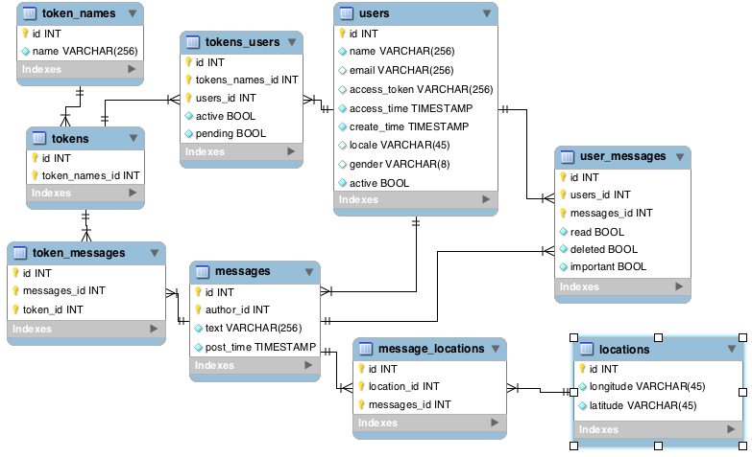
Relational Database Structure

Slide 16
Challenges
Deciding Project Title/Domain Name
Many domain names already taken
Legality Issues
Dividing project tasks
Team is split up for different implementations
Front end vs. back end
Task Delegation
Scheduling team meetings and conference call meetings
Back end: Schema
Choosing Facebook login type
Button vs. Facebook login screen shot
Facebook developer website difficult to navigate through
Incorrect Facebook password at log-in provides incorrect navigation to messages page
Home-page Facebook Login Button customization

Slide 17
Future tasks
Implement mass-text sending capability
Implement group creation
Incorporate geo-location API
Convert web application to native application
Refine user interface
Testing/Refactoring

Slide 18
Special Thanks to:
Gergana Markova (Client)
IBM technical mentors
Chris Montalvo
Dean Ocamura
Michael Stein
Neil Sahota
Steve Havachi

Slide 19
Prototype
http://whoop-txt.com/
Both desktop and smartphone demonstrations
Notes:
Wade will present what he made using MWF at this point.

