Slide 1
Whoop-Txt!
Anthony Balmeo
Jessica Kain
Zorayr Khalapyan
Wade Norris
Zachary Policzer
Parth Shah

Slide 2
What Is Whoop-txt?
A geo-aware mobile web application which integrates with Facebook to create an engaging and entertaining text-sharing environment.
Software Goals:
Support creation of texting groups.
Enable users to text others within a certain user-defined vicinity.

Slide 3
Requirements
System Features will include:
Group creation and management
Whoop Sharing
Whoop-Txt conversation list
Dependent on API’s
Facebook
Mobile Web Framework
User interface will be easy to navigate and is organized into several pages

Slide 4
Group Creation & Management
Allows users to specify who they will send and receive information to and from
Functionality:
Create new groups for sharing information
Invite friends to become member of group
Accept/decline invitations
Leave from subscribed group

Slide 5
Whoop Sharing
Create a post and share it with explicitly selected “tags” that will modify who will be able to see this post.
Functionality:
The user will be able to select group tags to share the message with specified Whoop-Txt users based on the groups they are in.
The user will be able to select “Nearby” as a tag to allow other users within a certain physical distance calculated using user’s geo-locations to see their message

Slide 6
Whoop-txt Conversation Lists
The users shall be able to view posts that have been shared with them by other Whoop-Txt users.
Functionality:
View a list of posts.
Select an individual post and view the post’s contents and the groups it was shared with.
Re-share a post they have received with the same tagging options and interface given to a new share.

Slide 7
User Interface
Authentication page
User’s log in with Facebook account
Message Stream page
List of user’s most recent message posts from other Whoop-Txt users along with their Facebook profile pictures. Included in the top screen of this page is a Menu button.
Menu page
Lists different navigation links:
Home - Takes you to the Message Stream Page.
New Message - Directs you to the Write Message Page.
Groups - Directs you to the Groups Page.
Invitations – Directs you to the Invitations Page.

Slide 8
User Interface (contd.)
New Message page
Allows you to send posts to other Whoop-Txt users. The user will have the choice of explicitly selecting “tags” that will modify who will be able to see or be notified of this post or they can text people a certain distance away from them using the Nearby tag.
Groups page
Lists all the groups the user is a part of, whether it is one they have created or have been added to. Users will be able to create custom groups and view members within the groups.

Slide 9
Interface Design

Slide 10
Architectural Design – Front End
The front end client utilizing JavaScript will issue AJAX requests to the server which after committing appropriate queries will return results in JSON format wrapped in an HTTP response.
Using technologies such as AJAX/JSON it is possible to separate responsibilities for the server side developer and the front end developer.
JavaScript utility component for generation of Mobile Web Framework Code based on data received from the back end.
JavaScript utility component for communication with the back end PHP code.

Slide 11
Architectural Design – Server SIDE
Main components will include:
PHP back end component for interfacing with the database.
Database component for the storage of user data and messages.
Using REST technology for API calls.
Using Active Record paradigm for database access.
In order to authenticate and authorize users, the server will contact Facebook and utilizing OAuth 2.0 protocol will gain a privileged access token to be used for future requests.

Slide 12
Component Design
HTML Component
JavaScript MWF Component
JavaScript Communication Component
PHP Component
Database Component
Notes:
There was a lot of information under each component which I removed because Zorro or Zach could elaborate on them.

Slide 13
Whoop-TXT API
API documentation on Wiki
Based on Model-View-Controller Architecture
API Calls include:
say_hello
send_message
get_messages
get_geomessages
mark_message
create_token
get_tokens
invite_to_token
ignore_token

Slide 14
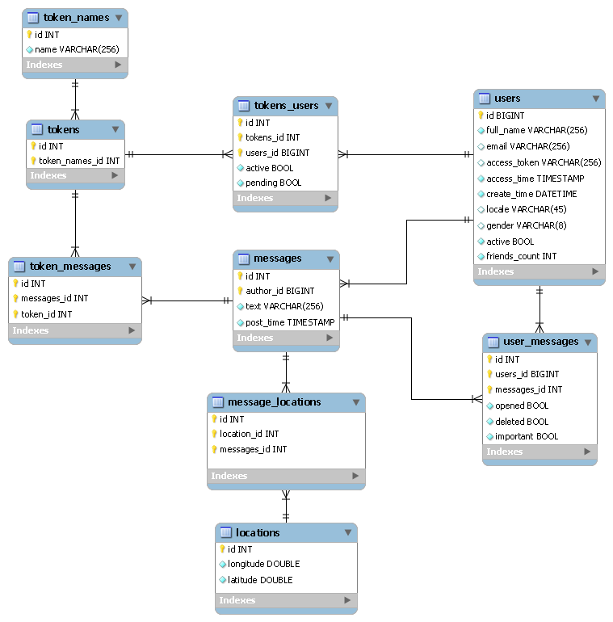
Relational Database Structure

Slide 15
Design Decisions
Creation of auto-complete system based on user typing instead of a long list of manually selectable options.
Used for choosing tags on a new message or friends to invite to a group.
Trying to display all friends would create a huge list that would take forever to find who you wanted. Auto-complete system is extremely fast and efficient and can handle a huge number of friends.
Desktop App
Users can log on to the desktop application through Facebook
User Interface:
Index Page (Messages), Nearby Messages, Groups Page, Help Page, Report/Feedback, Private Policy
Drop-Down display for groups and members in groups
Help displays for first time users

Slide 16
Development decisions
Communication protocol done using AJAX instead of jQuery for communication between front and back end.
Allowed for a more light weight system with less unnecessary dependencies.
Extra work on the Communication Utility Component allowed for equivalent platform independent communication using standard AJAX.

Slide 17
Development decisions
SQL database vs. No-SQL document storage
Considered using Mongo DB to store the application data for the project
Decided to stick to SQL instead as we began to realize that the data for the application was chiefly relational.
Active Record Design Pattern
Used in the implementation of the PHP API calls.
Provided readability and ease of use when it came to interactions with the database.

Slide 18
Notable accomplishments
Connected MWF Geo-Location Utility to sharing of Whoops to allow for geo-aware messaging in a platform independent manner.
Loading users friends from the Facebook Graph API for usage in inviting new friends to a group.
Creation of auto-complete system for ease of inviting new friends and applying existing tags.
Connecting auto-complete system to tag ids and Facebook ids from Graph API for appropriate back end association.
Pulling Facebook profile pictures for display next to messages.

Slide 19
Testing and Debugging
Manual testing was done by many members of the team as features became available.
Issues found were posted on the Github Issue Tracker and assigned a label based on the group it was relevant to.
Members of this group could assign the task to an individual based on availability or who had worked on the target area.
Debugging could then be done by the most relevant person and once they felt it was done they posted a message on the Issue Tracker and the person who opened the issue could verify it was fixed and close it.

Slide 20
Testing and Debugging
Automated Testing
Automated unit testing was developed through the use of Qunit, a javascript test suite.
Has modules divided into error handling and happy path scenarios
Provides easy URL interface that explains what tests passed or failed and why

Slide 21
Main Challenges
Task delegation
Three different development teams: Desktop front-end, Mobile front-end, and Database
Challenging before Whoop-Txt database fully implemented
Front-end functionality implemented later in the quarter
Deciding on UI design
Goal: To make application visually pleasing and user-friendly
Different design ideas
Integrating database with desktop and mobile front-end skeletons
Understanding how to communicate with the database
Solution: API documentation
Additional functionality needed to be added to database
Solution: Integration and development done concurrently
Coding errors
Solution: Creation of Github Issues Page

Slide 22
Potential Future Functionality
Integration with other websites
E.g. Google Maps, Twitter, and Myspace
Refine User Interface
Notification capability
Centralized page or inbox option to view new notifications
Facebook’s Request 2.0 to handle the sending of requests and invitations
Reason: more user friendly
Improvement of Group List Members
Include Facebook profiles in addition to the current names
Posting Whoop-Txt information on Facebook Walls
Promotes application and notifies both Whoop-Txt and non-Whoop-Txt users
PhoneGap application for mobile side
Allows access to web technologies and app stores

Slide 23
Demo
http://apps.facebook.com/whoop-txt
Both desktop and smartphone demonstrations
Notes:
Wade will present what he made using MWF at this point.

Slide 24
The End
Thank you for listening! Any questions?
Special thanks to:
Gergana Markova (Client)
IBM technical mentors
Chris Montalvo
Dean Ocamura
Michael Stein
Neil Sahota
Steve Havachi

