Slide 2
64
32
16
8
4
2
1
OpenMP
hpx::parallel::for_each(par) (static)
hpx::parallel::for_each(par) (dynamic)
Speedup
1 2 4 8 16 32 64
Number of Threads

Slide 3
64
32
16
8
4
2
1
hpx::lcos::local::dataflow
hpx::async with hpx::parallel::for_each(par(task))
OpenMP
hpx::parallel::for_each (par)
Efficiency
1 2 4 8 16 32 64
Number of Threads

Slide 4
150
125
100
75
50
25
hpx::parallel::for_each (dynamic)
hpx::parallel::for_each (static)
OpenMP
Execution Time (Seconds)
1 2 4 8 16 32 64
Number of Threads

Slide 5
64
32
16
8
4
2
1
hpx::lcos::local::dataflow
OpenMP
Speedup
1 2 4 8 16 32 64
Number of Threads

Slide 6
64
32
16
8
4
2
1
hpx::async with hpx::parallel::for_each(par(task))
OpenMP
Speedup
1 2 4 8 16 32 64
Number of Threads

Slide 7
150
125
100
75
50
25
OpenMP
hpx::lcos::local::dataflow
Execution Time (Seconds)
1 2 4 8 16 32 64
Number of Threads

Slide 8
64
32
16
8
4
2
1
OpenMP
hpx::lcos::local::dataflow
hpx::parallel::for_each
Speedup
1 2 4 8 16 32 64
Number of Threads

Slide 9
64
32
16
8
4
2
1
100,000
1,000,000
10,000,000
100,000,000
1,000,000,000
Speedup
1 2 4 8 16 32 64 128
Number of Nodes

Slide 10
128
64
32
16
8
4
2
1
HPX
N=100,000,000
MPI
N=1000,000,000
Speedup
4 8 16 32 64 128 256
Number of Localities

Slide 11
16
8
4
2
1
HPX
N=10,000,000
MPI
N=100,000,000
N=1000,000,000
Speedup
4 8 16 32 64 128
Number of Nodes

Slide 12
1.2
1.1
1
0.9
0.8
0.7
0.6
100,000
1,000,000
10,000,000
100,000,000
1,000,000,000
Efficiency
1 2 4 8 16 32 64 128
Number of Nodes

Slide 13
60
55
50
45
40
35
30
HPX
Ideal Scale
Time (minutes)
1 2 4 8 16 32 64 128
Number of Nodes

Slide 14
60
55
50
45
40
35
30
HPX
Ideal Scale
Time (minutes)
1 2 4 8 16 32 64 128
Number of Nodes

Slide 15
60
55
50
45
40
35
30
HPX
Ideal Scale
Time (minutes)
1 2 4 8 16 32 64 128
Number of Nodes

Slide 16
1000
800
600
400
200
10
10,000,000
100,000,000
50
40
30
20
10
1
Time (minutes)
1 2 4 8 16 32 64 128
1 2 4 8 16 32 64 128
Number of Nodes

Slide 17
1000
800
600
400
200
1
10,000,000
1,000,000
25
20
15
10
5
1
Time (minutes)
1 2 4 8 16 32 64 128
1 2 4 8 16 32 64 128
Number of Localities

Slide 18
16
14
12
10
8
4
2
1
hpx::async
OpenMP
hpx::parallel-for-each
Speedup
1 2 4 8 10 12 14 16
Number of Threads

Slide 19
hpx::async
20
18
16
14
12
10
8
4
2
1
OpenMP
hpx::parallel-for-each
Speedup
1 2 4 8 10 12 14 16 18 20
Number of Threads

Slide 20
16
14
12
10
8
4
2
1
HPX Without Hilbert
HPX With Hilbert
OpenMP
Speedup
1 2 4 8 10 12 14 16
Number of Threads

Slide 21
14
12
10
8
4
2
0
HPX Without Hilbert
HPX With Hilbert
Time (Seconds)
1,000 10,000 100,000 1,000,000 10,000,000
Number of Particles

Slide 22
200
150
100
50
Barnes Hut
Barnes Hut with FMM
Time (seconds)
100 500 1000 1500
Number of Particles

Slide 23
200
150
100
50
?
Efficiency
100 500 1000 1500
Number of Localities

Slide 24
c
e
b1
b2
d

Slide 25
D
r

Slide 26
p1
parent
new
p1
parent
old
4 8 16 32 64 128

Slide 27
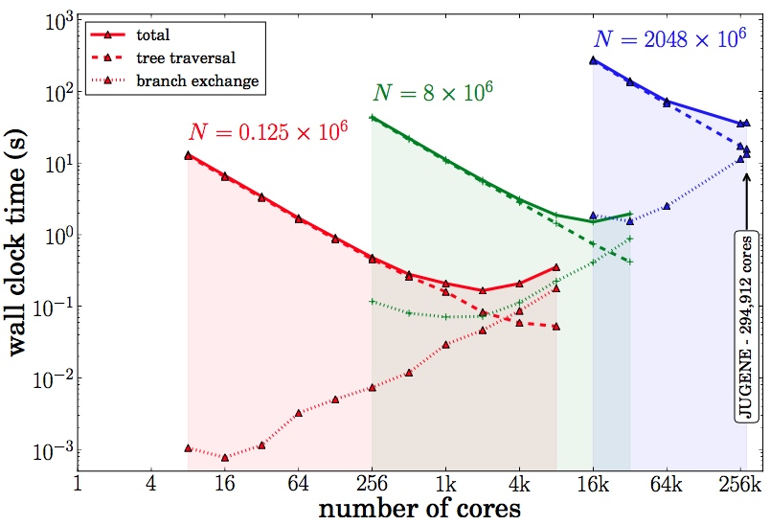

Slide 28
Joint Global Barrier
1
1
2
2
Master Thread
3
3
Parallel Threads
Parallel Threads

Slide 29
Locality 1
future.get()
suspend thread 1
Locality 2
execute thread 2
reactivate thread 1

Slide 30
Inputs Dataflow Object
in
1
.
.
.
in
1 2 n
2
out
.
.
.
F(in , in , … , in )
.
.
.
in
n

