Slide 2
64
32
16
8
4
2
1
OpenMP
hpx::parallel::for_each (static)
hpx::parallel::for_each (dynamic)
Speedup
1 2 4 8 16 32 64
Number of Threads

Slide 3
150
125
100
75
50
25
hpx::parallel::for_each (dynamic)
hpx::parallel::for_each (static)
OpenMP
Execution Time (Seconds)
1 2 4 8 16 32 64
Number of Threads

Slide 4
64
32
16
8
4
2
1
hpx::lcos::local::dataflow
OpenMP
Speedup
1 2 4 8 16 32 64
Number of Threads

Slide 5
150
125
100
75
50
25
OpenMP
hpx::lcos::local::dataflow
Execution Time (Seconds)
1 2 4 8 16 32 64
Number of Threads

Slide 6
64
32
16
8
4
2
1
OpenMP
hpx::lcos::local::dataflow
hpx::parallel::for_each
Speedup
1 2 4 8 16 32 64
Number of Threads

Slide 7
64
32
16
8
4
2
1
100,000
1,000,000
10,000,000
100,000,000
1,000,000,000
Speedup
1 2 4 8 16 32 64 128
Number of Nodes

Slide 8
128
64
32
16
8
4
2
1
HPX
N=100,000,000
MPI
N=1000,000,000
Speedup
4 8 16 32 64 128 256
Number of Localities

Slide 9
16
8
4
2
1
HPX
N=10,000,000
MPI
N=100,000,000
N=1000,000,000
Speedup
4 8 16 32 64 128
Number of Nodes

Slide 10
1.2
1.1
1
0.9
0.8
0.7
0.6
100,000
1,000,000
10,000,000
100,000,000
1,000,000,000
Efficiency
1 2 4 8 16 32 64 128
Number of Nodes

Slide 11
60
55
50
45
40
35
30
HPX
Ideal Scale
Time (minutes)
1 2 4 8 16 32 64 128
Number of Nodes

Slide 12
60
55
50
45
40
35
30
HPX
Ideal Scale
Time (minutes)
1 2 4 8 16 32 64 128
Number of Nodes

Slide 13
60
55
50
45
40
35
30
HPX
Ideal Scale
Time (minutes)
1 2 4 8 16 32 64 128
Number of Nodes

Slide 14
1000
800
600
400
200
10
10,000,000
100,000,000
50
40
30
20
10
1
Time (minutes)
1 2 4 8 16 32 64 128
1 2 4 8 16 32 64 128
Number of Nodes

Slide 15
1000
800
600
400
200
1
10,000,000
1,000,000
25
20
15
10
5
1
Time (minutes)
1 2 4 8 16 32 64 128
1 2 4 8 16 32 64 128
Number of Localities

Slide 16
16
14
12
10
8
4
2
1
hpx::async
OpenMP
hpx::parallel-for-each
Speedup
1 2 4 8 10 12 14 16
Number of Threads

Slide 17
hpx::async
20
18
16
14
12
10
8
4
2
1
OpenMP
hpx::parallel-for-each
Speedup
1 2 4 8 10 12 14 16 18 20
Number of Threads

Slide 18
16
14
12
10
8
4
2
1
HPX Without Hilbert
HPX With Hilbert
OpenMP
Speedup
1 2 4 8 10 12 14 16
Number of Threads

Slide 19
14
12
10
8
4
2
0
HPX Without Hilbert
HPX With Hilbert
Time (Seconds)
1,000 10,000 100,000 1,000,000 10,000,000
Number of Particles

Slide 20
200
150
100
50
Barnes Hut
Barnes Hut with FMM
Time (seconds)
100 500 1000 1500
Number of Particles

Slide 21
200
150
100
50
?
Efficiency
100 500 1000 1500
Number of Localities

Slide 22
c
e
b1
b2
d

Slide 23
D
r

Slide 24
p1
parent
new
p1
parent
old
4 8 16 32 64 128

Slide 25
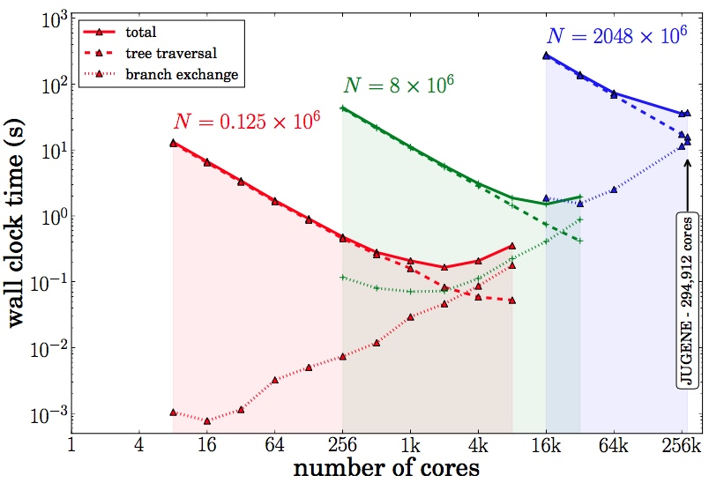

Slide 26
Joint Global Barrier
1
1
2
2
Master Thread
3
3
Parallel Threads
Parallel Threads

Slide 27
Locality 1
future.get()
suspend thread 1
Locality 2
execute thread 2
reactivate thread 1

