Slide 2
64
32
16
8
4
2
1
OpenMP
hpx::async
hpx::parallel::for_each
Speedup
1 2 4 8 16 32 64
Number of Threads

Slide 3
64
32
16
8
4
2
1
100,000
1,000,000
10,000,000
100,000,000
1,000,000,000
Speedup
1 2 4 8 16 32 64 128
Number of Nodes

Slide 4
128
64
32
16
8
4
2
1
HPX
N=100,000,000
MPI
N=1000,000,000
Speedup
4 8 16 32 64 128 256
Number of Localities

Slide 5
16
8
4
2
1
HPX
N=10,000,000
MPI
N=100,000,000
N=1000,000,000
Speedup
4 8 16 32 64 128
Number of Nodes

Slide 6
1.2
1.1
1
0.9
0.8
0.7
0.6
100,000
1,000,000
10,000,000
100,000,000
1,000,000,000
Efficiency
1 2 4 8 16 32 64 128
Number of Nodes

Slide 7
60
55
50
45
40
35
30
HPX
Ideal Scale
Time (minutes)
1 2 4 8 16 32 64 128
Number of Nodes

Slide 8
60
55
50
45
40
35
30
HPX
Ideal Scale
Time (minutes)
1 2 4 8 16 32 64 128
Number of Nodes

Slide 9
60
55
50
45
40
35
30
HPX
Ideal Scale
Time (minutes)
1 2 4 8 16 32 64 128
Number of Nodes

Slide 10
1000
800
600
400
200
10
10,000,000
100,000,000
50
40
30
20
10
1
Time (minutes)
1 2 4 8 16 32 64 128
1 2 4 8 16 32 64 128
Number of Nodes

Slide 11
1000
800
600
400
200
1
10,000,000
1,000,000
25
20
15
10
5
1
Time (minutes)
1 2 4 8 16 32 64 128
1 2 4 8 16 32 64 128
Number of Localities

Slide 12
16
14
12
10
8
4
2
1
hpx::async
OpenMP
hpx::parallel-for-each
Speedup
1 2 4 8 10 12 14 16
Number of Threads

Slide 13
hpx::async
20
18
16
14
12
10
8
4
2
1
OpenMP
hpx::parallel-for-each
Speedup
1 2 4 8 10 12 14 16 18 20
Number of Threads

Slide 14
16
14
12
10
8
4
2
1
HPX Without Hilbert
HPX With Hilbert
OpenMP
Speedup
1 2 4 8 10 12 14 16
Number of Threads

Slide 15
14
12
10
8
4
2
0
HPX Without Hilbert
HPX With Hilbert
Time (Seconds)
1,000 10,000 100,000 1,000,000 10,000,000
Number of Particles

Slide 16
200
150
100
50
Barnes Hut
Barnes Hut with FMM
Time (seconds)
100 500 1000 1500
Number of Particles

Slide 17
200
150
100
50
?
Efficiency
100 500 1000 1500
Number of Localities

Slide 18
c
e
b1
b2
d

Slide 19
D
r

Slide 20
p1
parent
new
p1
parent
old
4 8 16 32 64 128

Slide 21
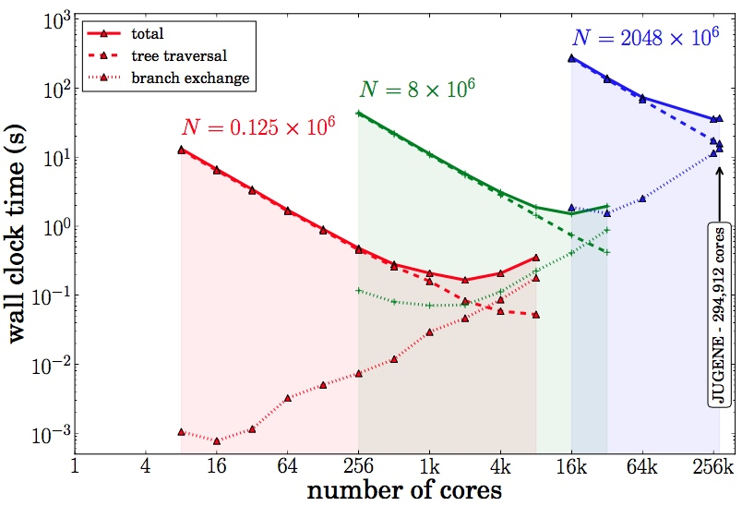

Slide 22
Joint Global Barrier
1
1
2
2
Master Thread
3
3
Parallel Threads
Parallel Threads

Slide 23
Locality 1
future.get()
suspend thread 1
Locality 2
execute thread 2
reactivate thread 1

