Slide 1





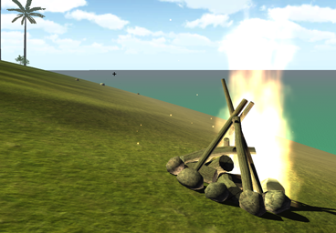

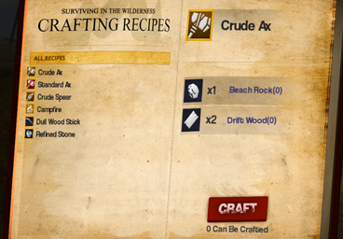


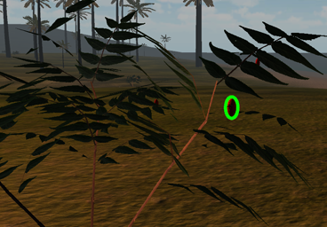

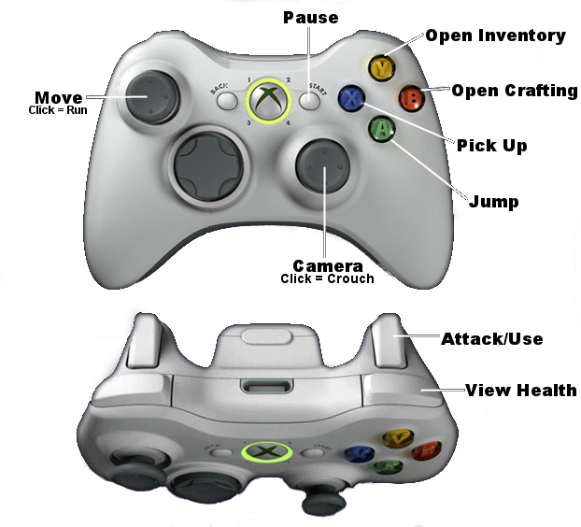




GAMEPLAY POSTER
Department of Computer Science and Engineering
The Ohio State University
Quentin Bloomfield, Keegan Donnelly, Jacob Grealy, Zach Knickerbocker, Nate Niederkorn, Sean Peck
It’s time for a vacation.
Your Goal
The setting for the game is a survival scenario. You've awoken on an island following a plane crash, and find yourself stranded with little resources in a dinosaur inhabited paradise. Weather the harsh conditions, collect and craft the survival tools you need, and ultimately attempt escape from the island. As quick as you can muster – “Get Away”!
\
Build the raft to escape the island!
Survive The Night
Craft a campfire, place it on the island, and then click it to quickly sleep through the night. This is a great way to replenish sanity, and avoid dinosaurs that crawl the island in the cover of darkness.
Weapons & Tools
Ax
Craft Weapons, Food, and More
Chop trees to get logs and other resources.
Crafting new items from the resources you collect around the island will enable your survival. Craft an axe to chop down a tree. Craft a spear the take down a dinosaur. The possibilities are many.
Spear
Take down dinosaurs with a thrust of your spear.
Bow & Arrow
Collect Resources
Shoot at dinosaurs from afar.
Resources used to craft items can be collected from the island. Some items are commonly available everywhere, whereas others are rarer and restricted to particular climates like the jungle.
Torch
The night is dark, but a torch will light your way.
Player Status
Controller Mapping
Health
Hunger
Thirst
Sanity

