Slide 1


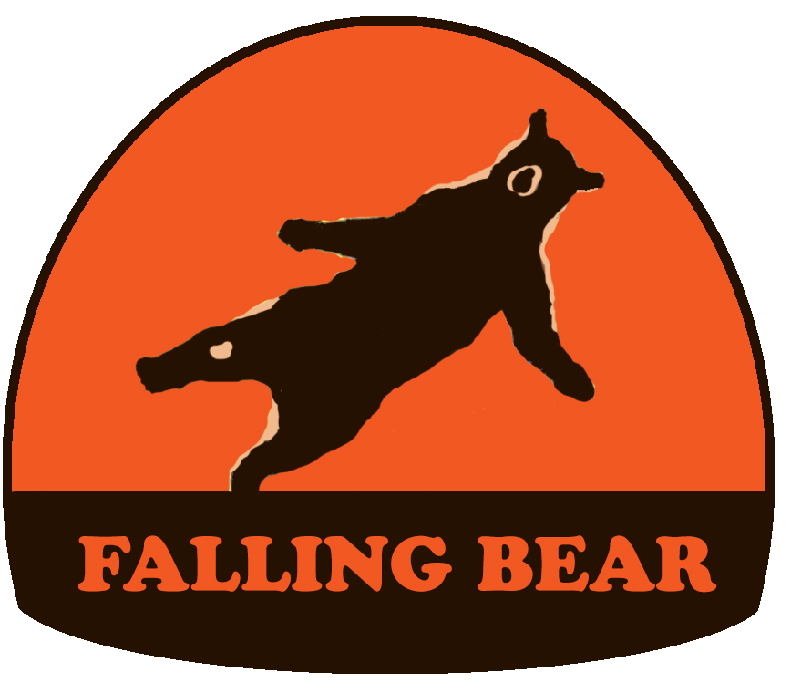
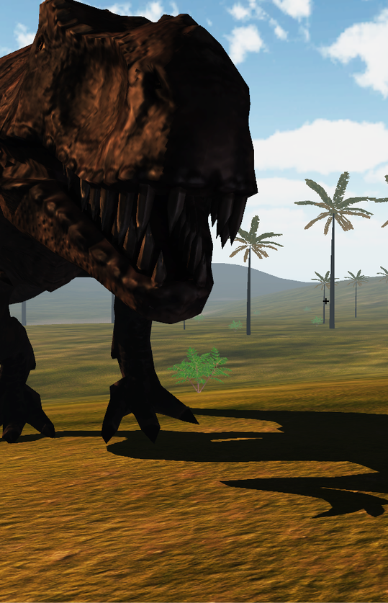
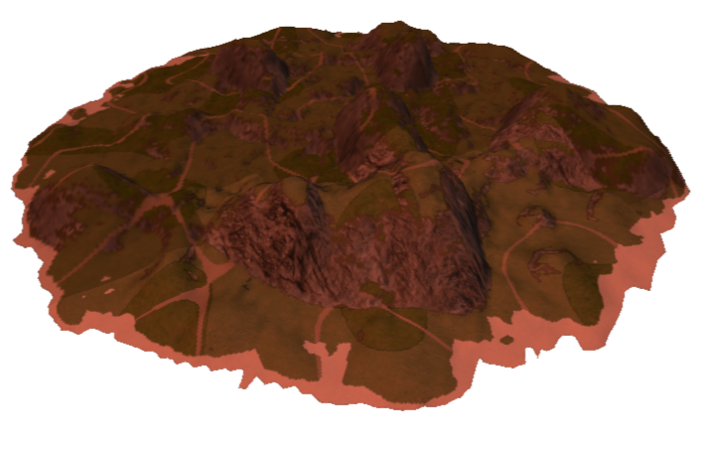
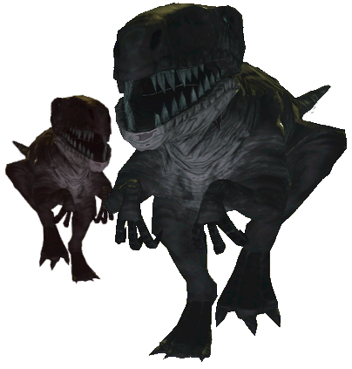
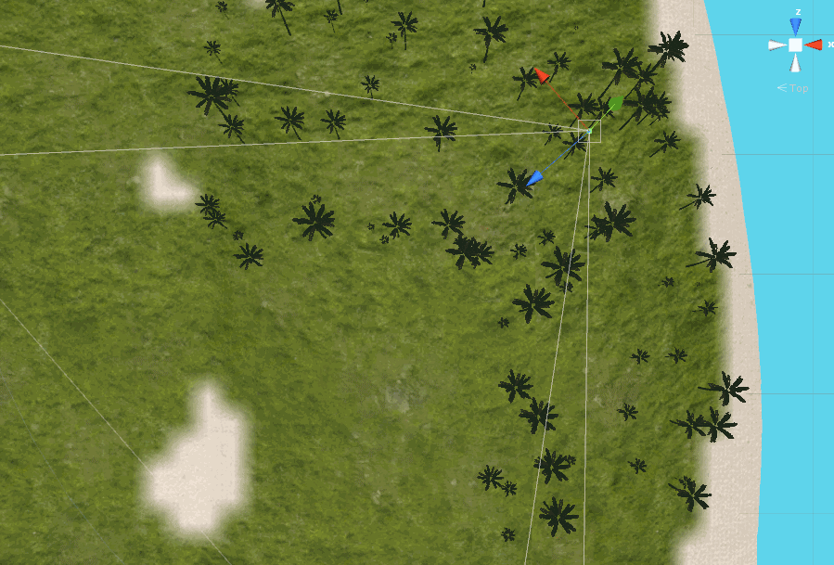
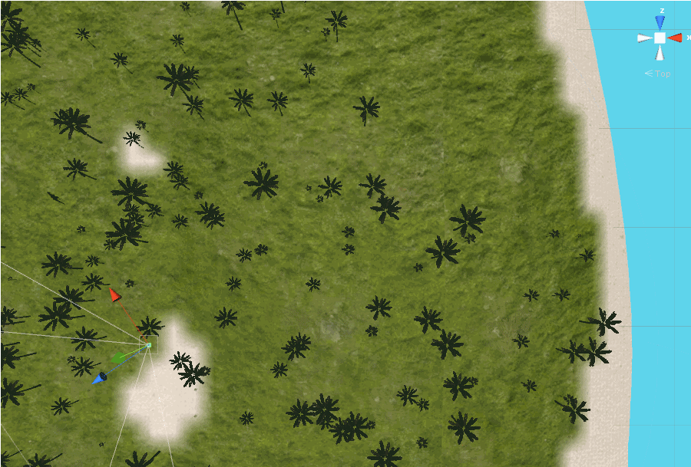
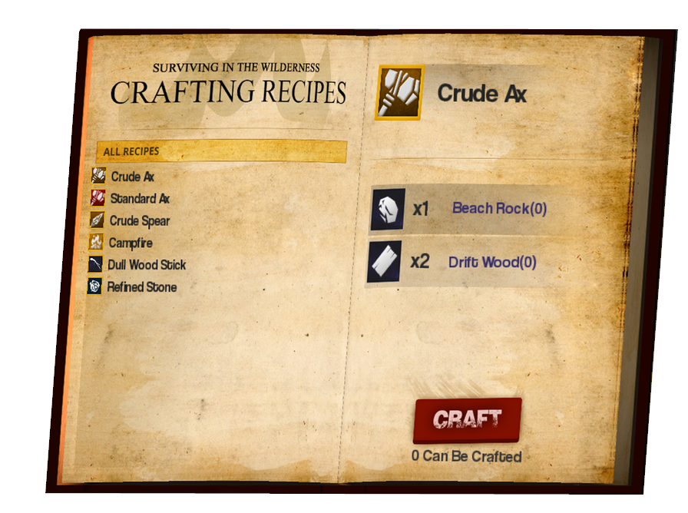
TECHNICAL POSTER
Department of Computer Science and Engineering
The Ohio State University
Quentin Bloomfield, Keegan Donnelly, Jacob Grealy, Zach Knickerbocker, Nate Niederkorn, Sean Peck
Procedural Island Generation
Dinosaur AI
Island generation starts with creating a height map for the terrain. This height map is created using a layered combination of fractals and simplex noise; it is constructed from bottom to top starting with large, tall, dense features and ending with sporadic, small, short features. Lastly a parabolic constraint is applied to give the island a dome
like shape ensuring that the
edge of the island drops off
gradually into the ocean.
Our dinosaur AI uses waypoints to dynamically plan a dinosaur’s route around flora, players, enemies, and obstructive island terrain (e.g. mountains). Flocking and other group behaviors are implemented to give packs of dinosaurs an intimidating presence.
The Dinosaur Food Chain
Dinosaurs interact with the other dinosaurs on the island using a number of heuristics. One of the most important is a literal food chain which dictates a dinosaurs decision to pursue, eat, flee, etc. from other dinosaurs.
Terrain Texturing
Pack AI
The terrain of the island is textured using a combination of sampled height, slope, and simplex noise values. The slope value is used to determine where cliffs and dirt textures will be applied as vegetation becomes
less dense with slope increase. For lesser slope values the height
value is then used to split the terrain into 3 sub categories of beach, meadow/jungle, and mountain. Finally, simplex noise is used to split
the meadow and jungle into separately textured areas. Simplex noise
is also used to add additional texture variety to each texture area.
“Pack AI”, as we’ve coined it, is an artificial intelligence which moves packs of dinosaurs around the island to simulate macro dinosaur travel behaviors, and keep the dinosaurs within reasonable distance from the player.
Flocking AI
While dinosaurs are typically found near others of their kind, they
usually act independently of one another. However, some packs
contain flocks of dinosaurs. Dinosaurs in a flock work together, and
alerting one of them means alerting all of the other flock members. To accomplish this behavior, we implemented a modified “Boids” flocking algorithm, Dinosaurs in flocks are incredibly dangerous, so be wary!
Custom LOD System
3D User Interface
GetAway’s graphical user interface elements have_ been designed using 3D models and text to give_ them a realistic presence in the game._ _
A level of detail (LOD) system is implemented to manage both the level of graphical detail and level of interactivity of static (non-moving) objects based on their distance from the player. The LOD system divides the island into evenly sized square sectors arranged in a 2-dimensional array. All static objects are placed into sectors based on their initial position. Every few frames the sectors closest to the player are updated and trigger the switching of level of detail of the objects contained in those sectors.
Data Driven Items & Crafting
Every item, island resource, and crafting recipe is. defined by an external JSON formatted data file..
This makes adding content to the game, and...
balancing existing content, quick and easy.._

