Slide 1

CO7201 Individual Project ESB Audit Software
Zhipeng Liang
21/05/2014

Slide 2
About the individual project
ESB Audit Software
Inviso Incident Project
Dynamic Form Software

Slide 3
Dynamic Form Software
Content can be filled out and stored in a database
Template management
A visualized process of template design
Supporting the key HTML elements
Review filled forms and print as reports
Run on the web in portable devices
Testing

Slide 4
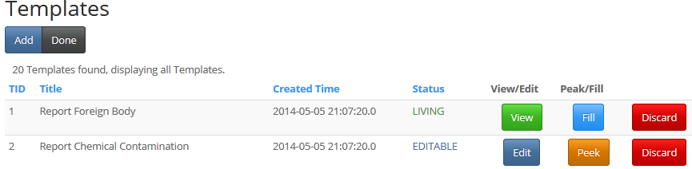
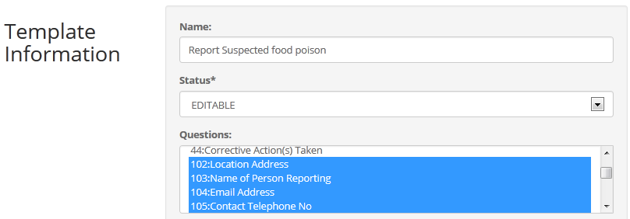
Template

Slide 5
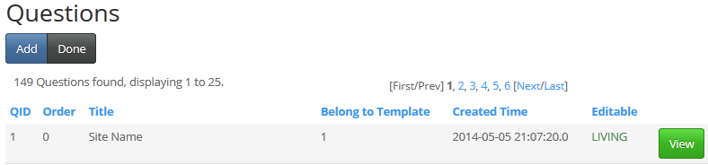
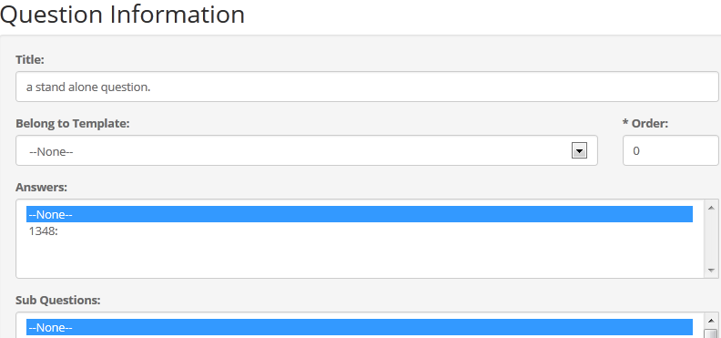
Question

Slide 6
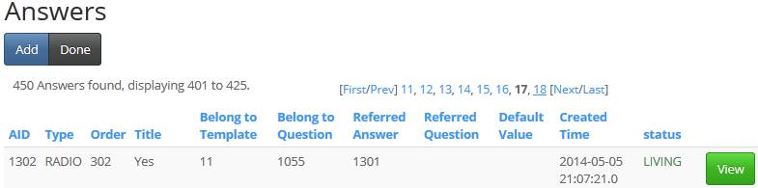
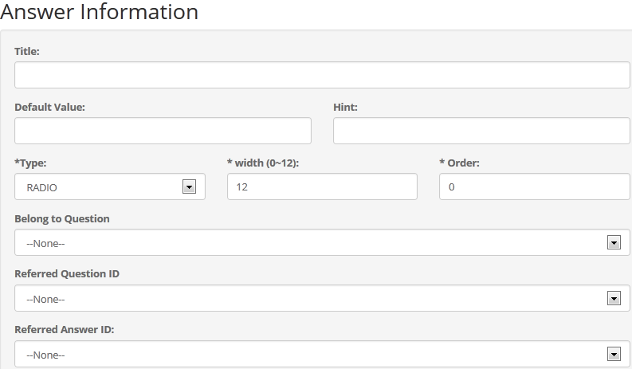
Answers

Slide 7
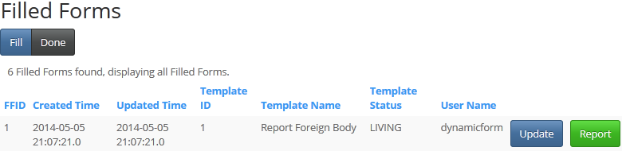
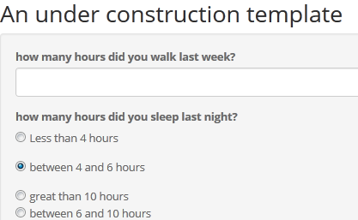
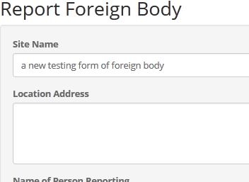
Filled Forms

Slide 8
Inviso Incident Project
Circumstance investigation
Scope management
Design of prototyping
Time management

Slide 9
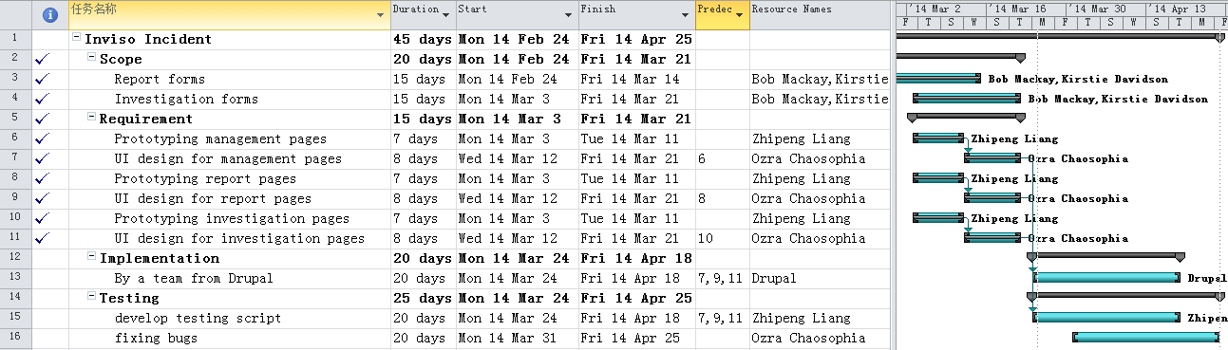
Time schedule
Time schedule (with a work breakdown structure and resources)

Slide 10
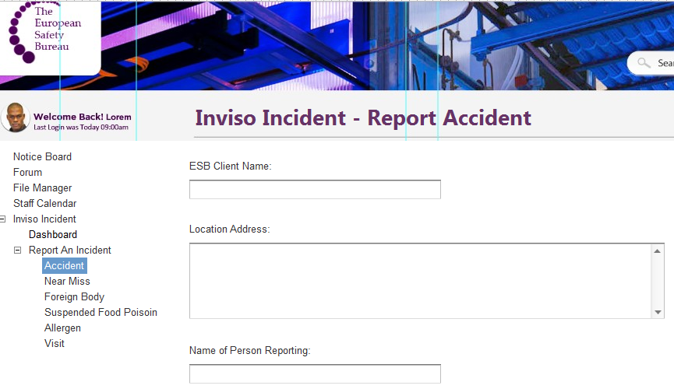
Prototyping design

Slide 11

在此输入标题
“
“
Thank you
输入文字
在此录入上述图表的综合分析结论
在此录入上述图表的综合分析结论
在此录入上述图表的综合分析结论
在此录入上述图表的综合分析结论
ZL91@STUDENT.LE.AC.UK

