Slide 1

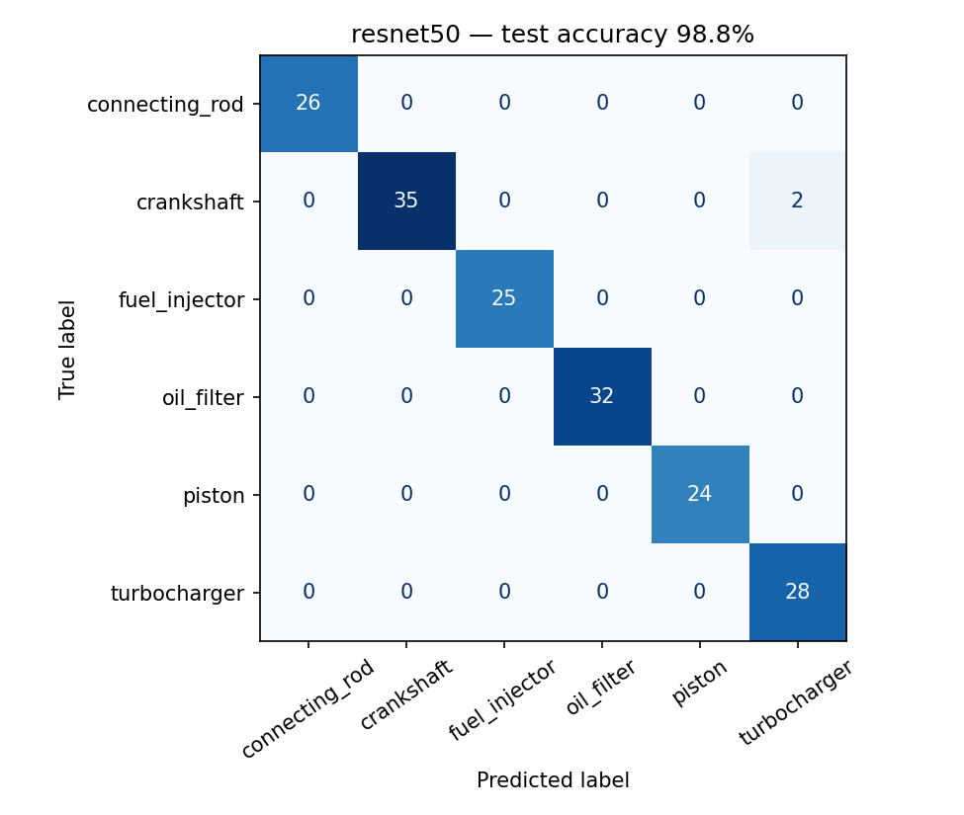
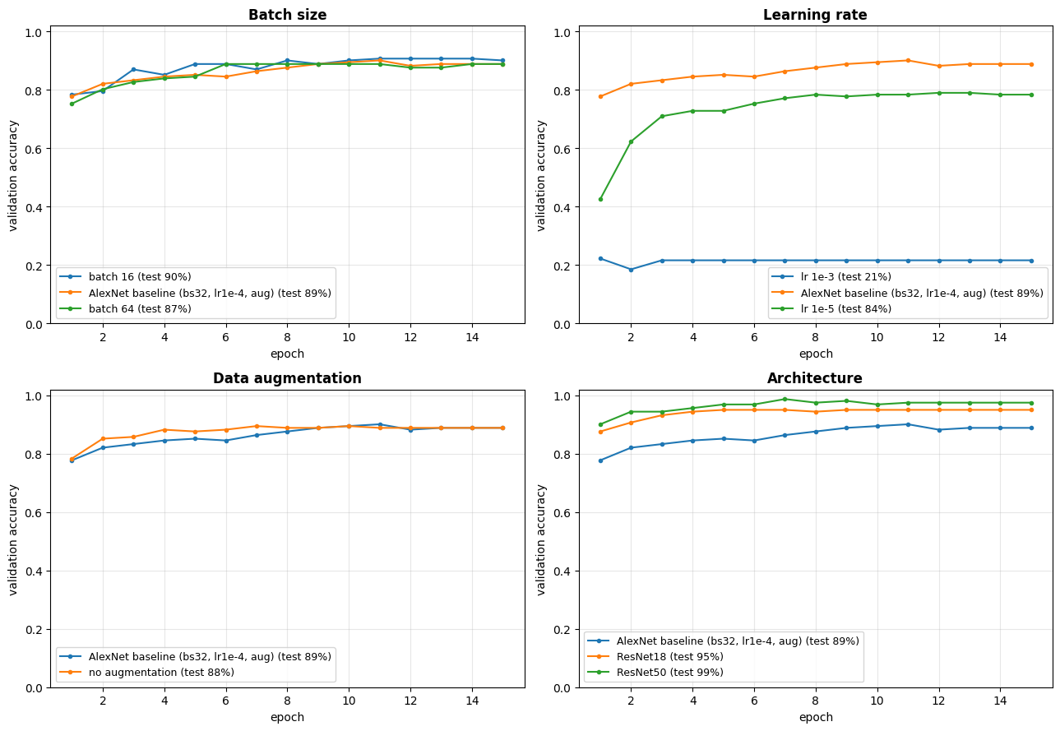
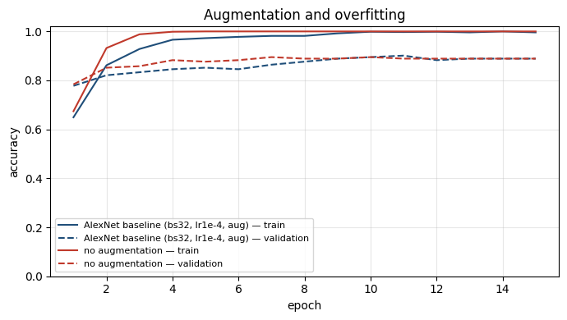
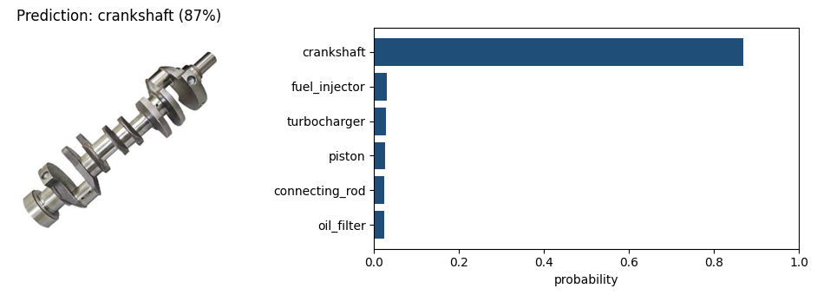
PartSight: Identifying Marine Diesel Engine Parts from Photos with AlexNet
Ziya Batur Koroglu · Mathematics of Data Science · Florida Atlantic University · Fall 2026
Problem Statement
Experiments & Results
Ship engineers often send suppliers a photo of a worn generator-engine part with no label or part number. Identifying it by eye is slow, depends on a few experts, and errors lead to wrong orders and longer vessel downtime.
Each run changes one setting from the AlexNet baseline (batch 32, LR 1e-4, augmentation on).
Run | Change | Test acc.
baseline | — | 89.0%
bs16 | batch 16 | 90.1%
bs64 | batch 64 | 87.2%
lr1e-3 | LR 1e-3 | 20.9%
lr1e-5 | LR 1e-5 | 84.3%
no_aug | no augmentation | 88.4%
resnet18 | ResNet18 | 95.3%
resnet50 | ResNet50 | 98.8%
Goal: given one photo, predict which of six high-volume parts it shows.
Fuel injector
Turbocharger
Best model (ResNet50) on 172 held-out test photos: 2 errors.
Piston
Connecting rod
Discussion
Crankshaft
Oil filter
Learning rate mattered most: 1e-3 wiped out the pretrained weights (20.9%, about guessing); 1e-5 learned too slowly (84.3%).
Batch size had a small effect: batch 16 was the best AlexNet (90.1%).
Augmentation slowed memorization; the test gain was small (89.0% vs 88.4%).
ResNet50 (98.8%) and ResNet18 (95.3%) beat AlexNet in the same ~4 minutes.
Data quality was the biggest lever: CLIP cleaning + more photos lifted ResNet50 from 89.6% to 98.8%.
Methods
Dataset
60 web image searches (10 per part) → 1,695 photos downloaded
CLIP filter removed off-topic photos and diagrams; near-duplicates removed
1,101 clean photos, split 70% train / 15% val / 15% test
AlexNet (Krizhevsky et al., 2012)
Conclusions & Future Work
Best AlexNet 90.1%; best overall ResNet50 98.8%
Clean data and one-change experiments mattered more than any single setting
Next: real engine-room photos, more parts, part-number prediction, phone app
Validation accuracy per epoch for each experiment group (test accuracy in the legend).
In
C1
P
C2
P
C3
C4
C5
P
F6
F7
F8
5 conv layers (C) with max-pooling (P), 3 fully connected layers (F). ImageNet-pretrained; last layer → 6 parts.
224×224 input; random crop, flip, rotation, color jitter
Cross-entropy (label smoothing 0.1), Adam, cosine LR, 15 epochs
Best epoch chosen on validation; scored once on test
PyTorch on Colab T4 GPU; runs logged to Weights & Biases
A new photo the model never saw: crankshaft, 87% confidence.
Without augmentation (red) training accuracy hits 100% by epoch 4: the model memorizes.
[1] Krizhevsky, Sutskever & Hinton (2012). ImageNet Classification with Deep CNNs. NeurIPS. [2] He et al. (2016). Deep Residual Learning. CVPR. [3] Radford et al. (2021). CLIP. ICML.

