Slide 1

PartSight
Identifying marine diesel engine parts from a photo with AlexNet
Ziya Batur Koroglu
Mathematics of Data Science · Final Project · Fall 2026
Notes:
Hi, I'm Ziya. I work in my family's marine diesel parts business, and my project, PartSight, uses AlexNet to identify engine parts from a single photo.

Slide 2




A part request starts with a photo
A typical generator-parts request today:
1. Engineer sends a photo
2. Supplier identifies it by eye
3. Look up the part & sources
4. Send the quote
Often no label, no part number, oily engine-room lighting
Depends on one experienced person being available
Match engine model, find stock or a vendor
Every hour of delay keeps the ship's generator down
Step 2 is the bottleneck. PartSight automates it.
Notes:
Here's how a parts request works. An engineer on a ship photographs a worn part. Someone on our side has to recognize it by eye. That step depends on experienced people and slows down every quote.

Slide 3



Why it matters
Shipping moves world trade
Downtime is expensive
Over 80% of global trade by volume travels by sea (UNCTAD). Every vessel depends on its generators for power.
A ship waiting on a part loses charter time and can miss port slots. Faster identification means faster quotes.
Expertise doesn't scale
Mistakes cost twice
Recognizing parts takes years of experience. New staff, nights and weekends create gaps.
A misidentified part means a wrong order, return shipping and a second delay.
Notes:
Why does this matter? Over 80 percent of world trade moves by sea, and every ship needs working generators. Downtime is expensive, expertise is hard to scale, and a wrong identification means a wrong order.

Slide 4






Six high-volume parts the model learns to recognize
Fuel injector
Turbocharger
Piston
Most frequently replaced wear part on generator engines
High-value unit; fast ID speeds up big quotes
Overhaul item with many crown shapes and sizes
Connecting rod
Crankshaft
Oil filter
Long forged part, easy to confuse with others
Large, expensive, long lead time
High-volume consumable ordered constantly
Notes:
I chose six parts that come up constantly in generator work: fuel injectors, turbochargers, pistons, connecting rods, crankshafts and oil filters. Each one is a class the model learns.

Slide 5
Building the dataset
1
Collect
What makes this hard
60 web image searches (10 per part) → 1,695 photos downloaded
Similar shapes: rods vs. crankshafts are both long forged steel
Catalog photos on white vs. greasy field photos
Lighting, angles and partial views vary a lot
Small dataset: hundreds of images, not millions
2
Clean
Remove corrupt, tiny and near-duplicate photos
3
Filter with CLIP
A second AI model removes off-topic photos and labeled diagrams
4
Split
1,101 clean photos → 70% train · 15% validation · 15% test
Notes:
To build the dataset, the notebook runs sixty web image searches and downloads about seventeen hundred photos. Web results are messy, so a second AI model called CLIP checks every photo and throws out anything that is not clearly the right part. That leaves eleven hundred clean photos, split into training, validation and test sets.

Slide 6
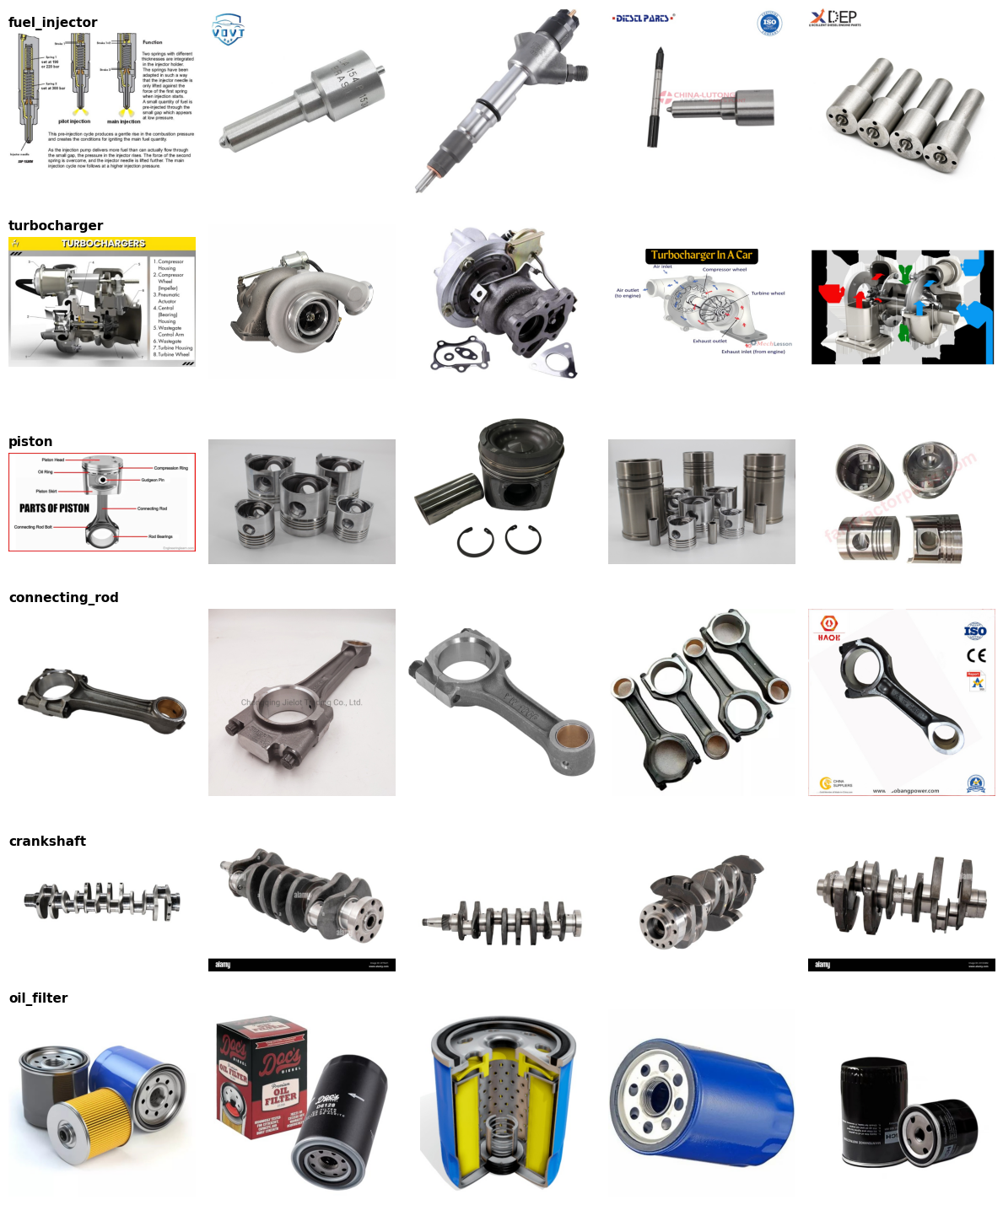
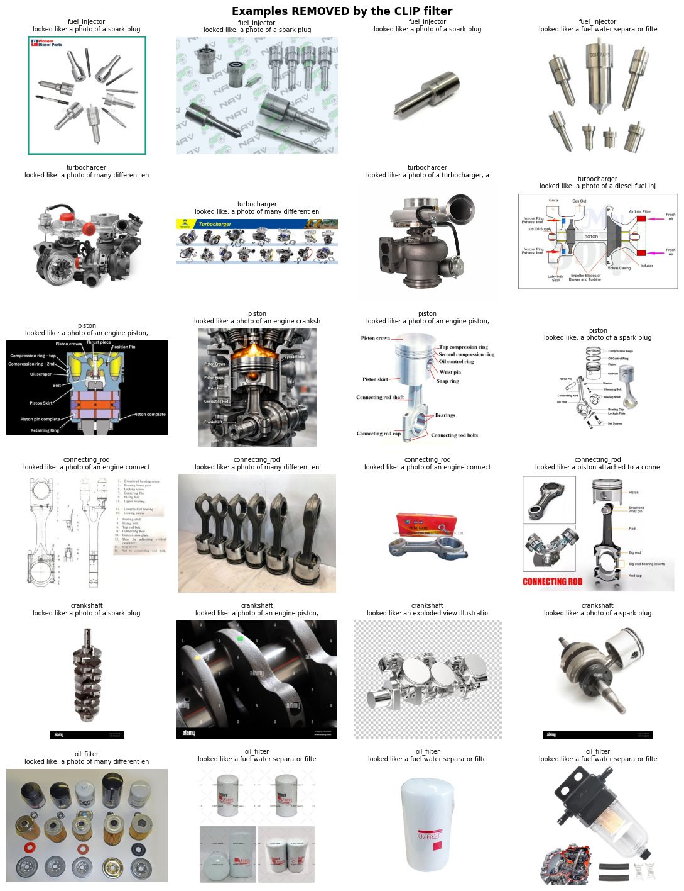
Kept vs. removed photos
Kept: training photos
Removed by the CLIP filter
The filter is strict: it removes diagrams and junk, and some good photos too (nozzles mistaken for spark plugs). Losing a good photo costs less than training on a wrong one.
Notes:
On the left are photos the model trained on. On the right are examples the filter threw away: mostly diagrams and multi-part photos. It is strict and also drops some good photos, but losing a good photo costs much less than training on a wrong one. Cleaning the data turned out to matter more than any training setting.

Slide 7

Goal: photo in, part type out
How we judge success
The task
Test accuracy
Input: one color photo of a part
Output: the part type and a confidence for each of the 6 classes
Type: supervised multi-class image classification
on images the model never saw in training
Per-class recall
no part type is systematically missed
Speed
a prediction in well under a second
Notes:
So the goal is simple: a photo goes in, and the part type comes out with a confidence score. I judge success by accuracy on a held-out test set, by recall for each part so none is consistently missed, and by speed.

Slide 8

Part 2
Technical solution: AlexNet
Notes:
Now the technical side: how AlexNet works and how I trained it.

Slide 9
AlexNet started the deep-learning era in vision
Krizhevsky, Sutskever & Hinton (2012)
ImageNet 2012 challenge, top-5 error
Learns its own features
Earlier systems used hand-designed features. AlexNet learned edges, textures and shapes directly from pixels.
Deep + trained on GPUs
8 learned layers and 60 M parameters, trained on two GPUs — huge for 2012.
Why we use it
Simple enough to understand layer by layer, and pretrained weights let it learn from a small dataset like ours.
Notes:
AlexNet won the 2012 ImageNet challenge with 15.3 percent top-5 error, versus 26.2 for the runner-up. It showed that a deep network could learn its own visual features, and it is simple enough to explain layer by layer.

Slide 10
AlexNet architecture: 5 conv + 3 dense layers
Input
Conv1
Pool
Conv2
Pool
Conv3
Conv4
Conv5
Pool
FC6
FC7
FC8
3×224×224
64 @ 11×11, s4
→ 55×55
3×3 max
→ 27×27
192 @ 5×5
→ 27×27
→ 13×13
384 @ 3×3
256 @ 3×3
256 @ 3×3
→ 6×6
9,216 values
4096
4096
6 parts
Feature extractor — finds edges → textures → part shapes
ReLU after every conv and FC layer · ~57 M parameters
Classifier — turns features into part scores (dropout 0.5)
Notes:
Here's the architecture. An image goes in as three channels of 224 by 224 pixels. Five convolutional layers, with max-pooling in between, shrink it to 256 feature maps of 6 by 6. Three fully connected layers then turn those features into a score for each of my six parts.

Slide 11
Layer by layer
Layer | Operation | Output | What it learns / does
Conv1 | 64 filters 11×11, stride 4 + ReLU | 64×55×55 | Edges, color blobs
MaxPool | 3×3, stride 2 | 64×27×27 | Shrinks maps, keeps strongest response
Conv2 | 192 filters 5×5 + ReLU | 192×27×27 | Corners, simple textures
MaxPool | 3×3, stride 2 | 192×13×13 | Down-sampling
Conv3–5 | 384 / 256 / 256 filters 3×3 + ReLU | 256×13×13 | Bolts, holes, cylinder & blade shapes
MaxPool | 3×3, stride 2 | 256×6×6 | Flattened to 9,216 numbers
FC6, FC7 | Dense 4096 + ReLU + Dropout 0.5 | 4096 | Combines features into part concepts
FC8 | Dense 6 (replaced layer) | 6 | One score per part → softmax probabilities
Notes:
This table walks through each layer. Early layers detect edges and colors, middle layers detect textures and shapes like bolt holes and turbine blades, and the final layers combine them into a decision.

Slide 12




Four ideas that made AlexNet work
ReLU activation
Dropout
max(0, x) instead of tanh — trains ~6× faster because gradients don't vanish.
Randomly switches off 50% of FC neurons during training, so the network can't memorize.
Overlapping max-pooling
Data augmentation
Keeps the strongest signal in each region and makes the model tolerant to small shifts.
Random crops, flips and color changes create new training images for free.
Notes:
Four ideas made AlexNet work: ReLU activations for fast training, dropout to prevent memorizing, max-pooling for robustness to position, and data augmentation to stretch a limited dataset.

Slide 13

How our photos flow into the model
Raw photo
Resize
Augment
Normalize
Tensor
AlexNet
Softmax
any size, JPG/PNG
224×224 pixels
train only: crop, flip, ±15° rotate, color jitter
ImageNet mean & std per channel
3×224×224
6 output scores
e.g. 92% turbocharger
Transfer learning
We start from AlexNet weights already trained on 1.2 M ImageNet photos, so it already knows edges, metal textures and shapes. We replace only the last layer (4096 → 1000 classes becomes 4096 → 6 parts) and fine-tune the whole network on our images.
Notes:
Every photo is resized to 224 by 224, augmented during training only, normalized with ImageNet statistics, and fed in as a tensor. The key trick is transfer learning: AlexNet already knows general visual features from ImageNet, so I just swap the final layer for six parts.

Slide 14
Training process
Loss
Optimizer
Each epoch
Cross-entropy
Adam
Forward pass: images → predicted part probabilities
Cross-entropy loss measures how wrong the predictions are
Backpropagation computes gradients; Adam updates the weights
Score the validation set; keep the best epoch's weights
After training: one final score on the untouched test set
Learning rate
Batch size
1 × 10⁻⁴
32
Epochs
Input
15
224×224 RGB
Framework
Tracking
PyTorch on Colab
Weights & Biases
Notes:
The baseline trains with cross-entropy loss and the Adam optimizer at a learning rate of one times ten to the minus four, batch size 32, for fifteen epochs, with label smoothing and a cosine learning-rate schedule. After every epoch I check validation accuracy and keep the best weights, then score once on a test set the model has never seen.

Slide 15

Experiments: change one thing at a time
Run | Model | Batch | Learning rate | Augment | Question
baseline | AlexNet | 32 | 1e-4 | Yes | Reference point
bs16 / bs64 | AlexNet | 16 / 64 | 1e-4 | Yes | Do smaller or bigger batches help?
lr1e-3 / lr1e-5 | AlexNet | 32 | 1e-3 / 1e-5 | Yes | Too fast vs. too slow learning?
no_aug | AlexNet | 32 | 1e-4 | No | Does augmentation reduce overfitting?
resnet18 / 50 | ResNet18/50 | 32 | 1e-4 | Yes | Does a modern network beat AlexNet?
Every run logs train/validation loss and accuracy per epoch, plus a test-set confusion matrix, to Weights & Biases.
Notes:
I ran eight experiments, each changing exactly one setting from the baseline: two batch sizes, two learning rates, no augmentation, and ResNet18 and ResNet50 as modern comparisons. Everything is logged to Weights and Biases.

Slide 16
Results: test accuracy by experiment
ResNet50: 98.8%
Best overall, on 172 photos it never saw
AlexNet: up to 90.1%
Best with batch size 16
LR 1e-3: 20.9%
Too high: wiped out the pretrained weights
Notes:
Here are the results. The AlexNet baseline scored 89 percent on the test set, and batch size 16 was the best AlexNet at 90.1 percent. A learning rate of 1e-3 collapsed to 21 percent, which is about guessing. ResNet18 reached 95.3 percent and ResNet50 98.8 percent.

Slide 17
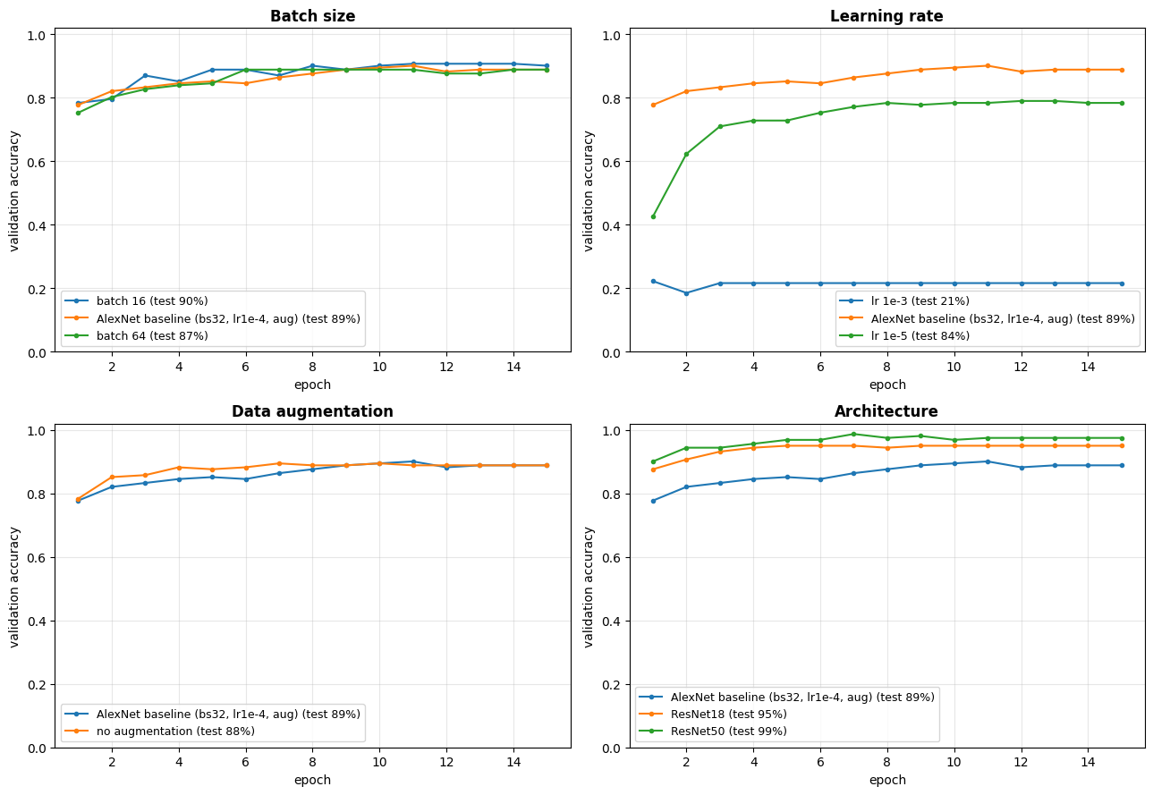
What each experiment showed
Learning rate mattered most
1e-3 diverged; 1e-5 learned too slowly (84.3%)
Batch size: small effect
16 > 32 > 64, within 3 points
Augmentation slowed memorizing
Small test gain: 89.0% vs 88.4%
Architecture: biggest jump
ResNets beat AlexNet in the same ~4 min
Notes:
These curves show validation accuracy every epoch. The learning rate mattered most: too high and the model never learns, too low and it learns slowly. Batch size made only a small difference. Without augmentation the model memorized the training photos faster. And the modern ResNet architectures were clearly better than AlexNet.

Slide 18
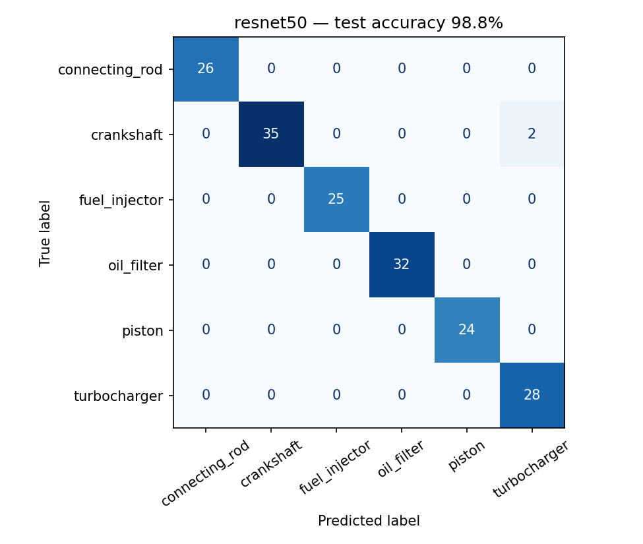
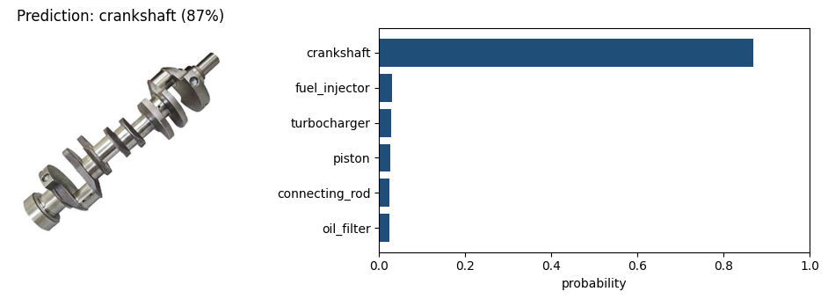
Best model: 2 mistakes out of 172 test photos
A new photo the model never saw: crankshaft, 87%
Both mistakes were crankshafts called turbochargers: a factory photo full of machinery and a whole-engine cutaway, not single-part photos. Below 60% confidence, PartSight answers “not sure” rather than guessing.
Notes:
The best model, ResNet50, made only two mistakes on 172 test photos. Both were crankshafts in busy scenes, not clean photos of a single part. When the model is less than 60 percent sure, it says not sure instead of guessing, which matters for a real quoting tool.

Slide 19


From photo to quote in seconds
Snap
Identify
Match
Quote
Engineer photographs the part
PartSight predicts the part type
Next: map to engine model & part number
Next: phone app for engineers
Best model: ResNet50, 98.8% · Best AlexNet: 90.1% · All runs tracked in Weights & Biases
Notes:
The vision: an engineer snaps a photo and gets a part identification in seconds. The next steps are mapping to exact part numbers and putting it in a phone app. Thank you!

