Slide 1
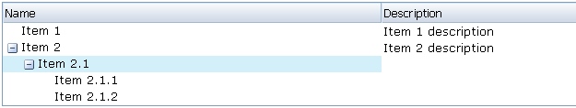

Slide 2
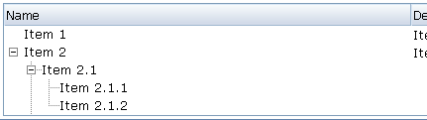
Notes:
div.tabpanel, div.tabpanel-accordion {normmoz.css.dsp (line 509)
border-bottom:1px solid #5C6C7C;
border-left:1px solid #5C6C7C;
border-right:1px solid #5C6C7C;
padding:5px;
}

Slide 3
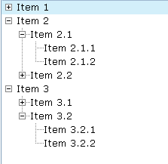
2
1
3
tree-root-open
tree-root-close
tree-tee-open
tree-tee-close
tree-last-open
tree-last-close
tree-tee
tree-vbar
tree-last
tree-spacer
10
8
9
6
4
5
7
Notes:
td.tab-3d-first1 {
background-image:url(/zkdemo/zkau/web/zul/img/tab/3d-first1.gif);
height:3px;
width:1px;
}
td.tab-3d-first2 {
background-image:url(/zkdemo/zkau/web/zul/img/tab/3d-first2.gif);
height:3px;
width:3px;
}
td.tab-3d-last1 {
background-image:url(/zkdemo/zkau/web/zul/img/tab/3d-last1.gif);
height:3px;
width:3px;
}
td.tab-3d-last2 {
background-image:url(/zkdemo/zkau/web/zul/img/tab/3d-last2.gif);
height:3px;
width:1px;
}

Slide 4
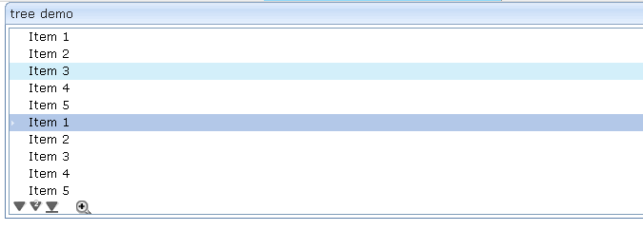
Hover
Selected
Normal
Notes:
td.tab-3d-tl-sel, td.tabaccd-3d-tl-sel {normmoz.css.dsp (line 517)
background-image:url(/zkdemo/zkau/web/zul/img/tab/3d-tl-sel.gif);
height:5px;
width:5px;
}
td.tab-3d-tm-sel, td.tabaccd-3d-tm-sel {normmoz.css.dsp (line 525)
background-image:url(/zkdemo/zkau/web/zul/img/tab/3d-tm-sel.gif);
height:5px;
}
td.tab-3d-tr-sel, td.tabaccd-3d-tr-sel {normmoz.css.dsp (line 533)
background-image:url(/zkdemo/zkau/web/zul/img/tab/3d-tr-sel.gif);
height:5px;
width:5px;
}
td.tab-3d-ml-sel, td.tabaccd-3d-ml-sel {normmoz.css.dsp (line 542)
background-image:url(/zkdemo/zkau/web/zul/img/tab/3d-ml-sel.gif);
width:5px;
}
td.tab-3d-mm-sel, td.tabaccd-3d-mm-sel {normmoz.css.dsp (line 550)
background-image:url(/zkdemo/zkau/web/zul/img/tab/3d-mm-sel.gif);
}
td.tab-3d-mr-sel, td.tabaccd-3d-mr-sel {normmoz.css.dsp (line 556)
background-image:url(/zkdemo/zkau/web/zul/img/tab/3d-mr-sel.gif);
width:5px;
}
td.tab-3d-bl-sel {normmoz.css.dsp (line 565)
background-image:url(/zkdemo/zkau/web/zul/img/tab/3d-bl-sel.gif);
height:3px;
width:5px;
}
td.tab-3d-bm-sel {normmoz.css.dsp (line 573)
background-image:url(/zkdemo/zkau/web/zul/img/tab/3d-bm-sel.gif);
height:3px;
}
td.tab-3d-br-sel {normmoz.css.dsp (line 581)
background-image:url(/zkdemo/zkau/web/zul/img/tab/3d-br-sel.gif);
height:3px;
width:5px;
}

Slide 5

Selected + Hover + Focused
Notes:
td.tab-3d-tl-uns, td.tabaccd-3d-tl-uns, td.groupbox-3d-tl {normmoz.css.dsp (line 521)
background-image:url(/zkdemo/zkau/web/zul/img/tab/3d-tl-uns.gif);
height:5px;
width:5px;
}
td.tab-3d-tm-uns, td.tabaccd-3d-tm-uns, td.groupbox-3d-tm {normmoz.css.dsp (line 529)
background-image:url(/zkdemo/zkau/web/zul/img/tab/3d-tm-uns.gif);
height:5px;
}
td.tab-3d-tr-uns, td.tabaccd-3d-tr-uns, td.groupbox-3d-tr {normmoz.css.dsp (line 537)
background-image:url(/zkdemo/zkau/web/zul/img/tab/3d-tr-uns.gif);
height:5px;
width:5px;
}
td.tab-3d-ml-uns, td.tabaccd-3d-ml-uns, td.groupbox-3d-ml {normmoz.css.dsp (line 546)
background-image:url(/zkdemo/zkau/web/zul/img/tab/3d-ml-uns.gif);
width:5px;
}
td.tab-3d-mm-uns, td.tabaccd-3d-mm-uns, td.groupbox-3d-mm {normmoz.css.dsp (line 553)
background-image:url(/zkdemo/zkau/web/zul/img/tab/3d-mm-uns.gif);
}
td.tab-3d-mr-uns, td.tabaccd-3d-mr-uns, td.groupbox-3d-mr {normmoz.css.dsp (line 560)
background-image:url(/zkdemo/zkau/web/zul/img/tab/3d-mr-uns.gif);
width:5px;
}
td.tab-3d-bl-uns {normmoz.css.dsp (line 569)
background-image:url(/zkdemo/zkau/web/zul/img/tab/3d-bl-uns.gif);
height:3px;
width:5px;
}
td.tab-3d-bm-uns {normmoz.css.dsp (line 577)
background-image:url(/zkdemo/zkau/web/zul/img/tab/3d-bm-uns.gif);
height:3px;
}
td.tab-3d-br-uns {normmoz.css.dsp (line 585)
background-image:url(/zkdemo/zkau/web/zul/img/tab/3d-br-uns.gif);
height:3px;
width:5px;
}

Slide 6
Hover:
tr.overd, td.overd
Selected:
tr.seld, td.seld
Focused + Selected + Hover:
tr.overseld, td.overseld, tr.focusd
Normal:
tr.item a:hover, tr.item, tr.item a, tr.item a:visited

Slide 7
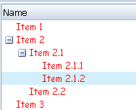
div.cell-inner

Slide 8

div.tree-head
div.tree-head th
div.tree-head tr
div.head-cell-inner
Notes:
td.tabpanels {normmoz.css.dsp (line 495)
border-bottom:1px solid #5C6C7C;
border-right:1px solid #5C6C7C;
border-top:1px solid #5C6C7C;
padding:5px;
}

Slide 9

tab-v3d-first1
tab-v3d-first2
tab-v3d-last1
tab-v3d-last2
Notes:
td.tab-v3d-first1 {normmoz.css.dsp (line 599)
background-image:url(/zkdemo/zkau/web/zul/img/tab/v3d-first1.gif);
height:1px;
width:3px;
}
td.tab-v3d-first2 {normmoz.css.dsp (line 603)
background-image:url(/zkdemo/zkau/web/zul/img/tab/v3d-first2.gif);
height:3px;
width:3px;
}
td.tab-v3d-last1 {normmoz.css.dsp (line 607)
background-image:url(/zkdemo/zkau/web/zul/img/tab/v3d-last1.gif);
height:3px;
width:3px;
}
td.tab-v3d-last2 {normmoz.css.dsp (line 611)
background-image:url(/zkdemo/zkau/web/zul/img/tab/v3d-last2.gif);
height:1px;
width:3px;
}

Slide 10
Notes:
td.tabpanels {normmoz.css.dsp (line 495)
border-bottom:1px solid #5C6C7C;
border-right:1px solid #5C6C7C;
border-top:1px solid #5C6C7C;
padding:5px;
}

Slide 11
tabpanels
Notes:
td.tabpanels {normmoz.css.dsp (line 495)
border-bottom:1px solid #5C6C7C;
border-right:1px solid #5C6C7C;
border-top:1px solid #5C6C7C;
padding:5px;
}

Slide 12
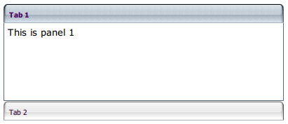
tabpanel-accordion

Slide 13
1
2
3
4
5
6
7
8
9
1. tabaccd-3d-tl-sel
2. tabaccd-3d-tm-sel
3. tabaccd-3d-tr-sel
4. tabaccd-3d-ml-sel
5. tabaccd-3d-mm-sel
6. tabaccd-3d-mm-sel
7. tabaccd-3d-mm-sel
8. tabaccd-3d-mr-sel
9. tabaccd-3d-b
Notes:
td.tab-3d-tl-sel, td.tabaccd-3d-tl-sel {normmoz.css.dsp (line 517)
background-image:url(/zkdemo/zkau/web/zul/img/tab/3d-tl-sel.gif);
height:5px;
width:5px;
}
td.tab-3d-tm-sel, td.tabaccd-3d-tm-sel {normmoz.css.dsp (line 525)
background-image:url(/zkdemo/zkau/web/zul/img/tab/3d-tm-sel.gif);
height:5px;
}
td.tab-3d-tr-sel, td.tabaccd-3d-tr-sel {normmoz.css.dsp (line 533)
background-image:url(/zkdemo/zkau/web/zul/img/tab/3d-tr-sel.gif);
height:5px;
width:5px;
}
td.tab-3d-ml-sel, td.tabaccd-3d-ml-sel {normmoz.css.dsp (line 542)
background-image:url(/zkdemo/zkau/web/zul/img/tab/3d-ml-sel.gif);
width:5px;
}
td.tab-3d-mm-sel, td.tabaccd-3d-mm-sel {normmoz.css.dsp (line 550)
background-image:url(/zkdemo/zkau/web/zul/img/tab/3d-mm-sel.gif);
}
td.tab-3d-mr-sel, td.tabaccd-3d-mr-sel {normmoz.css.dsp (line 556)
background-image:url(/zkdemo/zkau/web/zul/img/tab/3d-mr-sel.gif);
width:5px;
}
td.tabaccd-3d-b, td.groupbox-3d-b {normmoz.css.dsp (line 594)
background-image:url(/zkdemo/zkau/web/zul/img/tab/3d-b.gif);
height:1px;
}

Slide 14
Non-selected Tab
1
2
3
4
5
6
8
7
9
1. tabaccd-3d-tl-uns
2. tabaccd-3d-tm-uns
3. tabaccd-3d-tr-uns
4. tabaccd-3d-ml-uns
5. tabaccd-3d-mm-uns
6. tabaccd-3d-mm-uns
7. tabaccd-3d-mm-uns
8. tabaccd-3d-mr-uns
9. tabaccd-3d-b
Notes:
td.tab-3d-tl-uns, td.tabaccd-3d-tl-uns, td.groupbox-3d-tl {normmoz.css.dsp (line 521)
background-image:url(/zkdemo/zkau/web/zul/img/tab/3d-tl-uns.gif);
height:5px;
width:5px;
}
td.tab-3d-tm-uns, td.tabaccd-3d-tm-uns, td.groupbox-3d-tm {normmoz.css.dsp (line 529)
background-image:url(/zkdemo/zkau/web/zul/img/tab/3d-tm-uns.gif);
height:5px;
}
td.tab-3d-tr-uns, td.tabaccd-3d-tr-uns, td.groupbox-3d-tr {normmoz.css.dsp (line 537)
background-image:url(/zkdemo/zkau/web/zul/img/tab/3d-tr-uns.gif);
height:5px;
width:5px;
}
td.tab-3d-ml-uns, td.tabaccd-3d-ml-uns, td.groupbox-3d-ml {normmoz.css.dsp (line 546)
background-image:url(/zkdemo/zkau/web/zul/img/tab/3d-ml-uns.gif);
width:5px;
}
td.tab-3d-mm-uns, td.tabaccd-3d-mm-uns, td.groupbox-3d-mm {normmoz.css.dsp (line 553)
background-image:url(/zkdemo/zkau/web/zul/img/tab/3d-mm-uns.gif);
}
td.tab-3d-mr-uns, td.tabaccd-3d-mr-uns, td.groupbox-3d-mr {normmoz.css.dsp (line 560)
background-image:url(/zkdemo/zkau/web/zul/img/tab/3d-mr-uns.gif);
width:5px;
}
td.tabaccd-3d-b, td.groupbox-3d-b {normmoz.css.dsp (line 594)
background-image:url(/zkdemo/zkau/web/zul/img/tab/3d-b.gif);
height:1px;
}

