Slide 1

Lock free programming in C++
Zhaokai Guan

Slide 2
Good news! This one won’t keep you longer than 10 mins. (my record is 9 m 30 seconds)
Bad news, I have 18 slides plus 1 program to go over. The pace will be fast.

Slide 3

About the presenter
Custom keyboard fan.
Hotel front desk for 3 years
Enjoy DB and backend works

Slide 4
Why you want to know this topic
To show off front of buddies.
Because it is hard not everyone understands this.
Most importantly, this is the black magic. If you do it right, the performance will be significantly enhanced.
(If you do it wrong, you will need a new job)

Slide 5
Start with some simple Code

Slide 6
Data race
The data race happens when the two instructions from different threads access the same memory location. At least one of these accesses is a write.
In the human language:
Those unisex washrooms in the K building.
If you forgot to lock it while using it…
“2 threads will try to access the same memory address.”
That example sounds funny but when this is happening because of you. GG, you will need a new job.
Why data race -> undefined behavior -> your solution became to garbage.

Slide 7
Solutions to data race
Lock Programming ( std::mutex, std::lock, std::async) (washroom example still applies)
Parallel programming abstraction (open MP, TPP)
Lock free programming

Slide 8
Atomic Operation
Nothing to do with Oppenheimer.
Atomic operation: it is guaranteed to execute as a single transaction.
Other threads will see the state of the system before the operation started or after it finished but cannot see any intermediate state.

Slide 9
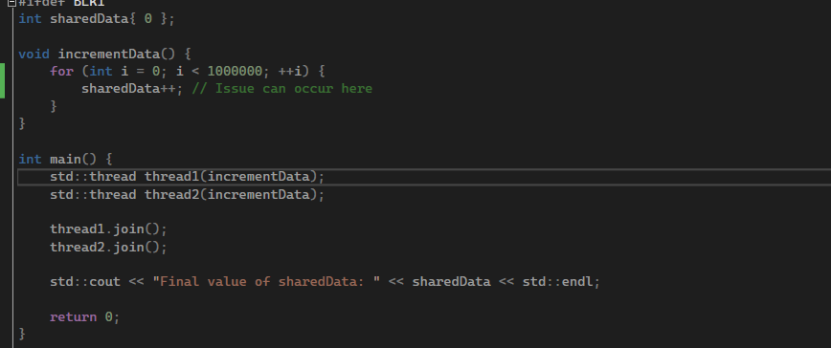
What happened in the race example?
Now sharedData is at 1000.
No sync between two threads operations.
After read done.
T2’s shared data 1000.
T1’s shared data 1000.
Because T1 accessed sharedData during T2’s intermediate state.
T2 increments 1000 by 1 writes 1001.
T1 increments 1000 by 1 write 1001.
Of course, the data race is happening.

Slide 10
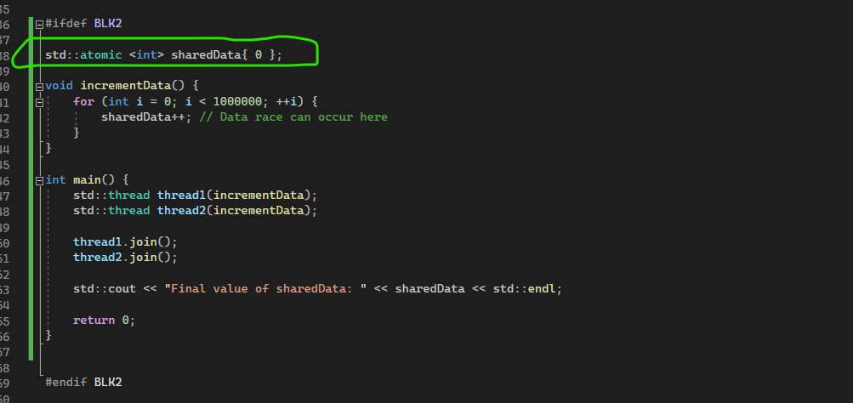
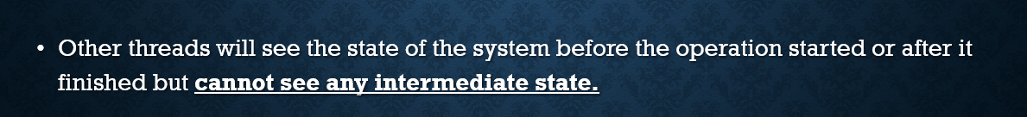
Std::atomic
The data race is gone, because no two threads are trying to write and write or read at the same time.

Slide 11
I will make everything atomic then
NOOOOOO
It does have overhead and
The template argument must be trivially copyable but not copyable
1. Continuous block of memory: so, it can be copied using memcpy().
2. There is no user defined copy, move constructor, assignment operator overload.
3. No virtual functions.

Slide 12
POP quiz
Std::string trivially copyable ?
5 seconds.

Slide 13
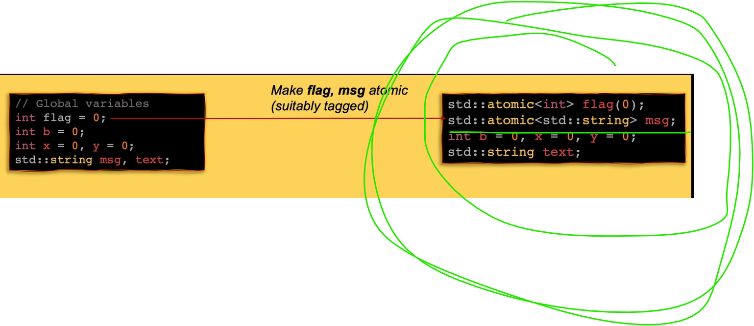


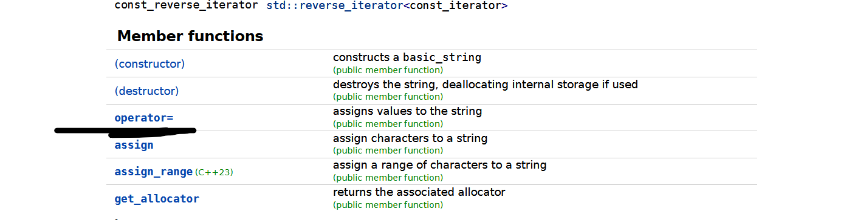
Answer is
If you say no, congrats.
You just beat a so-called “C++ master” on YouTube who has 10k followers.
Don’t learn from these influencer please.

Slide 14
Glance of methods and overloaded operators
Special way to guarantee the store and load operations are atomic.
And because the std::atomic objects are trivially copyable. So you can’t use assignment operator here.
Because overloaded postfix-increment operator, my operation became to atomic.
If you do
sharedData = sharedData + 1 ; // No it won’t work.

Slide 15
summary
Data race
Data race Solution Types
Lock free in C++
Std::atomic<T> and Trivially copyable

Slide 16
Go deeper on this topic?
I just covered not even 10 percent of this topic.
Wanna step up? Go for std::memory_order, program order, “happens-before”, “sequence-before”.
Understanding how to use that second parameter will make you become to one of those 5%.

Slide 17
Discussions
And if my 10 mins raise your interests on this topic:
Don’t learn from influencers. Learn from those big names Herb Sutter, Fedor Pikus, Antony Williams.
I know it is hard to understand them. Try to rewatch it after a while. Every time, you just got something new from the same video. ( more precious than those “learn C++ in 5 mins”)
You might never need to use this because 99% of the chance, your performance bottle neck is not the lock programming or using parallel programming abstraction.
Please understand the risk before start implementing it.

Slide 18
Questions? Comments? Feedbacks?
Thank you for listening to me!

