Slide 1
MSC THESIS DEFENSE
Data-Driven Cognitive Phenotyping
in Acquired Brain Injury
Do routine neuropsychological data reveal cognitive subtypes?
Zoltan Kunos
MSc Fundamental Principles of Data Science · Universitat de Barcelona
Supervisor: Dr. Alejandro García-Rudolph
16 October 2026
Notes:
MSC THESIS DEFENSE
Data-Driven Cognitive Phenotyping
in Acquired Brain Injury
Do routine neuropsychological data reveal cognitive subtypes?
Zoltan Kunos
MSc Fundamental Principles of Data Science · Universitat de Barcelona
Supervisor: Dr. Alejandro García-Rudolph
16 October 2026
Source: report/main_short.pdf, Chapters 3–6 and Appendix A; saved analysis outputs in results/. Patient-level extension: report/research/clustering_results_2026.md (15 October 2026). Statistics refer to their stated assessment-level or patient-level design; clinical utility remains unconfirmed.

Slide 2
WHY THIS MATTERS
The clinical problem: heterogeneity
ABI can disrupt attention, memory, language, executive function, orientation and visuospatial cognition.
Impairment does not follow the same pattern in every patient.
Diagnosis and injury severity are useful categories — but they do not capture cognitive heterogeneity.
Incomplete assessments are common, especially among more impaired patients.
Research question
Can data-driven clustering recover clinically meaningful cognitive organisation when missing data are handled explicitly — rather than ignored?
Zoltan Kunos · Data-Driven Cognitive Phenotyping in ABI
2
Notes:
Start with the clinic. Acquired brain injury can disrupt attention, memory, language, executive function, orientation and visuospatial cognition — and it does not do so in the same way in any two patients. That is the core fact: impairment after ABI is heterogeneous. Clinicians manage that with broad categories — diagnosis, injury severity — which describe the scope of the problem, not the individual profile or its degree. Two patients who both 'have memory problems' can need completely different programmes. So the question writes itself: can a data-driven method recover a cognitive organisation that is actually meaningful — and can we trust it when missing data are handled honestly rather than ignored?

Slide 3
POSITIONING
Research gap and contribution
Common limitation in prior work | This dissertation
Samples often below 200 participants | 17,406 assessments · 7,285 patients
Complete-case analysis | Ten imputation strategies compared
Limited algorithmic sensitivity testing | Hyperparameter, seed and missingness checks
Predetermined number of clusters | Density-based clustering (HDBSCAN)
Limited clinical validation | Association with clinical-unit assignment
Zoltan Kunos · Data-Driven Cognitive Phenotyping in ABI
3
Notes:
Where does this sit relative to prior work? Earlier cognitive-phenotyping studies tend to share a set of limitations: small samples, often under two hundred; reliance on complete-case analysis; little algorithmic stress-testing; a number of clusters fixed in advance; and seldom any clinical validation. This dissertation pushes on each. It works at scale — over seventeen thousand assessments. It compares ten imputation strategies instead of deleting incomplete rows. It runs hyperparameter, seed and missingness sensitivity checks. It uses density-based clustering that does not fix the number of clusters in advance. And it validates against clinical-unit assignment. Those five moves are the contribution.

Slide 4
HYPOTHESES
Four hypotheses, objective criteria
H1
Are stable clusters recoverable?
At least eight methods meet selected embedding thresholds; discreteness requires separate evidence
Silhouette ≥ 0.40 · noise ≤ 30% · ≥ 2 clusters
H2
Robust to imputation choice?
Assessments retain similar assignments across imputations under a fixed reference rule
Median pairwise ARI > 0.50 (fixed reference)
H3
Are tiers associated with clinical units?
Severity tier relates to clinical unit, even after accounting for diagnosis
χ² test · Cramér's V > 0.10 · CMH adjust for diagnosis
H4
Does domain aggregation help?
Domain aggregation improves conditioning while preserving similar separation
Higher silhouette · lower VIF & condition number
Zoltan Kunos · Data-Driven Cognitive Phenotyping in ABI
4
Notes:
HYPOTHESES
Four hypotheses, objective criteria
H1
Are stable clusters recoverable?
At least eight methods meet selected embedding thresholds; discreteness requires separate evidence
Silhouette ≥ 0.40 · noise ≤ 30% · ≥ 2 clusters
H2
Robust to imputation choice?
Assessments retain similar assignments across imputations under a fixed reference rule
Median pairwise ARI > 0.50 (fixed reference)
H3
Are tiers associated with clinical units?
Severity tier relates to clinical unit, even after accounting for diagnosis
χ² test · Cramér's V > 0.10 · CMH adjust for diagnosis
H4
Does domain aggregation help?
Domain aggregation improves conditioning while preserving similar separation
Higher silhouette · lower VIF & condition number
Source: report/main_short.pdf, Chapters 3–6 and Appendix A; saved analysis outputs in results/. Patient-level extension: report/research/clustering_results_2026.md (15 October 2026). Statistics refer to their stated assessment-level or patient-level design; clinical utility remains unconfirmed.

Slide 5
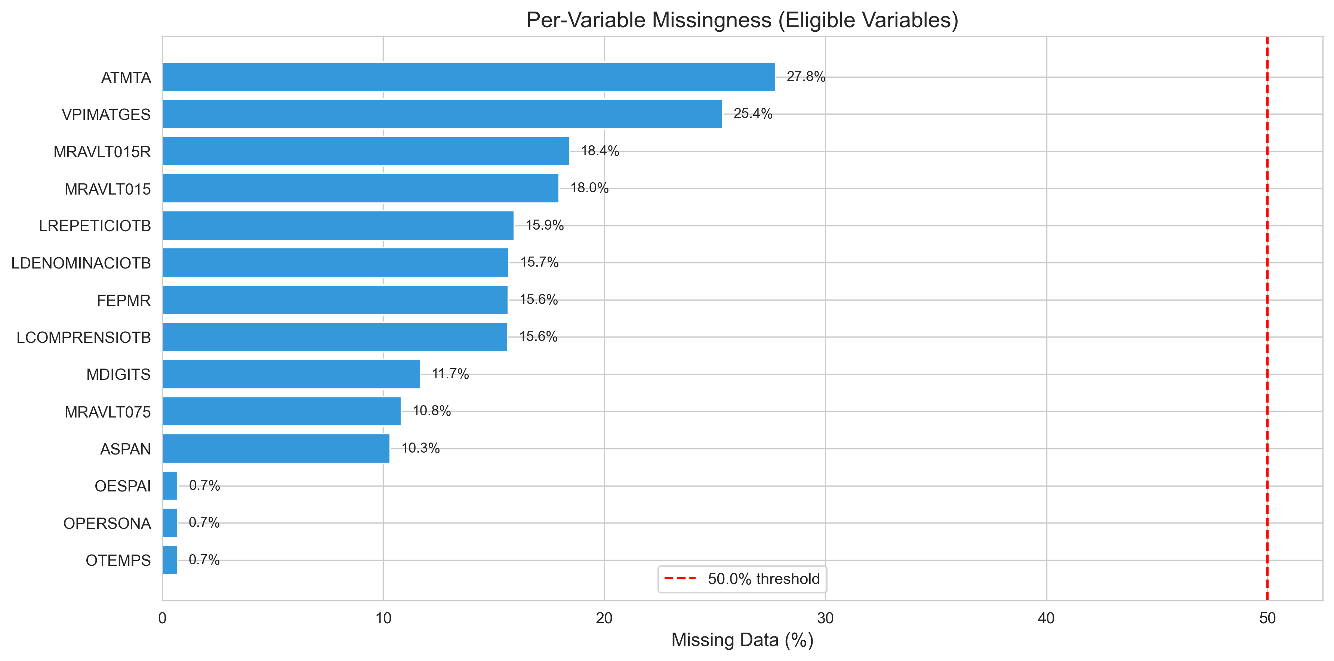
THE DATA
A large but incomplete cohort
17,406
7,285
14
6
assessments
patients
variables
cognitive domains
53.1%
of rows are complete across all 14 variables
Complete-case analysis discards 46.9% of assessments.
Missingness follows structured patterns; its mechanism remains uncertain.
Imputation retains partially observed assessments.
Zoltan Kunos · Data-Driven Cognitive Phenotyping in ABI
5
Notes:
THE DATA
A large but incomplete cohort
17,406
assessments
7,285
patients
14
variables
6
cognitive domains
53.1%
of rows are complete across all 14 variables
Complete-case analysis discards 46.9% of assessments.
Missingness follows structured patterns; its mechanism remains uncertain.
Imputation retains partially observed assessments.
Source: report/main_short.pdf, Chapters 3–6 and Appendix A; saved analysis outputs in results/. Patient-level extension: report/research/clustering_results_2026.md (15 October 2026). Statistics refer to their stated assessment-level or patient-level design; clinical utility remains unconfirmed.

Slide 6
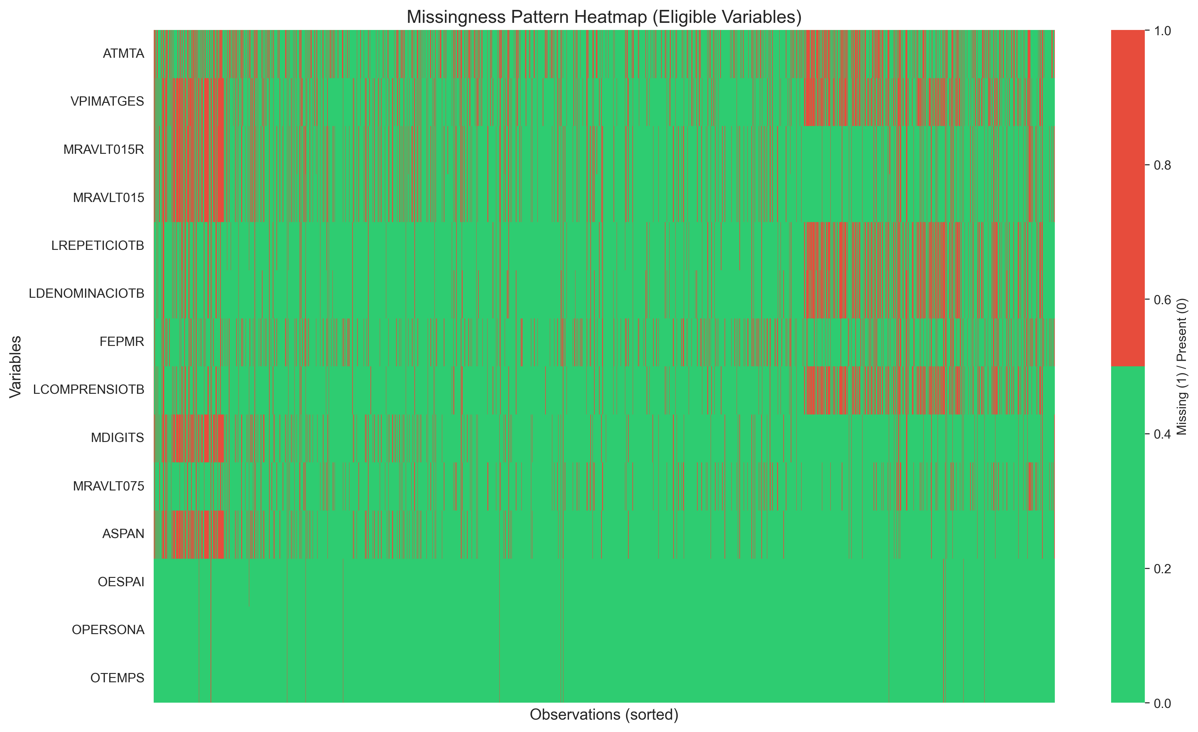
METHOD RATIONALE
Why imputation is necessary
Missingness reflects the clinical testing process
Fatigue or reduced motivation
Cognitive overload or task aversion
Disorientation or motor limitations
Limited tolerance for long batteries
Clinician selects a more suitable test
Complete-case selection changes the cohort. Whether excluded assessments are more impaired cannot be established from missing scores alone.
Zoltan Kunos · Data-Driven Cognitive Phenotyping in ABI
6
Notes:
METHOD RATIONALE
Why imputation is necessary
Missingness reflects the clinical testing process
Fatigue or reduced motivation
Cognitive overload or task aversion
Disorientation or motor limitations
Limited tolerance for long batteries
Clinician selects a more suitable test
Complete-case selection changes the cohort. Whether excluded assessments are more impaired cannot be established from missing scores alone.
Source: report/main_short.pdf, Chapters 3–6 and Appendix A; saved analysis outputs in results/. Patient-level extension: report/research/clustering_results_2026.md (15 October 2026). Statistics refer to their stated assessment-level or patient-level design; clinical utility remains unconfirmed.

Slide 7
METHODS
Analysis pipeline
→
→
→
→
Impute
Scale
Aggregate
UMAP
HDBSCAN
10 strategies
simple → deep learning
orient scores —
higher = better
14 variables →
6 domains
manifold
embedding
density clustering
+ sensitivity
Fixed-reference design (H2)
A scaler, UMAP embedding and three-group k-means rule are fitted once on MICE domain scores. Other imputations use those same transformations and assignment rule.
✓ Tests assignment agreement across imputations while the reference geometry is fixed.
✗ Not tested that re-fitting the whole pipeline per dataset would rediscover the same cluster hierarchy.
Zoltan Kunos · Data-Driven Cognitive Phenotyping in ABI
7
Notes:
METHODS
Analysis pipeline
Impute
10 strategies
simple → deep learning
→
Scale
orient scores —
higher = better
→
Aggregate
14 variables →
6 domains
→
UMAP
manifold
embedding
→
HDBSCAN
density clustering
+ sensitivity
Fixed-reference design (H2)
A scaler, UMAP embedding and three-group k-means rule are fitted once on MICE domain scores. Other imputations use those same transformations and assignment rule.
✓ Tests assignment agreement across imputations while the reference geometry is fixed.
✗ Not tested that re-fitting the whole pipeline per dataset would rediscover the same cluster hierarchy.
Source: report/main_short.pdf, Chapters 3–6 and Appendix A; saved analysis outputs in results/. Patient-level extension: report/research/clustering_results_2026.md (15 October 2026). Statistics refer to their stated assessment-level or patient-level design; clinical utility remains unconfirmed.

Slide 8
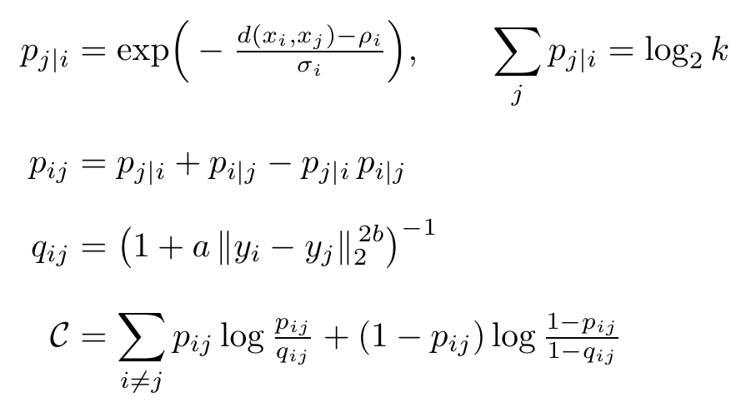
METHODS · DIMENSIONALITY REDUCTION
UMAP
Uniform Manifold Approximation & Projection · McInnes, Healy & Melville, 2018
Builds a fuzzy k-NN graph of neighbourhood structure.
Balances local and global geometry.
Reduces dimensionality before density clustering.
FORMAL DEFINITION
Caveat: separation in UMAP space can be optimistic — it must be backed by sensitivity analyses.
Zoltan Kunos · Data-Driven Cognitive Phenotyping in ABI
8
Notes:
First method: UMAP, for dimensionality reduction. Intuitively it builds a fuzzy k-nearest-neighbour graph that captures neighbourhood structure, balances local and global geometry, and gives the clustering step a clean low-dimensional space. Formally — the equations on the right — the directed membership of edge i-to-j decays exponentially with distance, normalised by a local scale sigma chosen so each point's memberships sum to log-base-two of k, and shifted by rho, the nearest-neighbour distance. Those directed memberships are symmetrised by a probabilistic t-conorm to give p-i-j. In the low-dimensional space a Student-t-like kernel defines q-i-j, and UMAP minimises the fuzzy-set cross-entropy between p and q by stochastic gradient descent. The caveat I keep on the slide: separation in UMAP space can look better than it is, so I back it with sensitivity analyses.

Slide 9
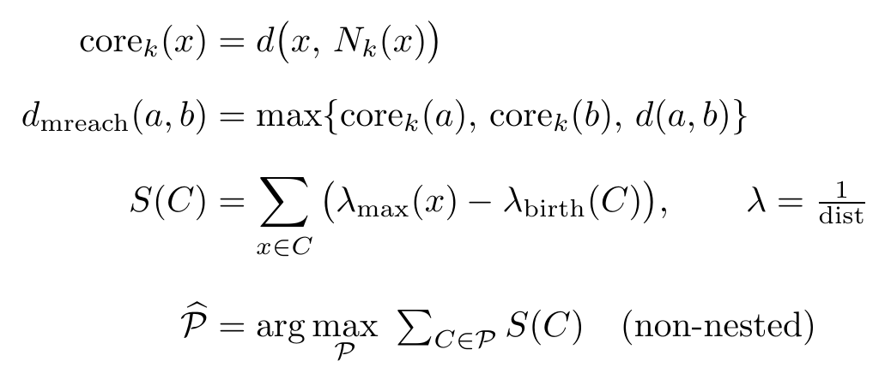
METHODS · DENSITY CLUSTERING
HDBSCAN
Hierarchical Density-Based Spatial Clustering of Applications with Noise · Campello, Moulavi & Sander, 2013
Needs no predefined number of clusters.
Finds regions dense across density levels.
Labels uncertain points as noise, not forced.
FORMAL DEFINITION
Minimum cluster size, density thresholds and selection settings affect the recovered partition.
Zoltan Kunos · Data-Driven Cognitive Phenotyping in ABI
9
Notes:
METHODS · DENSITY CLUSTERING
HDBSCAN
Hierarchical Density-Based Spatial Clustering of Applications with Noise · Campello, Moulavi & Sander, 2013
Needs no predefined number of clusters.
Finds regions dense across density levels.
Labels uncertain points as noise, not forced.
Minimum cluster size, density thresholds and selection settings affect the recovered partition.
FORMAL DEFINITION
Source: report/main_short.pdf, Chapters 3–6 and Appendix A; saved analysis outputs in results/. Patient-level extension: report/research/clustering_results_2026.md (15 October 2026). Statistics refer to their stated assessment-level or patient-level design; clinical utility remains unconfirmed.

Slide 10
METHODS · IMPUTATION
Ten imputation strategies
Simple → model-based
Donor / matrix / deep learning
1. Mean imputation
2. Expectation–maximization
3. MICE (reference)
4. K-nearest neighbours
5. MissForest
6. Predictive mean matching
7. SoftImpute
8. Non-negative matrix factorization
9. Denoising autoencoder
10. Variational autoencoder
Agreement under a fixed rule tests imputation sensitivity. Independent refitting and missingness assumptions require separate checks.
Zoltan Kunos · Data-Driven Cognitive Phenotyping in ABI
10
Notes:
METHODS · IMPUTATION
Ten imputation strategies
Simple → model-based
Donor / matrix / deep learning
1. Mean imputation
2. Expectation–maximization
3. MICE (reference)
4. K-nearest neighbours
5. MissForest
6. Predictive mean matching
7. SoftImpute
8. Non-negative matrix factorization
9. Denoising autoencoder
10. Variational autoencoder
Agreement under a fixed rule tests imputation sensitivity. Independent refitting and missingness assumptions require separate checks.
Source: report/main_short.pdf, Chapters 3–6 and Appendix A; saved analysis outputs in results/. Patient-level extension: report/research/clustering_results_2026.md (15 October 2026). Statistics refer to their stated assessment-level or patient-level design; clinical utility remains unconfirmed.

Slide 11
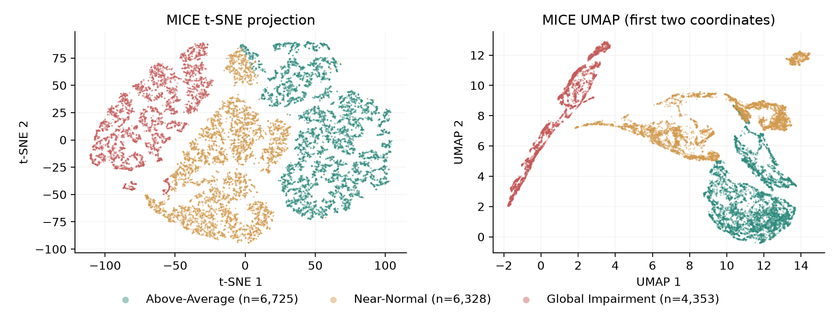
RESULT · H1
Three cognitive severity tiers emerge
Above-Average
6,725
above cohort mean
Near-Normal
6,328
close to the average
Global Impairment
4,353
below cohort mean
All 10 methods meet the selected embedding thresholds. MICE silhouette ≈ 0.53 after reassignment; k = 3. Discrete phenotypes remain unconfirmed.
Zoltan Kunos · Data-Driven Cognitive Phenotyping in ABI
11
Notes:
RESULT · H1
Three cognitive severity tiers emerge
Above-Average
above cohort mean
6,725
Near-Normal
close to the average
6,328
Global Impairment
below cohort mean
4,353
All 10 methods meet the selected embedding thresholds. MICE silhouette ≈ 0.53 after reassignment; k = 3. Discrete phenotypes remain unconfirmed.
Source: report/main_short.pdf, Chapters 3–6 and Appendix A; saved analysis outputs in results/. Patient-level extension: report/research/clustering_results_2026.md (15 October 2026). Statistics refer to their stated assessment-level or patient-level design; clinical utility remains unconfirmed.

Slide 12
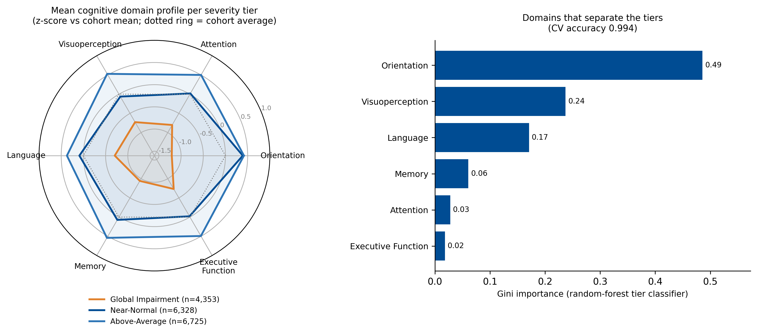
INTERPRETATION · H1
Continuum evidence: level, not shape
PC1
≈ 56%
of variance — one dominant axis
Radar profiles are roughly concentric.
All domains move in the same direction.
All domains load positively on PC1.
Signal = global severity, not dissociation.
Zoltan Kunos · Data-Driven Cognitive Phenotyping in ABI
12
Notes:
This is the conceptual heart of the thesis. If these were genuine subtypes, the tiers would have different shapes — strong here, weak there. They don't. The radar profiles on the left are roughly concentric: the tiers differ in overall size, not in shape, and every domain moves in the same direction together. The PCA on the right confirms it — the first principal component alone explains nearly 56 percent of the variance, and every domain loads positively on it. That is the signature of a single dominant axis: overall cognitive severity. So the dominant signal is global severity, not a symptom-specific dissociation. The three tiers discretize a continuum; they are not a catalogue of phenotypes.

Slide 13
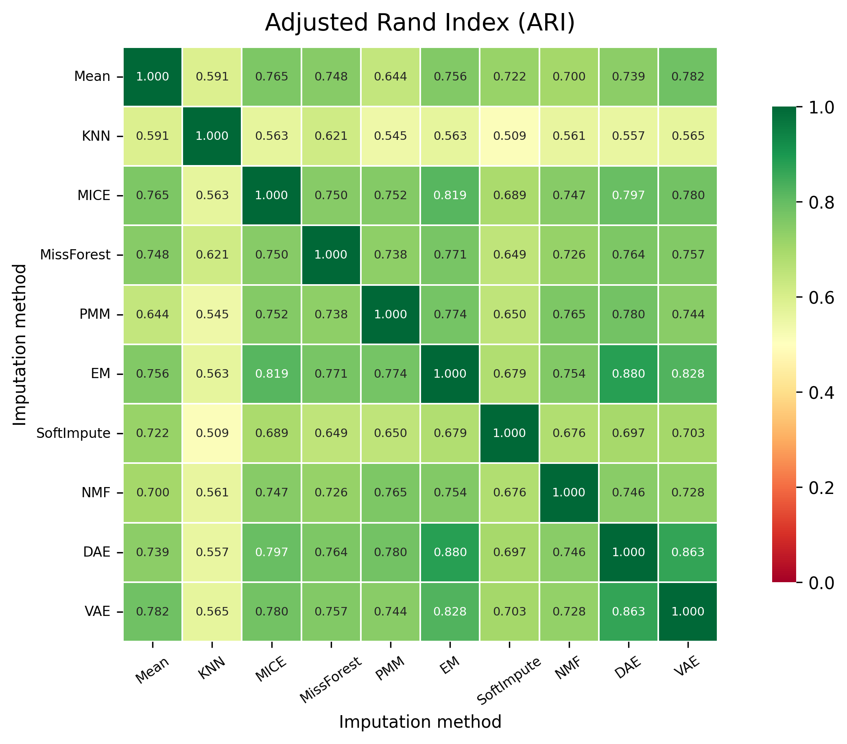
RESULT · H2
Robust across imputation methods
0.71
mean ARI · assessment-bootstrap 95% interval 0.702–0.717
44 / 45
method pairs survive Holm correction
> 86%
assessments with at least 80% assignment agreement
Scope: point assignments are robust under a fixed scaler, embedding and partition — not full invariance of independently re-fit pipelines.
Pairwise ARI across all ten imputation methods
Zoltan Kunos · Data-Driven Cognitive Phenotyping in ABI
13
Notes:
RESULT · H2
Robust across imputation methods
Pairwise ARI across all ten imputation methods
0.71
mean ARI · assessment-bootstrap 95% interval 0.702–0.717
44 / 45
method pairs survive Holm correction
> 86%
assessments with at least 80% assignment agreement
Scope: point assignments are robust under a fixed scaler, embedding and partition — not full invariance of independently re-fit pipelines.
Source: report/main_short.pdf, Chapters 3–6 and Appendix A; saved analysis outputs in results/. Patient-level extension: report/research/clustering_results_2026.md (15 October 2026). Statistics refer to their stated assessment-level or patient-level design; clinical utility remains unconfirmed.

Slide 14
RESULT · H2
Complete-case analysis changes the answer
 | MICE reference | Complete-case
Assessments retained | 100% | 53.1%
Tiers recovered | 3 | 2
Silhouette | ≈ 0.53 | ≈ 0.26
ARI vs. reference (shared rows) | — | ≈ 0.63
Complete-case selection changes
the cohort and partition.
The supplementary baseline used raw-test aggregation. These statistics do not validate the standardized patient-level pipeline.
Zoltan Kunos · Data-Driven Cognitive Phenotyping in ABI
14
Notes:
RESULT · H2
Complete-case analysis changes the answer
Complete-case selection changes
the cohort and partition.
The supplementary baseline used raw-test aggregation. These statistics do not validate the standardized patient-level pipeline.
Source: report/main_short.pdf, Chapters 3–6 and Appendix A; saved analysis outputs in results/. Patient-level extension: report/research/clustering_results_2026.md (15 October 2026). Statistics refer to their stated assessment-level or patient-level design; clinical utility remains unconfirmed.

Slide 15
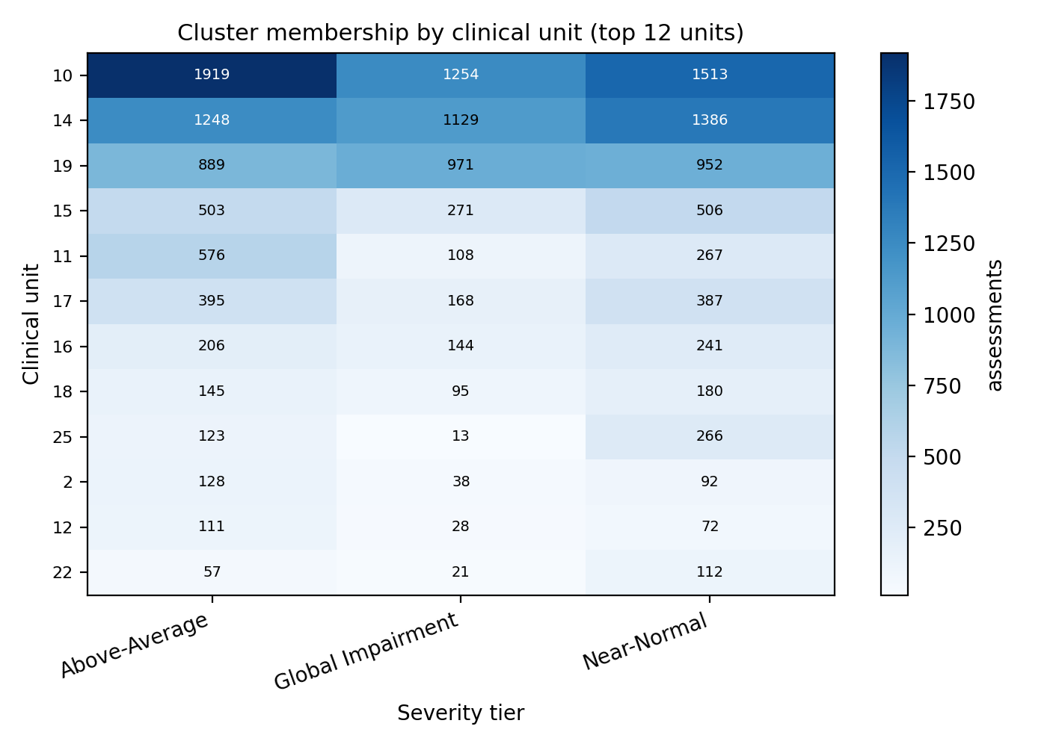
RESULT · H3
Tiers track clinical unit assignment
χ² = 911 p < 10⁻¹⁵⁶
0.16
Cramér's V · criterion > 0.10
Small association with clinical-unit assignment.
Patient-grouped log-loss gain: 0.0013; interval includes zero.
Added predictive value beyond diagnosis is unconfirmed.
Zoltan Kunos · Data-Driven Cognitive Phenotyping in ABI
15
Notes:
RESULT · H3
Tiers track clinical unit assignment
χ² = 911 p < 10⁻¹⁵⁶
0.16
Cramér's V · criterion > 0.10
Small association with clinical-unit assignment.
Patient-grouped log-loss gain: 0.0013; interval includes zero.
Added predictive value beyond diagnosis is unconfirmed.
Source: report/main_short.pdf, Chapters 3–6 and Appendix A; saved analysis outputs in results/. Patient-level extension: report/research/clustering_results_2026.md (15 October 2026). Statistics refer to their stated assessment-level or patient-level design; clinical utility remains unconfirmed.

Slide 16
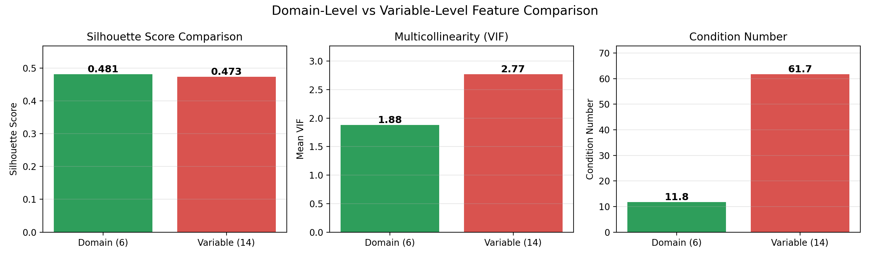
RESULT · H4
Domain aggregation improves conditioning
Silhouette
Mean VIF
Condition number
0.473 → 0.481
2.77 → 1.88
61.7 → 11.8
variables → domains
variables → domains
variables → domains
Zoltan Kunos · Data-Driven Cognitive Phenotyping in ABI
16
Notes:
RESULT · H4
Domain aggregation improves conditioning
Silhouette
0.473 → 0.481
variables → domains
Mean VIF
2.77 → 1.88
variables → domains
Condition number
61.7 → 11.8
variables → domains
Source: report/main_short.pdf, Chapters 3–6 and Appendix A; saved analysis outputs in results/. Patient-level extension: report/research/clustering_results_2026.md (15 October 2026). Statistics refer to their stated assessment-level or patient-level design; clinical utility remains unconfirmed.

Slide 17
WHAT IT MEANS
A continuum, not a catalogue
Above-Average
Near-Normal
Global Impairment
less impaired
more impaired
Subtypes would imply qualitatively different cognitive profiles.
A gradient implies differences lie mostly along one severity axis.
The tiers are practical bands extracted from that continuum.
Domain-specific dissociations may exist — but they don't dominate here.
Poor scaling, redundant or non-cognitive features, or complete-case selection can fake subtype structure.
Zoltan Kunos · Data-Driven Cognitive Phenotyping in ABI
17
Notes:
Let me pull the interpretation together, because the distinction is the whole point. A subtype account says patients differ qualitatively — different profiles, different kinds. A gradient account says they differ mostly along one shared axis of severity, and the tiers are practical bands cut from that axis. Everything points to the gradient: concentric profiles, over half the variance on PC1, all-positive loadings, tiers behaving like ordered bands. I'm not claiming domain-specific dissociations never exist — they can. I'm claiming that in this dataset, with an imputation-robust domain-level pipeline, overall severity dominates. And a warning is embedded here: poor scaling, redundant or non-cognitive features, or complete-case selection can all manufacture patterns that look like subtypes but aren't.

Slide 18
IMPLICATIONS
Clinical and analytic utility
Clinical users
Analytic users
Descriptive cognitive-score bands.
Agreement scores express model consensus.
Clinical utility still requires independent validation.
Reproducible missingness-aware pipeline.
Explicit, testable imputation decisions.
Adaptable for linking cognition to outcomes.
Long-term contribution: make missing-data decisions explicit, then test their influence — rather than hiding them.
Zoltan Kunos · Data-Driven Cognitive Phenotyping in ABI
18
Notes:
IMPLICATIONS
Clinical and analytic utility
Clinical users
Descriptive cognitive-score bands.
Agreement scores express model consensus.
Clinical utility still requires independent validation.
Analytic users
Reproducible missingness-aware pipeline.
Explicit, testable imputation decisions.
Adaptable for linking cognition to outcomes.
Long-term contribution: make missing-data decisions explicit, then test their influence — rather than hiding them.
Source: report/main_short.pdf, Chapters 3–6 and Appendix A; saved analysis outputs in results/. Patient-level extension: report/research/clustering_results_2026.md (15 October 2026). Statistics refer to their stated assessment-level or patient-level design; clinical utility remains unconfirmed.

Slide 19
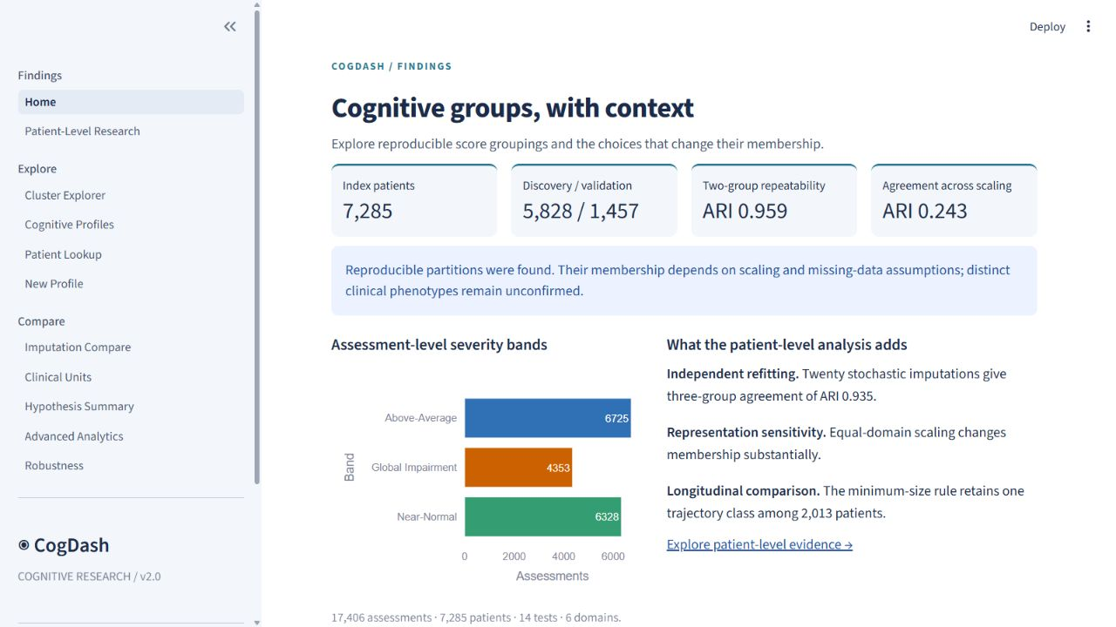
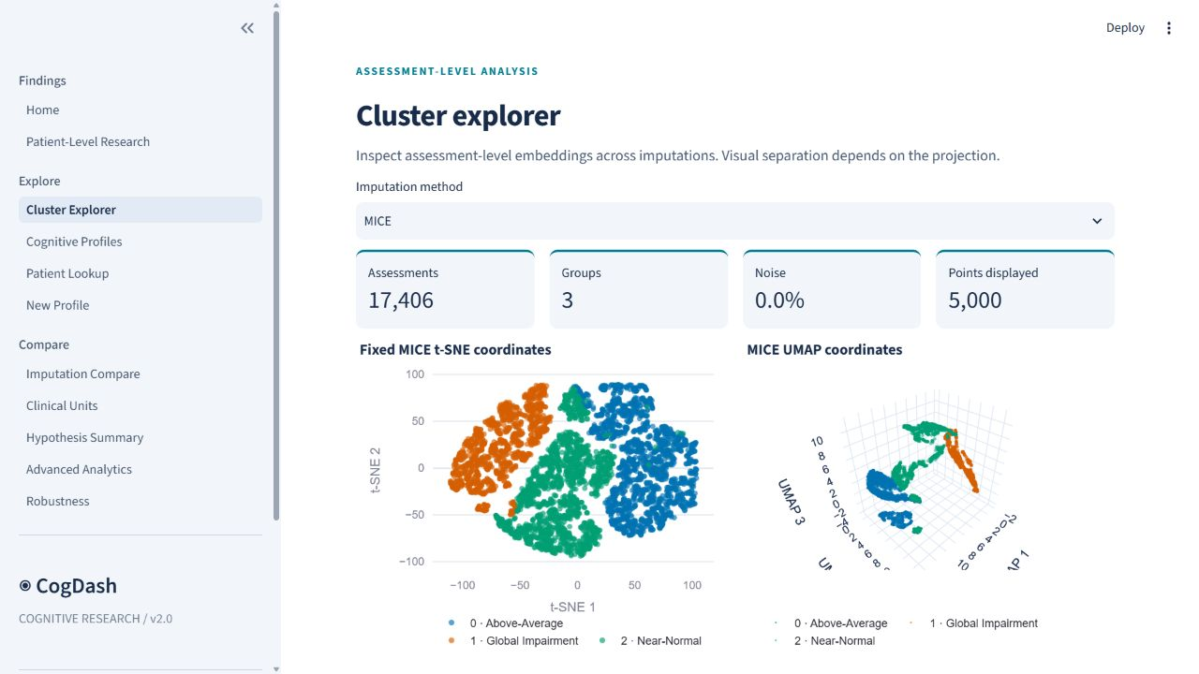
TRANSLATION
CogDash — exploring the research findings
Assessment-level and patient-level findings in eleven pages.
Saved-model profile comparison reports distances, not clinical probabilities.
Research use; diagnostic and treatment utility remain unconfirmed.
Zoltan Kunos · Data-Driven Cognitive Phenotyping in ABI
19
Notes:
TRANSLATION
CogDash — exploring the research findings
Assessment-level and patient-level findings in eleven pages.
Saved-model profile comparison reports distances, not clinical probabilities.
Research use; diagnostic and treatment utility remain unconfirmed.
Source: report/main_short.pdf, Chapters 3–6 and Appendix A; saved analysis outputs in results/. Patient-level extension: report/research/clustering_results_2026.md (15 October 2026). Statistics refer to their stated assessment-level or patient-level design; clinical utility remains unconfirmed.

Slide 20
CAVEATS
Limitations
Single site
Longitudinal selection
One rehabilitation centre — external replication is required.
One trajectory class meets the 5% size rule; nonlinear change and informative dropout remain unresolved.
Missing-data assumptions
No functional outcomes
MAR is a working assumption; MNAR cannot be excluded.
Return-to-work, length-of-stay and independence were unavailable.
Embedding-based validation
Pipeline sensitivity
UMAP-space silhouette may overstate separation.
Scaling changes patient-level membership substantially (ARI 0.243).
Zoltan Kunos · Data-Driven Cognitive Phenotyping in ABI
20
Notes:
CAVEATS
Limitations
Single site
One rehabilitation centre — external replication is required.
Longitudinal selection
One trajectory class meets the 5% size rule; nonlinear change and informative dropout remain unresolved.
Missing-data assumptions
MAR is a working assumption; MNAR cannot be excluded.
No functional outcomes
Return-to-work, length-of-stay and independence were unavailable.
Embedding-based validation
UMAP-space silhouette may overstate separation.
Pipeline sensitivity
Scaling changes patient-level membership substantially (ARI 0.243).
Source: report/main_short.pdf, Chapters 3–6 and Appendix A; saved analysis outputs in results/. Patient-level extension: report/research/clustering_results_2026.md (15 October 2026). Statistics refer to their stated assessment-level or patient-level design; clinical utility remains unconfirmed.

Slide 21
IN SUMMARY
Three conclusions
1
Empirical
Repeatable score groups exist under specified choices. Distinct clinical phenotypes remain unconfirmed.
2
Methodological
Scaling, imputation and test availability materially affect group membership.
3
Practical
Domain aggregation improves conditioning. Clinical utility requires independent outcomes and external replication.
Zoltan Kunos · Data-Driven Cognitive Phenotyping in ABI
21
Notes:
IN SUMMARY
Three conclusions
1
Empirical
Repeatable score groups exist under specified choices. Distinct clinical phenotypes remain unconfirmed.
2
Methodological
Scaling, imputation and test availability materially affect group membership.
3
Practical
Domain aggregation improves conditioning. Clinical utility requires independent outcomes and external replication.
Source: report/main_short.pdf, Chapters 3–6 and Appendix A; saved analysis outputs in results/. Patient-level extension: report/research/clustering_results_2026.md (15 October 2026). Statistics refer to their stated assessment-level or patient-level design; clinical utility remains unconfirmed.

Slide 22
THANK YOU
Questions & discussion
Reproducible cognitive score groupings, with sensitivity to scaling and missingness. Clinical phenotypes remain unconfirmed.
Zoltan Kunos · Supervisor: Dr. Alejandro García-Rudolph
MSc Fundamental Principles of Data Science · Universitat de Barcelona
Notes:
THANK YOU
Questions & discussion
Reproducible cognitive score groupings, with sensitivity to scaling and missingness. Clinical phenotypes remain unconfirmed.
Zoltan Kunos · Supervisor: Dr. Alejandro García-Rudolph
MSc Fundamental Principles of Data Science · Universitat de Barcelona
Source: report/main_short.pdf, Chapters 3–6 and Appendix A; saved analysis outputs in results/. Patient-level extension: report/research/clustering_results_2026.md (15 October 2026). Statistics refer to their stated assessment-level or patient-level design; clinical utility remains unconfirmed.

Slide 23
APPENDIX
Backup slides for examiner questions
Notes:
Backup slides follow, prepared for detailed examiner questions on the imputation set, the fixed-reference design, HDBSCAN, silhouette caveats, MNAR sensitivity, the clinical interpretation boundary, and future work.

Slide 24
PATIENT-LEVEL EXTENSION
Independent refitting and sensitivity
1
5,828 discovery patients · 1,457 validation patients
2
20 independent imputations: ARI 0.959 (2 groups), 0.935 (3 groups)
3
Robust versus equal-domain scaling: ARI 0.243
4
Student t mixtures select 8 components at the search boundary
5
2,013 longitudinal patients: one class meets the 5% size rule
Zoltan Kunos · Data-Driven Cognitive Phenotyping in ABI
24
Notes:
PATIENT-LEVEL EXTENSION
Independent refitting and sensitivity
1
5,828 discovery patients · 1,457 validation patients
2
20 independent imputations: ARI 0.959 (2 groups), 0.935 (3 groups)
3
Robust versus equal-domain scaling: ARI 0.243
4
Student t mixtures select 8 components at the search boundary
5
2,013 longitudinal patients: one class meets the 5% size rule
Source: report/main_short.pdf, Chapters 3–6 and Appendix A; saved analysis outputs in results/. Patient-level extension: report/research/clustering_results_2026.md (15 October 2026). Statistics refer to their stated assessment-level or patient-level design; clinical utility remains unconfirmed.

Slide 25
APPENDIX · A
Imputation hyperparameters
Method | Hyperparameters
Mean | Single-pass arithmetic mean per variable.
EM | Multivariate normal model; convergence 1e−6; max 500 iterations.
MICE | Linear regression per variable; 10 iterations; single imputed dataset for clustering.
KNN | k = 5; inverse-distance weighting; Euclidean distance.
MissForest | 100 trees per forest; up to 10 iterations; variables imputed by increasing missingness.
PMM | 5 donors; 10 iterations; implemented within the MICE framework.
SoftImpute | Regularisation chosen by CV over 20 log-spaced values (1e−3 to 1e2); convergence 1e−5; max 200 iterations.
NMF | Rank r = 5 selected by grid search over {2, 3, 5, 7, 10}; multiplicative updates; max 500 iterations.
DAE | 15-128-64-32 autoencoder; ReLU + batch norm; dropout 0.5/0.3; 20% pattern-aware masking; MSE on observed entries; Adam (lr 1e−3); early stopping; 5 runs averaged.
VAE | Same layer dimensions as DAE; latent dim 32; loss = MSE + β-weighted KL (cyclical annealing, βmax 0.1); 20 latent samples averaged.
Zoltan Kunos · Data-Driven Cognitive Phenotyping in ABI
25
Notes:
This is thesis Appendix A: the exact hyperparameter settings for all ten imputation methods. Where published defaults exist I used them; the rest were chosen by cross-validation or grid search — for example SoftImpute's regularisation and NMF's rank. The two deep methods, the denoising and variational autoencoders, share a 15-128-64-32 architecture with the configuration shown. I keep this slide for reproducibility questions or queries about any specific method's setup.

Slide 26
APPENDIX · B
H2 fixed-reference design
Fit the reference scaler on MICE-imputed domain scores.
Fit one UMAP embedding from the MICE reference.
Fit a three-group k-means assignment rule.
Apply the frozen transformations to other imputations.
Compare assignments using pairwise ARI and NMI.
Tests
Robustness of point assignments to imputed values.
Does not test
Full invariance of independently discovered structures.
Zoltan Kunos · Data-Driven Cognitive Phenotyping in ABI
26
Notes:
APPENDIX · B
H2 fixed-reference design
Fit the reference scaler on MICE-imputed domain scores.
Fit one UMAP embedding from the MICE reference.
Fit a three-group k-means assignment rule.
Apply the frozen transformations to other imputations.
Compare assignments using pairwise ARI and NMI.
Tests
Robustness of point assignments to imputed values.
Does not test
Full invariance of independently discovered structures.
Source: report/main_short.pdf, Chapters 3–6 and Appendix A; saved analysis outputs in results/. Patient-level extension: report/research/clustering_results_2026.md (15 October 2026). Statistics refer to their stated assessment-level or patient-level design; clinical utility remains unconfirmed.

Slide 27
APPENDIX · C
HDBSCAN logic
Estimate local density via core distance.
Construct mutual-reachability distances.
Build a minimum spanning tree.
Extract a hierarchy of density-connected components.
Select persistent clusters by stability.
Label points outside persistent regions as noise.
Unlike DBSCAN, HDBSCAN does not reduce to a single fixed-ε DBSCAN solution — it integrates across density levels.
Zoltan Kunos · Data-Driven Cognitive Phenotyping in ABI
27
Notes:
HDBSCAN estimates local density via core distance, builds mutual-reachability distances, constructs a minimum spanning tree, extracts a hierarchy of density-connected components, selects persistent clusters by stability, and labels points outside persistent regions as noise. Unlike DBSCAN it does not reduce to a single fixed-epsilon solution — it integrates across density levels, which is why it can recover clusters of varying density without a preset count.

Slide 28
APPENDIX · D
Silhouette caveats
UMAP emphasizes neighbourhood structure.
Embedding silhouette can overstate measured-domain separation.
Hyperparameter and seed selection make the chosen score optimistic.
Historical assessment subsampling gives mean ARI 0.273.
Interpret silhouette as an internal pipeline-quality metric — not proof of natural categories.
Zoltan Kunos · Data-Driven Cognitive Phenotyping in ABI
28
Notes:
APPENDIX · D
Silhouette caveats
UMAP emphasizes neighbourhood structure.
Embedding silhouette can overstate measured-domain separation.
Hyperparameter and seed selection make the chosen score optimistic.
Historical assessment subsampling gives mean ARI 0.273.
Interpret silhouette as an internal pipeline-quality metric — not proof of natural categories.
Source: report/main_short.pdf, Chapters 3–6 and Appendix A; saved analysis outputs in results/. Patient-level extension: report/research/clustering_results_2026.md (15 October 2026). Statistics refer to their stated assessment-level or patient-level design; clinical utility remains unconfirmed.

Slide 29
APPENDIX · E
Missing-not-at-random sensitivity
MAR is a working assumption.
Observed data alone cannot rule out MNAR mechanisms.
Agreement across imputations does not establish MNAR robustness.
Clinically justified delta-shift sensitivity remains future work.
Zoltan Kunos · Data-Driven Cognitive Phenotyping in ABI
29
Notes:
APPENDIX · E
Missing-not-at-random sensitivity
MAR is a working assumption.
Observed data alone cannot rule out MNAR mechanisms.
Agreement across imputations does not establish MNAR robustness.
Clinically justified delta-shift sensitivity remains future work.
Source: report/main_short.pdf, Chapters 3–6 and Appendix A; saved analysis outputs in results/. Patient-level extension: report/research/clustering_results_2026.md (15 October 2026). Statistics refer to their stated assessment-level or patient-level design; clinical utility remains unconfirmed.

Slide 30
APPENDIX · F
Clinical interpretation boundary
Research summaries provide
The severity tier does NOT
cohort-relative score bands;
assignment agreement across methods;
exploratory profile comparison;
candidates for outcome validation.
diagnose a patient;
prescribe treatment;
determine clinical placement;
replace professional judgement.
Zoltan Kunos · Data-Driven Cognitive Phenotyping in ABI
30
Notes:
APPENDIX · F
Clinical interpretation boundary
Research summaries provide
cohort-relative score bands;
assignment agreement across methods;
exploratory profile comparison;
candidates for outcome validation.
The severity tier does NOT
diagnose a patient;
prescribe treatment;
determine clinical placement;
replace professional judgement.
Source: report/main_short.pdf, Chapters 3–6 and Appendix A; saved analysis outputs in results/. Patient-level extension: report/research/clustering_results_2026.md (15 October 2026). Statistics refer to their stated assessment-level or patient-level design; clinical utility remains unconfirmed.

Slide 31
APPENDIX · G
Future work
External replication across rehabilitation centres.
Nonlinear trajectories and informative follow-up or dropout.
Validation against independent functional outcomes.
Broader incomplete-data models and MNAR sensitivity.
Prospective evaluation of CogDash before clinical use.
Continuous scores versus added value from group membership.
Zoltan Kunos · Data-Driven Cognitive Phenotyping in ABI
31
Notes:
APPENDIX · G
Future work
External replication across rehabilitation centres.
Nonlinear trajectories and informative follow-up or dropout.
Validation against independent functional outcomes.
Broader incomplete-data models and MNAR sensitivity.
Prospective evaluation of CogDash before clinical use.
Continuous scores versus added value from group membership.
Source: report/main_short.pdf, Chapters 3–6 and Appendix A; saved analysis outputs in results/. Patient-level extension: report/research/clustering_results_2026.md (15 October 2026). Statistics refer to their stated assessment-level or patient-level design; clinical utility remains unconfirmed.

Slide 32
APPENDIX · H
How to read the metrics
Clustering quality & robustness
Association & conditioning
Silhouette
χ² statistic
Cohesion vs. separation — how well a point fits its own tier vs. the nearest other.
Evidence that tier and clinical unit are associated — significance, not effect size; grows with N.
−1 to 1 · criterion ≥ 0.40 · selected embedding ≈ 0.53
χ² = 911 · p < 10⁻¹⁵⁶
Adjusted Rand Index (ARI)
Cramér's V
Agreement between two partitions, corrected for chance.
Effect size of that association, scaled 0–1.
0 = chance, 1 = identical · median criterion > 0.50
Interpret with table dimensions · observed 0.162
Normalised Mutual Information
VIF (variance inflation factor)
Shared information between two partitions, scaled 0–1.
Per-feature redundancy from collinearity.
0 = independent, 1 = identical · corroborates ARI
1 = none; > 5–10 concerning · 2.77 → 1.88
Consensus agreement
Condition number
For each assessment, the fraction of methods assigning its modal label.
Global conditioning of the feature set (λmax / λmin of the correlation matrix).
86.2% of assessments have agreement ≥ 80%
Smaller is better conditioned · 61.7 → 11.8
Zoltan Kunos · Data-Driven Cognitive Phenotyping in ABI
32
Notes:
APPENDIX · H
How to read the metrics
Clustering quality & robustness
Silhouette
Cohesion vs. separation — how well a point fits its own tier vs. the nearest other.
−1 to 1 · criterion ≥ 0.40 · selected embedding ≈ 0.53
Adjusted Rand Index (ARI)
Agreement between two partitions, corrected for chance.
0 = chance, 1 = identical · median criterion > 0.50
Normalised Mutual Information
Shared information between two partitions, scaled 0–1.
0 = independent, 1 = identical · corroborates ARI
Consensus agreement
For each assessment, the fraction of methods assigning its modal label.
86.2% of assessments have agreement ≥ 80%
Association & conditioning
χ² statistic
Evidence that tier and clinical unit are associated — significance, not effect size; grows with N.
χ² = 911 · p < 10⁻¹⁵⁶
Cramér's V
Effect size of that association, scaled 0–1.
Interpret with table dimensions · observed 0.162
VIF (variance inflation factor)
Per-feature redundancy from collinearity.
1 = none; > 5–10 concerning · 2.77 → 1.88
Condition number
Global conditioning of the feature set (λmax / λmin of the correlation matrix).
Smaller is better conditioned · 61.7 → 11.8
Source: report/main_short.pdf, Chapters 3–6 and Appendix A; saved analysis outputs in results/. Patient-level extension: report/research/clustering_results_2026.md (15 October 2026). Statistics refer to their stated assessment-level or patient-level design; clinical utility remains unconfirmed.

