Slide 1
Data-Driven Cognitive Phenotyping in Acquired Brain Injury
17,406
assessments
7,285
patients
A cognitive severity gradient that survives the choice of imputation method
10
imputation methods
3
Zoltán Kunos
severity tiers
MSc Fundamental Principles of Data Science · Universitat de Barcelona
Supervisor: Dr. Alejandro García-Rudolph · 2026

Slide 2
Thesis in one sentence
02
The main signal is not a hidden subtype
Across incomplete routine neuropsychological data, unsupervised learning recovers a robust cognitive severity gradient.
Diagnosis alone does not capture cognitive heterogeneity.
Imputation is necessary because missingness is clinically structured.
The recovered tiers remain stable across imputation strategies.

Slide 3
Clinical problem
03
Same injury category, different rehabilitation needs
ABI affects attention, memory, language, executive function and visuoperception in different combinations.
Severity bands and diagnostic labels group together patients with different cognitive profiles.
Research question
Broad batteries are often incomplete because impaired patients cannot finish every test.
Can data-driven clustering recover clinically meaningful cognitive structure, and can we trust it under missing data?
Excluding incomplete records risks removing exactly the patients most relevant to rehabilitation planning.

Slide 4
Pre-registered tests
04
Four quantitative tests define success
H1
Discrete, stable clusters
silhouette > 0.40, noise < 30%, ≥ 2 clusters
H2
Imputation robustness
mean pairwise ARI > 0.50
H3
Clinical-unit link
χ² significant, Cramér's V > 0.10
H4
Domain-level advantage
domains win silhouette, VIF and condition

Slide 5
Cohort
05
The cohort is large, but incomplete
Routine clinical data gives scale; missingness creates the central methodological risk.
17,406
7,285
One rehabilitation centre.
assessments
patients
14 eligible neuropsychological variables retained after filtering.
14 → 6
53.1%
Scores were aggregated into six cognitive domains.
scores to domains
complete rows
Complete-case analysis would discard 46.9% of assessments.

Slide 6
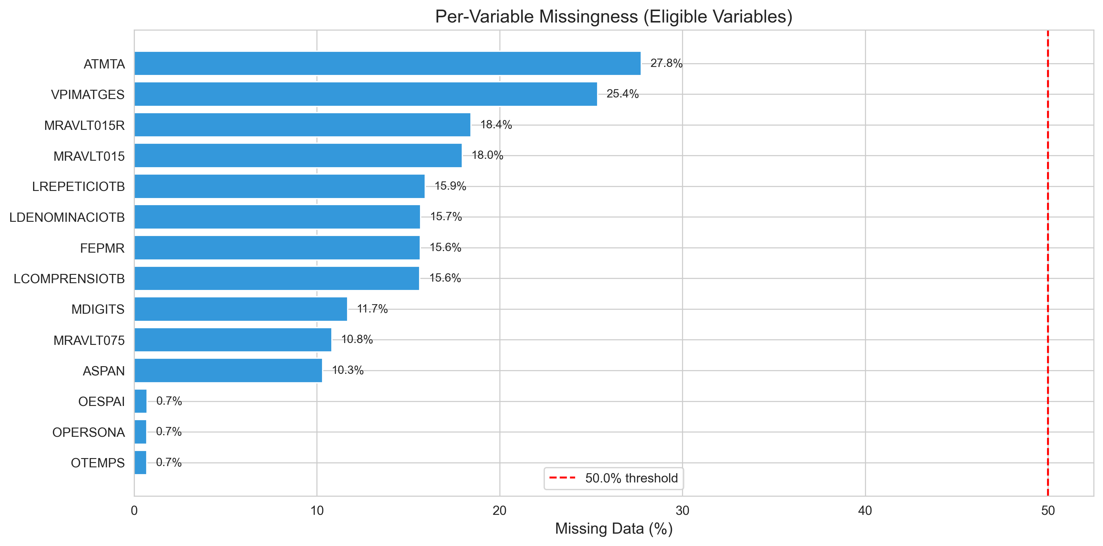
Missingness
06
Missingness is structured, not incidental
Specialised assessments have higher missingness than routine screening tests.
What to take away
Only 53.1% of rows are complete.
Missingness reflects the clinical testing process.
Imputation keeps partially tested and impaired patients in the analysis.

Slide 7
Pipeline
07
One pipeline, ten imputation strategies
The design tests whether the clustering solution depends on the imputation method.
Impute
10 methods
Scale
UMAP
HDBSCAN
Best-Q
clusters
→
→
→
→
Q = Silhouette × (1 - noise proportion)
1,080 clustering configurations searched.
Domain-level and variable-level representations compared.
For H2, MICE fixed the scaler, embedding and cluster boundaries.

Slide 8
H1 result
08
Three cognitive severity tiers emerge
The clusters are ordered bands on a severity continuum.
6,725
6,328
4,353
Above-Average
above cohort mean on all domains
Near-Normal
near the cohort average
Global Impairment
below cohort mean on all domains
All 10 imputation methods clear the pre-registered thresholds.
MICE reference: silhouette 0.53, k = 3.
One severity axis explains 56% of variance.

Slide 9
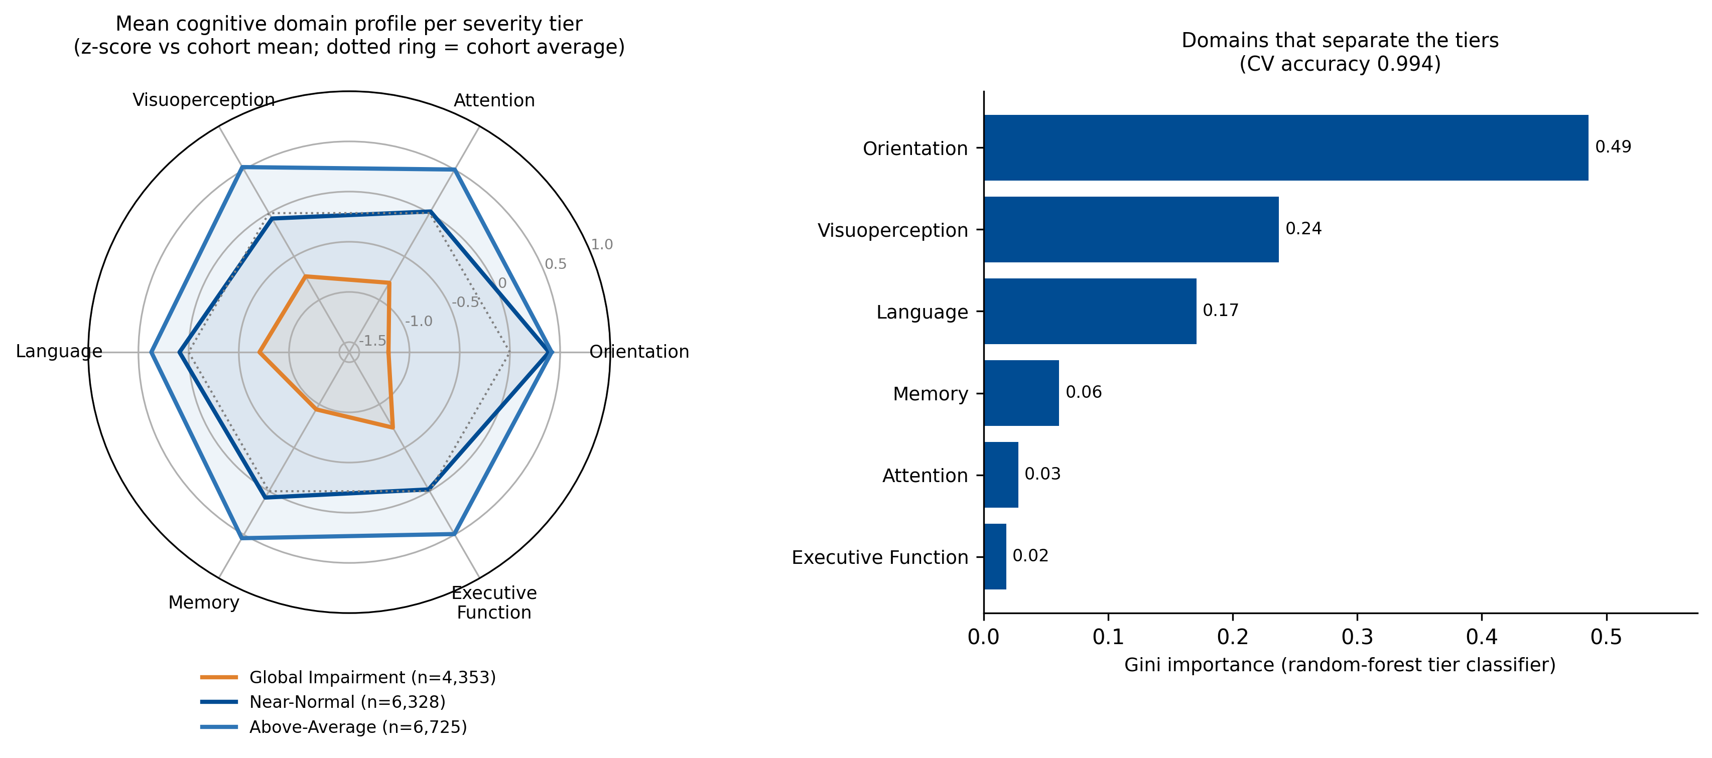
Severity profile
09
The tiers differ by level, not profile shape
The polygons are nearly concentric: domains move together.
What to take away
The signal is global cognitive severity.
PC1 explains 56% of variance.
No attention-specific dissociation remains after proper scaling.

Slide 10
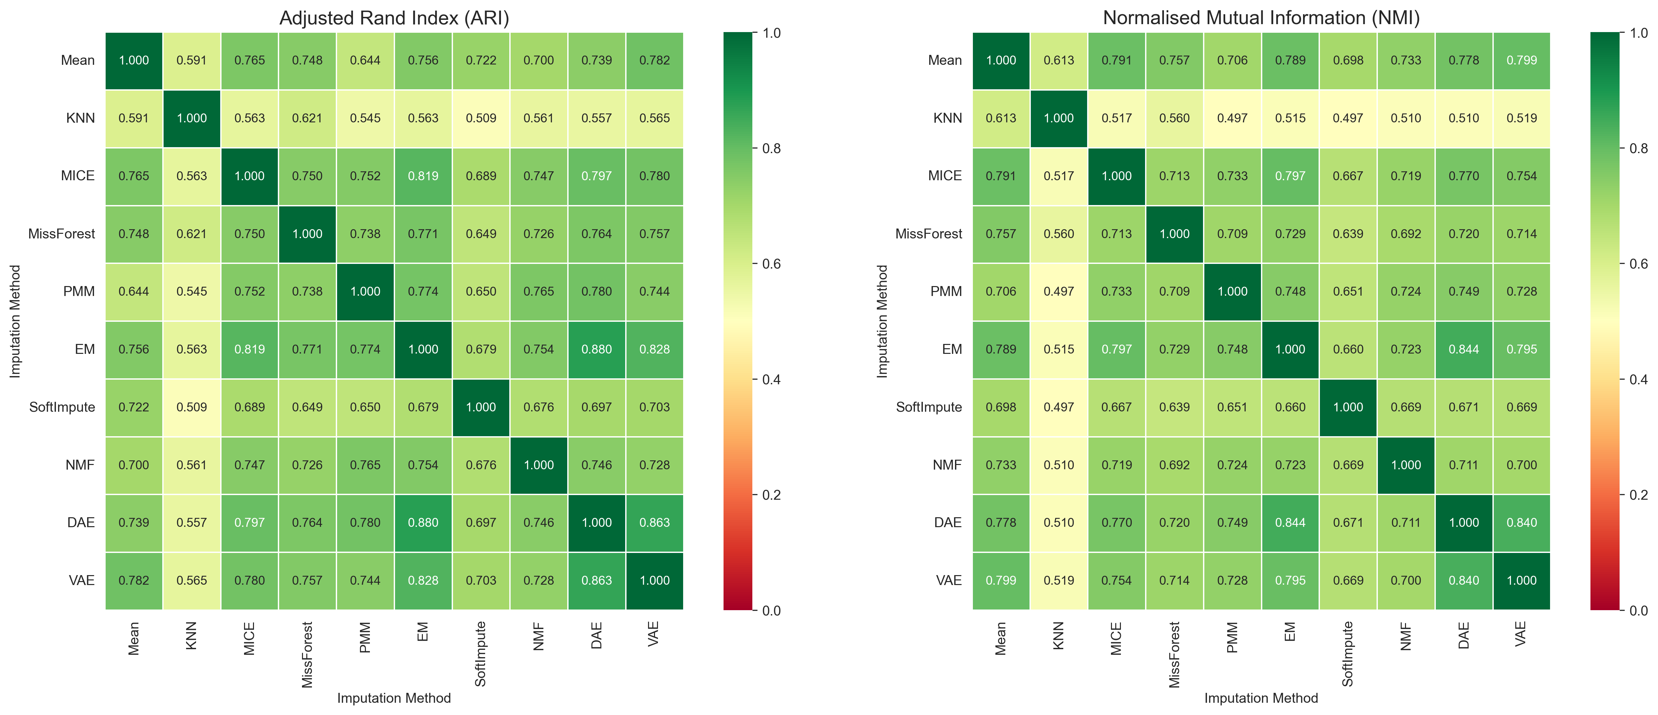
H2 result
10
The tiers are robust to imputation
Every method pair agrees above the pre-registered threshold.
What to take away
Mean pairwise ARI = 0.71 [95% CI 0.70-0.72].
44 of 45 pairs survive Holm correction.
86% of assessments receive high-confidence consensus labels.

Slide 11
Why imputation matters
11
Listwise deletion changes the result
Removing incomplete rows does not merely reduce power; it changes the partition.
Complete-case rows
53%
Complete-case baseline keeps 9,245 of 17,406 assessments.
Imputed rows
100%
It returns 2 clusters rather than 3 tiers.
Listwise silhouette
26%
ARI vs. MICE = 0.63: related, but not equivalent.
MICE silhouette
53%

Slide 12
H3 result
12
Severity tier tracks treating clinical unit
The association survives adjustment for diagnosis.
χ² = 911
V = 0.16
CMH
clinical unit association
p ≈ 10^-156
Cramér's V
above 0.10 threshold
not explained solely
by diagnosis group
Severity tier adds information beyond diagnostic category, supporting severity-informed patient routing.

Slide 13
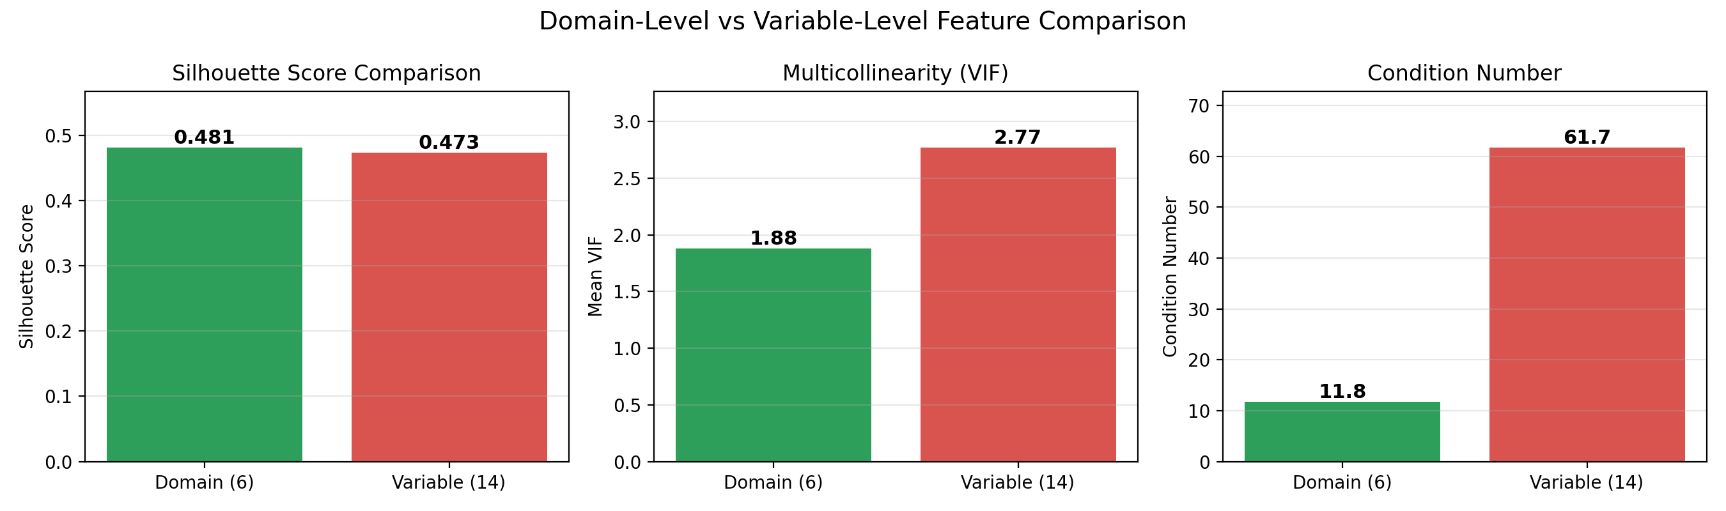
H4 result
13
Six domains beat fourteen raw tests
Domain aggregation preserves separation while improving numerical conditioning.
What to take away
Silhouette: 0.48 vs. 0.47.
Mean VIF: 1.9 vs. 2.8.
Condition number: 12 vs. 62.
Clinical interpretation is cleaner at domain level.

Slide 14
Result summary
14
All four hypotheses are supported
H1
Supported
3 stable severity tiers
H2
Supported
mean ARI 0.71; robust across imputation
H3
Supported
clinical-unit association persists after diagnosis adjustment
H4
Supported
domain aggregation improves conditioning

Slide 15
Interpretation
15
This is a severity gradient, not a subtype catalogue
The strongest unsupervised signal is general cognitive severity.
PC1 = 56%
All domains load positively
Tiers are bands of one gradient
Domain-specific phenotypes are weaker than the shared severity axis.
A preprocessing artefact can look like a phenotype unless scaling and variable screening are handled carefully.

Slide 16
Clinical and analytical value
16
The framework has two practical audiences
For the clinic
For analysts
Match rehabilitation intensity to severity tier.
Use MICE as a practical default.
Report tier assignments with confidence.
Run sensitivity checks with more than one imputation method.
Use severity tier alongside diagnosis, not instead of it.
Cluster domain-level scores rather than raw tests.

Slide 17
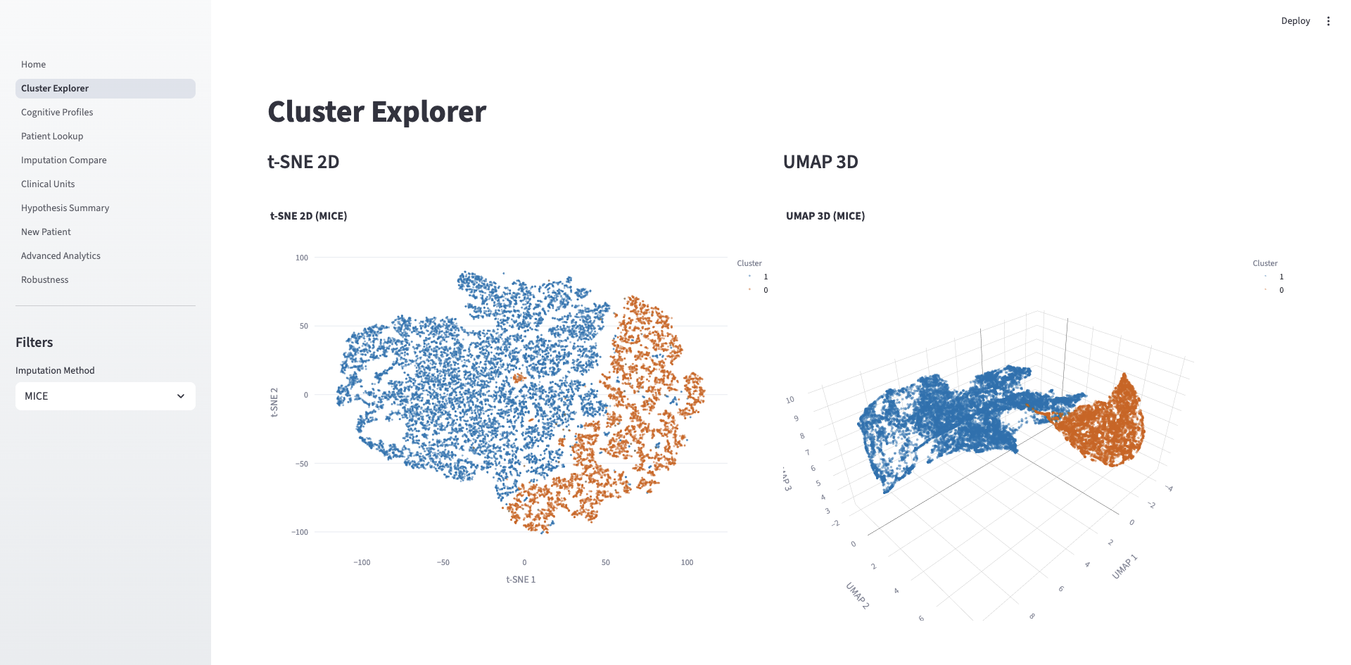
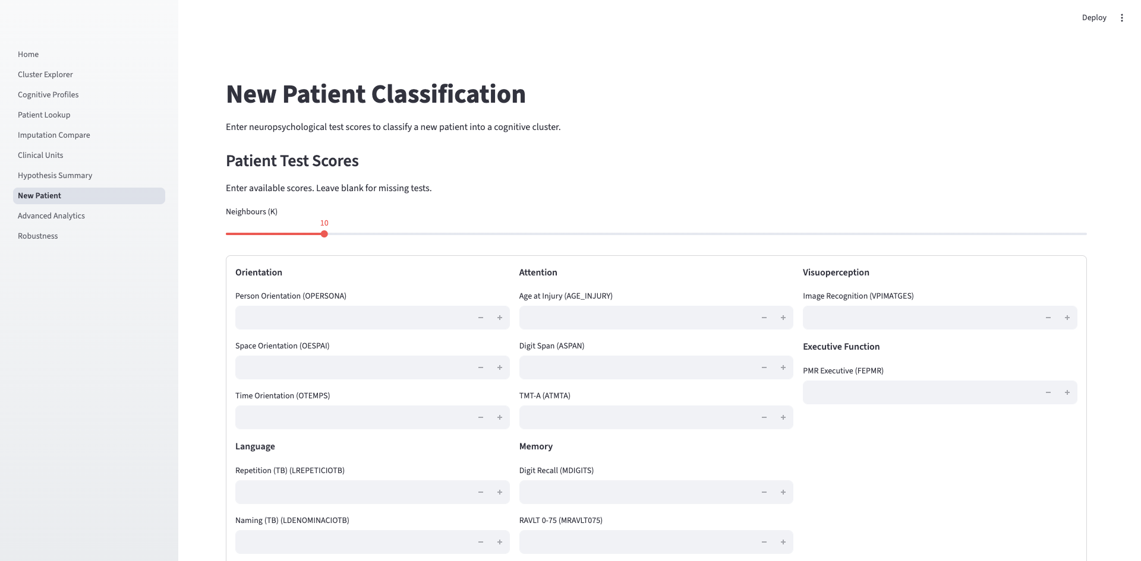
Translation
17
CogDash turns the pipeline into decision support
A Streamlit dashboard classifies new patients and reports confidence.
cluster explorer
patient lookup
new-patient classifier
hypothesis summary
advanced analytics

Slide 18
Limitations
18
The main limits are design constraints
Single centre
needs external validation.
Cross-sectional
recovery trajectories require longitudinal modelling.
MAR assumption
MNAR cannot be ruled out from observed data alone.
No functional outcomes
return-to-work and length-of-stay validation remain future work.

Slide 19
Conclusion
19
Three conclusions for a 20-minute defense
1
A robust ABI cognitive severity gradient exists in routine clinical data.
2
Imputation is a substantive modelling decision, not a cosmetic preprocessing step.
3
Domain-level severity tiers provide a clinically interpretable and numerically stable representation.

Slide 20
Thank you
Questions and discussion
Email: z.kunos@gmail.com
Code & dashboard: github.com/zkunos/thesis_project
CogDash: dashboard + new-patient classifier

