Slide 1
Data-Driven Cognitive Phenotyping
in Acquired Brain Injury
A cognitive severity gradient that survives the choice of imputation method
Zoltán Kunos
MSc Fundamental Principles of Data Science · Universitat de Barcelona
Supervisor: Dr. Alejandro García-Rudolph
MSc Thesis Defence · 2026

Slide 2
Part 1
Background

Slide 3
Same injury severity, very different cognitive profiles —
severity labels hide what should guide treatment
Acquired brain injury (stroke, TBI, hypoxia, encephalitis) is a leading cause of long-term disability in working-age adults.
Effects scatter across attention, memory, language, executive function and visuoperception.
Diagnosis and severity bands group together patients whose cognitive profiles differ substantially.
The within-group variation that could guide rehabilitation stays hidden.
The question
Can data-driven clustering recover clinically meaningful cognitive phenotypes that diagnosis alone misses — and can we trust them?
ABI cognitive assessment: Lezak et al. (2012)
3

Slide 4
Four pre-registered questions, each with a quantitative threshold
1
Distinct phenotypes? Does clustering find discrete cognitive phenotypes?
H1 Silhouette > 0.40, noise < 30%, ≥ 2 clusters
2
Imputation-robust? Are phenotypes stable across imputation methods?
H2 Mean pairwise ARI > 0.50
3
Clinically linked? Does the cluster relate to the treating clinical unit?
H3 χ² significant, Cramér's V > 0.10
4
Better at domain level? Do 6 cognitive domains beat 14 raw tests?
H4 Domain wins all 3 quality metrics (silhouette, VIF, condition)
Thresholds fixed before analysis (pre-registration)
4

Slide 5
Part 2
Data & Methods

Slide 6
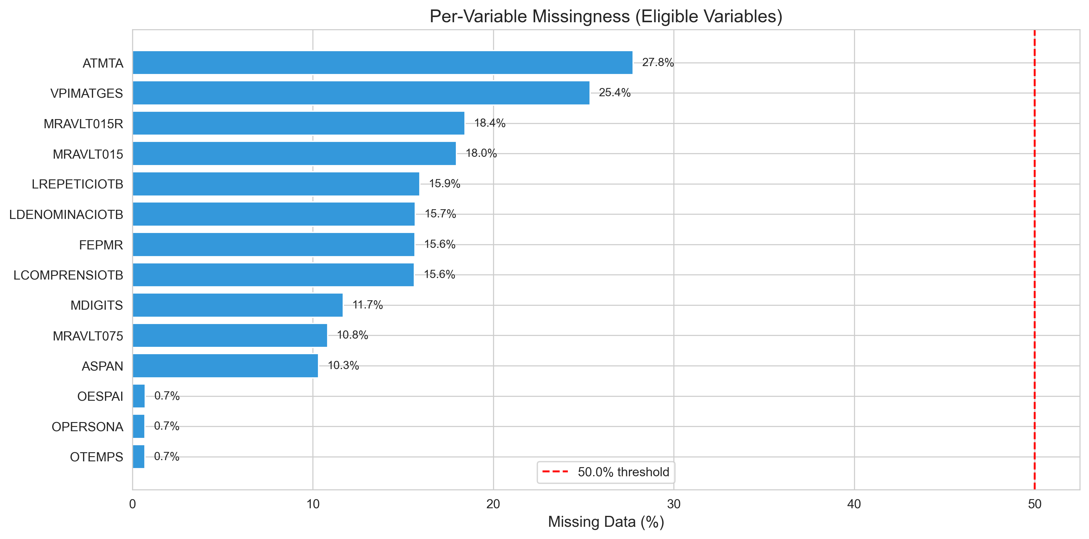
Routine clinical data is large but 47% incomplete —
imputation is unavoidable, not optional
17,406 assessments from 7,285 patients, one rehabilitation centre.
14 cognitive tests → 6 domains after a 50%-missing filter.
Only 53.1% of rows are complete — listwise deletion would discard 47% of the data.
Pipeline
Impute
(10 methods)
›
Scale
›
UMAP
›
HDBSCAN
›
Best-Q
clusters
MICE: van Buuren & Groothuis-Oudshoorn (2011); UMAP: McInnes et al. (2018); HDBSCAN: Campello et al. (2013)
6

Slide 7
Ten imputation methods across five categories —
extending the standard taxonomy with deep learning
Category | Methods | Idea
Conventional statistical | Mean · EM · MICE | distributional / chained equations
Machine learning | KNN · MissForest | non-parametric, non-linear
Hybrid | PMM | draws real donor values
Matrix completion | SoftImpute · NMF | low-rank reconstruction
Deep learning (new) | DAE · VAE | learn non-linear latent structure
10 methods × 2 representations (variable- and domain-level) = 20 pipeline runs. DAE/VAE detail in Appendix B.
Extends the 4-category taxonomy of Afkanpour et al. (2024)
7

Slide 8
A 1,080-configuration sweep selects clusters by a single
quality score — no hand-tuning
Imputed
data
→
Standard
scaler
→
UMAP
(9 configs)
→
HDBSCAN
(120 configs)
→
Best-Q
selection
UMAP grid
HDBSCAN grid
n_neighbors: 15, 30, 50
n_components: 3, 5, 8
min_dist: 0.0
min_cluster_size: 500–3000
min_samples: 5, 10, 25, 50
method: eom / leaf · ε: 0.0, 0.1, 0.5
Selection score Q = Silhouette × (1 − noise proportion)
UMAP: McInnes et al. (2018); HDBSCAN: Campello et al. (2013)
8

Slide 9
For H2, a shared pipeline isolates imputation as the
only varied factor
1. Fit StandardScaler on MICE → transform every other method.
2. Fit UMAP on MICE → transform every other method.
3. Fit K-Means on the MICE embedding → predict all others.
Same k, same boundaries, same embedding geometry. The only thing that changes between runs is the imputed values themselves — so any difference in cluster assignment is attributable to imputation alone.
HDBSCAN labels are kept for H1/H3/H4; K-Means labels are used only for the H2 concordance test.
9

Slide 10
Part 3
Results

Slide 11
H1: Three cognitive severity tiers emerge —
a gradient, not dissociated phenotypes
6,725
6,328
4,353
Above-Average
Near-Normal
Global Impairment
above cohort mean on all domains
near the cohort average
below cohort mean on all domains
All 10 imputation methods clear the thresholds (silhouette > 0.40, noise < 30%); MICE reference: silhouette 0.53, k = 3.
One severity axis (PC1) explains 56% of variance — all domains move together; core Jaccard 0.63 / 0.62 for the extreme tiers.
Cluster stability: Hennig (2007); silhouette: Rousseeuw (1987)
11

Slide 12
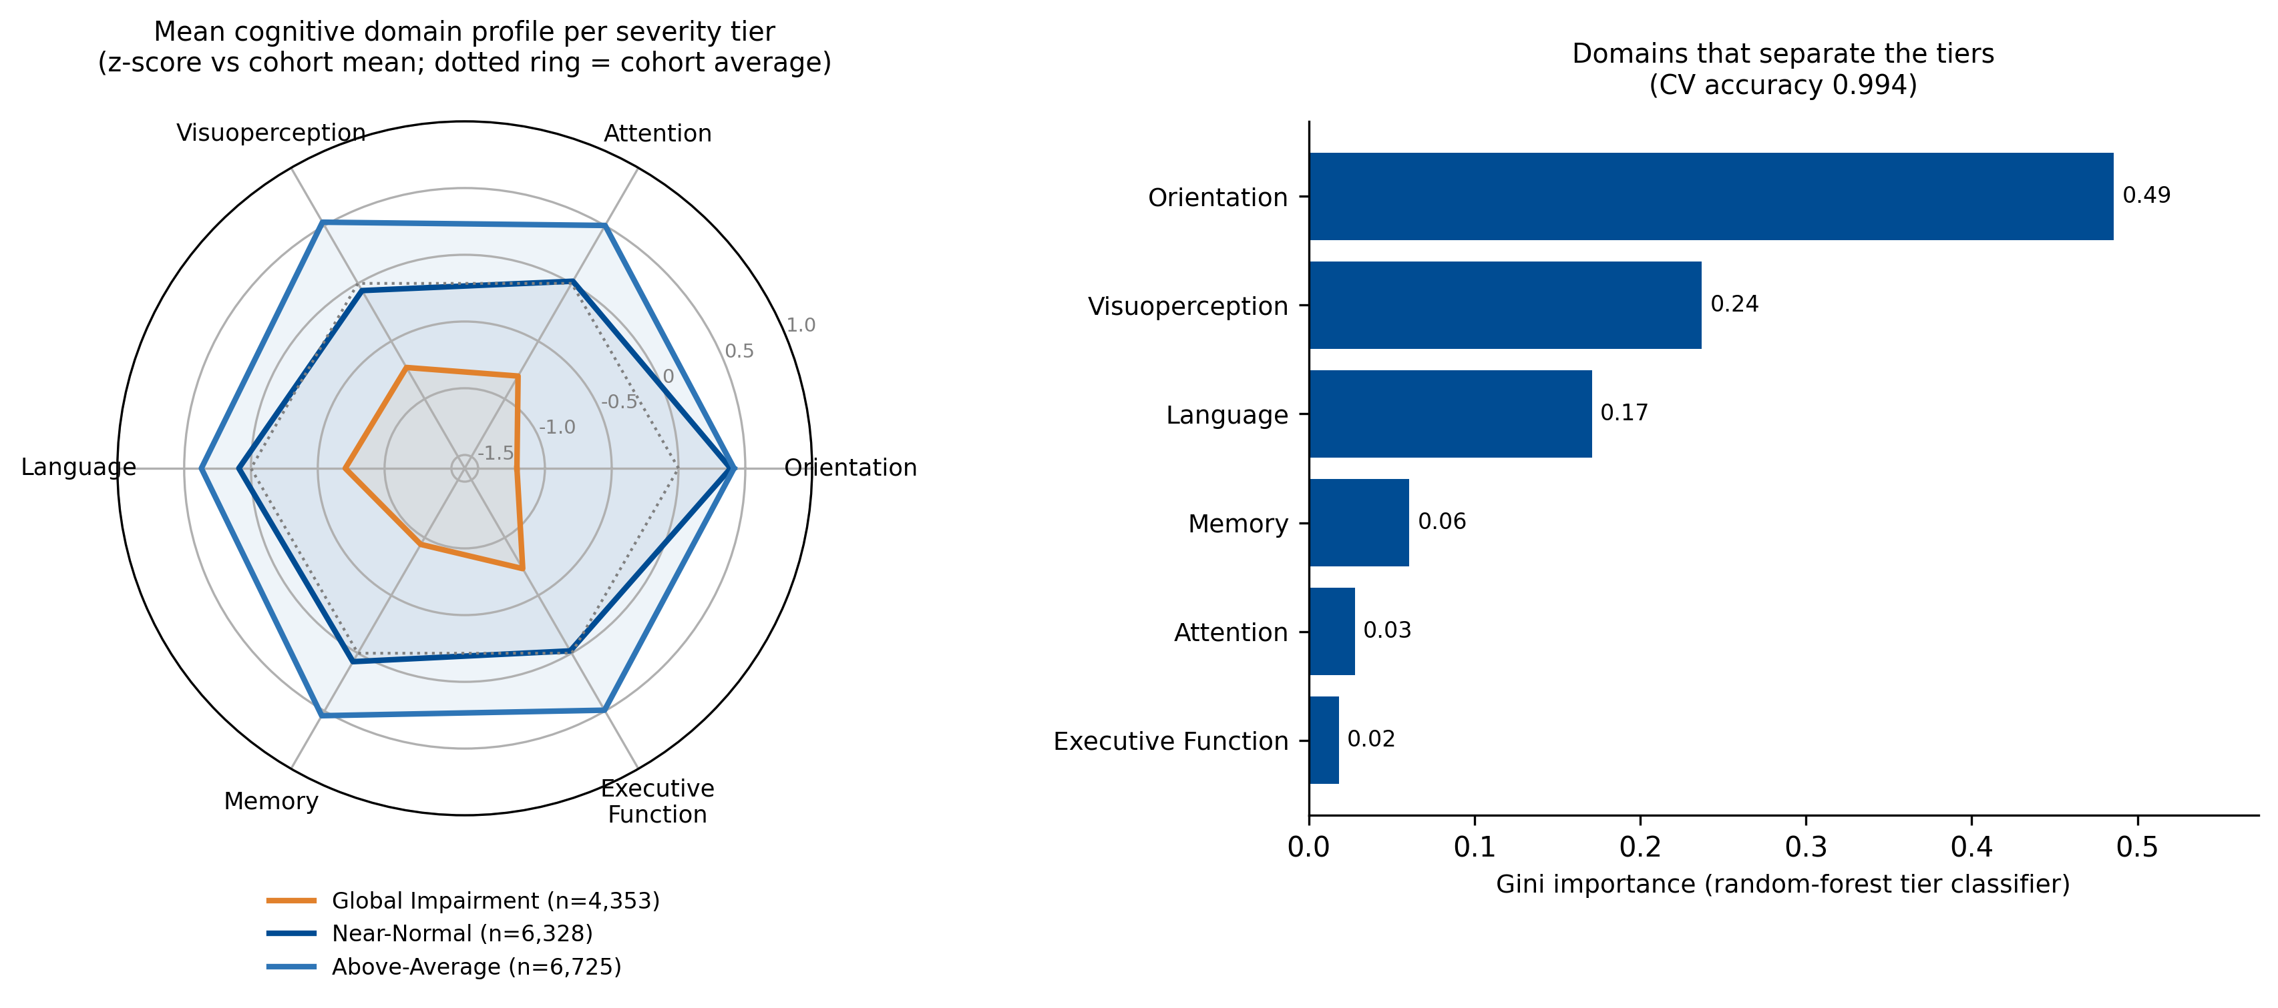
The three tiers are nearly concentric:
domains move together — a severity gradient
What to take away
Concentric polygons: tiers differ in overall level, not in profile shape.
PC1 = 56% of variance with near-equal positive loadings on all six domains.
No attention-specific dissociation — the tiers differ in overall level, not profile shape.
Domain z-scores from the MICE solution; n = 17,406
12

Slide 13
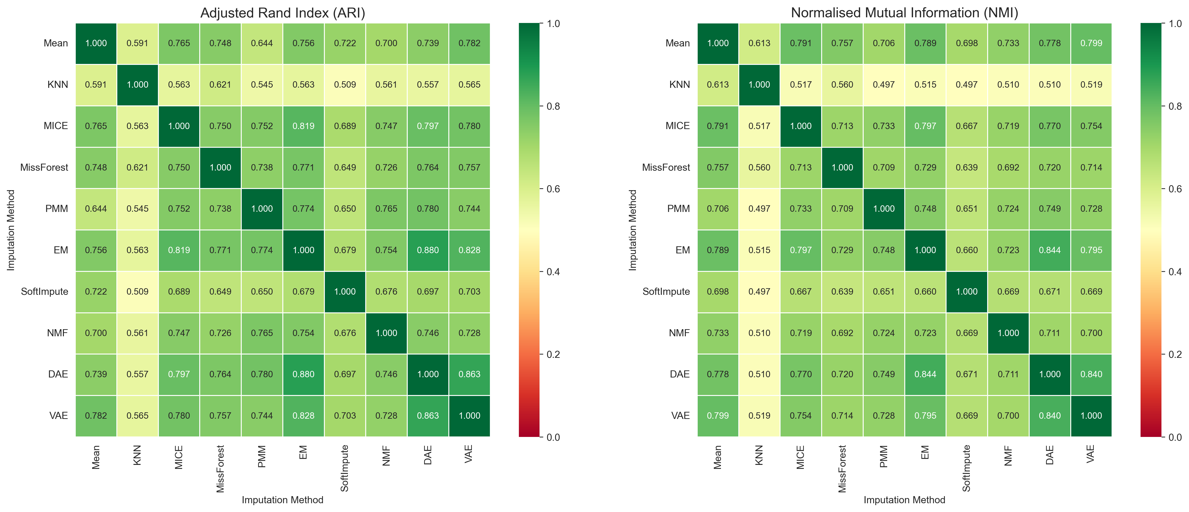
H2: The severity tiers are robust to imputation —
every method pair agrees
What to take away
Mean pairwise ARI = 0.71 [95% CI 0.70–0.72]; every one of 45 pairs exceeds 0.50.
44 of 45 method pairs pass after Holm correction (only KNN–SoftImpute borderline).
86% of patients receive a high-confidence label under consensus clustering.
Practical guidance: the tiers survive every imputation choice; MICE is a safe default.
ARI: Hubert & Arabie (1985); shared pipeline isolates the imputation effect (see Appendix)
13

Slide 14
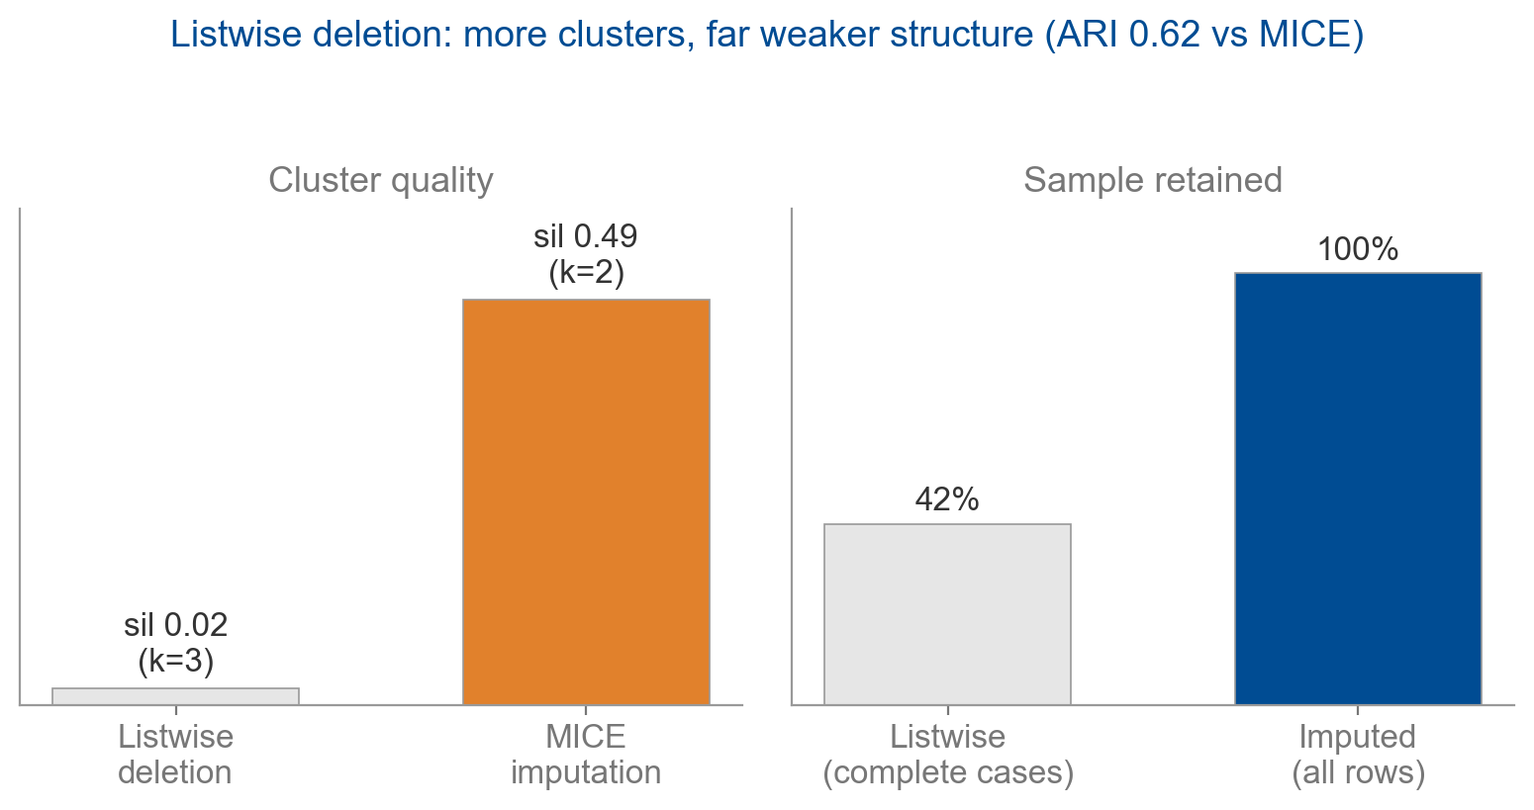
Imputation is not cosmetic: discarding incomplete rows
changes the cluster structure itself
Why it matters
Listwise deletion keeps only 53% of rows.
It returns 2 clusters with silhouette 0.26 vs 3 tiers (0.53) under MICE.
ARI vs MICE = 0.63: a different partition, not a subset.
The choice to impute is itself a finding.
Complete-case baseline: 9,245 of 17,406 rows
14

Slide 15
H3 ✓ Severity tier tracks the treating clinical unit —
and the link survives adjustment for diagnosis
χ² = 911
V = 0.16
not confounded
association of severity tier with clinical unit (p ≈ 10⁻¹⁵⁶)
Cramér's V effect size — above the 0.10 bar
Cochran–Mantel–Haenszel, holds within diagnosis
The association is not a diagnosis confound: it holds after stratifying by diagnosis group, so severity tier adds explanatory power beyond the diagnostic label — supporting severity-informed routing of patients.
Cramér's V: Cramér (1946); CMH: Cochran (1954). Rubin-pooled V = 0.15
15

Slide 16
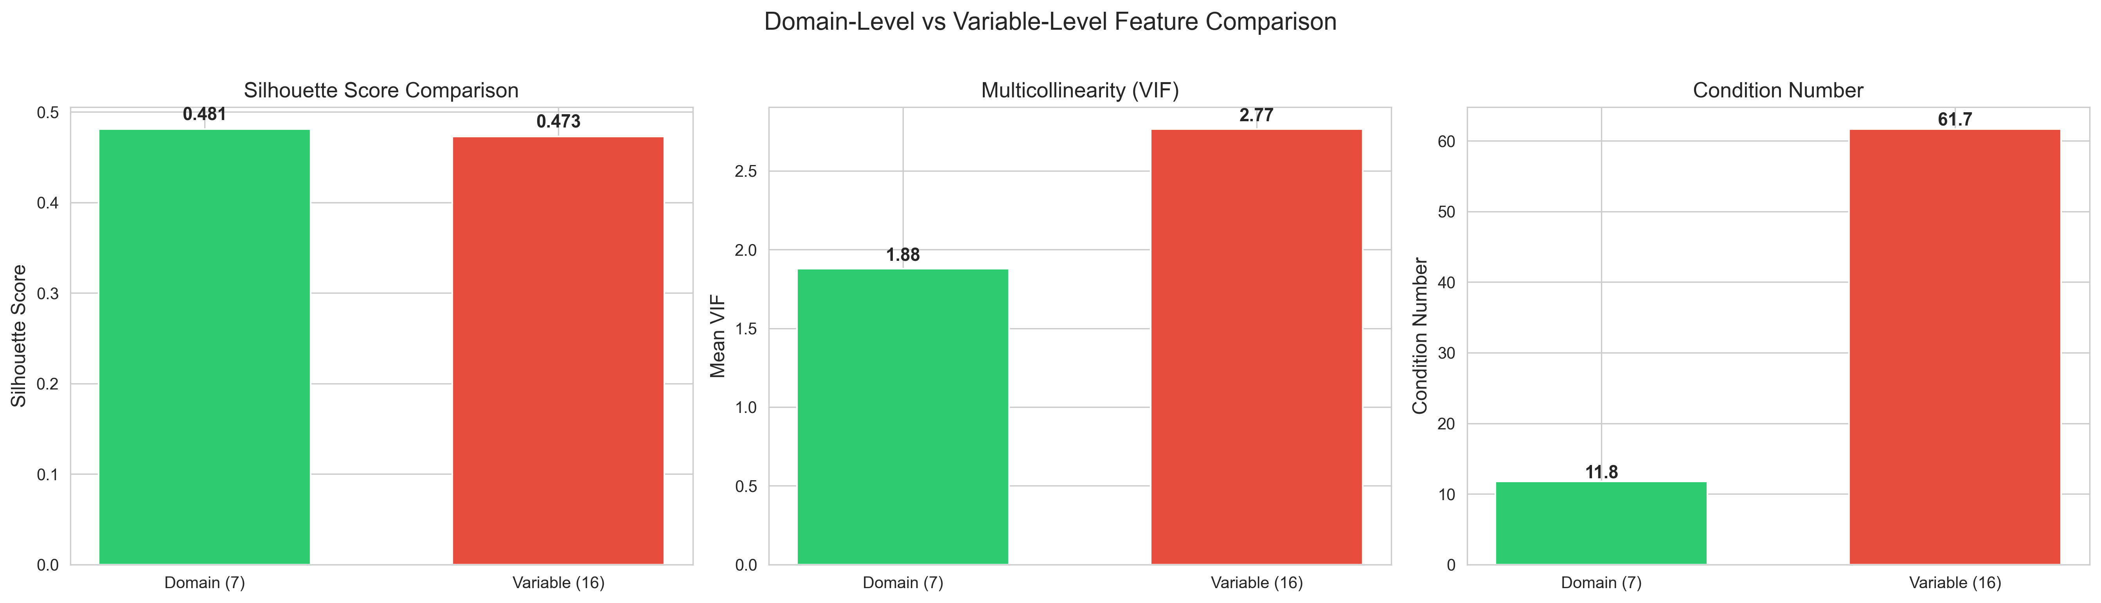
H4 ✓ Six domains beat fourteen raw tests on all three quality metrics
Why it matters
Comparable separation (silhouette 0.48 vs 0.47), far less multicollinearity.
Better conditioned — VIF 1.9 vs 2.8, condition number 12 vs 62.
More interpretable — clinicians reason in domains.
VIF and condition number quantify multicollinearity; lower is better
16

Slide 17
All four pre-registered hypotheses are supported
Hypothesis | Verdict | Key evidence
H1 Discrete, stable clusters | Supported | 10/10 methods pass silhouette + noise; 3 severity tiers
H2 Imputation robustness | Supported | Mean ARI 0.71; 44/45 pairs survive Holm correction
H3 Clinical-unit link | Supported | χ² = 911, V = 0.16, CMH not confounded by diagnosis
H4 Domain vs variable | Supported | Domain wins all 3 quality metrics (silhouette, VIF, condition)
Robustness: all four conclusions hold under bootstrap 95% CIs, Holm correction, Rubin pooling (M = 5), and a listwise-deletion baseline.
17

Slide 18
Part 4
Discussion & Conclusions

Slide 19
A severity gradient — and a cautionary methodological
tale about preprocessing artefacts
Cognition after ABI is dominated by a general-severity factor — the strong positive manifold of inter-test correlations, recovered here without supervision.
A data-driven method rediscovers severity before it finds anything domain-specific; this is a weaker, more honest form of phenotyping.
The apparent attention phenotype was an artefact — it dissolved once a mis-scaled demographic was removed and variables were properly standardised.
Contribution: a reproducible severity-stratification pipeline, and a worked demonstration of how scaling artefacts masquerade as structure.
The signature
One severity axis
(PC1 = 56%) with equal positive loadings on all six domains.
Tiers = bands of the same gradient.
Consistent with Lezak et al. (2012); García-Rudolph et al. (2020)
19

Slide 20
Severity tiers translate into matching rehabilitation
intensity to level of need
For the clinic
For the analyst
Above-Average → vocational rehabilitation and community-return planning.
Global Impairment → intensive, structured, lower-level rehabilitation.
Report each assignment with its confidence, not as a hard label.
Standardise and screen features before aggregating — artefacts masquerade as structure.
Use MICE as the default; test sensitivity with ≥ 2 imputation methods.
Cluster on domain-level features, not raw tests.
One framework, two audiences: a reproducible severity signal for the bedside, and careful defaults for the next analysis.
20

Slide 21
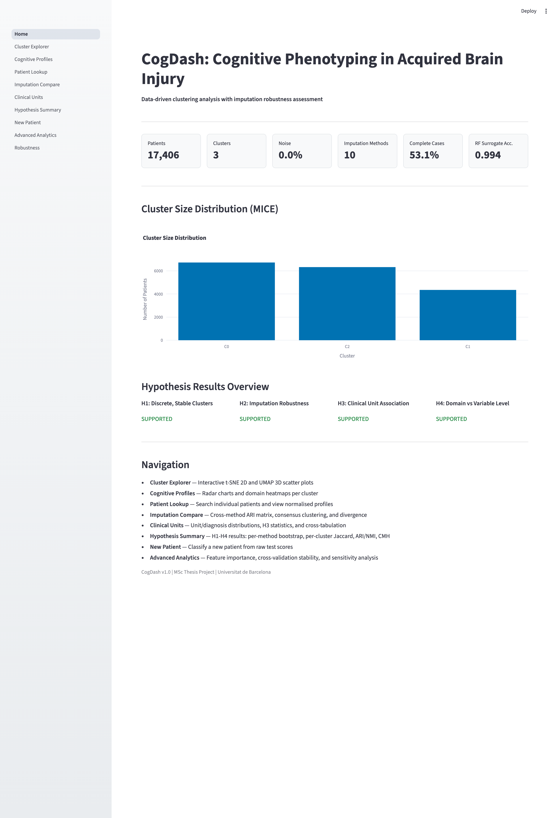
Phenotypes power CogDash — decision support that
classifies a new patient and reports its confidence
8 modules:
cluster explorer, cognitive profiles, patient lookup, imputation compare, clinical units, hypothesis summary, new-patient classifier, advanced analytics.
Streamlit + Plotly, colour-blind-safe, Docker-packaged.
21

Slide 22
Main limitations are design constraints — partly offset by
built-in sensitivity analyses
Single centre — but the test battery (TMT, Stroop, digit span, RAVLT) is internationally standard
Cross-sectional — yet multiple assessments per patient span the recovery continuum
MAR assumption — 10 methods, Rubin pooling and a listwise baseline serve as built-in sensitivity checks
No functional outcomes — (return-to-work, length of stay); only outcome-adjacent proxies available
22

Slide 23
Conclusions
1. A cognitive severity gradient in ABI — three tiers on a single severity axis (PC1 56%), cutting across diagnostic categories.
2. Imputation is not cosmetic — listwise deletion changes the structure; the tiers survive every imputation choice (ARI 0.71).
3. Severity tier adds clinical value beyond diagnosis (CMH not confounded); 86% of assessments get high-confidence labels.
4. A robustness framework — and a cautionary tale — preprocessing artefacts can masquerade as phenotypes unless features are scaled with care.
z.kunos@gmail.com Code & dashboard: github.com/zkunos/thesis_project

Slide 24
References
Afkanpour, M., et al. (2024). Identifying the best imputation methods for clinical data. BMC Medical Informatics and Decision Making.
Campello, R.J.G.B., Moulavi, D., & Sander, J. (2013). Density-based clustering based on hierarchical density estimates (HDBSCAN). PAKDD.
Cramér, H. (1946). Mathematical Methods of Statistics. Princeton University Press.
Hennig, C. (2007). Cluster-wise assessment of cluster stability. Computational Statistics & Data Analysis, 52, 258–271.
Hubert, L. & Arabie, P. (1985). Comparing partitions. Journal of Classification, 2, 193–218.
Lezak, M.D., et al. (2012). Neuropsychological Assessment (5th ed.). Oxford University Press.
McInnes, L., Healy, J., & Melville, J. (2018). UMAP: Uniform Manifold Approximation and Projection. arXiv:1802.03426.
Rousseeuw, P.J. (1987). Silhouettes: a graphical aid to cluster interpretation. J. Computational & Applied Mathematics, 20, 53–65.
Stekhoven, D.J. & Bühlmann, P. (2012). MissForest — non-parametric missing value imputation. Bioinformatics, 28(1), 112–118.
van Buuren, S. & Groothuis-Oudshoorn, K. (2011). mice: Multivariate Imputation by Chained Equations in R. J. Statistical Software, 45(3).
24

Slide 25
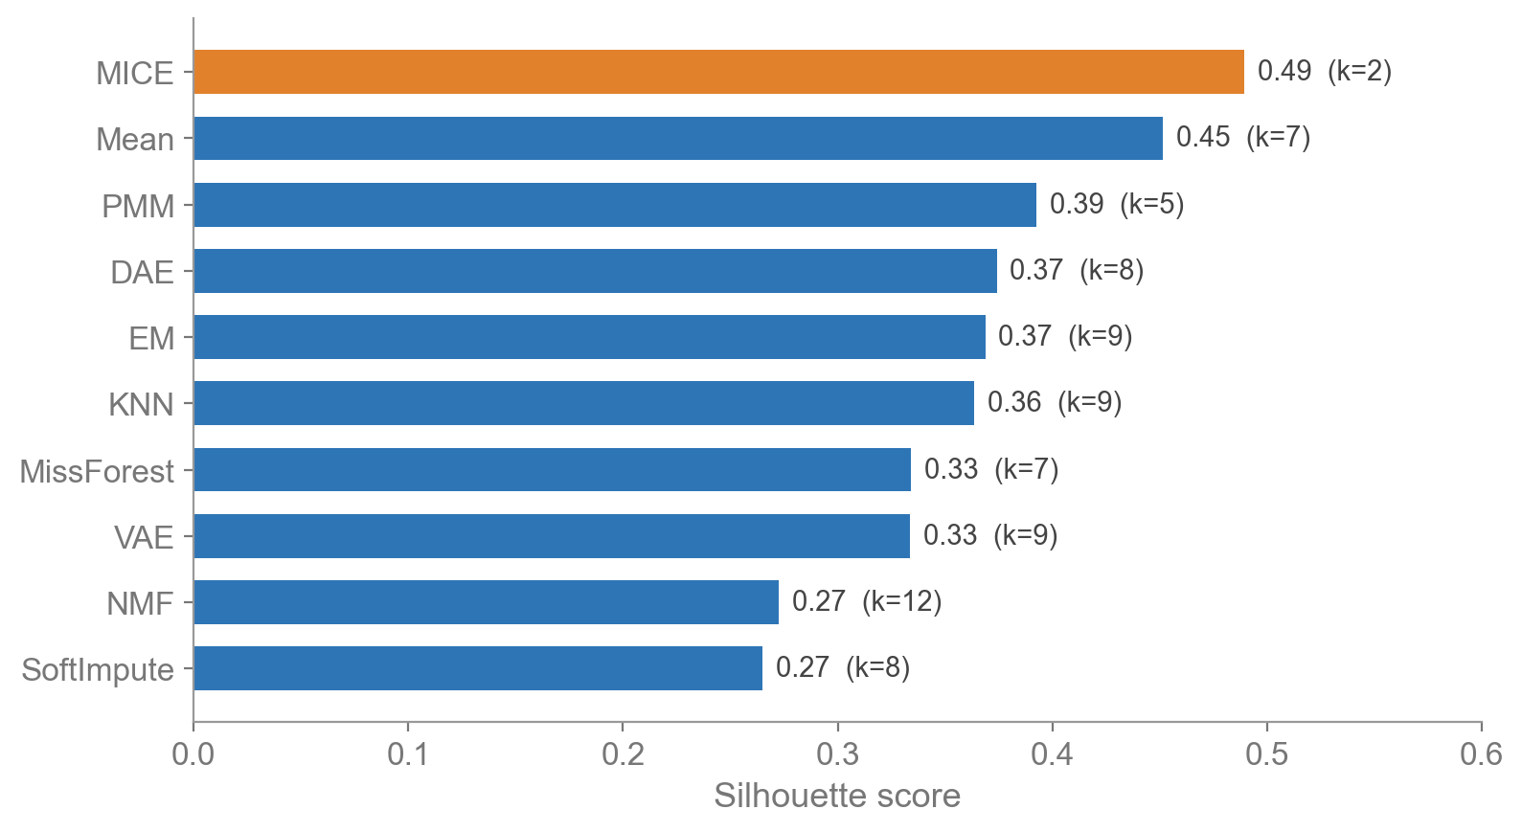
Appendix A — Imputation method comparison
Cluster quality is consistent across imputation; the severity signal persists
Silhouette is tight across methods (0.50–0.61); k = 3–5.
MICE gives the reference 3-tier solution.
All ten methods clear the pre-registered thresholds.

Slide 26
Appendix B — Deep-learning imputation improvements
Two targeted fixes make autoencoder imputation work on structured missingness
DAE — pattern-aware corruption
VAE — cyclical β-annealing
Real missingness is structured: tests are ordered together.
50% of training masks sampled from the empirical co-occurrence pattern.
Architecture 15→128→64→32→…→15; 5 runs averaged.
Fixed β causes posterior collapse — latent space ignored.
β ramps 0→0.1 over 40-epoch cycles.
Latent dim 32; K = 20 samples averaged.
Held-out 10% RMSE confirms DAE outperforms VAE on every variable.

Slide 27
Appendix C — Robustness analyses
Every headline result was re-tested under stricter conditions
Re-estimation
Baselines & stability
Bootstrap 95% CIs: ARI [0.70, 0.72]; V [0.15, 0.18].
Holm correction over 45 H2 pairs: 44 survive; only KNN–SoftImpute borderline.
Rubin pooling (M = 5 MICE): conclusions unchanged.
Listwise baseline: 2 clusters, silhouette 0.26 vs 0.53 — imputation matters.
50% of multi-assessment patients keep their tier; transitions move up the gradient (recovery) 3:1.
Time-since-injury differs by tier (214 / 188 / 172 days, p ≈ 10⁻²⁸).

