Slide 1
MSc Thesis Defence · 2026
Data-Driven Cognitive Phenotyping in Acquired Brain Injury
17,406
assessments
7,285
patients
A cognitive severity gradient that survives the choice of imputation method
10
imputation methods
Zoltán Kunos
3
MSc Fundamental Principles of Data Science · Universitat de Barcelona
Supervisor: Dr. Alejandro García-Rudolph
severity tiers

Slide 2
Part 1
Background
02

Slide 3
Background
03
Same injury severity, very different cognitive profiles
Severity labels hide the cognitive variation that should guide rehabilitation.
ABI effects scatter across attention, memory, language, executive function and visuoperception.
The question
Diagnosis and severity bands group together patients whose cognitive profiles differ substantially.
Can data-driven clustering recover clinically meaningful cognitive phenotypes that diagnosis alone misses, and can we trust them?
The within-group variation that could guide rehabilitation stays hidden.
ABI cognitive assessment: Lezak et al. (2012)

Slide 4
Study design
04
Four pre-registered questions, each with a quantitative threshold
H1
Distinct phenotypes?
Silhouette > 0.40, noise < 30%, ≥ 2 clusters
H2
Imputation-robust?
Mean pairwise ARI > 0.50
H3
Clinically linked?
χ² significant, Cramér's V > 0.10
H4
Better at domain level?
Domain wins silhouette, VIF and condition
Thresholds fixed before analysis (pre-registration)

Slide 5
Part 2
Data & Methods
05

Slide 6
Data
06
Routine clinical data is large
The cohort is big enough for phenotyping, but incomplete enough that deletion would bias the story.
17,406
7,285
One rehabilitation centre.
assessments
patients
50%-missing filter preserves variables with enough observed data.
14 → 6
53.1%
tests to domains
complete rows
Listwise deletion would discard nearly half of the cohort.
MICE: van Buuren & Groothuis-Oudshoorn (2011); UMAP: McInnes et al. (2018); HDBSCAN: Campello et al. (2013)

Slide 7
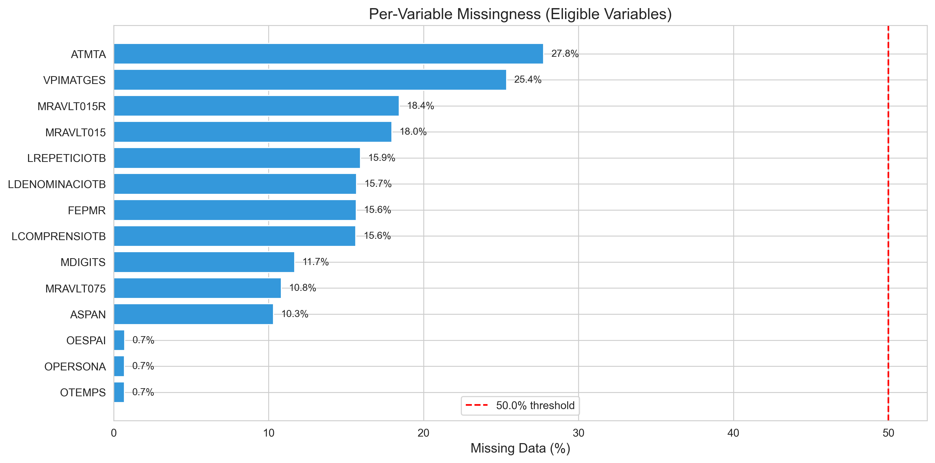
Missingness
07
Missingness is structured, not incidental
Specialised assessments have higher missingness than routine screening tests.
What to take away
Only 53.1% of rows are complete.
Missingness is tied to the clinical testing process.
Imputation preserves impaired and partially tested patients.
Complete-case analysis would remove 47% of the data.
Eligible neuropsychological variables after Tier 1 filtering

Slide 8
Imputation strategy
08
Ten imputation methods across five categories
The standard taxonomy is extended with deep-learning imputers.
Category
Methods
Idea
Conventional statistical
Mean · EM · MICE
distributional / chained equations
Machine learning
KNN · MissForest
non-parametric, non-linear
Hybrid
PMM
draws real donor values
Matrix completion
SoftImpute · NMF
low-rank reconstruction
Deep learning
DAE · VAE
learn non-linear latent structure
10 methods × 2 representations = 20 pipeline runs. DAE/VAE detail in Appendix B.

Slide 9
Model selection
09
A 1,080-configuration sweep selects clusters by one quality score
No hand-tuning.
Imputed data
Standard scaler
UMAP
9 configs
HDBSCAN
120 configs
Best-Q
selection
→
→
→
→
UMAP grid
HDBSCAN grid
n_neighbors: 15, 30, 50
min_cluster_size: 500-3000
n_components: 3, 5, 8
min_samples: 5, 10, 25, 50
min_dist: 0.0
method: eom / leaf · ε: 0.0, 0.1, 0.5
Q = Silhouette × (1 - noise proportion)

Slide 10
Imputation isolation
10
For H2, a shared pipeline isolates imputation as the only varied factor
1
Fit StandardScaler on MICE → transform every other method.
2
Fit UMAP on MICE → transform every other method.
3
Fit K-Means on the MICE embedding → predict all others.
Same k, same boundaries, same embedding geometry. The only thing that changes between runs is the imputed values themselves.
HDBSCAN labels are kept for H1/H3/H4; K-Means labels are used only for the H2 concordance test.

Slide 11
Part 3
Results
11

Slide 12
H1
12
Three cognitive severity tiers emerge
A gradient, not dissociated phenotypes.
6,725
6,328
4,353
Above-Average
above cohort mean on all domains
Near-Normal
near the cohort average
Global Impairment
below cohort mean on all domains
All 10 imputation methods clear the thresholds.
MICE reference: silhouette 0.53, k = 3.
One severity axis explains 56% of variance.
Core Jaccard 0.63 / 0.62 for the extreme tiers.

Slide 13
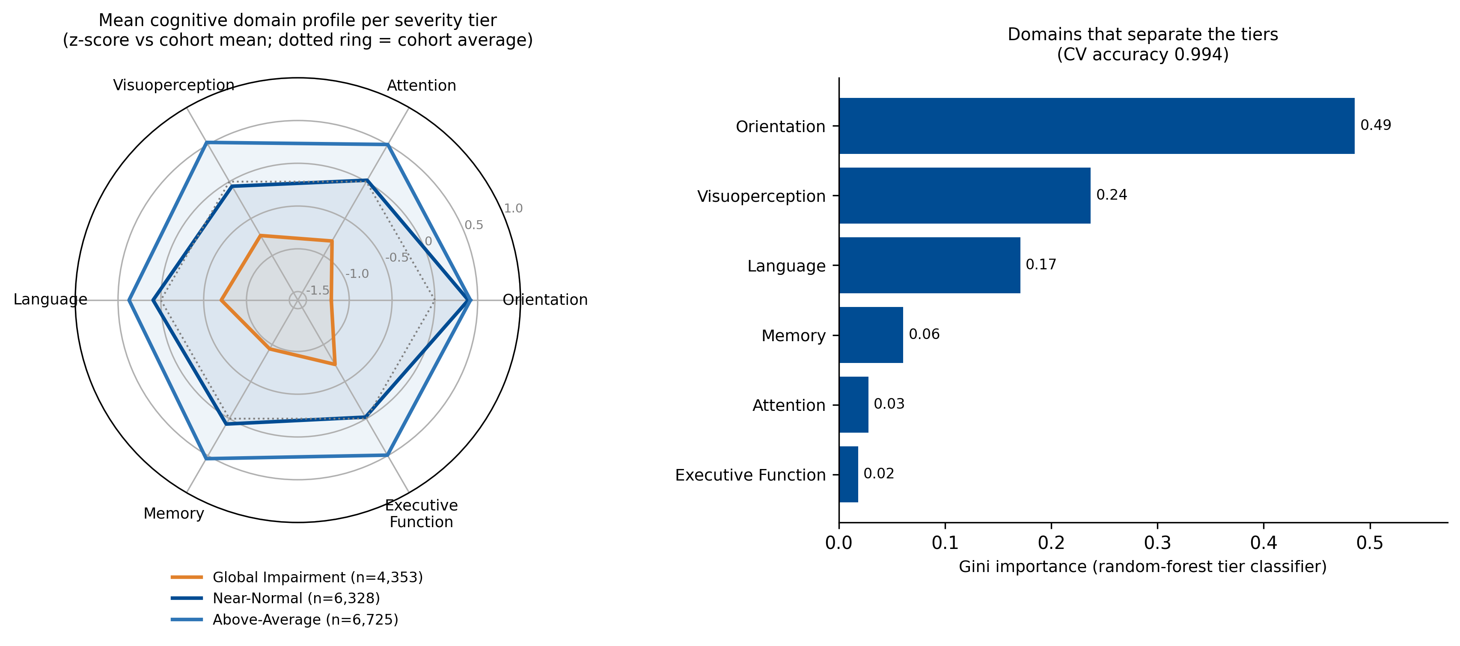
H1 profile shape
13
The three tiers are nearly concentric
Domains move together; the signal is general severity.
What to take away
Tiers differ in overall level, not profile shape.
PC1 explains 56% of variance with near-equal positive loadings.
No attention-specific dissociation appears after proper scaling.
Domain z-scores from the MICE solution; n = 17,406

Slide 14
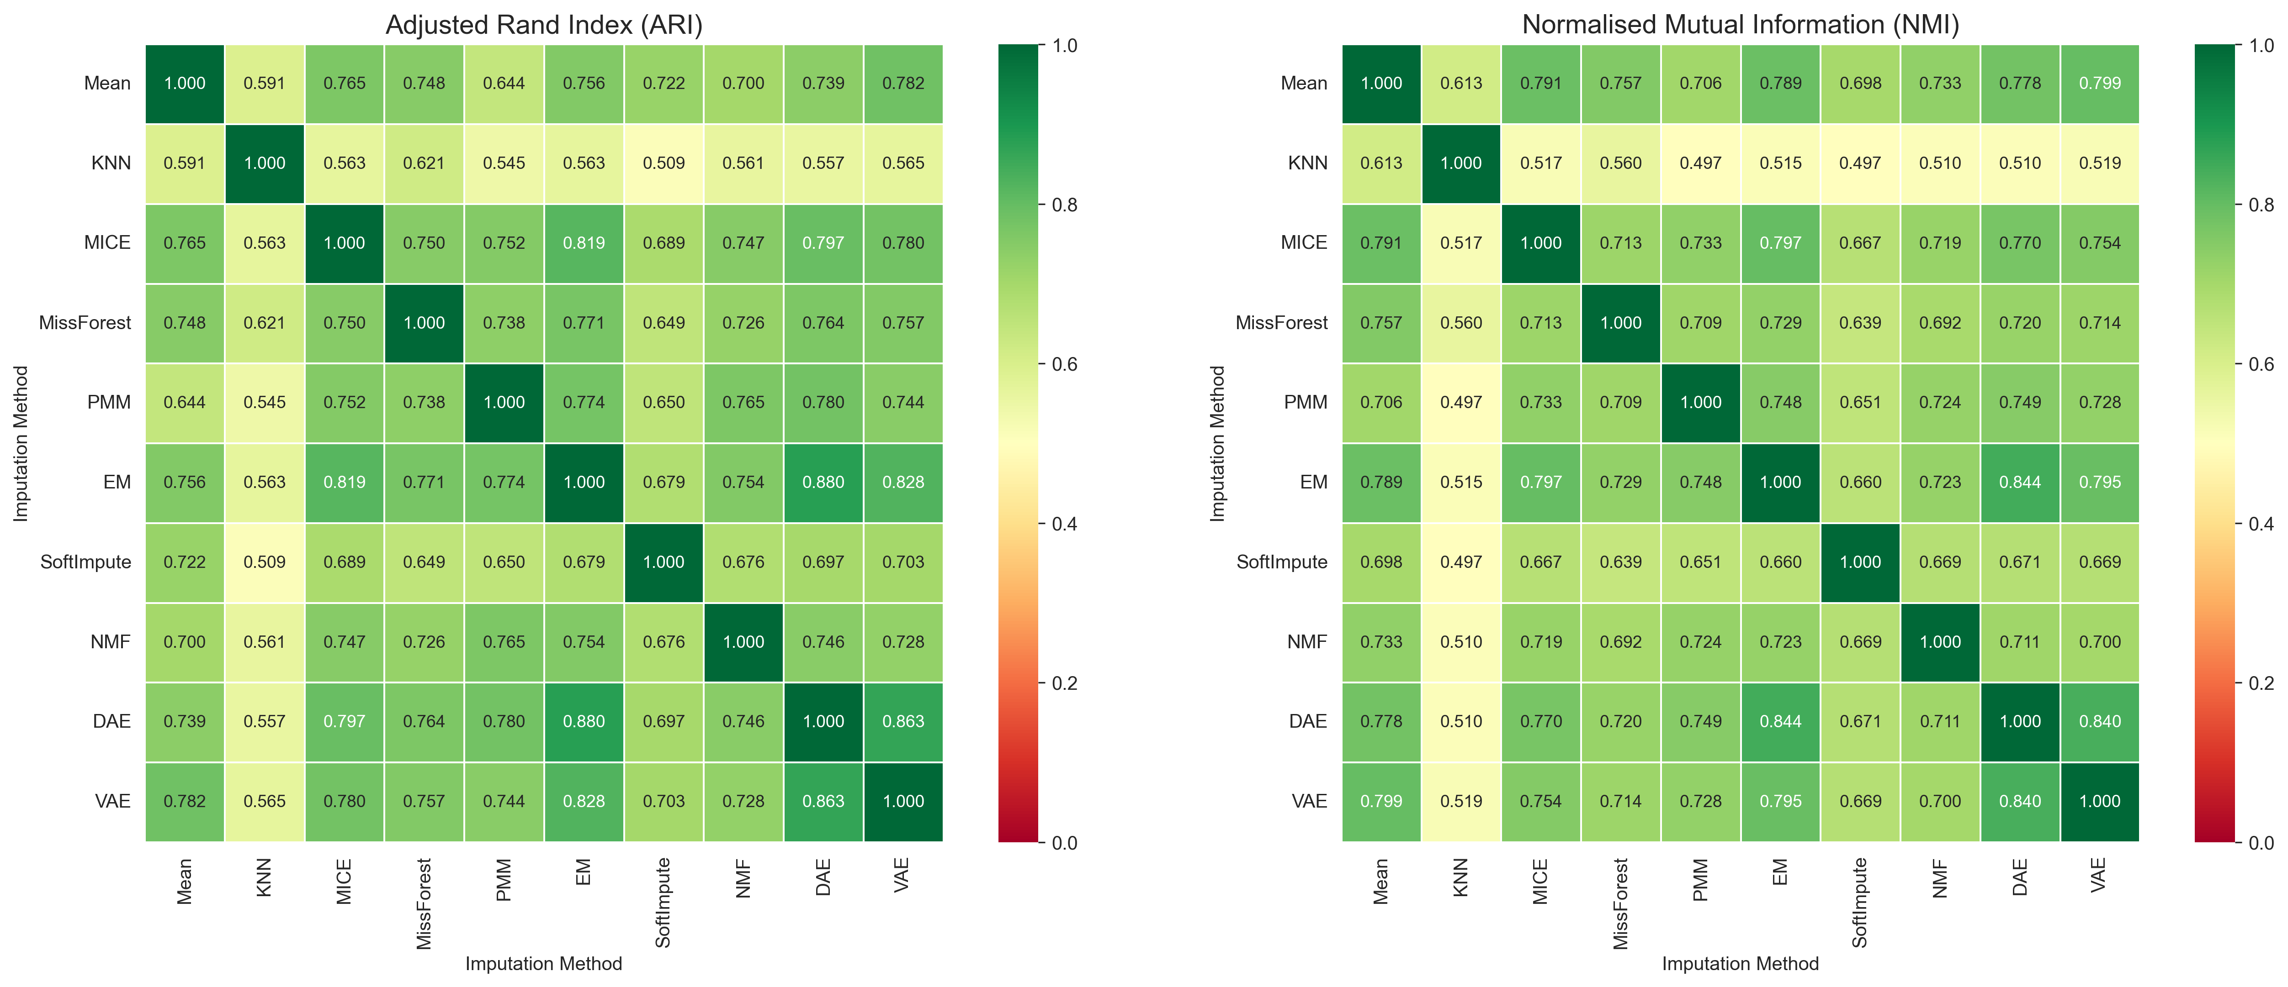
H2
14
The severity tiers are robust to imputation
Every method pair agrees above the pre-registered threshold.
What to take away
Mean pairwise ARI = 0.71 [95% CI 0.70-0.72].
44 of 45 method pairs pass after Holm correction.
86% of patients receive a high-confidence consensus label.
Practical guidance: MICE is a safe default.

Slide 15
Complete-case baseline
15
Imputation is not cosmetic
Discarding incomplete rows changes the cluster structure itself.
complete case
53%
Listwise deletion keeps only 53% of rows.
imputed
100%
It returns 2 clusters with silhouette 0.26 vs. 3 tiers with 0.53 under MICE.
listwise
26%
ARI vs. MICE = 0.63: a different partition, not a subset.
MICE
53%

Slide 16
H3
16
Severity tier tracks the treating clinical unit
The link survives adjustment for diagnosis.
χ² = 911
V = 0.16
not confounded
association with clinical unit
p ≈ 10^-156
Cramér's V effect size
above the 0.10 bar
Cochran-Mantel-Haenszel
holds within diagnosis
Severity tier adds explanatory power beyond the diagnostic label, supporting severity-informed routing of patients.
Cramér's V: Cramér (1946); CMH: Cochran (1954). Rubin-pooled V = 0.15

Slide 17
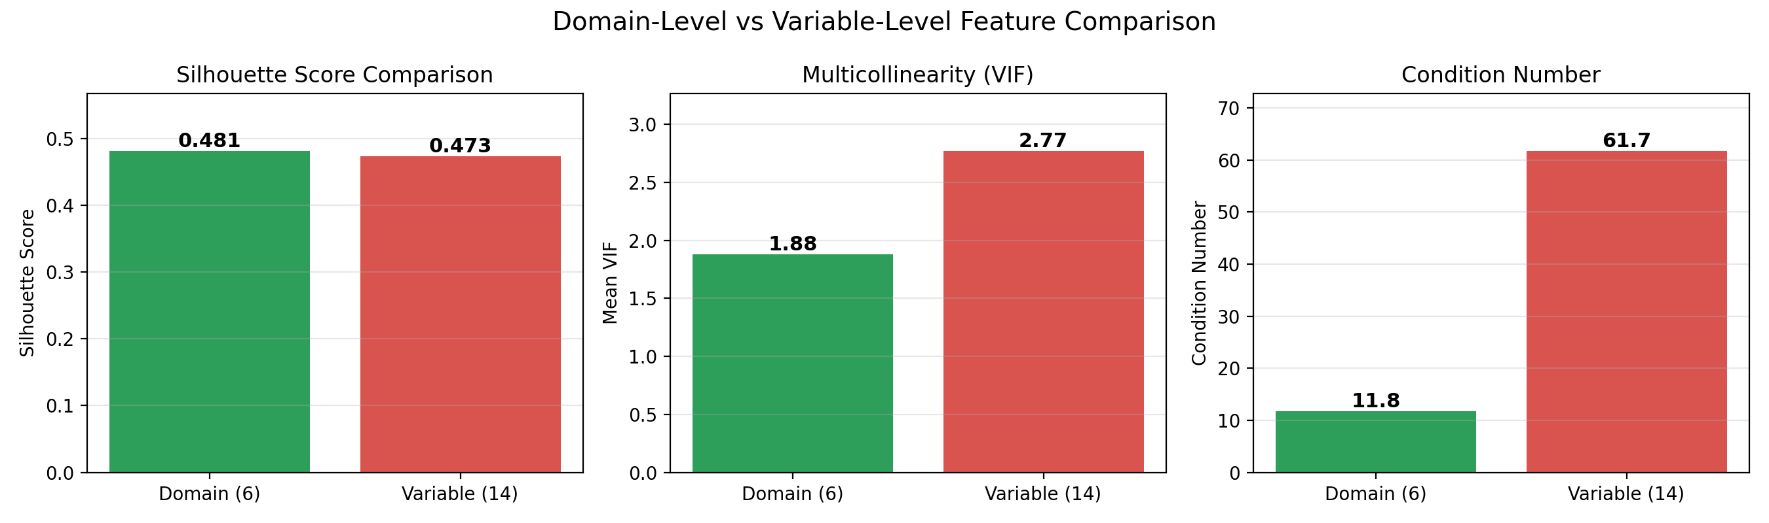
H4
17
Six domains beat fourteen raw tests on all three quality metrics
Comparable separation, far better numerical conditioning.
What to take away
Comparable separation: silhouette 0.48 vs. 0.47.
Lower multicollinearity: VIF 1.9 vs. 2.8.
Better conditioning: 12 vs. 62.
More interpretable: clinicians reason in domains.

Slide 18
Hypothesis summary
18
All four pre-registered hypotheses are supported
Hypothesis
Verdict
Key evidence
H1
Discrete, stable clusters
Supported
10/10 methods pass thresholds; 3 tiers
H2
Imputation robustness
Supported
Mean ARI 0.71; 44/45 pairs survive Holm correction
H3
Clinical-unit link
Supported
χ² = 911, V = 0.16, CMH not confounded
H4
Domain vs. variable
Supported
Domain wins silhouette, VIF and condition
Robustness: bootstrap 95% CIs, Holm correction, Rubin pooling (M = 5), and listwise-deletion baseline.

Slide 19
Part 4
Discussion & Conclusions
19

Slide 20
Interpretation
20
A severity gradient, and a cautionary tale about preprocessing artefacts
Cognition after ABI is dominated by a general-severity factor.
One severity axis
PC1 = 56%
Tiers = bands of the same gradient
A data-driven method rediscovers severity before it finds anything domain-specific.
The apparent attention phenotype dissolved once a mis-scaled demographic was removed and variables were properly standardised.
Contribution: a reproducible severity-stratification pipeline and a worked demonstration of how scaling artefacts masquerade as structure.

Slide 21
Clinical translation
21
Severity tiers translate into matching rehabilitation intensity to level of need
For the clinic
For the analyst
Above-Average → vocational rehabilitation and community-return planning.
Standardise and screen features before aggregating.
Global Impairment → intensive, structured, lower-level rehabilitation.
Use MICE as the default; test sensitivity with ≥ 2 imputation methods.
Report each assignment with its confidence, not as a hard label.
Cluster on domain-level features, not raw tests.
One framework, two audiences: a reproducible severity signal for the bedside and careful defaults for the next analysis.
One framework, two audiences: a reproducible severity signal for the bedside and careful defaults for the next analysis.

Slide 22
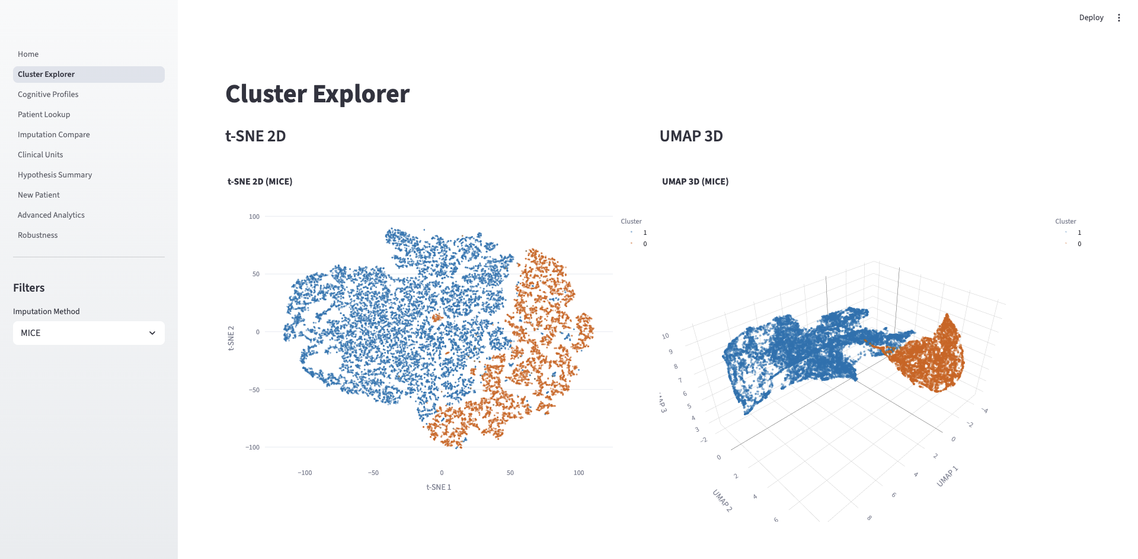
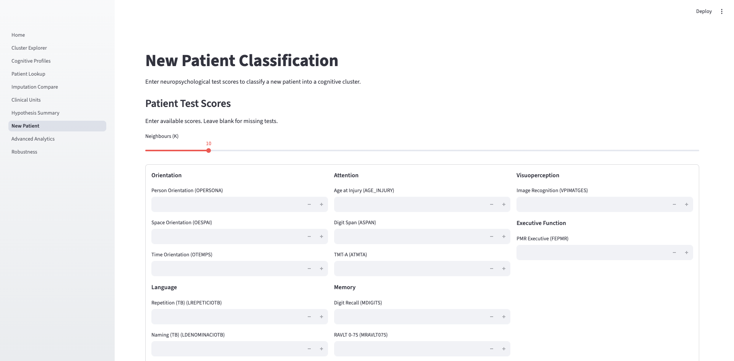
CogDash
22
Phenotypes power CogDash
Decision support that classifies a new patient and reports confidence.
Built for use
8 modules
Streamlit + Plotly
Colour-blind-safe
Docker-packaged

Slide 23
Limitations
23
Main limitations are design constraints
Partly offset by built-in sensitivity analyses.
Single centre
standard international test battery
Cross-sectional
multiple assessments span the recovery continuum
MAR assumption
10 methods, Rubin pooling, listwise baseline
No functional outcomes
only outcome-adjacent proxies available

Slide 24
Thank you
Questions and discussion
A cognitive severity gradient in ABI: three tiers on a single severity axis.
Contact
Imputation is not cosmetic: listwise deletion changes the structure.
z.kunos@gmail.com
Severity tier adds clinical value beyond diagnosis.
email
Preprocessing artefacts can masquerade as phenotypes unless features are scaled with care.
github.com/zkunos
thesis_project · code & dashboard
CogDash
dashboard + new-patient classifier

Slide 25
Thesis defence
25
References
Afkanpour, M., et al. (2024). Identifying the best imputation methods for clinical data. BMC Medical Informatics and Decision Making.
Lezak, M.D., et al. (2012). Neuropsychological Assessment (5th ed.). Oxford University Press.
Campello, R.J.G.B., Moulavi, D., & Sander, J. (2013). Density-based clustering based on hierarchical density estimates (HDBSCAN). PAKDD.
McInnes, L., Healy, J., & Melville, J. (2018). UMAP: Uniform Manifold Approximation and Projection. arXiv:1802.03426.
Cramér, H. (1946). Mathematical Methods of Statistics. Princeton University Press.
Rousseeuw, P.J. (1987). Silhouettes: a graphical aid to cluster interpretation. J. Computational & Applied Mathematics, 20, 53-65.
Hennig, C. (2007). Cluster-wise assessment of cluster stability. Computational Statistics & Data Analysis, 52, 258-271.
Stekhoven, D.J. & Bühlmann, P. (2012). MissForest: non-parametric missing value imputation. Bioinformatics, 28(1), 112-118.
Hubert, L. & Arabie, P. (1985). Comparing partitions. Journal of Classification, 2, 193-218.
van Buuren, S. & Groothuis-Oudshoorn, K. (2011). mice: Multivariate Imputation by Chained Equations in R. J. Statistical Software, 45(3).

Slide 26
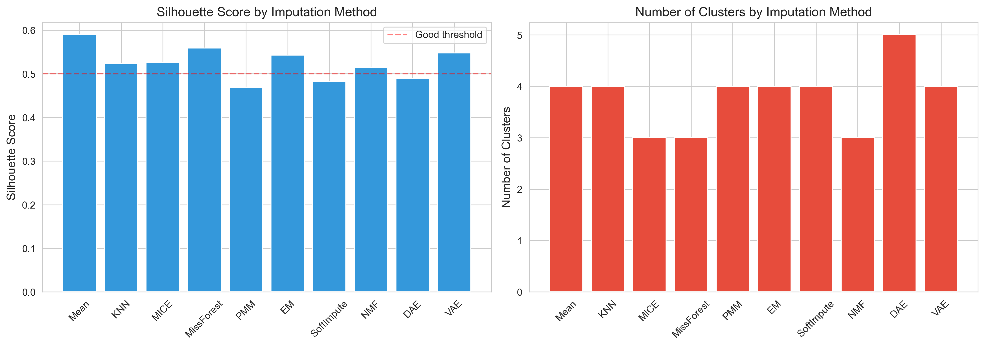
Appendix A
26
Cluster quality is consistent across imputation
The severity signal persists.
What to take away
Silhouette is tight across methods.
MICE gives the reference 3-tier solution.
All ten methods clear the pre-registered thresholds.

Slide 27
Appendix B
27
Two targeted fixes make autoencoder imputation work on structured missingness
DAE — pattern-aware corruption
VAE — cyclical β-annealing
Real missingness is structured.
Fixed β causes posterior collapse.
50% of training masks sampled from empirical co-occurrence.
β ramps 0→0.1 over 40-epoch cycles.
Architecture 15→128→64→32→...→15; 5 runs averaged.
Latent dim 32; K = 20 samples averaged.
Held-out 10% RMSE confirms DAE outperforms VAE on every variable.
Held-out 10% RMSE confirms DAE outperforms VAE on every variable.

Slide 28
Appendix C
28
Every headline result was re-tested under stricter conditions
Re-estimation
Baselines & stability
Bootstrap 95% CIs: ARI [0.70, 0.72]; V [0.15, 0.18].
Listwise baseline: 2 clusters, silhouette 0.26 vs. 0.53.
Holm correction over 45 H2 pairs: 44 survive.
50% of multi-assessment patients keep their tier; transitions move up 3:1.
Rubin pooling (M = 5 MICE): conclusions unchanged.
Time-since-injury differs by tier: 214 / 188 / 172 days, p ≈ 10^-28.

