Slide 1


Update For CSPS Project
Kuangzheng Zhou
Dr.Kraft

Slide 2
Project Progress:
1. Designed a method to synchronize video and sensor data.
2. Record the live video stream automatically in certain time interval and make the clips organized by time stamp.
3. Use sample data to simulate the sensor data and video synchronization.
4. Several side works (Motion tracking and sensor design).

Slide 3
Record Live videos
I use Opencv (a vision processing library) and C++ (it can be python or even Javascript or Java for Android) to program this.
This program can take the image form the camera and make it a live video(The fps is also adjustable to make video with different quality). At the same time it will make video clips out of the live video in every 5 seconds(or any time interval).
Use Ffmpeg (Image decode and code library ) to convert the video to html accepted format automatically.

Slide 4
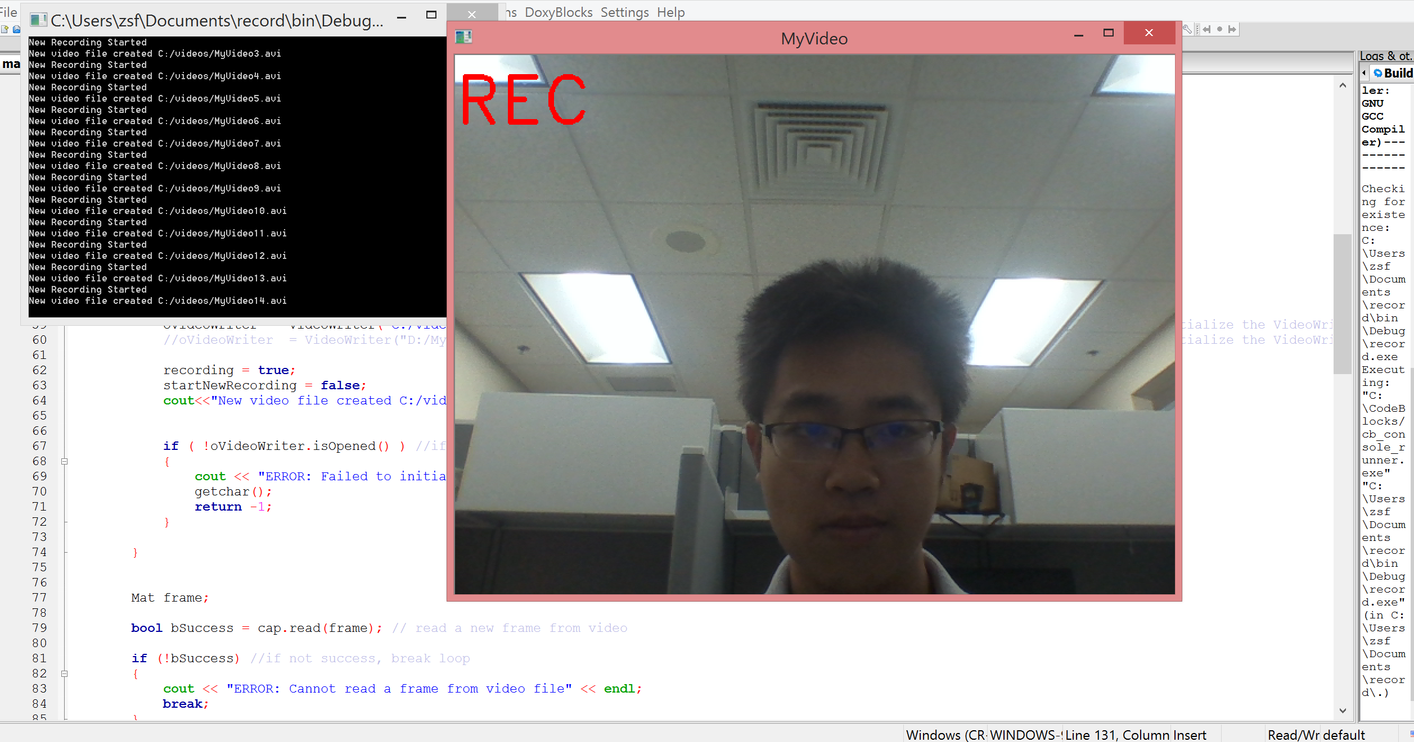
Video screen

Slide 5
Sensor data and video synchronization
1. The next step is synchronization.
2. I just get the computer with Win10 and I am working on make this program works with the real data from sensors.(Sorry for the delay!)
3. In this program, I inserted some sample data with G-Force and time.
For example: If there is a shock in 11 seconds after the sensor is turned on. The program will link that data point with the video recorded at the same time and be really for user to play.

Slide 6
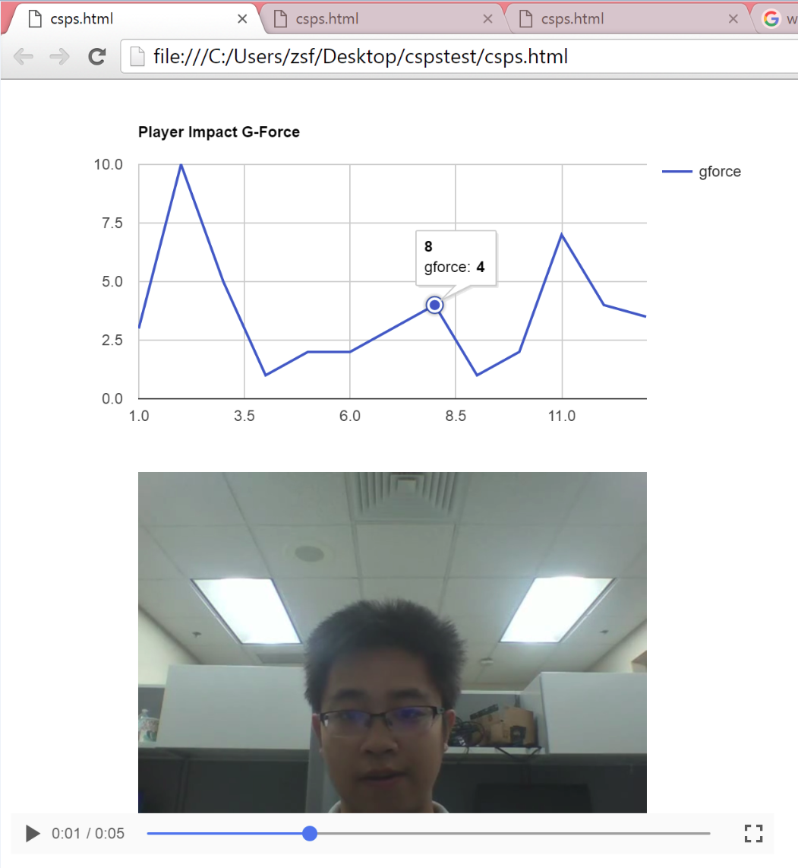
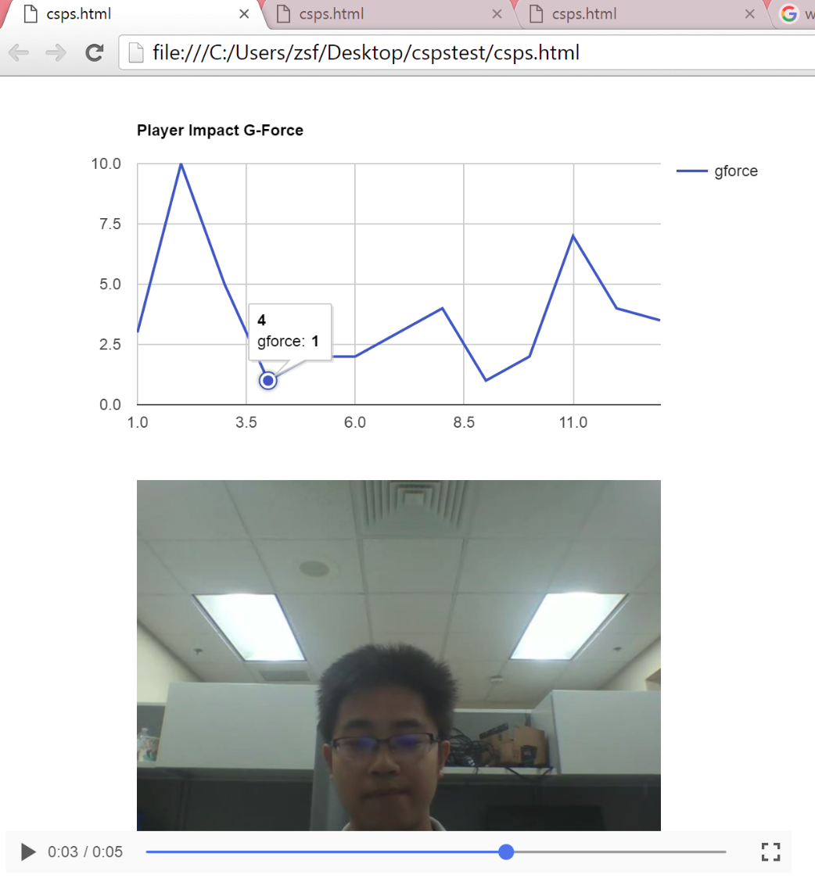
Sample sensor data (G-Force)
Video with the same time.

Slide 7
Next Step:
1. Try to do the real video and sensor data synchronization as soon as possible.
2. Use Node.js and Express frame to build a web app which will be adaptive for both mobile devices and desktops.

Slide 8
Side Projects
I also did several side project in case you are interested.
1. Use openCV track the moving subject in a video. In this next slide I will show the working progress. I think it may be useful for Randy if he wants to provide the coaches some information about how the players are moving in the field with the support of video processing technology.
2. I made some sensors which can also record impact and I think they can work side by side of the i1 sensors to validate the data.
For example: if the i1 sensor drops on the ground or get shocked not in the field, my sensor can provide some data at the same time to make the comparison and validate the generated data.

Slide 9
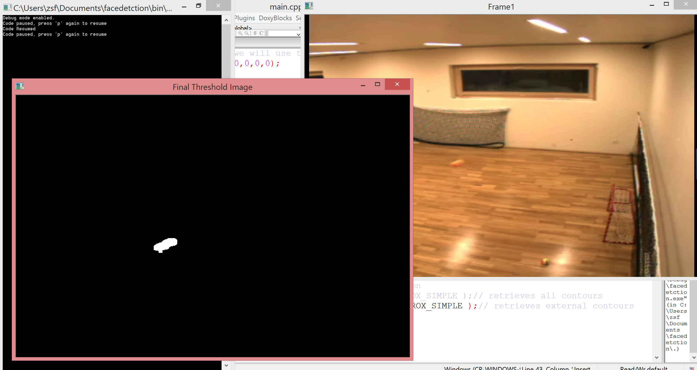
Tracking Moving Subject
The moving ball in the video
The Tracked object

Slide 10
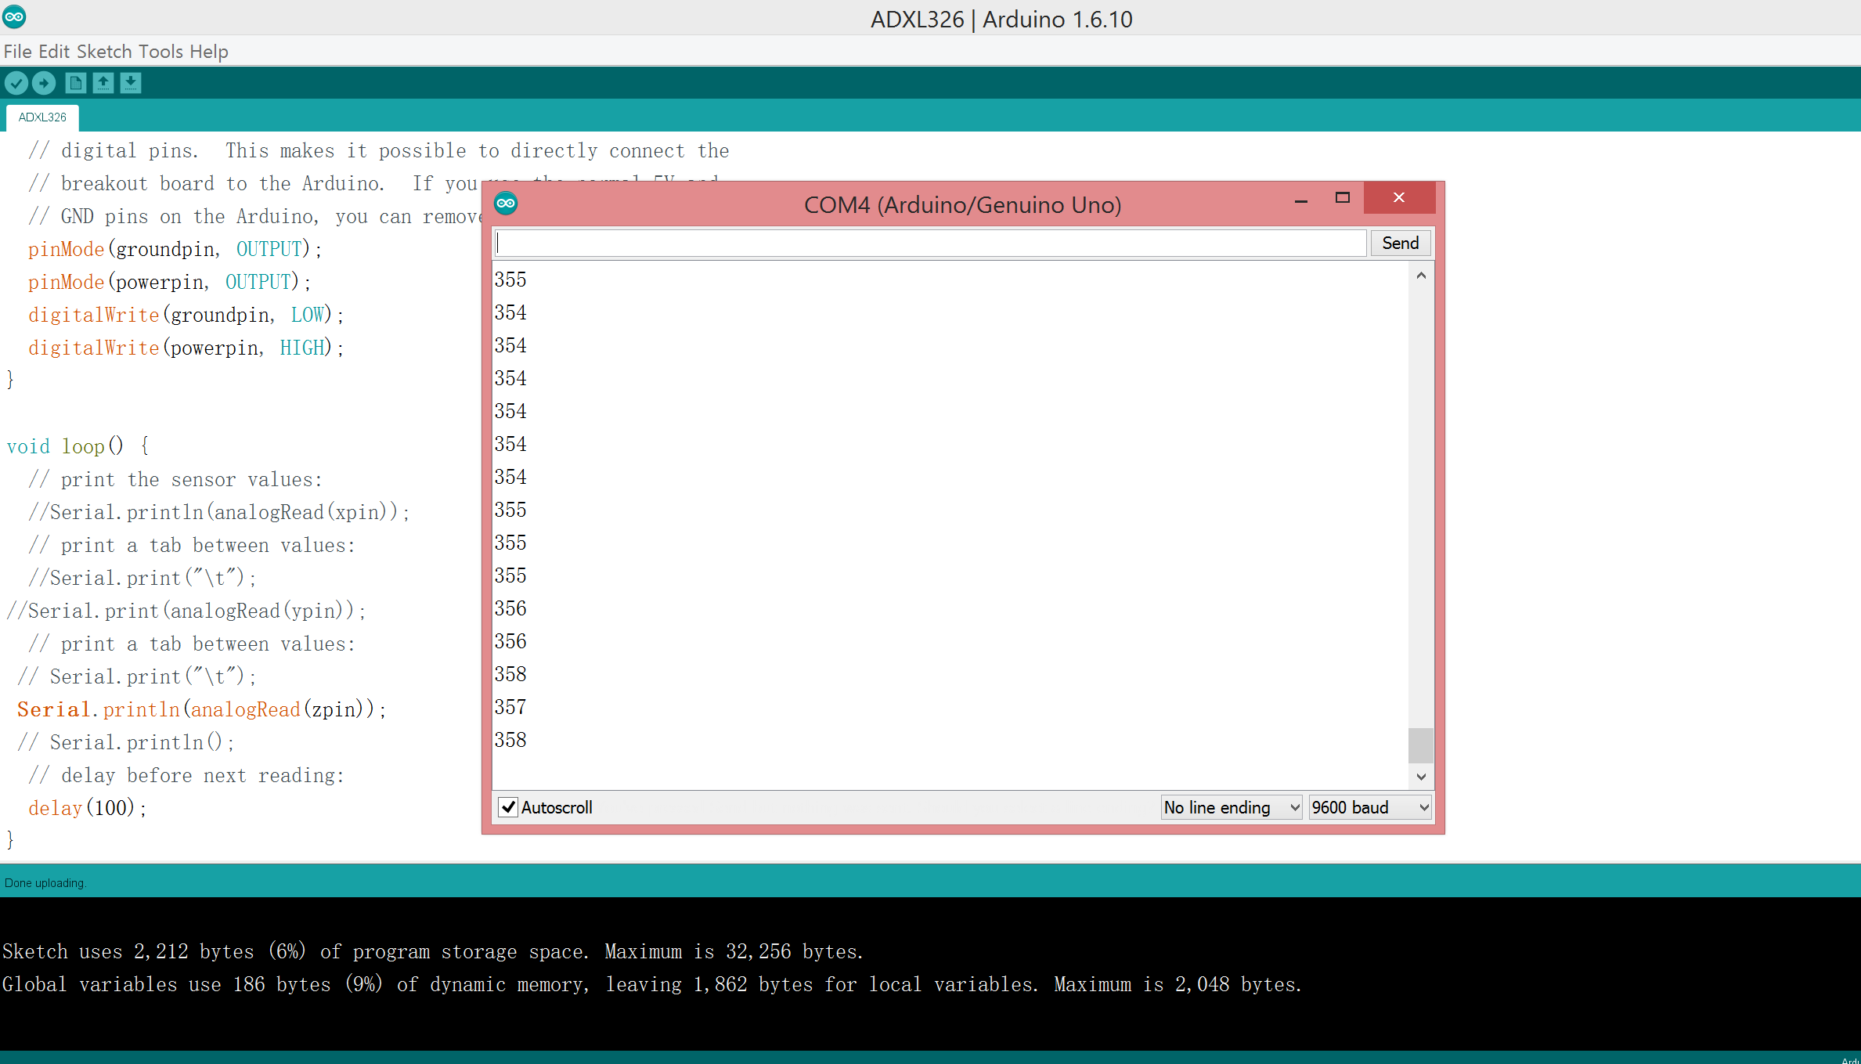
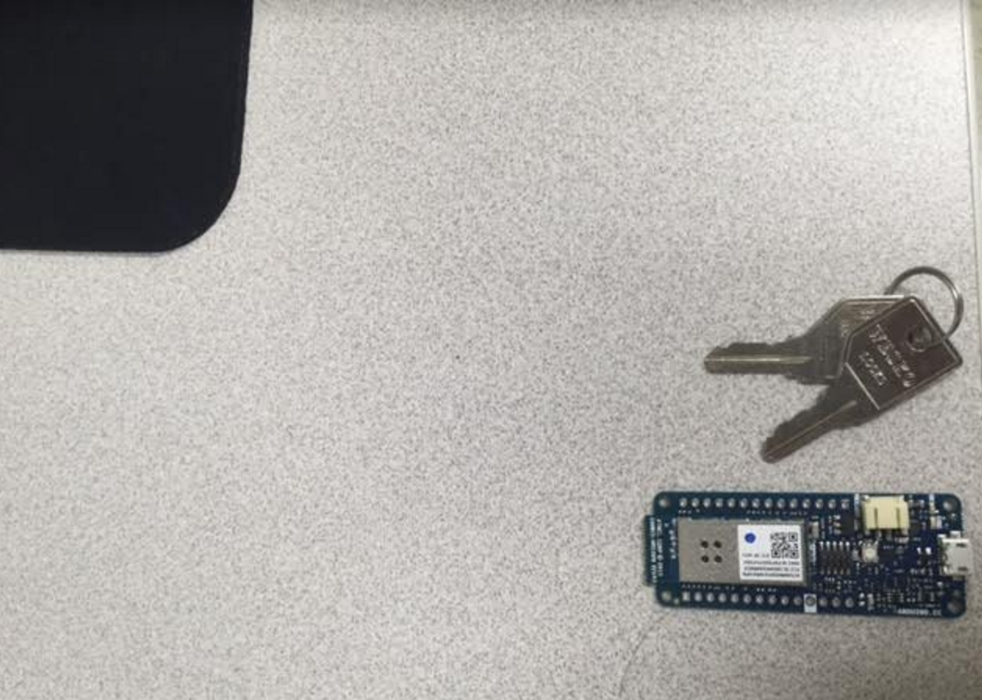
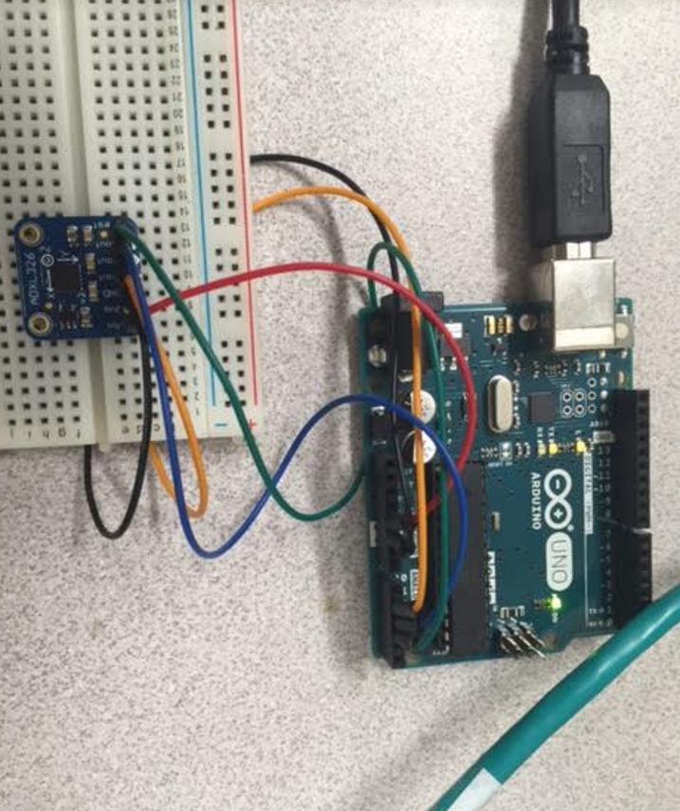
Impact Sensor by Arduino and Node.js
Sensor and processor

Slide 11
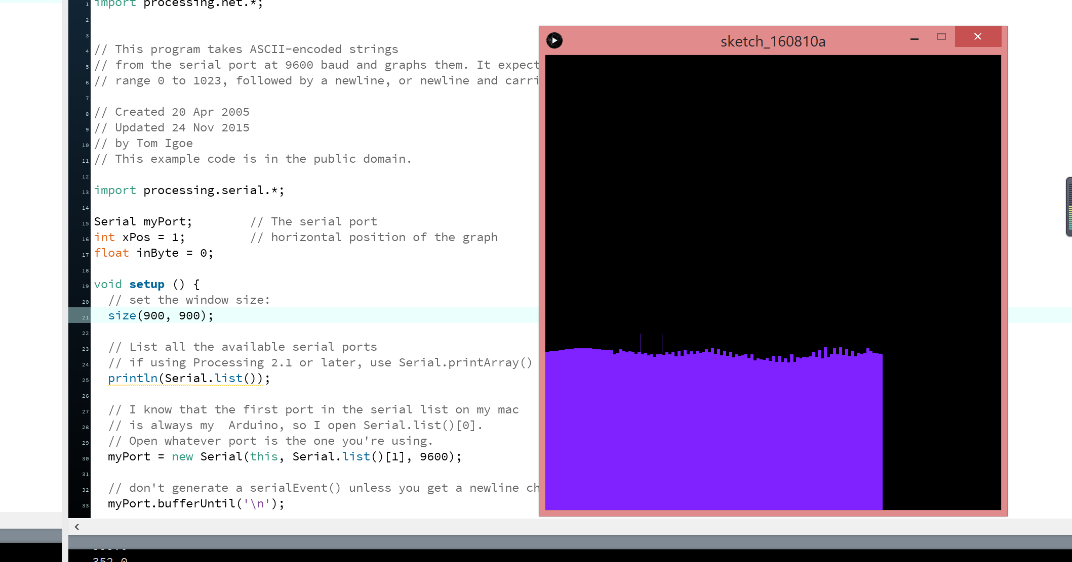
Small shocks caused by tapping the sensor

